Slide 1



PET Neuroimaging Data Harmonization
Gitte Moos Knudsen, Professor.
Neurobiology Research Unit, Rigshospitalet and University of Copenhagen, Denmark

Slide 2
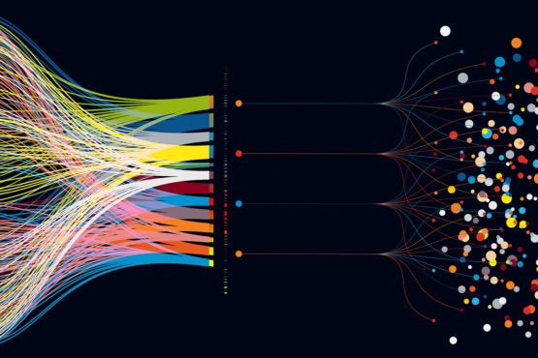
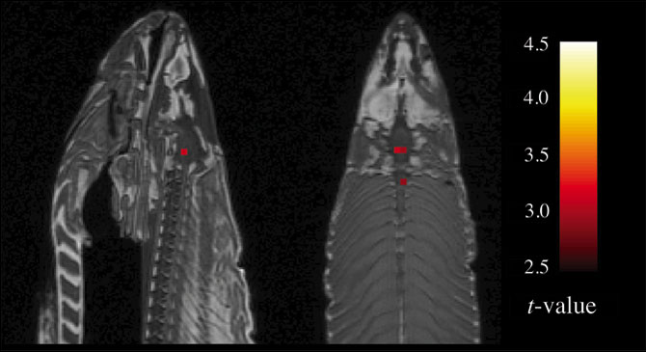

The reproducibility crisis in neuroscience
Data
  Insufficient power
  Noise
Analysis
  Highly flexible processing workflows with multiple decision trees
  Unreported assumptions
  Insufficient statistics
Biased reporting
Notes:
Model reproducibility is independent researchers' ability to recreate a model without original code.
Low model reproducibility stems mostly from authors' omitting to provide crucial information in scientific papers and sharing all computer code and data is not a solution.

Slide 3
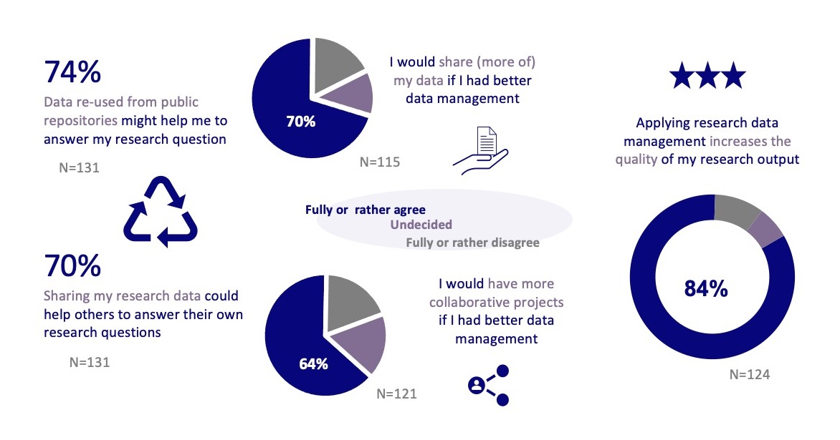
The German National Research Data Infrastructure in Neuroscience (NFDI-Neuro)
Klingner et al, bioRxiv 2022
Notes:
NFDI-Neuro conducted a comprehensive survey amongst the neuroscience community to determine the current needs, challenges, and opinions with respect to RDM.
barriers with respect to RDM and data sharing mainly linked to (1) lack of data and metadata standards, (2) lack of community adopted provenance tracking methods, 3) lack of a privacy preserving research infrastructure for sensitive data (4) lack of RDM literacy and (5) lack of required time and resources for proper RDM.

Slide 4
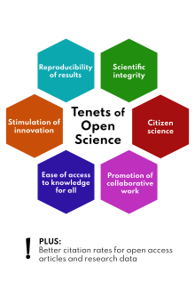
Barriers for Open Science
are due to lack of data and metadata standards,
of community adopted provenance tracking methods,
of research data management literacy,
of required time and resources for proper research data management, and
of a privacy preserving research infrastructure for sensitive data.

Slide 5
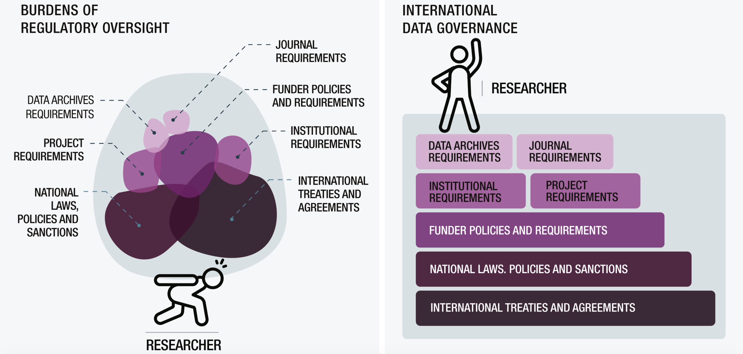
Credit: International Brain Initiative

Slide 6
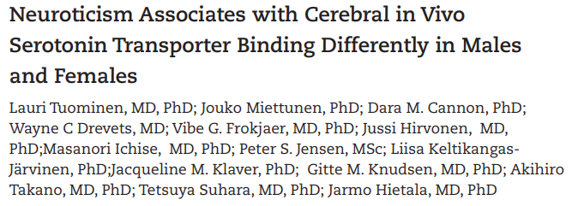
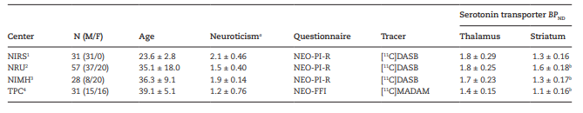
Example of brain PET data sharing
Data from four different PET centers to address whether neuroticism is related to serotonin transporter binding in vivo. The data includes thalamic and striatal serotonin transporter BP_{ND} values and personality scores from 91 healthy males and 56 healthy females.

Slide 7
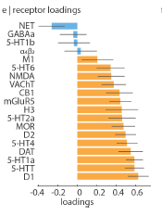
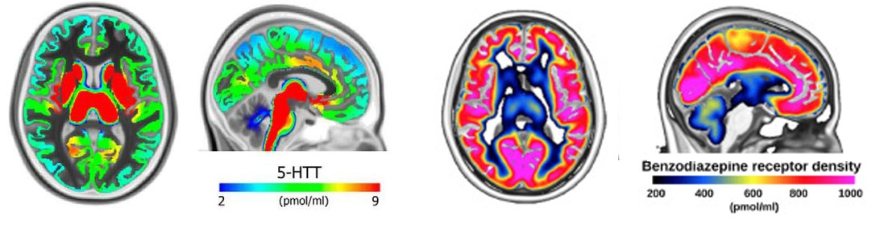
Molecular (and functional) brain atlases
MNI (volume) and FreeSurfer Average (Surface)
Tracer based vs. Target based atlases (multi-sites, multi-tracers harmonization)
How do the different anatomical and functional (fMRI connectivity) atlases match receptor maps?
Beliveau et al, J Neurosci 2017; Norgaard et al, NeuroImage 2021; Hansen et al, Nature Neurosci 2022 (in press).

Slide 8
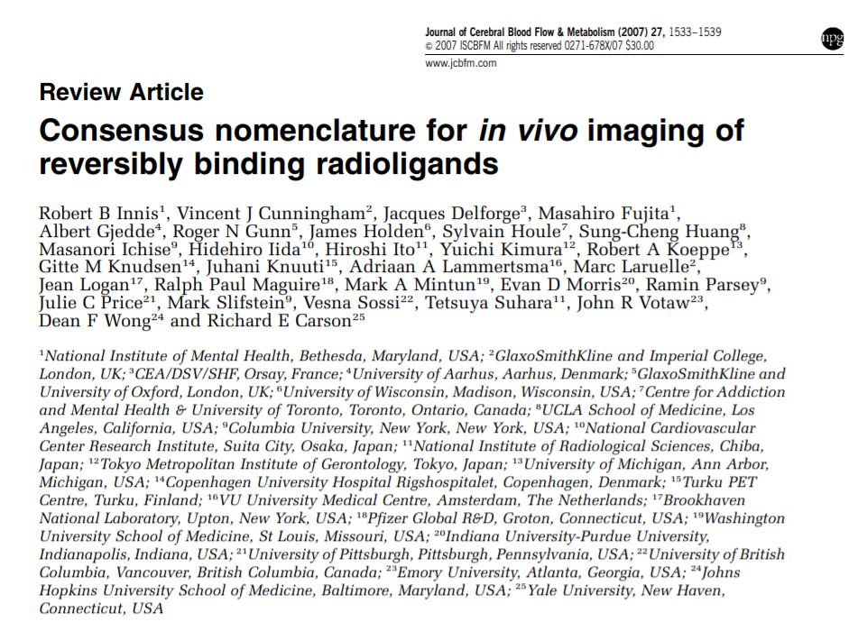
Standard nomenclature
Notes:
2006-2007 1875 citations – and still counting

Slide 9
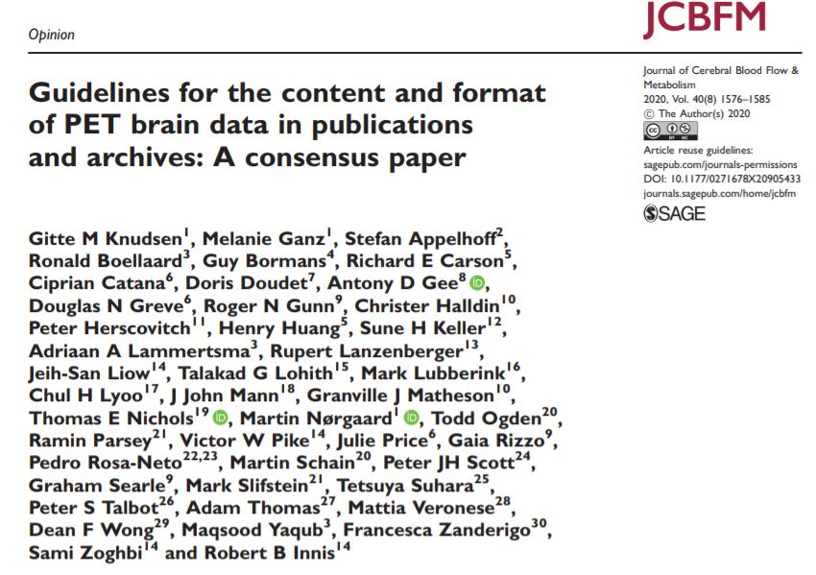
Consensus on publishing PET experiments
Replication in science can be improved with standards for reporting and sharing of primary research data
Notes:
2016-2020 22 publications

Slide 10
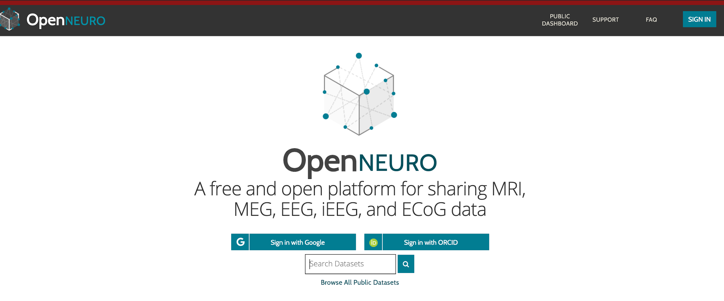
From OpenNeuro ...
Official repository for BRAIN Initiative
Part of the Amazon Public Datasets project
627 public datasets
21.756 subjects / ~16 TB
10-20 new dataset uploads per
month
Serving 1000 + downloads/month (almost 20TB of data)
Over 8K users/month

Slide 11
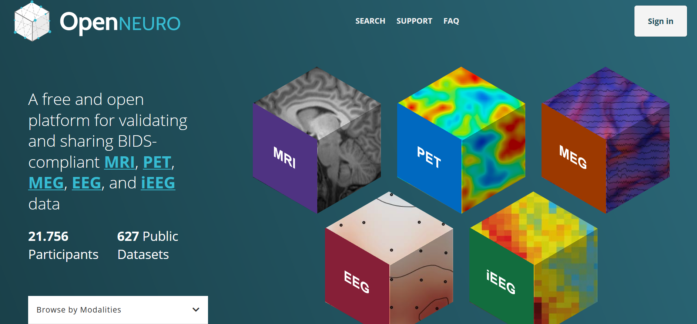
...to OpenNeuroPET
Establish PET archive as an extension of OpenNeuro
  Standard format and content
  “Best Practices” for pipelines and QC checks
Educate and seek feedback from the PET user community
Establish average images of receptor density, connecting to the larger fMRI community

Slide 12
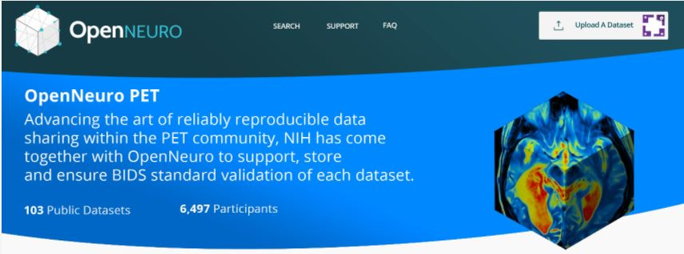
OpenNeuroPET
Principles
  Standard format to meaningfully share and combine data
  Follow Guidelines, include “best practices” for data pipelines, and sample data sets for QC
Benchmarks of success
  Number of scans deposited
  Number of resulting publications
Community engagement
  Provide help to sites
  Integrate with commonly used software
  Stimulate projects

Slide 13




OpenNeuroPET
OpenNeuroPET setup

Slide 14
OpenNeuroPET
  PI: Robert Innis
  Funding: NIMH via BRAIN Initiative (Brain Research through Advancing Innovative Neurotechnologies)
  Duration: Oct 2021 – Sept 2026
  Collaborator: NRU, Rigshospitalet; MGH
  Consultant: Russell Poldrack (Stanford)
  PI: Gitte Moos Knudsen
  Funding: Novo Nordisk Foundation (Research Infrastructure program)
  Duration: Jan 2021 – Dec 2025
  Collaborator: NIMH; MGH
  Consultant: Russell Poldrack (Stanford)
Notes:
Funds: $4.4 M and Funds: $1.5 M

Slide 15
Data scales in neuroimaging (OpenNeuro PET version)
Articles
(space aggregated, binding and TAC missing)
Peak coordinates & ROI
Potential for reuse
NeuroVault & al.
Molecular brain atlases
OpenNeuroPET
nEUrothenticate
Raw data -- study based
CIMBI
Raw (PET+anat MRI) + processed data + clinical
-- tracer based
Adapted from Poldrack & Gorgolewski (2014) https://www.nature.com/articles/nn.3818

Slide 16
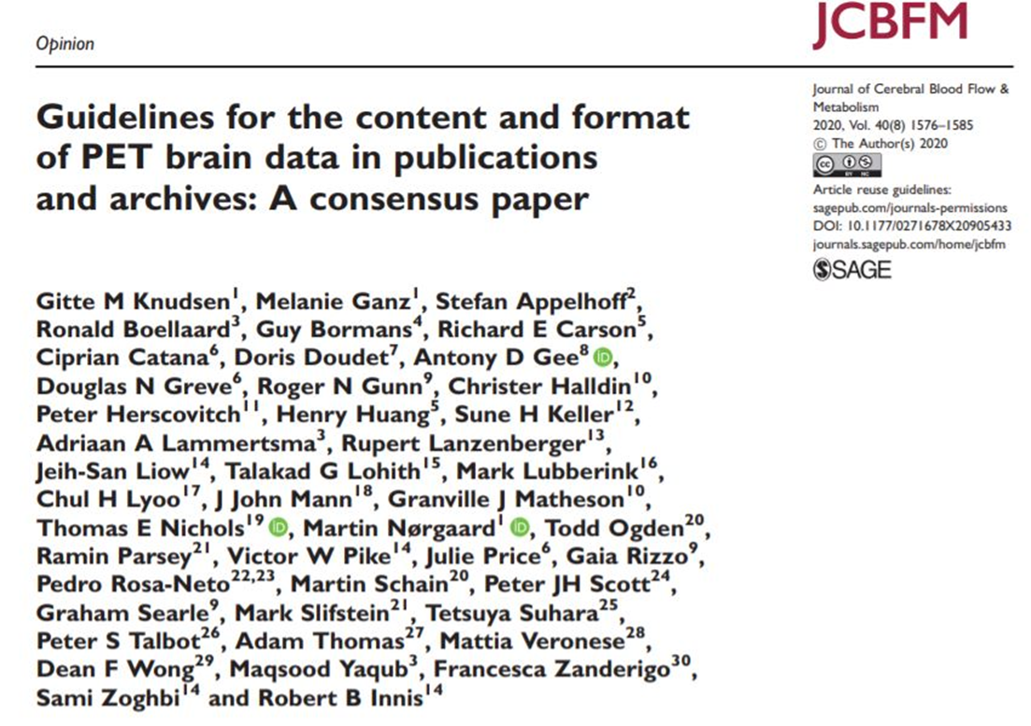
Raw Data harmonization

Slide 17
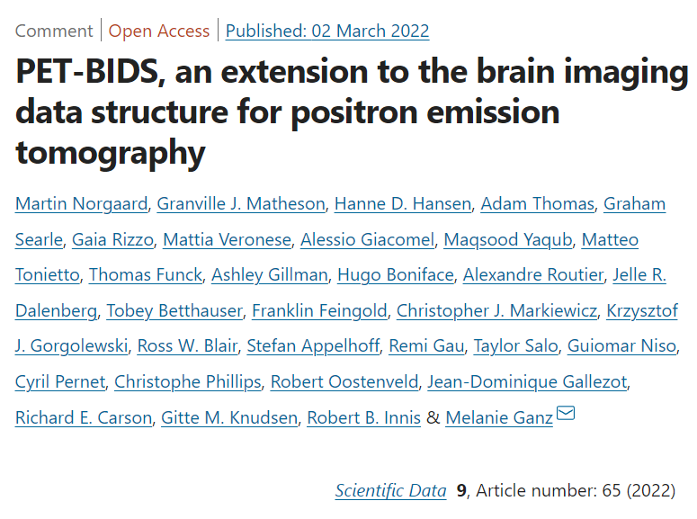
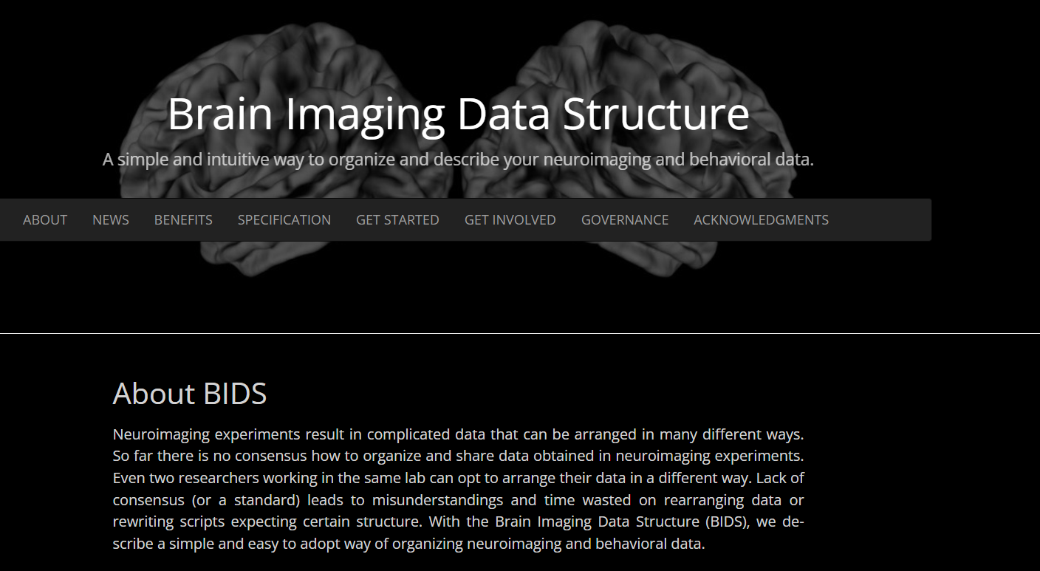
Raw Data harmonization
Use a common, community-based data structure (the way to store data on hard-drives) and naming
https://bids.neuroimaging.io/

Slide 18
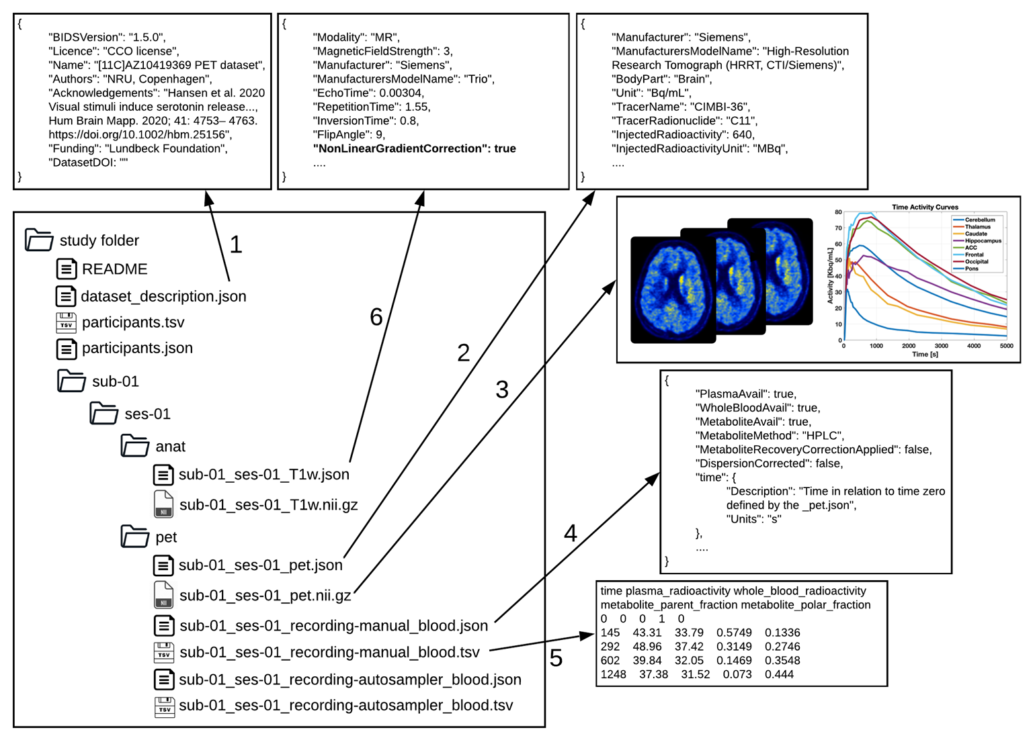
Raw Data harmonization
OpenNeuro PET: new library PET2BIDS to curate PET and blood data to BIDS standard (https://github.com/openneuropet/PET2BIDS)
There is a lot of extra information which is not in the image data (ecat or dcm) – all tracer related, the library helps creating all metadata and validates them
Image courtesy of Melanie Ganz 10/08/2022

Slide 19
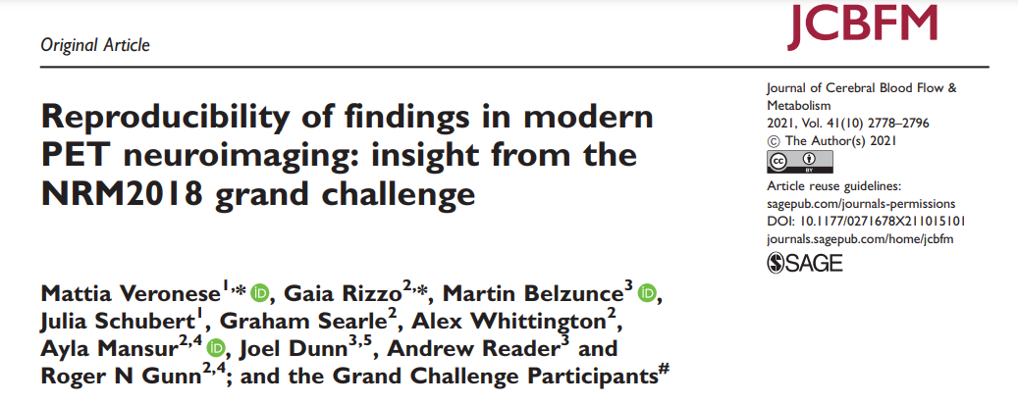
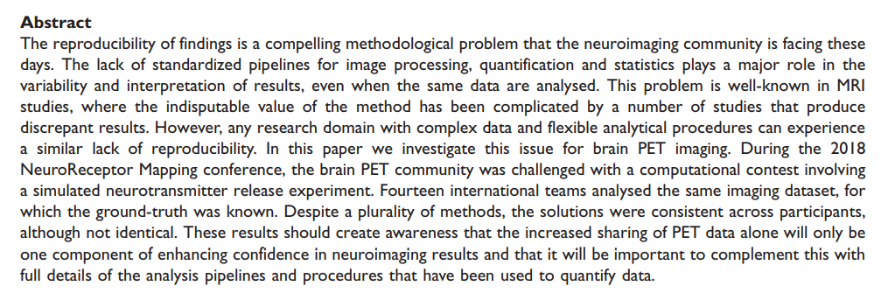
Data Processing harmonization

Slide 20
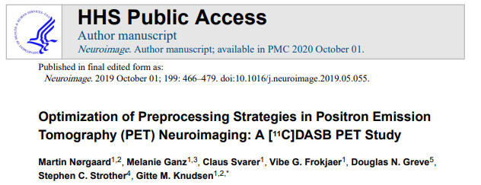
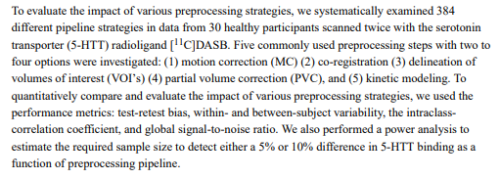
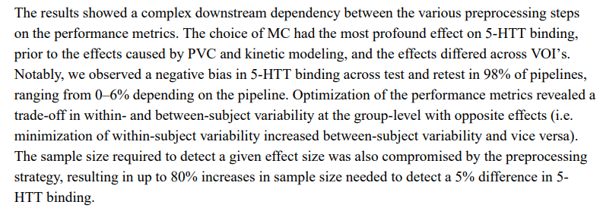
Data Processing harmonization

Slide 21
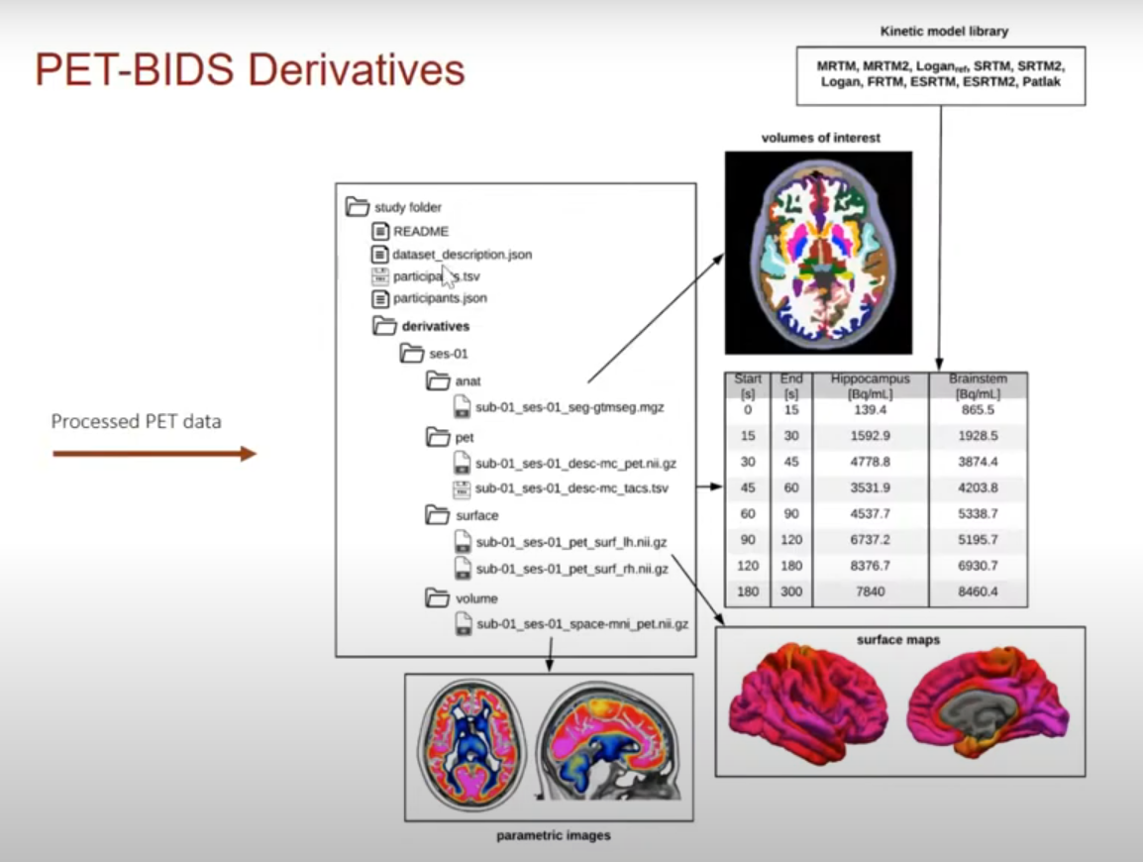
Data Processing harmonization
OpenNeuro PET: development of volume and surface based data analysis pipelines (with/without containerization) to have fully reproducible workflows (https://github.com/openneuropet/PET_pipelines)
BIDS PET preprocessing derivatives: what should be shared, which form, etc .. (open specification to contribute)
Image courtesy of Martin Nørgaard 15/12/2021

Slide 22






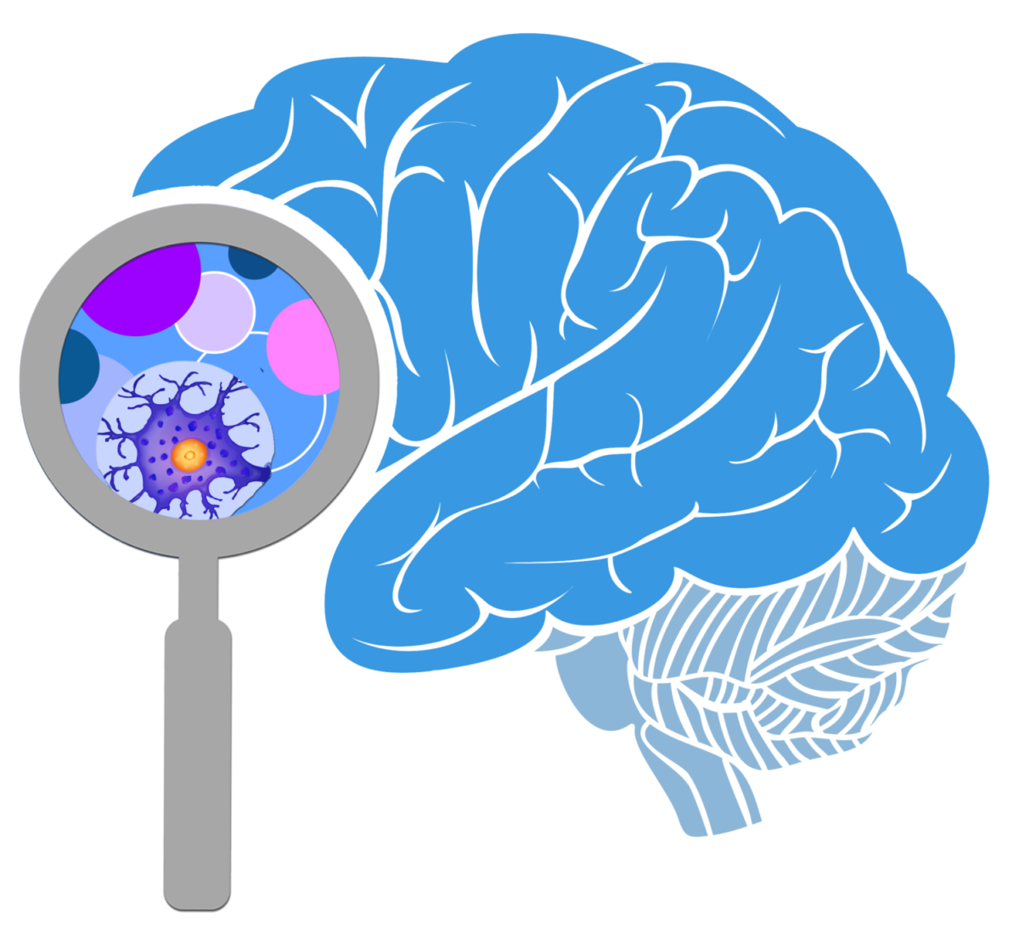





Thank you!

