Slide 1



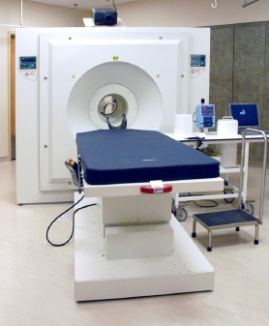
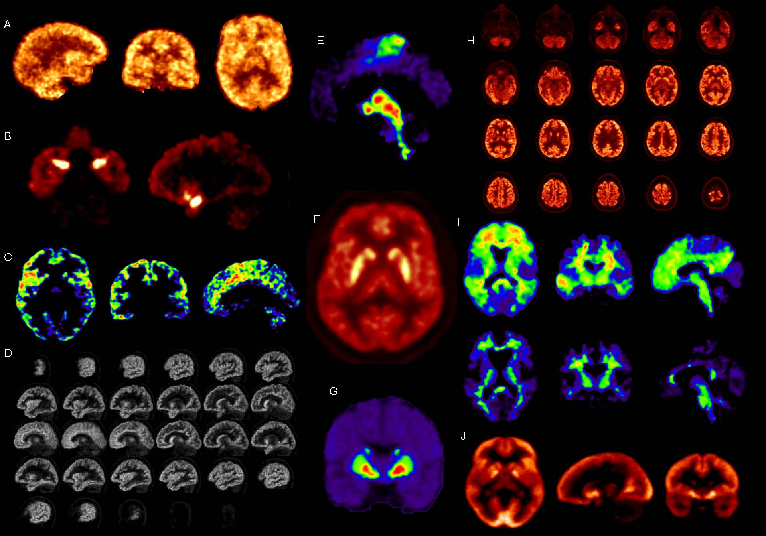
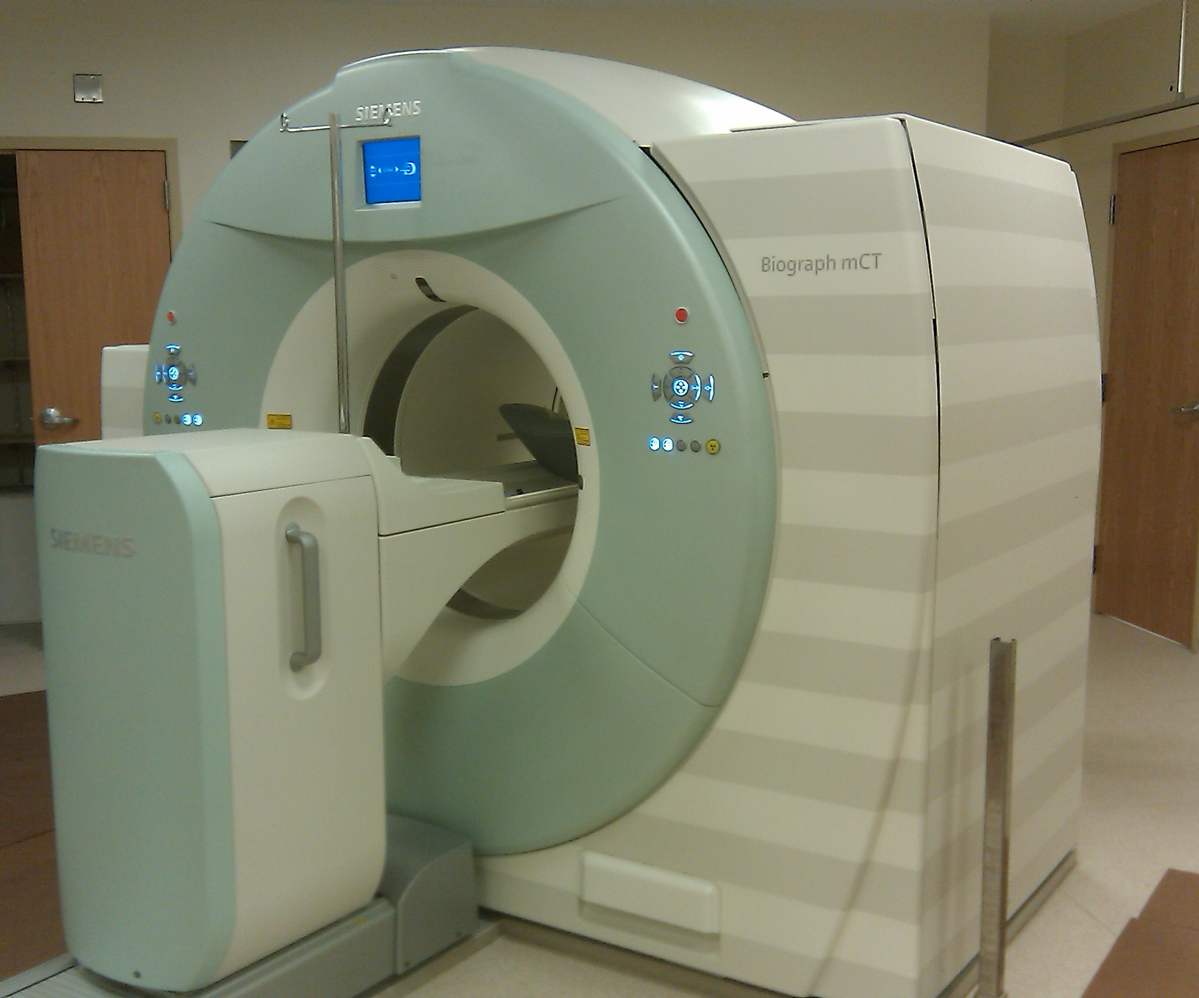
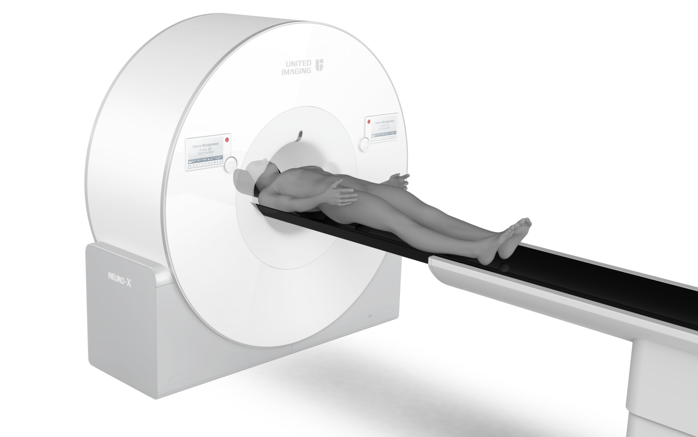
NeuroEXPLORER (NX)
Novel applications of next-generation brain PET scanners
May 29, 2022
Richard E. Carson, Ph.D.
Yale University

Slide 2
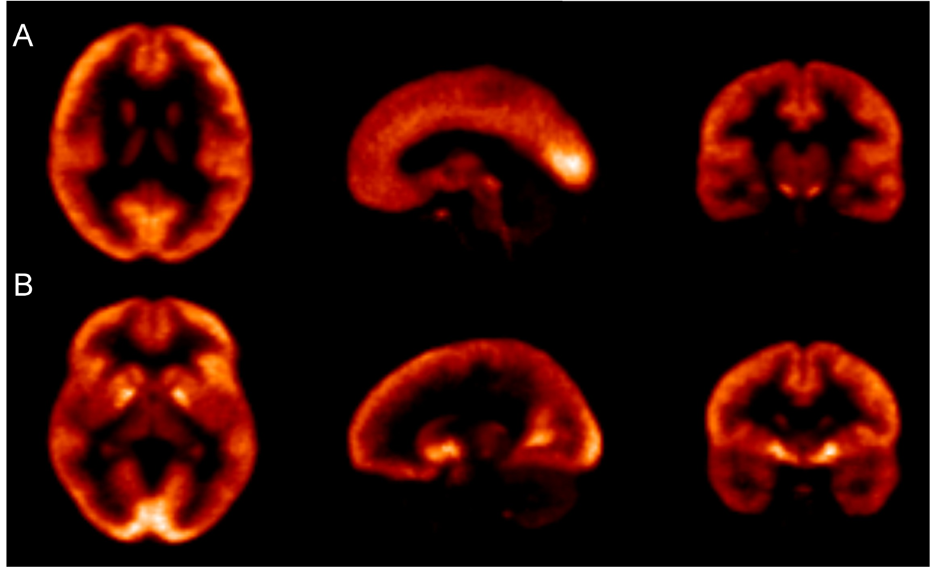
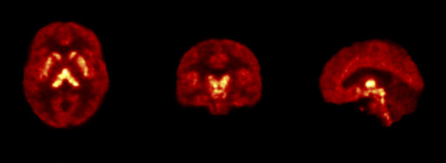
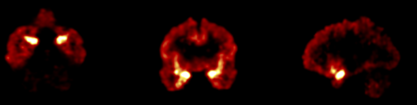
High Resolution Human Brain PET Imaging
Serotonin-1B Receptors
Serotonin Transporter
Kappa Receptors
Synaptic Density (SV2A)

Slide 3
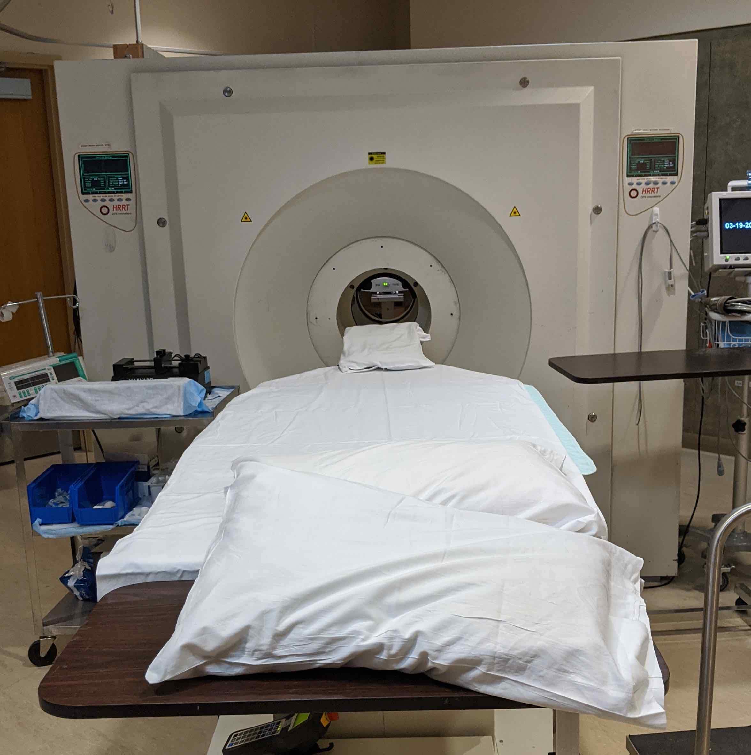
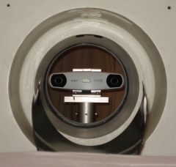
HRRT @ Yale PET Center
State-of-the art for brain PET
Design > 20 years old
~ 4500 human studies
~ 50 different tracers
~ 50 current NIH grants for brain PET at Yale
Dynamic (list-mode) acquisition for 60-150 min
Arterial blood sampling in ~ 60% of the scans
Operating at ~ 3 mm resolution (probably)
Online hardware motion correction

Slide 4
What have we learned from the HRRT at Yale
Insufficient system sensitivity
  Counts are usually the limiting case
  Radioactivity images are often noisy
  Parametric images from voxel-by-voxel kinetic modeling are noisier
  Some form of filtering / noise reduction is needed
We rarely can produce images at the system’s best possible resolution
People move!
  High resolution is not meaningful without great motion correction

Slide 5

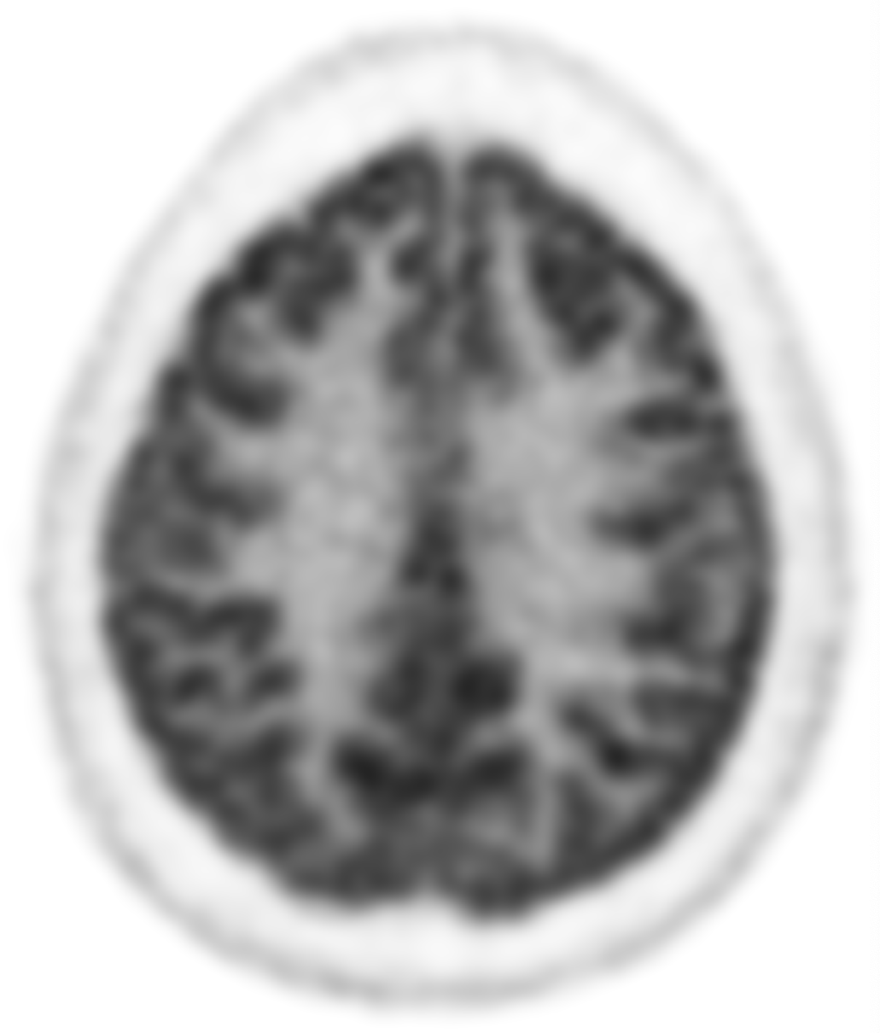
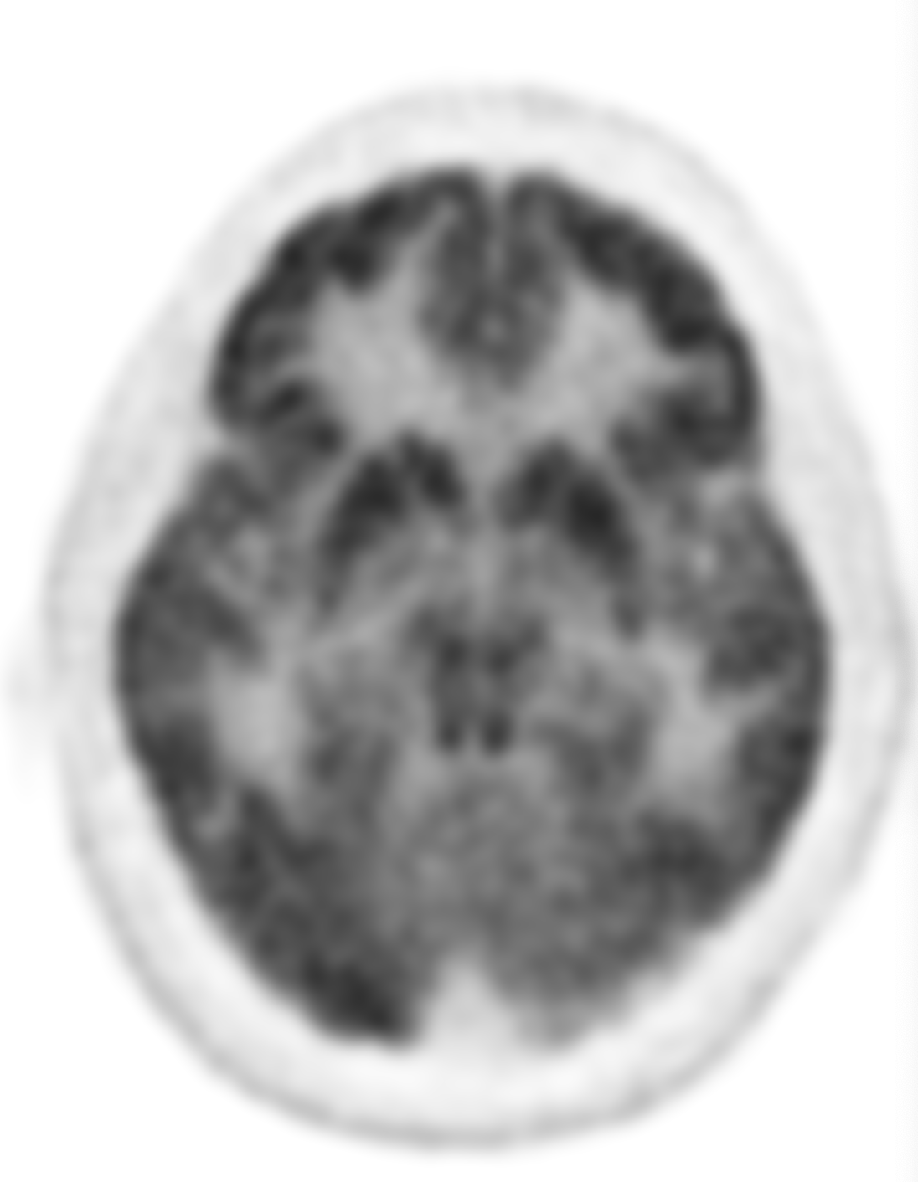
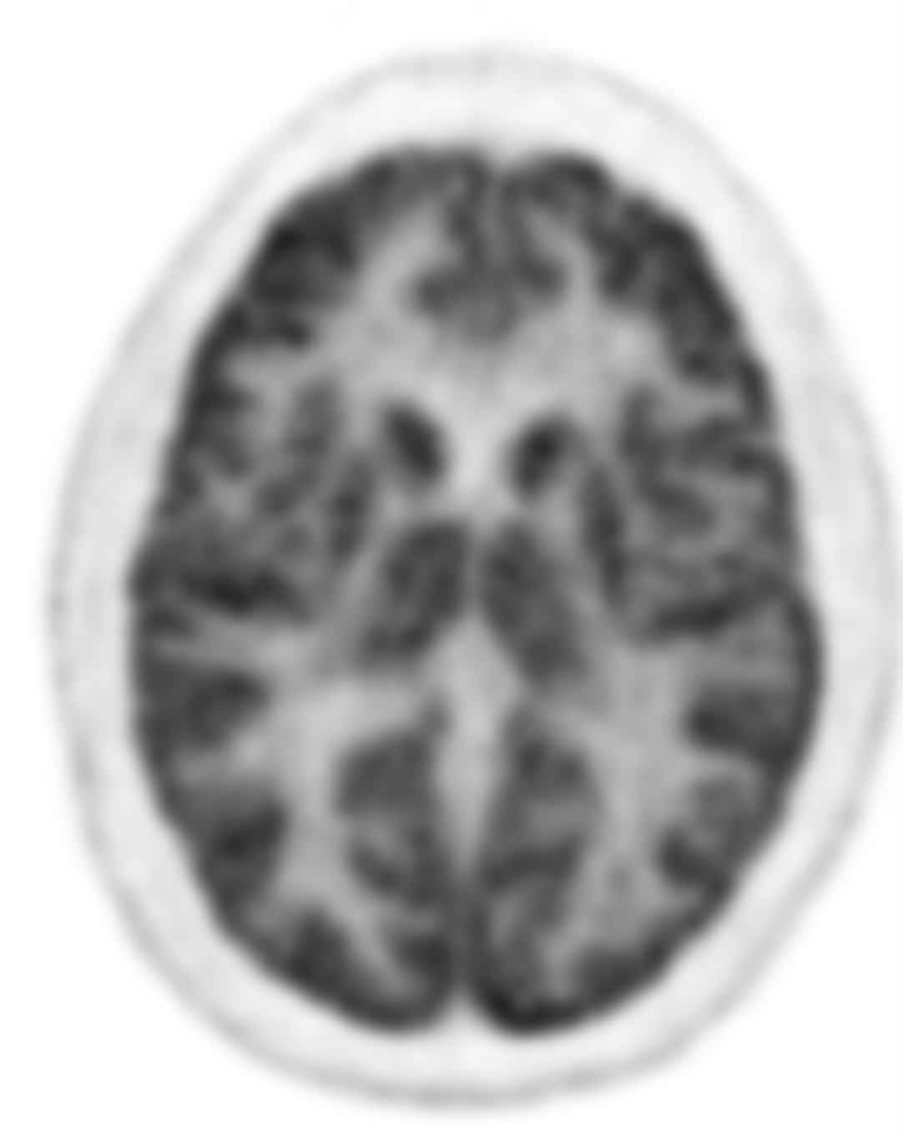
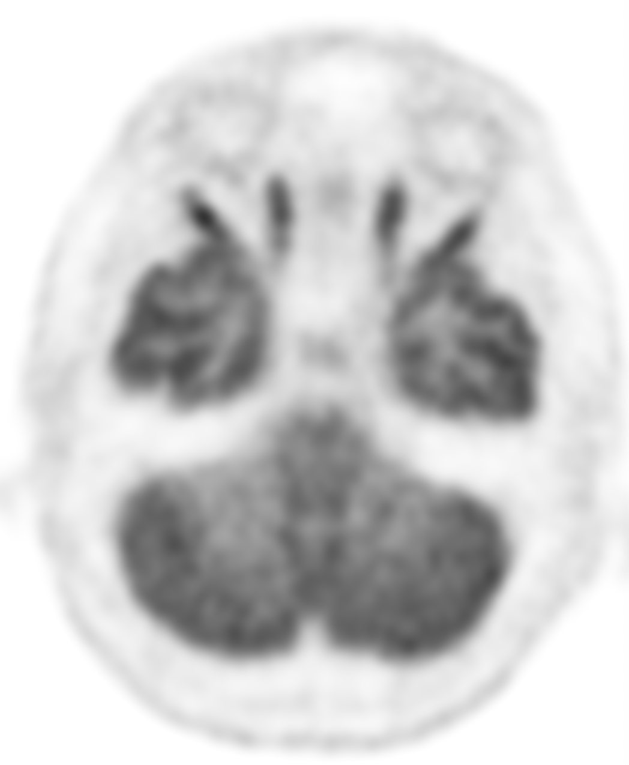

What have we learned from the EXPLORER
at UC Davis
High sensitivity enables high SNR for short scan durations
300 sec frame
Also enables sub-second temporal sampling of the arterial input function and bolus arrival times and transit times
Ki
0.06
This enables parametric imaging at high spatial resolution with no smoothing.
0.1 sec frames
0

Slide 6
High sensitivity in Next-Generation Dedicated Brain PET
Needed to achieve high resolution
  Need enough counts per resolution element
Improved quantification
  Many useful tracers labeled with C-11 (20-min half-life)
  For longer scans with slower kinetics, especially for regions with highest binding
  For targets with low concentration (B_{max})
Assess dynamics
  Neurotransmitter release due to stimuli
  Large changes in small regions or small changes in large regions
Low noise
  To precisely measure small longitudinal changes in disease
Lower injected dose
  Pediatric imaging
  More repeat scans

Slide 7
High resolution in Next-Generation Dedicated Brain PET
Image focal structures
  Raphe nucleus, Locus coeruleus, substantia nigra, entorhinal cortex
  Distinguish distribution across cortical layers (1-2 mm) in human beings
Reduce partial volume effect
  Distinguish atrophy effects from loss of target proteins in remaining tissue
Ensure uniformity of image resolution
  Over space and time
Measure the tracer input function
  HRRT’s resolution not good enough for carotid artery quantification

Slide 8
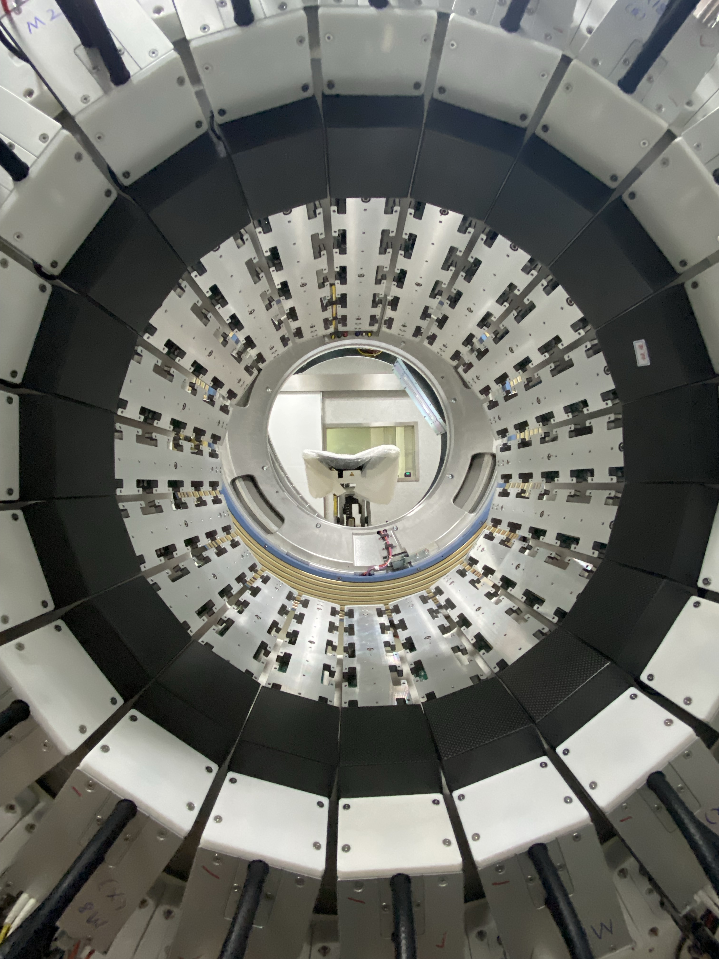
The NeuroEXPLORER, a next-generation ultra-high performance human brain PET imager
Richard E. Carson, Ramsey D. Badawi, Simon R. Cherry, Junwei Du, Kathryn Fontaine, Paul Gravel, Ansel Hillmer, Nathaniel Holderman, Praveen Honhar, Jocelyn Hoye, Lingzhi Hu, Terry Jones, Edwin Leung, Tiantian Li, Yusheng Li, Chi Liu, Qiong Lu, Stanislaw Majewski, Evan D. Morris, Tim Mulnix, Suranjana Samanta, Aaron Selfridge, Ekaterina Shanina, Xishan Sun,
Takuya Toyonaga, Tianyi Zeng, Jiazhen Zhang, Xuezhu Zhang, Jinyi Qi, Hongdi Li
Yale University, New Haven, CT, USA
University of California, Davis, Davis, CA, USA
United Imaging Healthcare America, Houston, TX, USA
Funding: U01EB029811

Slide 9

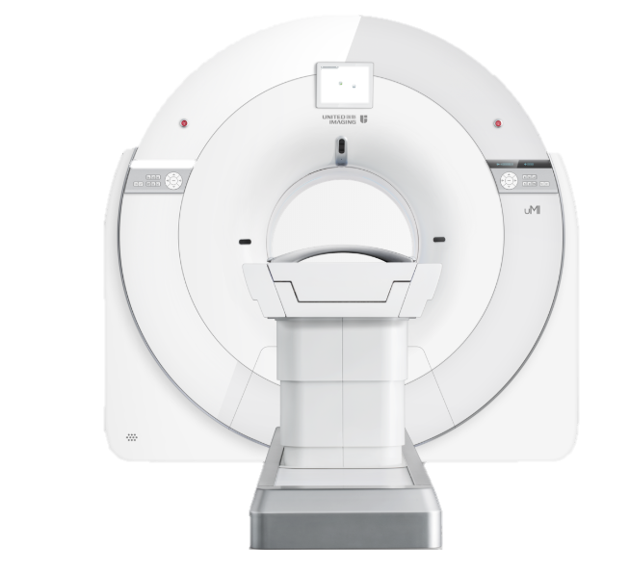
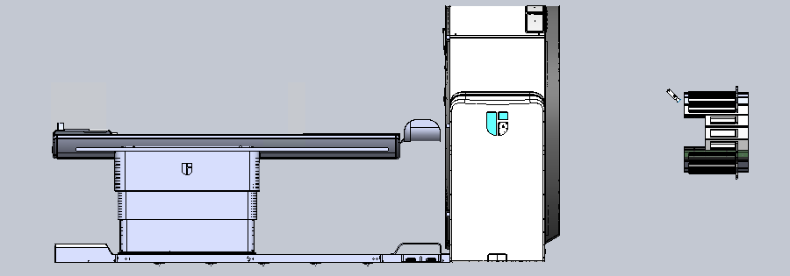
X10 effective sensitivity than the HRRT
51.6 cm detector diameter
48.1 cm length / shoulder cutout
1.56 x 3.07 x 20 mm³ LYSO detector
131,328 detector elements read out by 65,664 SiPMs organized in 16,416 micro-blocks
Time-of-flight (TOF) < 270ps
Depth-of-interaction (DOI) < 4mm / single-end readout
IDIF of Carotid Arteries
Built-in camera for motion-free imaging
Open platform / Ultra-High-Resolution panels
80 slice CT for PET attenuation correction
Geometry
Detector
Others
NIH BRAIN Initiative U01EB029811

Slide 10
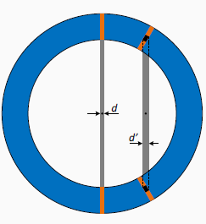
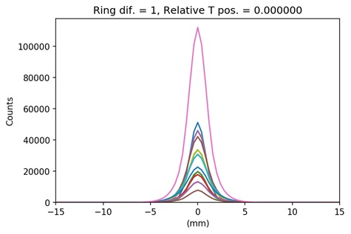
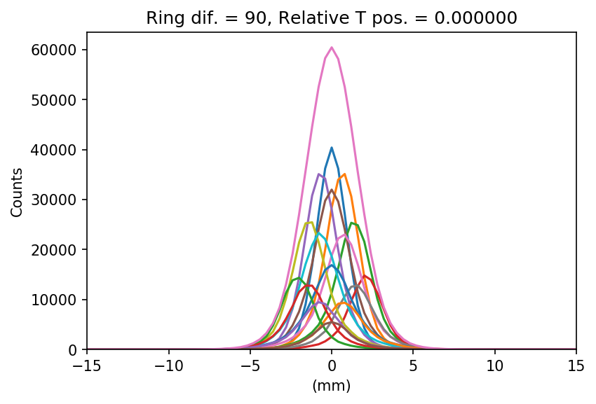
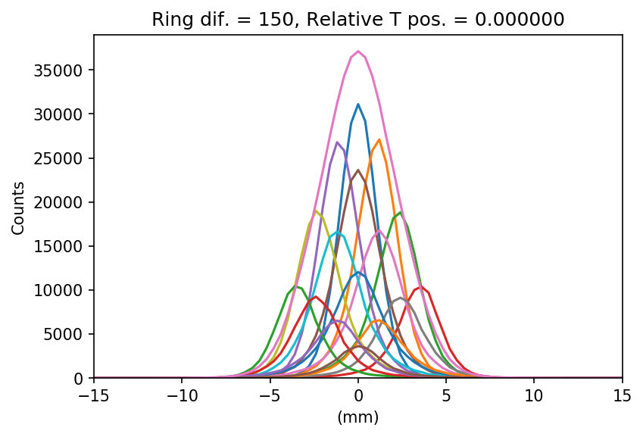
What have we have learned from the EXPLORER?
Depth-of-interaction (DOI) is essential for high-resolution imaging
3
3
3
2
2
2
1
1
1
0
0
0
DOI_2-3
0
FWHM ~2mm
0
FWHM ~4.0 mm
0
FWHM ~6 mm
1
1
1
DOI is essential for transverse and axial resolution
2
2
2
3
3
3
Monte Carlo PSF modeling with / without DOI

Slide 11
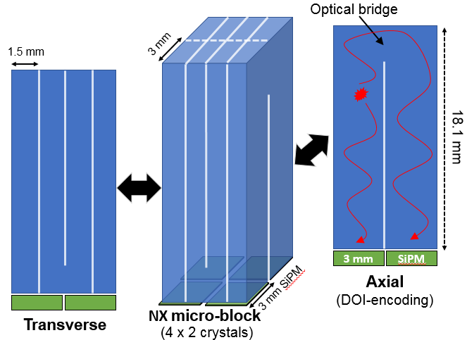
Depth-of-Interaction and Inter-Crystal Scatter detection
Inter-crystal scatter (ICS) up to 30%
20 mm
d2
d1
d1<d2
NX micro-block detector
Patient
Single-end readout
Easy to manufacture / low-cost
DOI resolution < 4mm
Improve axial resolution by using DOI-induced oversampling

Slide 12
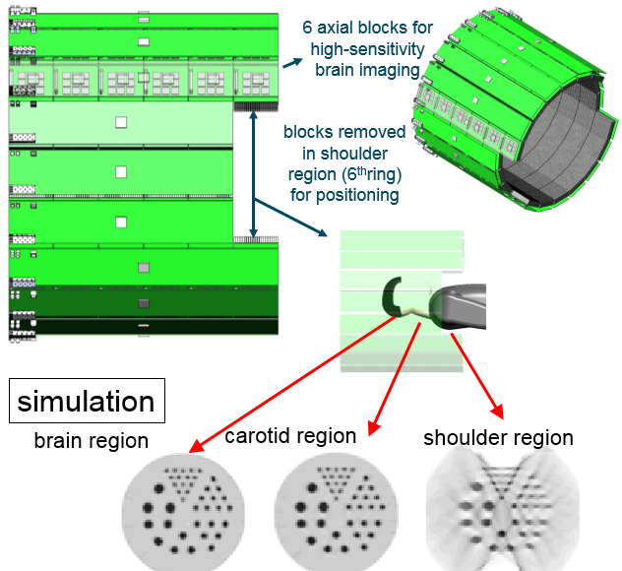
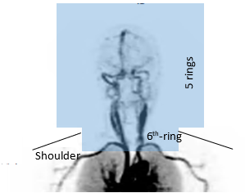
Partial Shoulder Ring
To maximize the sensitivity for the brain: 50-cm axial FOV
Center the brain in the axial FOX
  Uniform sensitivity throughout the brain
Partial 6th ring to accommodate all shoulder sizes
  3 blocks removed on both sides
With TOF, 10-fold higher sensitivity than the HRRT
  Even greater gain for the carotids
Reconstruction:
  Take advantage of the added oblique LORs without introducing artifacts into FOV
  Deep learning to reduce limited angle artifact if necessary

Slide 13
Ultra-high resolution insert
Open platform for zoom-in or multi-organ imaging
Improve resolution and sensitivity for imaging carotid artery
Image reconstruction using all events:
  NX coincidences
  NX-insert coincidences (higher res.)
  Insert-insert coincidences (highest res.)
Goal: high-resolution images without limited angle artifacts

Slide 14
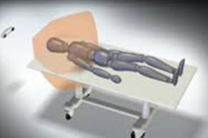
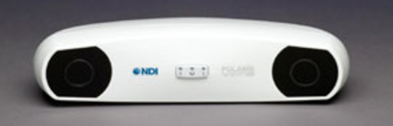
Head Motion Correction
Real-time Markerless Motion Tracking
Stereovision with Structured Light
Top-class precision enabled by unique
WindMill™ structured light technology
Independent of ambient light with
advanced laser technology
Real-time streaming of 3D point clouds
provided by novel fiber communication
design and state-of-the-art processor
Human testing on Siemens mCT
  “Head-to-head” vs. Vicra

Slide 15
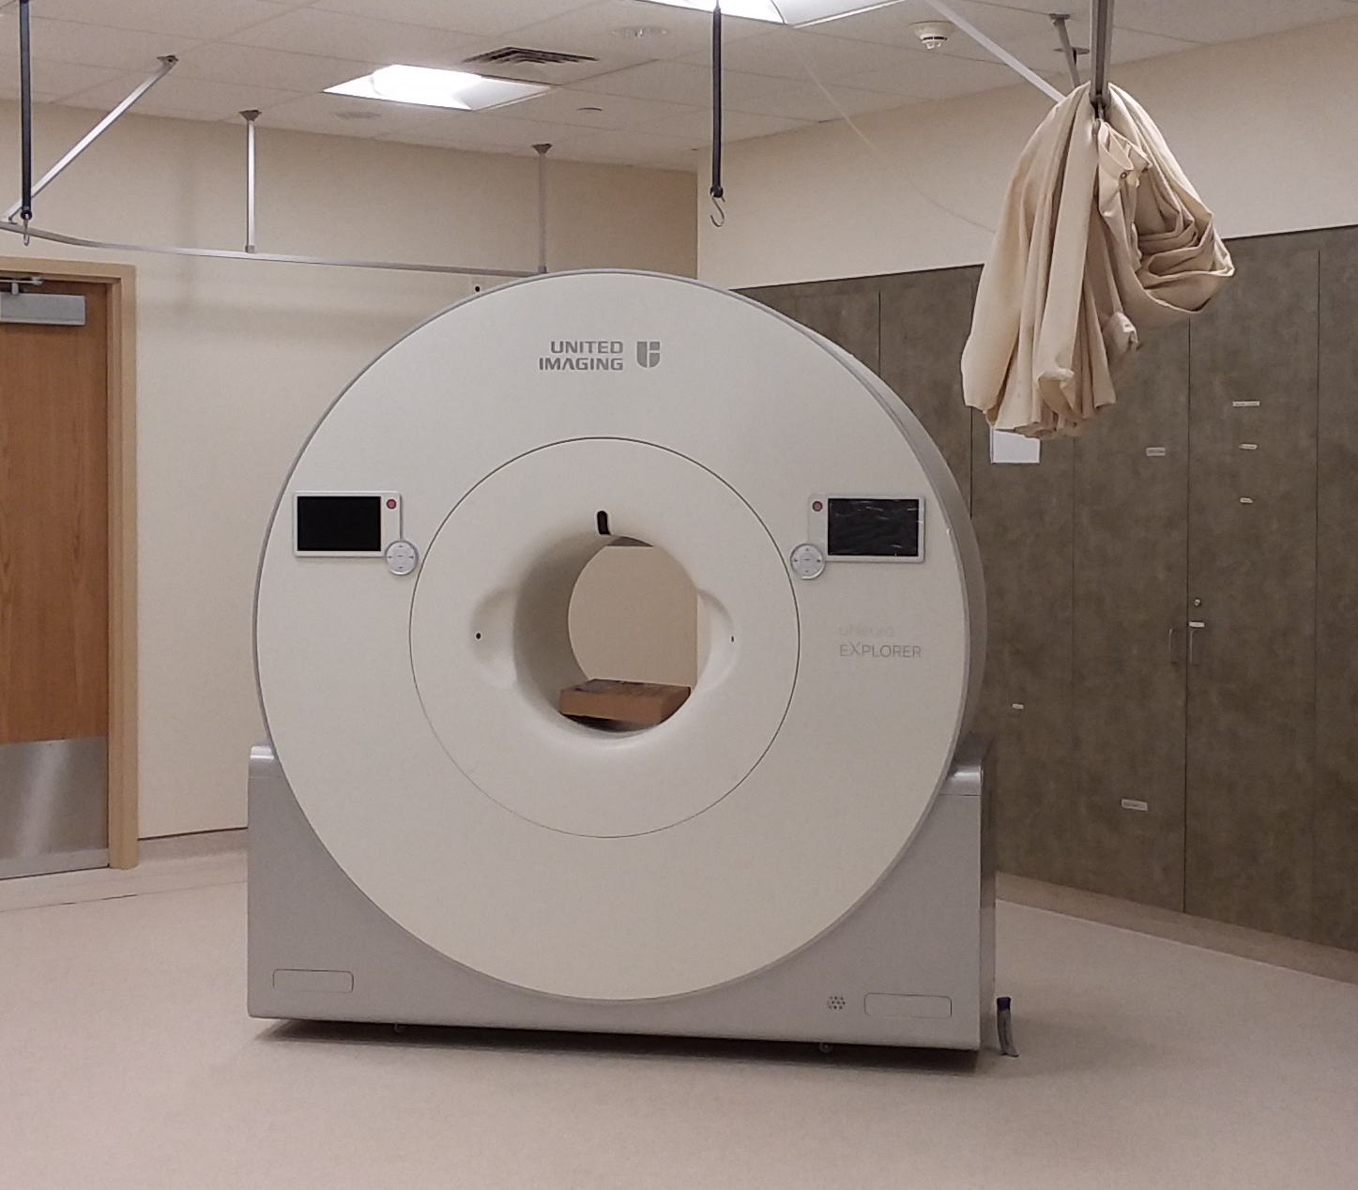
NeuroEXPLORER Summary
A fully-functional well-characterized
commercially-available brain PET system
Key Features:
  At least 10-fold higher effective sensitivity than the HRRT
  Useable resolution of <2 mm in the human brain
  Continuous motion correction
What can we do with such a system?

Slide 16
Outline
Total-body brain-PET applications
How body data helps the brain
  IDIF
  Metabolites
How brain data helps the body
  BAT imaging – brain reference region
  In utero SV2A imaging
Next-generation Brain PET
The NeuroEXPLORER (NX)
Novel applications of next-generation brain PET
  New Imaging Paradigms
  Radiation Dose Reduction
  Methodological Improvements

Slide 17
What Can Next-generation Brain PET Accomplish?
International group of brain PET experts
  Anissa Abi-Dargham2, David J. Brooks, Kelly P. Cosgrove, Lars Farde, Alexander Hammers, William J. Jagust, Gitte M. Knudsen, Diana Martinez, Rajesh Narendran, Eugenii A. Rabiner
  Many years of experience in human brain PET research covering schizophrenia, substance use disorders, depression, dementia, epilepsy and Parkinson’s disease , as well as pharmaceutical industry applications.
Our aim was to identify the un-fulfilled wish lists of studies that rest upon improved scanner performance.
Three overall directions:
  New Imaging Paradigms
  Radiation Dose Reduction
  Methodological Improvements

Slide 18
New Imaging Paradigms
Imaging small brain structures
Measuring low-density binding sites
Spinal cord imaging
Dynamic neurotransmitter release
Measuring small within-subject changes
Atlas of therapeutic targets

Slide 19
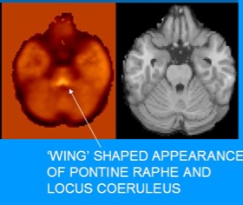
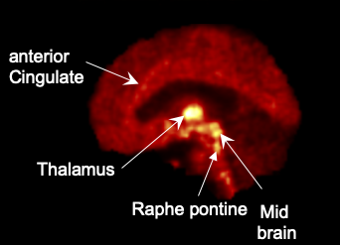
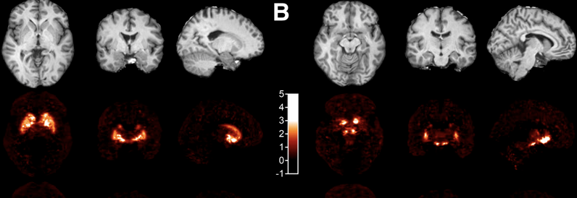
1. Imaging small brain structures
Locus coeruleus
Raphe nuclei (SERT)
Substantia nigra
Ventral tegmental area?
Nucleus basalis of Meynert
Sub-nuclei of thalamus
Sub-nuclei of amygdala
Hippocampal subfields

Slide 20
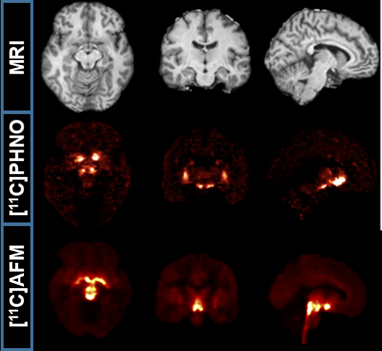
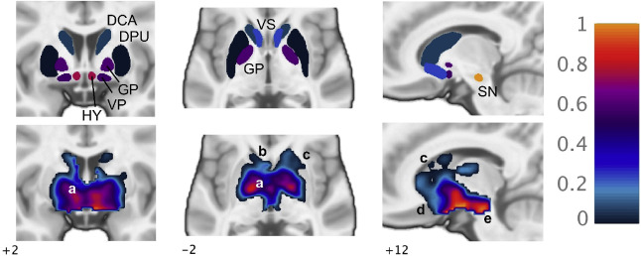
Imaging small brain structures:
Test/retest in small brain nuclei
Small midbrain nuclei (raphe nuclei, substantia nigra, ventral tegmental area)
Current PET systems have poor reli­ability in these regions
  ¹¹C-PHNO binding potential (BP_{ND}) in SN has
  20% repro­ducibility.
Test-retest PET scans
¹¹C-PHNO (D₂/D₃ receptors) BP_{ND} in SN and VTA
¹¹C-AFM (serotonin transporters) BP_{ND} in the raphe

Slide 21
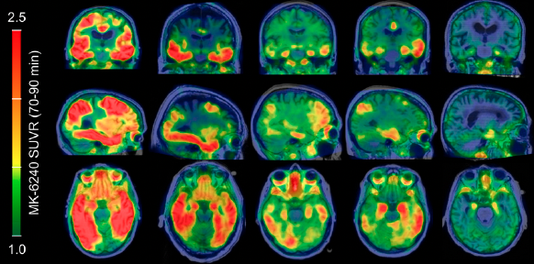
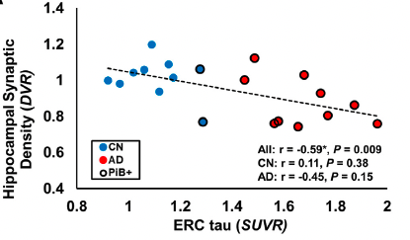
2. Measuring low-density binding sites
Binding potential: B_{max}/K_{d}
Low-density targets currently requires
specialized tracers with high affinity
  Such tracers not useful in brain regions
  with high target density or slow kinetics.
  With high sensitivity, measuring regions with low binding potential may become possible without the need for high affinity
  A single scan can provide whole-brain data
Tau deposition in the earliest phase
of dementia
  Low signal in small region
  Off-target binding
  Multi-tracer evaluation:
  tau and synaptic density
Betthauser et al, 2019

Slide 22
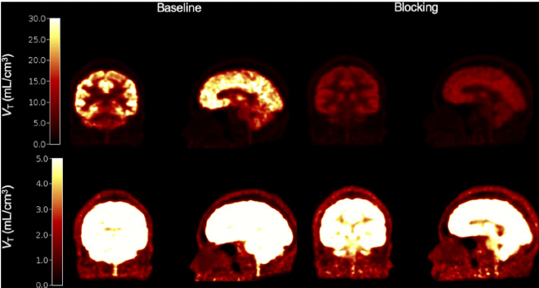
3. Spinal cord imaging
¹¹C-UCB-J Synaptic imaging
High relevance to spinal cord
injury and ALS
Small diameter (8-12 mm)
Low target densities
Dedicated brain systems need high sensitivity, high resolution and long axial FOV to image cervical cord
Rossano et al, 2022

Slide 23
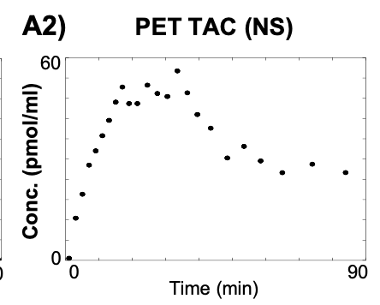
4. Dynamic neurotransmitter release
Problem: Looking for a Neurotransmitter Needle
in ¹¹C-Raclopride Haystack
PET
signal
Which is better?
or
Dopamine signal?

Slide 24
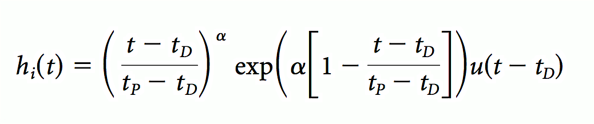
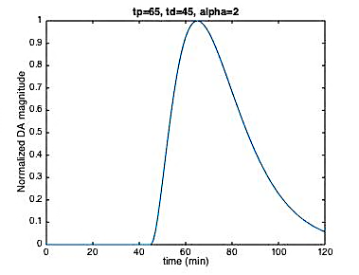
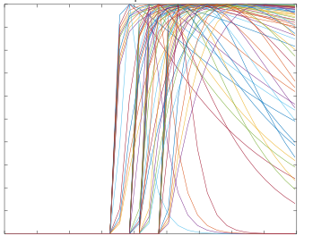
The lpnt-PET model
Steady-State Tracer Signal
Transient Dopamine Signal
${C_{T\left(t\right)}=R}_{1}C_{R}\left(t\right)+k_{2}\int_{0}^{t}{C_{R}\left(u\right)du}−k_{2a}\int_{0}^{t}{C_{T}\left(u\right)du}−γ\int_{0}^{t}{C_{T}\left(u\right)h_{i}\left(u\right)du}$
Dopamine Signal Parameterized:
Dopamine Signal Implemented:
Basis functions
t_{p} (peak-time)
$α$(recovery rate)
DA magnitude
DA magnitude
t_{D} (start-time)
time
time
Morris et al, 2005
Notes:
And this what the integral-linearized equation looks like. It’s called linear-parametric…
See there’s a term describing SS...another describing a DA transient.
I’ve told you that DA release is described by an amplitude + 3 timing variables.
something interesting about these 3 timing parameters is that they aren’t EXPLICITLY estimated. Instead we use whats called basis function implementation.
basically, all possible DA parameters are discretized and defined before implementation
we give the model a bunch of basis functions that are formed by these discretized params and let it pick the best one

Slide 25
Men Release Dopamine in R Vent Striat when Smoking a Cigarette. Women do not.
Previous Finding with lpnt-PET
Cosgrove KP, et al. Sex-Differences in the Brain’s Dopamine Signature of Cigarette Smoking. J Neurosci. 2014
Notes:
Summary finding. 8 men and 8 women smokers were scanned with 11C-raclopride B/I in HRRT with Vicra. Subjects smoked in the middle of the scan. We estimated their dopamine response to smoking at each voxel in precommisural striatum using lpntPET (Kim et al., HBM 2014). Only ‘significant’ dopamine responses contributed to the “scored” at each voxel. The probability of activation at a voxel is the fraction of men (or women) who had a significant dopamine respone at that location. A Permutation test (100,000 re-samplings of 8 and 8) showed that the likelihood of finding such a large difference in number of activated voxels in r Vent Striatum was p < 0.1)

Slide 26
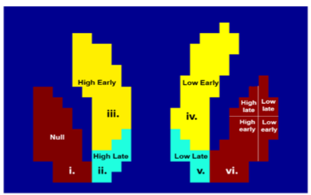
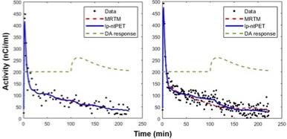
Enhanced sensitivity to dopamine release
Can we assess smaller signals (frontal cortex)?
Simulations: limbic phantom
Varied DA response magnitude and kinetics
Increased NX count sensitivity will dramatically increase detection sensitivity to DA dynamics
Increased time sampling
Liu and Morris, PMB, 2021

Slide 27
Testing enhanced sensitivity to neurotransmitter dynamics
Dopamine release in frontal cortex with a stress task
  Small DA response in a large (?) region
Multi-neurotransmitter effects
  Morphine-induced DA release in striatum
  Small DA release in a region with higher signal
Pain response in periaqueductal gray
  Brief capsaicin pain stimulus at 35 min postinjection of ¹¹C-carfentanil.
  Large (?) opioid response in a small region

Slide 28
5. Small within-subject changes
Small changes
Short-term, medium-term or long-term effects
Small regions or large regions
Drug occupancy
Acute response to drugs or stimuli
Synaptic plasticity from sleep or learning
Slow accumulation of amyloid or tau
Need high sensitivity for great test-retest variability in small regions

Slide 29
Tests of small within-subject changes:
Receptor occupancy with ultra-low drug doses
PET can assess direct competition between drugs and tracers. However, PET sensitivity limits the precision to measure small changes.
Characterize small dynamic changes in receptor availability
by performing dynamic human scans with ultra-low doses
of brivaracetam (BRV)
  Occupies SV2A and imaged with ¹⁸F-SynVesT-1
Previous studies performed with a single large IV brivaracetam dose: 100 mg (A)
Begin to measure dose-response curves in single subjects
  Example with monkey study
  Never done in humans
Use sequential IV microdoses of 2.5 and 5 mg
  predicted to produce 5% and 10% occupancy.

Slide 30
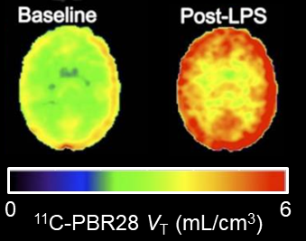
Low dose endotoxin to precisely measure small between-scan changes
Brain immune signaling influences behavior and cognitive function.
We used ¹¹C-PBR28 PET Imaging to measure human brain response to an acute immune stimulus (1 ng/kg endotoxin, right). This large dose elicits potent flu-like symptoms much greater than subtle changes relevant to healthy brain function.
Aim is to determine if the NX is sensitive to order of magnitude lower dose, more relevant to fluctuations in healthy brain
Use 0.1 ng/kg endotoxin, predicted to elicit a 5-10% signal increase, in n=8 subjects to demonstrate measurement of small, behaviorally-relevant immune stimuli in the healthy brain.

Slide 31
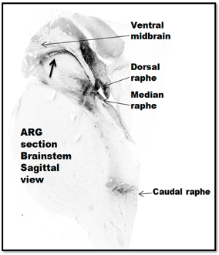
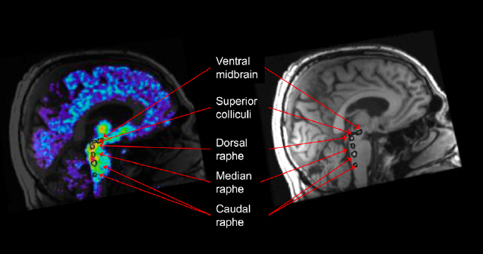
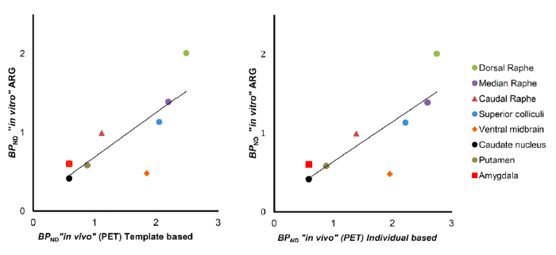
6. Atlases of therapeutic targets
¹¹C-MADAM and ³H-MADAM SERT
Magnitude and distribution of receptors, transporters, and enzymes is often based on expensive and resource-demanding autoradiographic studies of postmortem human brain tissue.
Using well-characterized tracers, PET brain imagers with resolution below 2 mm and high sensitivity have the potential to provide nearly gold-standard in vivo data for the distribution of future brain therapeutic targets.
Fazio et al, Neuroimage, 2016

Slide 32
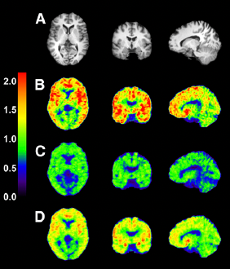
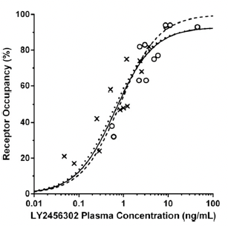
Radiation Dose Reduction
High Sensitivity
Adolescent research imaging
  Epilepsy
  ASD, Schizophrenia
  Synaptic pruning
  Need ultra-low dose and excellent motion correction
Longitudinal follow-up (multi-tracer)
  Dementia (progression or medication effects)
  Substance use disorders (withdrawal and recovery)
Single-subject drug occupancy studies
  More scans per subject ➔ Less variability
Controls
  Ease recruitment challenges
Target radiation dose:
  Dose of an intercontinental flight
Naganawa et al, JPET, 2016

Slide 33
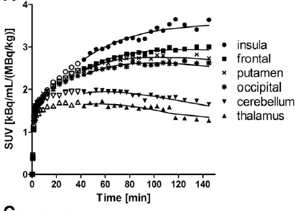
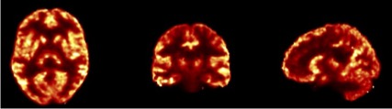
Methodological improvements
Extended scan time for short-lived tracers
  Make tracers more useful
Parametric imaging
  Less noisy
More complex modeling
  Distinguish compartments
    Statistically reliable microparameters (k₂, k₃)
    No need for constraints
  Multi-tracer PET
    Offset injections of 2 tracers
  Tracers that bind to multiple targets
    “Dirty tracers”
  Models that account for brain uptake of metabolites
Slow kinetics ¹¹C-GR103545
Kappa agonist
¹¹C-UCB-J V_{T} parametric images

Slide 34
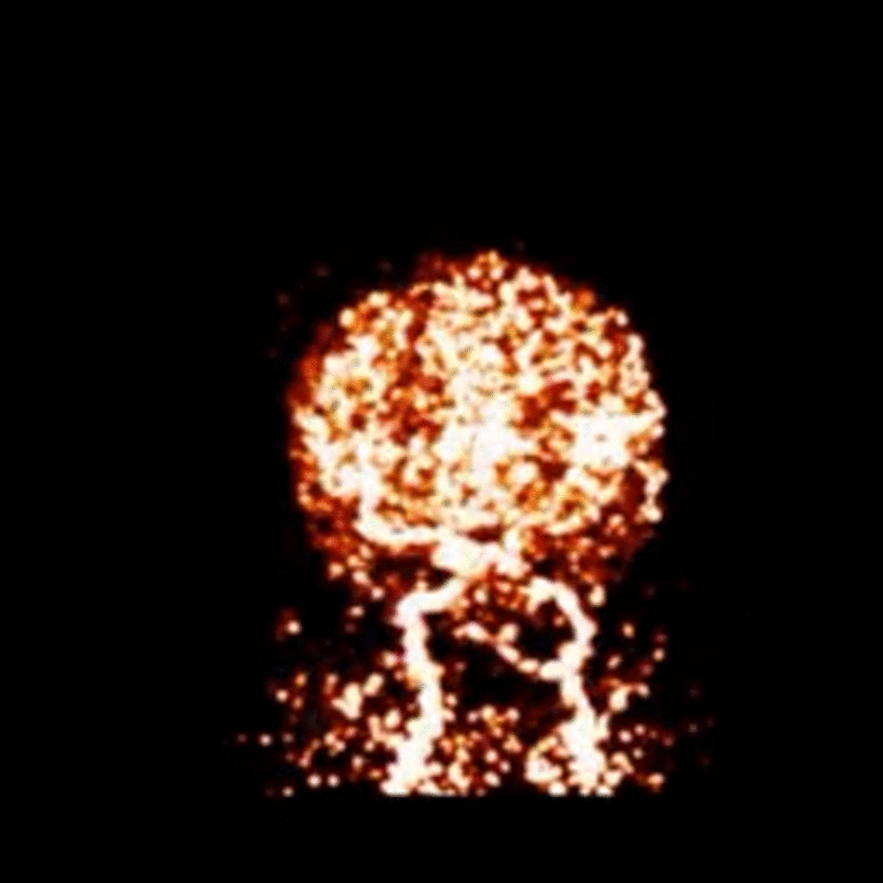
Carotid Artery Imaging
  Accurate input function for kinetic analysis
  Image-derived input function is more desirable
  Challenges:
    Small size of the carotid arteries
    Different tracers
    Both high and low contrast
  Validation of the carotid artery input function
    Validation using phantoms (digital or physical)
    Validation using human data (arterial samples) with
    multiple tracers
  Whole blood vs. plasma
  Radiolabeled metabolites
Tracer: ¹¹C-LSN3172176
Target : Muscarinic (M₁) Receptor
Image : MIP of summed activity
(0 – 1 min)
Scanner: HRRT

Slide 35
Acknowledgment: U01EB029811 and the NX Team

