Slide 1



Update of D2 Corrector Prototype in China
Shaoqing Wei, Zhan Zhang, Lingling Gong, Quanling Peng, Qingjin Xu (IHEP, Beijing)
Dongsheng Ni, Wenjie Yang, Yu Liang, Bo Zhao, Wei Wu (IMP, Lanzhou)
Meng Li, Wei Liu, Chao Li (WST, Xi’an)
WP3 meetings – Beijing – 30 Sep. 2019

Slide 2
Outline
Update of the 2.2-m long D2 Corrector Prototype
Status of the Magnetic Measurements System
Schedule of the 2.2-m long D2 Corrector Prototype
Summary

Slide 3
Outline
Update of the 2.2-m long D2 Corrector Prototype
Status of the Magnetic Measurements System
Schedule of the 2.2-m long D2 Corrector Prototype
Summary

Slide 4
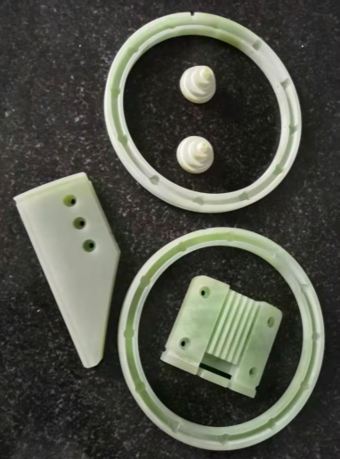
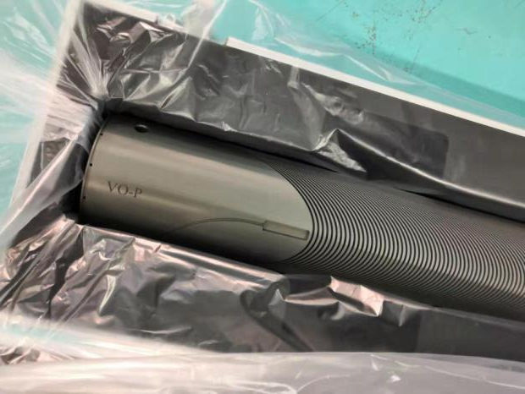
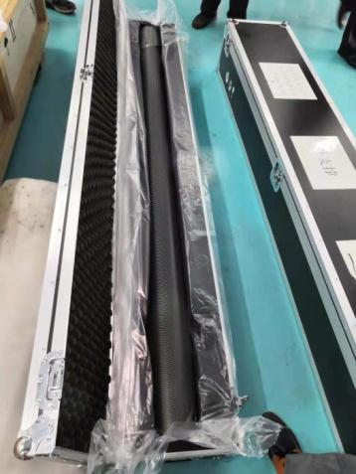
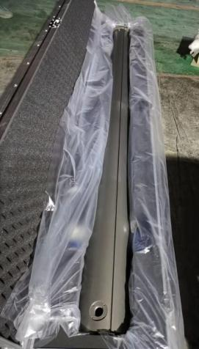
Update of the 2.2-m long D2 Corrector Prototype -Formers
1st Set of Former (HE-Racing)
  1st inner former has posted to WST.
  1st outer former and former assemblies will be received on 1 Oct. at WST.
Former assemblies
Anodized former and external support tube

Slide 5
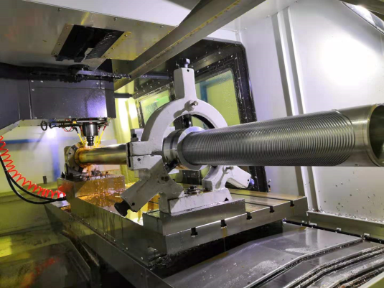
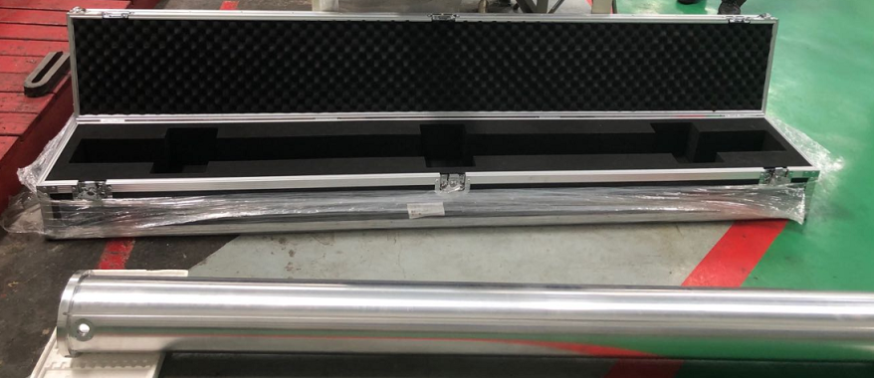
Update of the 2.2-m long D2 Corrector Prototype -Formers
2nd Set of Former(HE-Racing)
  Inner former → waiting for cylinder roughing.
  Outer former → finished machining, next it will be polished and anodized.
  External support → finished machining, next it will be anodized.

Slide 6
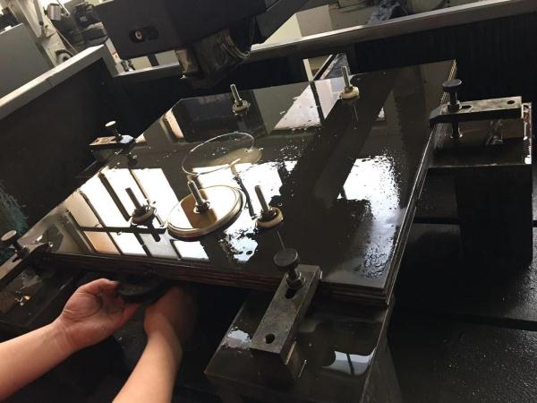
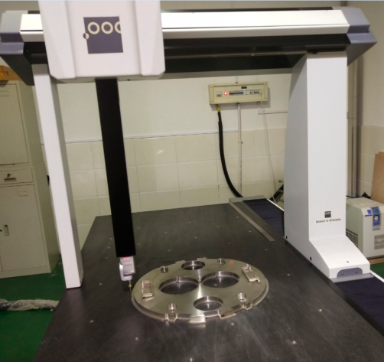
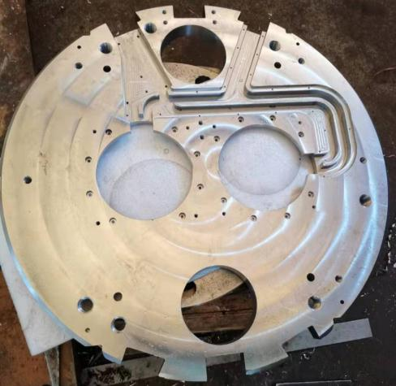
Update of the 2.2-m long D2 Corrector Prototype -Yoke
1st Set of Yoke (KEYE)
  End plates → finish machining, now is in measuring
  Yoke assemblies → almost finish machining, now is in measuring.
  Yoke lamination → in machining, can be done by the end of October

Slide 7
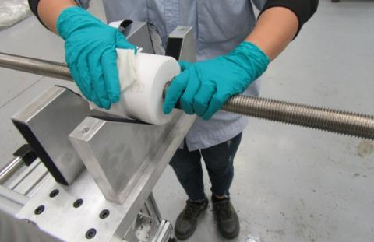
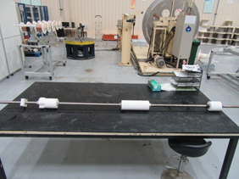
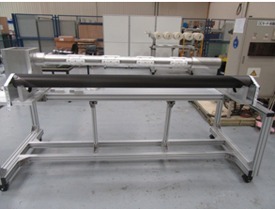
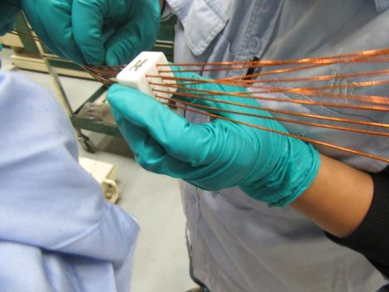
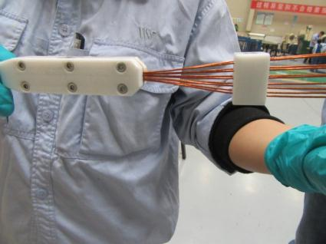
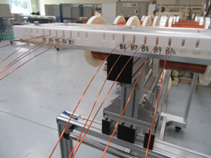
Update of the 2.2-m long D2 Corrector Prototype -Winding
Winding (WST)
  1st inner coil finished winding

Slide 8
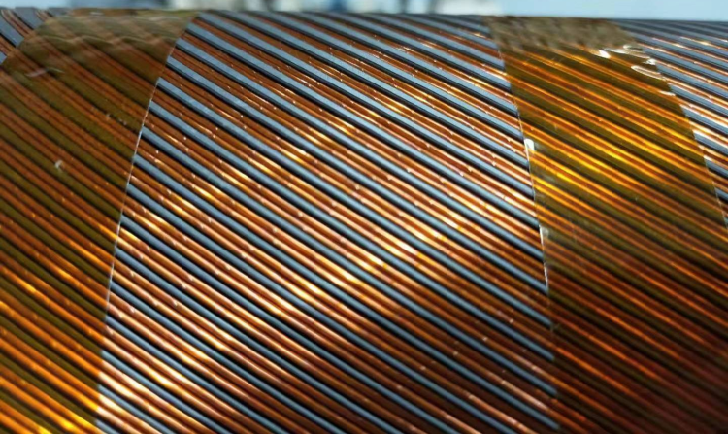
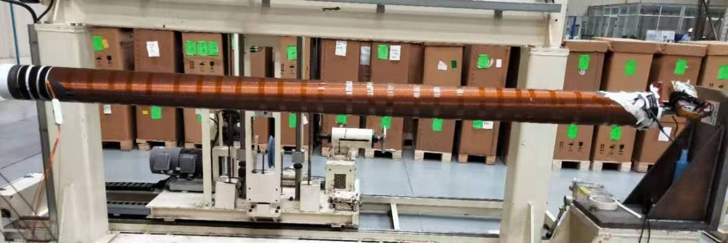
Update of the 2.2-m long D2 Corrector Prototype -Winding
Winding (WST)
  1st inner coil finished winding

Slide 9
Outline
Update of the 2.2-m long D2 Corrector Prototype
Status of the Magnetic Measurements System
Schedule of the 2.2-m long D2 Corrector Prototype
Summary

Slide 10
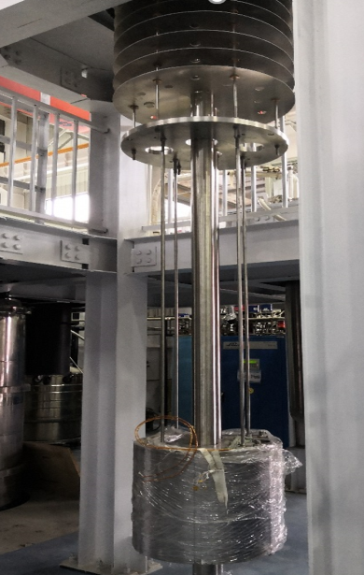
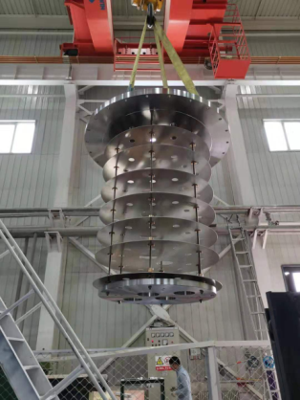
Status of the Magnetic Measurement Systems
RT Field Measurement System (IHEP)
  All the needed production has been posted to WST. When 1st coil is finished winding, then the field will be measured at room temperature.
System for 4.1K measurement (IMP)
  Test for 0.5 m prototype
Lifting magnet has been basically completed.
Leveled and collimated.
All programs have completed offline debugging.
The purification of helium has been completed.
And the on-line commissioning of the external
purifier has been completed.

Slide 11
Outline
Update of the 2.2-m long D2 Corrector Prototype
Status of the Magnetic Measurements System
Schedule of the 2.2-m long D2 Corrector Prototype
Summary

Slide 12
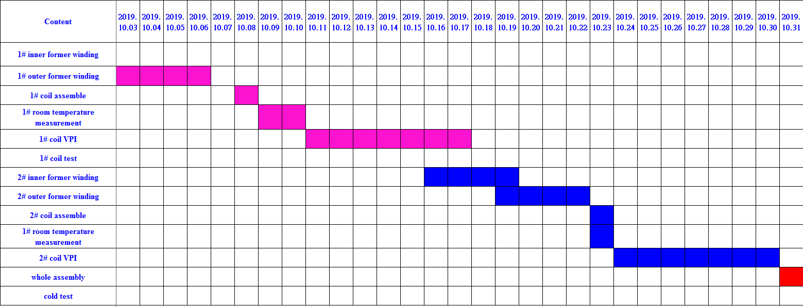
Schedule of the 2.2-m long D2 Corrector Prototype

Slide 13
Outline
Update of the 2.2-m long D2 Corrector Prototype
Status of the Magnetic Measurements System
Schedule of the 2.2-m long D2 Corrector Prototype
Summary

Slide 14
Summary
    The 1st coil can be finished winding before 7. Oct.
    The 1st coil VPI can be finished before 17 Oct.
    At the end of October, the VPI of two coils can finished.
    The delivery time of the prototype is ~ December, 2019

Slide 15
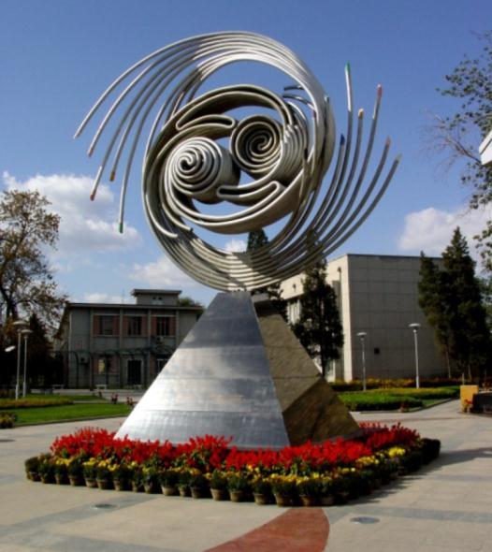
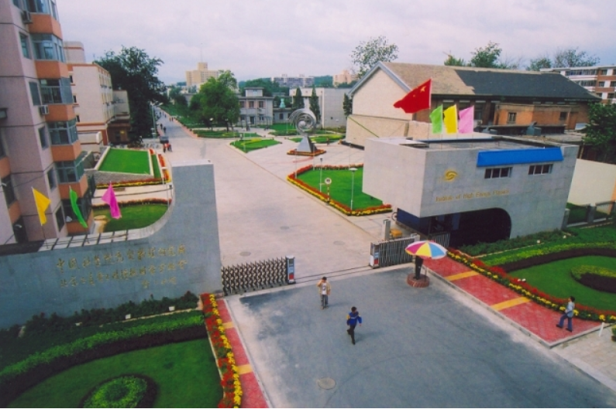
Thanks for your attention!

