Slide 1
Discussion on LS3 Activities Sequencing “Version-0”
M. Modena, M. Mendes, M. Alcaide and P. Fessia
11 October 2019
EDMS 2254475

Slide 2
Scope:
To present the assumptions taken, boundary conditions and how we proceeded for this 1st LS3 sequencing exercise.
DISCLAIMER:
Even if the sequencing is quite detailed in the analysis of certain phases (we collected a lot of info in the last year...), it will be misleading to assume the consequent time estimations as already fully representative!
... all is “in work” and it passes through a continuous iteration... so all is subject of changes.
What we can say is that the detailed (and already quite “solid”) knowledge on some HL-LHC activities inter-relation permit to extrapolate some general tendency for the full LS3 future planning.
This is the first exercise of a long iterative process, the dates presented are very preliminary and they will be changed multiple times during the optimization procedure that will take place.
So, the shown preliminary dates and milestones SHALL NOT be used to induce or justify any change of your planning, in particular on production schedules.
As explained after, this work considers HL-LHC IP1 and IP5 alone and therefore the impact of the other LS3 activities is not accounted for (same for HL-LHC activities in other IPs).

Slide 3
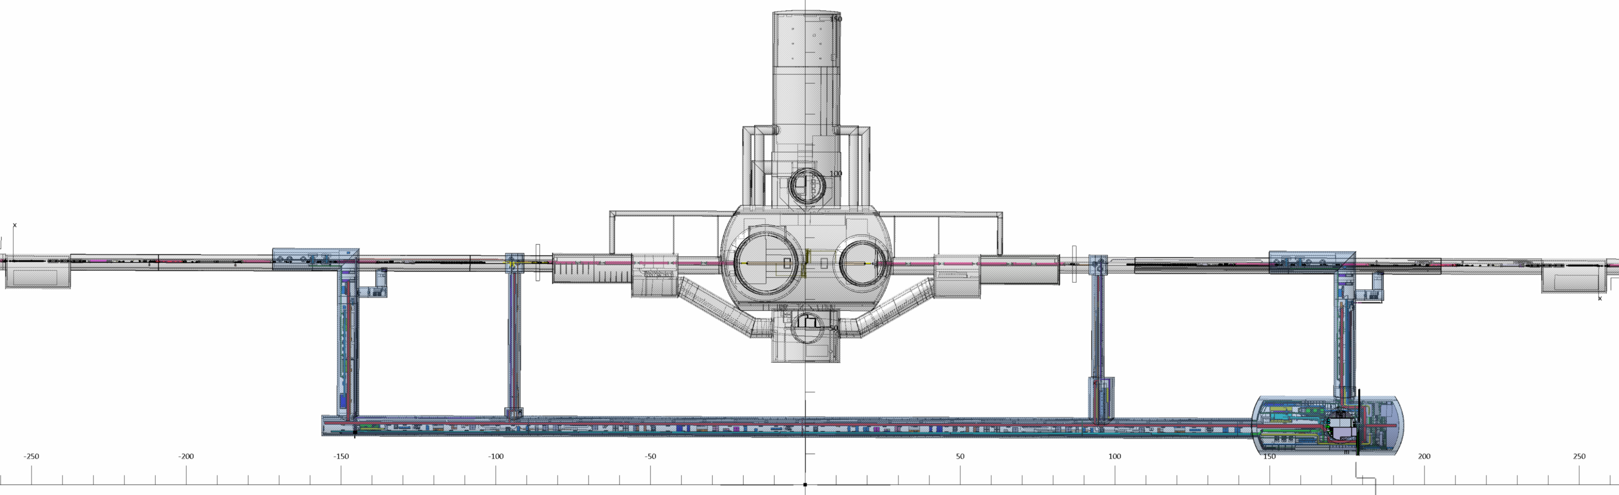
Point 1
P8
IP1L
IP1R
P2
LEFT
IP1
RIGHT
238.1 M
238.1 M
207 M
19
19
207 M
RR13
RI132
UJ13
UJ14
RB14
RB26
UJ16
UJ17
RI171
RR17
156.7
53.3
53.25
156.7
Q6
Q5
Q4
D2
D1
Q3
Q2A
Q2A
Q3
D1
D2
Q4
Q5
Q6
UA13
CP
Q2B
Q1
Q1
Q2B
CP
79.75 M
HL-LHC layout
UL13
UL17
UA17
LHC AREA IMPACTED
UL14
US15
UL16
US17
UR15
NEW HL-LHC AREA
53.69 M
94.25 M
94.25 M

Slide 4
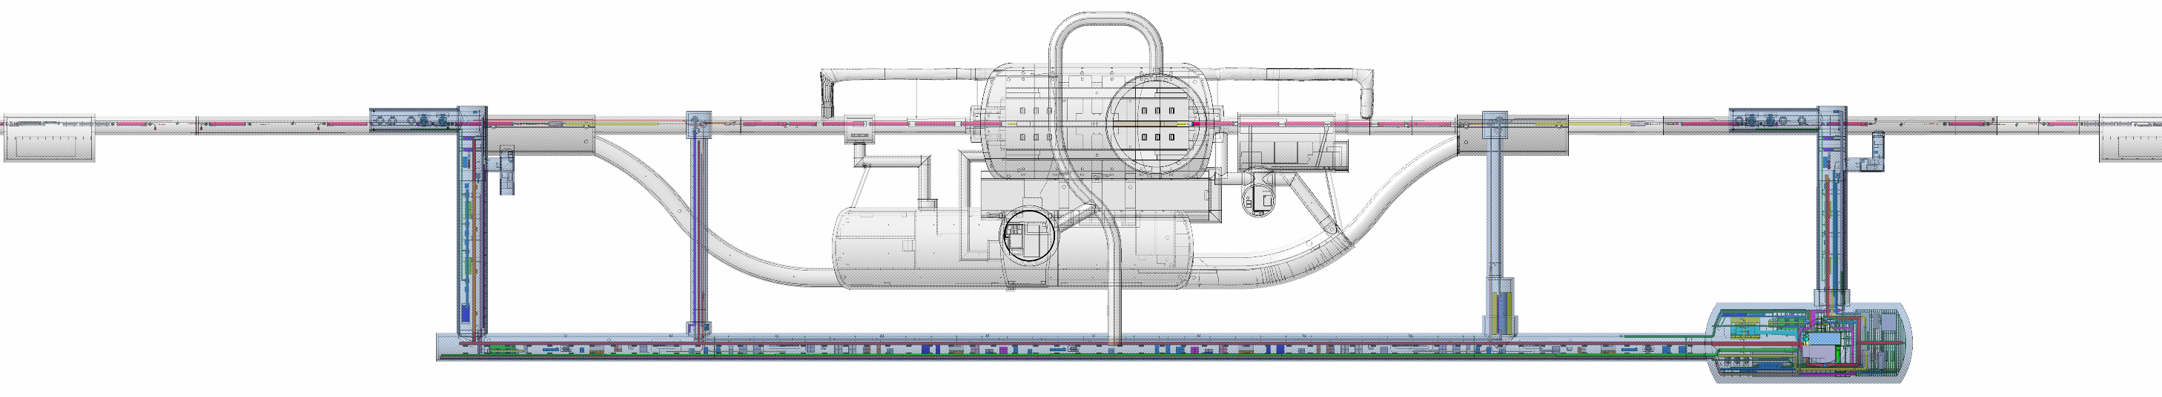
Point 5
P4
IP5 L
IP5 R
P6
LEFT
IP5
RIGHT
238.1 M
238.1 M
207 M
207 M
19
19
RR53
R532
UJ53
R541
RZ54
R542
R561
UJ56
R562
UJ57
R571
RR57
93.6
25.1
88.4
22
30
25.1
127.1
Q6
Q5
Q4
D2
D1
Q3
Q2A
Q2A
Q3
D1
D2
Q4
Q5
Q6
CP
Q2B
Q1
Q1
Q2B
CP
UA53
79.75 M
UA57
HL-LHC machine
USC55
UL57
OUVRAGE LHC IMPACTED
UL53
UL557
US57
UR55
NEW HL-LHC AREA
53.69 M
94.25 M
94.25 M

Slide 5
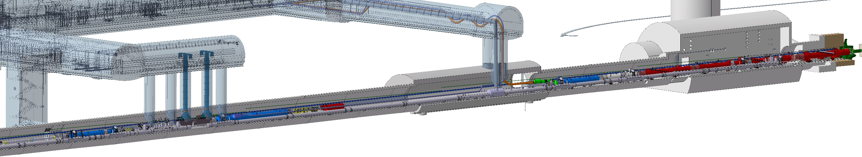
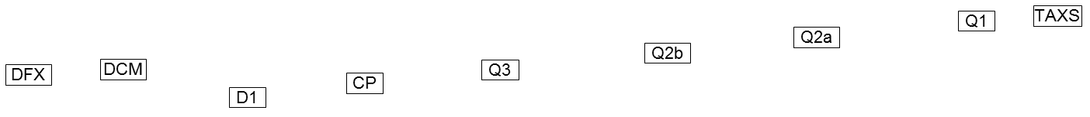
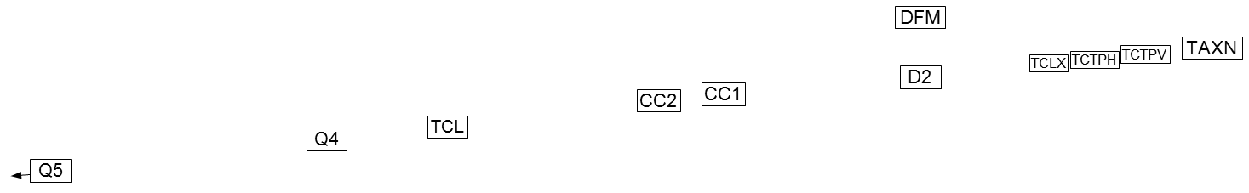
UR55
UL57
UA57
UPR57
BBLR
BBLR
Q5
TCL
TCLMB
TCTPV
TCTPH

Slide 6
Summary:
We started assuming the LS3 duration as normally stated in the Project/Sector, i.e. 2.5 years (30 months).
We start to build this “Version-0” from the top (i.e. from the LHC shut-down at the end of Run3 and towards de-installation…) and from the bottom (i.e. from commissioning and backwards… ). This approach provided a 1st evaluation of the available “windows” for the HL machine & services installation on the base of a 2.5 years LS3 duration.
Then, in parallel we built the sequencing for the HL-LHC machine and services installation and, putting together the different parts, we estimate a 1st preliminary (but more realistic) duration for LS3.

Slide 7
Meetings done for inputs collection
Work done with participation of EN-ACE-OSS / HL-LHC Planning Office (M. Alcaide).
Over last 18 months with meet with:
WP3: H. Prin, S. Le Naour, N. Bourcey, E. Todesco;
WP4: G. Vandoni;
WP5: I. Lamas Garcia, S. Redaelli;
WP6A: V. Parma;
WP6B: N/A (not in the tunnel)
WP7: D. Wollmann, R. Denz, G. D’Angelo;
WP8: F. Sanchez Galan, M. Luque;
WP9: S. Claudet, M. Sisti, E. Monneret, K. Brodzinsky,
A. Perin, A. John Lees;
WP12: V. Baglin, J. Perez Espinos, R. Tavares Rego;
WP13: R. Jones, G. Schneider;
WP15.4: H. Mainaud-Durand, J.-F. Fuchs, A. Herty;
WP16: M. Pojer;
WP17.1: P. Mattelaer, L. Lopez-Hernandez, C. Gasnier, P. Vardoulakis, L. Barthelemy;
WP17.2: S. Bertolasi, N. Dos Santos, D. De Luca, S. Costa Machado, J. Troller, J. Blanc;
WP17.3: M. Battistin, P. Pepinster, A. Broche, F. Borralho;
WP17.4: T. Hakulinen;
WP17.7: C. Bertone, J.-L. Grenard, C. Carvalheiras.
Others:
HL-LHC Project Office
EN-EL: S. Bertolasi, N. Dos Santos, D. De Luca, J.-C. Guillaume, S. Costa Machado, J. Troller, J. Blanc; (for the De/Re cabling NOT formally part of HL-LHC)
HSE-RP: C. Adorisio. A. Infantino
HSE-OHS: J. Gascon
EN-ACE-OSA: J. Bossi
EN-SMM: G. Lunghi, M. Di Castro
EN-ACE: M. Barberan, M. Bernardini, K. Foraz

Slide 8
General Assumptions
We look at LSS1 and 5 only, assuming no cross-talk with other Sectors activities:
  → Resources (staff & tooling,supplies) available as needed for LSS1 and 5, that means:
    Dismantling of IP1 and 5 done in priority ASAP after LHC cryo lock-out
    Any activities on the “4 Not-HL” Sectors + others LHC areas are less prioritary (and so done in the shadow) of activities required for IP1 and 5
    Same applies for cool down of Sectors at IP1 and 5
For activities on the critical path, we assume Groups/WPs resources available to work in parallel in two locations, (today it seems not possible more than that).
The same consideration for SMB cores excavation activities: two locations in parallel where the cores are drilled one after the other.
  Still under definition the minor CE works in the LHC tunnel (refurbishment of LHC floor in LSS, survey deep reference boring 25-m deep, others?) – but for now assumed these activities to be done in parallel of the cores boring.
Most relevant transports (e.g. the magnets) assumed done in night shift.

Slide 9
Assumptions: LHC Shutdown
Based on best past experience as tracked by EN-ACE plannings (LS1, LS2).
LSSs anyway strongly linked to the Arcs: some activities (e.g. warm-up and ELQA) are tightly linked and cannot be suppressed even for a final de-installation of LHC LSS circuits (e.g.: ELQA, even if simplified for some equipment, still needed).
We tried to optimize times considering all known HW implications and all possible co-habitation and parallelisms of intervening teams.
Mechanical works on LHC equipment can only start after Cryo Lock-out of the whole Sector.
Survey: an extra and complete survey of LHC from Q1 up to ~Q12 prior to the dismount of LSS is needed. It will provide the reference for the re-installation of HL-LHC LSS, (this special survey was NOT done in LS1 and LS2).

Slide 10
Assumptions: Dismantling
Critical path: magnets (+ DFBX TE-CRG responsibility) dismantling.
  Assumed 2 full teams/trains of MSC activities proceeding in the LHC tunnel.
  MSC preferred option: work in adjacent LSSs (e.g. LSS1L in parallel with LSS1R).
  Note: Other equipment (collimators, TAN, shieldings, vacuum, forward physics) de-installed in the shadow – and in co-habitation – with magnet removal.
  Note: TAS dismantling must be coordinated with Experiment Planning (and depends by the detectors opening status).
Critical path: EN-EL De-cabling (after machine de-installation):
  Activities under discussion, current best estimation: 18.5w = 9w (S&C) + 0.5w (OF) + 9 w(TBC) (PW), one shift. IP sides R and L in parallel and including the temporarly displacement of some safety and access cables.
  Note: Possible reduction (factor 1.7) could come from 2 shifts work but with major impact for CERN supervision (today not expected/possible).

Slide 11
Assumptions: Re-installation of Services
Critical path: 1st Cable re-installation phase (general services after cores completion and before HL-LHC equipment installation):
  EN-EL FC: 1 w/IP side to re-install fibers ducts and re-position safety cables trays and ducts.
  EN-EL powering: 8 w/IP side (TBC!)
  Same consideration for improvment with 2 shift activities.
Re-installation of monorail (EN-HE) and CV piping not yet fully detailed, since very localized in the areas, we assume could be done in the shadow of EN-EL activities.
So, finally we assume at the moment 9 weeks/IP side for this part (not needed at the moment to do more than 2 IP sides in parallel).

Slide 12
Assumptions: HL-LHC Installation
At this stage, only activities on critical path (i.e. cryogenics, magnets and cabling) were considered in more details, we assume that other installation could be done in the shadow of the critical path activities).
On critical path:
  a) Cryogenics QXL installation with 1 full commissioning/performance system test: estimated ~4 months/IP (at least for the 1st with the “system test”)
  b) Magnets installation and interconnection (assumeed all magnets available for installation at requested date)
    b.1: sequence: Q1-Q2a-Q2b-Q3-CP-D1-DCM-DFX-SC link : 16 weeks / 1st IP just for the interconnections between magnets, not counting leak checks.
    b.2: sequence of stand alone magnets: D2-Interlink-DFM-SC Link, Q4-DSL, Q5-DSL: 9 weeks / 1st IP for the 4 objects, not counting leak checks.
    Learning curve for the 2nd IP applied.
    DSHX/DFX installation assumed in PARALLEL of inner triplet activities (not in the same area)
    DSHM/DFM installation assumed AFTER D2 installation.
  c) Cabling installation:
    Signal/Control provided an estimate of 51w/IP side, (EN-EL ENP activities still to be included)
      7 w/IP side for machine related (but NOT-HL) cables taken out for CE activities.
      24 w/IP side for cabling campaign connecting LHC Tunnel with HL-LHC technical galleries
      20 w/IP side for cabling campaign within LHC Tunnel and LHC technical galleries.
    Working now on the optimisation of these (long) cabling campaigns in order to permit co-habitation with HL-LHC equipment installation (major saving in time expected…). At the moment we have cabling in co-habitation with triplets interconnection, other optimization under study!…

Slide 13
Assumptions: HL-LHC 1st commissioning & Cool Down
Commissioning & Cool down sequence (including ELQA, leak tests, survey, powering tests...): The “non HL-LHC” sectors considered done before HL-LHC sectors (this would make available resources for S12, S45, S56, S81)
Commissioning & Cool down sequence of LSS1/5 in HL-LHC will be technically independent from that of the adjacent Arcs, but in order to profit of that, a deep re-assessment and re-arrangement of the safety aspects in the areas is needed (and probably with some extra hardware, e.g. extra pressure doors?, others?).
Today, a maximum of 2 Sectors can be cool-down and commissioned in parallel (resources of various teams + N2 and He logistic implications).

Slide 14
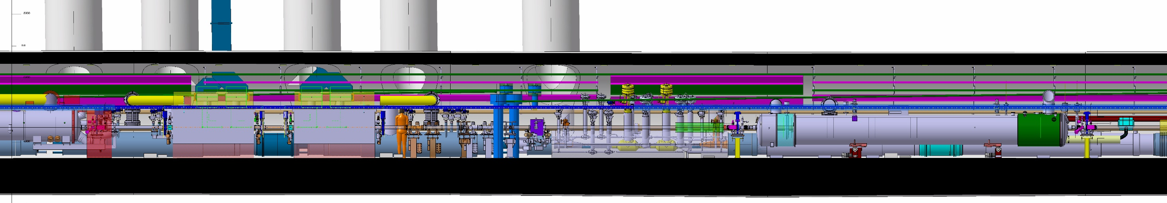
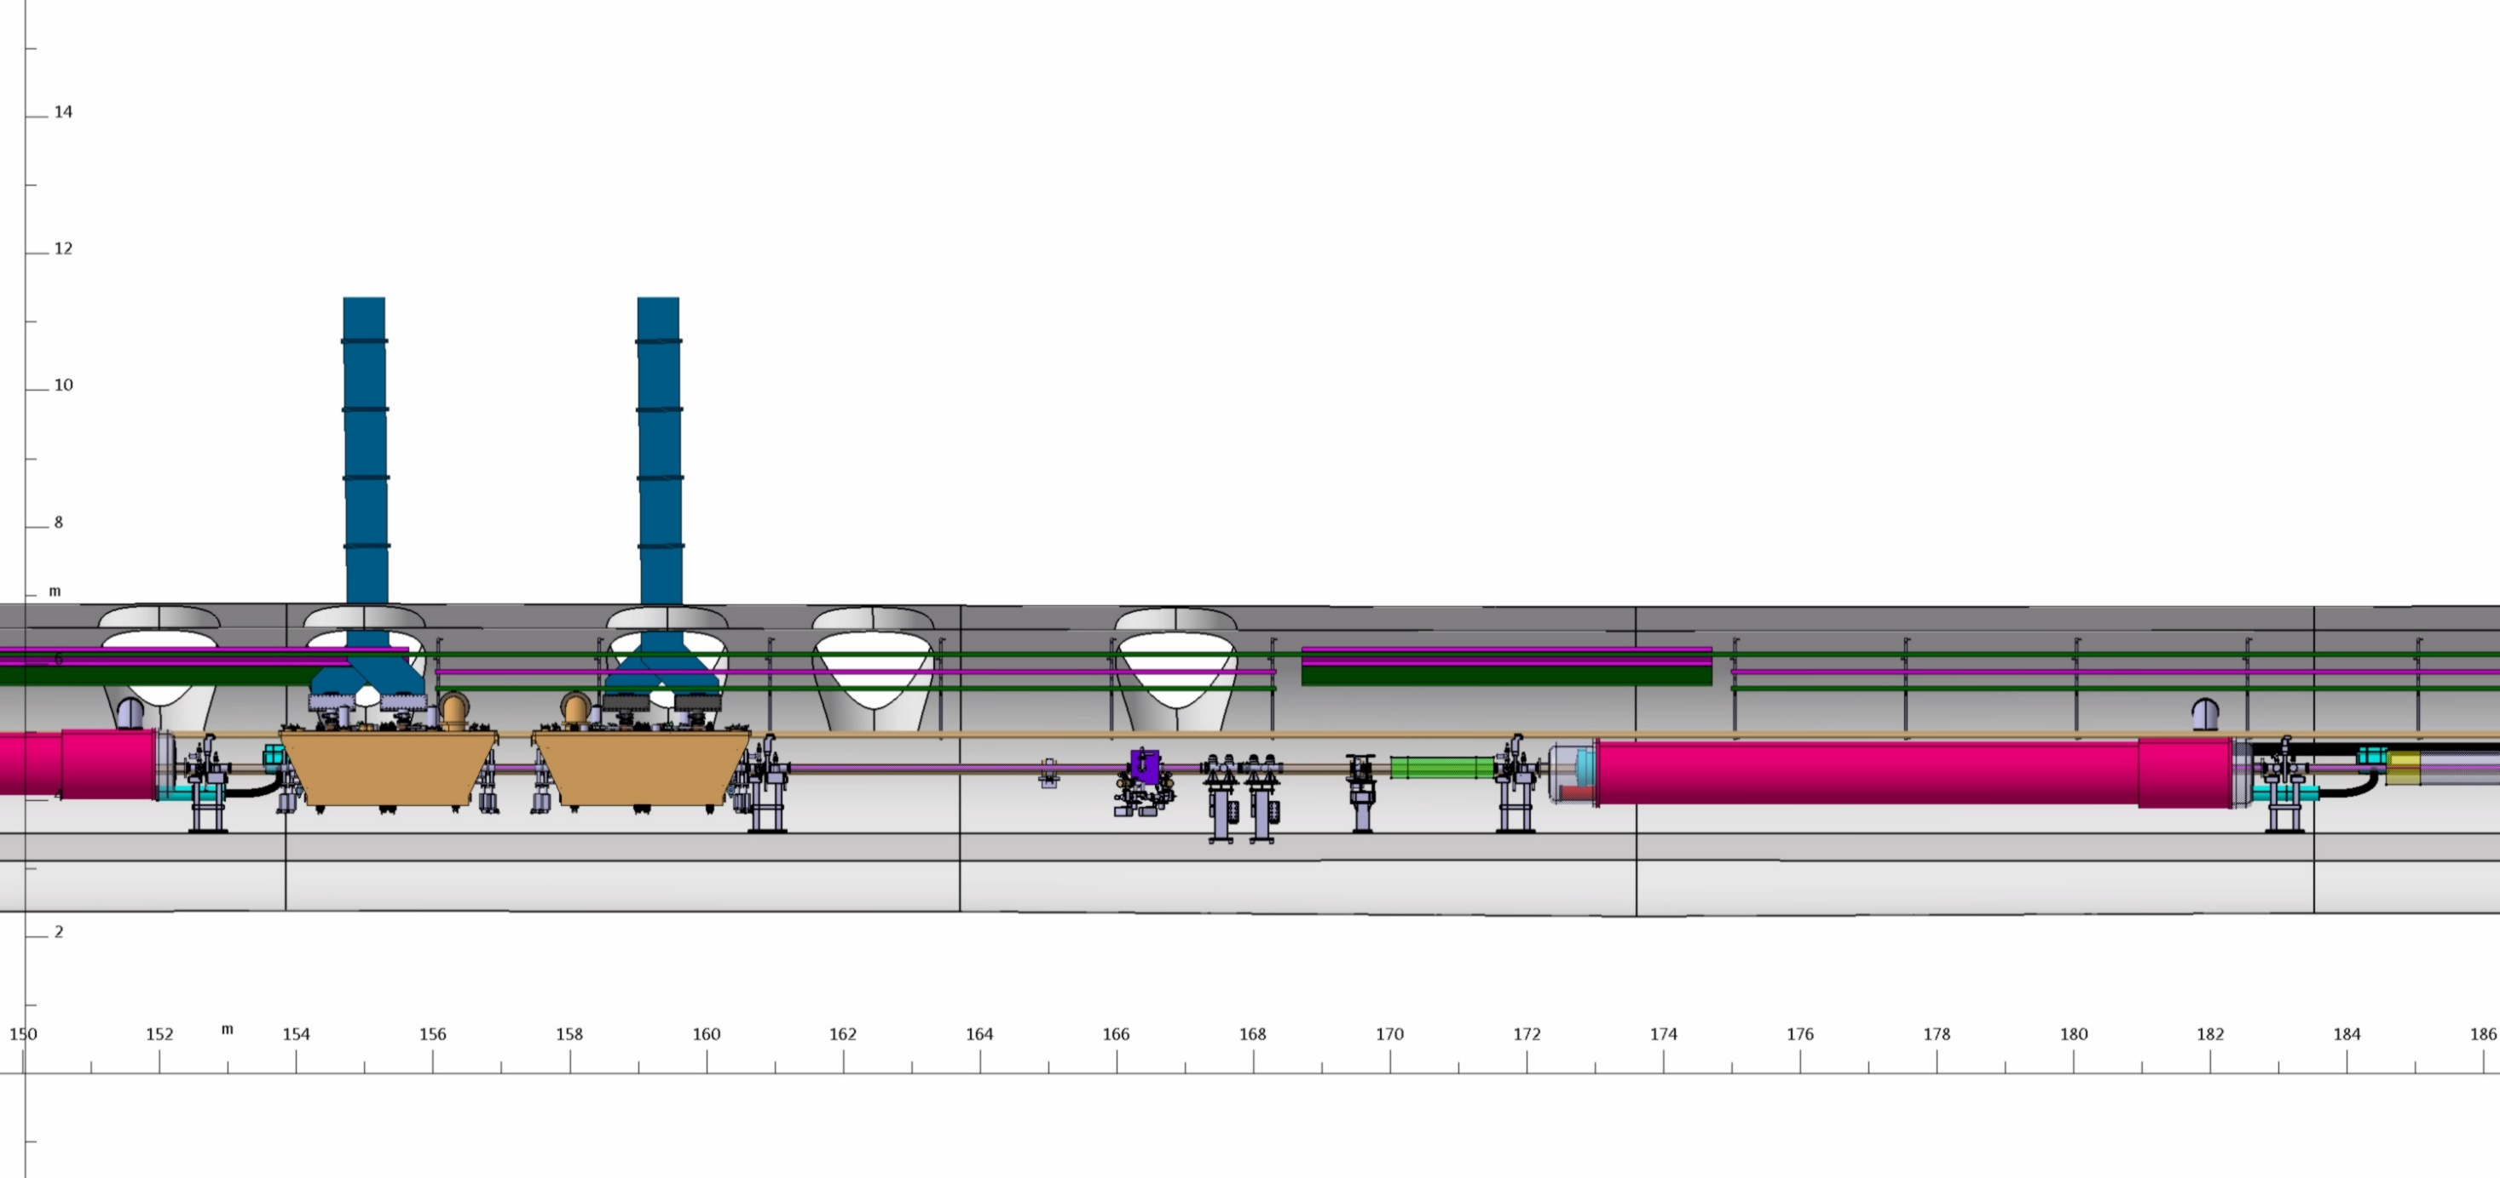
Separation QRL-QXL
UR55
UL57
UA57
UPR57
D2
CC1
(DQW)
CC2
(DQW)
Q4
L=3400mm
x
InterLink
APWL
BPTX
APWL
BPTX
TCLMB
HL-DSL

Slide 15
Next steps
On WP15 side:
  Working to complete the collection of inputs on the following WPs/points (e.g. :not exhaustive list):
    with WP6a (More realistic installation times, but design of equipment and TOOLING not yet completed...)
    with WP8 (TAXN and TAXS – but the TAXS intervention depends mainly by the experiments planning...)
    with WP12 (for more accurate estimation, ex. leak tests)
    ...
    with EN-EL (get more precise time estimation: (not “full dismantling”, temporary installation needed?, future contracts boundaries/requirements...)
    with HSE (open discussion for a possible sectorization of other system done as for cryo (for parallel commissioning&cool-downs of arc vs. LSS)
    ...
On Project Management side (already decided and planned):
  All this info will be sent to WPs (to WPL and WPDL end of this week), then discuss at a TCC meeting (24 Oct)
  Present the Sequencing Version-0 at the C&S Review (12 Nov) as it was asked by the Reviewers.

Slide 16
Next steps
Some possible improvement paths:
  EN-EL activities optimization (dedicated new service contract ?, etc.)
  Increasing n. of MSC parallel teams in the tunnel ?
  Increase n. of parallel cores boring ?
  Further optimization of “floats/slacks”along the sequencing at IP1 and 5
  “Systems test” for new equipment optimization ?
  Optimization of LS3 starting time? (to take advantage of 2023/4 Christmas shut-down)
  ELQA optimization ?
  Cool-down optimization ?
  ...
  Others ?

Slide 17
WPs Specific inputs and comments

Slide 18
WP3
This is the first exercise of a long iterative process. The installation dates are therefore very preliminary and they will be changed multiple times during the optimization procedure that will take place; the current installation dates SHALL NOT be used to induce or justify any change on production schedules.
Only two teams of TE-MSC doing interconnections are available at one given time, which puts all magnet-related activities in the LS3 critical path.
De-installation inputs coming from the meeting in September/2018. A train of activities is considered, with non-MSC groups coming first (MPE, Survey, BE/BI, VSC,...), and then MSC team following. Durations are based on the procedure for inner triplet removal of TE-MSC (never officially released, but it was considered in the meeting that the time estimates would be sufficiently good at this stage).
Installation inputs were given by H. Prin and S. Le Naour, following discussion/agreement with WP3/TE-MSC management:
  For the Inner Triplet, the reasoning was as follows:
    there are 8 interconnections to be done (Q1-Q2a-Q2b-Q3-CP-D1-DCM-DFX-SC Link), which is equivalent to 4 LHC standard dipoles.
    Interconnection of 4 LHC standard dipoles by the “MSC train” takes 8 weeks.
    A 2x corrective factor was considered due to the new, very different, types of interconnects. We arrive thus to a total of 16 weeks/IP side that you will find in the interconnection path (without leak checks, jumper connections, closing w-bellows).
    For the 2nd IP, we considered a learning curve and so the time was reduced to 13 weeks/IP side.
  For the stand alone magnets (D2-Interlink-DFM-SC Link; Q4-DSL; Q5-DSL):
    Also based on LHC standalone experience, a total of 9 weeks is considered; no learning curve at this stage for D2 (because the whole system is still not very well defined; it seems likely that the jumper will need to be welded in the tunnel; interlink concept not developed yet – dangerous at this stage to reduce this time).
Q10 replacement is considered for the moment a “floating” activity that is not in the critical path, so we put its de-installation “whenever needed” and its installation “as late as possible”. It should be detailed in a next iteration.
No information at all for DCM mechanical installation, should be in the shadow of critical activities.

Slide 19
WP4
This is the first exercise of a long iterative process. The installation dates are therefore very preliminary and they will be changed multiple times during the optimization procedure that will take place; the current preliminary installation dates SHALL NOT be used to induce or justify any change on production schedules.
Installation was based on SPS planning that was adapted to LHC by G. Vandoni (EDMS 2215056);
However, we took out some of the TE-VSC activities since (after the meeting with G. Vandoni), TE-VSC prefers to do all their activities in one go.
The CC installation is a floating activitiy in the LS3 plan: it is not in the critical path, it seems that there will be a relatively large time window to install them.
The activities that will take place at the same time in the LHC tunnel and in the HL-LHC new galleries (UR and UA) are key milestones in LS3 planning and must be detailed soon.
So far, RF conditioning is not addressed; it is included as a “floating block” that we need to address in terms of time duration and, more important, its impact on the remaining activities of the cool down sequence.

Slide 20
WP5
This is the first exercise of a long iterative process. The installation dates are therefore very preliminary and they will be changed multiple times during the optimization procedure that will take place; the current installation dates SHALL NOT be used to induce or justify any change on production schedules.
De-installation:
  based on inputs from the meeting on 02/11/2018 (minutes EDMS 2044884). After checking with RP, for now the baseline would be to take out the collimators as one of the first activities, because it would reduce the integrated total dose for all the people that will be working in these LSSs. This can be changed later without big consequences if RP changes policy, as collimator de-installation is a fast, well-known activity.
  Removal of the collimator supports is a short activity in our planning that is being put in the shadow of more critical activities, but it is an activity that has some floating.
Installation:
  We assume at this stage that the installation of collimator supports and collimators themselves are activities with a known procedure, that do not create severe constraints in the tunnel, and as such it will be possible to perform these tasks in the shadow of activities in the critical path (grey area in the planning file).

Slide 21
WP6A
This is the first exercise of a long iterative process. The installation dates are therefore very preliminary and they will be changed multiple times during the optimization procedure that will take place; the current installation dates SHALL NOT be used to induce or justify any change on production schedules.
The times presented at this stage for the installation of WP6A components in the tunnel (DFX, DFM, D2 SC link) are a 1st estimation to be revised in future following the consolidation of the equipment design.
  DFX in principle should only come once D1 is in place, but it must be there once the interconnection D1-DCM is done;
  D2 SC Link and DFM installation is not yet clear from technical point of view, so for us is still a “moving block”.
Currently, it is not foreseen exclusive time in the LHC tunnel;
The activities that will take place at the same time in the LHC tunnel and in the HL-LHC new galleries (UR and UL) are key milestones in LS3 planning and must be detailed soon.
The DSL works in Q4 and Q5 must be done before that the interconnection team gets to these magnets (interconnection team is a critical resource).

Slide 22
WP6B
This is the first exercise of a long iterative process. The installation dates are therefore very preliminary and they will be changed multiple times during the optimization procedure that will take place; the current installation dates SHALL NOT be used to induce or justify any change on production schedules.
We are not aware of any WP6B activity in the tunnel (Activities outside LSS1 and 5 are not yet considered, e.g. 60A and 120A PC in the arcs belonging to HL-CONS)
Installation of DC copper cables of 120A and 200A circuits is done by EN-EL and included in the big cabling campaign.

Slide 23
WP7
This is the first exercise of a long iterative process. The installation dates are therefore very preliminary and they will be changed multiple times during the optimization procedure that will take place; the current installation dates SHALL NOT be used to induce or justify any change on production schedules.
Warm-up:
  ELQA activity was discussed with Giorgio d’Angelo.
  The planning of this stage is so far based on LS2 experience, slightly adapted to LS3 reality: need to do ELQA on LHC circuits of LSS1 & 5 that will need to be dismantled, should be justified.
  Activity ELQA @ cold is included but tagged as “needed?” following discussions among CERN groups about its usefulness. It could make us win 5 weeks if suppressed, because warm-up would be done over Christmas holidays. But so far, this option is not included.
De-installation:
  We suppose that MPE activities will be preceding the magnet de-installation, but they are simple and not long. 2 teams should be available (one for each IP side).
Installation:
  So far, we have not explicitly discussed MPE activities in the tunnel with WP7. We believe that these activities will be done in parallel with other activities, and we are giving you 2 weeks in the end of the installation period.
Cool-down:
  ELQA activity was discussed with Giorgio d’Angelo and Mirko Pojer.
  Duration of activities is based on LS2 with a corrective factor and WP16 is asking for an ELQA@80K.

Slide 24
WP8
This is the first exercise of a long iterative process. The installation dates are therefore very preliminary and they will be changed multiple times during the optimization procedure that will take place; the current installation dates SHALL NOT be used to induce or justify any change on production schedules.
TAN/TAXN
  De-installation:
    Inputs based on the meeting of 28-09-2018 (EDMS 2029635)
    Actual slot of de-installation is a floating activity that will be done in the shadow of critical activities.
  Installation:
    We assume at this stage that the installation of the TAXN (apart from transport, which could be done over night) does not create severe constraints in the tunnel, and as such it will be possible to install the TAXN in the shadow of activities in the critical path (grey area in the planning file).
TAS/TAXS
  De-installation:
    Inputs based on the meeting of 28-09-2018 (EDMS 2029635)
    Actual slot of de-installation of the TAS is a floating activity that depends on coordination with experiments/radiation authorization, but it does not affect the tunnel planning.
  Installation:
    Actual slot of installation of the TAXS is a floating activity that depends on coordination with experiments, but it must be done before Q1 interconnection.

Slide 25
WP9
This is the first exercise of a long iterative process. The installation dates are therefore very preliminary and they will be changed multiple times during the optimization procedure that will take place; the current installation dates SHALL NOT be used to induce or justify any change on production schedules.
Warm-up:
  Based on LS2 standard warm-up sequence; to be seen the open point on the need to go back to cryo-conditions after Christmas break (because of ELQA @ cold)
De-installation:
  Two types of works, the careful removal of the QRL until Q4 area, and the quicker dismantling of the part that won’t be re-used.
  Durations and co-activities were estimated by WP15, deemed reasonable by WP9, but still subject to final confirmation.
  De-installation of the DFBX is also within TE-CRG responsibility, discussed with Antonio Perin. So far we have 3 weeks of work (careful removal because TE-MSC wants to re-use current leads as spares), eventually it can be faster, but since it is not in the critical path it is better to be conservative at this stage.
Installation:
  The activities that will take place at the same time in the LHC tunnel and in the HL-LHC new galleries (UR and UL) are key milestones in LS3 planning and must be detailed soon.
  The duration of the activities “QRL/QXL installation” and “Cryo comissioning & cold test” is still pending full confirmation from TE-CRG colleagues.
  The 1st IP side to be completed includes a cool-down of the cryo plant as a “system test”, so far foreseen on both LSSs of the same IP; this will not be repeated on the 2nd IP (thus the activities on the 2nd LSS should be faster – TBC by how much)
  A small cabling action of EN-EL is needed before the cryo commissioning & cold test activity; the duration of this task remains unknown as TE-CRG has not issued pre-DICs yet.
Final Cool down (before operations):
  The current cryogenic baseline allows a separation between QRL cool down (from the arc until Q4, included) and QXL cool down (crab cavities to inner triplet). To maximize the use of this possibility for cool-down of these sectors, it is necessary to extend this separation to other machine systems (i.e. Powering) and aspects (i.e. Accessibility). This will be subject of future technical discussions. When converged, it will be possible to optimize this part of the planning.
  Times for the QRL cool down were taken from LS2 planning; times for QXL cool down still miss full validation.

Slide 26
WP12
This is the first exercise of a long iterative process. The installation dates are therefore very preliminary and they will be changed multiple times during the optimization procedure that will take place; the current installation dates SHALL NOT be used to induce or justify any change on production schedules.
Inputs coherent with EDMS 2220090.
Warm-up:
  Sequence based on LS2 planning with inputs from Jaime Perez Espinos. To be seen if there is the need to do a detailed leak tightness check on components that will be removed in the LSS.
De-installation:
  After checking with RP, for now the baseline would be to take the collimators as one of the first activities, because it would reduce the integrated total dose for all the people that will be working in these LSSs. This can be changed later without big consequences if RP changes policy, as collimator de-installation is a fast, well-known activity.
  VSC activities to allow de-installation of magnets will be the priority in the de-installation sequence. Other VSC activities can be done in the shadow, not necessarily in the allocated slots (these are just to represent the need to de-install sector valves, vacuum chambers, etc.).
Installation:
  All leak tightness checks in MSC activities have their durations estimated as best guess from LHC experience; this is subject to validation with TE-VSC. It is stated in EDMS 2220090 that estimates from string planning would be passed on to WP15 – this was not yet done.
  As requested, VSC is the last WP to install their equipment in the LHC tunnel. To be studied if it is not possible to perform the vacuum installation & bake-out of sectors that will be cool down with the QRL, before those of the QXL (i.e. coherent with cryogenic separation).
  In this sequencing there are 3 weeks of overlap in the bake-out activities of the 4 LSS. This seems not feasible due to resources limitation. Point to be optimized in future iterations.

Slide 27
WP13
This is the first exercise of a long iterative process. The installation dates are therefore very preliminary and they will be changed multiple times during the optimization procedure that will take place; the current installation dates SHALL NOT be used to induce or justify any change on production schedules.
De-installation:
  We suppose that BI activities will be preceding the magnet de-installation, but they are simple and not long. If needed, 2 teams should be available in parallel (one for each IP side).
Installation:
  So far, we have not explicitly discussed BI activities in the LHC tunnel with WP13. We believe that these activities will be done in parallel with other activities, and we are giving you 2 weeks in the end of the installation period.

Slide 28
WP15.4
This is the first exercise of a long iterative process. The installation dates are therefore very preliminary and they will be changed multiple times during the optimization procedure that will take place; the current installation dates SHALL NOT be used to induce or justify any change on production schedules.
Warm-up:
  Based on inputs from H. Mainaud Durand and J.-F. Fuchs from April 2019, but supposing two teams available working on both LSSs of the same IP (as all critical-path activities in this planning) – so reduced to 3 weeks wrt initial request of 5 weeks.
De-installation:
  We suppose that Survey activities will be preceding the magnet de-installation, but they are simple and not long. If needed, 2 teams should be available in parallel (one for each IP side).
Installation:
  Survey “core” activities:
    Agreed with H. Mainaud Durand in September 2019, we consider that after the cores opening SU team marks the position of all LSS elements (no co-activities in the 1st week, some with cryogenics on the 2nd);
    Installation of HLS on the part closer to the IP could be done at the same time as cryogenics.
    Installation of all remaining systems was considered to be not critical (i.e. can be done in the shadow of other more critical activities).
    Smoothing of equipment and FRAS installation to take place already in cool down period.
  Contribution to other activities (pre-alignment of magnets etc.)
    Not explicitly included in the planning but survey contributions should follow installation activities when needed.

Slide 29
WP16 (commissioning)
This is the first exercise of a long iterative process. The installation dates are therefore very preliminary and they will be changed multiple times during the optimization procedure that will take place; the current installation dates SHALL NOT be used to induce or justify any change on production schedules.
Duration of powering tests I and II and dipole training are very preliminary and they will only be more accurate in 2-3 years.
Access constraints imposed by the powering tests, and how to match these with the independant cool down of QRL-QXL, could be optimized (creating ARC/LSS systems separation coherent with the QRL/QXL system separation), leading to overall less time for the cool down.
RF conditioning still not studied.

