Slide 1
WP17.2 – Electrical distribution
Power distribution
LS3 De-cabling works phasing and durations in LSS1-5
N. Dos Santos on behalf of HL-LHC_EN-EL team (for electrical distribution)
EDMS: 2258944

Slide 2
Summary
Reminder of
presentation done end-Jan 18
EDMS 1896611
Works baseline
EN-EL electrical distribution
  Services and cables to remain LIVE during CE cores works
  LSS1 services displacement
  LSS5 services displacement
LS3 works breakdown, durations and costs estimation status (electrical distribution only)
Conslusions/Next steps
Reminder of
presentation done end-Jun 19
EDMS 2258938

Slide 3
Reminder of
presentation done end-Jan 18
EDMS 1896611

Slide 4
Context and requests
Reminder of
presentation done end-Jan 18
EDMS 1896611
Areas Sectorisation
  LHC 1 :
    Secteur 1 : Zone interne USA15 (sans tunnel),
    Secteur 2 : Zone interne US15 (sans tunnel)
    Secteur 3 : Zone tunnel (RR13 jusqu’à l’UX15) en prenant tout ce qui est interne au tunnel et ce qui va vers les zones de services
    Secteur 4 : Zone tunnel (l’UX15 jusqu’au RR17) en prenant tout ce qui est interne au tunnel et ce qui va vers les zones de services
  LHC 5 :
    Secteur 1 : Zone interne USC55 (sans tunnel)
    Secteur 2 : Zone interne UL55-UJ56 (sans tunnel)
    Secteur 3 : Zone tunnel (RR53 jusqu’à l’UXC55) en prenant tout ce qui est interne au tunnel et ce qui va vers les zones de services
    Secteur 4 : Zone tunnel (UXC55 jusqu’au RR57) en prenant tout ce qui est interne au tunnel et ce qui va vers les zones de services
Hypothesis and boundary conditions
  For the LHC machine we take the hypothesis that all cables going from technical caverns to equipment between Q6 and Q6 must be dismounted + services areas concerned by LHC
  For the other cable systems we take the hypothesis to dismount all cables and equipment inside LHC new cores areas (UAs and ULs cores)
Cost estimation granularity
  Cables “LHC Machine” to be permanently dismounted
  Cables “Security Systems” serving the HL-HLC area that has to be temporarily removed
  Cables “Service Generaux” serving the HL-HLC area that has to be temporarily removed
  Cables (machine and other) not link to HL-LHC but “crossing the areas” and so also eventually affected by HL-LHC so that have to be temporarily removed

Slide 5
Assumptions for the Cost Estimation
Reminder of
presentation done end-Jan 18
EDMS 1896611
Only cables in EL cables DataBase
  Not documented cables are not counted in EL estimations – for ex.:
    Cables pulled by experiments
    Cables between EL distrib. and monorail
    …
Only equipment belonging to EL
  Not counted in EL estimations – for ex.:
    Signal boxes installed by EL but belonging to others
    Power sockets strips installed by others
    …
Only fibre optics installed by EL
  Not counted in EL estimation users or experience fibres
Assumptions:
  Prices based on actual EL installation contracts: S213 (cabling) – S214 (FO) (prices from 2016)
  Straight dismounting approach – 1 phase per point
  Rate exchange: 1 EUR = 1.2 CHF
  Costs Uncertainty: Rank 3-4 according→ -10%, +20%
Extra costs not considered in EL cost estimation:
  M4P for preparation and execution phases – different budget according HL-LHC C&R
  Safety compensatory measures during de-installation EL work phase and next
  Civil eng. and metallic structures modifications required for EL equipment
  Handling and transport of equips and cables
  Treatment of irradiated cables and equipment
  Personnel radiation protections for radiation areas during de-installation work
  Others cables and equips not documented in EL DB

Slide 6
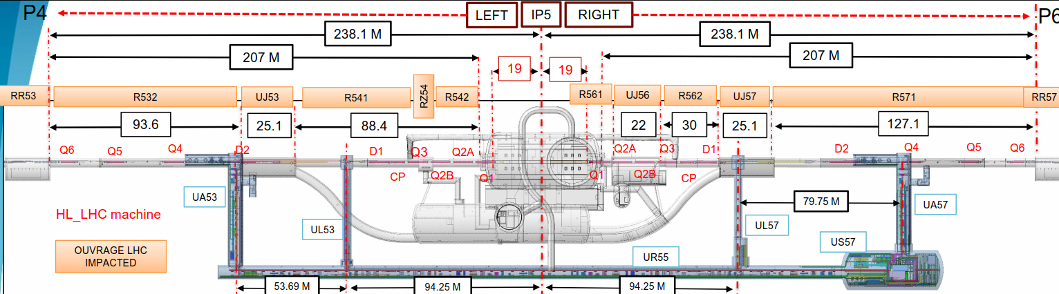
Assumptions for the Cost Estimation
Reminder of
presentation done end-Jan 18
EDMS 1896611
Each LHC points divided in 4 sectors:
  2 services sectors and 2 tunnel sectors
  Each sector was sub-divided on 2 main de-installation activities for:
    LHC machine definitive de-installation (Q6-Q6, UL55, USC55, UL14-16, US15
    New cores creation LHC tunnel (UAs and ULs)
Cables and equipment related to LHC machine definitive de-installation :
  Removal of all EL existing equipment related to LHC machine, ex.:
    Power socket boxes +distribution boxes dedicated to Vacuum systems in tunnel
  Removal of all cables connecting to LHC machine equipment (inside LHC tunnel and services areas)
4 Sectors identified in LHC 5

Slide 7
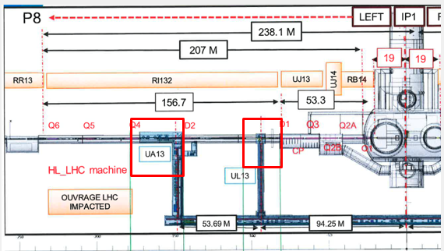
Assumptions for the Cost Estimation
Reminder of
presentation done end-Jan 18
EDMS 1896611
Cables and equipment related to new cores creation inside LHC tunnel (UAs and ULs)
  Removal of all EL existing equipment inside of the tunnel near CE works for new cores drilling areas →+10 m from each side of the cores. Equip. ex.:
    Pw socket boxes and platines, luminaires, “tableautins”, cable trays & supports, “goulotte sécurité”
De-installation of all cables (pw and signal) & fibres identified by EL in transit inside CE work areas – whole length of the cables between source connection point, ex.: cable from SE1 to RR13

Slide 8
Reminder of
presentation done end-Jun 19
EDMS 2258938

Slide 9
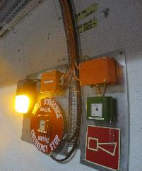
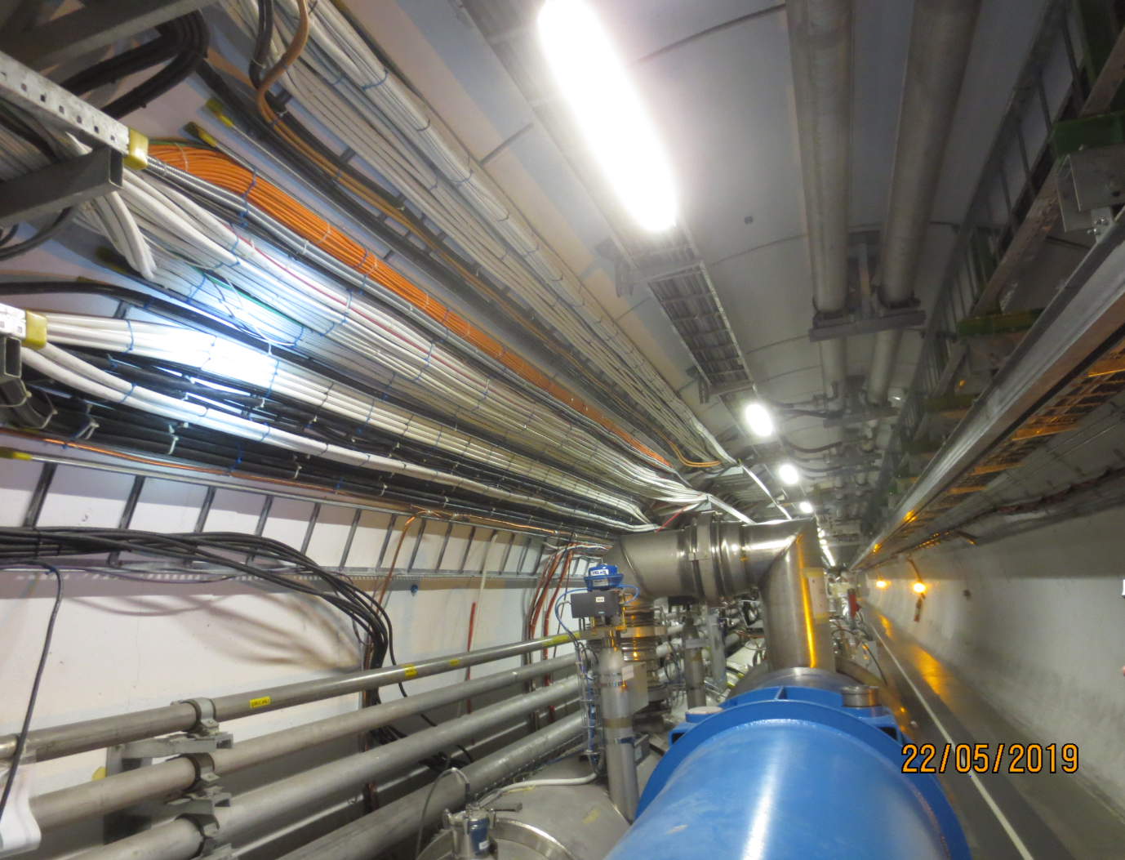
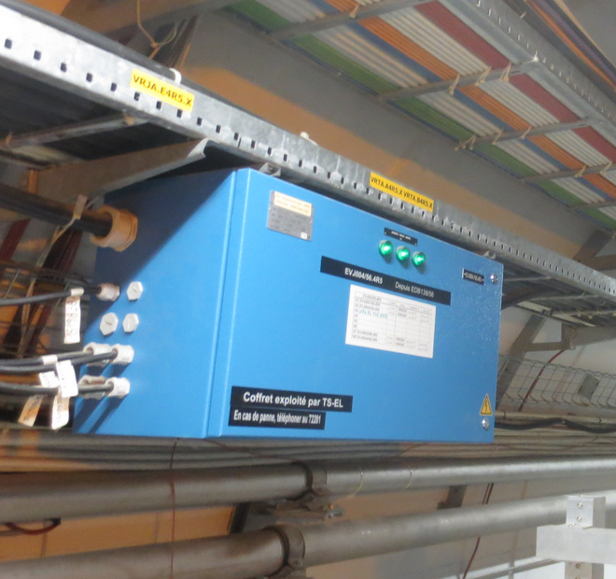
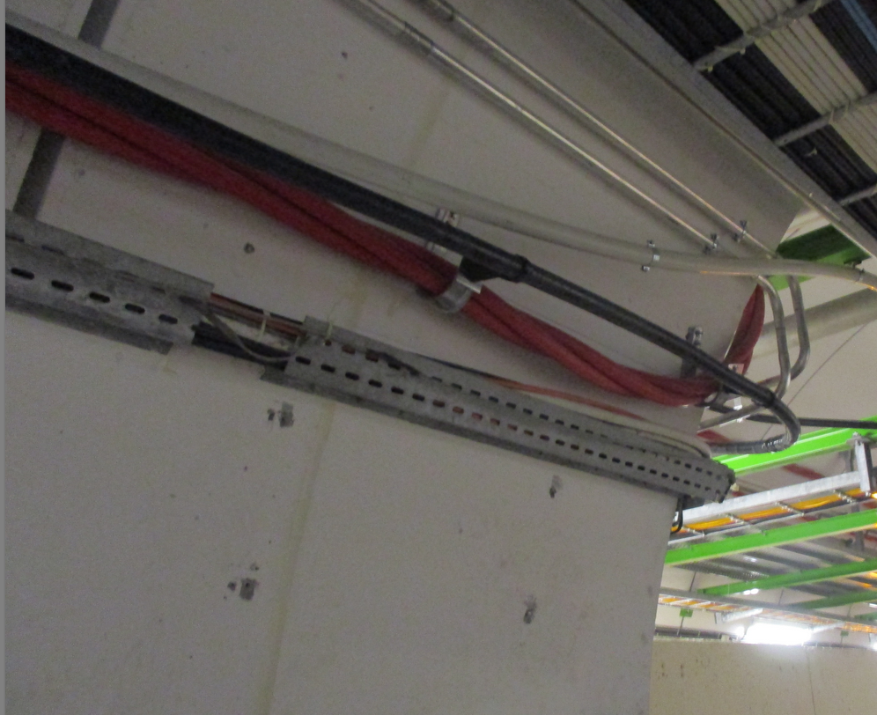
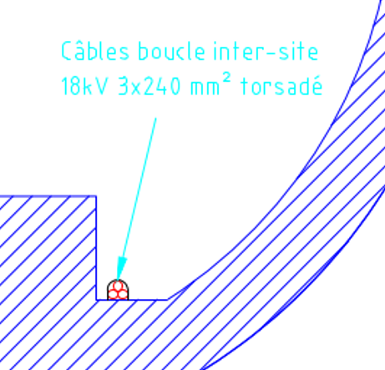
EN-EL electrical services
Reminder of
presentation done end-Jun 19
EDMS 2258938
Services maintained and to be keep LIVE during cores drilling works:
  Arrêt d’Urgence Généraux (AUG) – AUG buttons installed on “tableautins”
  Lighting:
    Switched (normal lighting commanded by CCC)
    Permanent (minimum lighting)
    Safety (luminaires installed on «tableautins»)
  General power distribution sockets (F1) – blue distribution boxes
  Main 18 kV power distribution loop – present in the «caniveau»
Cables locked-out but to keep if possible
  18 kV cable dedicated to RRs power converters

Slide 10
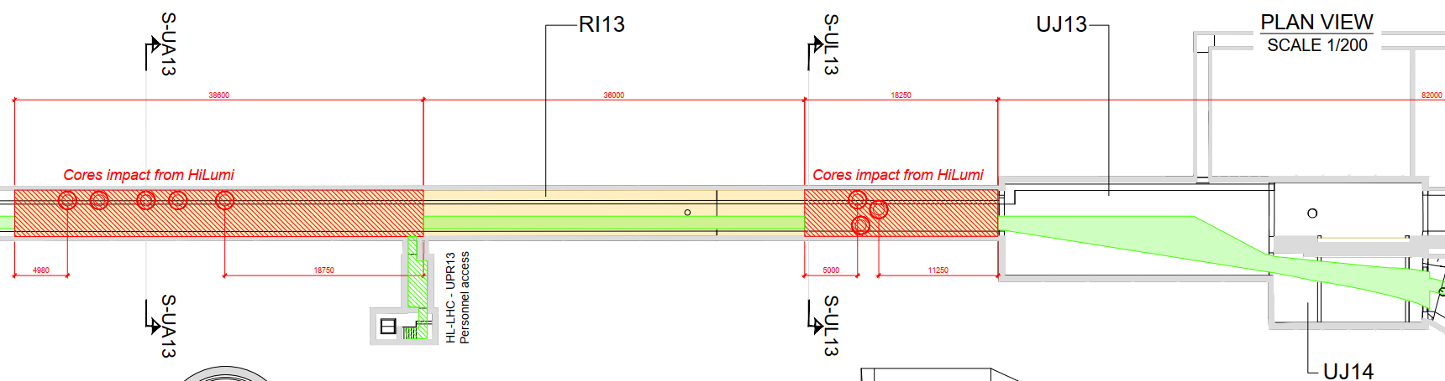
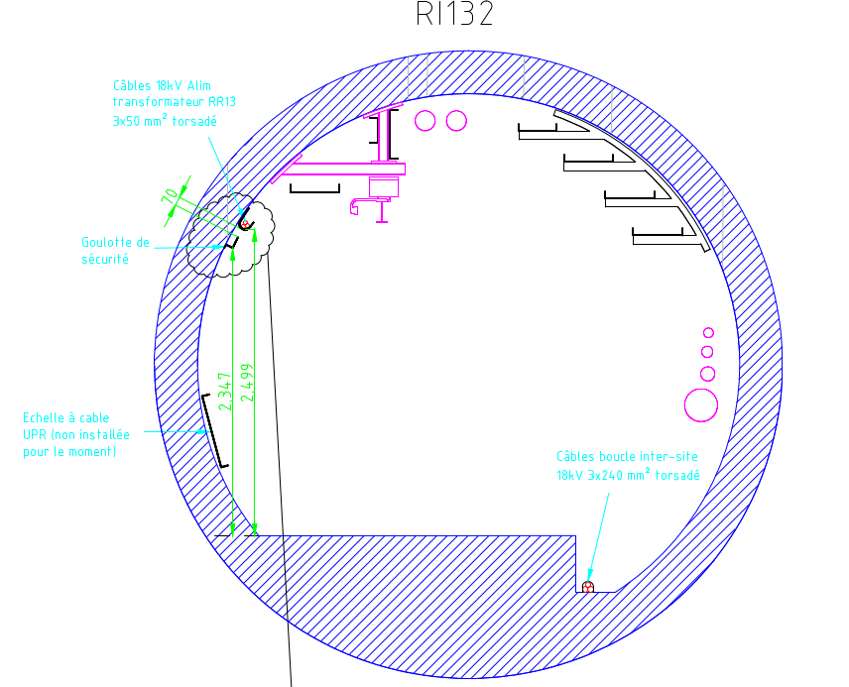
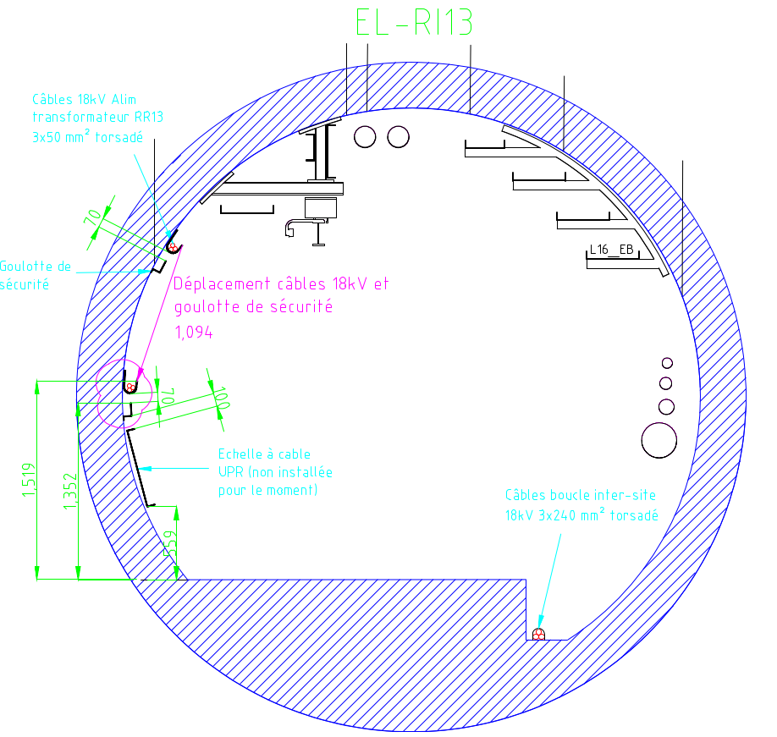
LSS1L – RI13
Reminder of
presentation done end-Jun 19
EDMS 2258938
Displacement of 18 kV cable and EL safety cables
Power cables & ladders
Switched and permanent luminaires
LHC Power cables & ladders
Power distribution coffrets – F1, F2 and F3 & plugs
Tableautins
Tableautins
Power sockets for Vacuum
Power sockets for Vacuum
New temporary power cabling for lighting and F1 distribution boxes
UPR cables
& ladder
UPR cables
& ladder
New temporary power cabling for lighting and F1 distribution boxes
UA Cores area
UL Cores area

Slide 11
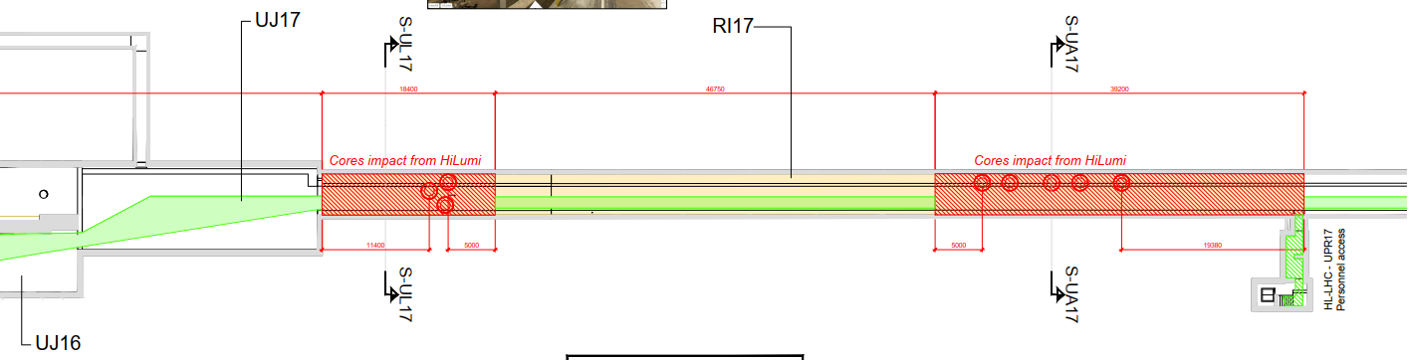
LSS1R – RI17
Reminder of
presentation done end-Jun 19
EDMS 2258938
Same proposition as for LSS1L – RI13
(see previous slide)

Slide 12
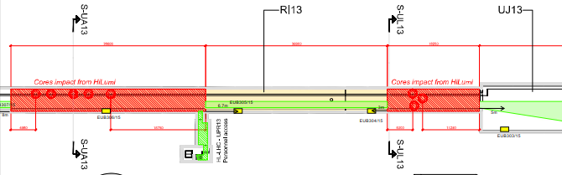
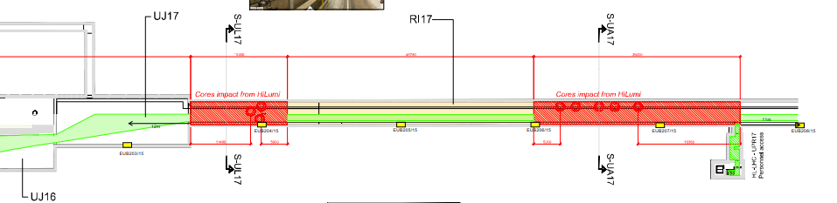
LSS1R – RI13 & RI17 - Tableautins
Reminder of
presentation done end-Jun 19
EDMS 2258938

Slide 13
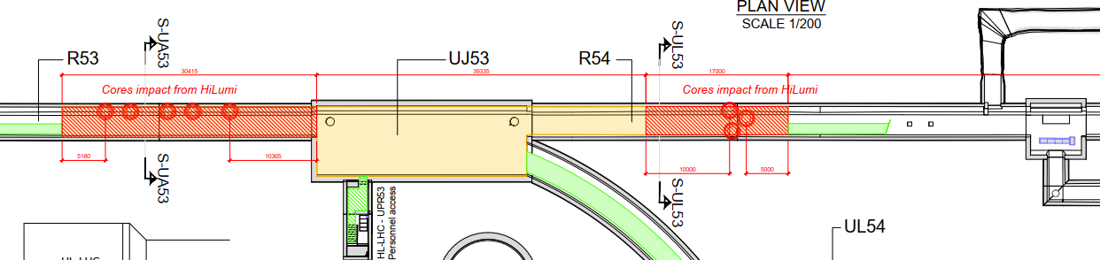
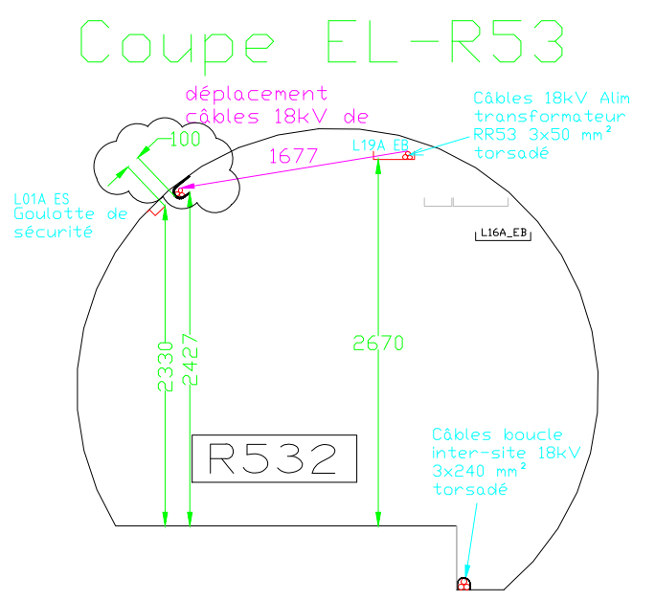
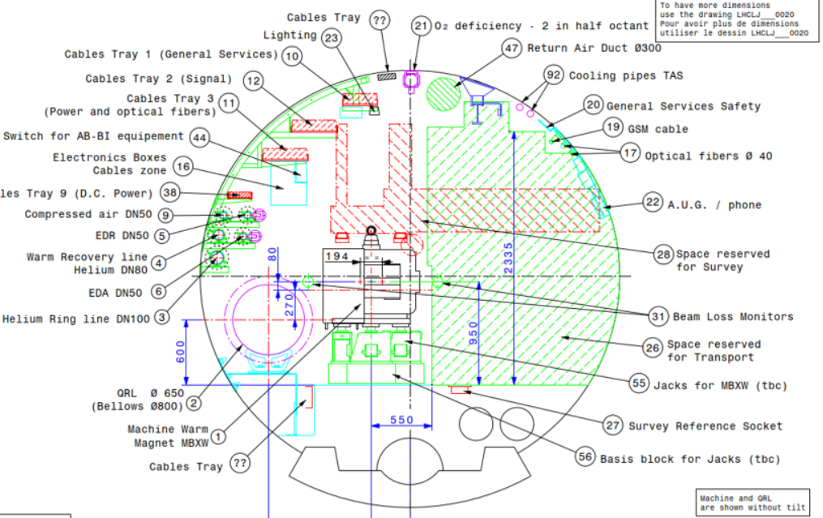
LSS5L – R53 & R54
Reminder of
presentation done end-Jun 19
EDMS 2258938
Displacement of 18 kV cable
Displacement of safety power cables (goulotte s.)
Tableautins
Power sockets for Vacuum
New temporary power cabling for lighting and F1 distribution boxes
UA Cores area
UL Cores area

Slide 14
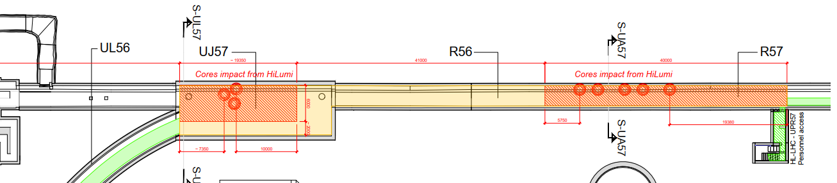
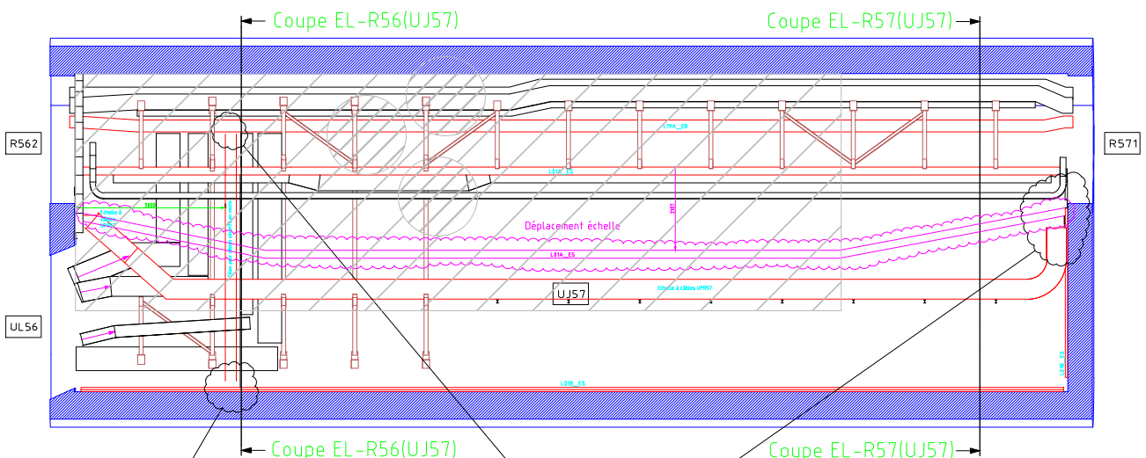
LSS5R – UJ57
CE agreed on this proposition?
Reminder of
presentation done end-Jun 19
EDMS 2258938
CE red area to be modiffied (proposition)
Dismatling of 18 kV cable (power convereters)
Futur UL cores
Modified safety power cables location (goulotte sécurité), to be checked again on site /!\
Non modified safety power cables location (goulotte sécurité)
UL Cores area

Slide 15
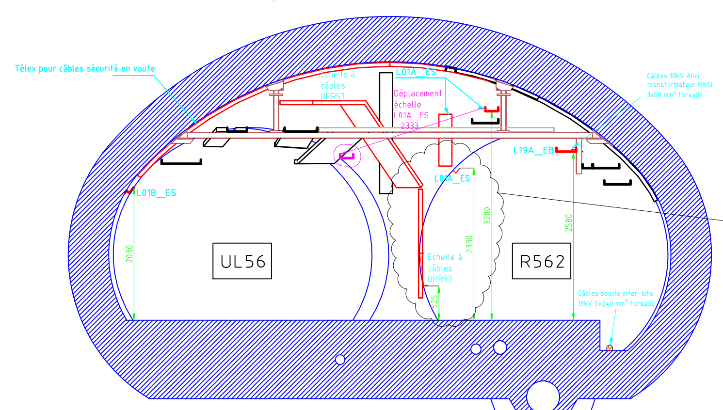
LSS5R – UJ57
Reminder of
presentation done end-Jun 19
EDMS 2258938
Displacement of few safety power cables (cables to be checked)
UPRs cables & ladder
Dismatling of 18 kV cable (power convereters)
Mechanical protection
New temporary power cabling for lighting and F1 distribution boxes

Slide 16
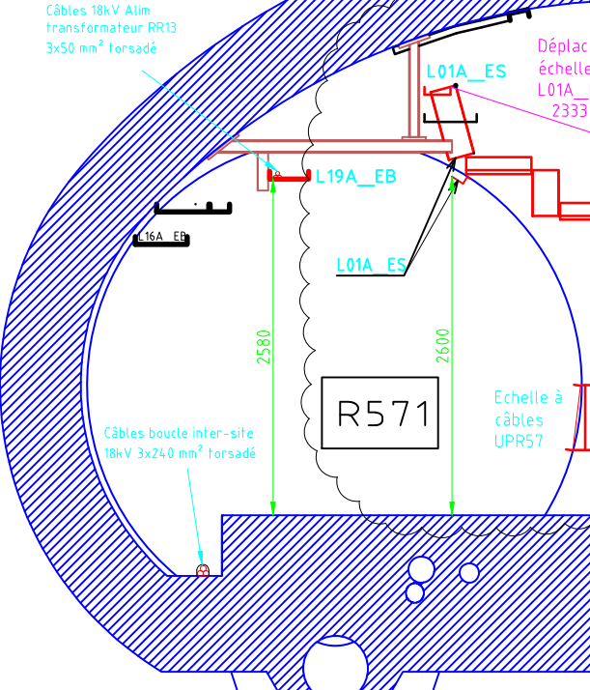
LSS5R – R57
Reminder of
presentation done end-Jun 19
EDMS 2258938
Dismatling of 18 kV cable (power convereters)
No displacing of Safety power cables (goulotte s.)
UPRs cables & ladder
UPRs cables & ladder
Mechanical protection
New temporary power cabling for lighting and F1 distribution boxes

Slide 17
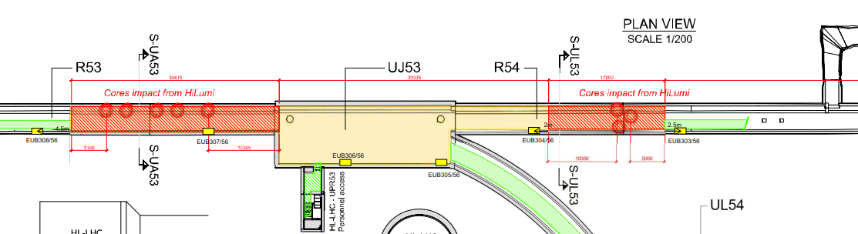
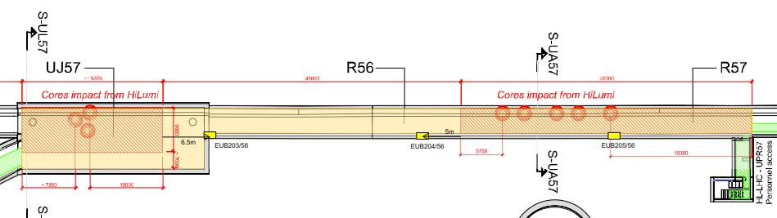
LSS5 – R53/54 & UJ57/R57 - Tableautins
Reminder of
presentation done end-Jun 19
EDMS 2258938

Slide 18
Conclusions/Next steps
Reminder of
presentation done end-Jun 19
EDMS 2258938
UJ57 displacement of safety cables to be investigated more in detail (EL or users cables)
UJ57 CE exclusion (red) area to be redefined
Mechanical protection of the remaining LIVE services to be defined by CE, in collaboration with EL
State about the EL safety systems needed inside CE exclusion (red) areas
CE works planning during LS3?
Cores diameters→ possible reduction?
Tb done by EL
?
Tb done
CE will assure safety of their personnel
Discussions on-going

Slide 19
LS3 Works breakdown for dismantling and re-installation of LSS1 & LSS5

Slide 20
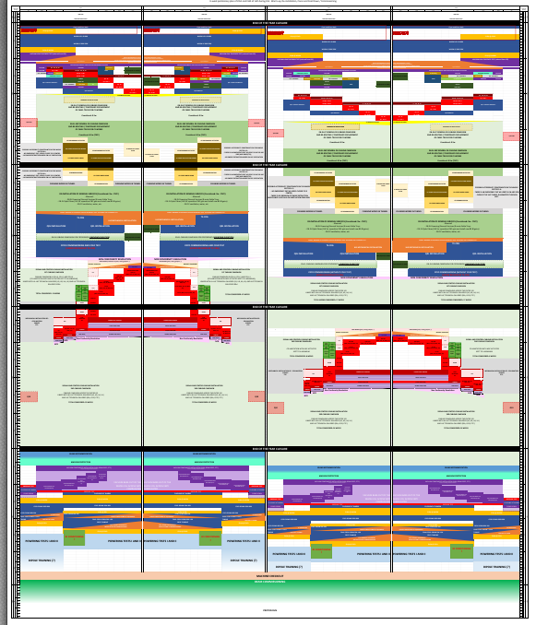
WP15 - LS3 Planning for C&SR Nov 2019
EDMS 2254475
For comments
(see next slides)

Slide 21
WP15 - LS3 Planning for C&SR Nov 2019
New baseline w/r to Jan 2018 presentation/baseline:
  All machine “coffrets” to be removed from D1 to Q6
  Keep and displace safety cables and some 18 kV cables
  Install temporary cables & connection for F1 power lines and lighting
  Temporary cable tray for LSS5R (tbc)
  Design on-going: new cable trays modifications according new machine layout → also impacts general services & machine cabling
Assumptions for next 2 slides (phasing & durations):
  Each of next 2 slides refers only to LSS1L & LSS5R (LSS1L~LSS1R & LSS5R~LSS5L)
  Only 1 shift of 8h/day
  Works not considered at this stage: new machine layout design
  EL works impact:
    Local work → co-activities possible
    No co-activities with others → only EL workers, mainly for cabling pulling

Slide 22
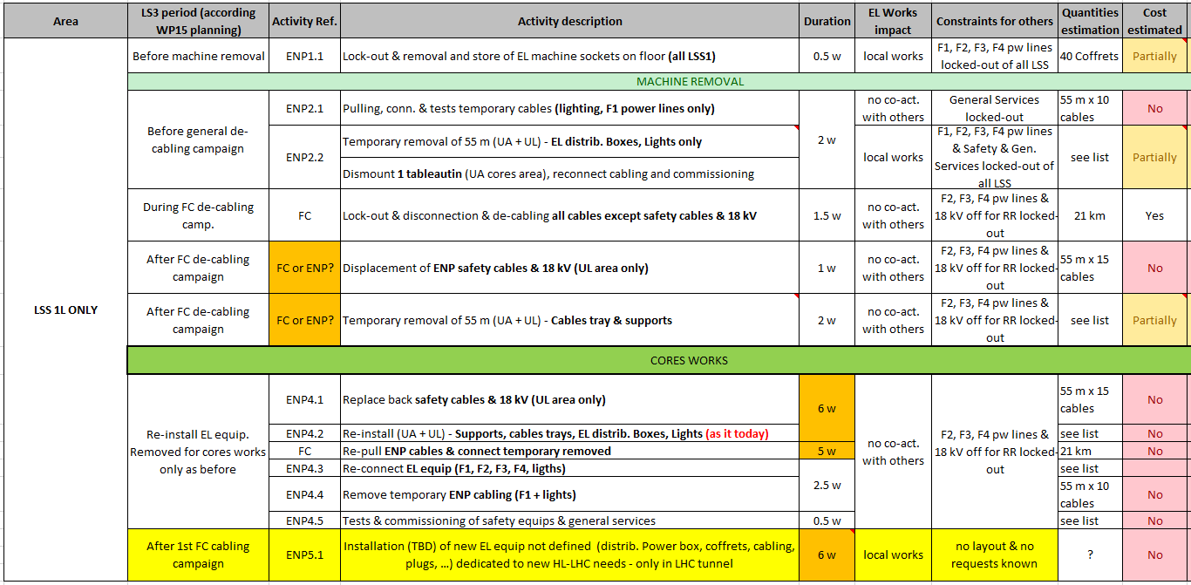
LS3 Electrical distribution works phasing and durations
LSS 1L (only)
To be defined once requests known

Slide 23
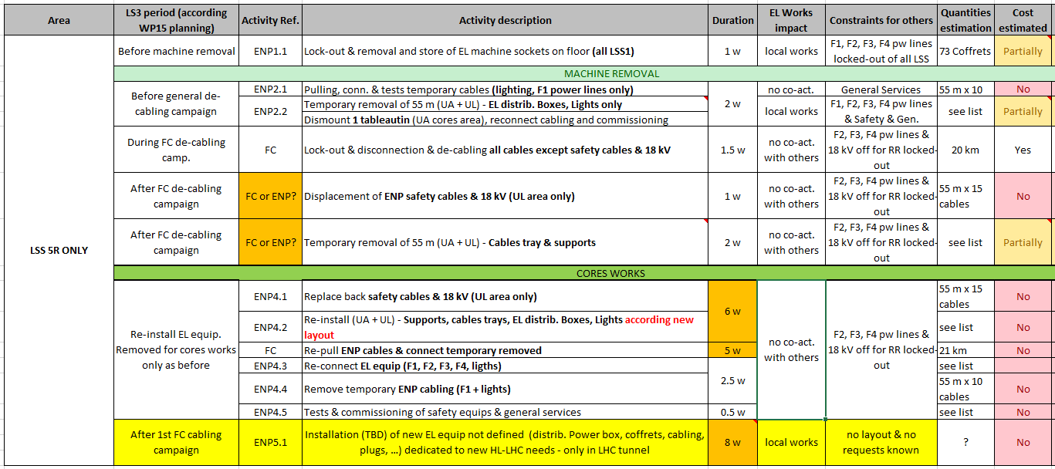
LS3 Electrical distribution works phasing and durations
LSS 5R (only)
To be defined once requests known

Slide 24
Conclusions/Next steps
Validate proposed works phasing → WP15-EL(ENP-FC)
Services & cables displacement propositions during cores works to be approved
Safety constraints in LHC sectors during works (cores & cabling & machine installation) to be defined
New LHC tunnel layout on-going → impact on dismantling/re-installation of pw cabling, cable trays, lights & power boxes → impact on schedule durations & costs
New machine power requests in LHC tunnel → to be announced/requested by concerned WPs

Slide 25
Conclusions/Next steps
Costs estimations (for power distrib.):
  For dismantling: to be re-evaluated as baseline changed for equipment removal and temporary repowering → WP15 budget
  For re-installation
    General services: not estimated → WP15 budget
    Machine “coffrets”: no requests → WPs requestor budget
  Deadlines?
Manpower for power distrib.→ under discussion

Slide 27
Backup slides

Slide 28
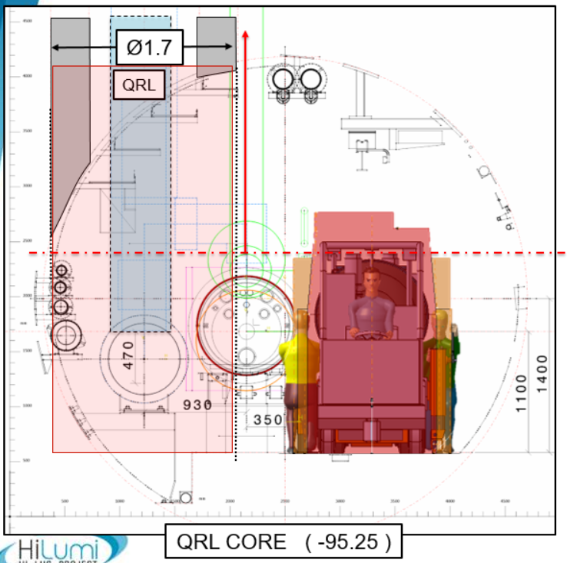
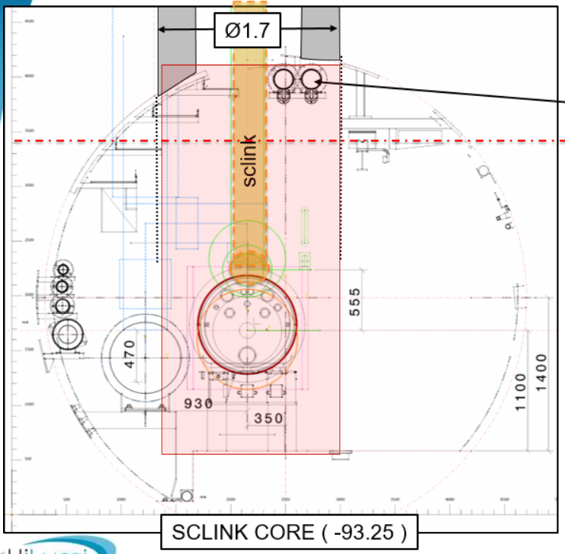
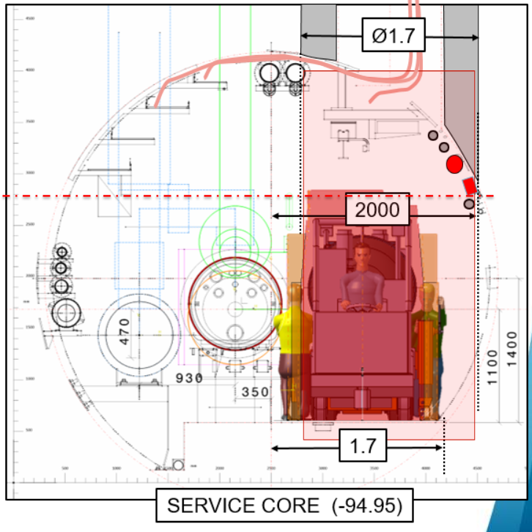
LSS1L – RI13 Cores impact forecast
Courtesy S. Maridor (presentation in 2018)

Slide 29
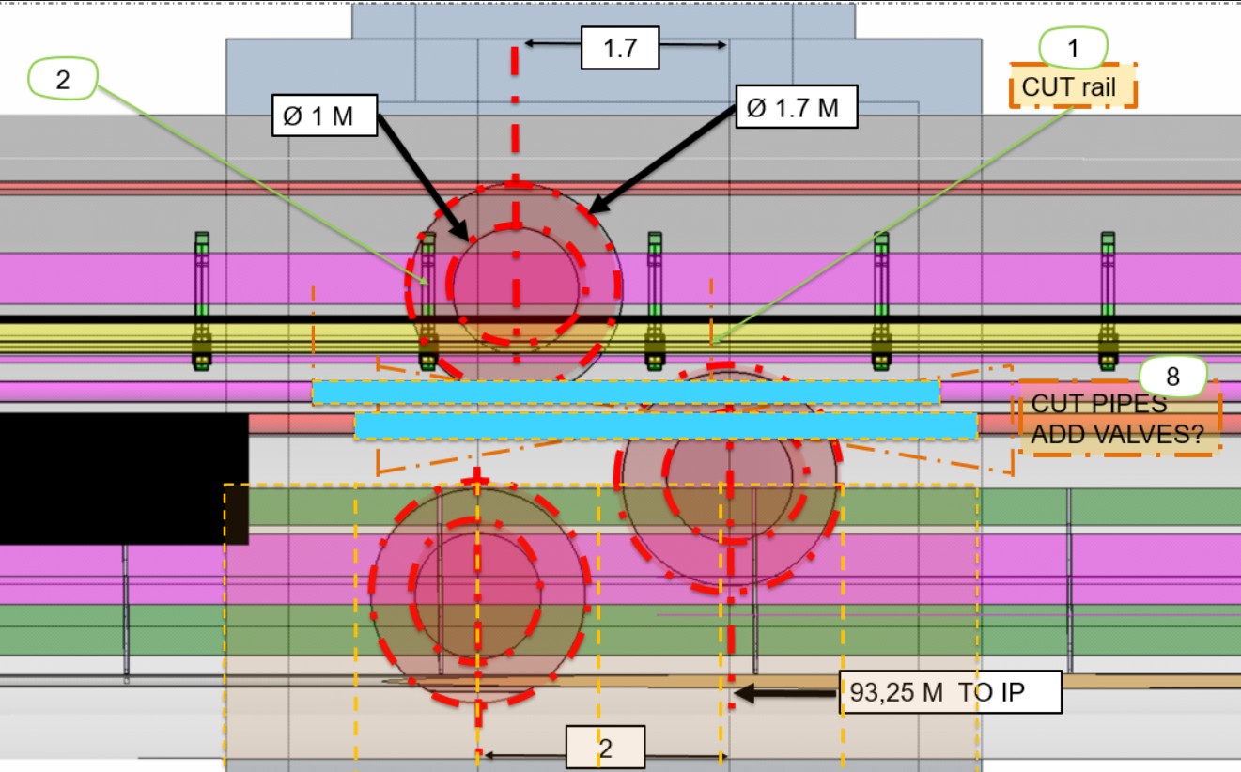
LSS1L – RI13 Cores impact forecast

Slide 30
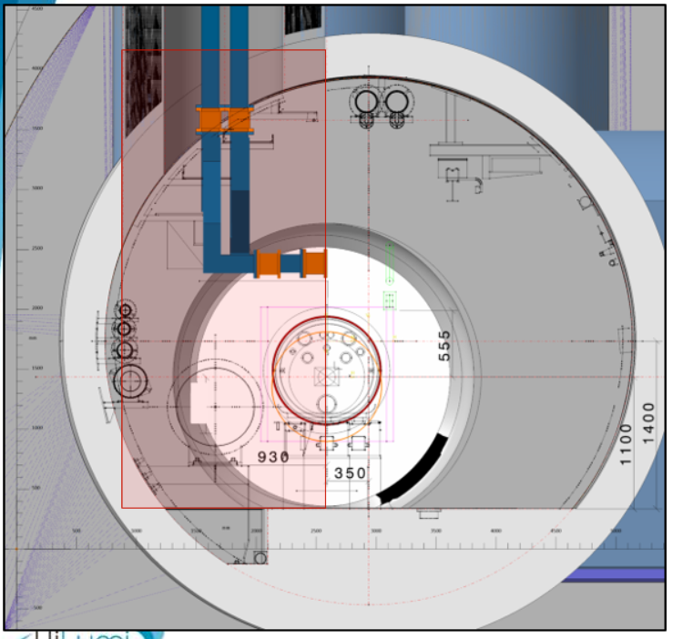
LSS1L – RI13 Cores impact forecast
Courtesy S. Maridor (presentation in 2018)

Slide 31
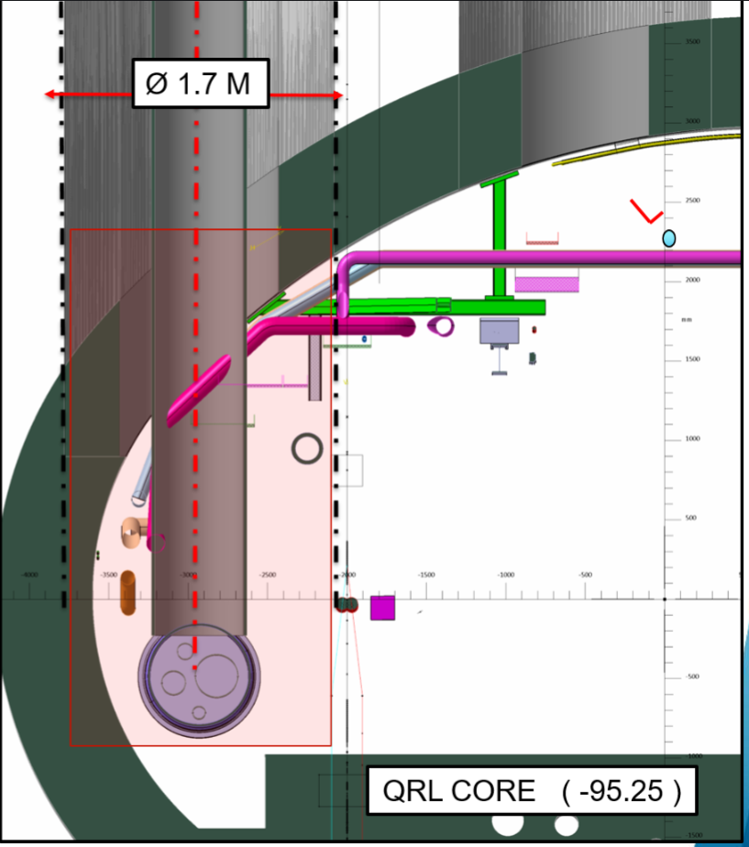
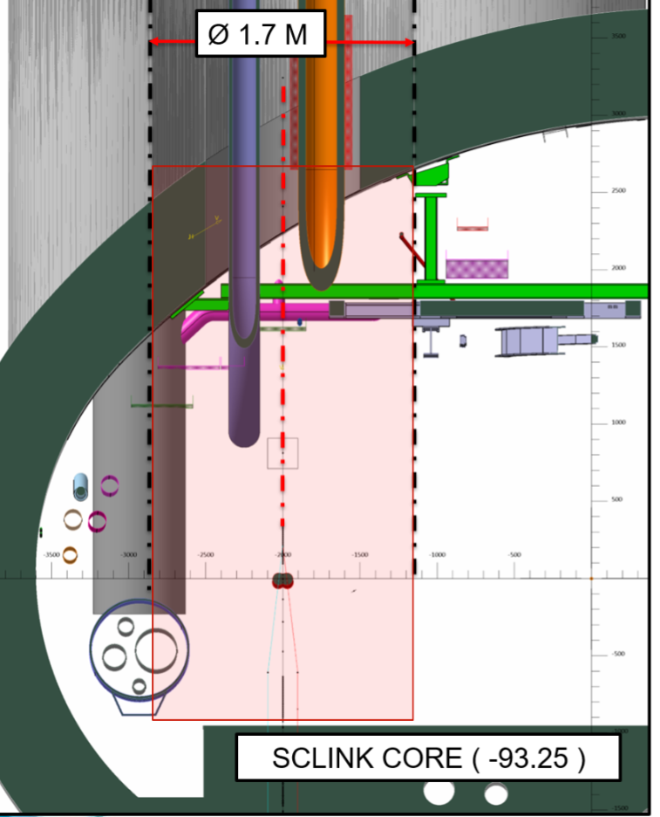
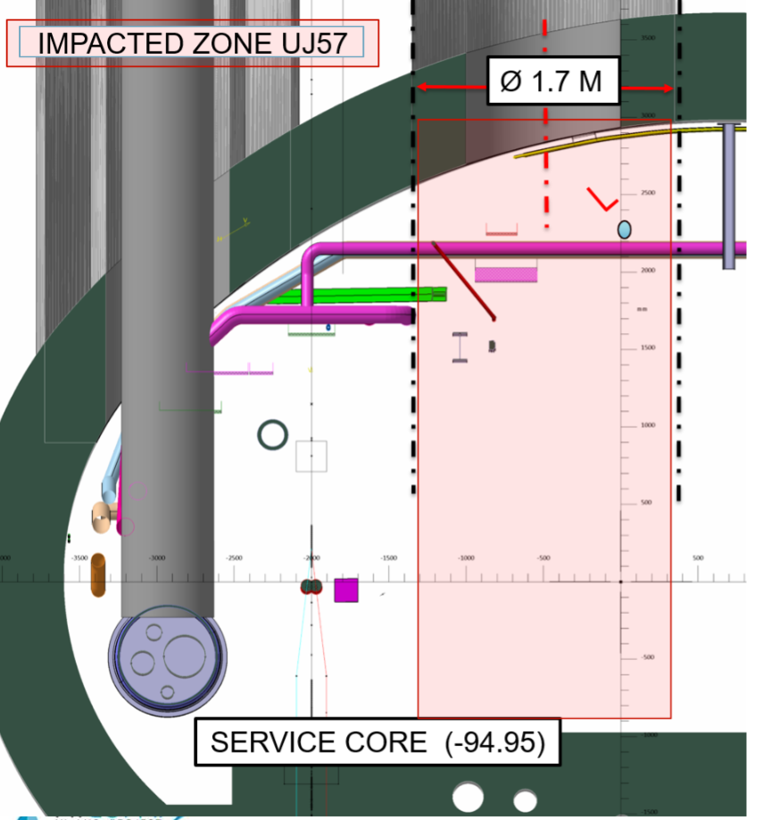
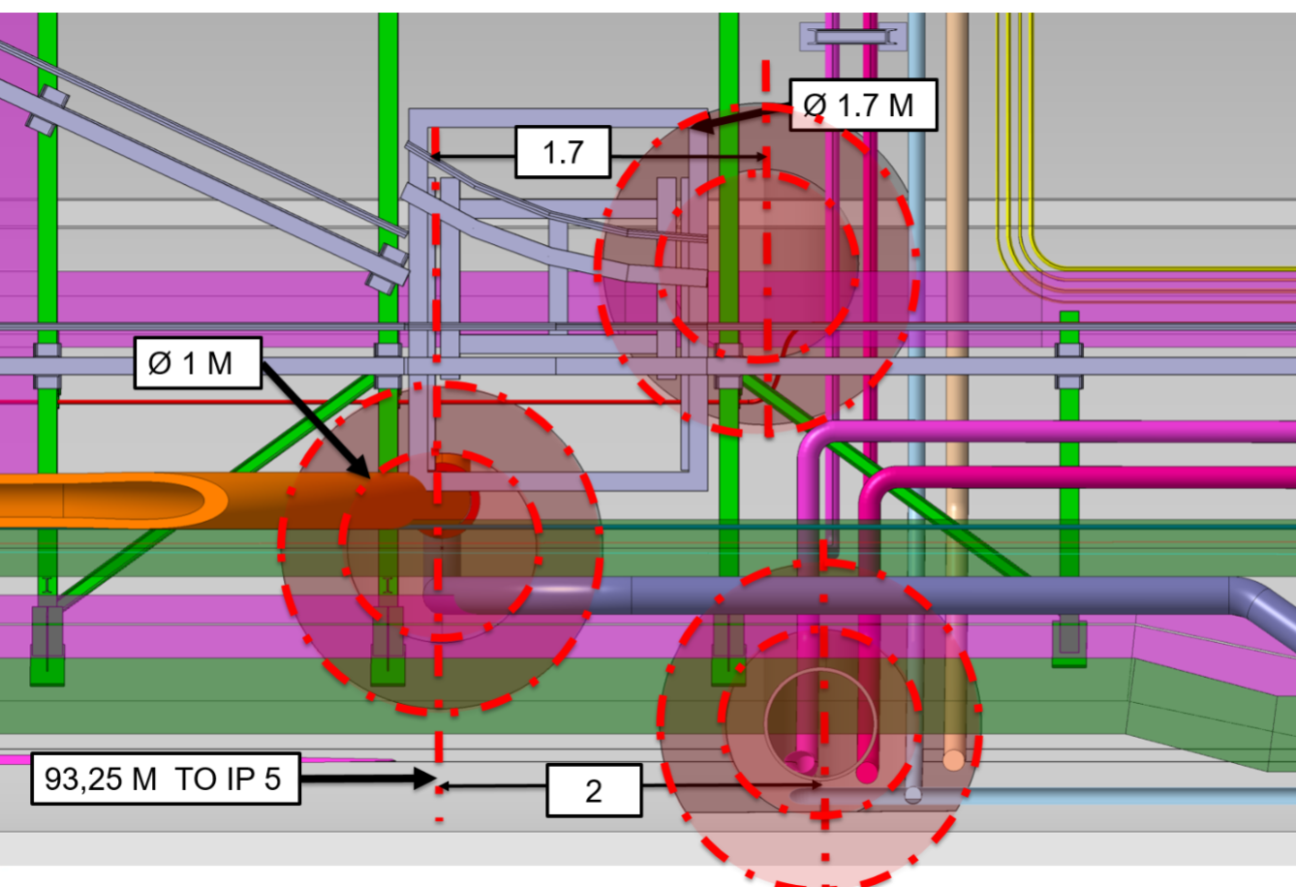
LSS5R – UJ57
Courtesy S. Maridor (presentation in 2018)

Slide 32
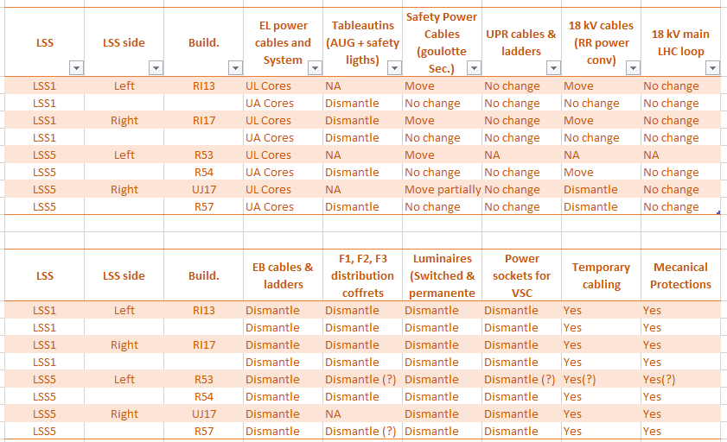
RESUME

Slide 33
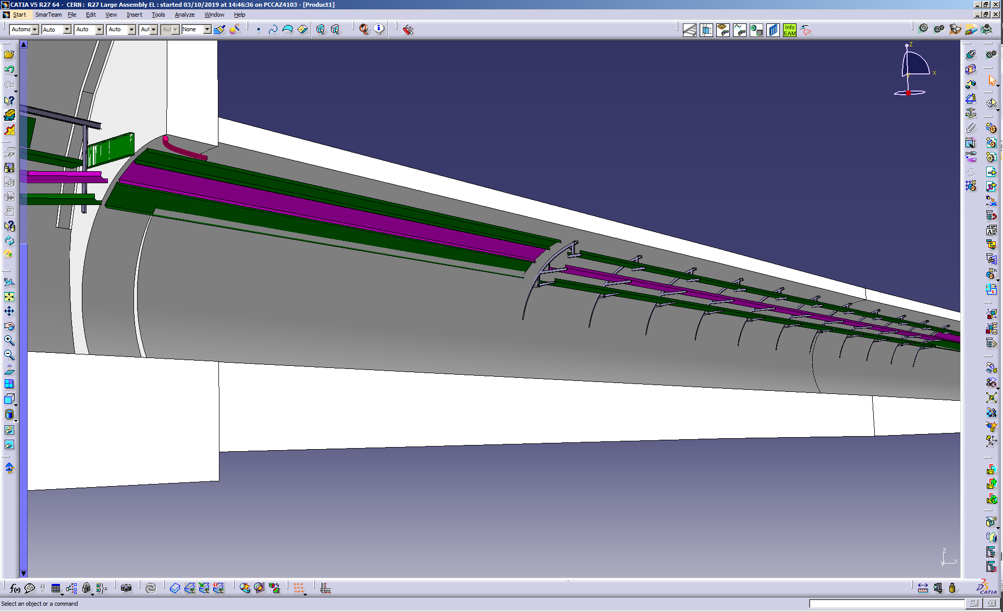
LHC
RR53
R532

Slide 34
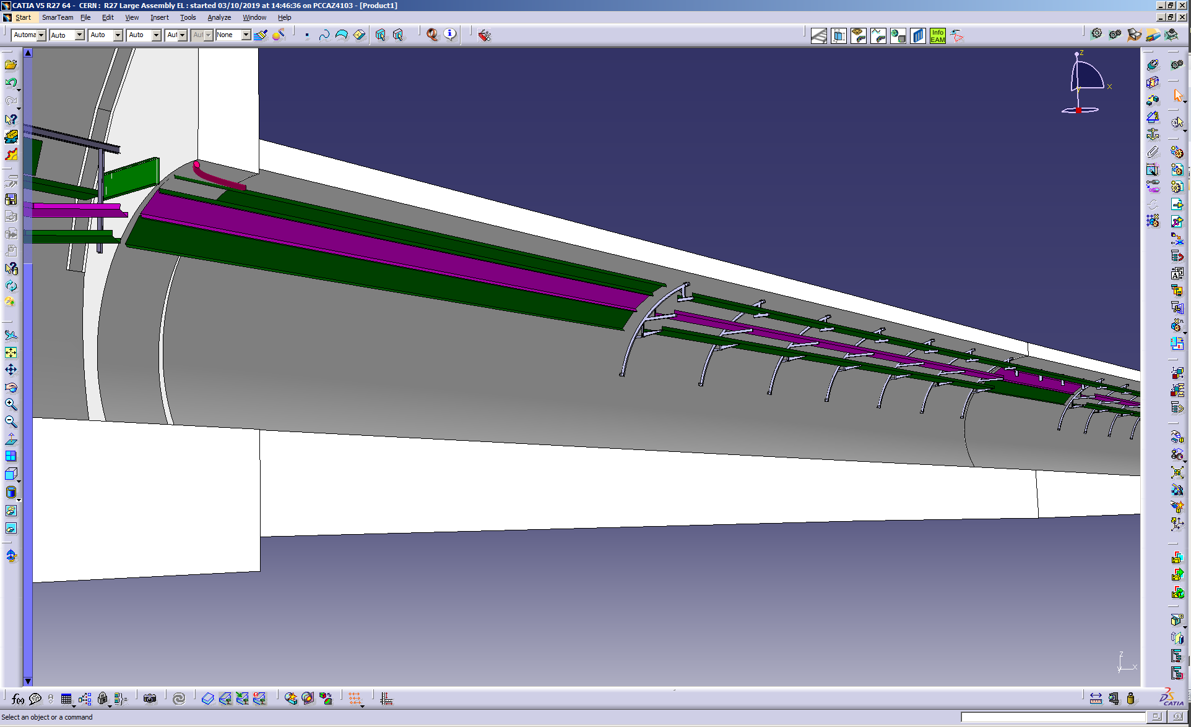
HL-LHC
RR53
R532

Slide 35
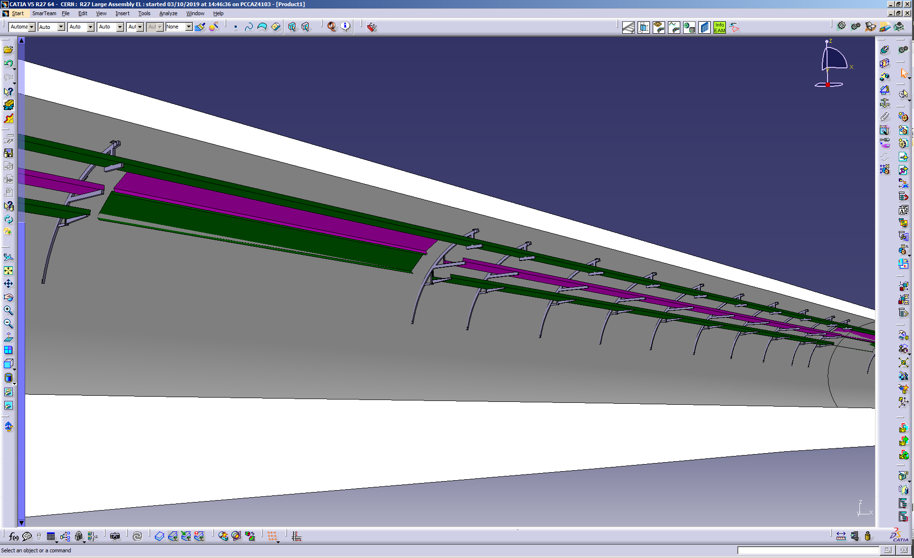
LHC
R532

Slide 36
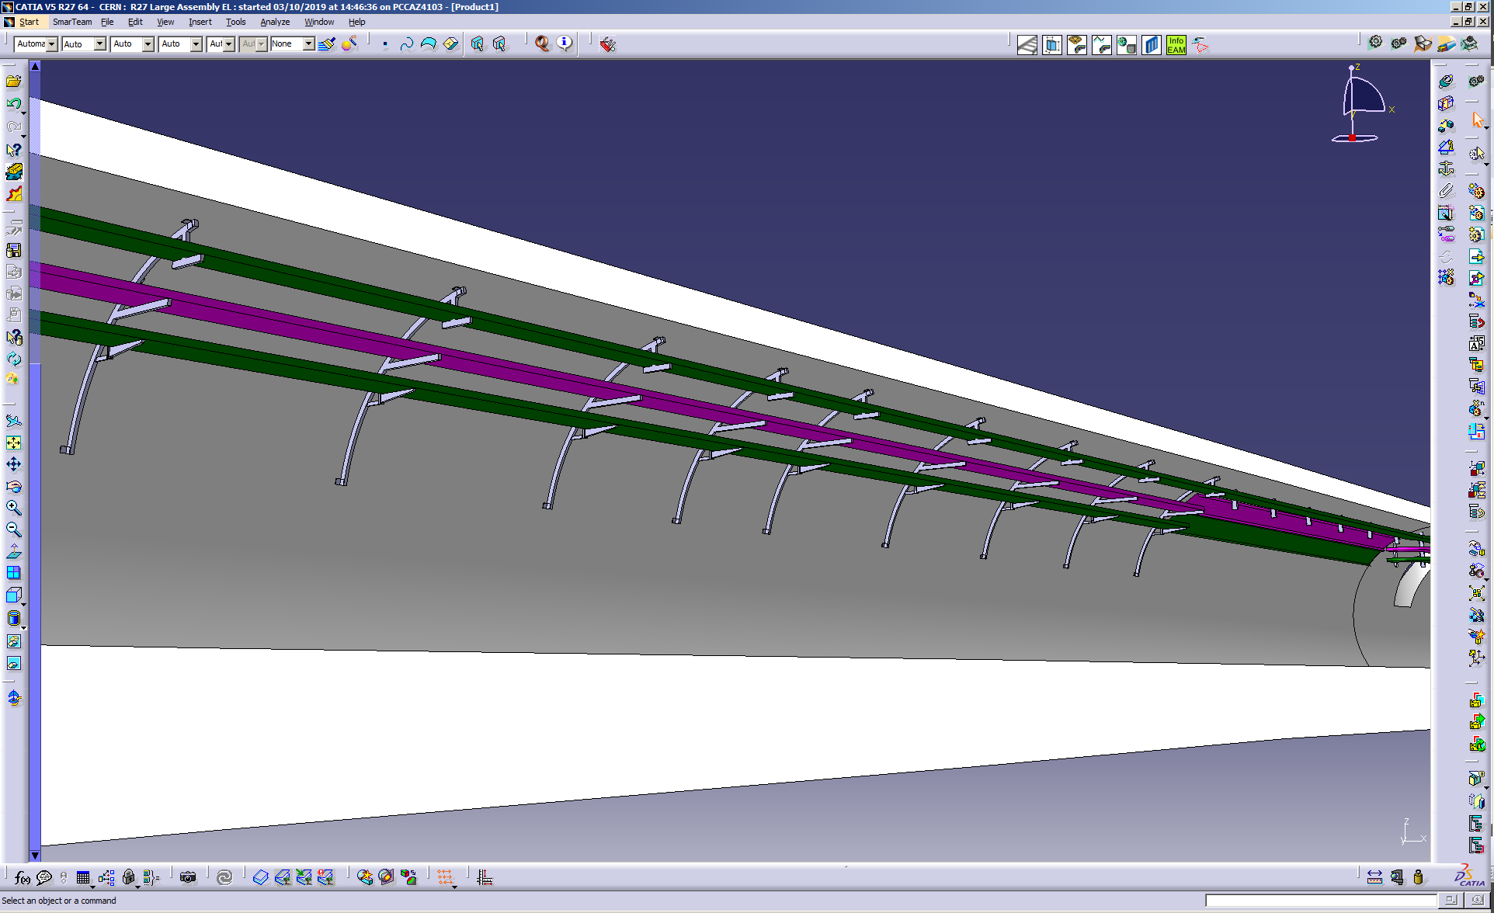
HL-LHC
R532

Slide 37
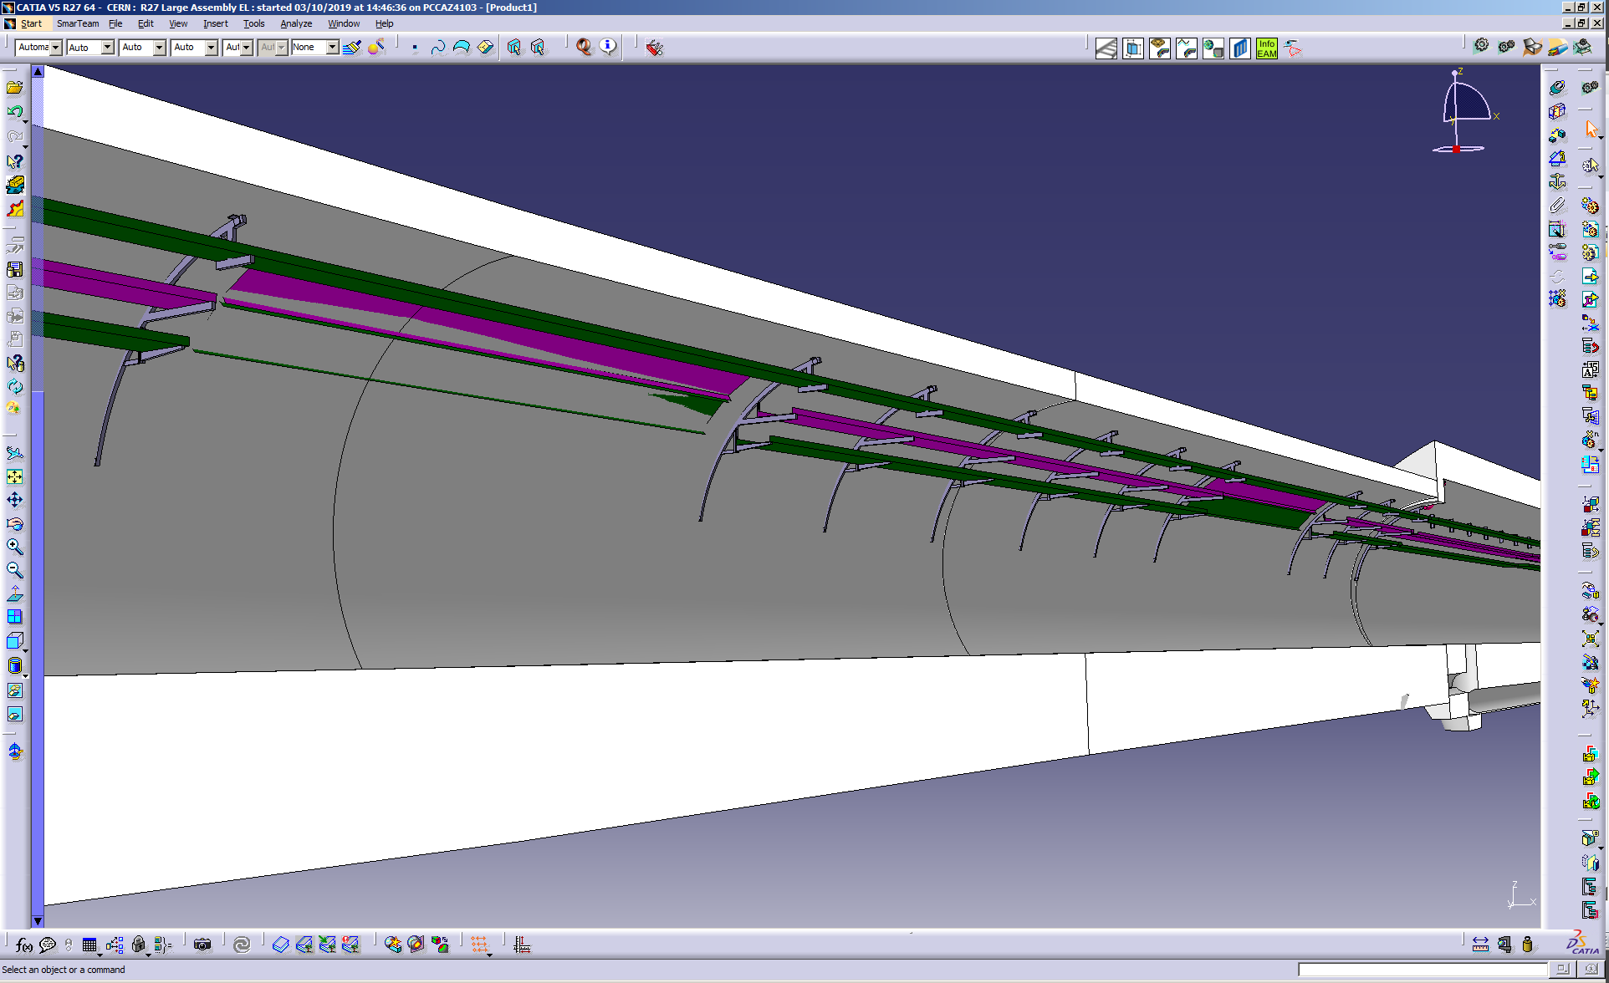
LHC
R532

Slide 38
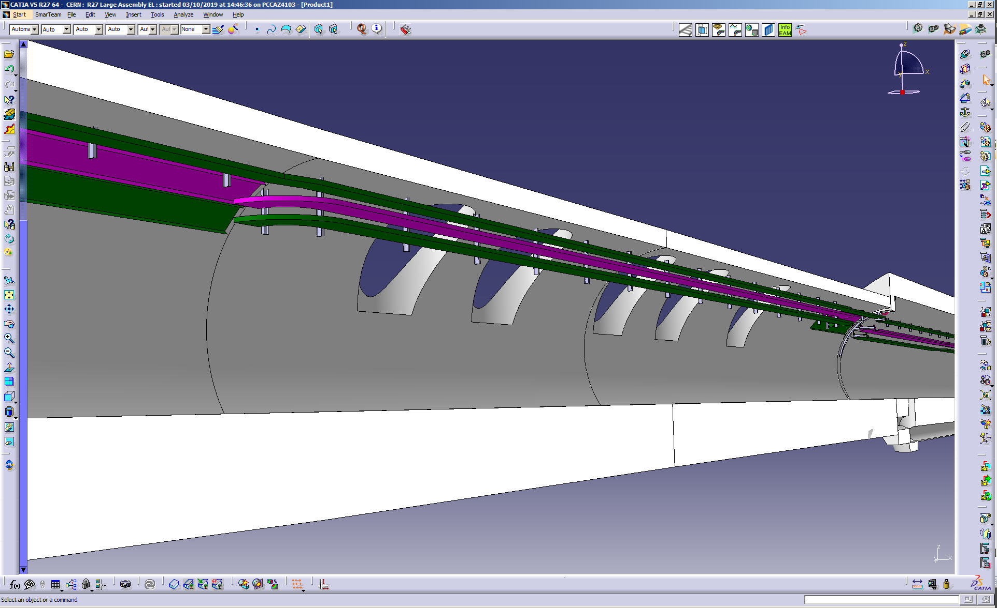
HL-LHC
R532

Slide 39
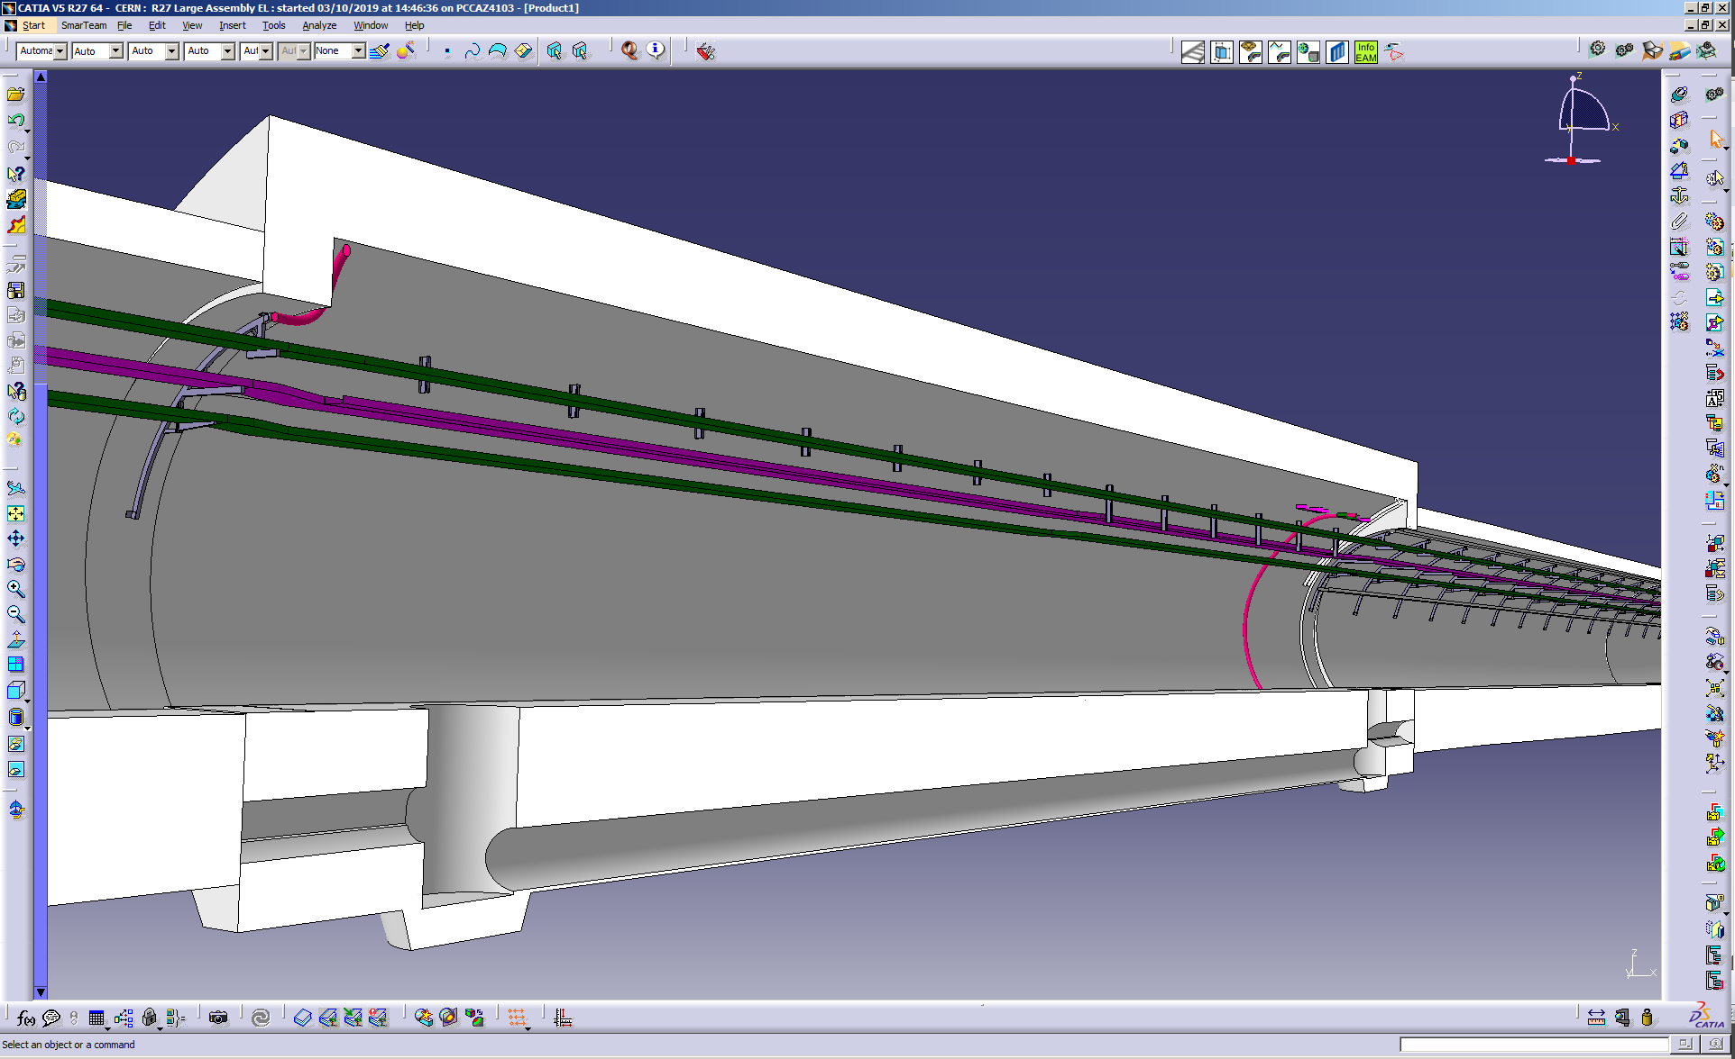
LHC
UJ53

Slide 40

HL-LHC
ZONE DFM - A MODIFIER
UJ53

Slide 41
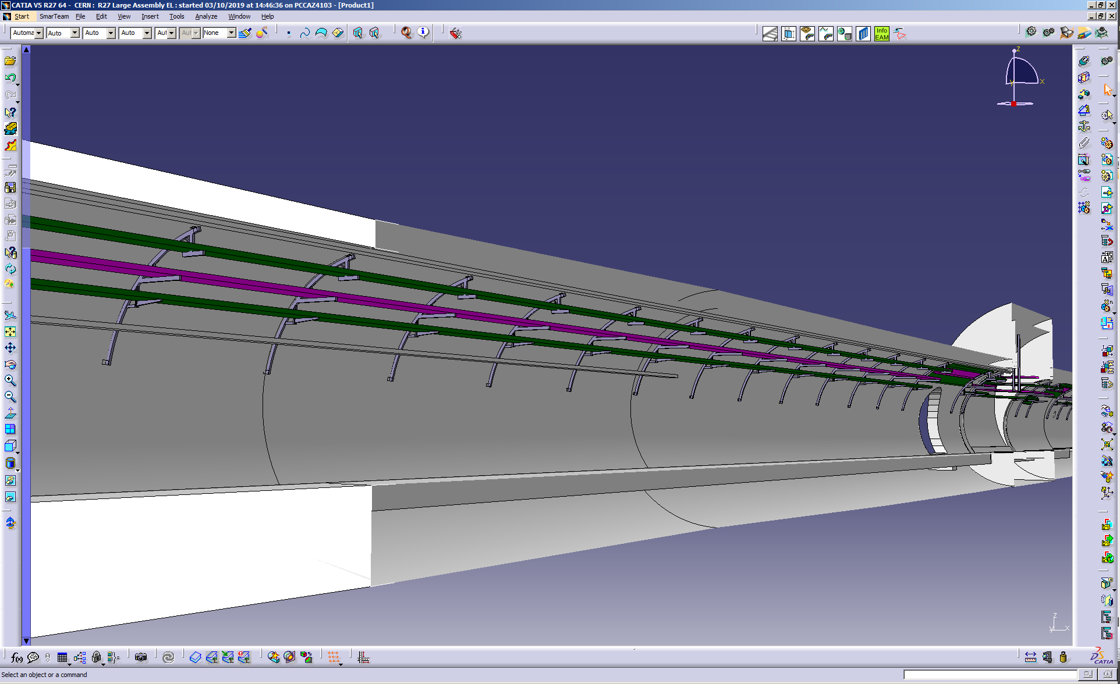
LHC
RZ54
R541

Slide 42
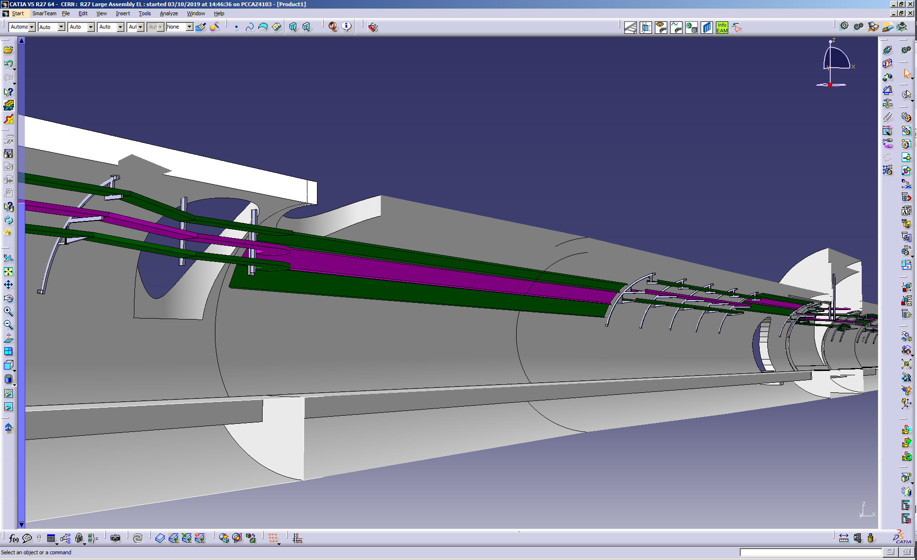
HL-LHC
RZ54
R541

