Slide 1

Accelerating GAN training using distributed tensorflow and highly parallel hardware
Renato Cardoso IT-DI-OPL, Sofia Vallecorsa IT-DI-OPL
IML 2020

Slide 2
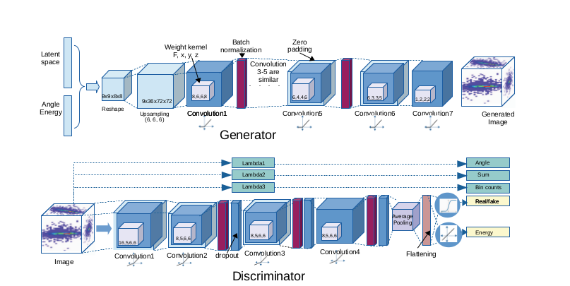
Architecture of the GAN
3D convolutional Generative Adversarial Network using physics constraints.
Generates 51x51x25 pixels images, representing energy depositions in calorimeters, similar to the ones generated by Monte Carlo.
IML 2020
Renato Cardoso | Accelerating GAN training using distributed tensorflow and highly parallel hardware

Slide 3
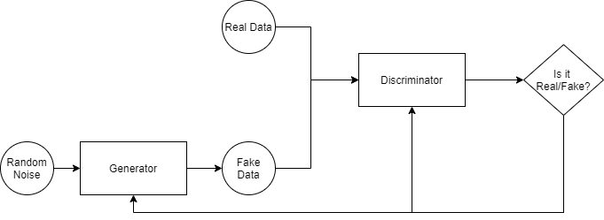
GAN Training - General Idea
The GAN training is divided into two steps: the Discriminator Training and the Generator Training
We train the Discriminator and then the Generator for each batch of data.
This process of training is repeated for a specific amount of epochs.
IML 2020
Renato Cardoso | Accelerating GAN training using distributed tensorflow and highly parallel hardware

Slide 4
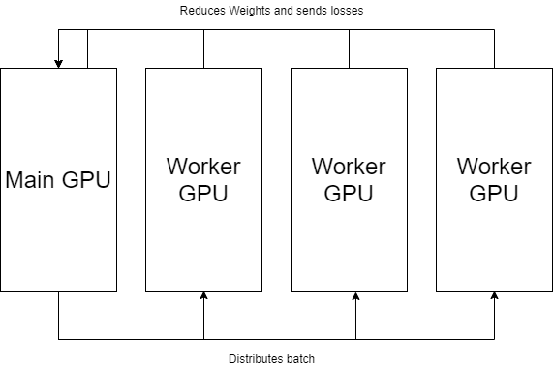
GPUs - Parallel Approach
Using Tensorflow Mirrored Strategy
Mirrored Strategy uses synchronous training with NVIDIA NCCL as the all-reduce implementation
Model needs to be initialized in strategy scope
Tensorflow Train_on_batch function takes care of distributed training.
IML 2020
Renato Cardoso | Accelerating GAN training using distributed tensorflow and highly parallel hardware

Slide 5
GPU Configuration
The models were run using the Mirrored Strategy to implement parallelization across the multiple GPUs
We used 1, 2 and 4 V100 GPUs present in Google Cloud
The batch used for each GPU was 128, meaning that for each step in the training (update of the discriminator and the generator) the global batch size is 128 x N_{GPUs}.
We measured the average time for each individual training for a batch of data, as well as the average training for a single epoch
All times are in seconds
IML 2020
Renato Cardoso | Accelerating GAN training using distributed tensorflow and highly parallel hardware

Slide 6
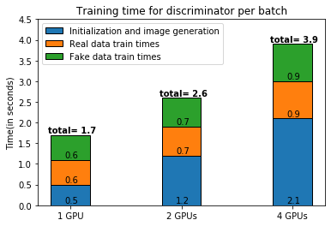
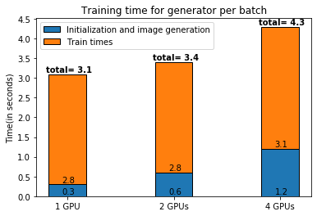
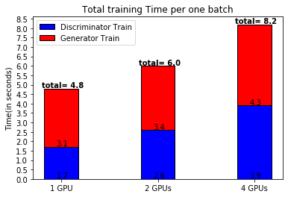
GPU Results
Batch size:
  1 GPU = 1 x 128 = 128
  4 GPUs = 4 x 128 = 512.
4 GPUs process 4x more data than 1 GPU per batch
1 GPU needs 4.8 x 4 = 19.2 seconds to process the same data.
Average Time per epoch:
1 GPU: 4999
2 GPU: 3481
4 GPU: 2565
IML 2020
Renato Cardoso | Accelerating GAN training using distributed tensorflow and highly parallel hardware

Slide 7
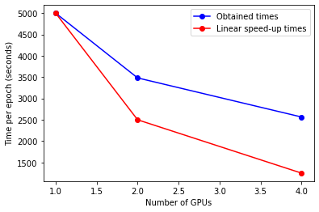
GPU Conclusions
Overall Decrease in Training time per epoch 4999 -> 3481 -> 2565
Small variances of training time while increasing number of GPUs 0.6 -> 0.7 -> 0.9
Bottleneck in initialization of data and image generation
Times obtained are not near linear speed-up.
IML 2020
Renato Cardoso | Accelerating GAN training using distributed tensorflow and highly parallel hardware

Slide 8
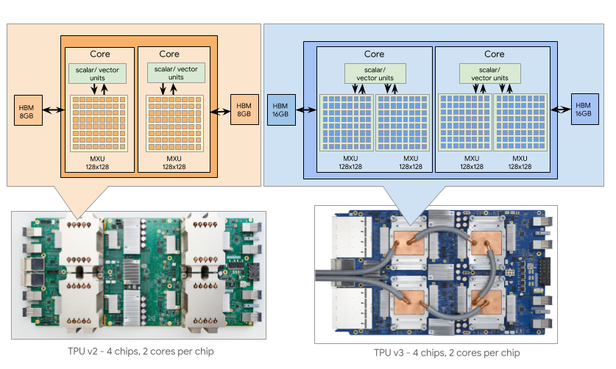
TPUs - Tensor Processing Units
Tensor Processing Units (TPUs) are application-specific integrated circuits (ASICs) developed by Google in order to accelerate the machine learning workload.
https://cloud.google.com/tpu/docs/system-architecture
IML 2020
Renato Cardoso | Accelerating GAN training using distributed tensorflow and highly parallel hardware

Slide 9
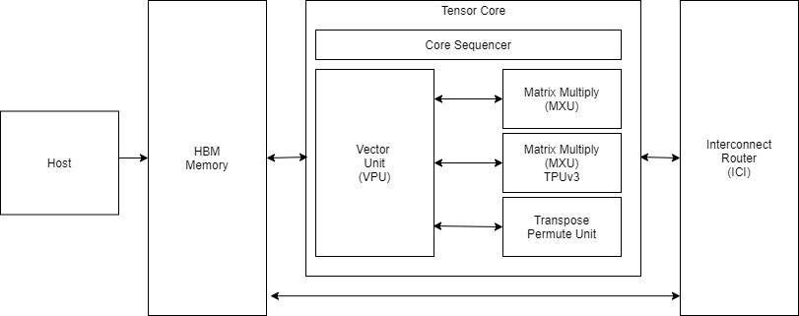
TPUs Hardware
A large two-dimensional matrix multiply unit (MXU) size of 128x128
Inter-Core Interconnect (ICI)
High Bandwidth Memory (HBM)
Core Sequencer
Vector Processing Unit
The Transpose Reduction Permute Unit
two cores per chip
2 MXUs per core for TPUsv3
IML 2020
Renato Cardoso | Accelerating GAN training using distributed tensorflow and highly parallel hardware

Slide 10
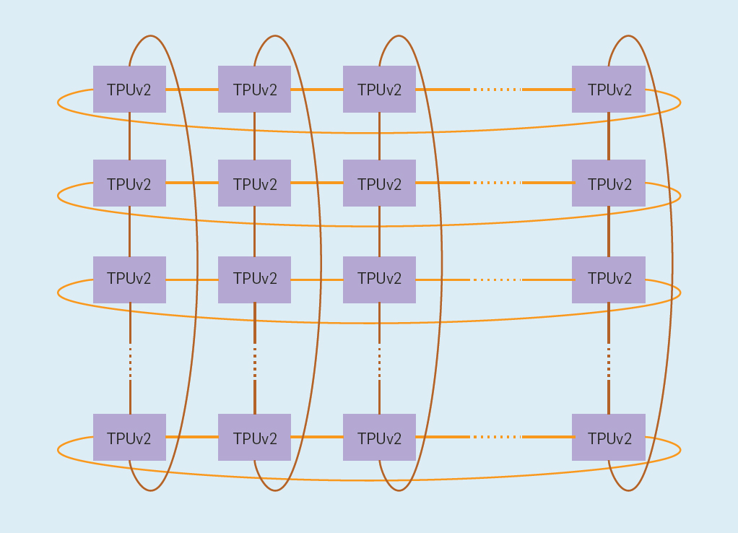
TPU Parallel Approach
Using Tensorflow TPU Strategy
Weight updates using All-reduce and a 2D torus topology
Model needs to be initialized in strategy scope
Tensorflow Train_on_batch function takes care of distributed training.
Cores on a Cloud TPU execute an identical program residing in their own respective HBM in a synchronous manner.
A reduction operation is performed at the end of each neural network step across all the cores.
DOI: 10.1145/3360307
IML 2020
Renato Cardoso | Accelerating GAN training using distributed tensorflow and highly parallel hardware

Slide 11
TPU Configuration
Test were run on TPU version 3 with 8 cores
Multiple batch sizes were used to see the difference in performance.
Batch specification for one TPU core:
  8 cores -> Global batch size = 8 x batch size
We measured the average of time for each individual training.
In the end we measured the average time for one epoch for the best setup
All times are in seconds
IML 2020
Renato Cardoso | Accelerating GAN training using distributed tensorflow and highly parallel hardware

Slide 12
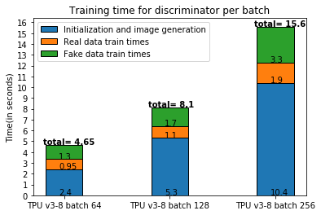
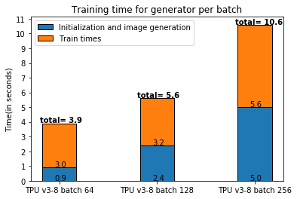
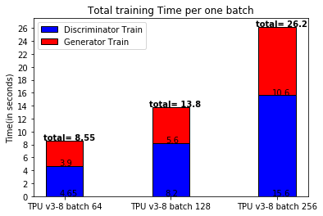
TPU Results
Best Result - 8 cores batch size of 128 for each core.
64 batch size - similar training time - double the batches
256 batch size - double training time
Average time per epoch of best Result: 2070 seconds
IML 2020
Renato Cardoso | Accelerating GAN training using distributed tensorflow and highly parallel hardware

Slide 13
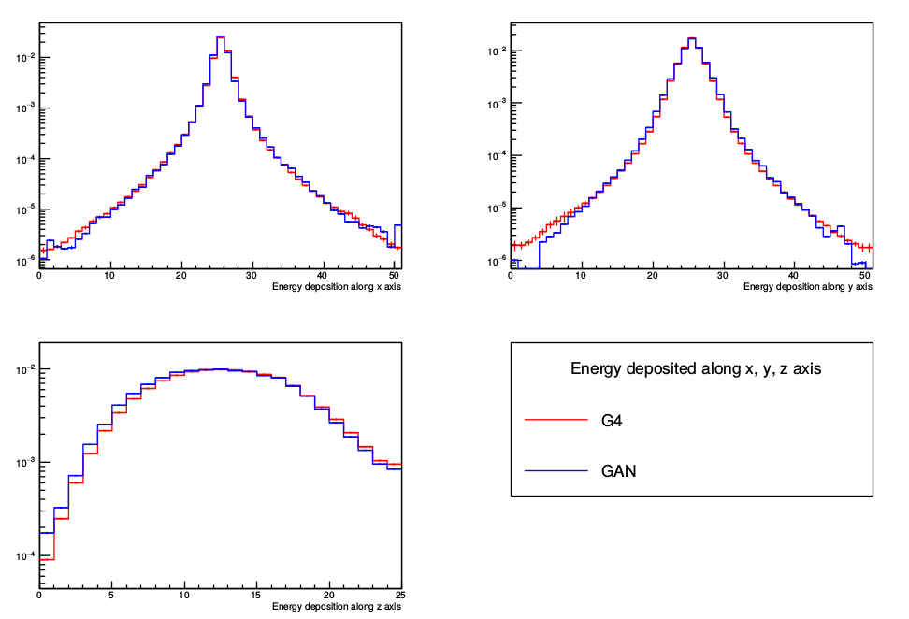
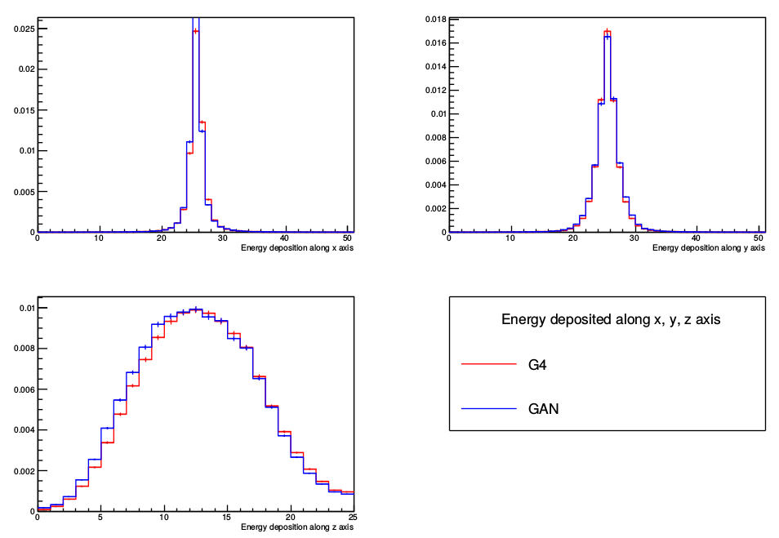
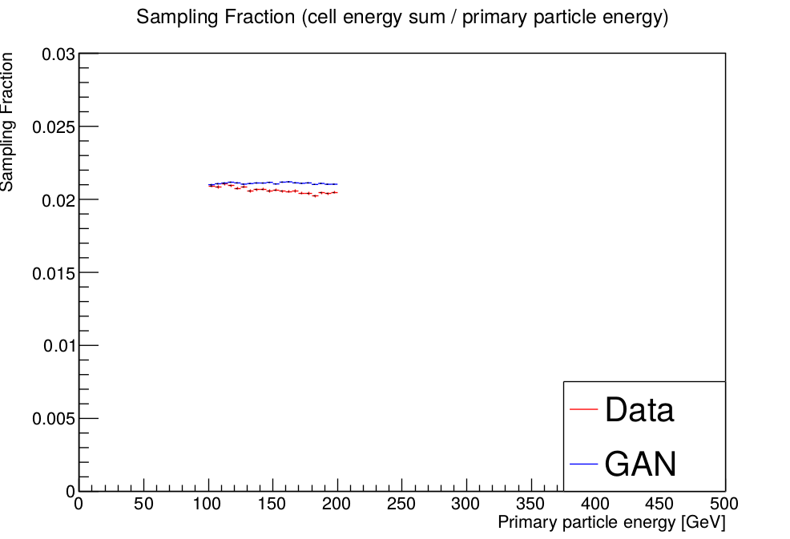
TPU Results Validation
Results obtained from running the on TPUs v3 with 8 cores and a batch per core of 128, during 40 epochs.
Shower Shapes for Geant4 vs. GAN events along x, y and z in log scale
Shower Shapes for Geant4 vs. GAN events along x, y and z
Sampling fraction GAN and Geant4 events for 100 − 200 GeV primary energy
IML 2020
Renato Cardoso | Accelerating GAN training using distributed tensorflow and highly parallel hardware

Slide 14
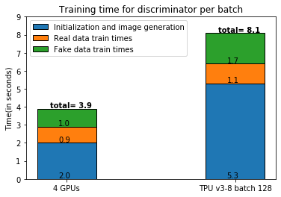
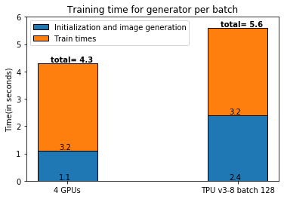
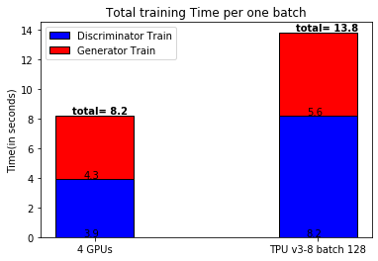
GPU+TPU Comparison
Batch size:
  4 GPU = 4 x 128 = 512
  8 cores TPU = 8 x 128 = 1024.
TPU are better than 4 GPUs
Price:
  TPU: 1 USD/hour -> 4,6 per epoch
  GPU: 1,8 USD/hour -> 5,13 per epoch
Average Time per epoch:
4 GPU: 2565
TPU v3-8: 2070
IML 2020
Renato Cardoso | Accelerating GAN training using distributed tensorflow and highly parallel hardware

Slide 15
Summary
Deployment of 3DGAN training on GPUs and TPUs
Benchmark of TPUs and GPUs
TPUs offer better performance than GPUs but still present a bottleneck in training
Future Work
Increase the amount of code being parallelized
Better strategies for data input
Modify models run on TPUs to achieve better performance
Resources accessed on GCloud thanks to the CERN openlab + Google collaboration
IML 2020
Renato Cardoso | Accelerating GAN training using distributed tensorflow and highly parallel hardware

Slide 16
Any questions?
IML 2020
Renato Cardoso | Accelerating GAN training using distributed tensorflow and highly parallel hardware

Slide 17

Thank you for your Attention!

Slide 18
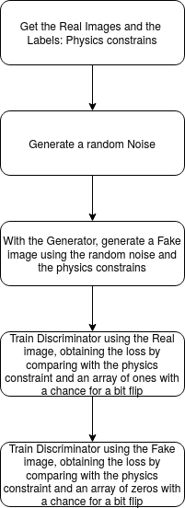
GAN Training - Discriminator
The Discriminator has two steps for training, the Real data training and the Fake data training.
In order to train the Discriminator on real data we use “1” labels + small fraction of “0” to introduce noise.
For the fake data we use “0” labels + a small fraction of “1” to introduce noise.
IML 2020
Renato Cardoso | Accelerating GAN training using distributed tensorflow and highly parallel hardware

Slide 19
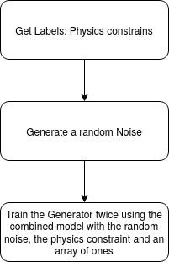
GAN Training - Generator
The Generator only needs to train using the random noise to generate the image and pass it to the Discriminator
The combined model is responsible for generating the image and updating the weights of the generator
The Generator is trained twice to balance the training of the Discriminator
We use “1” labels in order to give the idea that the generated data is all real data.
IML 2020
Renato Cardoso | Accelerating GAN training using distributed tensorflow and highly parallel hardware

Slide 20
Backup v3-32
 |  | TPU v3-32 batch 128 | TPU v3-8 batch 128
Discriminator Training | Initialization and image generation | 18,1 | 5,3
 | Real data train times | 13,2 | 1,1
 | Fake data train times | 16,3 | 1,7
 | Sum of times | 47,6 | 8,2
Generator Training | Initialization | 0,6 | 2,4
 | Image generation | 0,047 | 0,013
 | Training | 2,7 | 1,6
 | Sum of times | 14,894 | 5,626
Total training Time |  | 62,494 | 13,626
IML 2020
Renato Cardoso | Accelerating GAN training using distributed tensorflow and highly parallel hardware

Slide 21
Backup v2-8
 |  | TPU v3-8 batch 128 | TPU v2-8 batch 128
Discriminator Training | Initialization and image generation | 5,3 | 5,2
 | Real data train times | 1,1 | 1,7
 | Fake data train times | 1,7 | 2,4
 | Sum of times | 8,2 | 9,3
IML 2020
Renato Cardoso | Accelerating GAN training using distributed tensorflow and highly parallel hardware

Slide 22


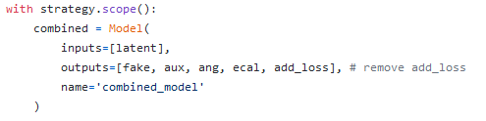
Backup Strategy code
IML 2020
Renato Cardoso | Accelerating GAN training using distributed tensorflow and highly parallel hardware

Slide 23

Backup TPU code
IML 2020
Renato Cardoso | Accelerating GAN training using distributed tensorflow and highly parallel hardware

Slide 24
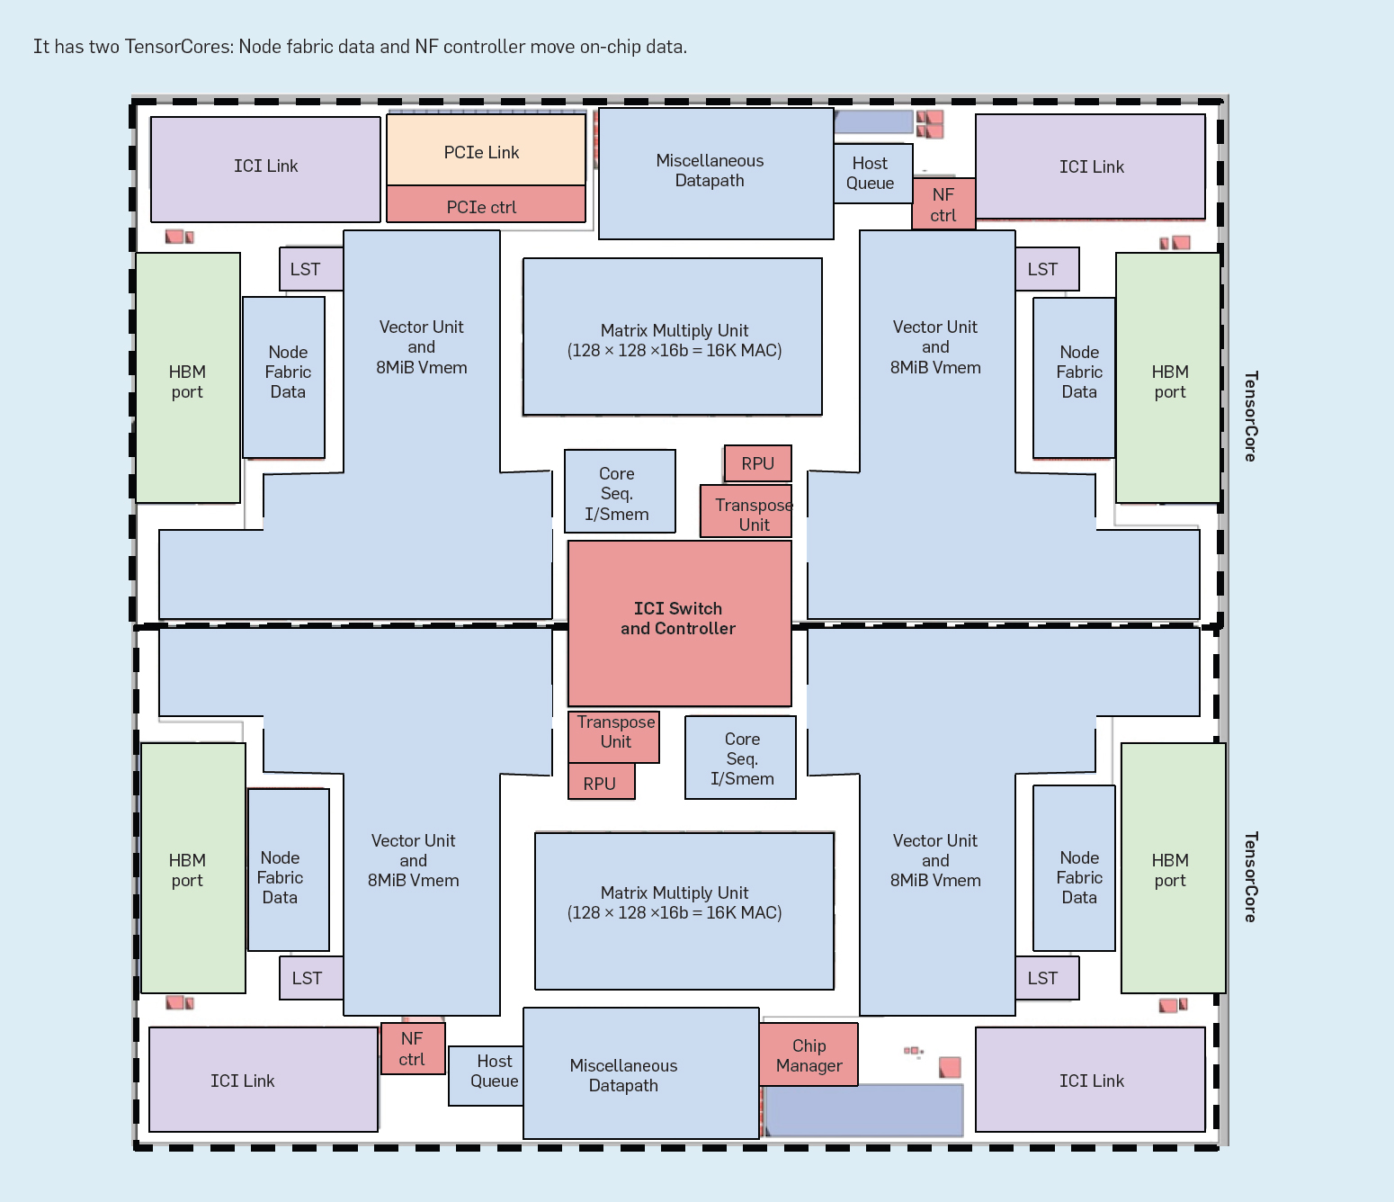
Full TPU Hardware
IML 2020
Renato Cardoso | Accelerating GAN training using distributed tensorflow and highly parallel hardware

