Slide 1



Welcome
Development of DC-DC Converters
-
Noise Studies at RWTH Aachen
ATLAS–CMS Power Working Group
31.03.2010
Lutz Feld, Rüdiger Jussen, Waclaw Karpinski,
Katja Klein, Jan Sammet

Slide 2
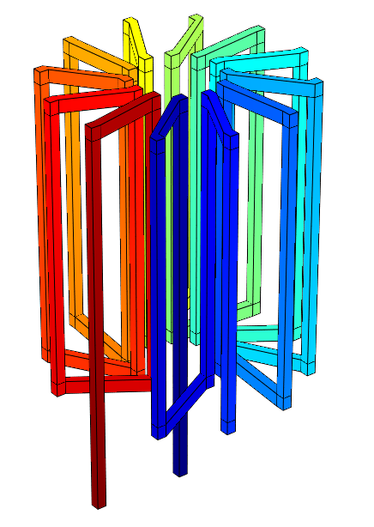
Welcome
Outline
DC-DC conversion
System tests
Measurement and simulation of radiated emissions
Radiated noise susceptibility

Slide 3
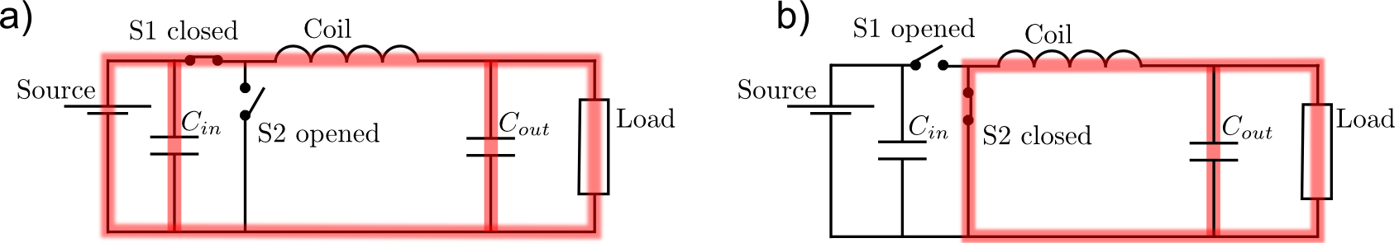
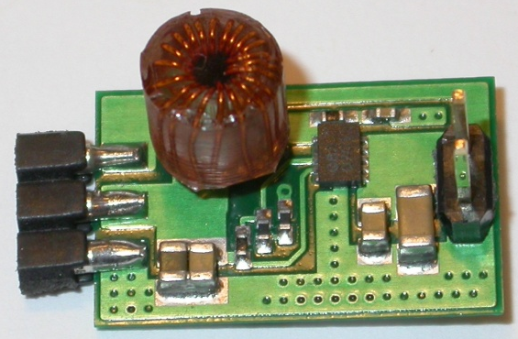
Welcome
DC-DC Buck Converters
Converter switches between
two states (ON/OFF)
Coil works as energy buffer
Conversion ratio r = V_{in}/V_{out}
ON
OFF
Conventional power supply
PS
Modul
Modul
Power supply with DC-DC Converters
PS
DC-DC
Modul
DC-DC
Modul
P = U·I = (rU) ·(I/r)
→ Voltage increases, current decreases
→ Power losses in cables P_{loss}=R·I² are reduced by factor r²
12mm
19mm

Slide 4
Welcome
DC-DC Buck Converters
Operation principle:
V_{out} is regulated via feed-back loop by
adjustment of duty cylce D = t_{on}/T
V_{out} = D V_{in} for lossless converter
Main parameters:
Conversion ratio r = V_{in}/ V_{out} ~ 2..10
Switching frequency f_{S} ~ MHz
Efficiency η = P_{out}/P_{in} ~80%
Output current I_{out} ~ A
Challenges:
Radiation hardness of transistors
High efficiency is mandatory
→ K. Klein’s talk
Handle switching noise
Use of air core coils mandatory due to
magnetic field (3.8T) of CMS
→ Current ripple leads to radiated noise
Total material budget should be reduced
despite addition of converters
Small size required for integration close to
detector modules

Slide 5
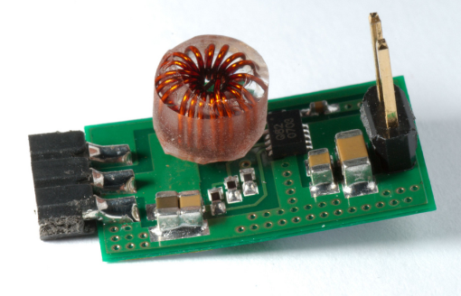
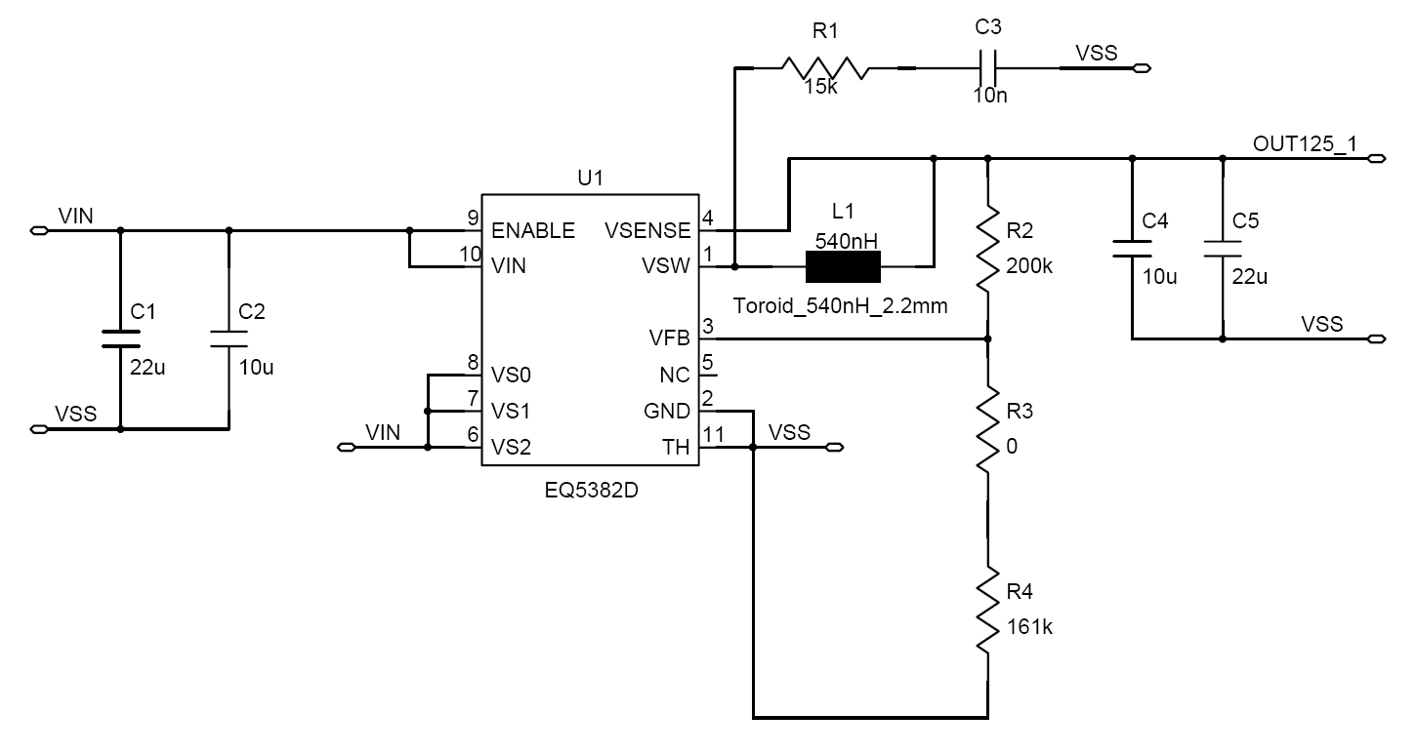
Welcome
R&D with Commercial ASICs
Buck converters with commercial non-radiation-hard chips
Used to optimize for low mass, low space, low noise, and for studies in system test
AC2
PCB:
2 copper layers a 35μm
FR4, 200µm
V = 2.3cm² x 10mm
m = 1.0g
12mm
19mm
Chip: Enpirion EQ5382D
V_{in} = 2.4-5.5V(rec.)/7.0V(max.)
I_{out} ≤ 0.8A
f_{s} ≈ 4MHz
Air-core inductor:
Custom-made toroid, ∅ ≈ 6mm
L = 200nH or 600nH
Input/output filters

Slide 6
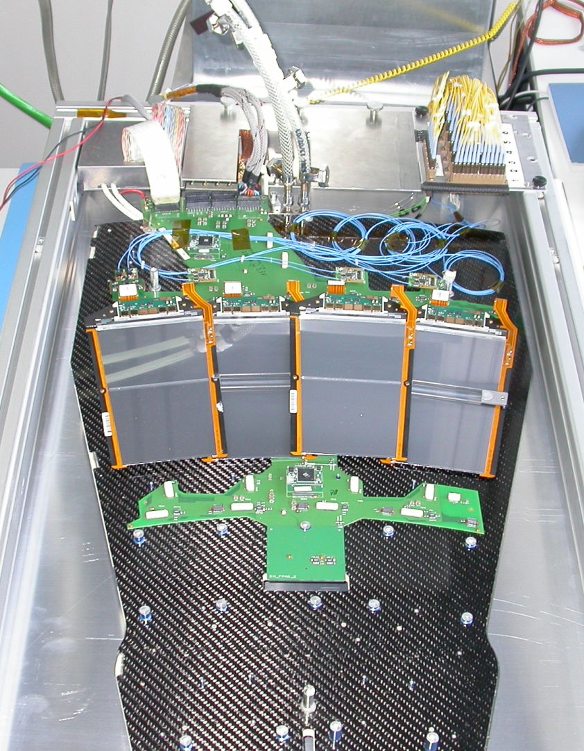
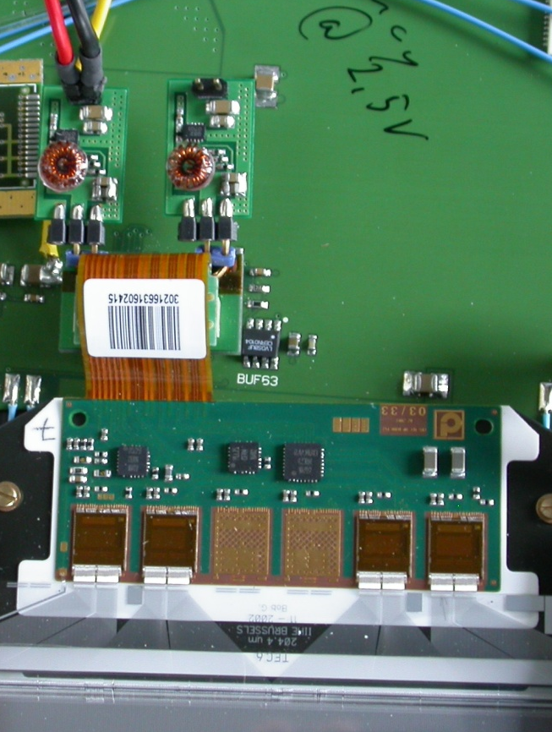
Welcome
System Test Set-Up
Two DC-DC converters per module
Integrated via additional adapter
V_{in} from lab power supply
TEC petal
APV25 readout chip:
0.25 µm CMOS
128 channels
- analogue readout
- per channel: pre-amp.,
CR-RC shaper, pipeline
- τ = 50ns
- 1.25V & 2.50V supply
- I₂₅₀ = 0.12A, I₁₂₅ = 0.06A
Ring 6 modules
6.4
6.3
6.2
6.1
Motherboard

Slide 7
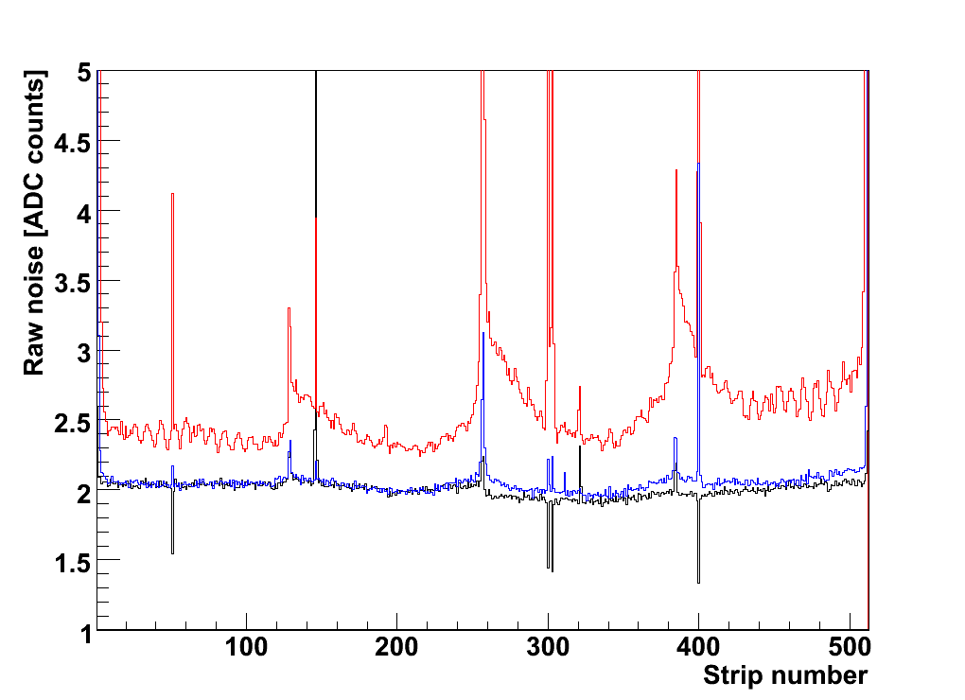
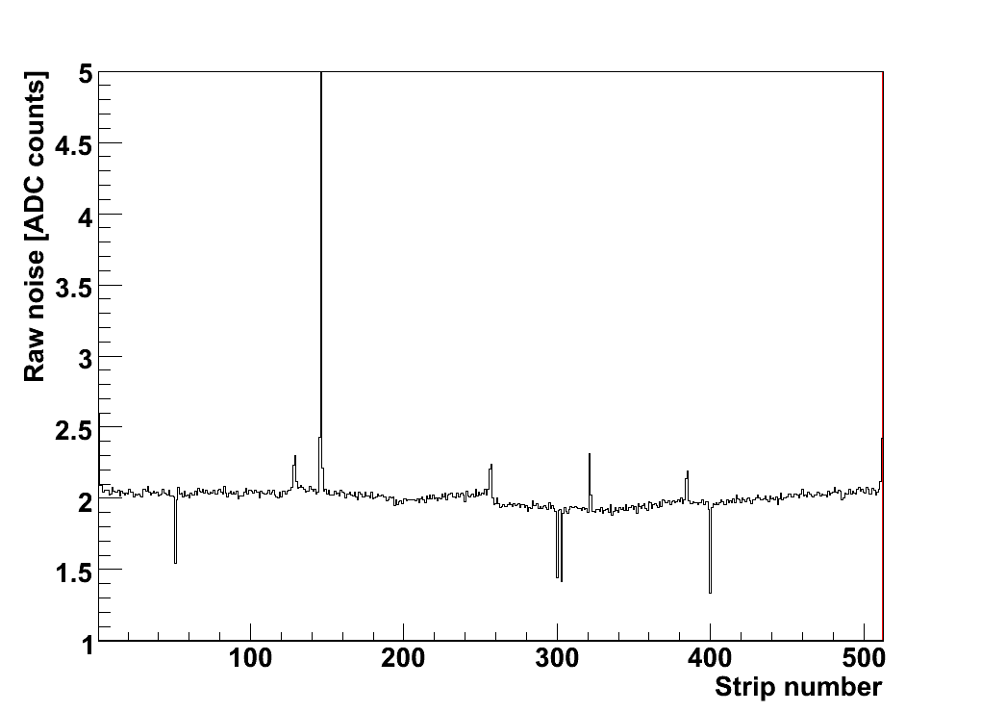
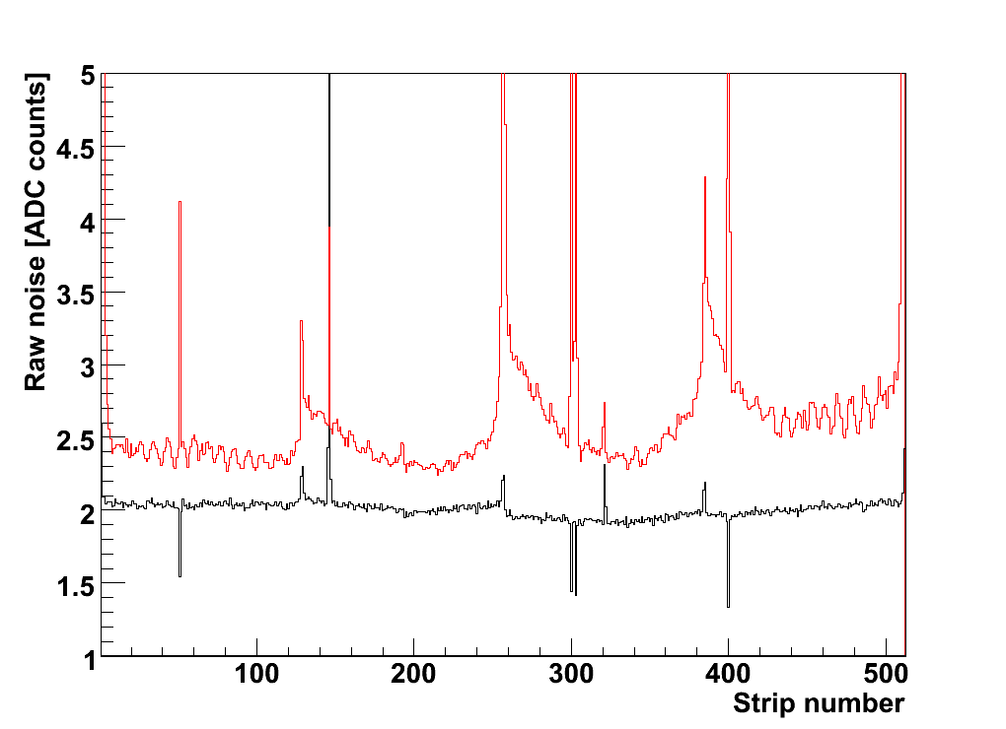
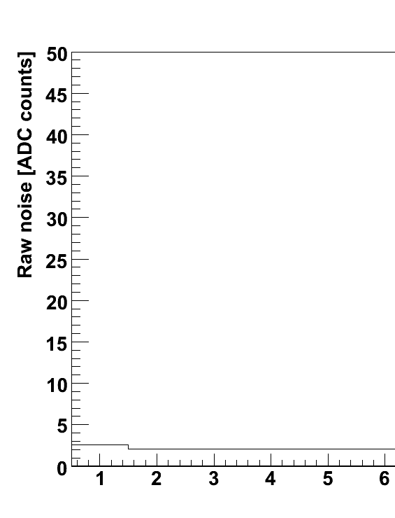
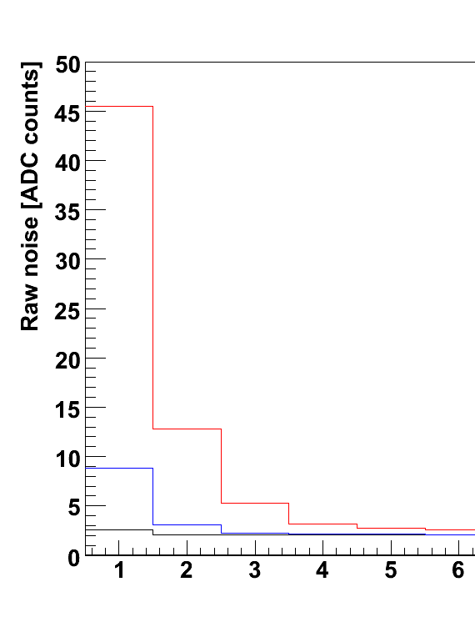
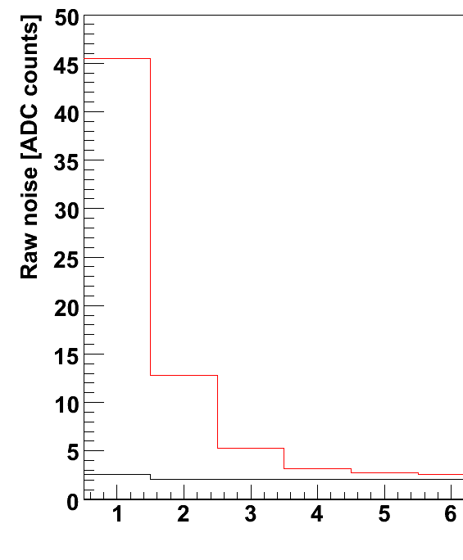
Welcome
System Test with CMS Strip Modules
Zoom onto edge channels
--- Conventional powering
--- DC-DC converter (AC1, 2008)
--- DC-DC converter (AC2, 2009)
--- Conventional powering
--- DC-DC converter (AC1, 2008)
--- Conventional
powering
--- DC-DC converter
(AC1, 2008)
Conventional
powering
--- Conventional
powering
--- DC-DC converter
(AC1, 2008)
--- DC-DC converter
(AC2, 2009)
Conventional
powering
{
1 APV = 128 strips
Raw noise: RMS of fluctuation around pedestal value
Edge channels are particularly sensitive (feature of APV25)
Large increase with previous generation of boards (AC1), in particular on edge strips
Focus on most sensitive indicator:

Slide 8
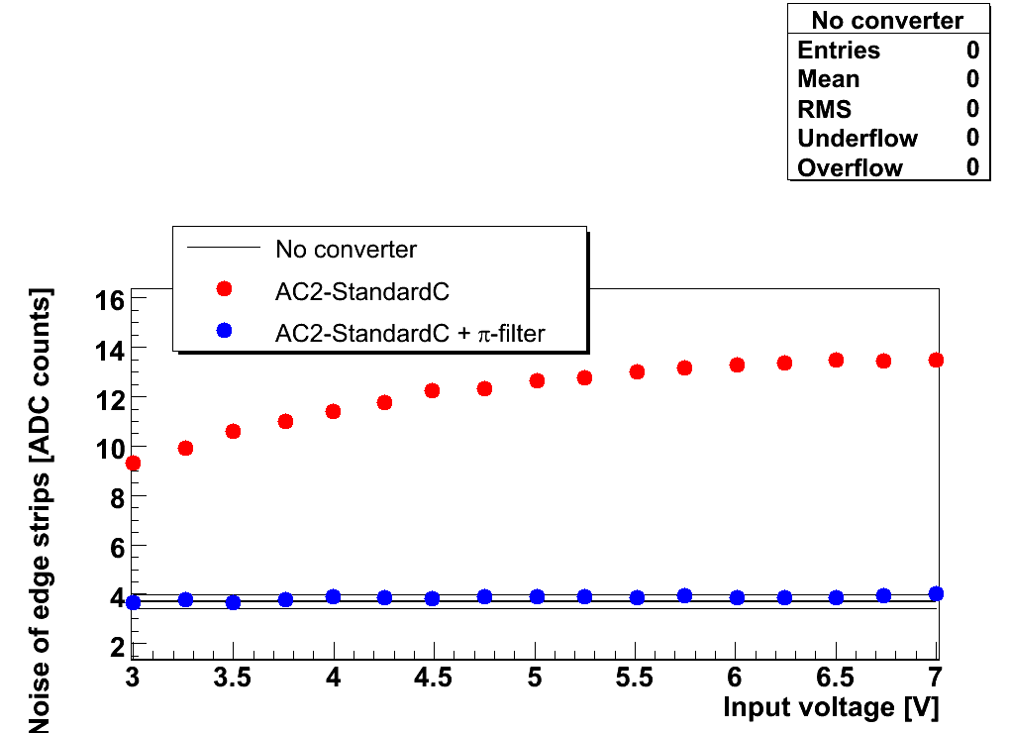
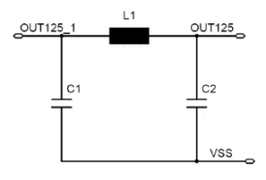
Welcome
Results with Commercial Converters
4 MHz, conversion ratio up to 5.6, output current ~0.5 A
No shielding
Simple pi filter suppresses conductive noise efficiently
Current ripple at inductor:
D decreases
with Pi filter
→ DC-DC powering without any noise increase is feasible

Slide 9
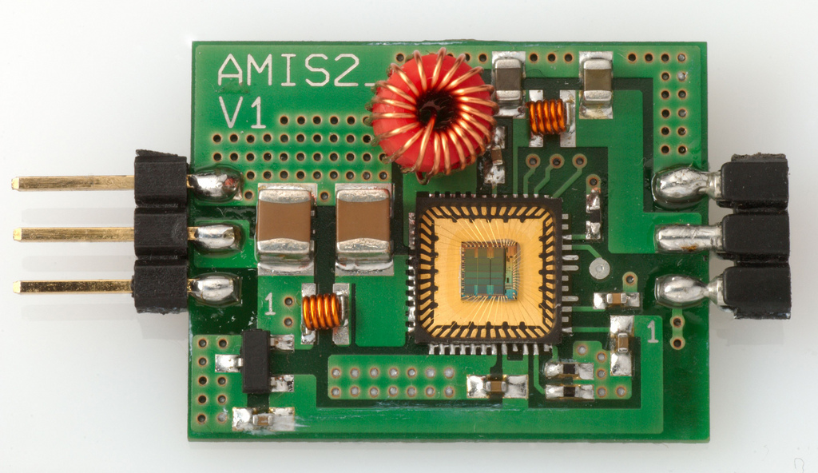
Welcome
Aachen Converters with AMIS2 ASIC
Radiation levels at 22cm & 3000fb⁻¹: fluence ~ 10¹⁵/cm² , dose ~ 1MGy
Two candidate technologies identified by F. Faccio, CERN [contrib. to TWEPP 09]
ASICs developed by S. Michelis, CERN [contrib. to TWEPP 09]
PCB:
2 copper layers a 35μm
FR4 1mm
V = 19x25mm² x 10mm
m = 2.5g
19mm
Chip: AMIS2 by CERN
V_{IN} = 6-12V (8.5V)
I_{OUT} < 3A
V_{OUT} = 1.2V and 2.5V
f_{S} ≈ 0.6…4MHz (1MHz)
(programmable via resistor)
25mm
External air-core inductor:
Custom-made toroid, ∅ ≈ 6mm,
height = 7mm, L = 600nH, R = 80mΩ
Input and output π-filters (Butterworth)
L = 12.1nH, C = 22µF, f_{cut} = 0.34MHz

Slide 10
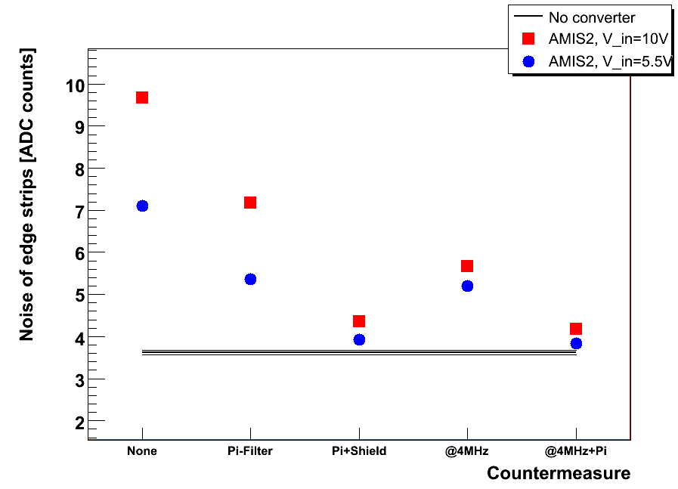
Welcome
Results with AMIS2 based Converters
Impact of input voltage
(duty cycle) is always visible
Influence of pi-filter remains
but is not sufficient
Shielding reduces noise
significantly (at 1MHz)
→ Radiated noise
If f_{s} = f_{s} of commercial chip = 4MHz
→ Very little noise even w/o shielding
→ Improve filters/shielding
→ Avoid shielding
→ Increase efficiency at 4 MHz (however susceptibility of future modules might be different)
→ Improve coil/converter design

Slide 11
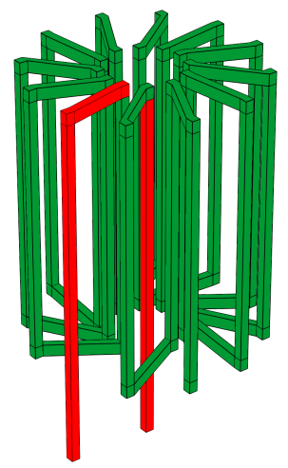
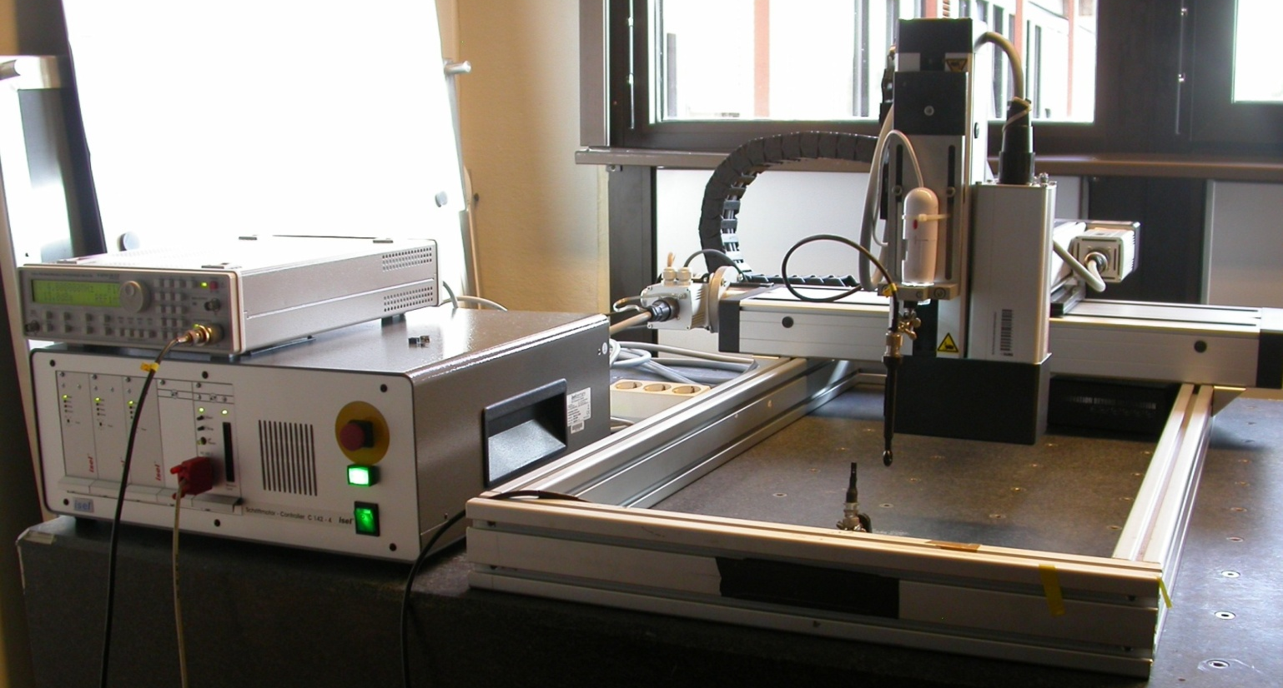
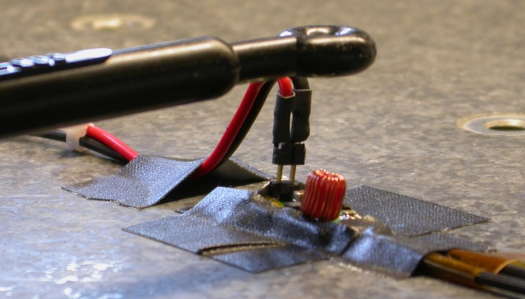
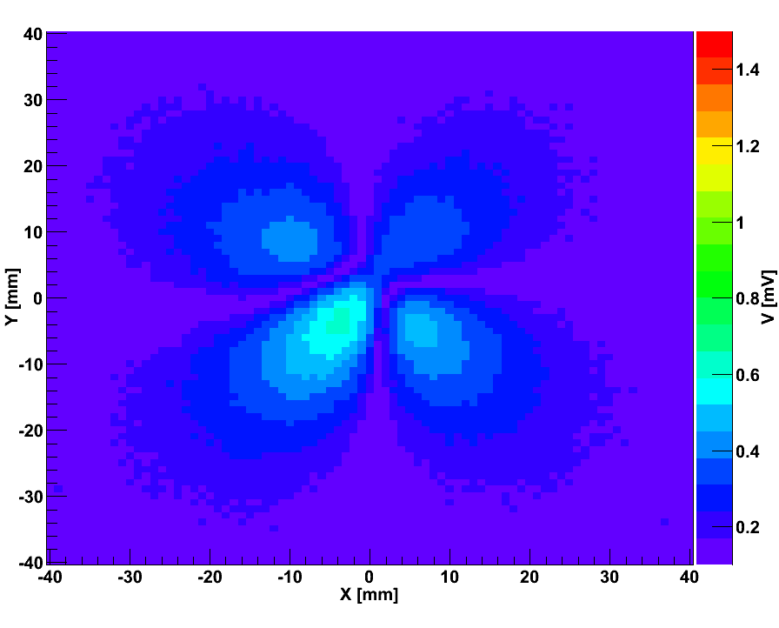
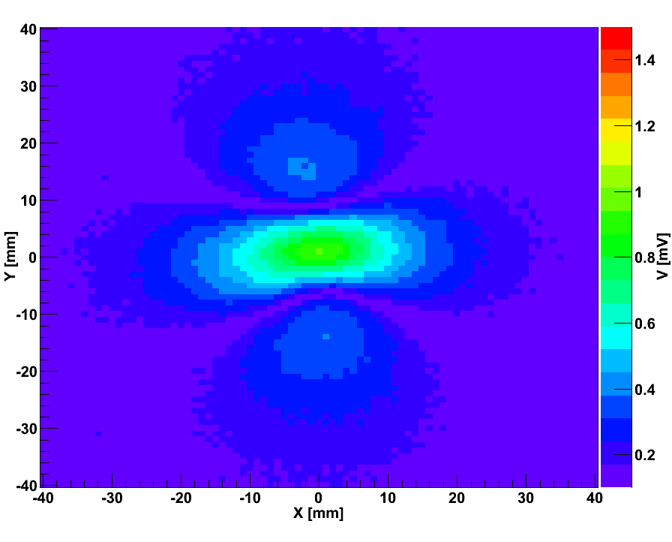
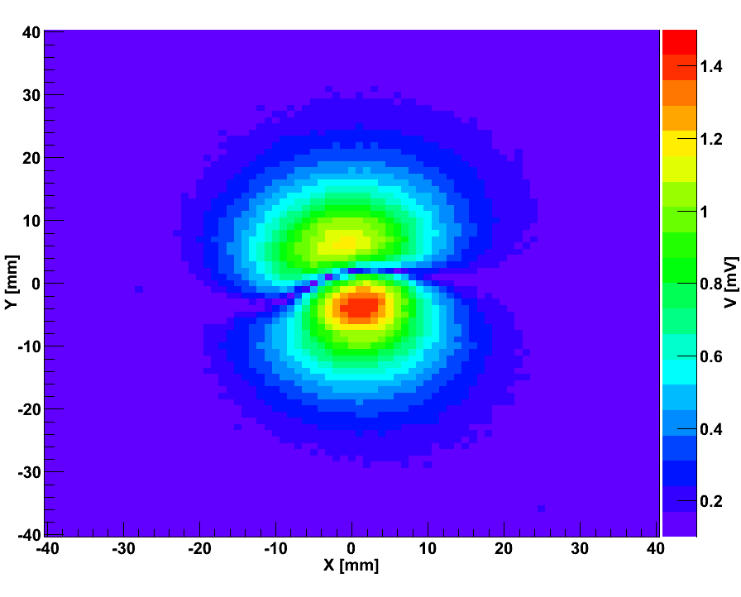
Welcome
Measurement of Magnetic Field
Z
Y
X
Set-Up
Measurement of B_{Z}
B_{x}
B_{y}
B_{z}
Measured field seems to be superposition of perfect toroid with field of single wire loop
→ Multi-polar shape

Slide 12
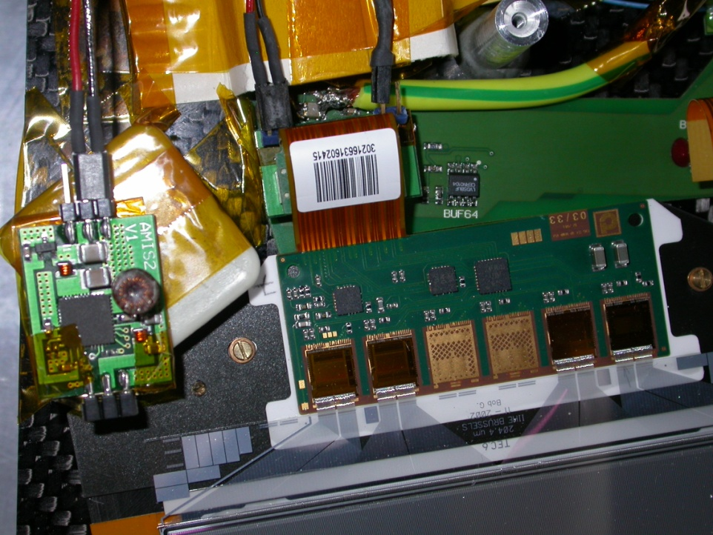
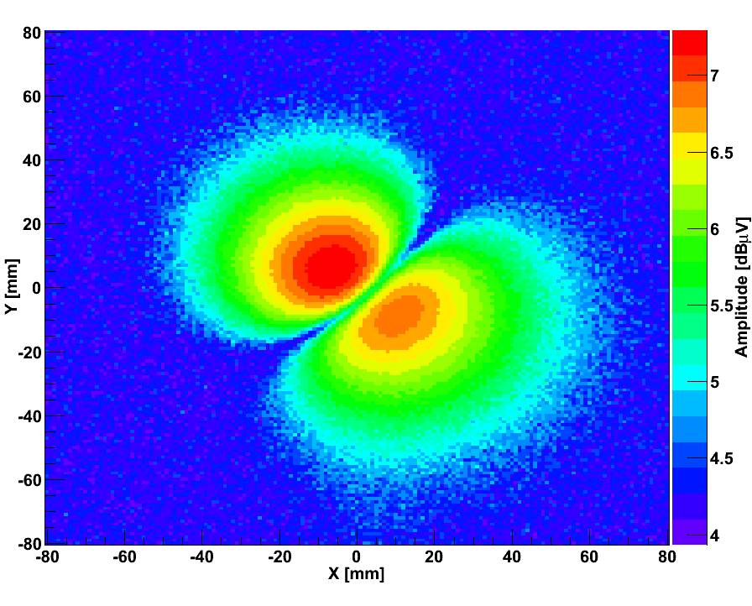
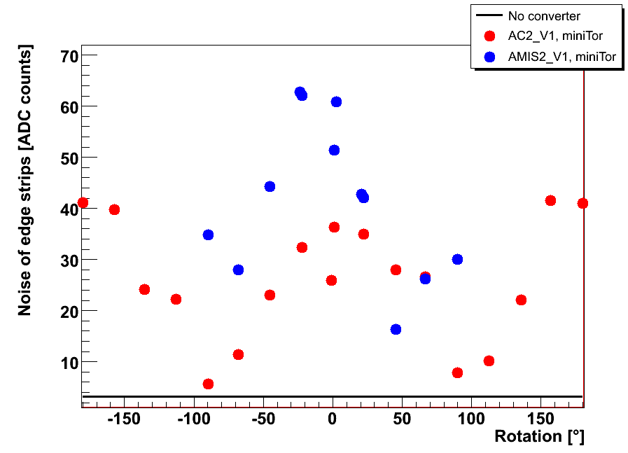
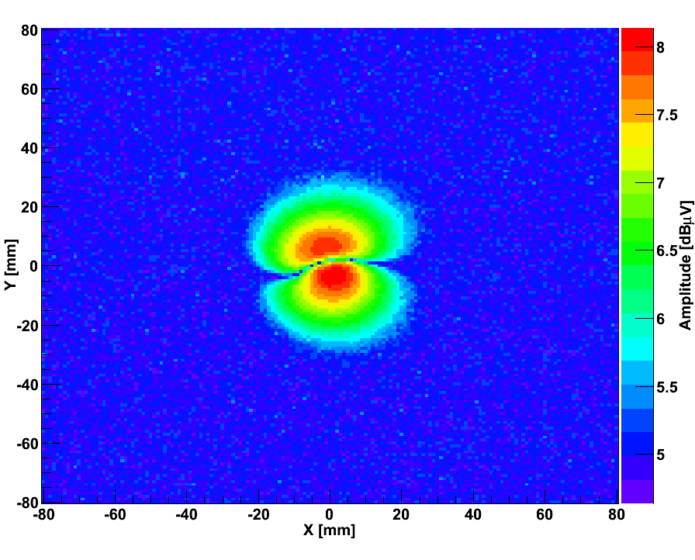
Welcome
Angle Depend System Tests
90°
-90°
0°
AC2-StandardC
V_{in}=5.5V, V_{out}=2.5V, f_{s}=4MHz
Measurement confirms angle dependency
Module noise mainly affected by B_{Z}
AMIS2-V1
V_{in}=8.5V, V_{out}=2.5V, f_{s}=1.3MHz

Slide 13
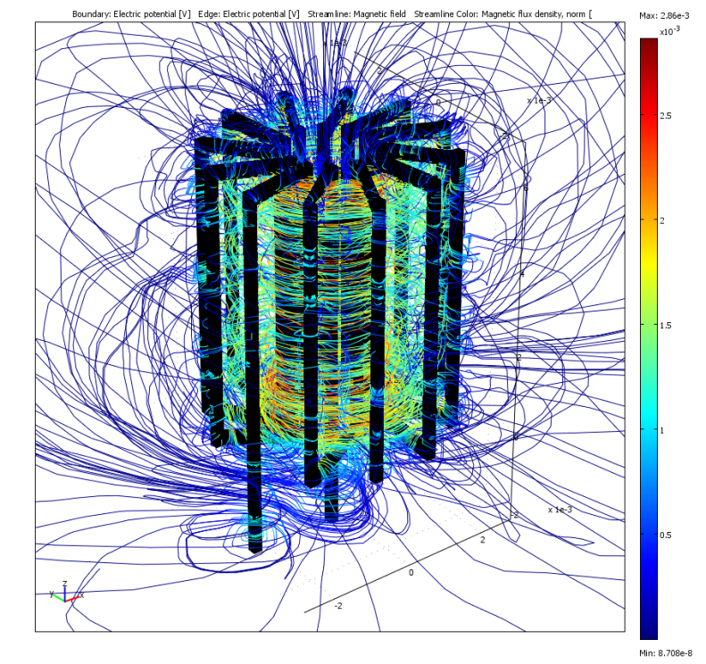
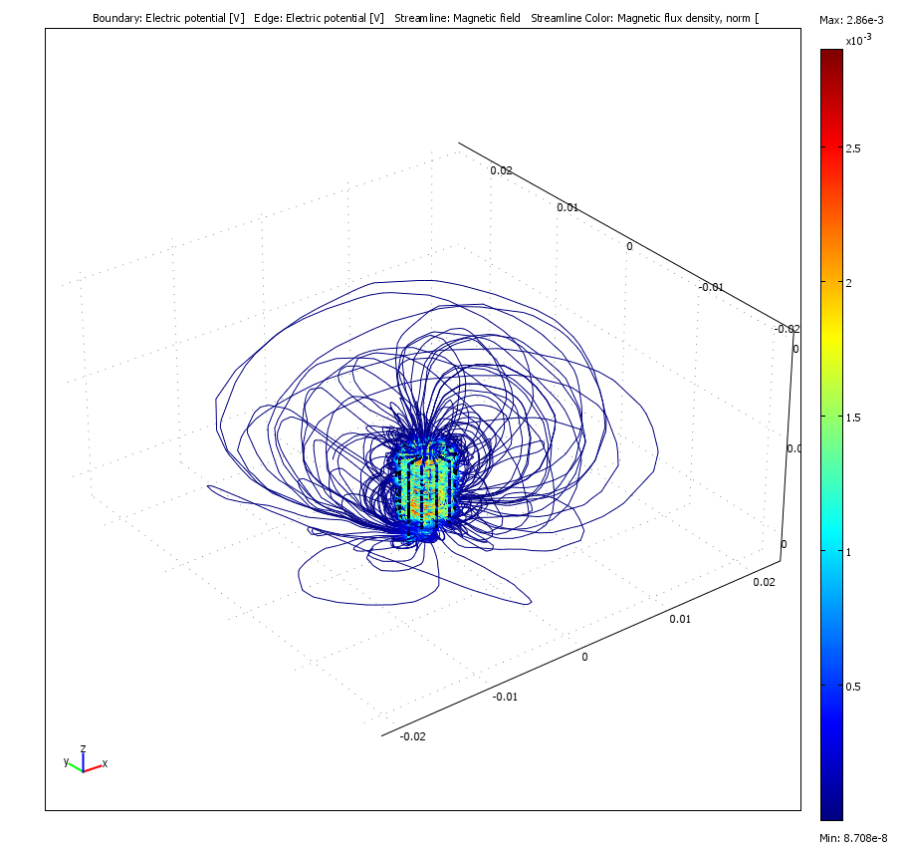
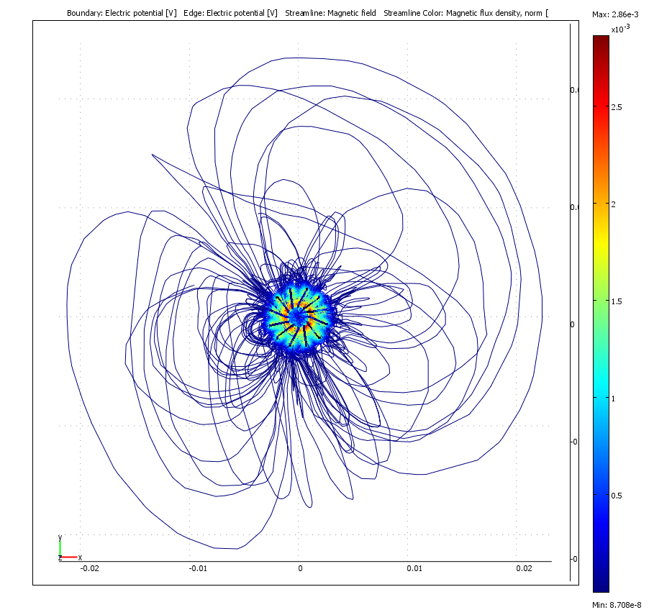
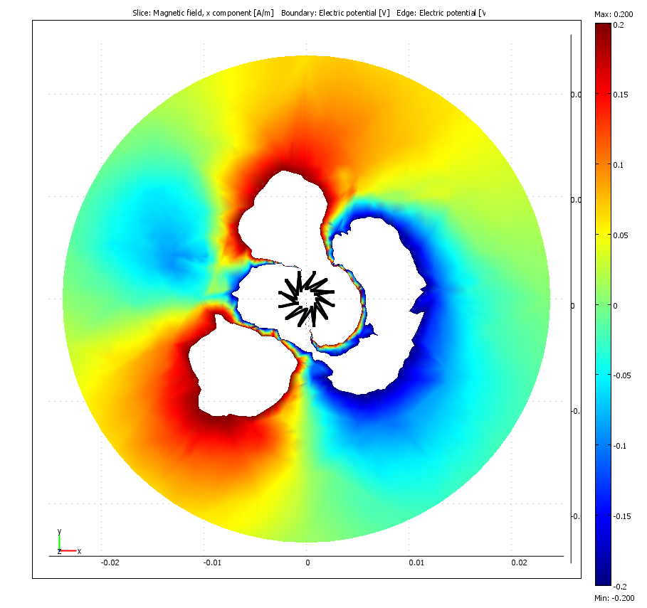
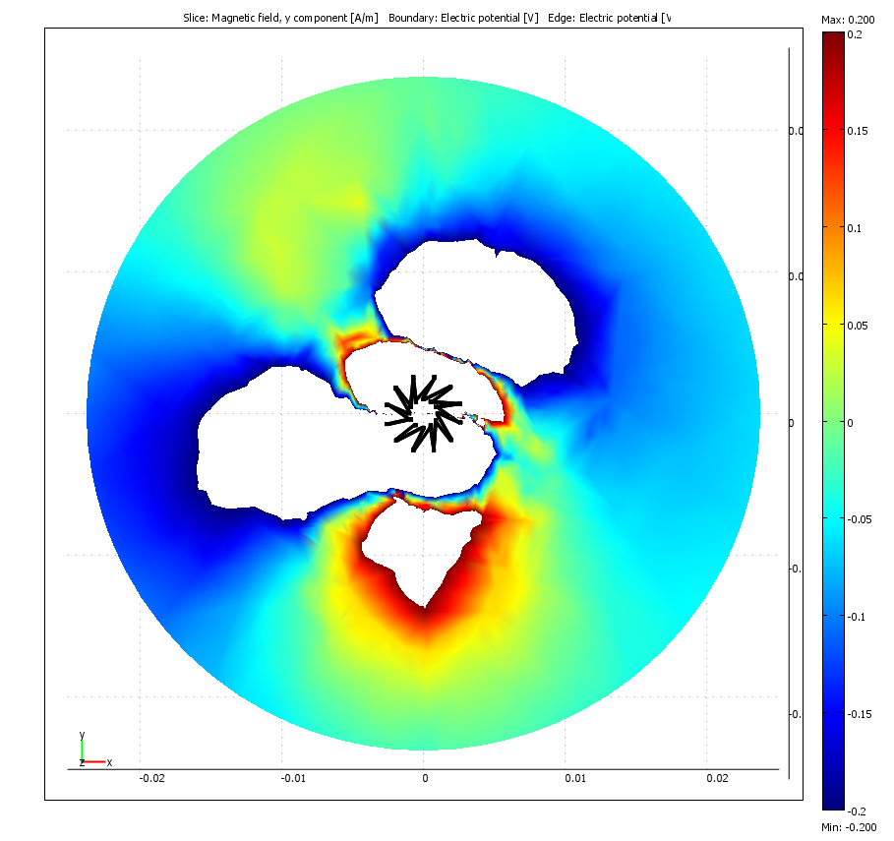
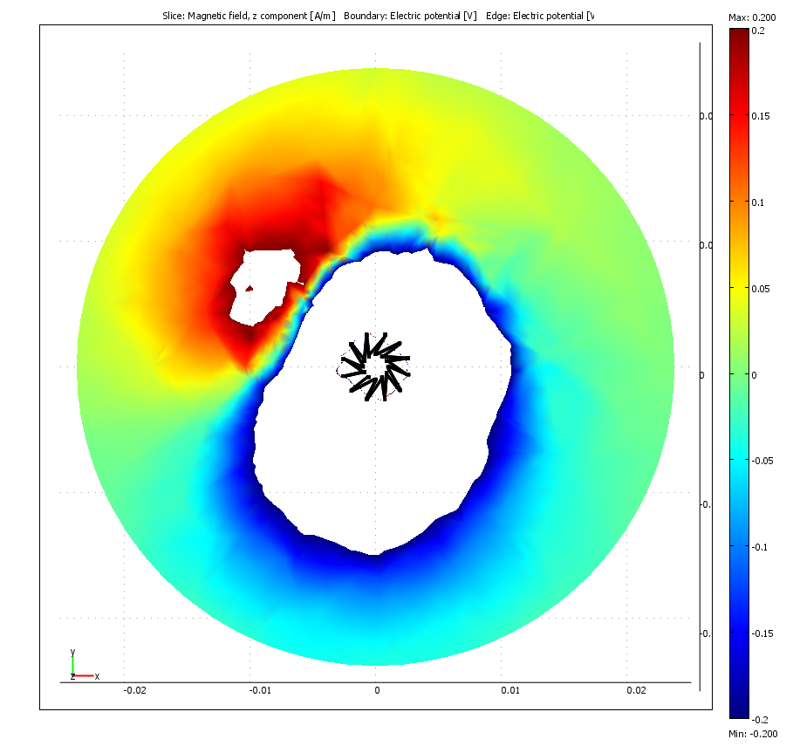
Welcome
FE Simulation mit „COMSOL Multiphysics”
DC-Simulation
12 Windungen
R_{i} = 1.1mm
R_{a} = 5.0mm
h = 6.0mm
Magnetic field lines
B_{X} [A/m]
B_{Y} [A/m]
B_{Z} [A/m]
Simulation confirms measurement
White areas in the centre are
caused by under/over flow

Slide 14
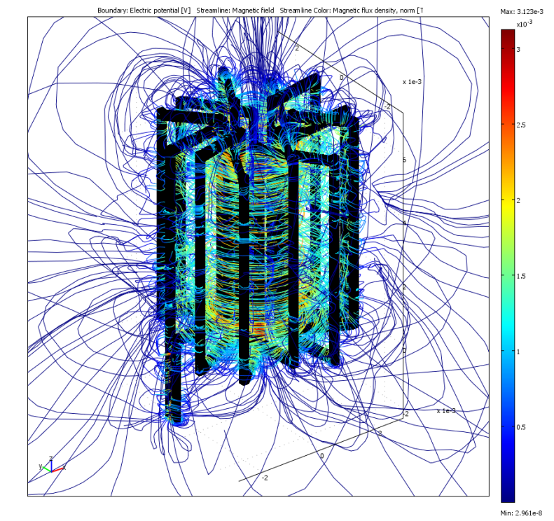
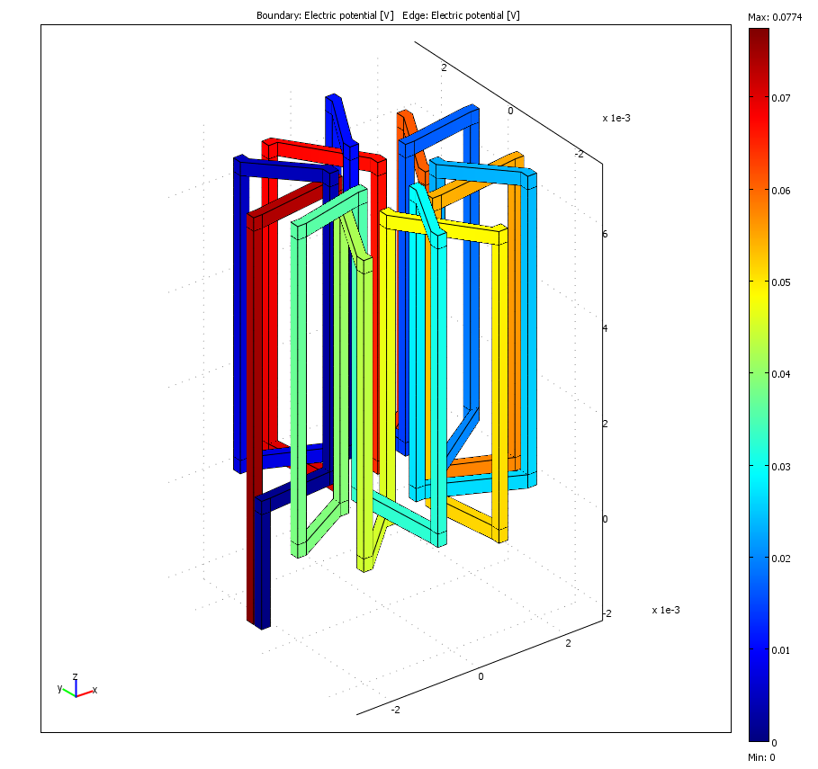
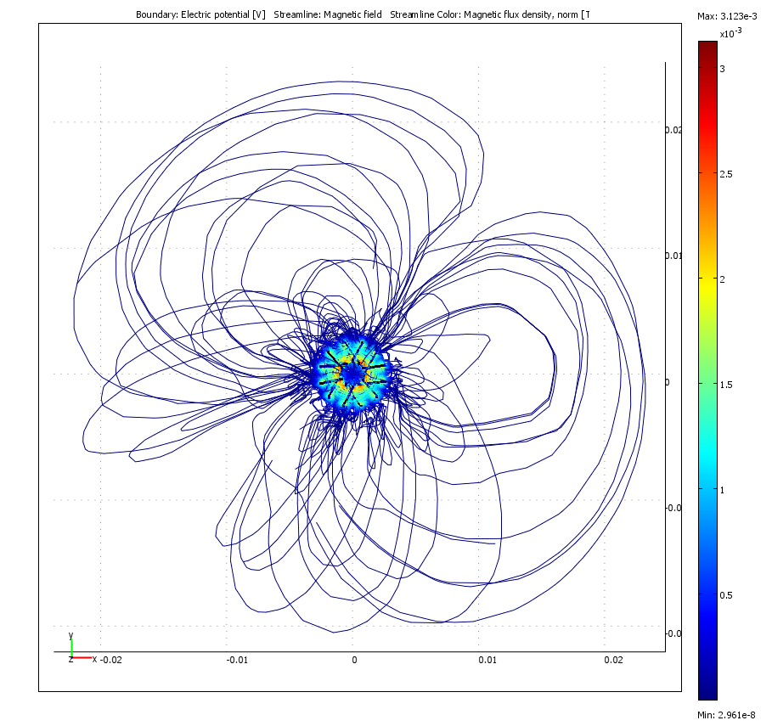
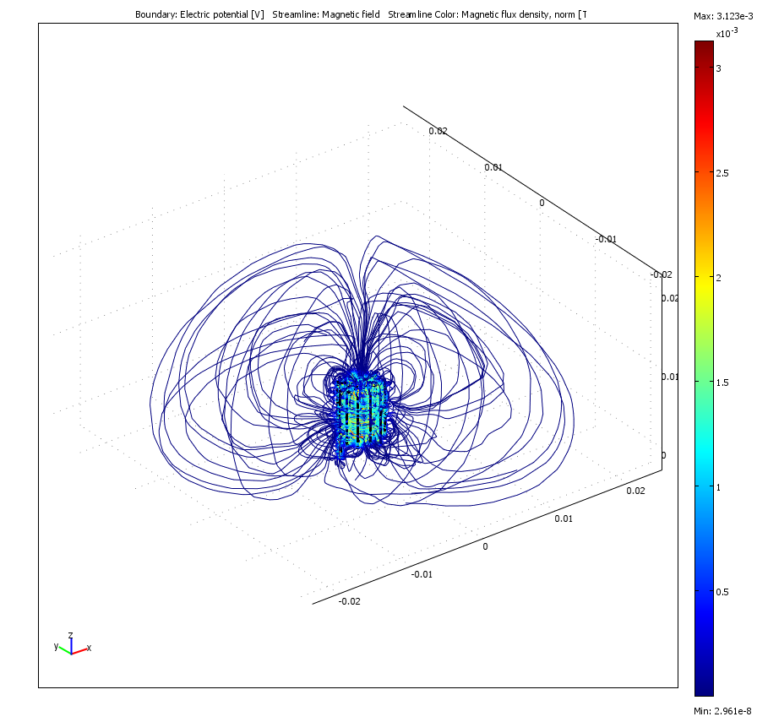
Welcome
Coil Optimization
Electric Potential
DC Simulation
12 turns
R_{i} = 1.1mm
R_{a} = 5.0mm
B-field
(from above)
Simplified
coil model
Magnetic Field Lines
Inductance decreases
slightly (196nH → 189nH)

Slide 15
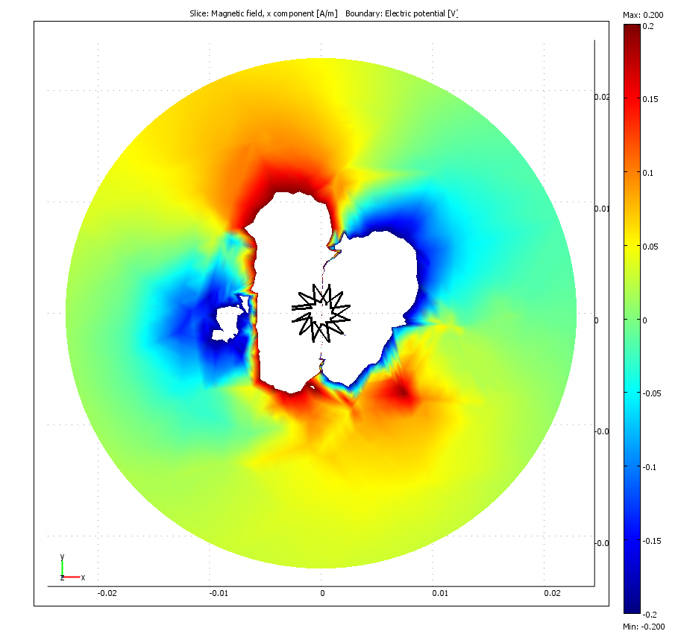
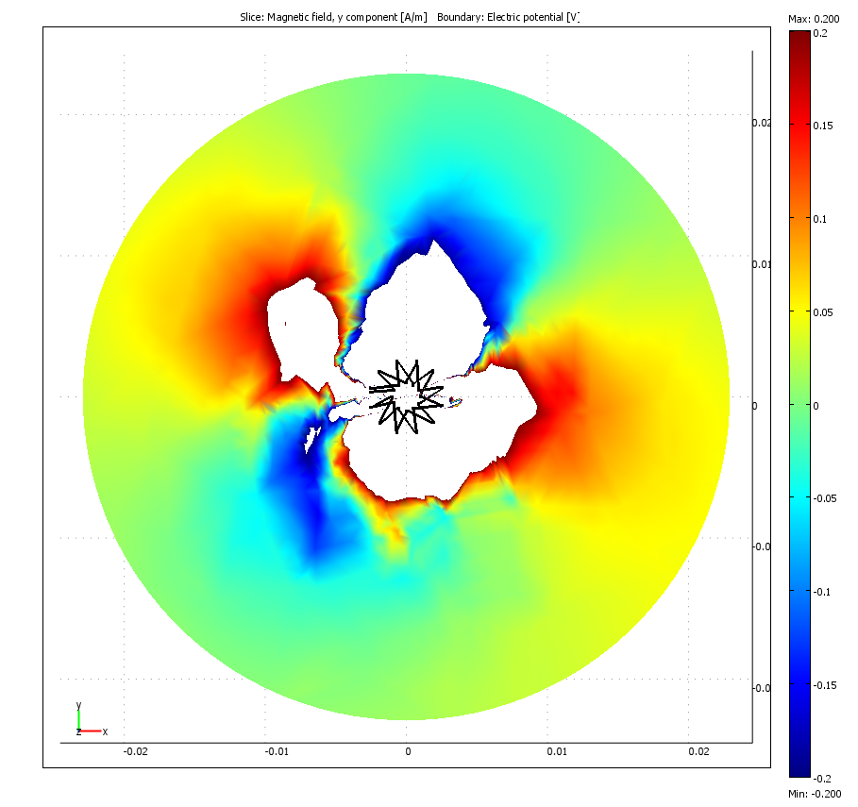
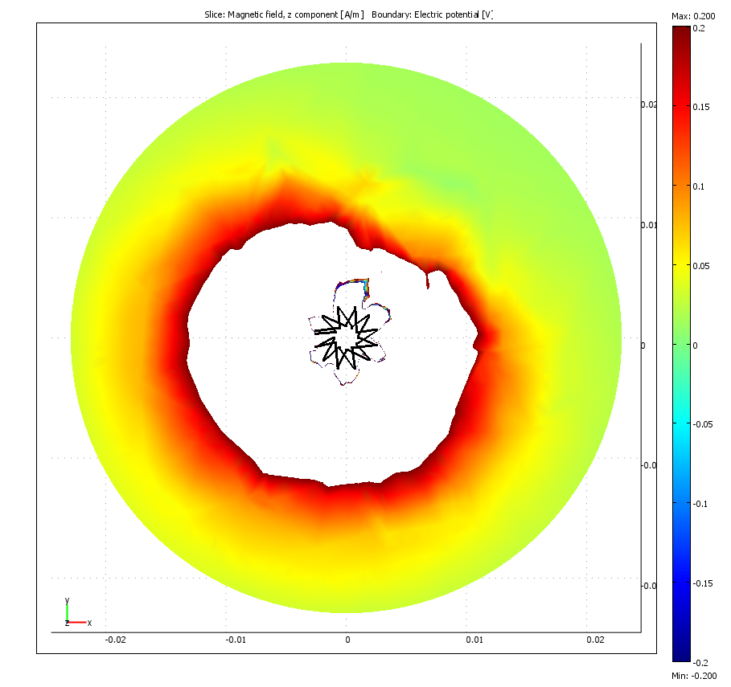
Welcome
B-Field-Slice, 1mm above coil
0.2
0.2
0.2
B_{X} [A/m]
B_{Y} [A/m]
B_{Z} [A/m]
Standard
Toroid
-0.2
-0.2
-0.2
0.2
0.2
0.2
B_{X} [A/m]
B_{Y} [A/m]
B_{Z} [A/m]
-0.2
-0.2
-0.2
“Single Loop Effect” is still present but weakened
Amplitudes of field decrease

Slide 16
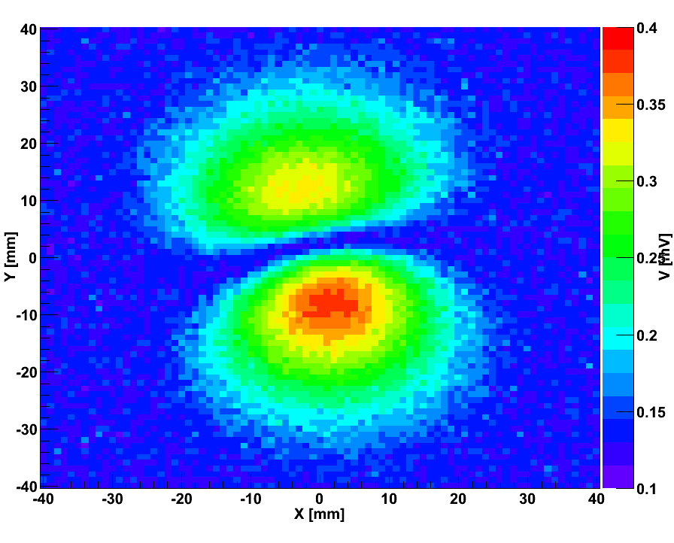
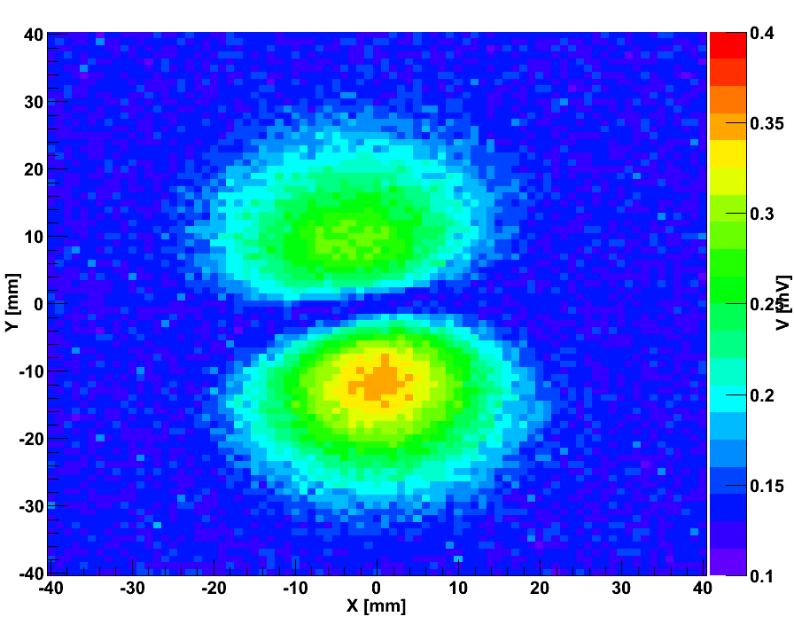
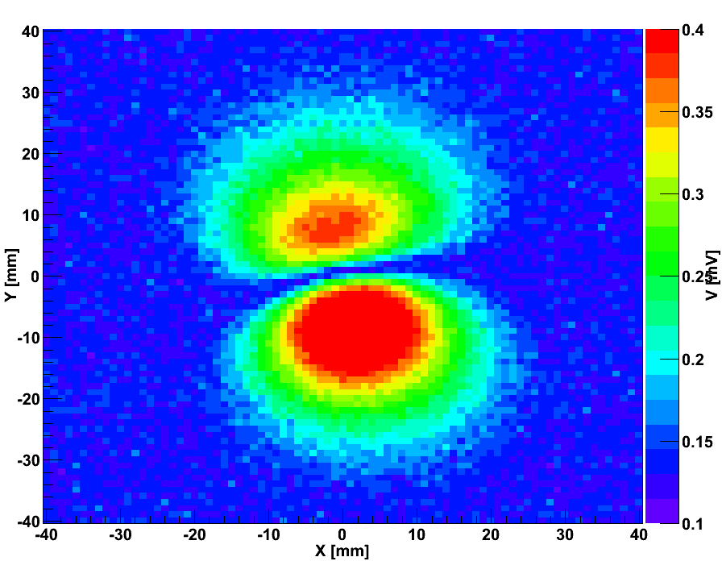
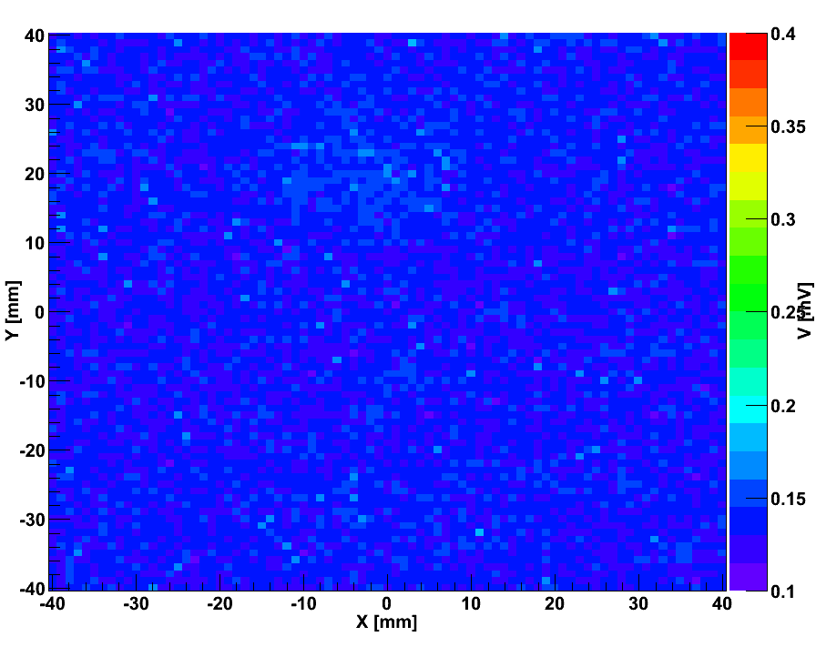
Welcome
Effect of 30µm Aluminium Shielding
B_{Z}-Field of AMIS2-V1, V_{in}=8.5V, V_{out}=2.5V, f=1.3MHz, L=600nH
No shielding
Inductor only
PCB only
Complete converter
Shielding only the inductor is not sufficient
B-field not measurable when converter is completely encased

Slide 17
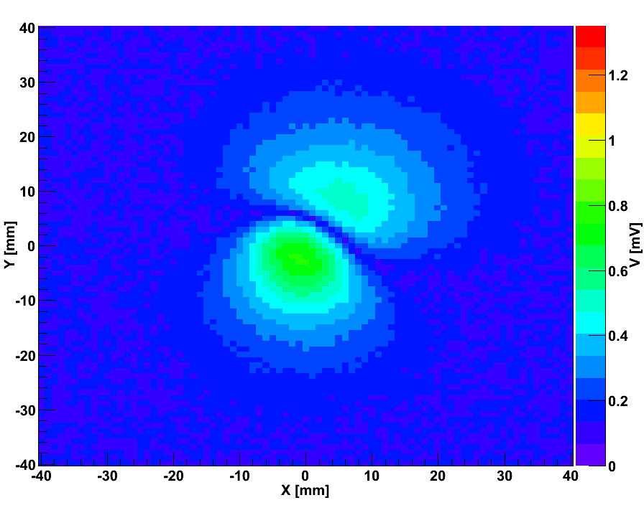
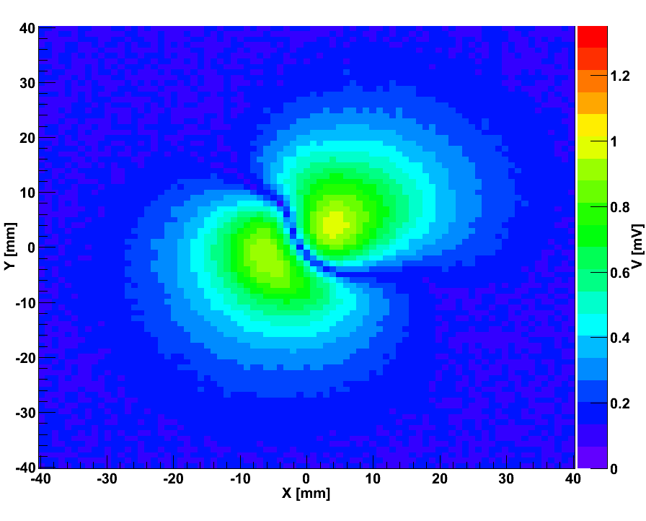
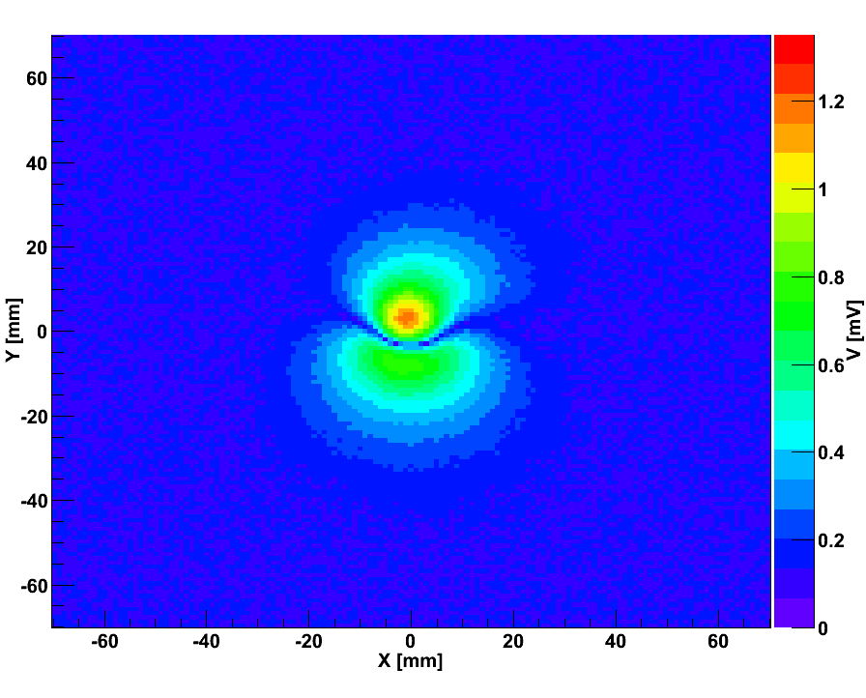
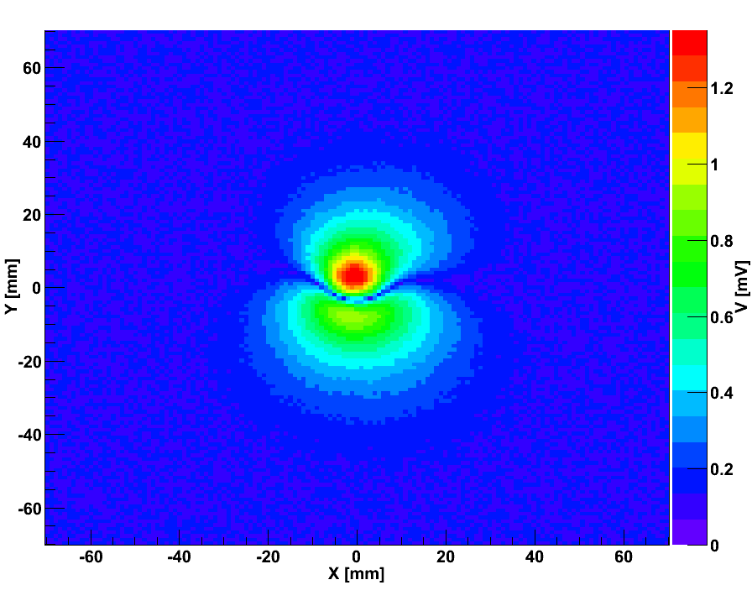
Welcome
Influence of Inductance and Input Voltage
B_{Z} of AMIS2-V2, V_{in}=8.5V, V_{out}=1.25V, f=1.3MHz
L decreases
L=600nH
L=200nH
B-Field of AMIS2-V2, V_{out}=2.5V, f=1.3MHz, L=600nH
V_{in}=5.5V
D decreases
V_{in}=11V
→ Emitted B-filed depends on current ripple ΔI_{L}
→ Radiated and conducted noise are linked

Slide 18
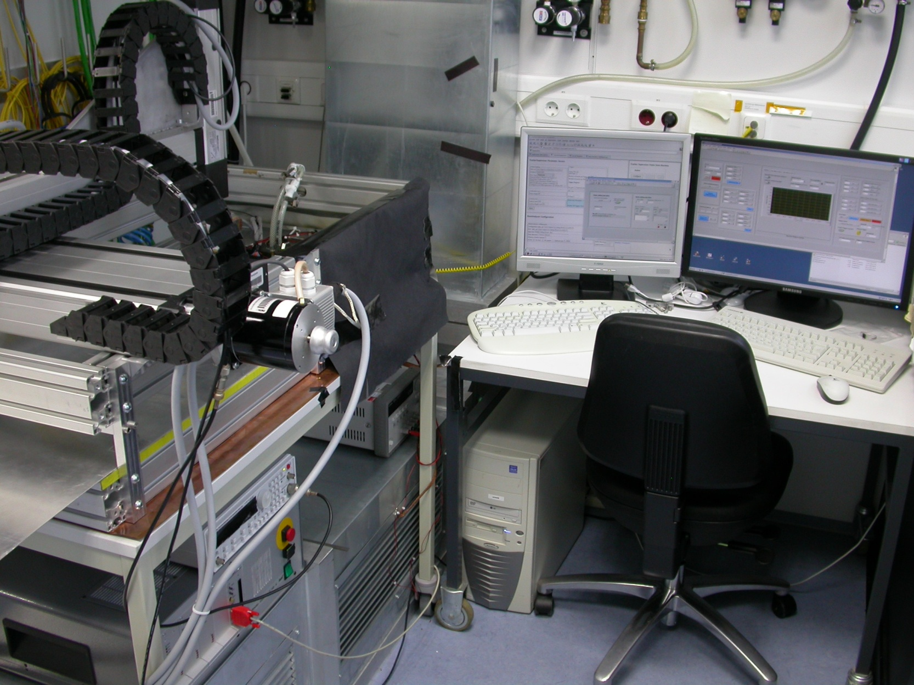
Welcome
Radiated Noise Susceptibility
xDaq
← TCP/IP →
Axes Control
isel Axes
B-Field
injection
E-Field
injection
Move B-Field / E-Field
source above modules
Record module noise
Frequency: 4MHz
Amplitude: fixed but
arbitrary
TEC Petal
BNC
cable
BNC
cable
Sinus Generator
Closed
loop
Open
loop

Slide 19
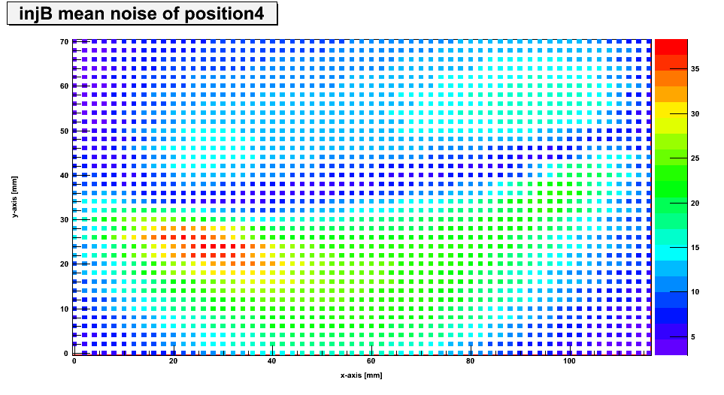




Welcome
Electromagnetic Susceptibility
Noise of edge strips [ADC Counts]
Noise of edge strips [ADC Counts]
y [mm]
y [mm]
Inject B
x [mm]
x [mm]
Noise of edge strips [ADC Counts]
Noise of edge strips [ADC Counts]
y [mm]
y [mm]
Inject E
x [mm]
x [mm]
Scanned area: 116mm x 70mm, Z≈10mm
Step size: 2mm x 2mm
Interpretation difficult due to form/size of injected
B-field and on-chip CM subtraction
Further tests are ongoing
Injected B_{Z}
at Z≈10mm

Slide 20
Welcome
Summary
Present CMS strip modules can be DC-DC powered without a significant increase in noise
Further R&D is needed to reduce noise at:
- Large conversion ratios
- Smaller frequencies (higher efficiencies)
- Without shielding
Measurements and simulations have revealed a multipolar magnetic field
Present modules seem to be affected mostly by the emitted B_{Z} component
Current ripple affects both conducted and radiated noise
Simulations indicate that further improvements in coil design are possible but difficult
Noise susceptibility measurements with E- and B-fields have begun

Slide 21
Welcome
Back-Up Slides...

Slide 22




Welcome
Conducted Switching Noise
Load
LISN = Line Impedance
Stabilization Network
Spectrum
Analyzer
AC2 Diff. Mode
V_{in}=5.5V, V_{out}=1.3V
AC2 Diff. Mode
V_{in}=5.5V, V_{out}=1.3V
Impact on detector system depends on its frequency dependent susceptibility

Slide 23



Welcome
Influence of the Switching Frequency
δV_{out} ~ 1/f²
→ Noise of AMIS2 converter decreases
for higher frequencies
→ Noise wings shrink (2.5V)
Enpirion ASIC on AC2 works at 4MHz
→ Wings do not appear
Wings often indicate non-conductive noise
Modules might be less sensitive at 4MHz

Slide 24



Welcome
Noise Susceptibility of APV25 Strip Modules
Bulk current injection (BCI) method used
A noise current of 70dBμA (I_{eff} = 3.16mA) is injected into the power lines
  Differential Mode (DM) and Common Mode (CM) on 2.5V and 1.25V
CMS
Module
From 1 to 4 MHz susceptibility increases
However influence of radiated noise is
bigger at 1 MHz
→ Amount of radiated noise is much
smaller at 4 MHz
and/or
Radiated noise susceptibility of the
modules is higher at 1 MHz

Slide 25

Welcome
Set-Up to Measure Electromagnetic Fields
Scanning Table
Three axes
Automated control via Labview
B-Field Probe
Diameter: 1cm
Loop:
- 50 ohm coax
- center conductor and shield are 360°
soldered to the shield at the shaft
- notch cut at the high point of the loop
creates balanced E-field shield
E-Field Probe
50 ohm coax
6mm of the centre conductor exposed at the tip
Data Taking
To avoid false signals from other sources a
spectrum analyzer is used to measure the induced
voltages only within a small range of frequencies
Set-Up
Z
Y
X
Measurement of B_{Z}
E-Field Probe

Slide 26

Welcome
B-Field & E-Field of AMIS2-V1 (V_{out}=2.5V)
B_{x}
B_{y}
B_{z}
Notice the different scales
in size and amplitude
Measured B-field does not correspond to
the expected field of a toroid, but to the
field of single current loop
→ Multi-polar shape
Measured E-field is much smaller than B-field
(which could also be a feature of the probe)
E-field and B-field measurements do not seem
to affect each other
- E-field amplitude is rotation symmetric
- B-field components are shaped multi-polar
|E|

Slide 27



Welcome
Influence of Output Voltage and Frequency
B_{Z} of AMIS2-V2, V_{in}=8.5V, L=600nH (mini toroid)
Current ripple increases
with V_{out}
→ B-field is amplified
Measured field increases
with frequency
Unexpected since δV~1/f²,
not consistent with system
tests (could be a feature
of this set-up)
V_{out}=1.25V, f=1.3MHz
V_{out}=2.5V, f=1.3MHz
V_{out}=1.25V, f=4MHz
V_{out}=2.5V, f=4MHz

Slide 28




Welcome
Inhomogeneous Toroid
Electric Potential
DC Simulation
12 turns
R_{i} = 1.1mm
R_{a} = 5.0mm
h = 6.0mm
L_{theo} = 260 nH
L_{sim} = 193 nH
B-field
(from above)
Simplified
coil model
Magnetic Field Lines
Inductance decreases
slightly (196nH → 193nH)

Slide 29






Welcome
Inhomogeneous Toroid – B-Slice, z = +1mm
28
42
60
B_{X} [A/m]
B_{Y} [A/m]
B_{Z} [A/m]
-25
-30
-27
0.2
0.2
0.2
B_{X} [A/m]
B_{Y} [A/m]
B_{Z} [A/m]
-0.2
-0.2
-0.2
Max. amplitudes decrease
Field grows in size Field strength is reduced

Slide 30




Welcome
Toroid with Bended Feeds
Electric Potential
DC Simulation
12 turns
R_{i} = 1.1mm
R_{a} = 5.0mm
L_{theo} = 260 nH
L_{sim} = 199 nH
B-field
(from above)
Simplified
coil model
Magnetic Field Lines
Inductance increases
slightly (196nH → 199nH)
most likely due to longer feeds

Slide 31









Welcome
Toroid with Bended Feeds – B-Slice, z=+1mm
28
18
23
B_{X} [A/m]
B_{Y} [A/m]
B_{Z} [A/m]
-20
-37
-59
2
2
2
B_{X} [A/m]
B_{Y} [A/m]
B_{Z} [A/m]
±0.2
-2
±0.2
-2
±0.2
-2
Magnetic field grows in strength and size

Slide 32




Welcome
Toroid with Crossed Feeds
Electric Potential
DC Simulation
12 turns
R_{i} = 1.1mm
R_{a} = 5.0mm
L_{theo} = 260nH
L_{sim} = 197nH
B-field
(from above)
Simplified
coil model
Magnetic Field Lines
Inductance doesn’t change
(196nH → 197nH)

Slide 33






Welcome
Toroid with Crossed Feeds – B-Slice, z=+1mm
33
37
13
B_{X} [A/m]
B_{Y} [A/m]
B_{Z} [A/m]
-37
-40
-71
0.2
0.2
0.2
B_{X} [A/m]
B_{Y} [A/m]
B_{Z} [A/m]
-0.2
-0.2
-0.2
“Single Loop Effect” is not improved (gets rather worse than better)
Amplitudes and field extent remain similar to those of the original toroid

Slide 34




Welcome
Toroid with Small Loop of Feeds
Electric Potential
DC Simulation
12 turns
R_{i} = 1.1mm
R_{a} = 5.0mm
L_{theo} = 260nH
L_{sim} = 172nH
B-field
(from above)
Simplified
coil model
Magnetic Field Lines
Inductance decreases
(196nH → 172nH)

Slide 35






Welcome
Small Loop of Feeds – B-Slice, z=+1mm
33
41
64
B_{X} [A/m]
B_{Y} [A/m]
B_{Z} [A/m]
-41
-22
-28
0.2
0.2
0.2
B_{X} [A/m]
B_{Y} [A/m]
B_{Z} [A/m]
-0.2
-0.2
-0.2
“Single Loop Effect” is not improved but amplified (the field extends much further)
Amplitudes remain close to those of the original toroid

Slide 36

Welcome
Influence of the Load
B_{Z} of AMIS2-V1 (f=1.3MHz), V_{in}=8.5V, V_{out}=2.5V, L=600nH (mini toroid)
No load
Load = 500 mA
B-field is not affected by the load
This is consistent with several earlier system test measurements

Slide 37
Welcome
Influence of Output Voltage and Frequency
B_{Z} of AMIS2-V2, V_{in}=8.5V, L=600nH (mini toroid)
B-field increases with V_{out}
Consistent with system tests
An explanation for this
could be the output ripple
which is higher for 2.5V
Measured field increases with
frequency
Unexpected since δV~1/f²,
not consistent with system
tests (could be a feature
of this set-up)
V_{out}=1.25V, f=1.3MHz
V_{out}=2.5V, f=1.3MHz
V_{out}=1.25V, f=4MHz
V_{out}=2.5V, f=4MHz

Slide 38

Welcome
Influence of Inductance (and Frequency)
B-Field of AMIS2-V2 (1.25V)
B_{Z} of AMIS2-V2, V_{in}=8.5V, V_{out}=1.25V
AMIS2-V2, default grounding
V_{in}=8.5V, f=4MHz, L=200nH
L=600nH, f=4MHz
AMIS2-V2, default grounding
V_{in}=8.5V, f=1.3MHz, L=600nH
AMIS2-V2, default grounding
V_{in}=8.5V, f=1.3MHz, L=200nH

Slide 39




Welcome
Mini Toroid Rotated by 90°

Slide 40



Welcome
B-Field Susceptibility (Higher Resolution)
ADC counts
y [mm]
x [mm]
z≈10mm
ADC counts
Scanned area:
- 116mm x 70mm
Step size:
- 2mm x 2mm
y [mm]
x [mm]

Slide 41


Welcome
E-Field Susceptibility
ADC counts
y [mm]
x [mm]
z≈10mm
ADC counts
Scanned area:
- 116mm x 70mm
Step size:
- 2mm x 2mm
y [mm]
x [mm]

Slide 42

Welcome
B-Field Susceptibility - Noise Distribution
z≈10mm
ADC counts
y [mm]
x [mm]

Slide 43

Welcome
E-Field Susceptibility - Noise Distribution
z≈10mm
ADC counts
y [mm]
x [mm]

Slide 44




Welcome
Do we need Pi-Filters on the Converter Input?
Run without pi-filter
f_{cut} = 1 MHz
So far the effect
of a filter on the
input is very small
This might change
for larger systems
( > 4 modules)
We have to keep
an eye on that
Another run without pi-filter
f_{cut} = 3 MHz

