Slide 1

Electrical schematics for gas modules and ELMB2 firmware status
Grzegorz Łacinnik
07.10.19

Slide 2
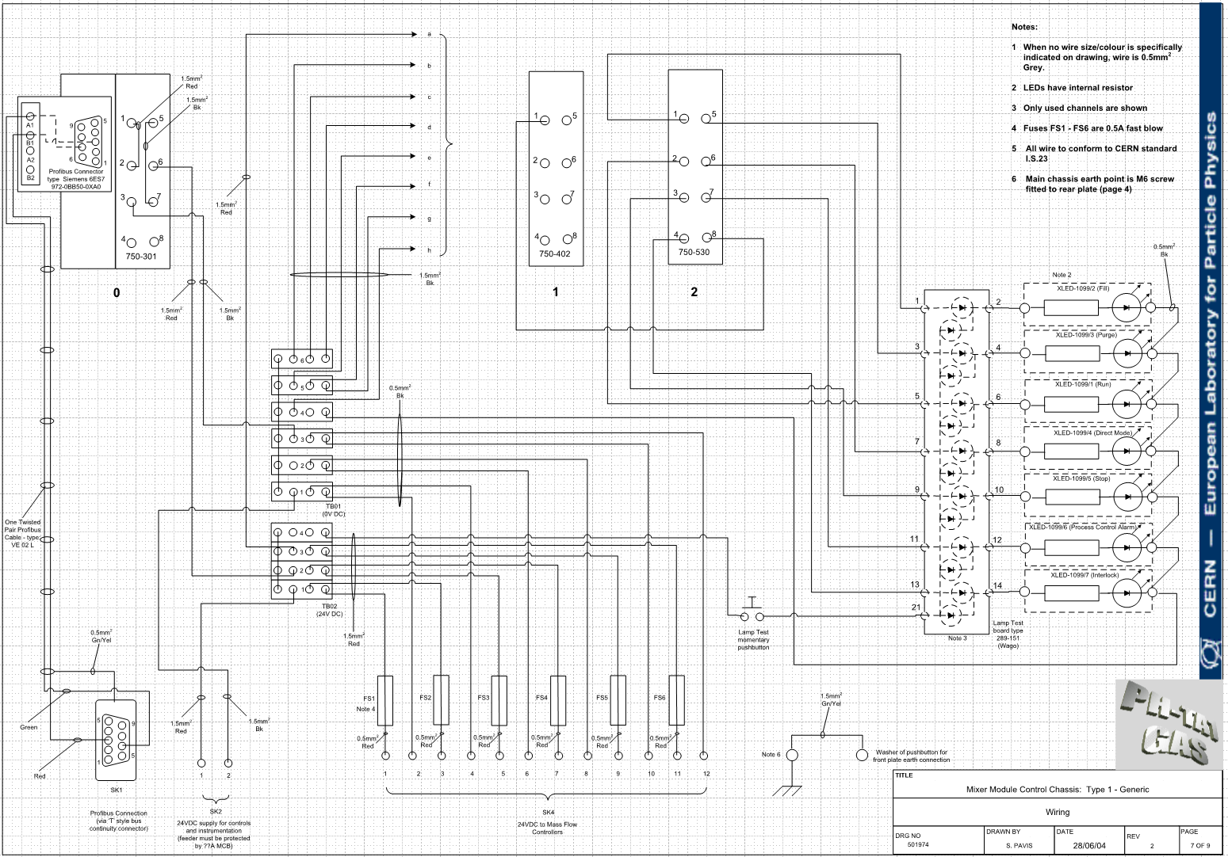
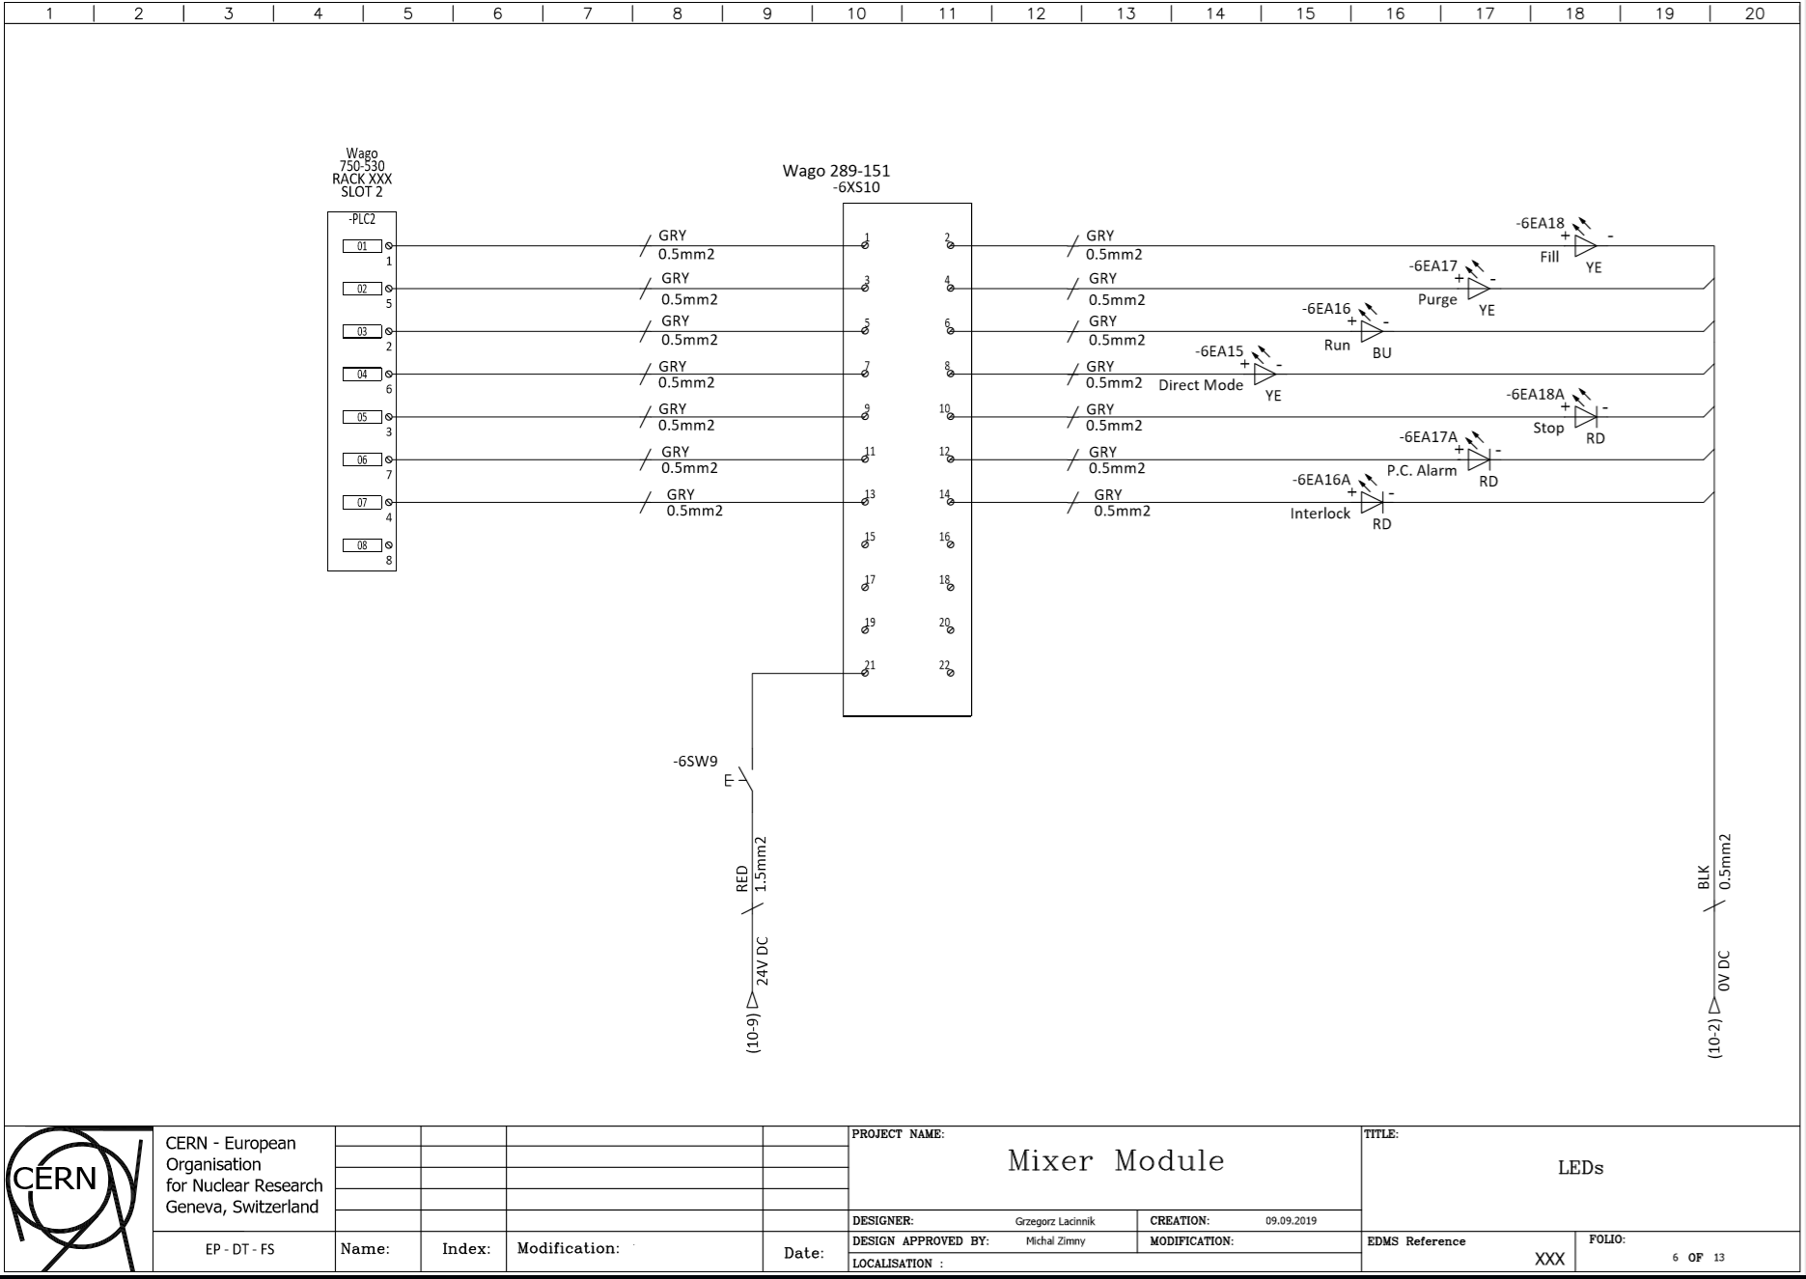
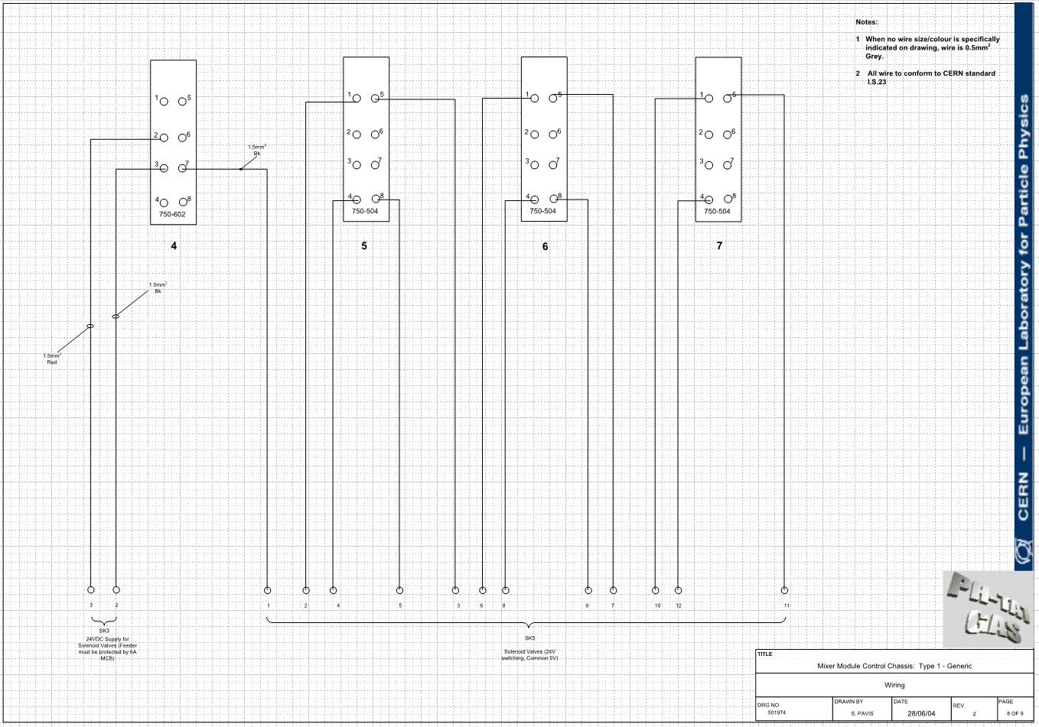
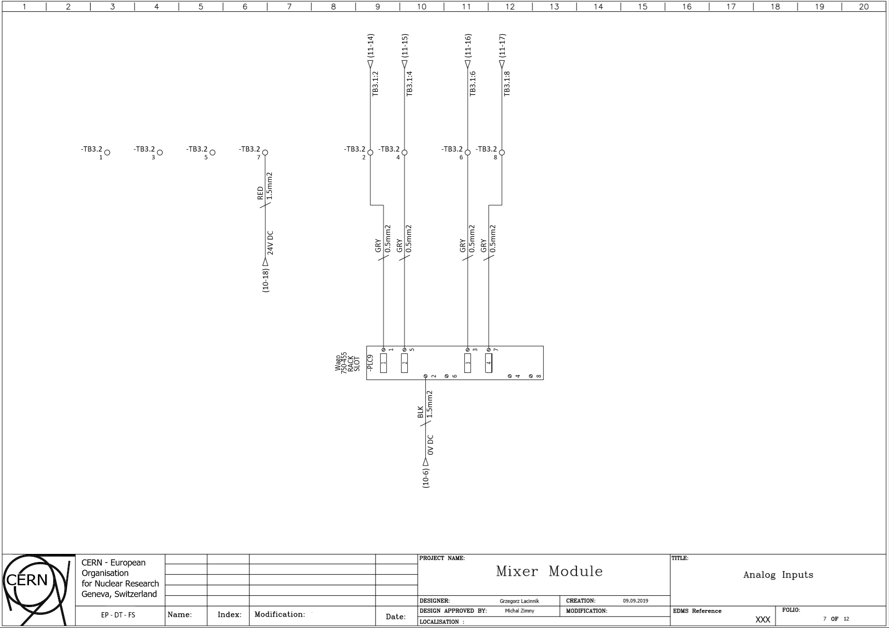
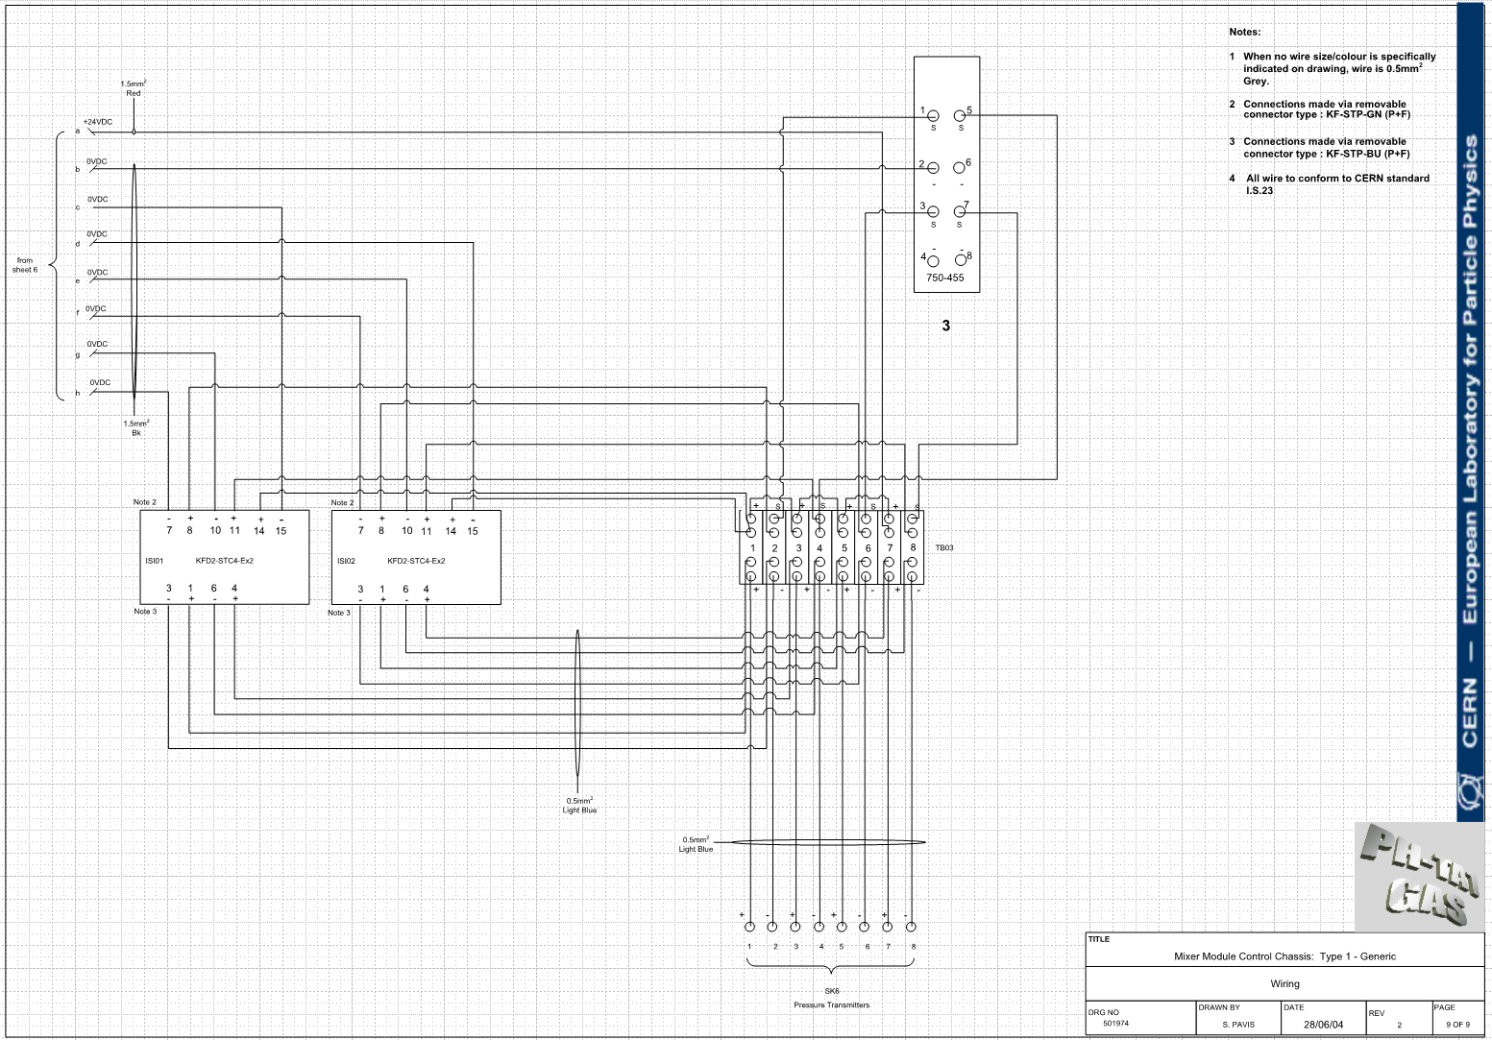
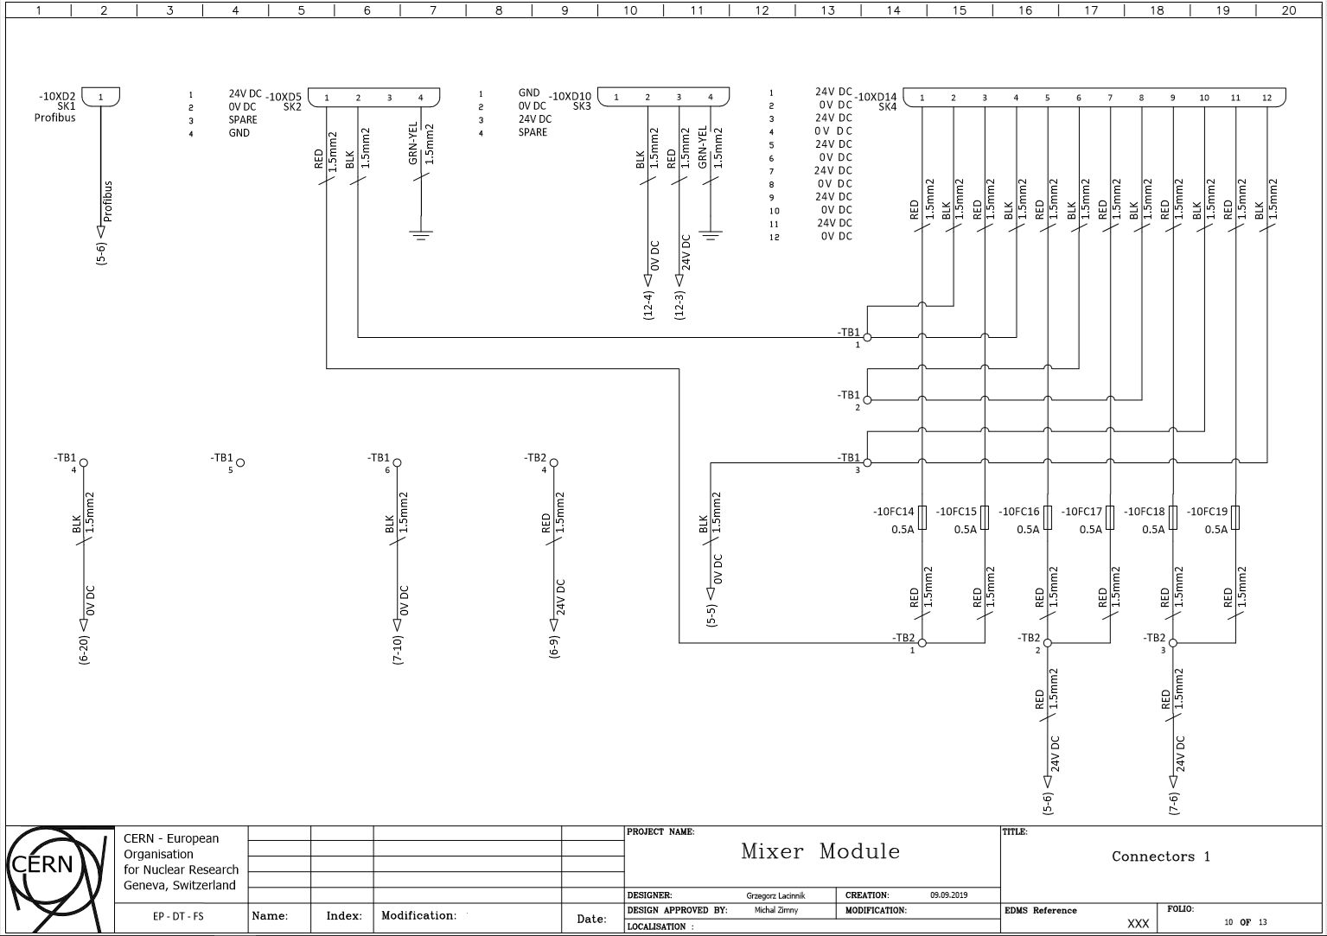
Introduction

Slide 3
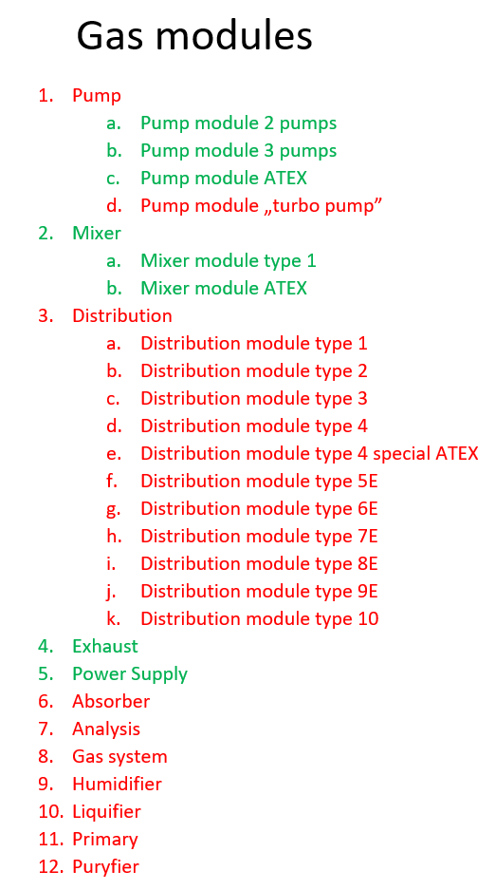

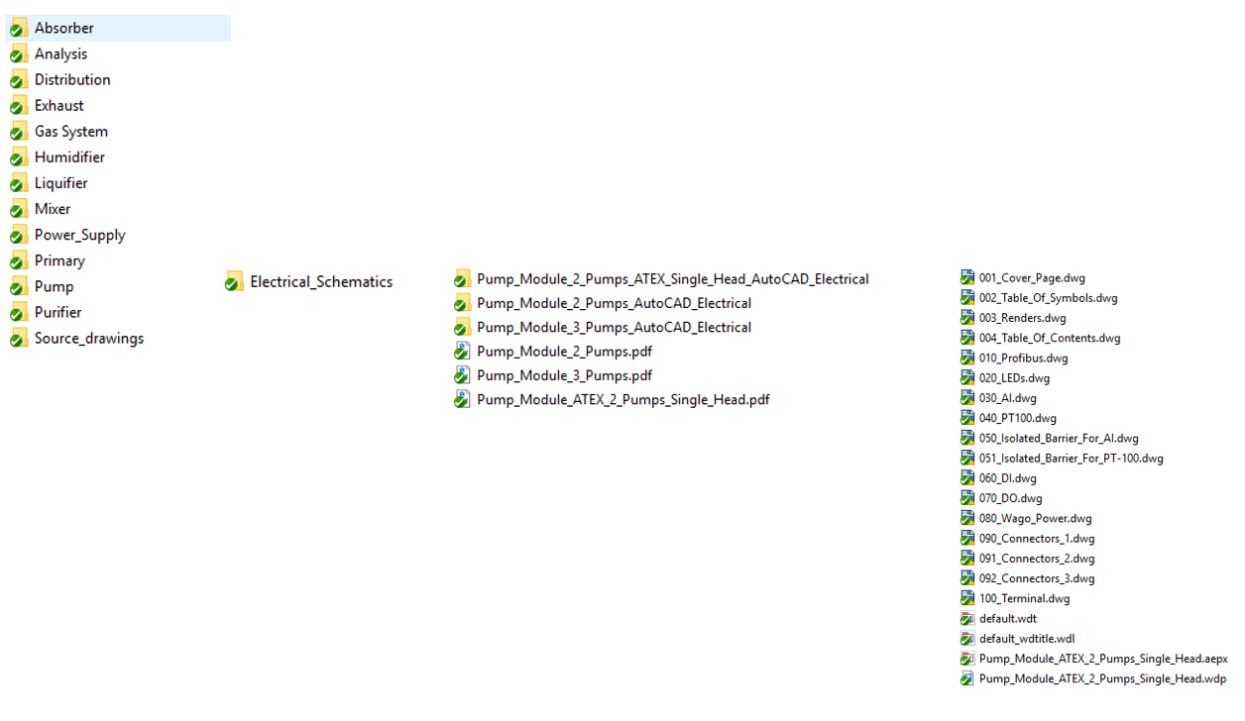
List of modules
Schematics are stored on SVN under path C:\SVN\GAS\Modules
Every module type has own folder
In addition to the electrical schematics, it is possible to add folders with the rest of the documentation

Slide 4

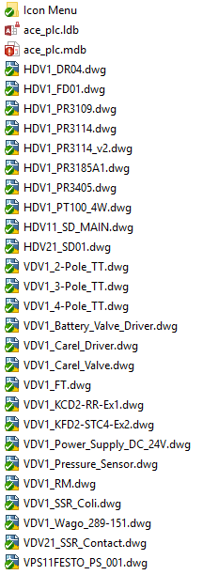

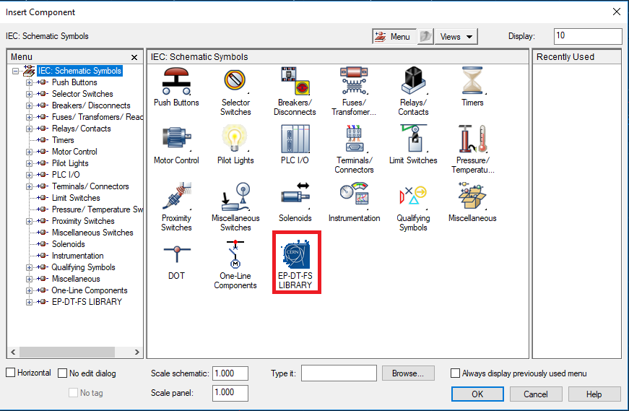
Symbol Library
The symbol library allows to store new symbols in one place and share them with other AutoCAD Electrical users.
Procedure of using library is described in document „AutoCAD project creation” in chapter 6. Basically this document is tutorial for users of Autocad Electrical
(C:\SVN\Fluidic-System\UNION\AutoCADElectrical\Autocad_project_creation)
We are testing the possibility of sharing a PLC database. This will increase the possibility of sharing the results of your work and will help to avoid conflicts between PLC symbols.

Slide 5
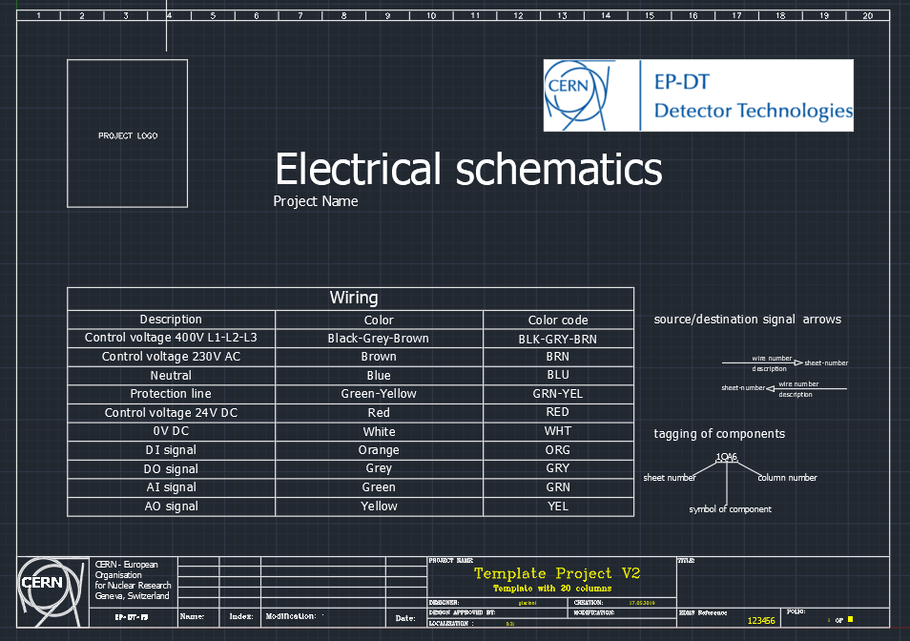
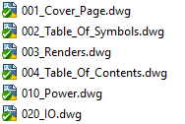
Drawing template
New drawing template has 20 columns configured so that the column number is one of atributes of the symbol name.
Template project contains the most frequently used drawings. User can choose which sample drawings he wants include to project. It saves time and ensures that the schematics would have a similar structure.

Slide 6
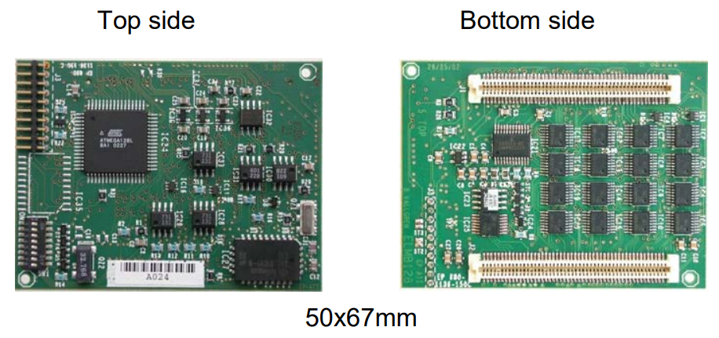
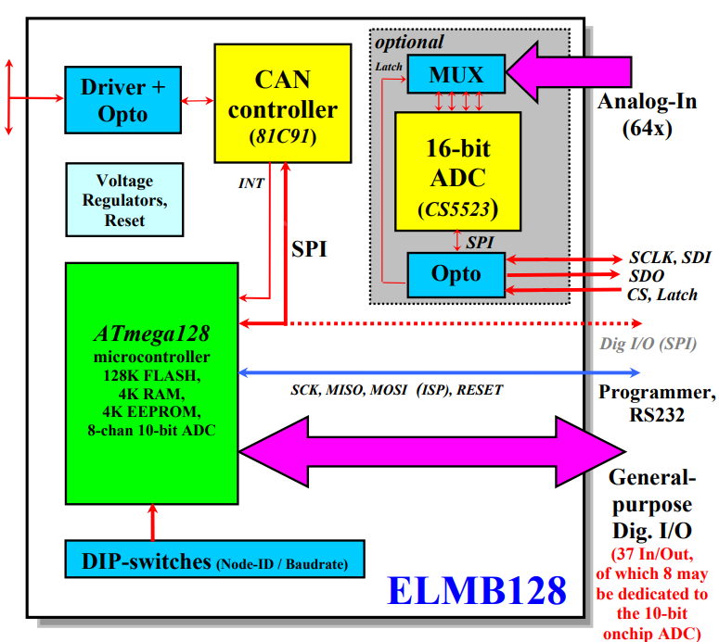
ELMB2 firmawre
In gas systems, ELMB128 reads analog signals from PT100 sensors.
ELMB128 are no longer produced. New version is ELMB2
Firmware for ELMB128 does not work with ELMB2.
The firmware developer for ELMB128 will adjust it for ELMB2.
The first tests ware scheduled for early November.

