Slide 1
Using a Paul trap to study intense beams
Lucy Martin
CERN – 09/10/19

Slide 2
Introduction
How is a LPT useful for accelerator physics?
What is a linear Paul trap (LPT) and how do they work?
Which accelerator physics questions can we answer with a Paul trap?
High intensity resonance studies.
Commissioning of the Intense Beam Experiment (IBEX) at RAL.
First experiments using IBEX.
Nonlinear integrable optics (NIO) – can it be tested on a Paul trap?
Experimental progress towards NIO.
Further diagnostics for Paul traps.
Future work.

Slide 3
Why is achieving high intensity difficult?
Why study these effects?
Tune in y
Why are they hard to understand?
Why not just use simulation?
Why not study resonances with an accelerator?
Tune in x

Slide 4
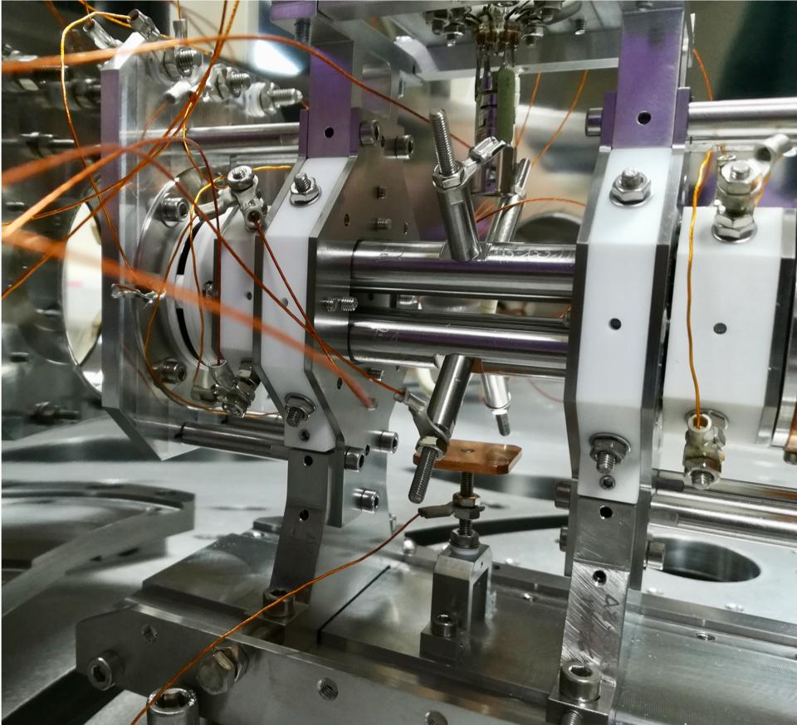
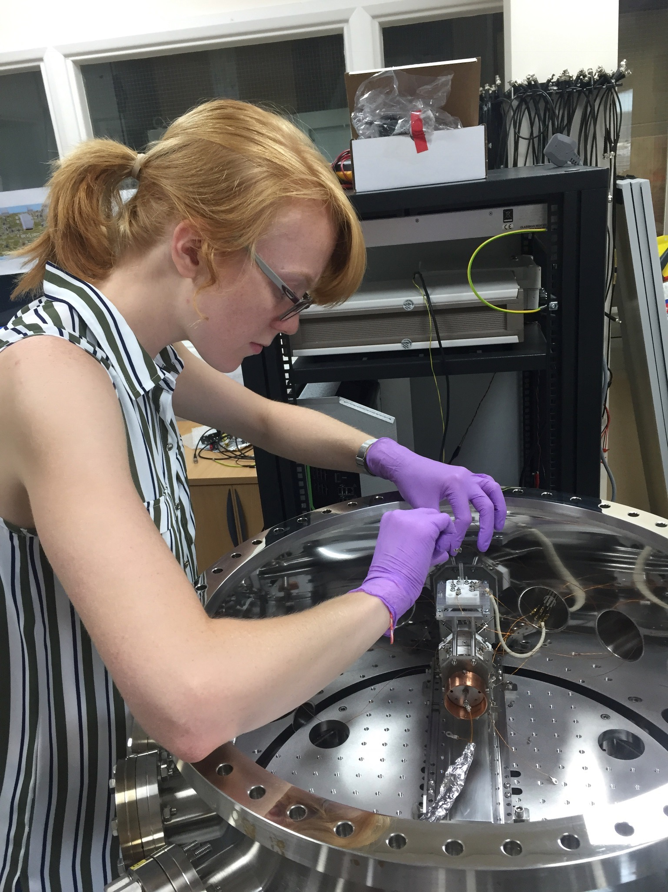

Slide 5
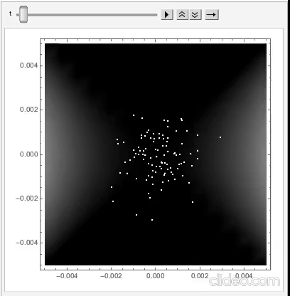
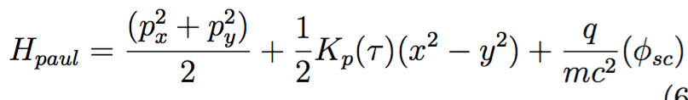
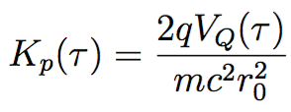
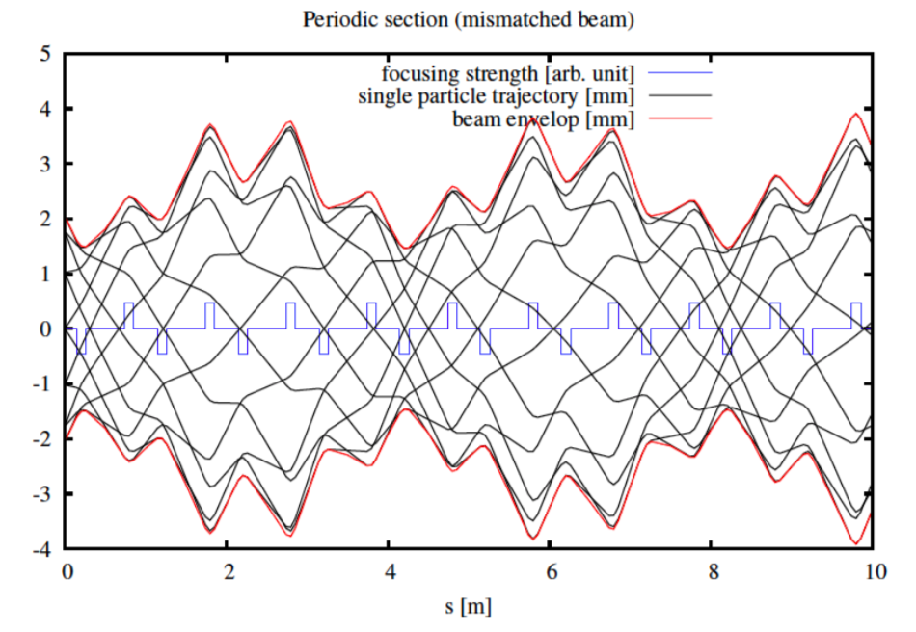
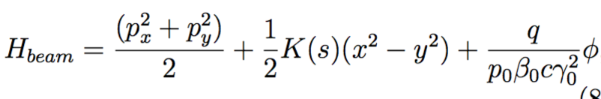
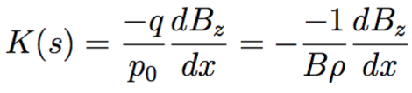
Motion in a Paul trap
Hamiltonian of a Paul trap :
where
Hamiltonian of a conventional accelerator:
where

Slide 6
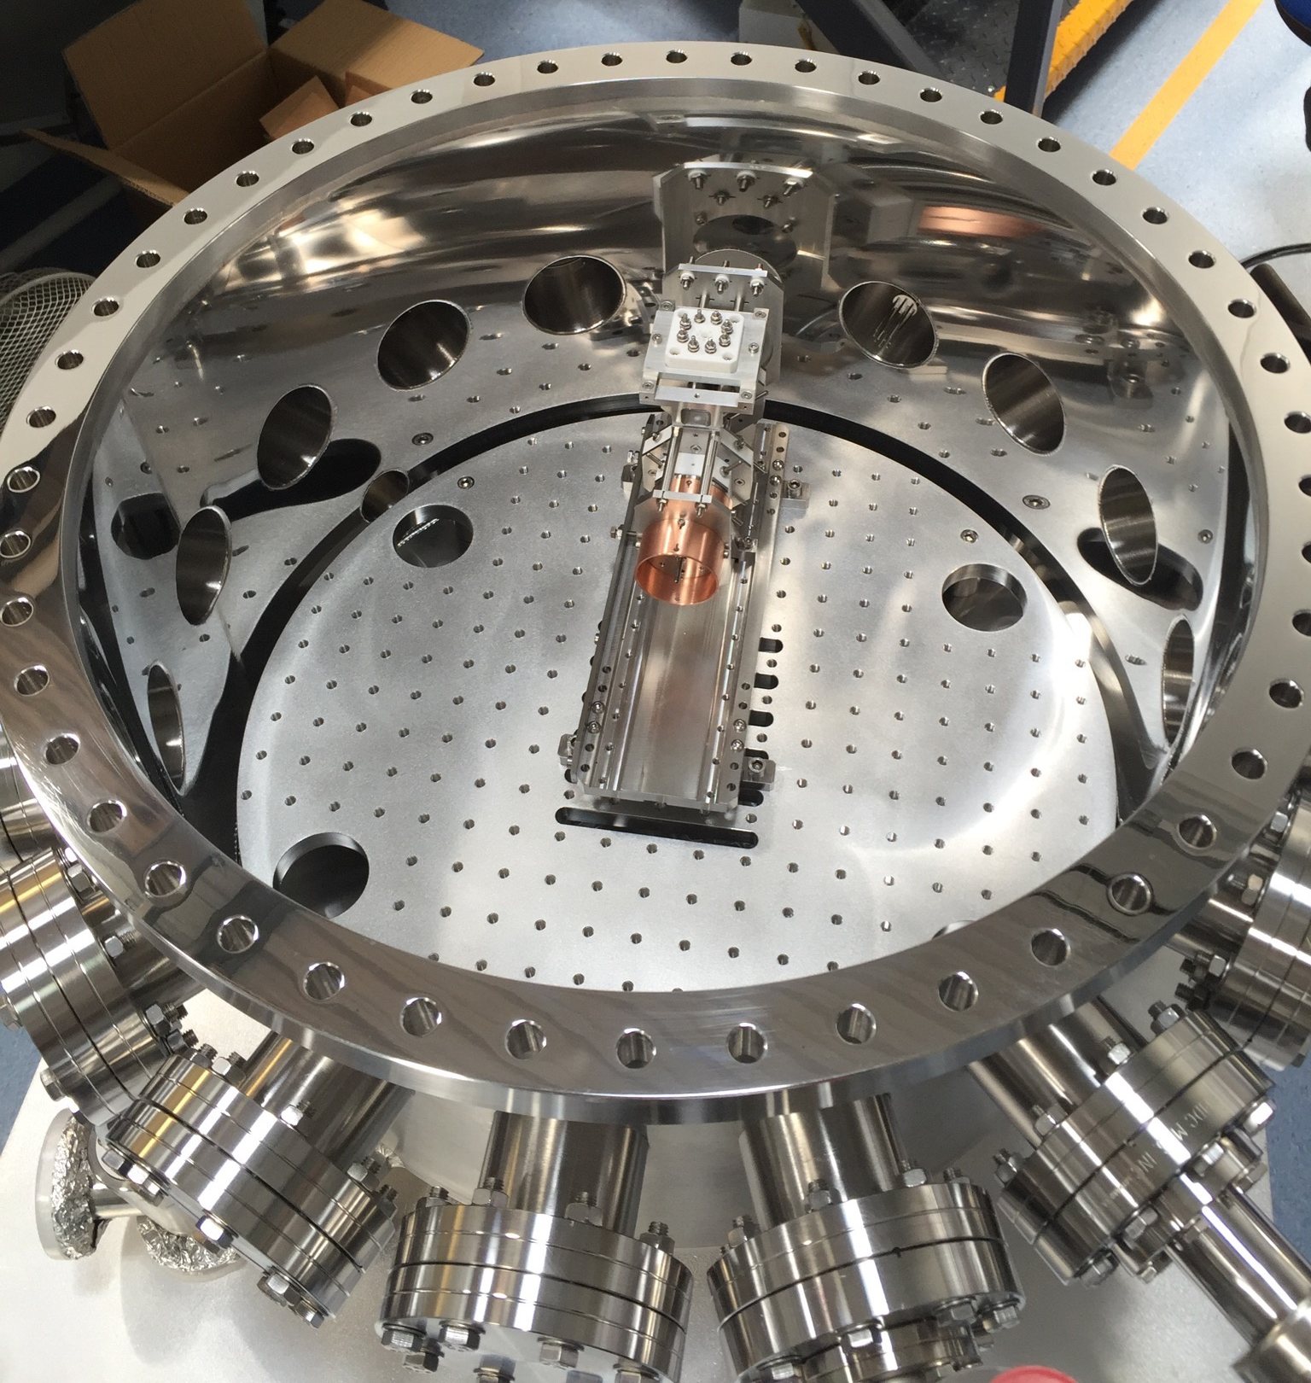
IBEX and SPOD: Linear Paul Traps
IBEX at the Rutherford Appleton Lab, UK
S-POD at Hiroshima University, Japan
PTSX at Princeton Plasma Physics lab, US
What are the advantages of a LPT?
What are the limitations?
  No longitudinal effects = coasting beam

Slide 7
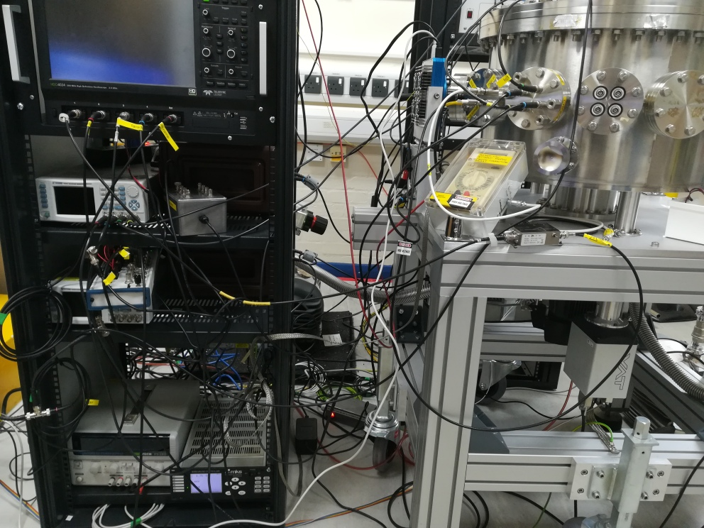
Past experiments on LPTs
Coherent motion
Excitation of dipole and quadrupole resonances
Study of how resonances interact at half integer tunes
Studying resonance crossing for novel FFA accelerators
Beam Halo and beam size growth

Slide 8
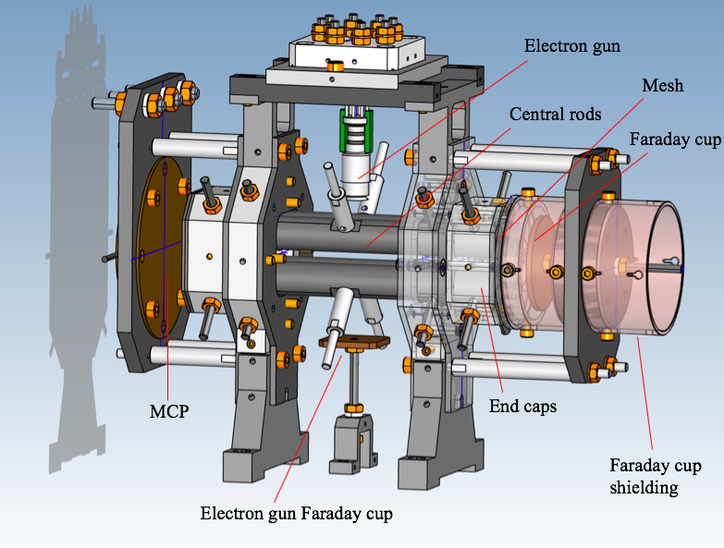
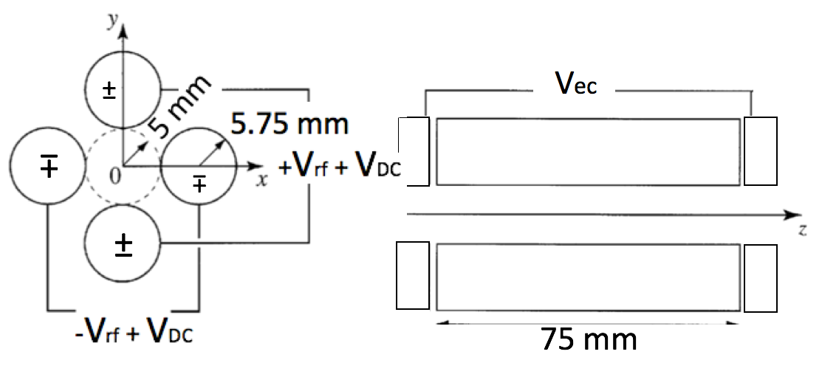
Linear Paul Trap
1. Argon gas introduced to vessel at ~10⁻⁷ mbar
2. Electron gun ionises Ar in trapping region
3. Ions confined transversely via 4 cylindrical rods
4. Ions confined longitudinally with end caps

Slide 9
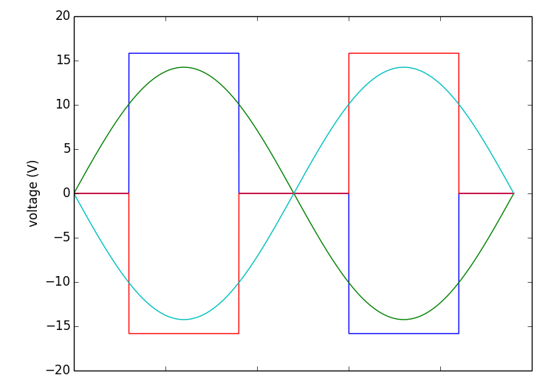
Experimental procedure
A simple FODO cell is created using a sine wave
  1 MHz
System scans across a large range of tunes
Ions are created at the optimal tune
Tune is then changed to the desired operating point by changing voltage
At this tune ions are stored for a given time (eg. 100ms)
Ions are then extracted onto an Micro Channel Plate (MCP) or a Faraday cup

Slide 10
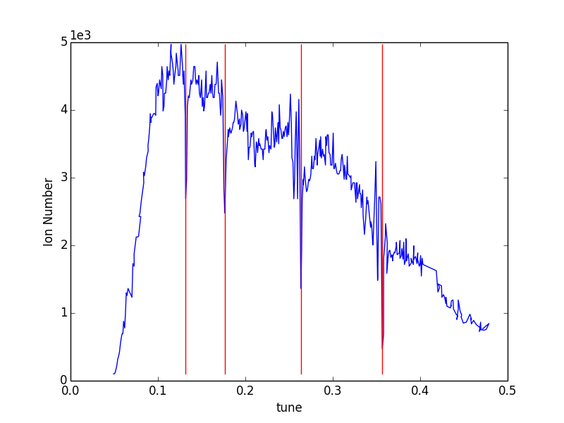
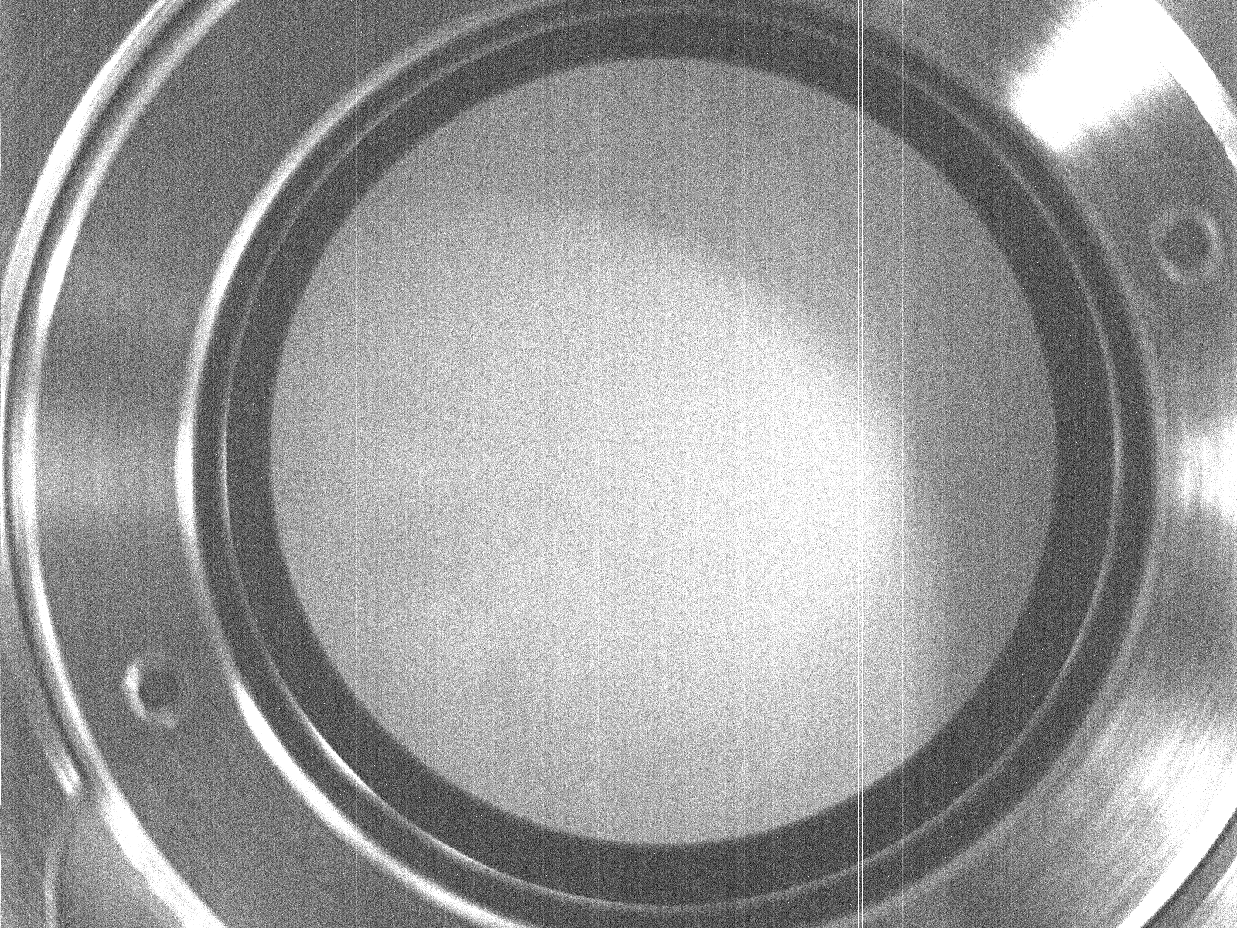
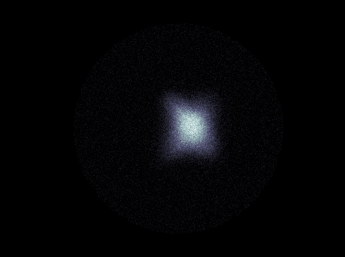
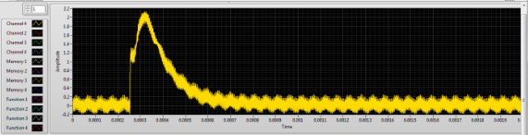
Diagnostics and Calibration
Tune scan takes ~ 2 hours
MCP image
17 mm
Faraday cup signal
200 μs
Cell tune

Slide 11
What can we discover using IBEX?
We want to know the location of (and understand!) dangerous resonances to help with the understanding and operation of current machines
We want to investigate novel schemes for creating high intensity beams

Slide 12
Resonant conditions
Incoherent resonant condition:
For a small multipole perturbation of order m with harmonic n
ΔQ = incoherent tune shift
Q₀ = tune set by accelerator (bare tune)
This too simple: In high intensity case beam size changes
Needs to be solved self consistently¹
Solutions for m=2 can be found from the envelope equations describing beam size
But more generally the system is solved using linearized Vlasov Poisson equations:

Slide 13
Index m = azimuthal and k = radial mode, m = k are rigid modes
Mode (m, k) is driven by terms x^{k−1} cos(nθ) with n ≈ mν
The dipole resonance C₁ = 0
C_{m} < 1 and C₁ < C₂< C₃ < C₄ …
In H. Okamoto and K. Yokoya’s² paper the theory is extended for SC driven resonances:
No smooth approximation is applied to the beta function
Aim to measure C_{m} factor for external and self field driven resonances
Theoretical values have been calculated (I. Hofmann 1998)

Slide 14
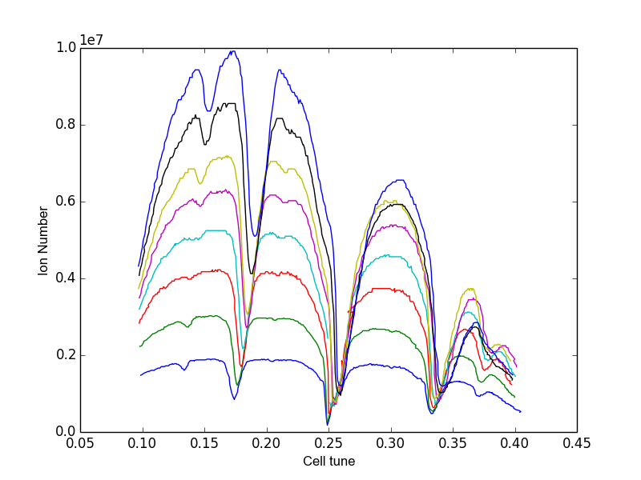
Identifying resonances…
SC = space charge driven
EF = external field driven
EF:
SC:
At cell tune ~1/5
SC n = 2, m = 5
EF n = 1, m = 5
At cell tune ~1/4
SC n = 1, m = 2
EF n = 1, m = 4
At cell tune ~ 1/6
SC n = 1, m = 3
EF n = 1, m = 6
At cell tune ~ 1/3
SC n = 1, m = 6
EF n = 1, m = 3
At cell tune ~ 1/8
SC n = 1, m = 4
EF n = 1, m = 8
At cell tune ~ 3/8
SC n = 3, m = 4
Cell tune

Slide 15
Incoherent (rms) tune shift
Gaussian distribution
y
Assume a cylinder of charge
Charges have Gaussian distribution
Calculate the first order tune depression
Motion in Paul trap is non relativistic
Can neglect the magnetic fields³
x
Defocusing
λ_{RF} = the RF wavelength of the trap
N = Ion number
L = effective plasma length
ε = emittance

Slide 16
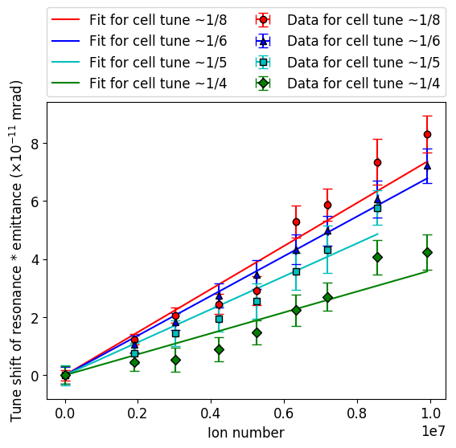
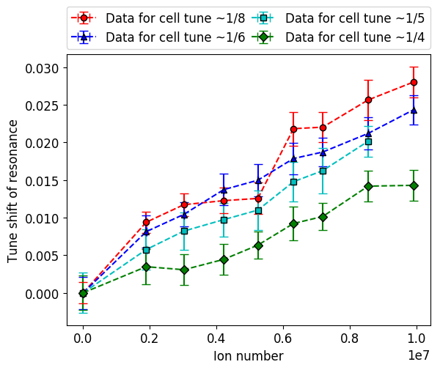
Assumptions:
Gaussian distribution (significant prior evidence from MCP)
Tune change from a cell tune of 0.15 (where the ions are collected) to the operating point, is adiabatic and no ions are lost – supported by simulation, but only to tunes lower than 0.25.

Slide 17
Simulation
Use the PIC code WARP
Create a 2d trap and apply voltages to the rods
Trap matched distribution of 2e6 ions at a cell tune of 0.15 for 50 rf periods
Adiabatically change tune over 100 rf periods
Store at new tune for 550 rf periods
Study emittance growth
Saw no evidence of coherent motion for 1/6 and 1/3, saw coherent motion at 1/4
Looked at:
  Phase space
  Tune footprints
  Kurtosis – A measure of the “tailedness” (4th moment)

Slide 18
Simulation: tune = 0.25 ^{4, 5, 6}
a
b
c
d
Blue = x
Red = y
b
RAMP
c
a
d

Slide 19
Coherent shape and finite stopband width
Simulation:
Y tune
Emittance increase
1
2
3
Experiment:
Ion number
X tune
X tune

Slide 20
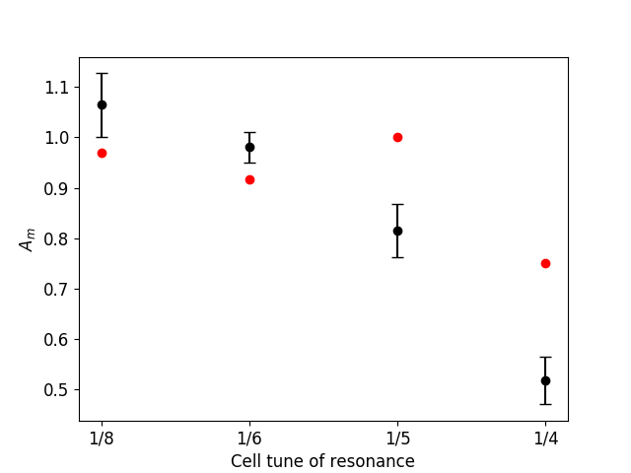
A_{m}

Slide 21
Interpretation
Many resonances are in competition at each tune!
Peak in emittance growth did not occur at the location predicted by the C_{m} factors
Experimental C₂ factor < Theoretical C₂
This is explained by stop band width and 4th order
Experiment shows that for 1/8 and 1/6 shift in tune doesn’t differ from that predicted incoherently, suggesting coherent oscillations may be landau damped⁷
Simulation also showed no coherent excitation

Slide 22
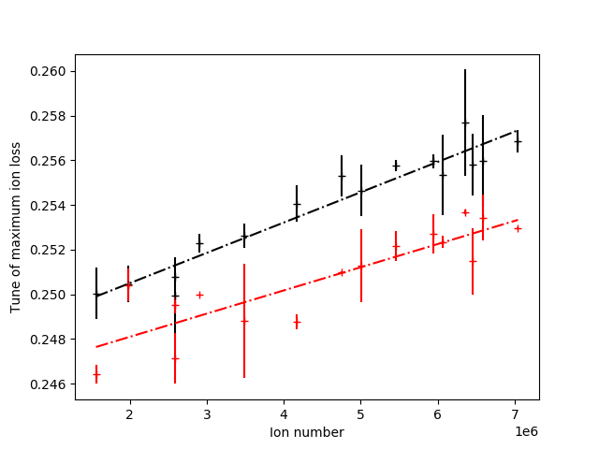
Similar experiments have since been performed on IBEX comparing equal and unequal tunes in the transverse directions⁸
Unequal tunes
Equal tunes
4
6
8
10
12
14

Slide 23
What can we discover using IBEX?
We want to know the location of (and understand!) dangerous resonances to help with the understanding and operation of current machines
We want to investigate novel schemes for creating high intensity beams.

Slide 24
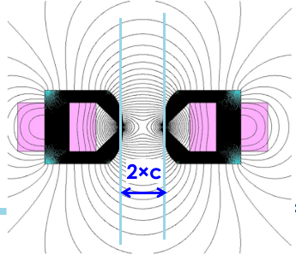

Future accelerators (Nonlinear Integrable Optics)
In linear accelerators the motion is integrable – it is known to be bounded
This is exactly what we want, the beam won’t be lost!
Susceptible to resonances
Realistically an accelerator can never be totally linear (errors + space charge)
Nonlinearities -> no longer integrable due to coupling between x and y
Require integrable system where small perturbations are allowed
At Fermilab they found such a system¹¹
Unfortunately it requires a complicated potential

Slide 25
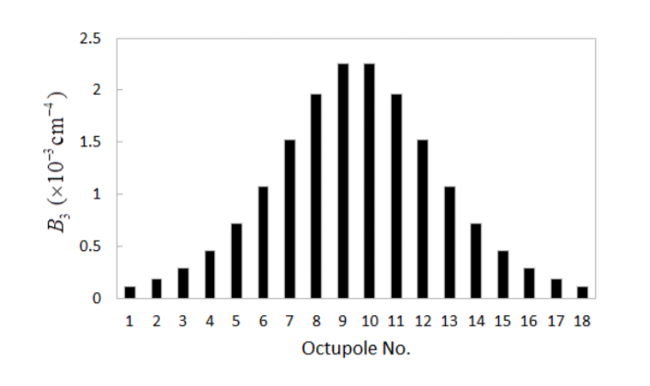
Non-linear integrable optics
Requires round beams and nπ phase advance
  This is called a “T-insert”
Quasi-integrable version involves only octupoles
Octupole must vary in strength proportional to 1/β³
Image from [12]
To test in a Paul trap we require 2 things:
To be able to create a good enough T-insert with the Paul trap
To at the same time be able to create the correct octupole potential

Slide 26
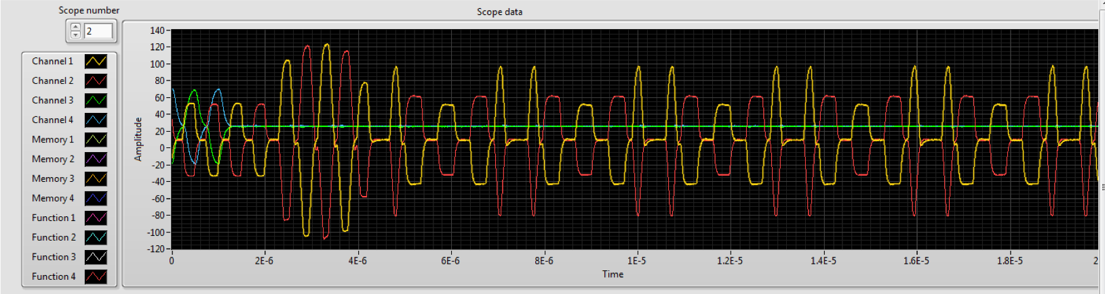
1. T-insert

Slide 27
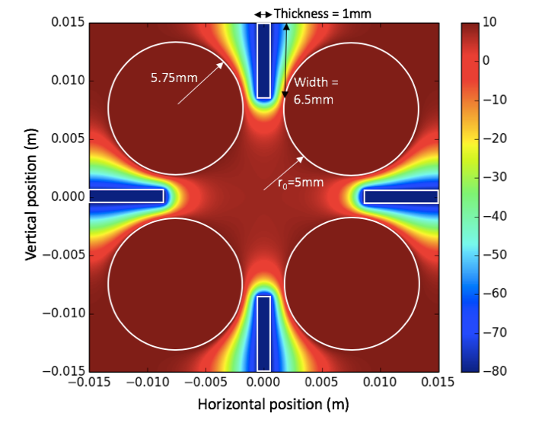
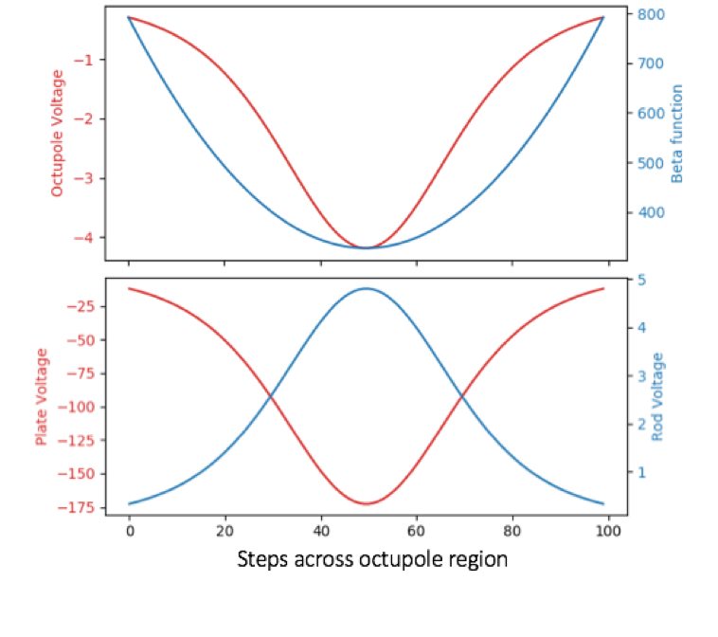
2. Quadrupole + Octupole trap
Building heavily on work from Hiroshima¹³
Voltage (V)

Slide 28
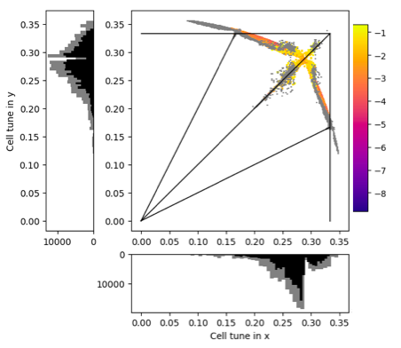
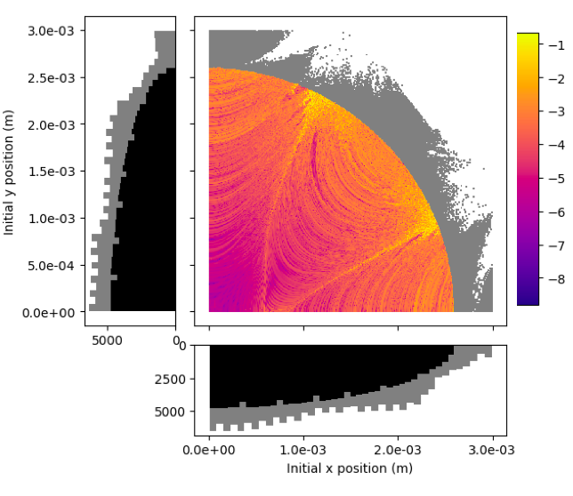
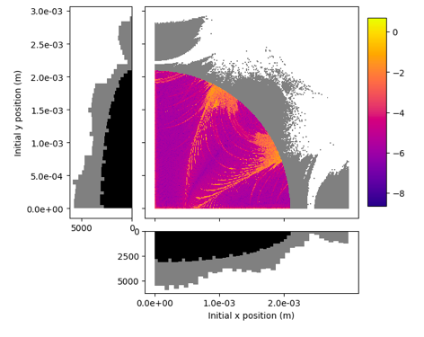
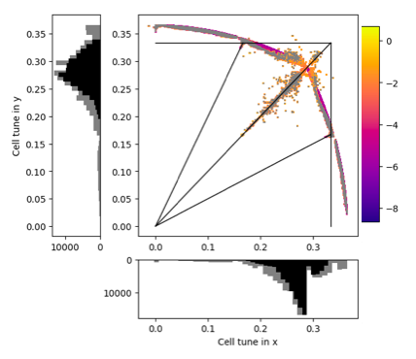
Perfect octupole
Dynamic aperture and tune spread over 1000 periods.
The T-insert is applied using a single matrix transformation.
The colour bar shows the log of the change in tune over the simulation for particles within the dynamic aperture.
Grey regions are particles that survived but are outside of the dynamic aperture¹⁰.
Log(Δυ)
Log(Δυ)
Dynamic Ap = 2.6 mm
Realistic Octupole
Log(Δυ)
Log(Δυ)
Dynamic Ap = 2.1 mm

Slide 29
Conclusions and future work
A Paul trap is a useful tool for accelerator physics
We can study a range of effects, from coherent resonances through to resonant crossing
SPOD (Hiroshima) was used for a detailed study of coherent resonances.
IBEX is now up and running!
Based on preliminary experiments and simulation results we are planning an upgrade to an octupole trap to investigate nonlinear integrable optics.

Slide 30
Thank you!

Slide 31
References
Sacherer F 1968 Transverse Space-Charge Effects in Circular Accelerators Ph.D. thesis University of California, Lawrence Radiation Laboratory, Berkley, California
Okamoto H and Yokoya K, Parametric resonances in intense one-dimensional beams propagating through a periodic focusing channel, Nuclear Instruments and Methods in Physics Research Section A, Volume 482, Issues 1–2, 2002
Schindl K 2006 http://cds.cern.ch/record/941316
Hofmann I and Boine-Frankenheim O 2015 Physical Review Letters 115 204802
Jeon D, Groening L and Franchetti G 2009 Physical Review Special Topics - Accelerators and Beams 12
Li C and Zhao Y 2014 Physical Review Special Topics - Accelerators and Beams 17
Martin, L. K. et al., “A study of coherent and incoherent resonances in high intensity beams using a linear Paul trap” New J. Phys. 21 053023
Martin, L. K. et al., “Recent Studies of the Resonances at a Cell Tune of 0.25 Using the Ibex Paul Trap”, 2019, J. Phys.: Conf. Ser. (In Press)
Baartman R , “Betatron resonances with space charge Proceedings of Space Charge Physics in High Intensity Hadron Rings” (Shelter Island, New York, USA, 1998) vol 448 p 56
Martin, L. K. et al., “Can a Paul Ion Trap Be Used to Investigate Nonlinear asi-Integrable Op- tics?”, 2019, J. Phys.: Conf. Ser. (In Press)
Danilov V and Nagaitsev S, “Nonlinear accelerator lattices with one and two analytic invariants”, PRAB, 2010
﻿Antipov S et al, JINST 12 P04008, 2017
FUKUSHIMA K and OKAMOTO H, “Design Study of a Multipole Ion Trap for Beam Physics Applications”, Volume 10, 1401081, 2015

Slide 32
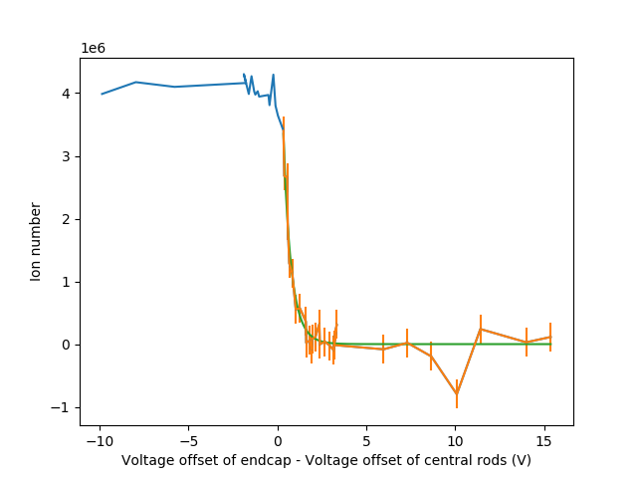



Emittance and length
0.2932 ± 0.033 eV longitudinally
Assumptions:
Ion distribution length L was determined experimentally using IBEX
A single emittance value cannot be assumed as the increased space charge forces at higher intensity will distort the potential experienced by the ions.

Slide 33
c
d
Simulations: ¼ resonance^{4, 5, 6}
a
b
c
d
a
b
a
A_{m}

Slide 34
Kurtosis
a
b
c
d
Emittance
Cell tune
0 = Gaussian
+ve = Matterhorn
-ve = Loaf of bread

Slide 35
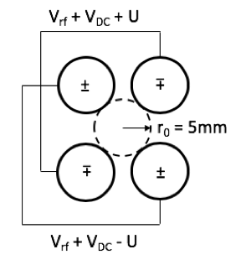
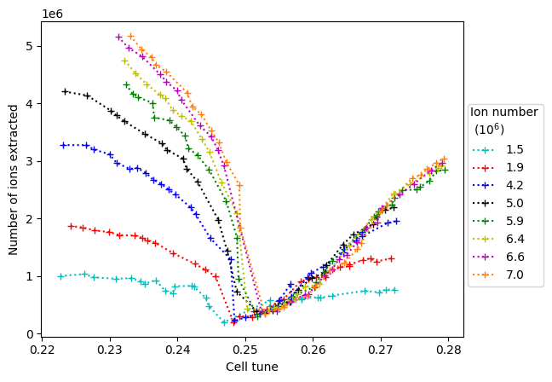
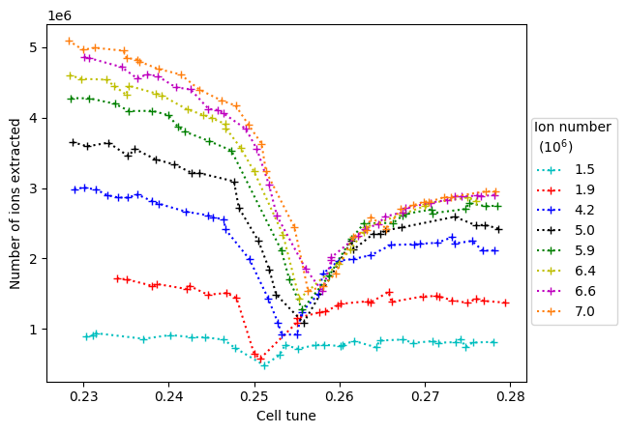
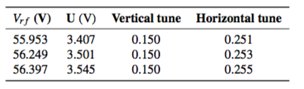
First IBEX experiments
Equal tunes
Unequal tunes
3.0
3.8
8.4
10.0
11.8
12.8
13.2
14.0
3.0
3.8
8.4
10.0
11.8
12.8
13.2
14.0
A DC offset was applied to give unequal tunes in the x and y.
The tune in the vertical was fixed at 0.15 and the tune in the horizontal
scanned across the range 0.23 – 0.28.

Slide 36
Why is this interesting? We expect C_{m} to change
Theory states that with split tunes we expect to see a different value of C_{m.}
For the second order envelope instability expect C_{m} to be 0.625, instead of 0.75 for equal tunes.
Simulation supports this.
Our experimental results don’t!
Simulation and theory don’t account for ion loss, potentially seeing the effect of losing ions in one direction only⁸.
Change in the number of ions lost will alter the rune depression giving different C_{m.}
4
6
8
10
12
14

