Slide 1
Data Analytics and Machine Learning in the Cloud
CERN openlab Technical Workshop
Riccardo Castellotti
23/01/2020

Slide 2

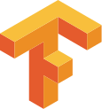
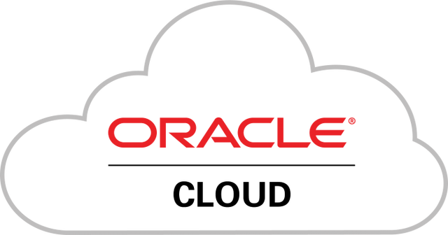
Motivations and Vision
Industry tools –
Apache Spark
Tensorflow
Kubernetes
Modern analytics platform
Reduce costs
Improve performance
Enable new types of analysis
Cloud resources –
CERN cloud (Openstack)
OCI: Oracle Cloud Infrastructure
CERN data intensive use-cases –
High Energy Physics
Accelerators
Notes:
Let me begin by introducing the long term vision of this project.
In the last ten years or so, there have been two big and distinct evolutions in the computing space: the diffusion of open source tooling, for both tasks related to data analytics ( eg python tools, tensorflow, pytorch) and software deployment tools(kubernetes, containers). On the other hand, the infrastructure landscape is evolving: big investments in cloud technologies lead to a point where the physical infrastructure is becoming more more an utility, like the electrical grid, and it became software-defined, much easier to deal with. In addition to this, CERN performs many activities that are data intensive: from the analysis done in HEP to the design, control and operation of very large experimental systems, such as the particle accelerators. Based on these 3 aspects, CERN is involved in the conception and development of new, modern analytics platforms, in order to reduce costs, improve performance and enable new, more advanced types of analytics.

Slide 3
The Ecosystem
Now, many open source tools are available:
  Systems (Apache Hadoop, Kafka)
  General purpose libraries (Numpy, Pandas, Apache Spark)
  Machine Learning frameworks (Tensorflow, Pytorch…)
Elasticity and separation of computing and storage
  Growth on demand
  Wide range of solutions (HW and SW)
Notes:
What is the most important new element in these last 10 years? A lot of open-source tools have become available in various parts of the software stack, from systems such as apache Hadoop, which nowadays is mostly a distributed filesystem, Apache Kafka, a distributed streaming platform. Then there are plenty of general purpose libraries, mostly in the Python ecosystem, such as numpy and pandas or in the java/python landscape a distributed computing engine such as apache spark. Last but not least new tools that offer advanced analysis methods, I am referring to machine learning, such as Tensorflow and Pytorch. Many communities have started adopting these solutions as they are offered by the Hadoop, Spark and Streaming service.

Slide 4
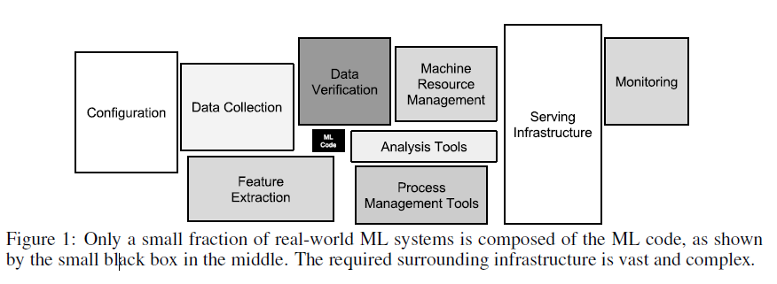
Complexity of Advanced Analytics
“Hidden Technical Debt in Machine Learning Systems”, D. Sculley et al. (Google), paper at NIPS 2015
Notes:
Now, if we move from the wider context to the technical problems, the first thing that we notice is how complex analytics workloads have become. In this picture, taken from a paper of 2015 written by Google authors, there is a very efficient drawing explaining what I mean. In this case, the authors were focusing mostly on ML workloads, but something very similar applies to analytics in general. Most of the complexity is not in the analytics task per se, but in the surrounding infrastructure necessary for various tasks, from data collection to the presentation results

Slide 5








Analytics Platform
Integrating new components with existing CERN infrastructure:
  Software
  Data
Experiments storage
HDFS
HEP software
Personal storage
Notes:
In this sense, we believe that the solution to provide the best value to users is to integrate the existing components, both software and data, in a more modern application. In this drawing, for example, we can see how presenting users with jupyter notebook allows us to abstract from a complex infrastructure. For example, you can see how we are able to schedule jobs in different clusters, such as kubernets ones or YARN. We can leverage the software distribution system in use in HEP and can access data wherever it is: in EOS, which contains the data from experiments, Hadoop HDFS or CERNbox, the personal storage space based on EOS where users can stage their data.

Slide 6
Achievements
Notes:
The second part of the presentation will focus on what has been done in this direction. As you will see, our approach consists in taking real use-cases and looking for a solution with approaches different from the current ones.

Slide 7
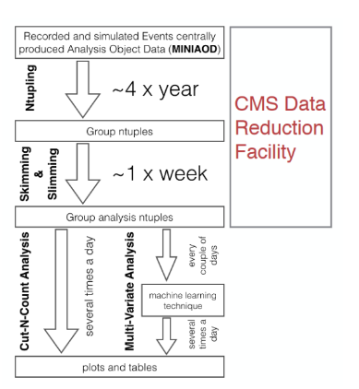
CERN Use Cases in the Cloud
Physics data reduction
Data reduction job on public dataset from CMS developed by the “CMS Big Data group” on a 1 PB dataset.
Tested OCI and CERN cloud:
storage backends
computing configurations
Notes:
The first use case is a physics data reduction. The CMS big data developed a data reduction job based on a public dataset. We tested several storage solutions and computing configurations, both in OCI and CERN cloud and managed to scale the workload up to a 1 PB input dataset. Part of the work necessary for the reproduction of this workload has been the development of software to read the ROOT file format and to access the EOS service.

Slide 8



Development and “Plumbing”
Building on previous openlab work:
  Access data stored within EOS service with Spark (hadoop-xrootd-connector: https://gitlab.cern.ch/db/hadoop-xrootd)
  Read datafiles in ROOT format with Spark (spark-root: https://github.com/diana-hep/spark-root)
Improvements to OCI:
  Developed patch for oci-hdfs-connector to connect to OCI Object Storage with latest Apache Spark https://github.com/cerndb/oci-hdfs-connector/pull/1
Notes:
In a previous openlab project with Intel, two “ connectors” have been developed: one to connect to any storage that supports the xrootd protocol, most importantly EOS, another one to be able to parse files in ROOT format spark.
On the other hand, while using the oci-hdfs-connector , that is the component implementing the Hadoop filesystem API for the OCI object storage, we developed a patch allowing to connect to the most recent apache spark stable releases, on which we rely for kubernetes support.

Slide 9
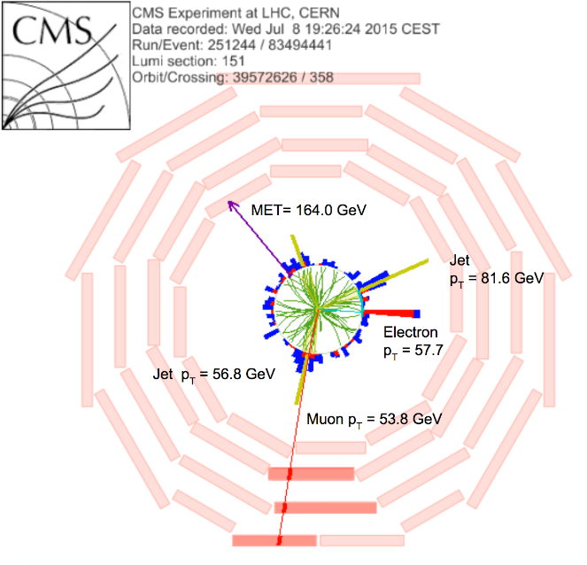
CERN use cases in the cloud
Particles Classifier Using Neural Networks
R&D to improve the quality of filtering systems
  Develop a “Deep Learning classifier” to be used by the filtering system
  Goal: Identify events of interest for physics and reduce false positives
  “Topology classification with deep learning to improve real-time event selection at the LHC”, Nguyen et al. Comput.Softw.Big Sci. 3 (2019) no.1, 12
W + j
Particle Classifier
QCD
t-t̅
Notes:
Another use-case that we worked on was the reproduction of a particle classifier for use in the online acquisition system in order to reduce the percentage of false positives that are recorded by the current filtering systems. After a discussion with the authors of the paper, it became evident that they faced all the problems that I was introducing you before: the most time consuming activity was not the development and use of ML models, but to have all the different components of the workload to talk to each other.

Slide 10

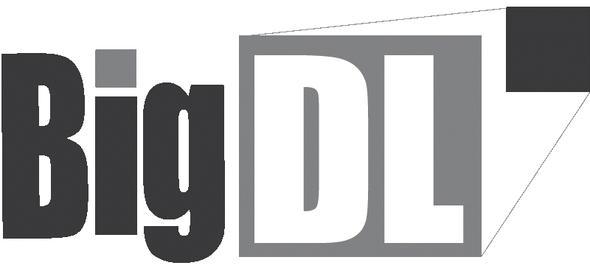
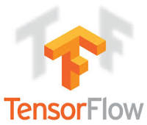
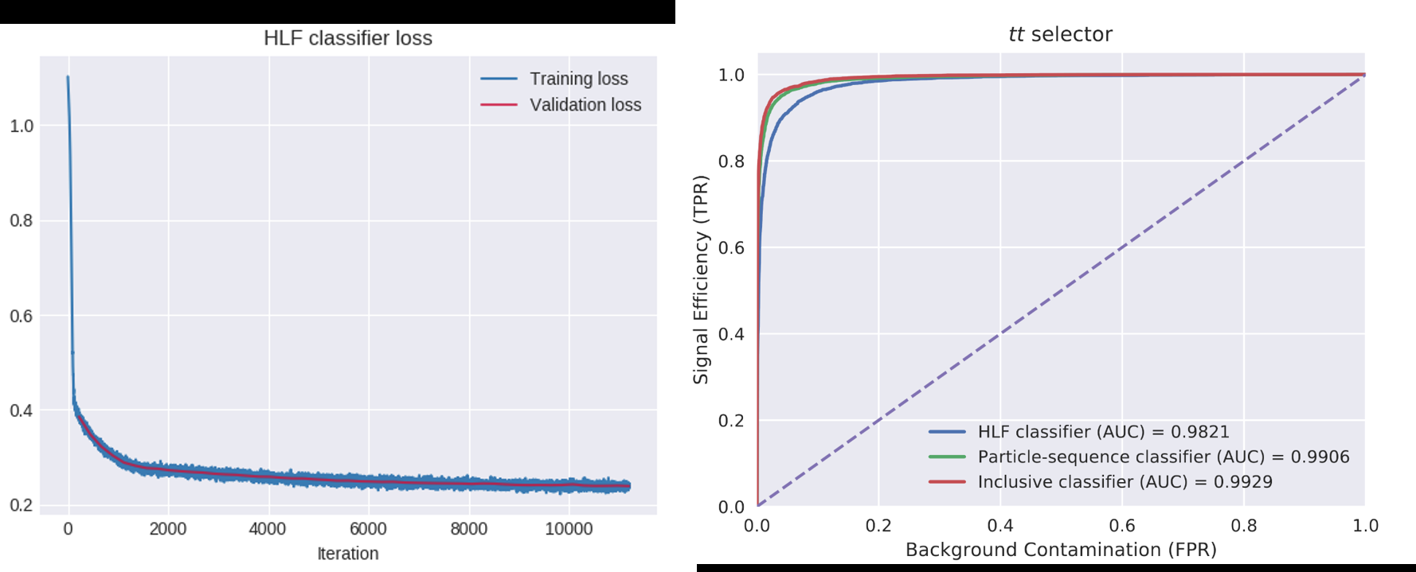



Machine Learning Pipeline
Data and models from Research
Input: labeled
data and DL models
Feature engineering at scale
Distributed model training
Output: particle selector model
Hyperparameter optimization (Random/Grid search)
Technology: the pipeline uses Apache Spark + Analytics Zoo and TensorFlow/Keras. Code on Python Notebooks. Input datasets 4.5 TB
Notes:
In this sense, our efforts have focused on reducing the attritions between the various stages rather than on improving the models themselves.

Slide 11
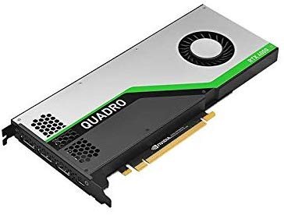


Python and Jupyter Notebooks
Unified interface and APIs for development and production
Object storage
Experiments storage
HDFS
HEP software
Personal storage
Notes:
As I mentioned before, our goal of providing an integrated analytics platform goes in the direction of abstracting the complexity from the users to let them concentrate on their task. In this sense, I showed how many integrations have been developed already. Now, we are focusing on adding more components. [animation] for example we want to let use users target GPUs for their tasks (mostly for deep learning) and potentially other specialized hardware. Then we are going to add the possibility to run the analysis in a public cloud, OCI. To do this we need to enable users to access the OCI object storage and to run their python notebooks on kubernetes resources hosted at OCI

Slide 12
Conclusions
Cloud resources and industry/open source tools
  Are a good fit for ML and data analytics at CERN
Successfully deployed on cloud resources (CERN and OCI)
  Use cases: CMS Bigdata Reduction and Deep Learning Particle classifier
Current work: integration of existing CERN analytics platform with OCI resources (CPU, GPU, cloud storage)

Slide 13
Acknowledgements
Luca Canali, Michał Bień, colleagues at the CERN Hadoop, Spark and Streaming service
Authors of “Topology classification with deep learning to improve real-time event selection at the LHC”
CMS Bigdata project
CERN openlab
Oracle

