Slide 1

SmartLINAC
Technical workshop 2020
Yann Donon
23/01/2020
Notes:
New project
Samara University, Russia : expertise in control system, in particular in the aerospace

Slide 2
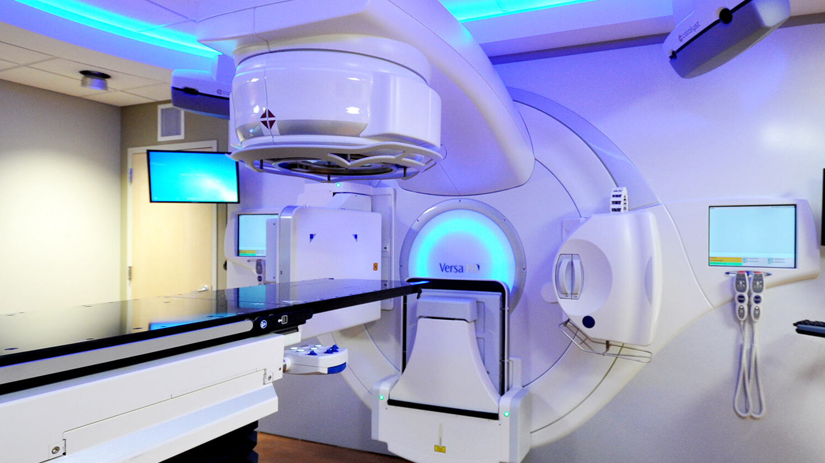
LINACs mecial applications
Electron linear accelerators are today the core of modern radiation therapy facilities
More widespread diffusion of this technology is prevented by maintenance cost
Maintenance cost is conditionned by harsh environments and lack of on-premise technical skills
“CERN-ICEC-STFC-hosted Workshop on Innovative, Robust and Affordable Medical Linear Accelerators for Challenging Environments”
SmartLINAC
Notes:
In research, at CERN, they are used as booster for circular accelerators

Slide 3
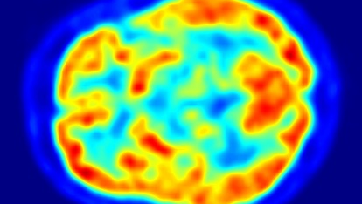
SmartLINAC project goals
Increase availability, reduce operational costs:
  Lower the technical skills maintenance requirements by:
    Fault diagnosis allowing local ressources to make guided interventions
  Planned maintenance by:
    Fault prediction (machine learning)
Increase scientific LINACs reliability to 99%
Bring medical LINACs reliability up to scientific’s reliability!!!
SmartLINAC

Slide 4
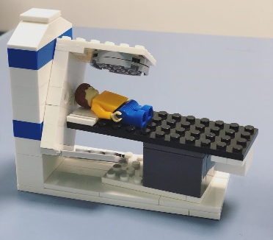

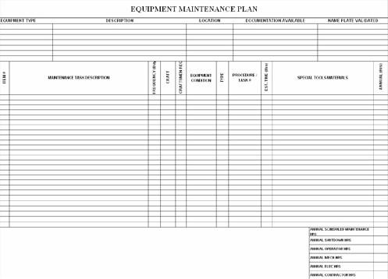

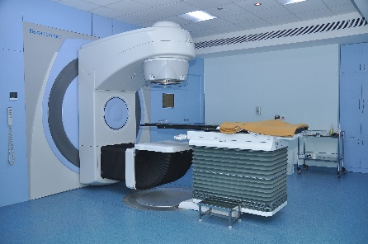

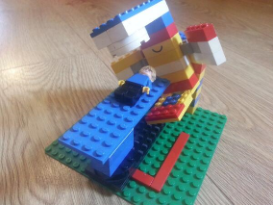
Personalized Preventive maintenance
Models trained on existing data from LINAC2/4
Initial maintenance plans
1
2
Initial models based on MTTF and know fault patterns
Real LINACs data
In different environments and operation constraints
3
5
Real data used to refine models
4
Personalized plans
and models

Slide 5
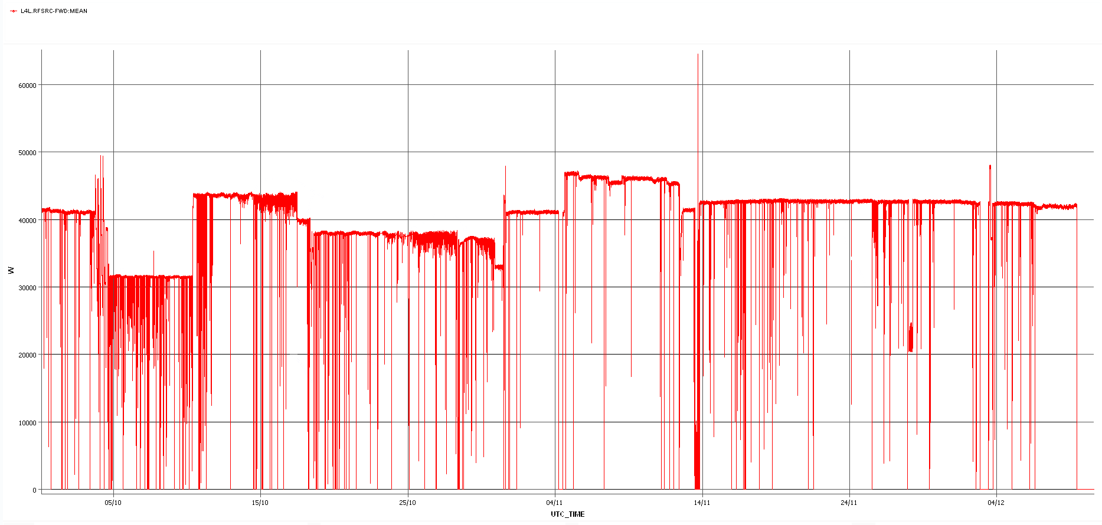
The LINAC4 RF power source data
Notes:
Challenges:
Understanding the nature of the data
Labelling the data
Understanding symptoms of anomalies
Highlighter: jitters (source decay)

Slide 6
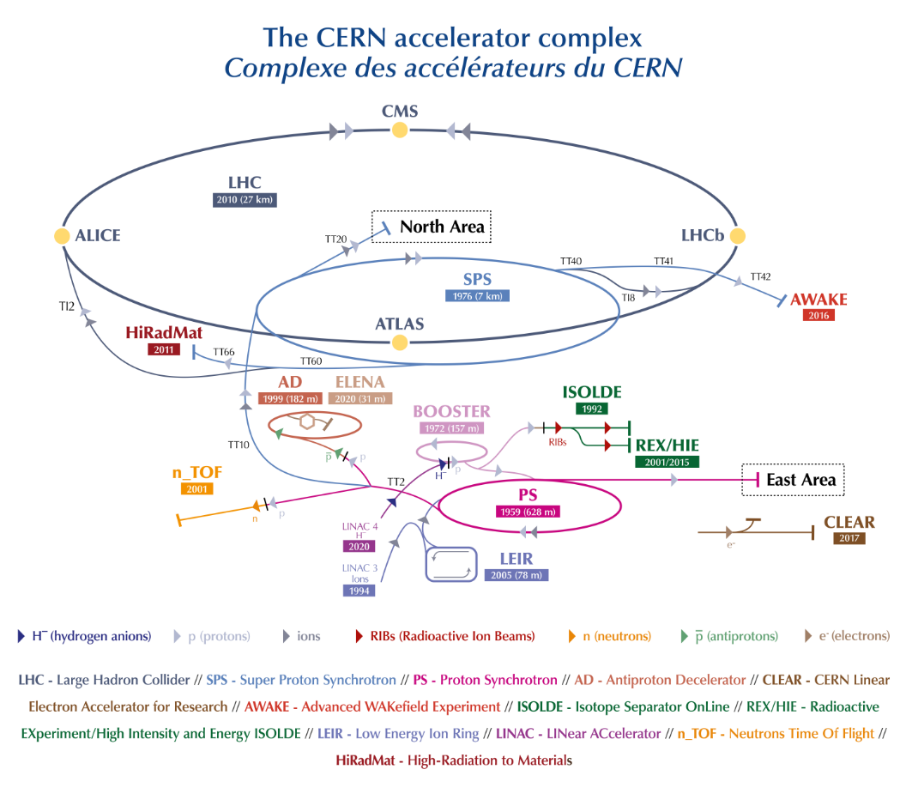
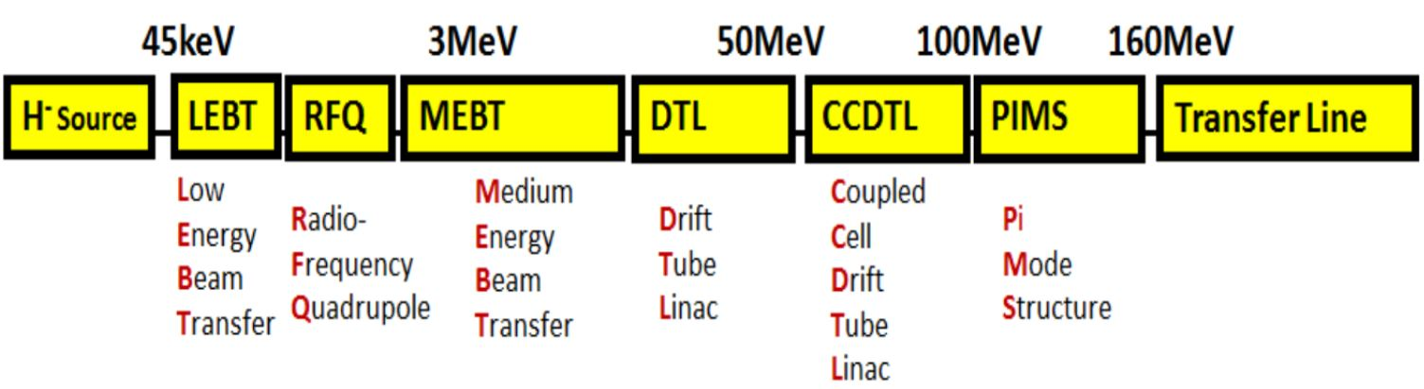
The LINAC4 RF?
Notes:
Why those data?
36,98%
Very representative data sample

Slide 7
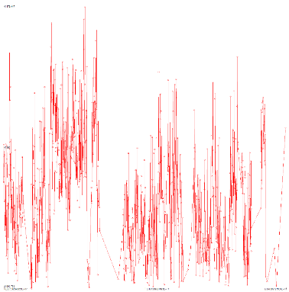
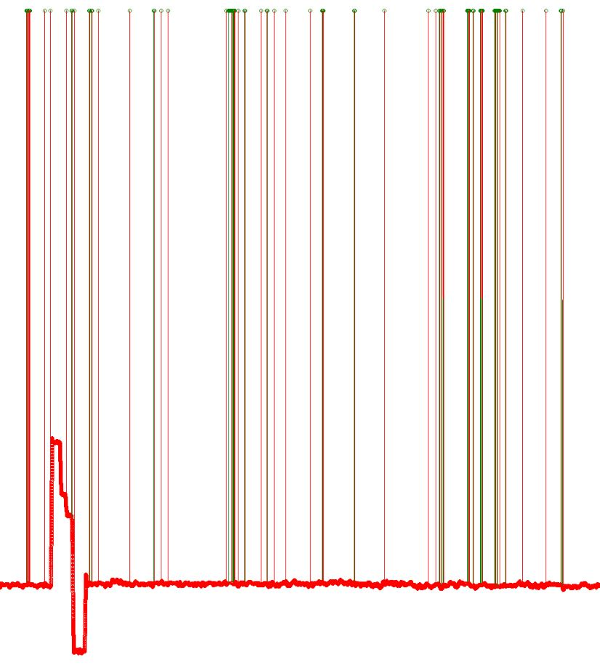
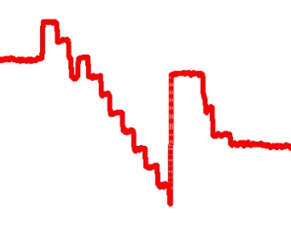



The noise
Volatility
Capture
Human
Jitters
Notes:
Different kind of noise,
Capture errors
Human interactions
General volatility
Jitters
Jitters are interesing as they have been found to be symptomatic of quality decay in the beam

Slide 8
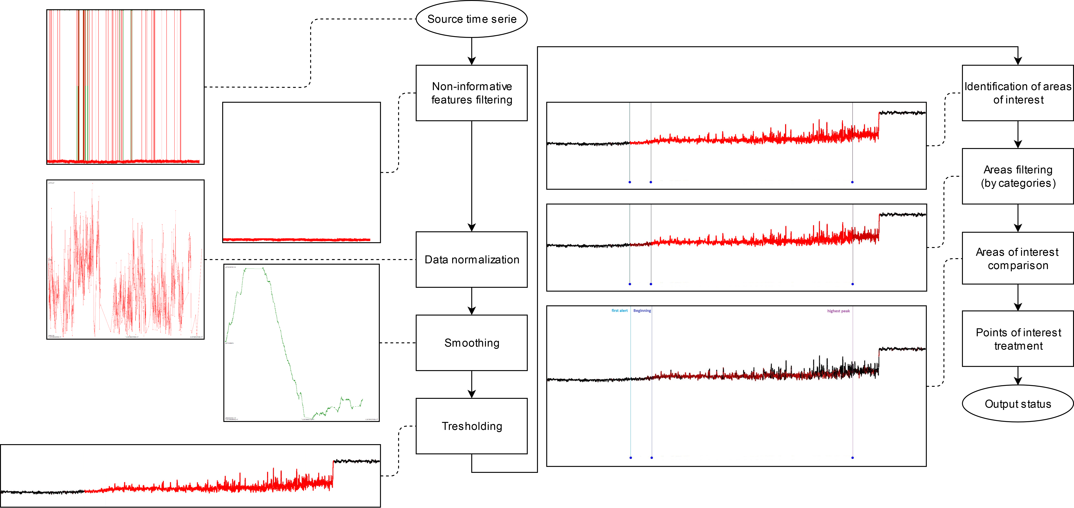
The (current) solution: SNiF
Notes:
neural network, KDE, ARI, statistical features analysis and Kalman filtering, none could tackle the challenge but all served well in understanding the data.
Proximity areas, prior to jitters with unique statistical properties
Many sources of false positive and false negative
New technique, based on a process developped for feature detection in images (BIM)
outliers filtering : Grubb’s test
Normalization the dataset: and Z-score algorithm
Smoothing using a Gaussian blurring kernel
Threshold: higher than average variance by sliding windows
Stochastic matrix comparison

Slide 9
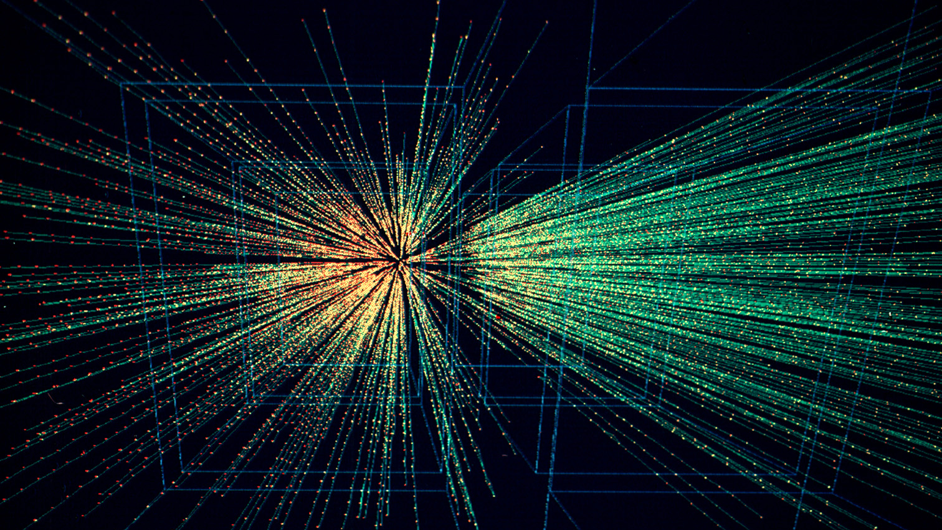
Future steps
Testing with more data from different sources
Building new collaborations
Test, train, repeat!
Platform

Slide 10
Thanks!
yann.donon@cern.ch

