Slide 1



Quantum Generative Adversarial Networks to Reproduce Calorimeters Outputs
CERN Openlab Technical Workshop
Su Yeon Chang, Sofia Vallecorsa

Slide 2
Motivation
Calorimeters outputs used to understand low distance processes occurring during the particle collision
Tremendous amount of time required by Monte Carlo based simulation to reconstruct outputs
→ Generative Adversarial Networks for fast simulations
Development on Quantum Machine Learning using compressed data representation in quantum states

Slide 3
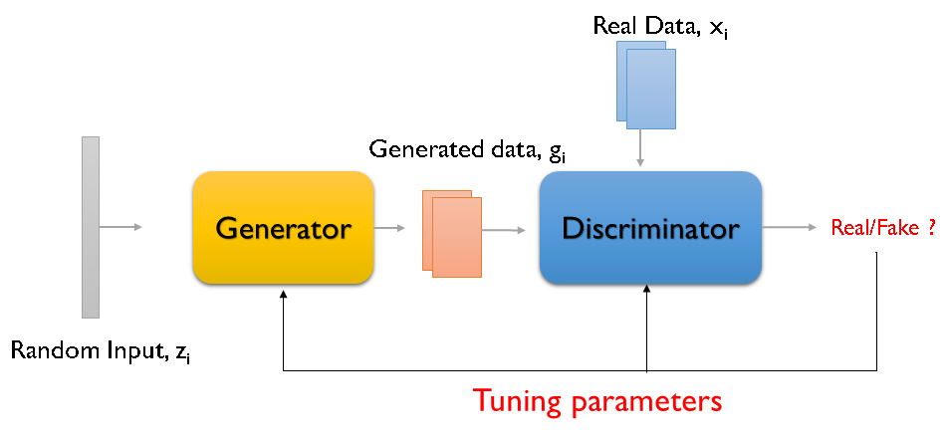
What is Generative Adversarial Network (GAN)?
Generative model with two neural networks :
Generator : Generates fake output from random input
Discriminator : Classify fake and real data
Play on minmax game with value function V
https://dl.acm.org/doi/proceedings/10.5555/2969033
$$V=\min_{G}{\max_{D}{E_{x\sim p_{real}(x)}[\log{D_{θ}(x)]}+E_{z\sim p_{z}}[log(1−{D_{θ}(G_{φ}\left(z\right)))]}}}$$
Likelihood to assign correct label to real samples
Likelihood to assign correct label to generated samples

Slide 4
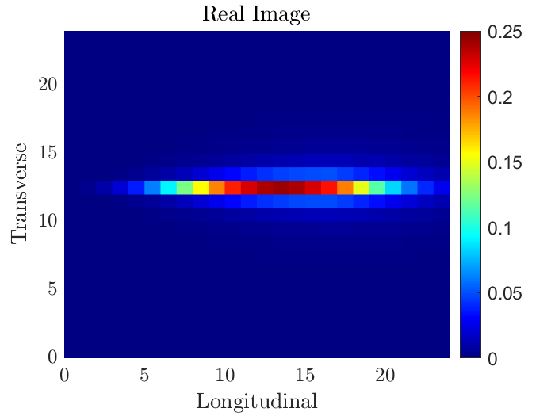
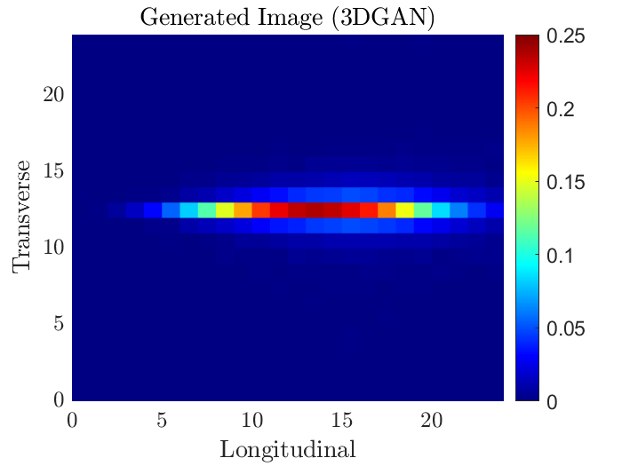
Application of GAN in HEP
Two-dimensional projection of 3D energy shower
→ Reproduced by 2D version of 3DGAN
Details on : https://indico.cern.ch/event/853334/contributions/3706456/attachments/1973668/3284005/3DGAN.pdf

Slide 5
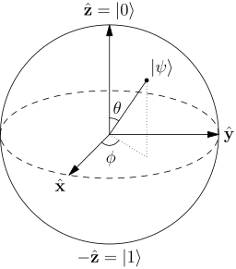

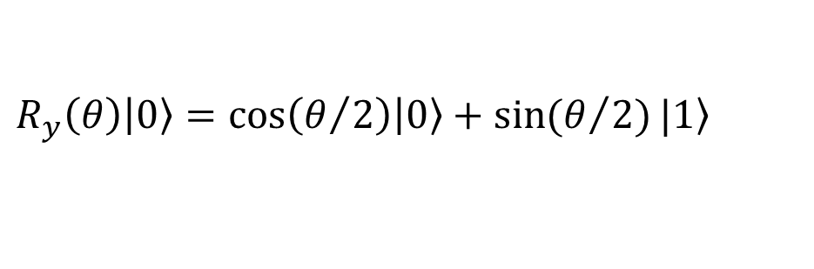
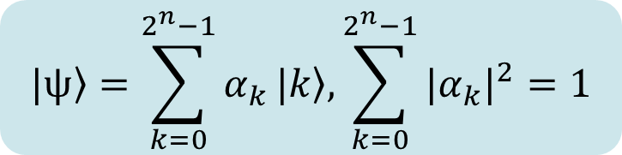
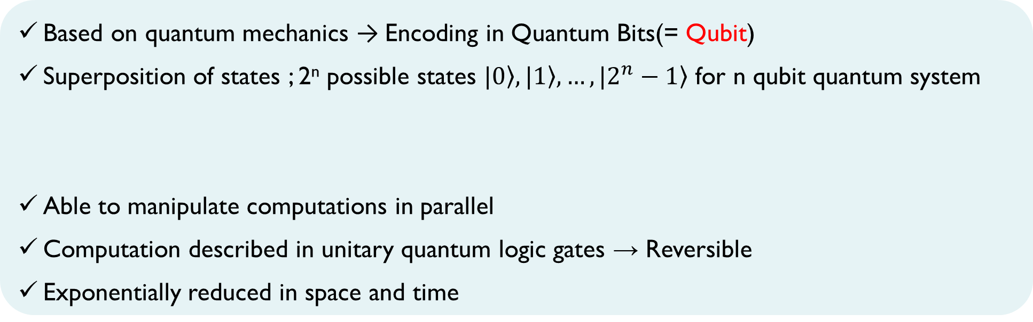
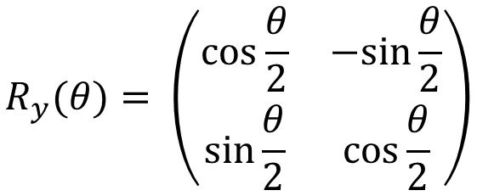
Principle of Quantum Computing (Circuit model)
Based on quantum mechanics → Encoding in Quantum Bits(= Qubit)
Superposition of states ; 2^{n} possible states $\left.|0\right\rangle , \left.|1\right\rangle , …,\left.|2^{n}−1\right\rangle$ for n qubit quantum system
Able to manipulate computations in parallel
Computation described in unitary quantum logic gates → Reversible
Exponentially reduced in space and time
$$\left.|0\right\rangle =\left(\begin{matrix}1 \\ 0\end{matrix}\right)\text{, } \left.|1\right\rangle =\left(\begin{matrix}0 \\ 1\end{matrix}\right)$$
$$\left.|ѱ\right\rangle =\sum_{k=0}^{2^{n}−1}{α_{k}}\left.|k\right\rangle ,\sum_{k=0}^{2^{n}−1}{{{|α}_{k}|}^{2}}=1$$
Example :
Pauli-Y-Rotation
$$R_{y}(θ)= \left(\begin{matrix}\cos{\frac{θ}{2}} & −sin{\frac{θ}{2}} \\ \sin{\frac{θ}{2}} & \cos{\frac{θ}{2}}\end{matrix}\right)$$
$$R_{y}\left(θ\right)\left|\left.0\right\rangle =\cos\left(θ/2\right)\right|\left.0\right\rangle +\sin{(θ/2)}|\left.1\right\rangle$$

Slide 6
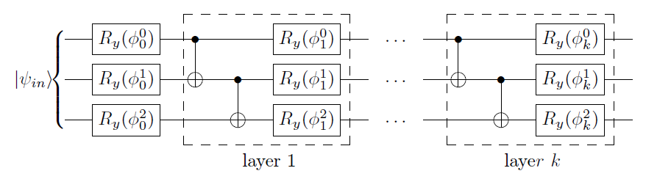
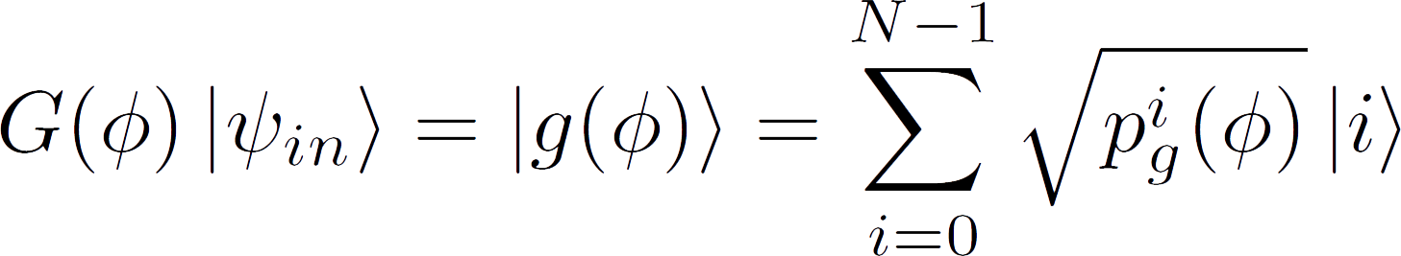
Quantum Generative Adversarial Networks
Based on QGAN model constructed by IBM (https://doi.org/10.1038/s41534-019-0223-2)
Hybrid model : Quantum Generator + Classical Discriminator
Efficient in loading and learning a probability over discrete values
More qubits → Higher resolution

Slide 7
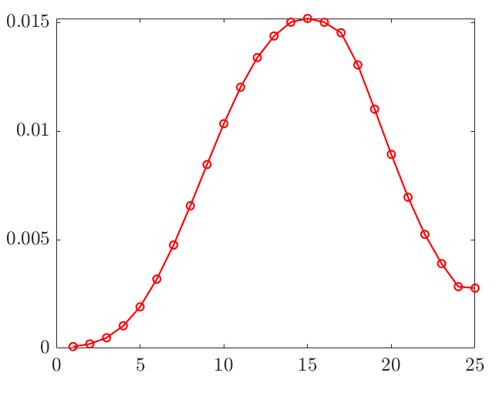
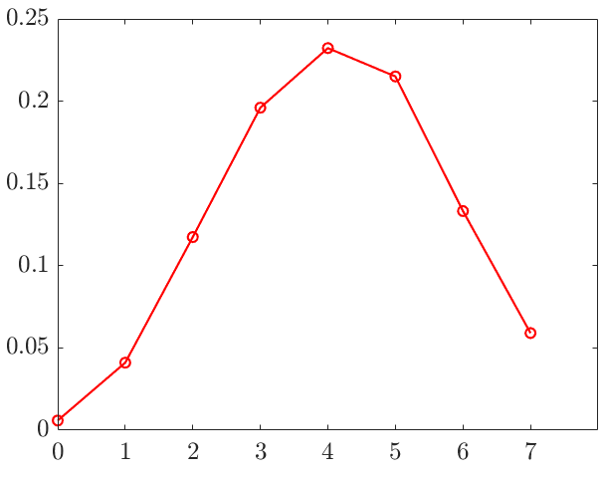
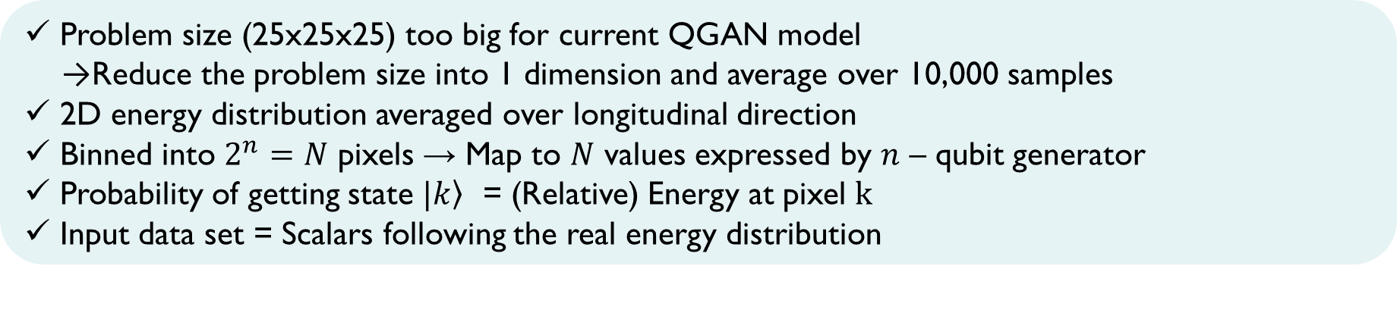
Application of QGAN in HEP
Application of QGAN in HEP
1D energy distribution
Problem size (25x25x25) too big for current QGAN model
→Reduce the problem size into 1 dimension and average over 10,000 samples
2D energy distribution averaged over longitudinal direction
Binned into $2^{n}=N$ pixels → Map to $N$ values expressed by $n$ – qubit generator
Probability of getting state $|\left.k\right\rangle$ = (Relative) Energy at pixel $k$
Input data set = Scalars following the real energy distribution

Slide 8
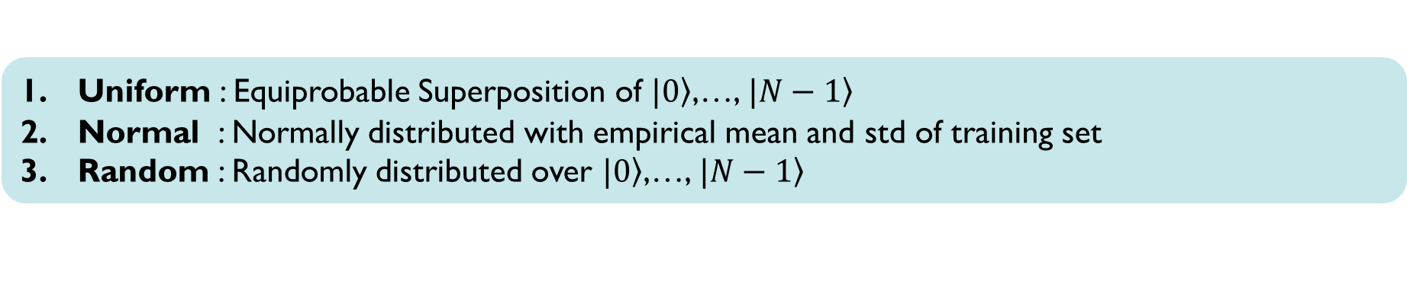
Application of QGAN in HEP
Application of QGAN in HEP
Preparation of Initial State
Uniform : Equiprobable Superposition of $|\left.0\right\rangle$,…, $|\left.N−1\right\rangle$
Normal : Normally distributed with empirical mean and std of training set
Random : Randomly distributed over $|\left.0\right\rangle$,…, $|\left.N−1\right\rangle$
Classical Discriminator
PyTorch Discriminator
512 nodes + Leaky ReLU → 216 nodes + Leaky ReLU → single-node + sigmoid
AMSGRAD optimizer for both generator and discriminator

Slide 9
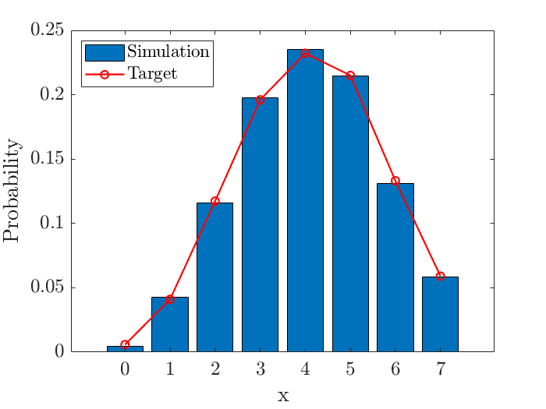
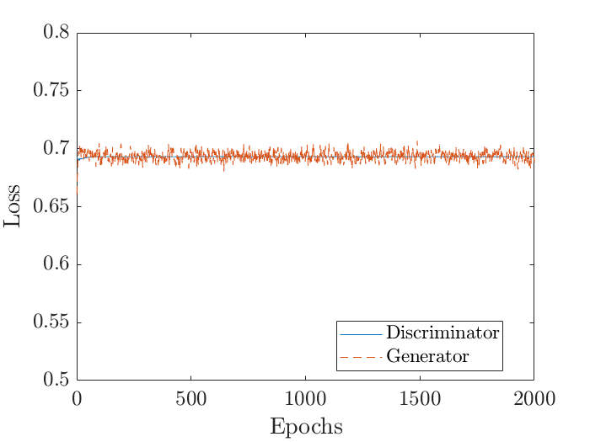
Application of QGAN in HEP (3 Qubits)
Depth 3 & Normal initialization

Slide 10
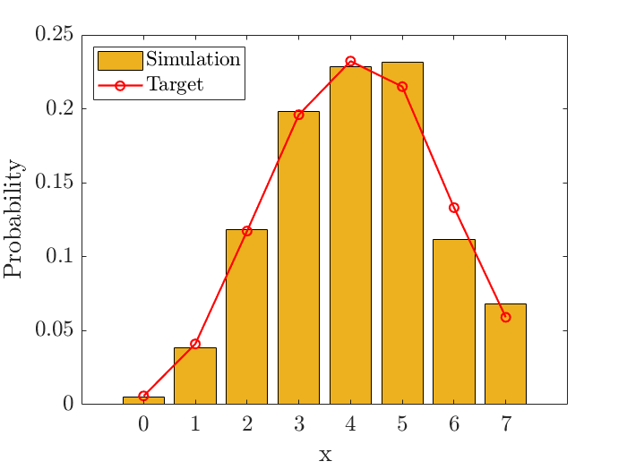
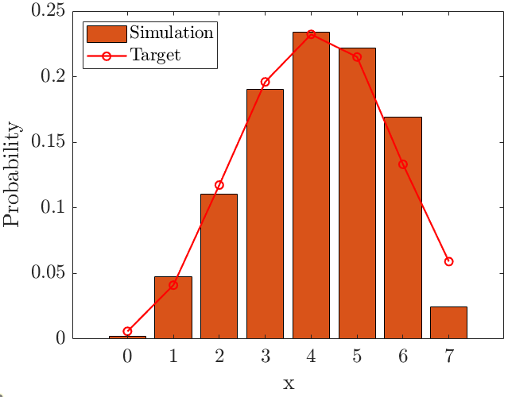
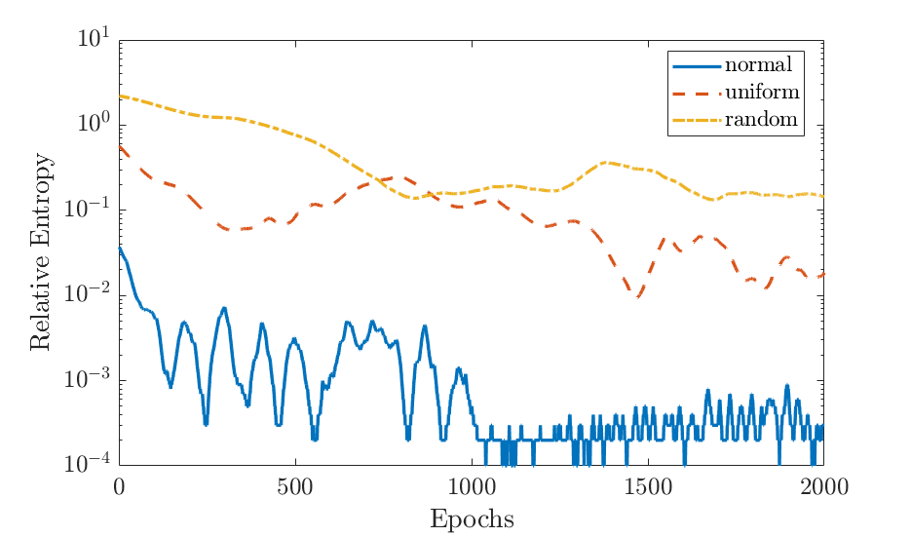
Application of QGAN in HEP (3 Qubits)
Progress in relative entropy for 3 qubits & depth 3
Random
Uniform
Quality of result depends on initial states
Normal

Slide 11
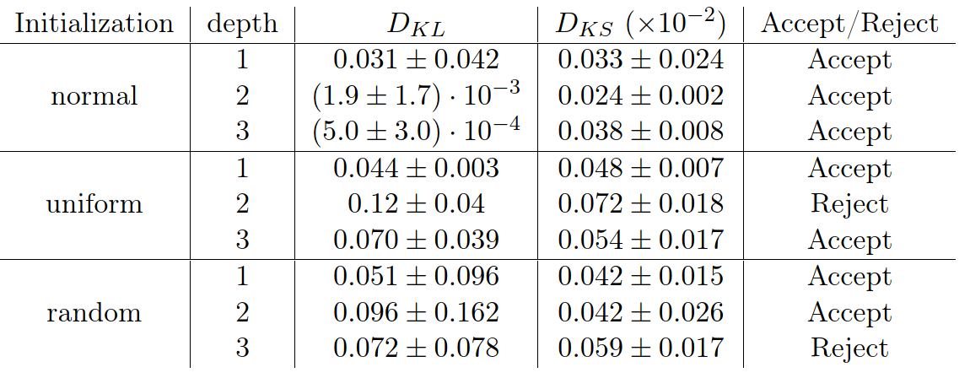

Application of QGAN in HEP (3 Qubits)
Kolmogrov-Smirnov Statistics : Measures equality between P(x) & Q(x)
→ With 95% confidence level & 1,000 samplings, null hypothesis is accepted if
$$D_{KS}⩽0.0547$$

Slide 12
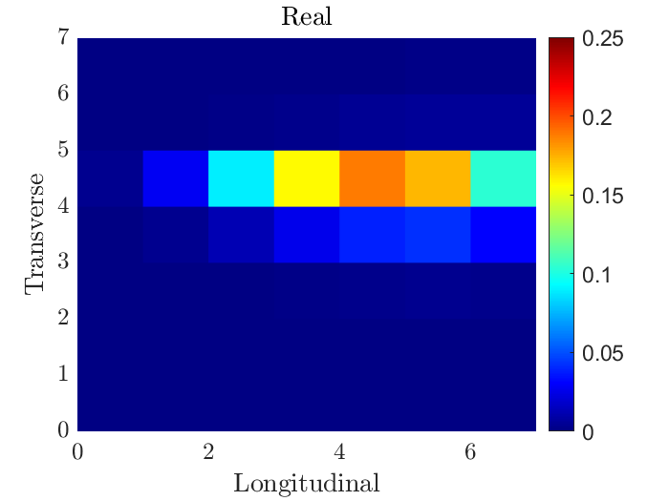
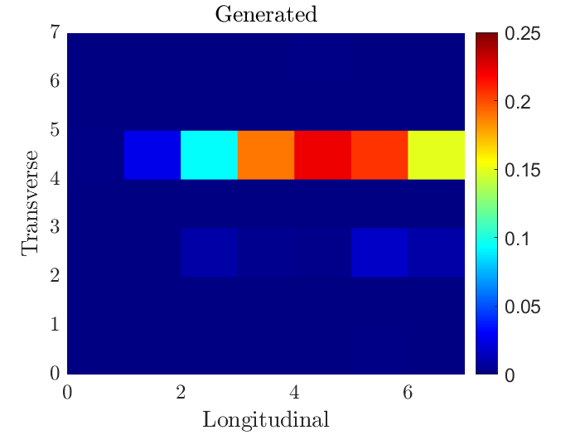
Application of QGAN in HEP (6 Qubits)
Using more powerful discriminator (4 hidden layers)
Uniform initialization + depth 1
After 3,000 epochs, able to reproduce similar shape

Slide 13
Conclusion
QGAN enables to reproduce a probability distribution with high fidelity
No exponential advantage proved yet
Limited in reproducing an average probability distribution over pixels
Aim to reproduce single image per run
1. Multidimensional QGAN, with a few qubits assigned for each pixel
→ Too expensive
2. Alternative approach to represent continuous variables
(ex : parametric approach)

Slide 14
Questions?
THANK YOU

