Slide 1



Quantum Optimization of Worldwide LHC Computing Grid data placement
Mircea-Marian Popa¹, F. Carminati², S. Vallercosa², F. Fracas², C. Grigoraş², L. Betev M. Carabaş¹, G. Pantelimon Popescu¹
¹University Politehnica of Bucharest, ²CERN
22/01/2020

Slide 2
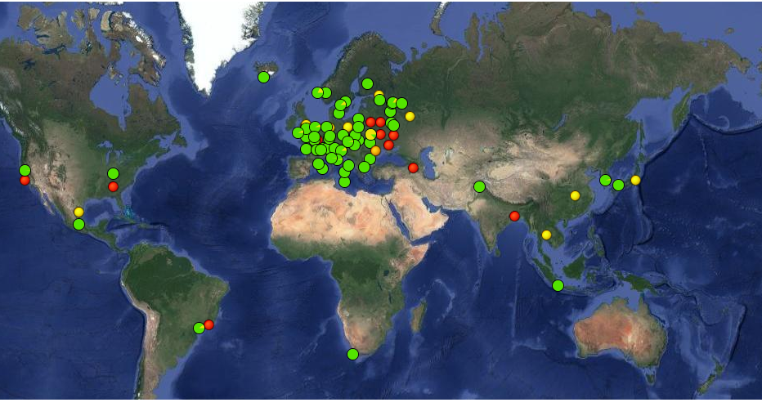
The Computing Grid
Connecting computer farms across the Globe
Clients launch jobs
Jobs run inside a computing farm and they access files
Files may be read from a remote storage element (SE) or they may be available locally
A file may have more than one copy spread across different storage elements

Slide 3
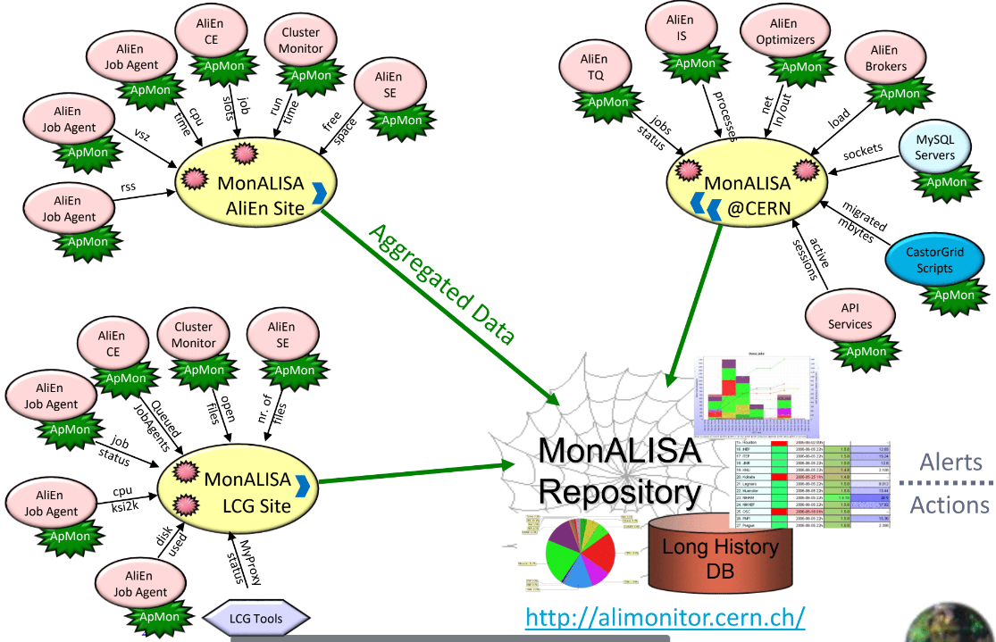
MonALISA
Coordinating and analyzing file transfer
Answers 2 types of questions (queries) from clients:
  which is the optimal SE to READ a input file from ?
  where to WRITE output data ?
Gathers data on network topology and SE availability
A set of central nodes answer queries using a heuristic
Currently focus on READ queries
  READ/WRITE ratio is 15/1 queries

Slide 4
Project Workflow
From Idea to Implementation
Goal: use a hybrid classical-quantum reinforcement learning algorithms to optimize global data access efficiency
  replace MonALISA heuristic with an intelligent agent
Steps:
  Gather raw data logged from the live system
  Preprocess raw data into a format suitable for machine learning
  Train classical deep/machine learning algorithms
  Develop quantum circuits to accelerate specific components

Slide 5
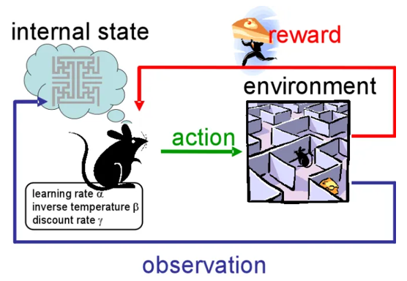
Reinforcement Learning (RL)
How software agents learn
An agent executes actions based on an input state in order to maximize a reward it will receive.
Agent-Environment interaction is key.
The Computing Grid is a dynamic environment.

Slide 6
MonALISA in a RL paradigm
Linking to RL elements
Agent: a machine learning algorithm
State:
  a Query
    a computing farm
    a list of SEs presented in no particular order
    a read size
Action:
  an Answer: a list of SEs optimally sorted
Reward:
  total throughput of the system
    Simulate using a Throughput Estimator (TE) (network)
Throughput
Grid environment
Answer: best SE
Choose best SE per query according to throughput
New throughput measurement

Slide 7
Throughput Estimator
Why do we need one ?
Throughput
MonALISA is a live system.
  The agent is pre-trained offline.
Need a benchmark function to asses the quality of the agent’s answers.
Throughput values are logged every 2 minutes.
  It is possible to get throughput values more frequently ?
  The Agent needs to modify its policy faster.
TE Input: (query, answer)
TE Output: Throughput
Throughput Estimator
Answer: best SE
Choose best SE per query according to throughput
New throughput measurement

Slide 8
Building the training data set
MonALISA is a very complex system
  ~120000 active jobs simulatneously
  ~150 million queries per 24 hours
Start by reducing problem size: focus on CERN(~ 40% of resources)
Log 24h raw data from the live system
Aggregate information from different sources/formats/time granularity
Correlate queries, answers and throughput values using the time tags
~500 ((queries, answers), throughput) values = training dataset

Slide 9
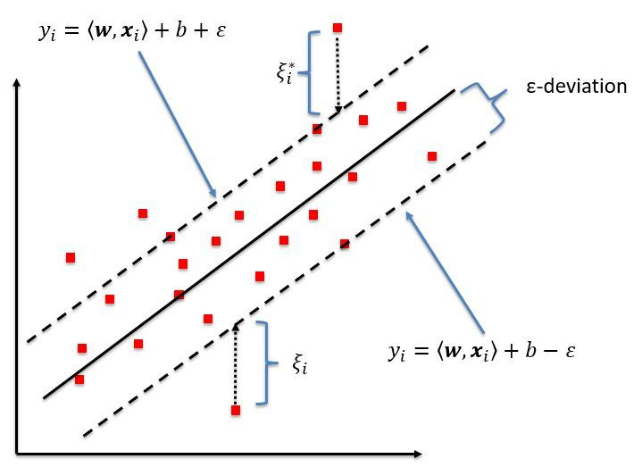
Throughput prediction
PRELIMINARY
Tested algorithms so far:
  Support Vector Regressor (SVR)
  Decision Forest Regressor
  Multilayer Perceptron - MLP
  Recurrent Neural Networks (RNN)
Metric M: mean absolute percentage error
Best so far
  Support Vector Regressor
    inspired by Support Vector Machine
    idea: include as many points as possible inside the margin
  Train: M= 55%, Validation: M= 65%
New data will be available in the near future → Deep Learning algorithms could be viable

Slide 10
Quantum Prospect
Reduces Theoretical Temporal Complexity
Use Quantum Computing to accelerate components in the RL approach
Reward Estimator network currently uses a SVR
Quantum Support Vector Machines are among the best studied cases today
  key: vector inner product is done using a quantum circuit
  can be adapted to a regression task
In the future: once quantum hardware interfaces faster with classical, the Agent could become quantum as well

Slide 11
Summary
Simulation and optimisation of a complex system such as MonALISA is a big challenge
We are re-casting the problem in terms of Reinforcement Learning
  Currently developing the Throughput Estimator
Initial results on a small dataset are promising
  Further optimisation is needed
  Alternative models (time series) will be investigated
A hybrid-quantum system is the final goal
  We will accelerate the Throughput Estimator by implementing it as a quantum circuit
Thank you

Slide 12
QUESTIONS?
mircea-marian.popa@cern.ch

Slide 13

CONTACTS
FEDERICO CARMINATI
CERN openlab CIO
federico.carminati@cern.ch
LATCHEZAR BETEV
ALICE Offline
Latchezar.Betev@cern.ch
SOFIA VALLERCOSA
CERN openlab
Sofia.Vallercosa@cern.ch
FABIO FRACAS
CERN openlab
fabio.fracas@cern.ch
COSTIN GRIGORAS
ALICE Offline
Costin.Grigoras@cern.ch
MIHAI CARABAS
UPB Associate Professor
mihai.carabas@gmail.com
PANTELIMON GEORGE POPESCU
UPB Associate Professor
pgpopescu@gmail.com
www.cern.ch/openlab

Slide 14
Building The Data Set
Size of the system:
  ~120000 active jobs each moment in time
  ~150 million queries per 24 hours across the entire Grid
Reduce problem size: use only queries for which CERN is the optimal choice
Log 24h raw data from the live system:
  A set of queries:
    count: ~ 4 million
  A set of measured throughput values:
    count: 627
Use MonALISA logs to answer queries
  Simulate the heuristic based onnetwork topology and SE availability
Correlate (queries, answers, throughput values) using the time tags, one can build a training set for the Reward Generator.

Slide 15
Building The Data Set
Part 2
Small data set at the moment:
  training: 501
  validation: 126
  why ?
    627 throughput values sampled at 2 minutes interval => a span of 1254 minutes = ~20 hours
    despite huge number of logged queries
In a 2 minute interval:
  maximum 96224 queries
  minimum 267 queries

Slide 16
Building The Data Set
Part 3
Problem: feeding one query answer at a time to the TE is not feasible
Solution: grouping total read size in a temporal bin ; example given:
  take a 60 minute period ending at the moment in time a throughput value is received
  split the period into 1000 equally-sized temporal bins
  60 minutes / 1000 = 3.6 seconds bins
  sum up the read size of all the queries that are perceived in a temporal bin
  why ?
    query answers favor CERN => more queries see CERN as their optimal option => read size per temporal bin is influenced

