Slide 1

Non-linear thinking for Puzzled CBIsters
October 25th, 2019 Markus Nordberg (CERN)
Here at CERN we are for not solving incremental challenges
…but what does it really mean?
Talk to Pablo, folks. These slides are by him!

Slide 2

Why would you be interested in “exponential”?
Because you maybe interested in “sustainability”
Let’s briefly explore together.

Slide 3
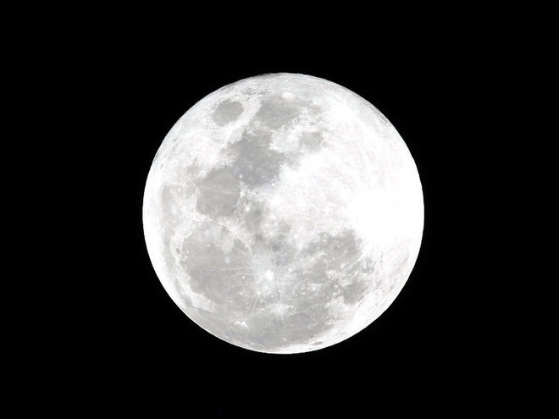
Second story: What is the cheapest way to get to the Moon?

Slide 4
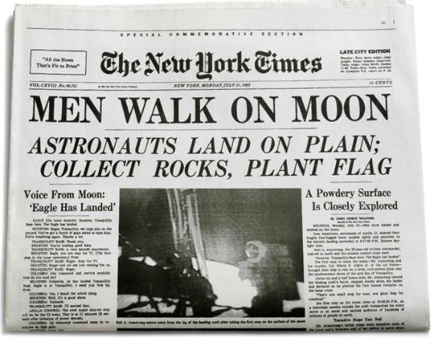
What is the cheapest way to get to the Moon?
1. Take a piece of paper.
2. Start folding it in half each time.

Slide 5
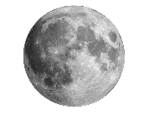
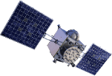




What is the cheapest way to get to the Moon?
45 folds ~ Congratulations, you have reached the Moon!
40 folds
~ GPS satellite orbit
30 folds
~ Altitude of planes
25 folds
~ Empire State Building
Folding increases thickness exponentially

Slide 6
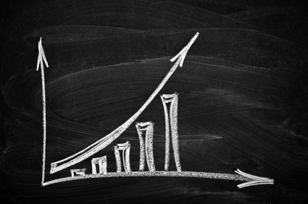
How does exponential growth looks like?
Amount of stuff
Time

Slide 7
Source:
“Global Change and the Earth System: A Planet Under Pressure” (2004), W. Steffen, et al., Springer-Verlag Berlin Heidelberg New York.

Slide 8
Source:
“Global Change and the Earth System: A Planet Under Pressure” (2004), W. Steffen, et al., Springer-Verlag Berlin Heidelberg New York.

Slide 9
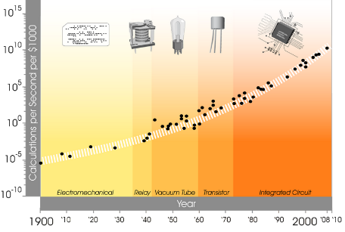
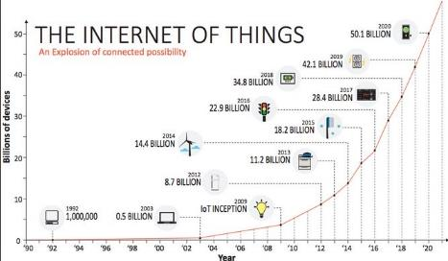
Technology seems to grow exponentially…
Internet of Things: online guide to the Internet of Things, http://www.i-scoop.eu/internet-of-things/ and https://exponential.singularityu.org/

Slide 10
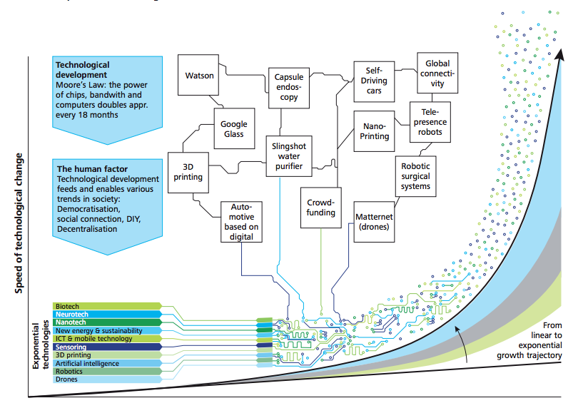
As well as the way several technologies are converging, adopted and the possibilities they may bring…
Source: Deloitte 4.0 report 2015 https://www2.deloitte.com/content/dam/Deloitte/ch/Documents/manufacturing/ch-en-manufacturing-industry-4-0-24102014.pdf

Slide 11
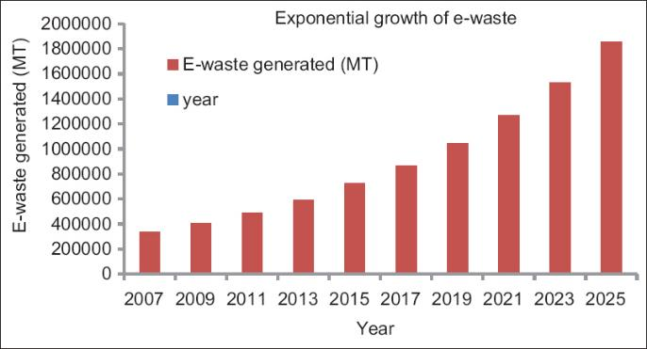
…but this doesn’t come for free…
(India figures)
J. Annamalai, Occupational health hazards related to informal recycling of E-waste in India: An overview, Indian Journal of Occupational and Environmental Medicine, Vol. 19, No. 1, January-April, 2015, pp. 61-65.

Slide 12
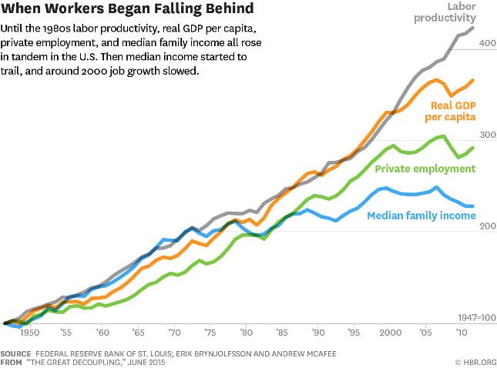
Quite some wise voices are starting to talk about “The Great Decoupling”:
productivity is rising, but employment may not.

Slide 13

The rule of 70
Quick math trick
Doubling time $=\frac{70}{\% growth rate}$
For example, if somebody tells you
that unemployment in your region
has 2% annual growth it will double in just 35 years.

Slide 14
Conclusion: We hope humankind will follow the right law…
Solutions
Problems
Solutions
Problems
Law of increasing ignorance
Law of increasing wisdom
But it is just hope…after all, we are just physicists working at CERN…

Slide 15
Transformation wanted!
Unknown
Paradigms
(Transformative Innovation)
Potentials
(Breakthrough Innovation)
Known
Facts
(No Innovation)
Possibles
(Incremental Innovation)
Knowns
Unknowns

Slide 16
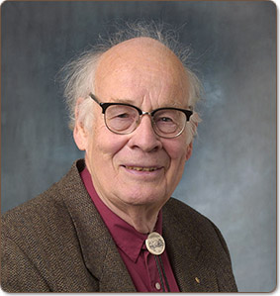
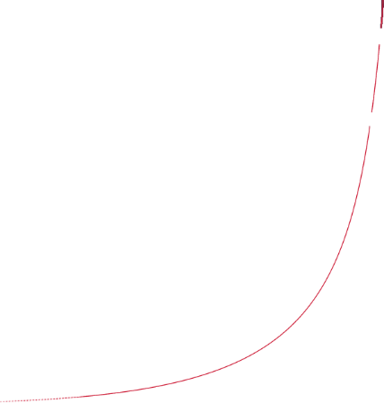
Thanks for your attention questions…
The greatest shortcoming of the human race is our inability to understand the exponential function.
Albert A. Bartlett (1923-2013), Physicist

