Slide 1


Probing Physics Beyond the Standard Model also in Finland?
Wladyslaw H. Trzaska

Slide 2


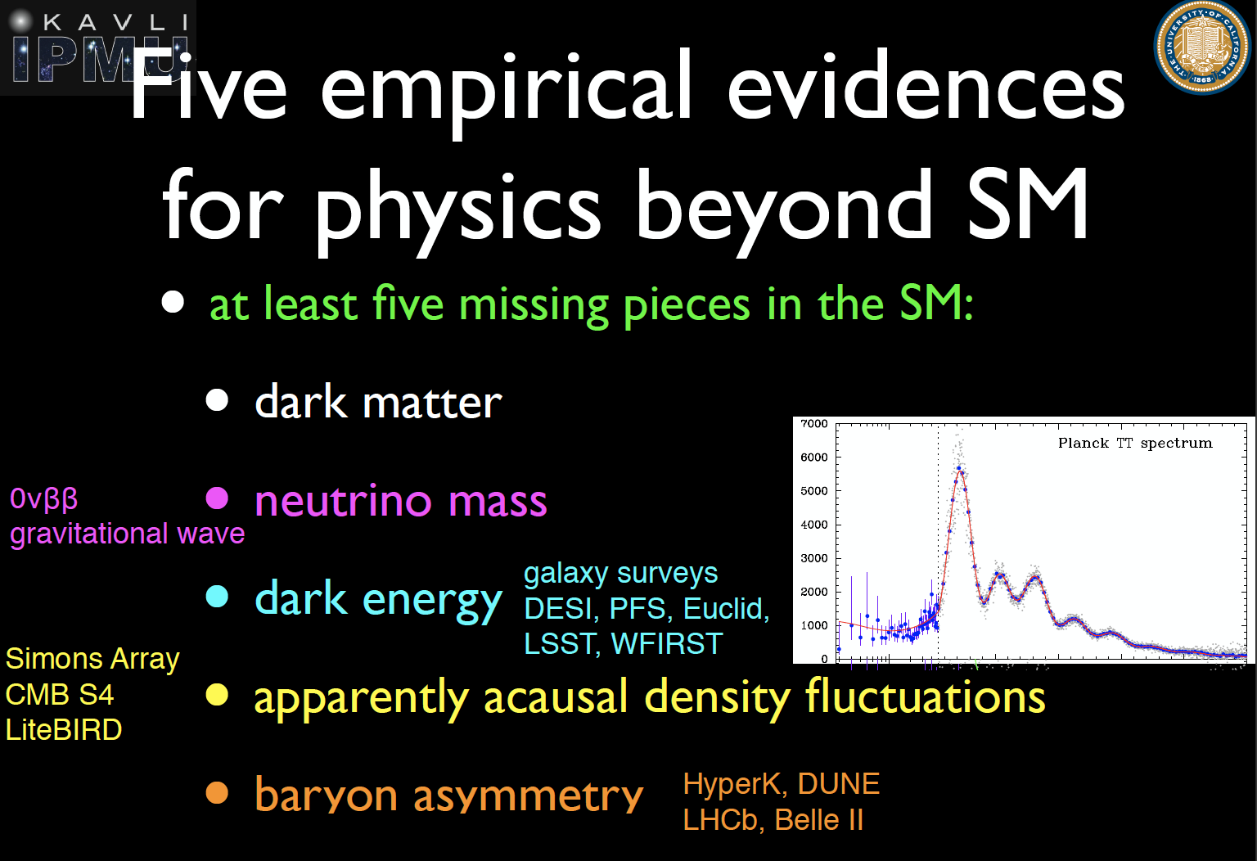
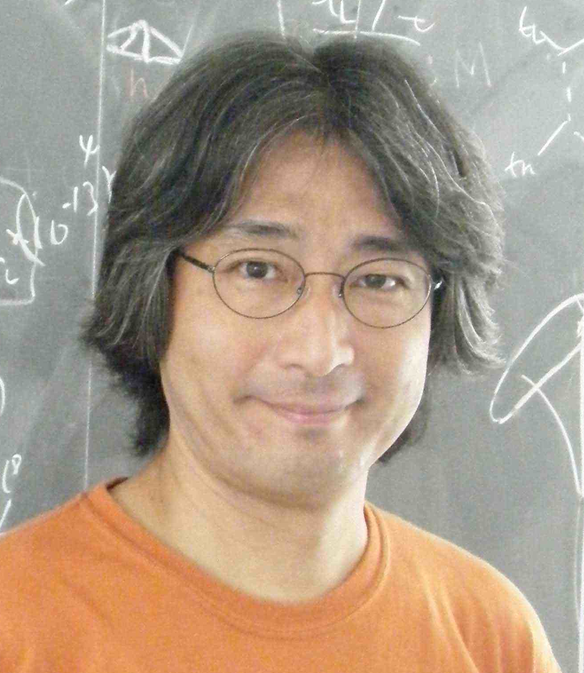
540 participants
2 Nobel laurates
Plenary talk by
Hitoshi Murayama
at the opening session
of TAUP 2019

Slide 3
Implicit conclusions
➔ Get more data; especially interesting would be extragalactic neutrinos
There is a broad consensus that we are at the threshold of a major breakthrough discovery in physics → keep looking!
We need more data → the first key steps towards the solution are bound to come from experiments!
Since neutrinos are the only known particles disobeying the predictions of the SM → focus on neutrinos!
Significance of cosmological aspects → importance of extragalactic messengers

Slide 4
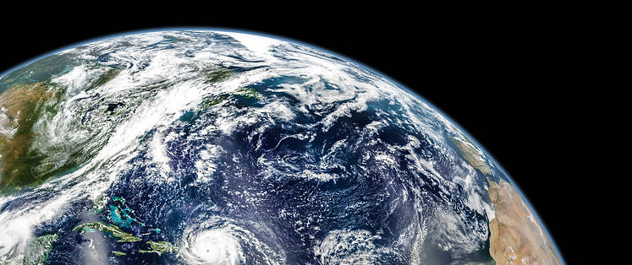
Global response to the BSM challenge
Just a few examples

Slide 5
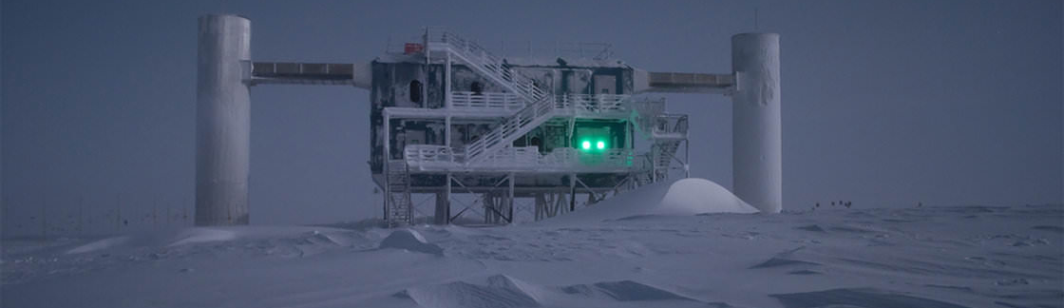
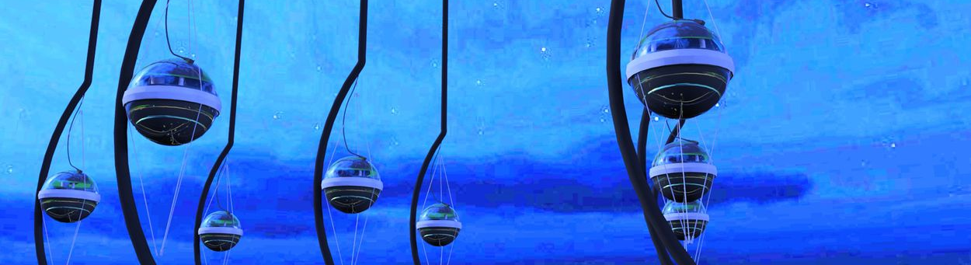
IceCube

Slide 6


Jiangmen Underground Neutrino Observatory
Multipurpose, medium-baseline
reactor neutrino experiment
20 kton LS
36 GW_{th}
53 km
~550 participants from 72 institutions in 17 countries

Slide 7
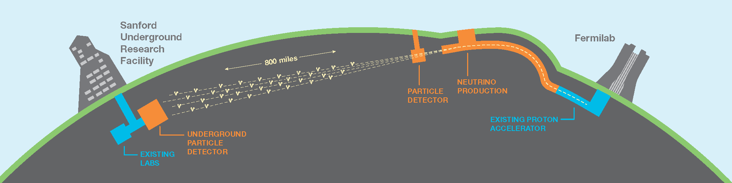

Collaboration
LBNO - phase of CP violation
in the leptonic sector
~1000 members, 184 inst. 32 countries + CERN

Slide 8
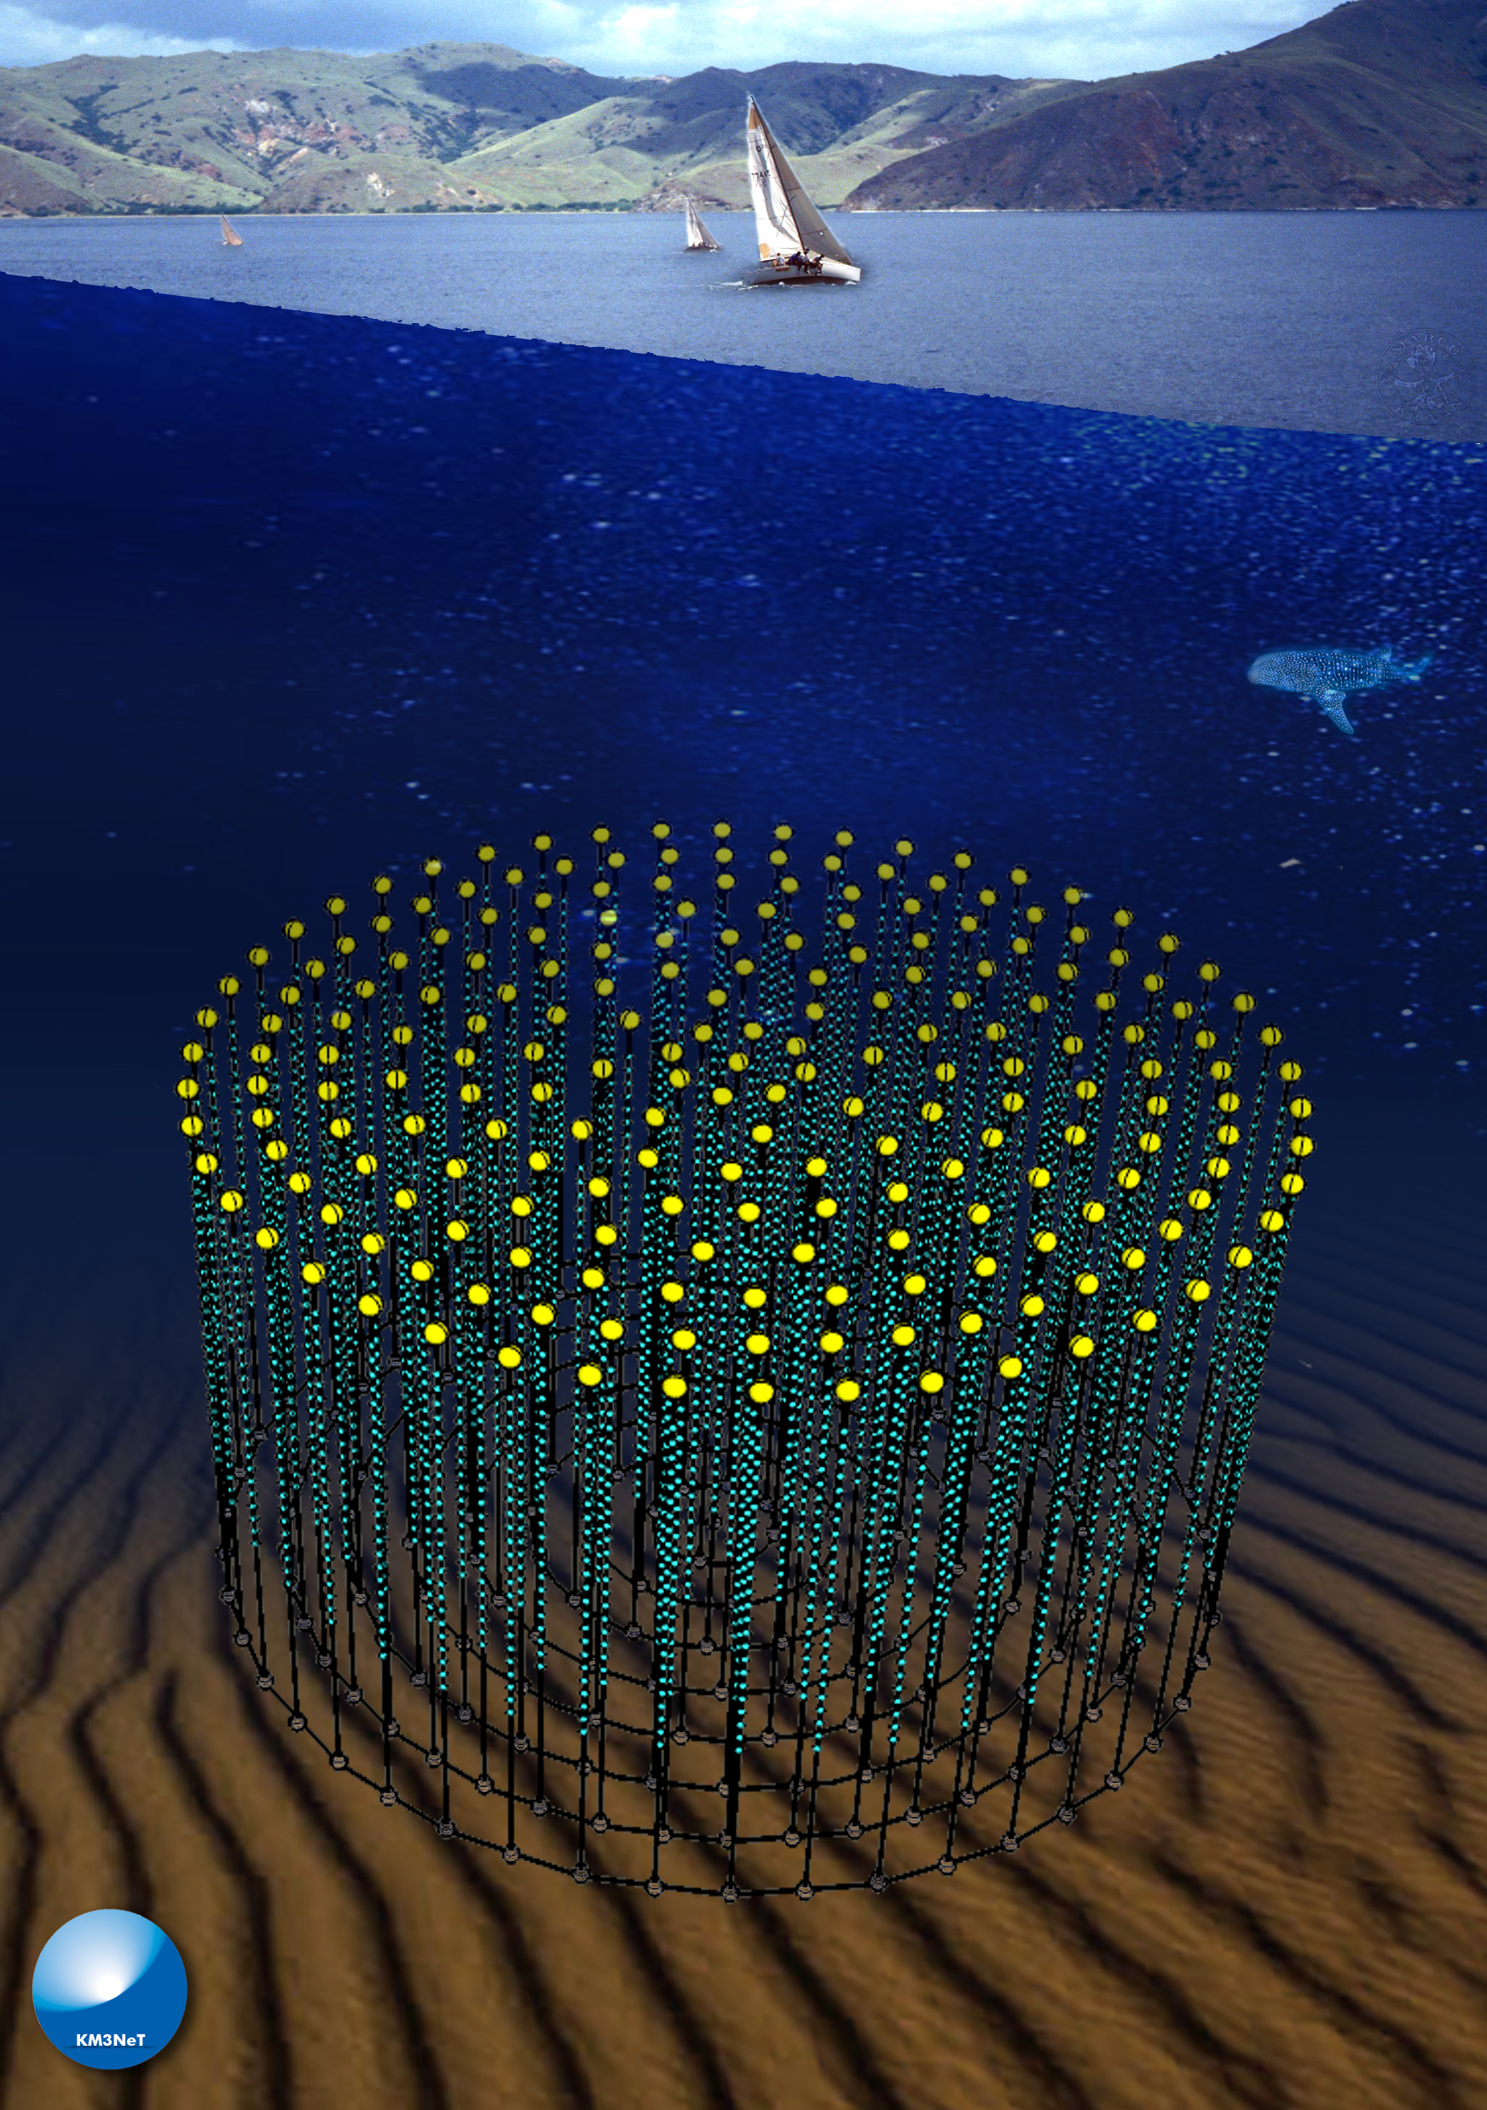
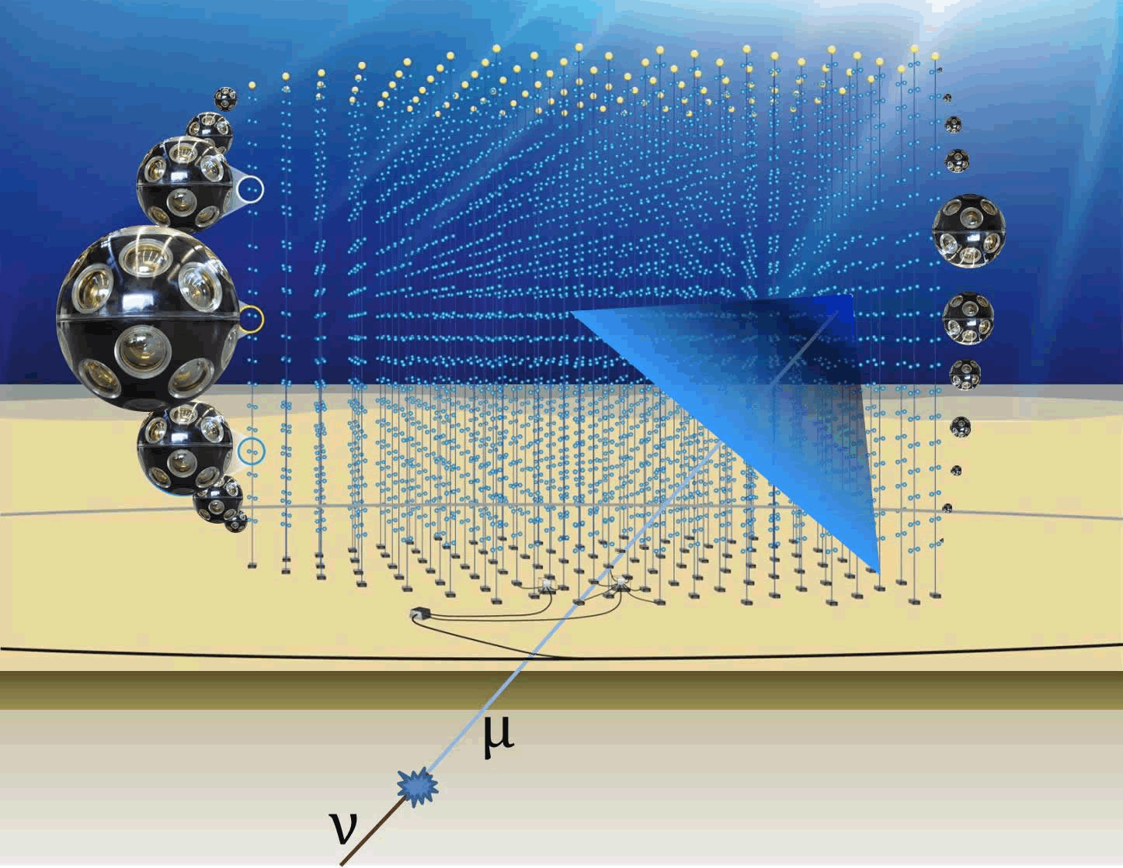
KM3NeT

Slide 9


What could be done in Finland now?
No financial resources → a novel idea is needed
No new constructions → use the available infrastructure
No new positions → rely on the network of experts

Slide 10

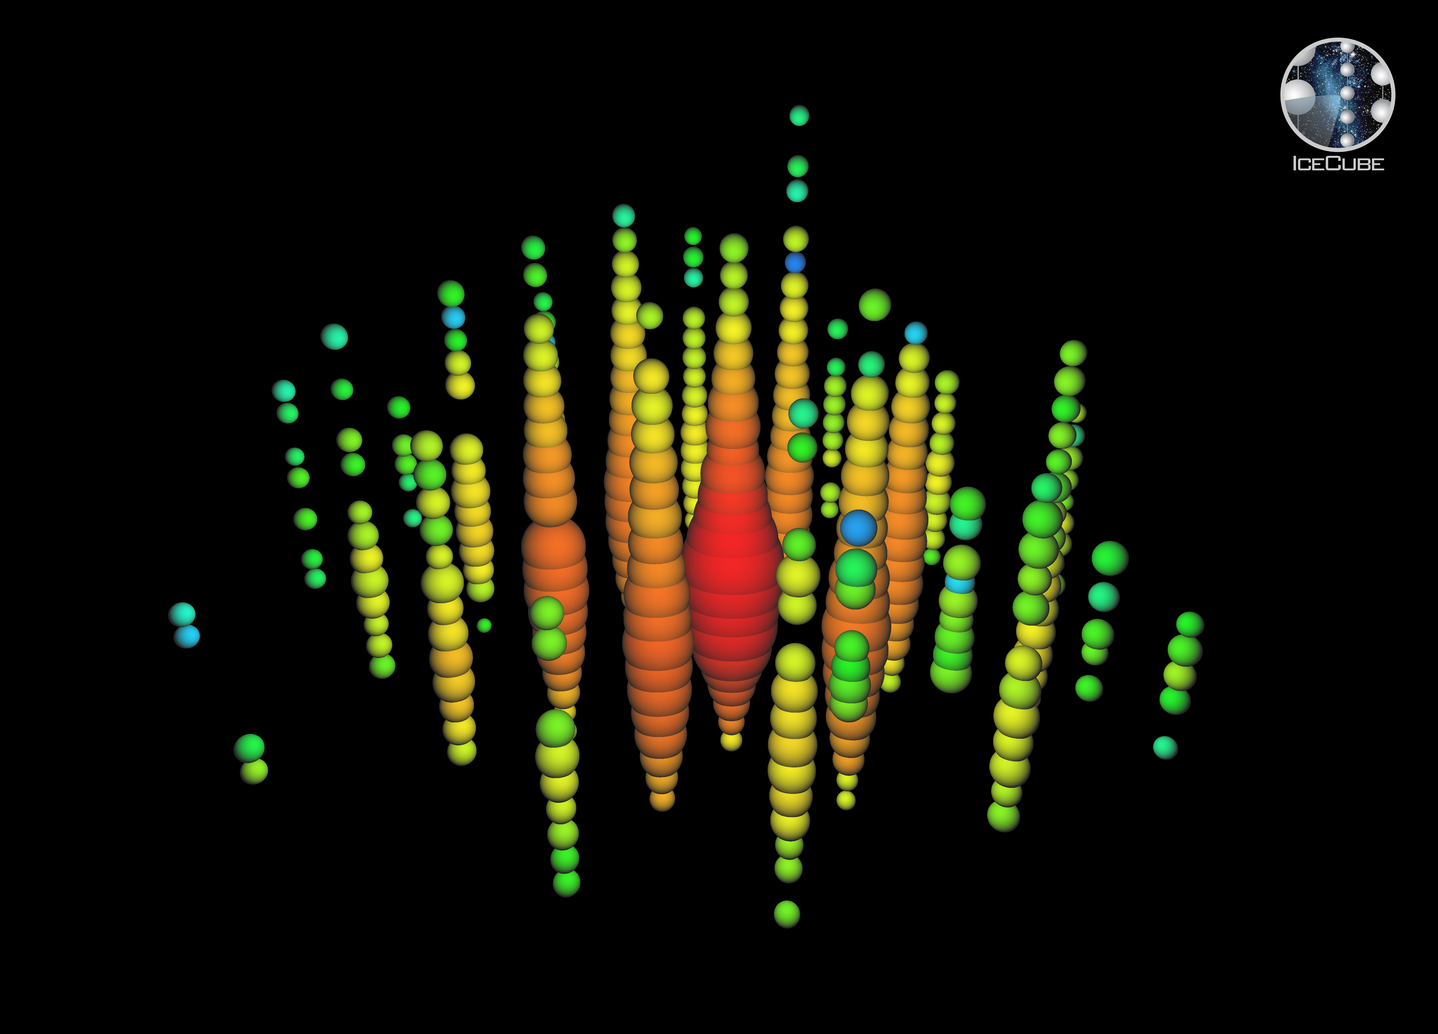
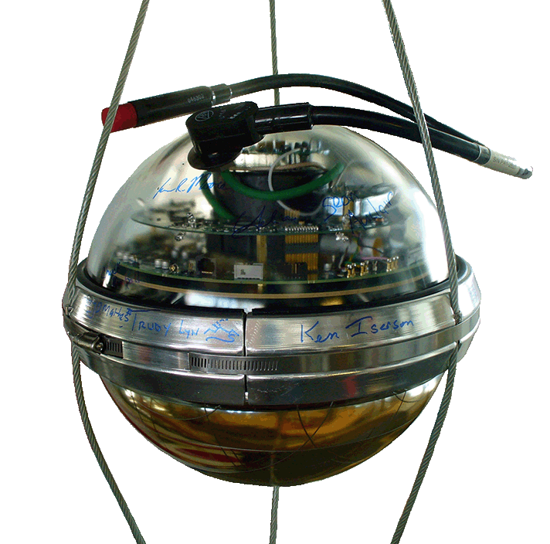
Background for the idea
Ernie: 1.14 PeV neutrino
Ultra high-energy neutrinos are extragalactic & rare
  giant target mass + long measurements
Size of water and ice-based experiments is limited ~km³
The density of water and ice is only 1 g/cm³
IceCube optical sensors are pointing downwards
  not optimized for top-to-bottom events
EeV neutrinos are not expected to traverse Earth

Slide 11
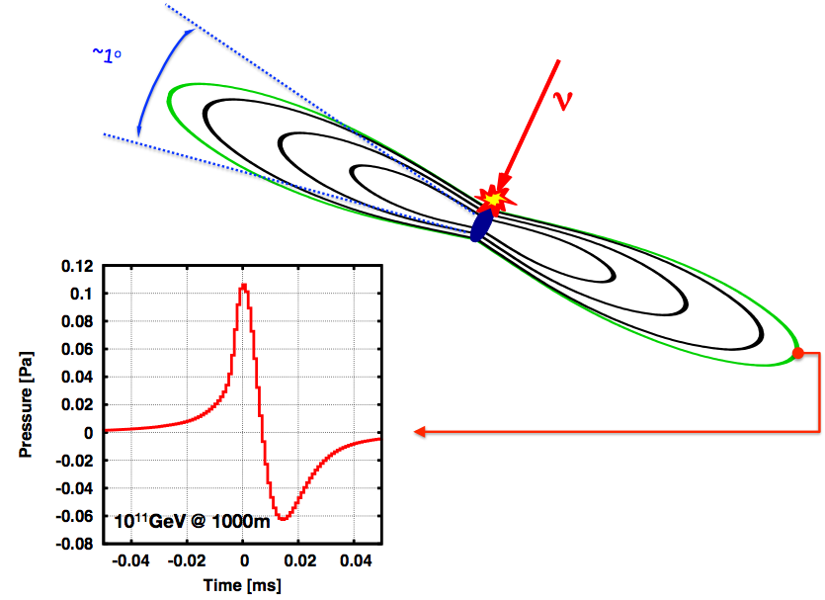

The idea: Acoustic detection of EeV neutrinos in bedrock
2018
Oral presentation and
peer-reviewed proceedings:
EPJ Web of Conferences 216, 04009 (2019)
https://arxiv.org/abs/1909.00417
Acoustic and Radio EeV Neutrino detection Activities

Slide 12
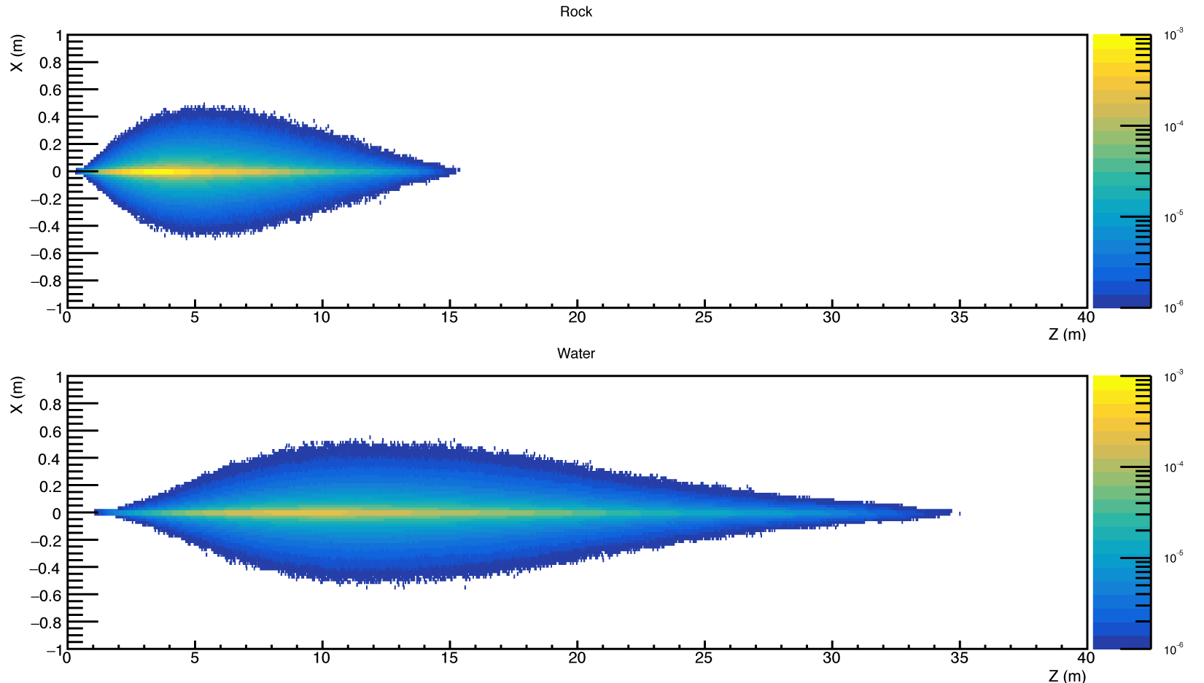
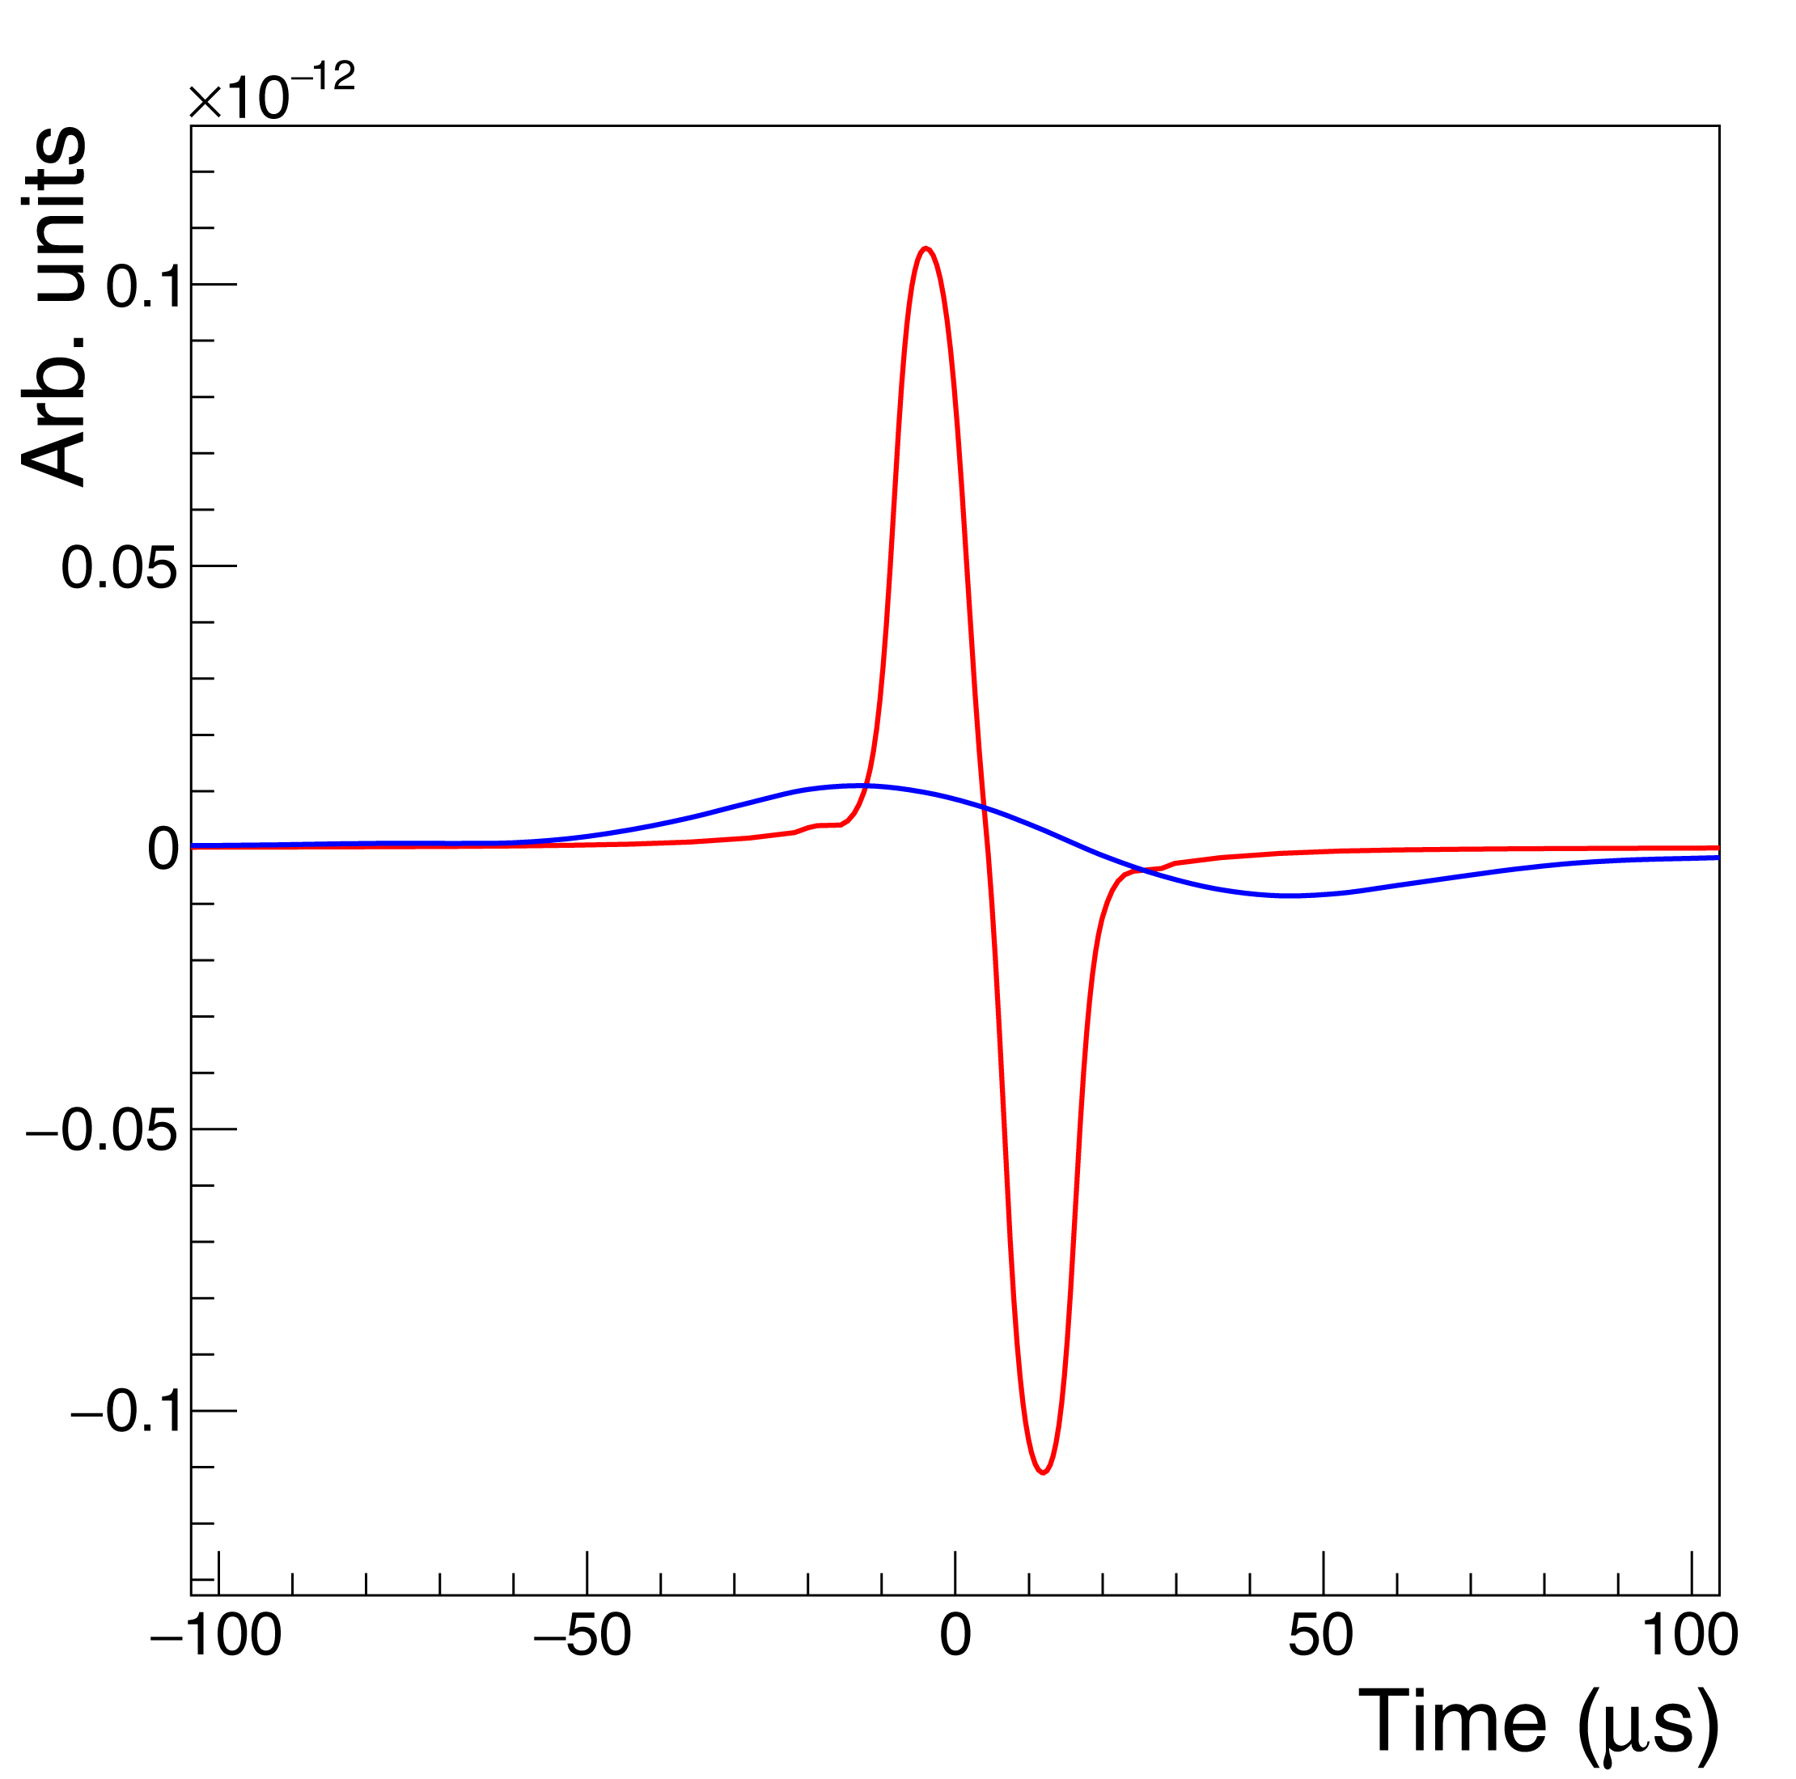
Rock vs. water
3x larger density
→increased target mass
→ higher event rate for neutrinos
4x larger speed of sound
10x larger pressure pulse
Longer attenuation length
Logistics (mine vs. ocean)

Slide 13
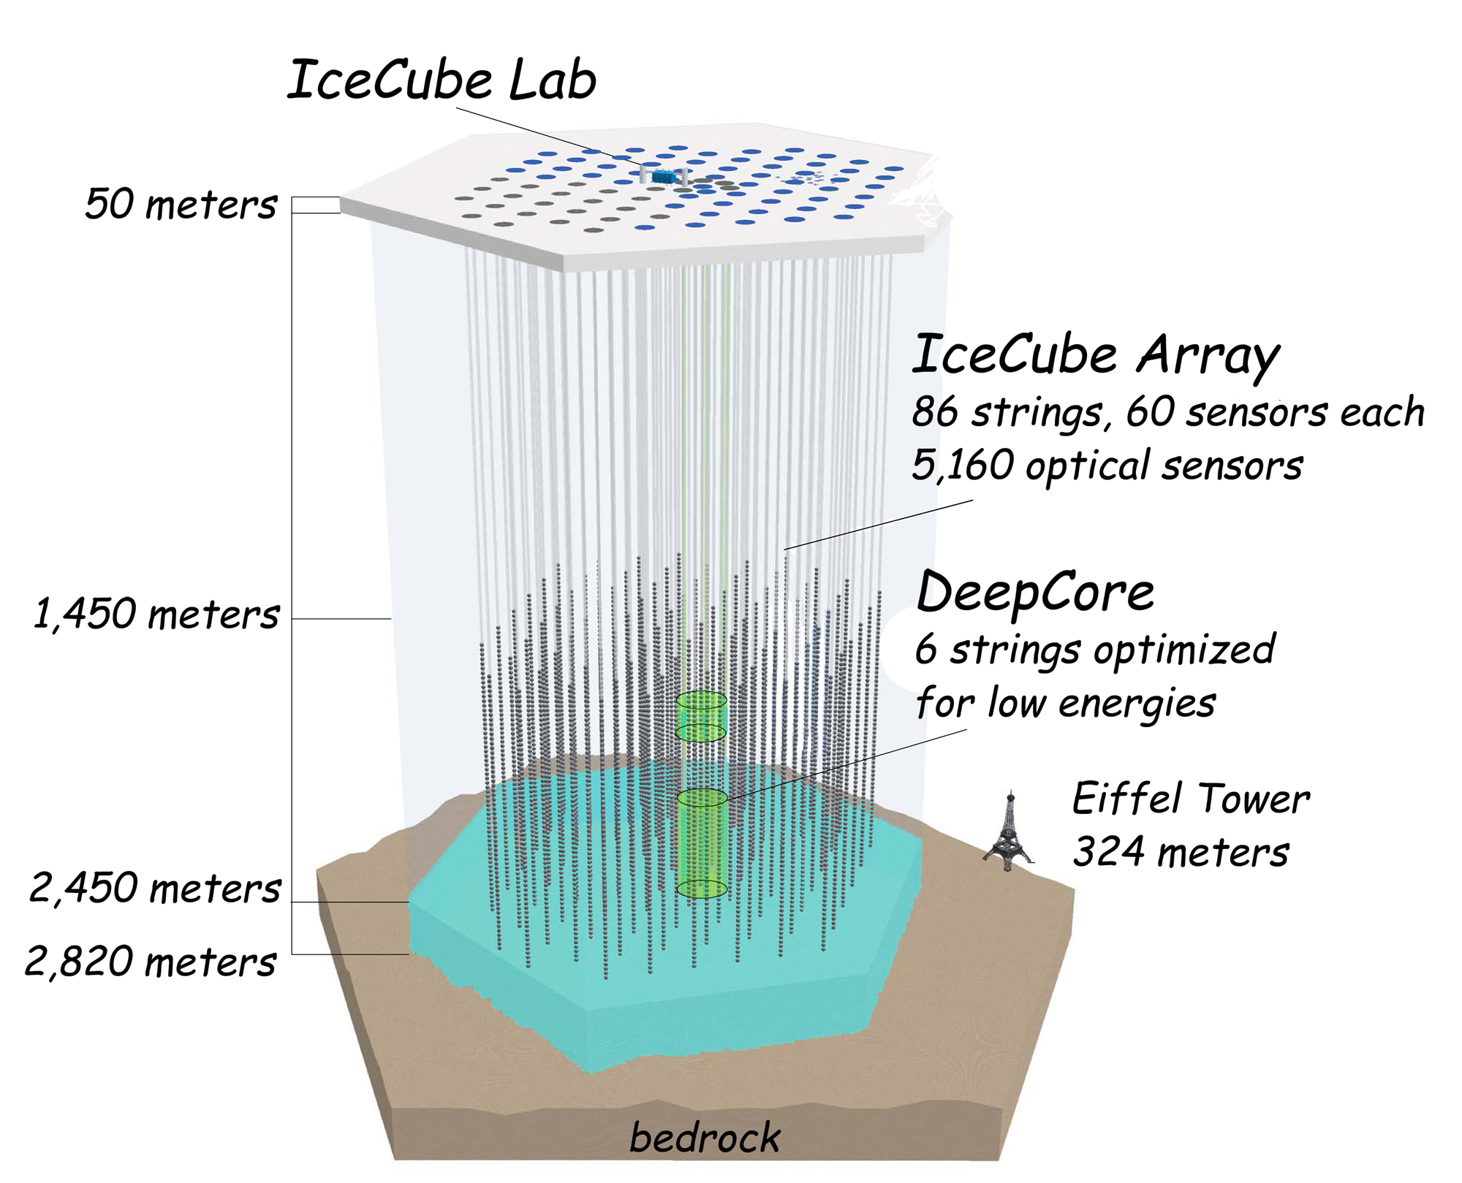
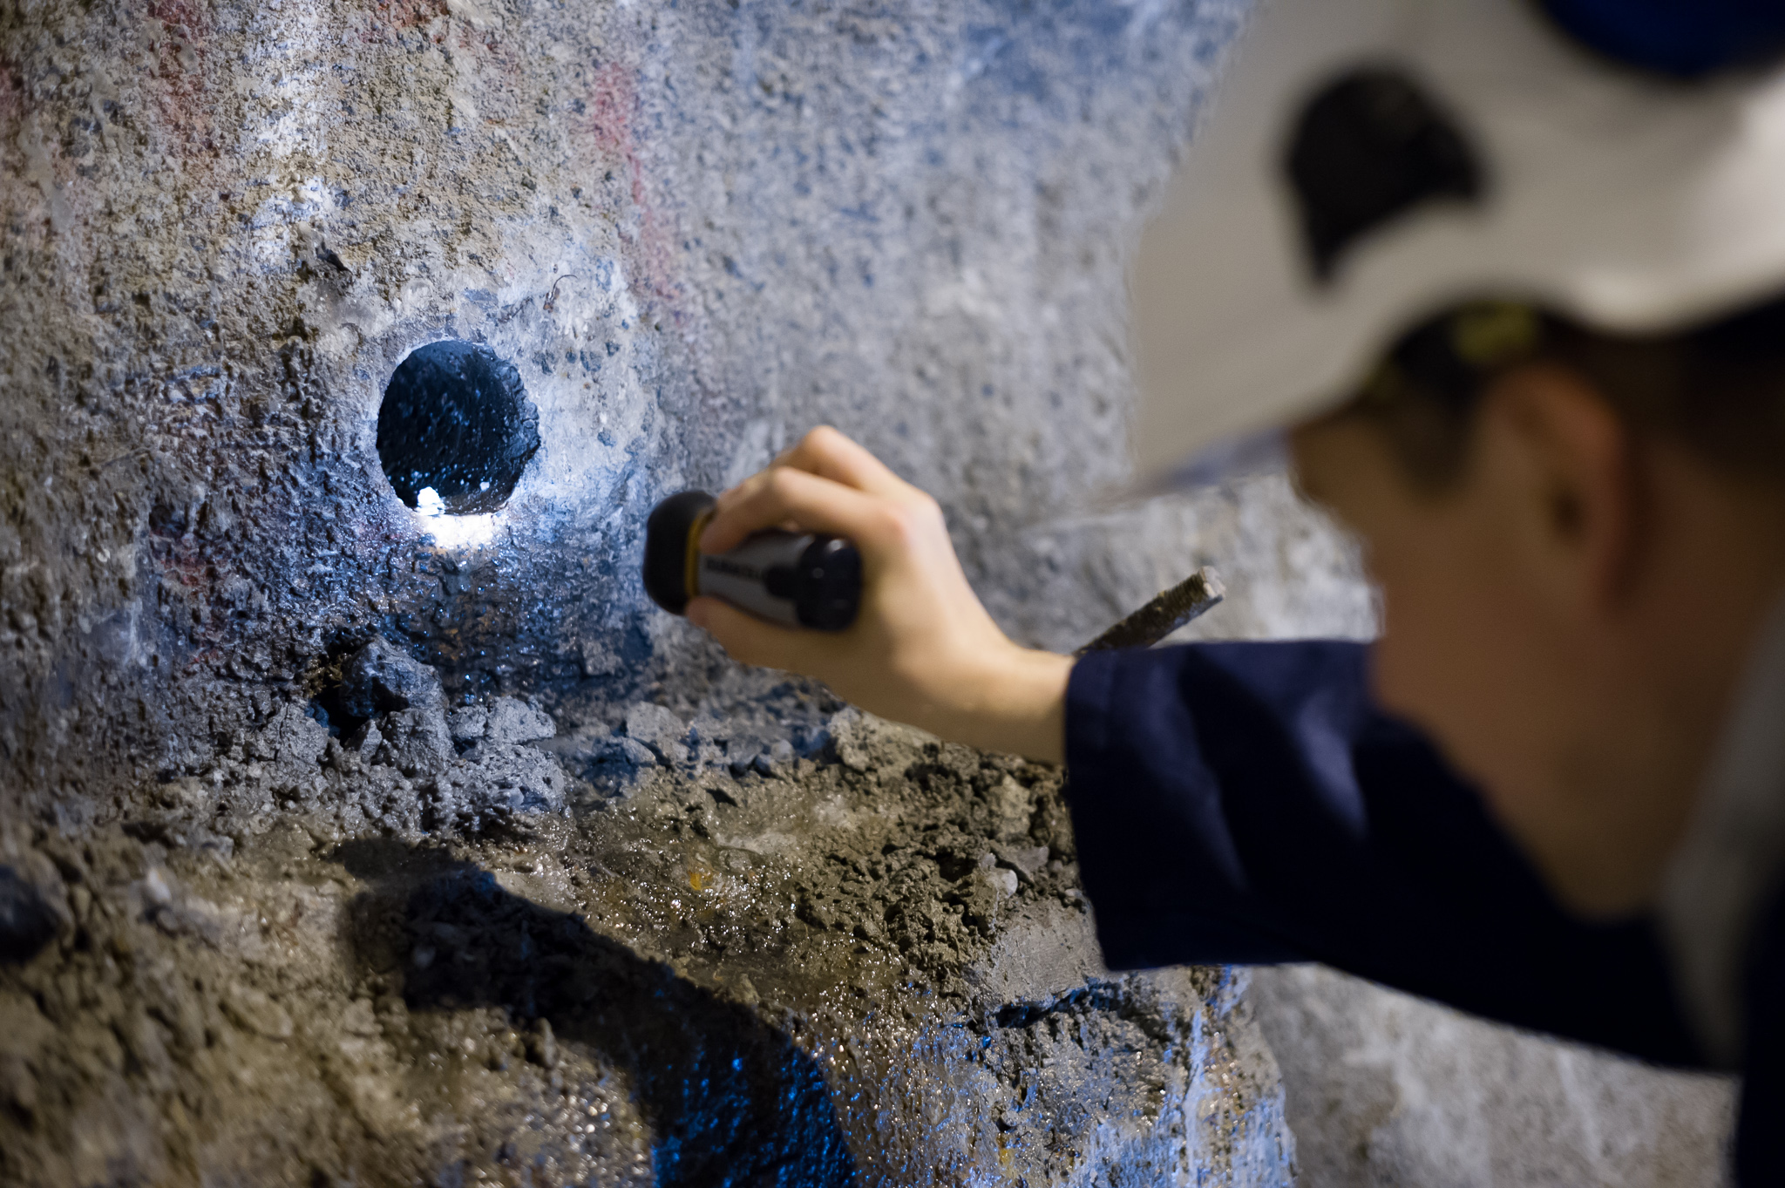
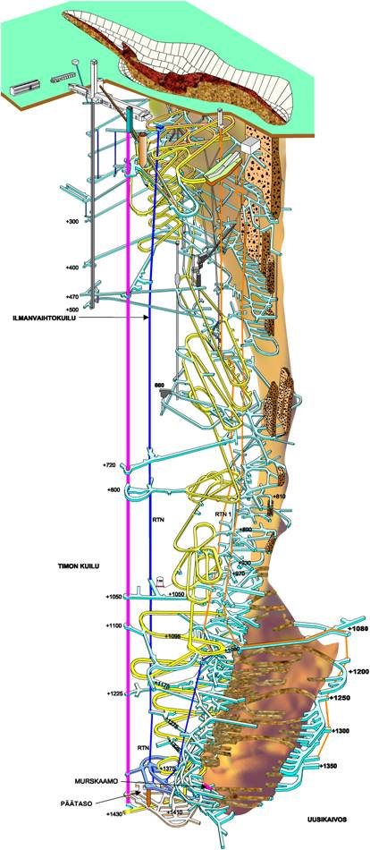
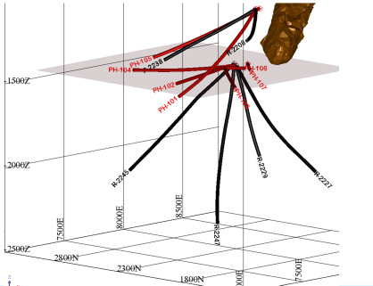
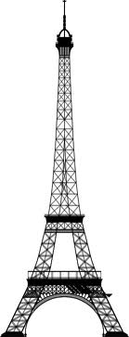
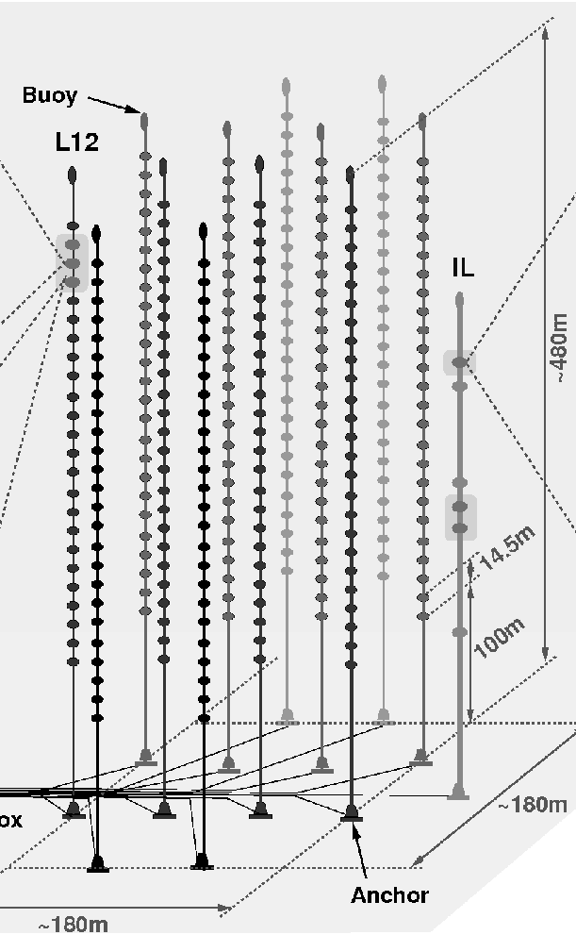
2. Infrastructure
AMADEUS - The Acoustic Neutrino Detection Test System of the ANTARES Deep-Sea Neutrino Telescope

Slide 14
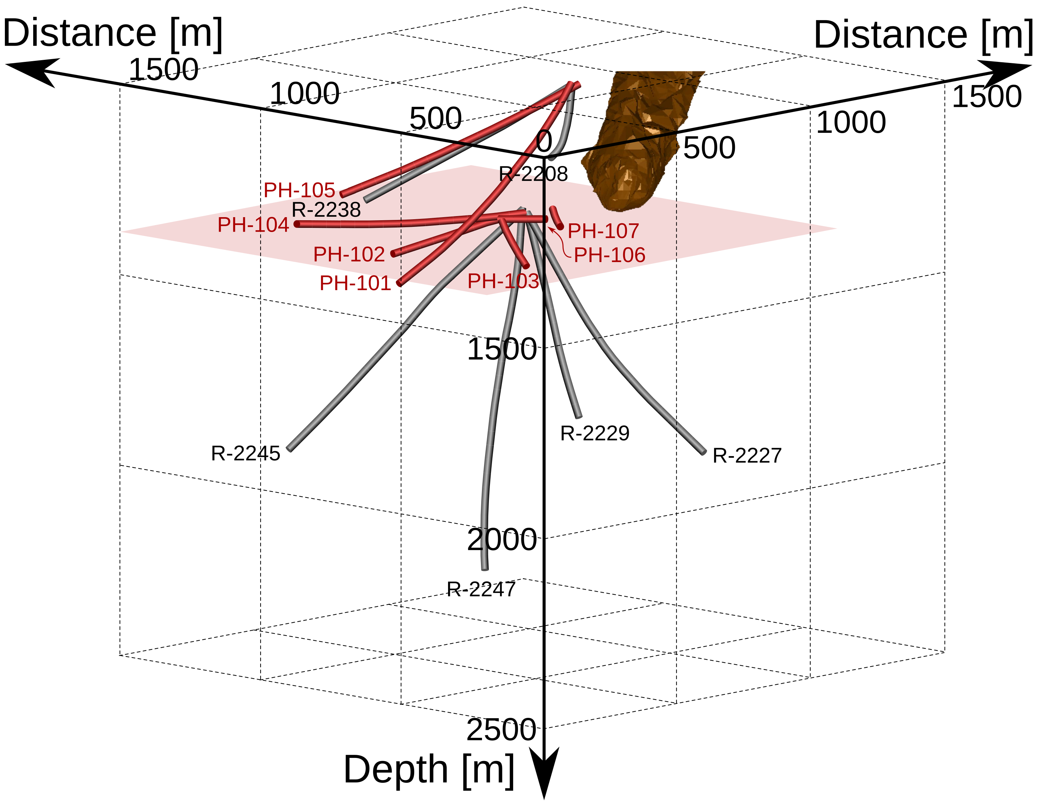
Size corrected for density

Slide 15


3. Know-how network
Applied Math
LUT
Neutrino community
Geology
HY, OY
THEIA

Slide 16

What is the bottleneck?
Funding for the on-site team
To make measurements in the mine, at least two scientist have to be stationed in Pyhäsalmi
A grant from the Academy would solve the problem

Slide 17
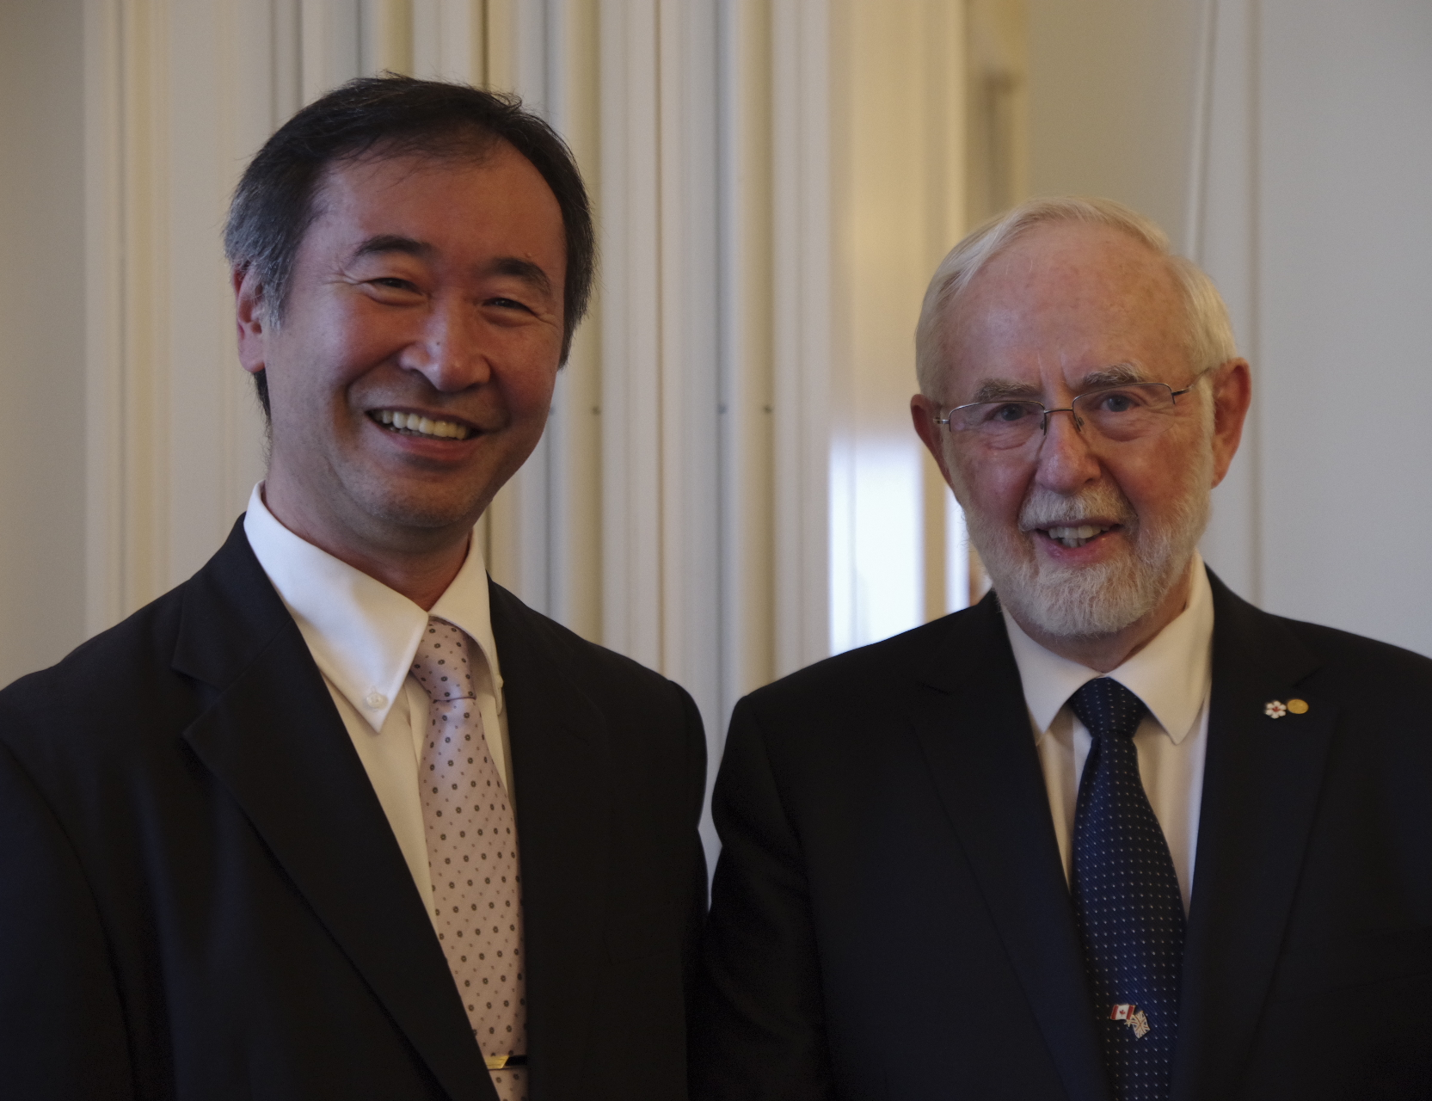
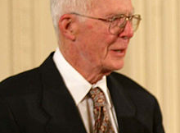
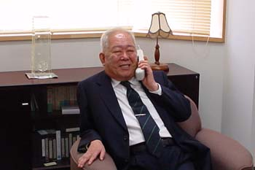
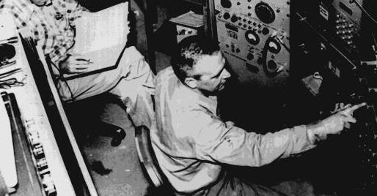
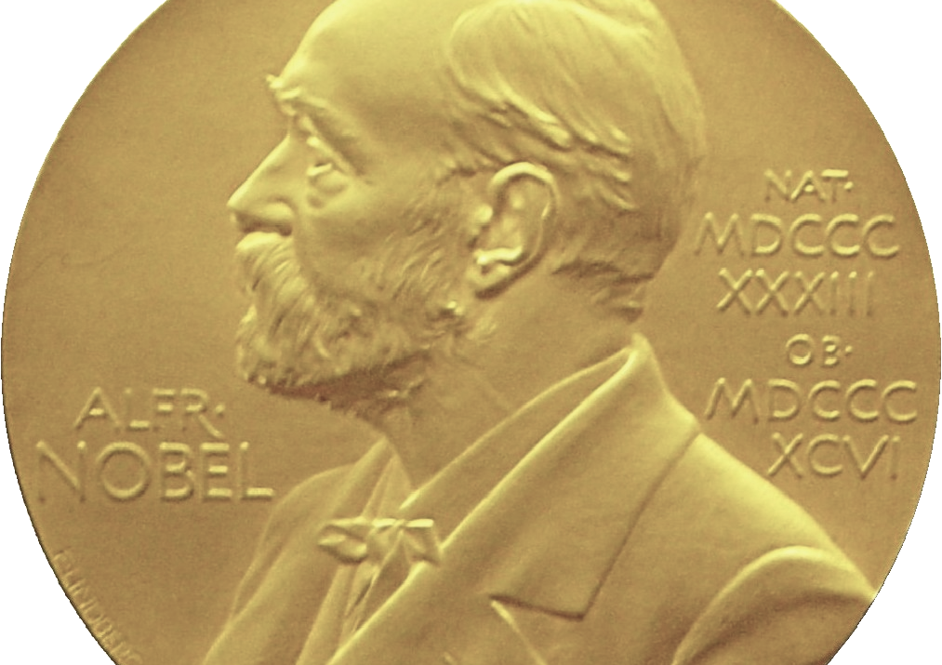
Conclusions:
1. Neutrinos are important & relevant
2015
2002
2002
1995
2. Finland has a realistic chance to make a significant contribution

Slide 18
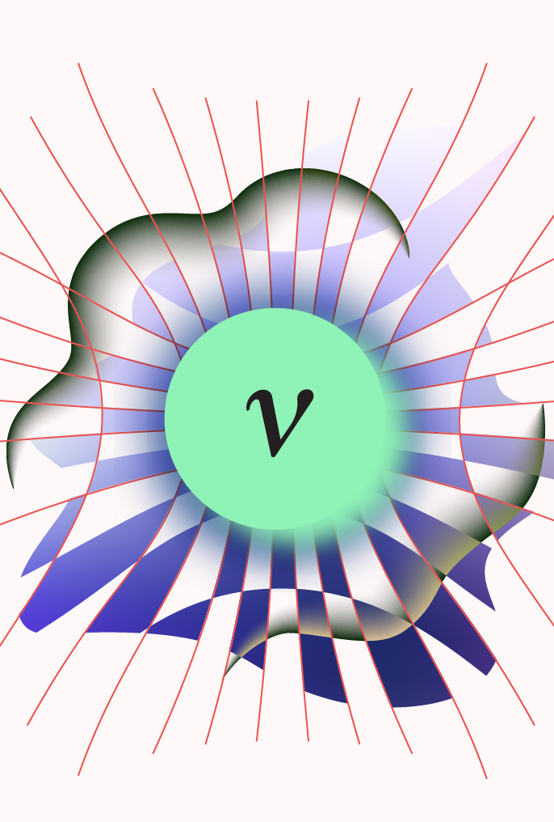
Thank you for your attention!
Courtesy: Wiki, TAUP, NASA, IceCube, JUNO, DUNE, KM3NeT
Artwork by Sandbox Studio, Chicago with Corinne Mucha

