Slide 1
Lattice strain mapping and tomography of thin-walled cooling pipe connections studied using synchrotron radiation
Speaker: Sophie A. M. McNair
University of Bath, GB
Contact: samw20@bath.ac.uk

Slide 2
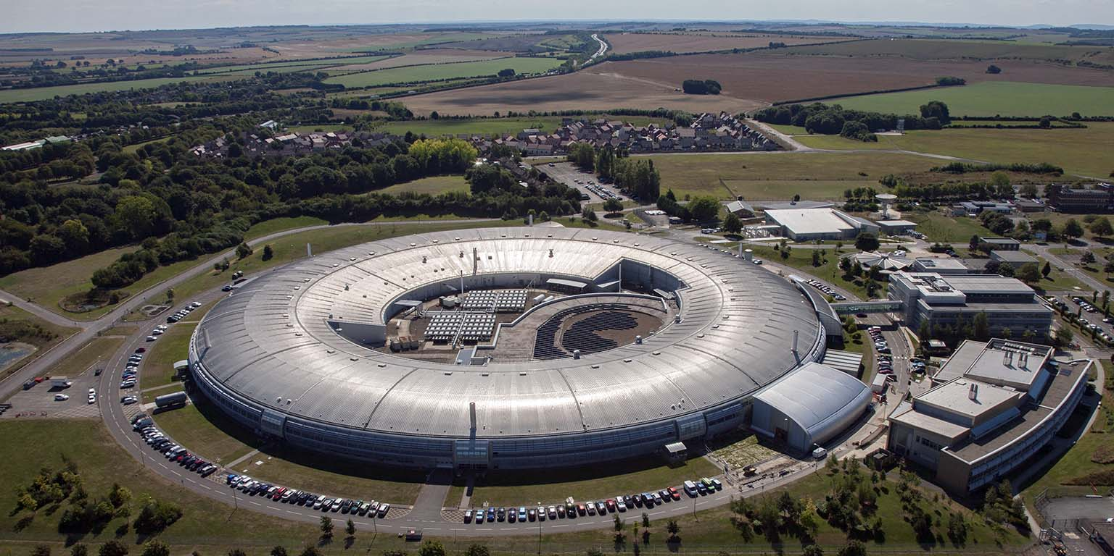

Introduction
We have performed in-situ tests on tension loaded thin-walled joints at the UK’s synchrotron facility, Diamond Light Source
We have tested:
  Two laser welded designs
  Two soldered designs
  Orbitally welded designs
We have utilised x-ray diffraction techniques and tomography to track changes in stress distribution during loading

Slide 3
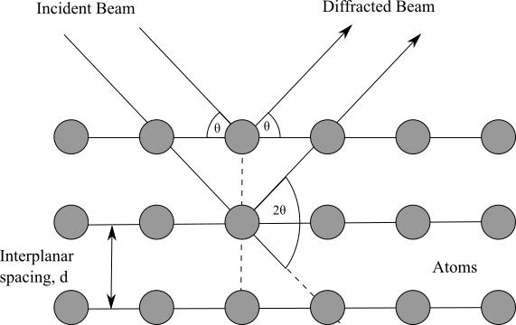
Theory
Theoretical scattering of an incident x-ray upon a crystalline material
X-Ray diffraction (XRD) is a technique used to characterise position of atoms, arrangement in their unit cell and spacing between atomic planes
Incident x-rays are scattered by the material, and their diffracted beam is directed towards a detector to produce a unique diffraction pattern
Diffraction pattern output by the detector

Slide 4
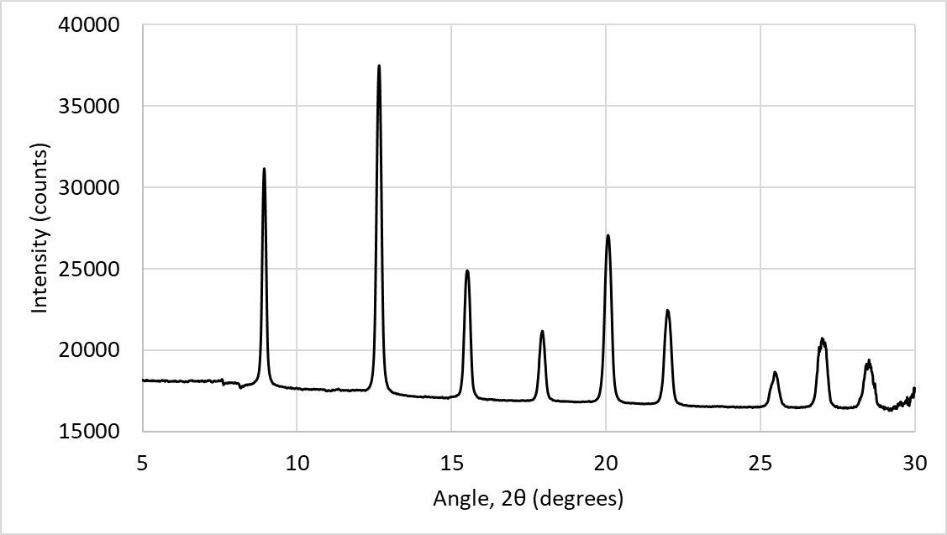
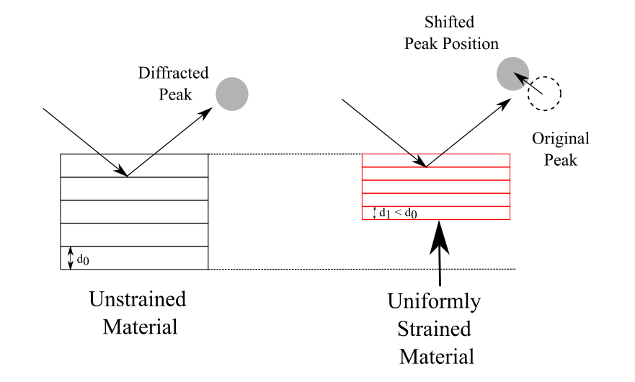
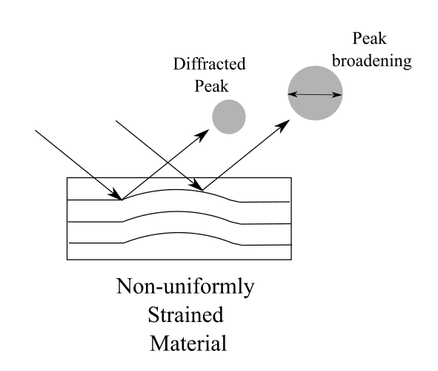
Theory
Azimuthal integration reduces the 2D images into a 1D diffractogram, intensity against angle
The peaks can be studied to directly determine the interplanar spacing, d, as well as strains in the material
A uniformly strained material will have a displaced peak, while a non-uniformly will show peak broadening
Azimuthal Integration to reduce data into 1D
Effect of strain on the 1D diffraction pattern

Slide 5
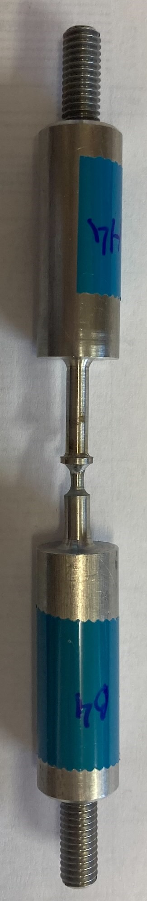
Experiment
3.6mm across, 1 XRD pattern taken at 0.2mm intervals = 19 patterns
Sample
XRD test area
Our experiment studied different types of thin-walled cooling pipe connections, under progressive tensile loading
Samples were placed in the synchrotron beam in a specially designed load cell which did not interrupt the beam, and tested in-situ
High resolution tomography was carried out, as well as XRD patterns
For the XRD patterns, samples were scanned over a known area, with a constant step size
This produced a diffraction pattern per point, with 100s of patterns produced per sample
5mm across, 1 XRD pattern taken at 0.2mm intervals = 26 patterns
19 * 26 = 494 unique diffraction patterns for a 5mm * 3.6mm test area
Tension Loading

Slide 6
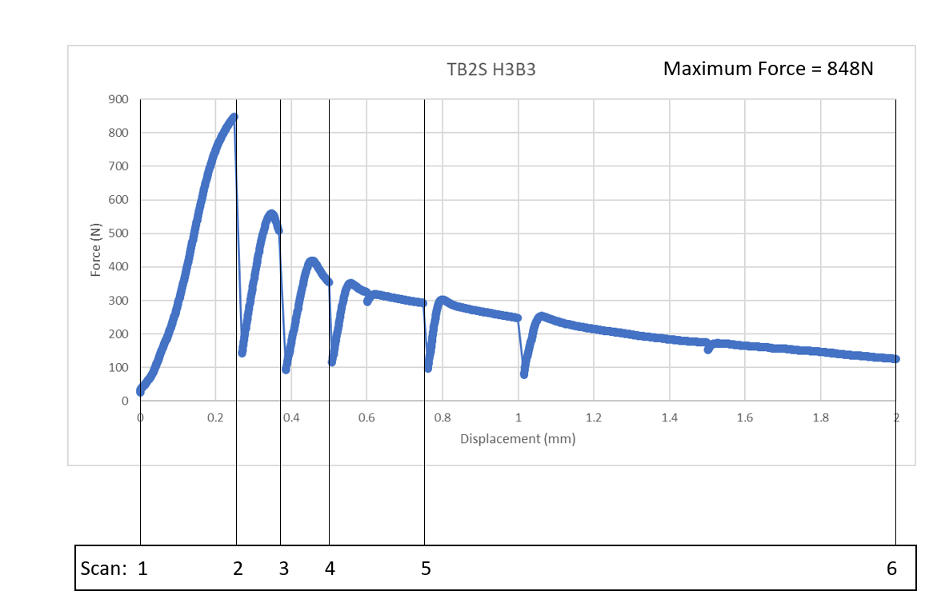
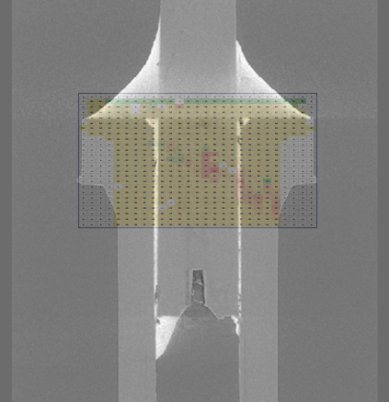
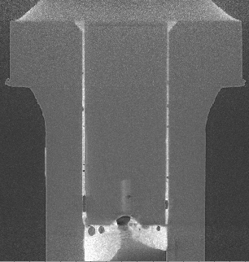
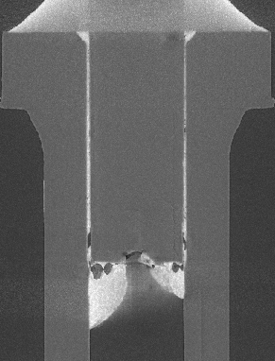
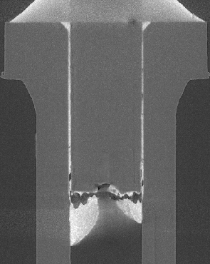
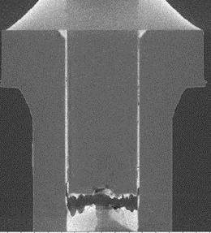
Experiment
XRD patterns taken over a smaller section
Load/displacement curves recorded
Sample under tensile load
Tomography scans at each load increment in situ
1
2
3
4

Slide 7
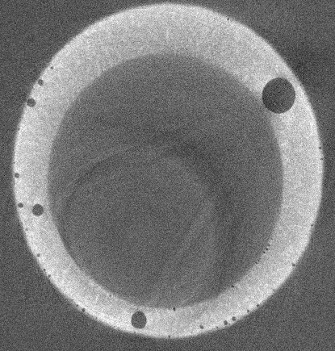
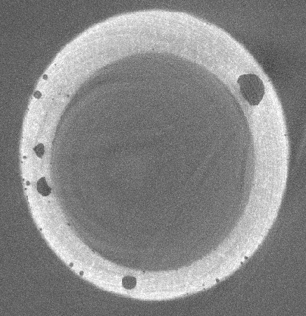
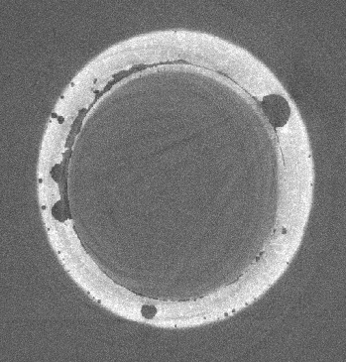
Tomography
Progressive load
TB2S
Unloaded – Voids present but round and distinct
0.5mm displacement – voids beginning to change in shape with some widening seen
0.75mm displacement – crack propagation seen between voids

Slide 8
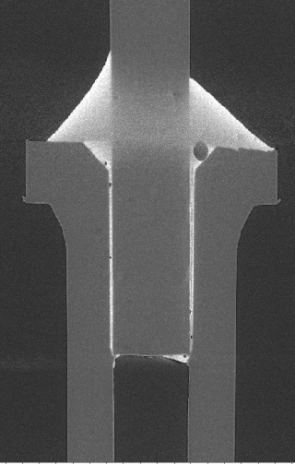
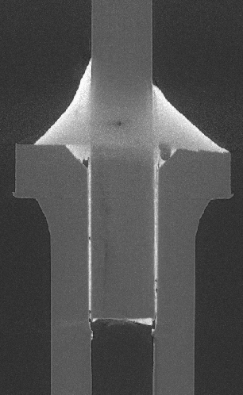
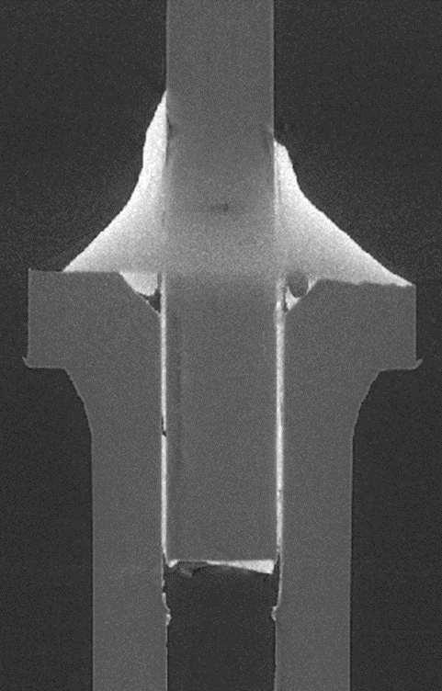
Tomography
Progressive load
TB2S
Unloaded – Voids present but round and distinct
0.5mm displacement – Cracks forming at edges of voids
0.75mm displacement – crack propagation along edge of solder, with change in shape at top

Slide 9
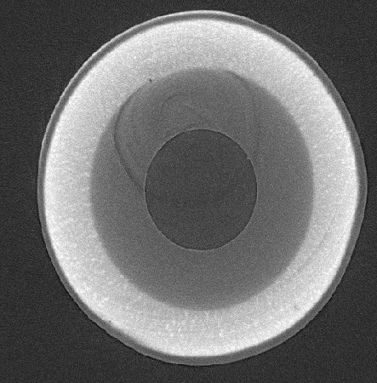
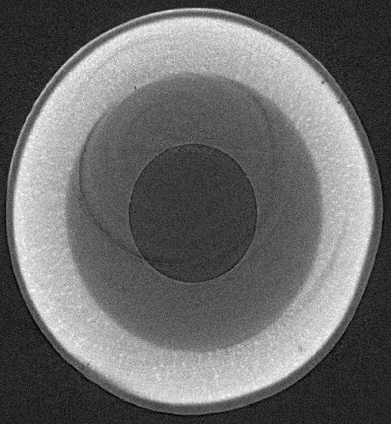
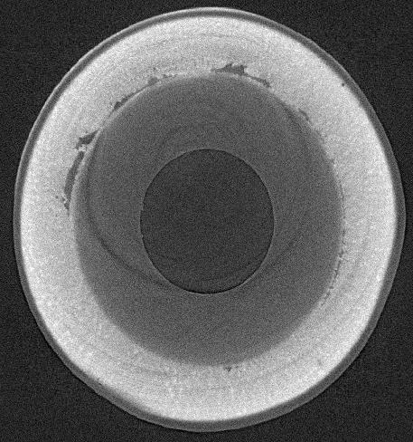
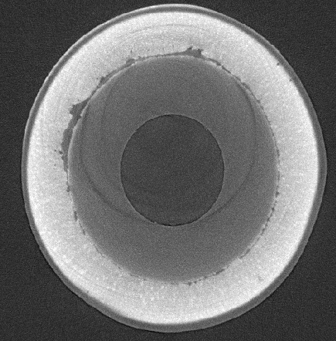
Tomography
Progressive load
TBPS
Unloaded
0.25mm displacement
0.50mm displacement
1mm displacement

Slide 10
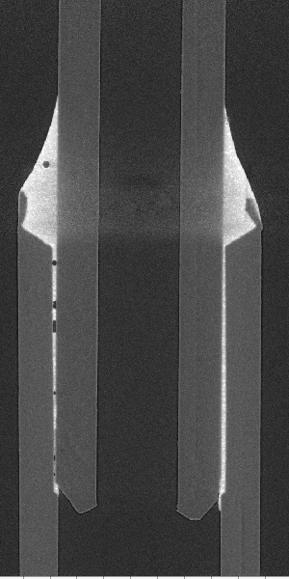
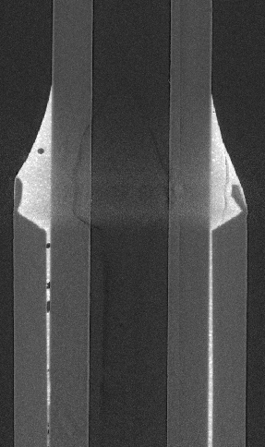
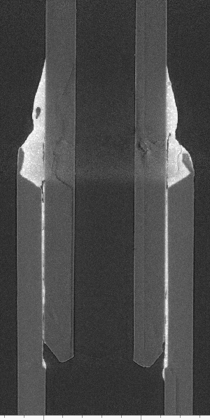
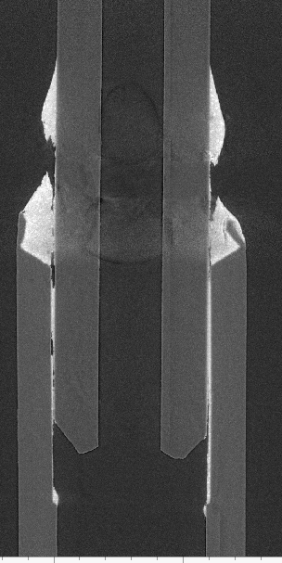
Tomography
Progressive load
TBPS
Unloaded
0.25mm displacement
0.50mm displacement
1mm displacement

Slide 11
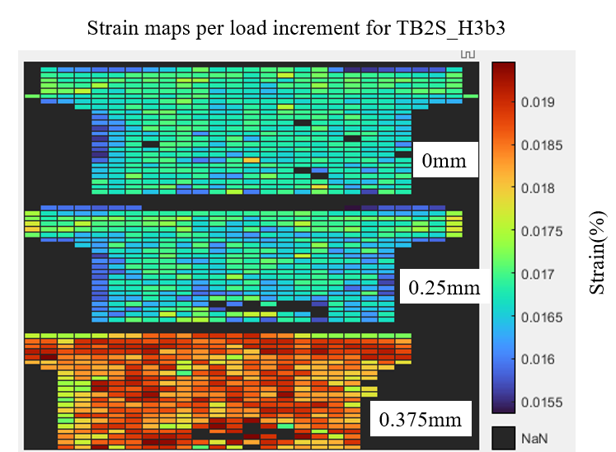
TB2S
The TB2S samples had relatively even distribution of strain, with low strain at unloaded at 0.25mm displacement and a large increase in strain at 0.375mm
This shows that although strain is increasing throughout the sample, it is fairly even, with no areas of significantly high strain

Slide 12
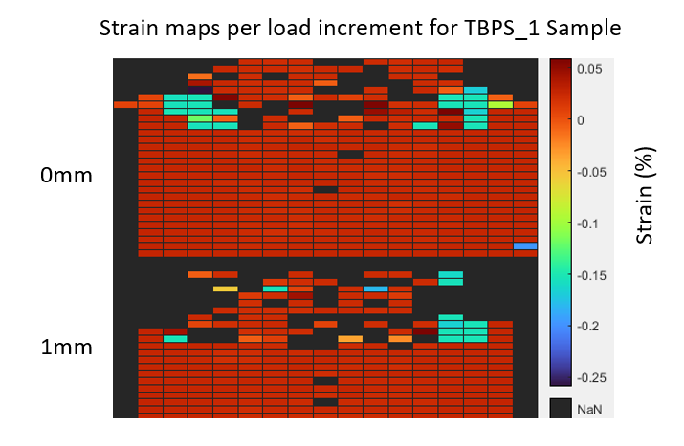
TBPS
The strain maps show that the areas of high strain are where the failures occur
However, there is already high strain in these areas before any loading takes place, suggesting that the joining method itself is the source of these high strain areas
High strain areas at failure points

Slide 13
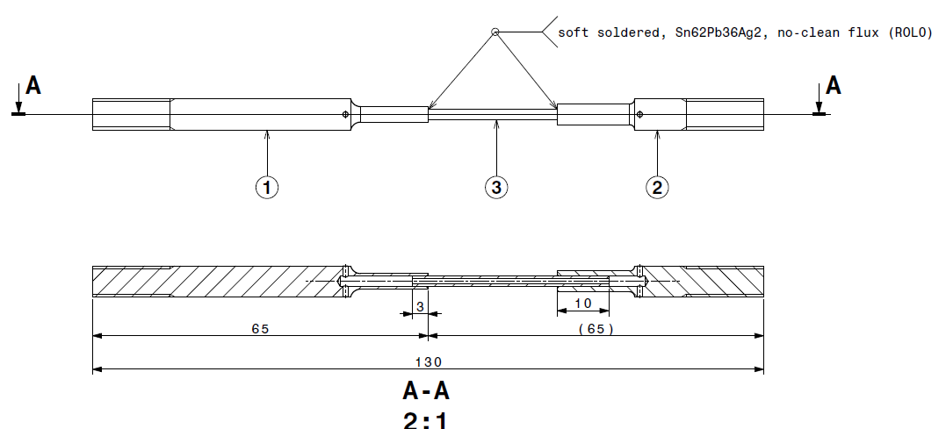
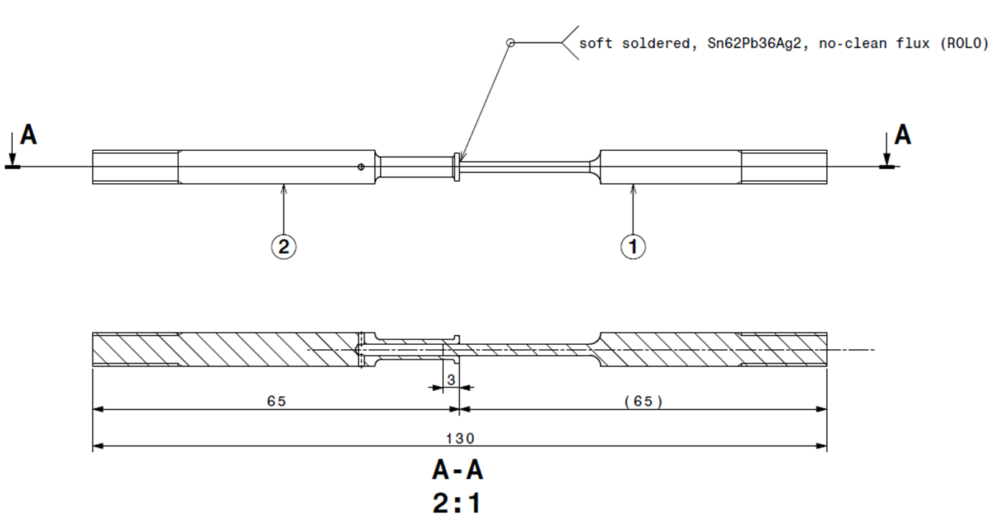
Soldered Samples Comparison
TBPS
TB2S
Strains localised where heat is applied
Less Voids seen in samples
Strains more evenly distributed across sample
Vertical strains always higher in magnitude than horizontal
Greater number of voids

Slide 14
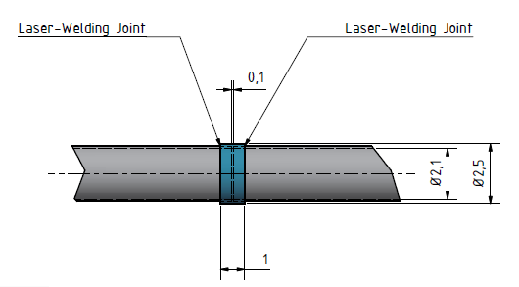
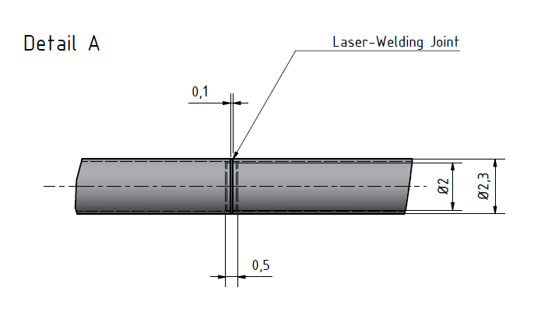
Laser Welded Samples
Two different samples tested – only difference is the insert used to join the two samples
However, had very different performance from load/displacement curves and from the strain maps

Slide 15
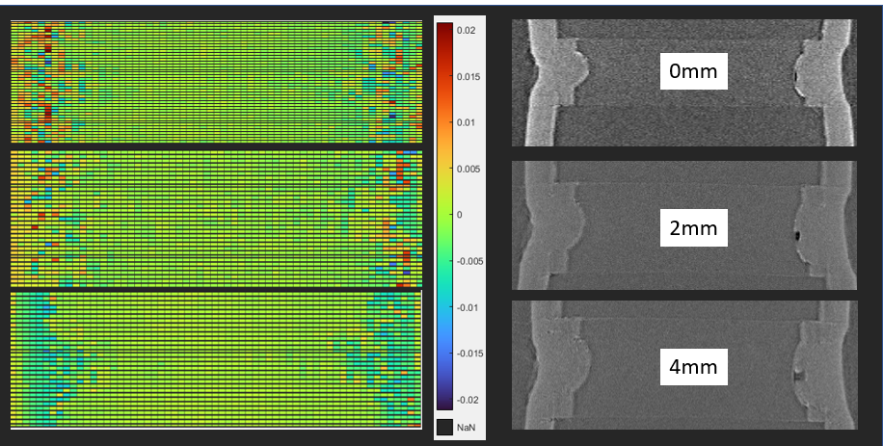
Laser Welded Samples
Flaw progression during loading
Here we can see high residual strains around the joint area and from the tomography it can be seen that there is a flaw in the joint
However, during loading the stresses even out and become less localised

Slide 16
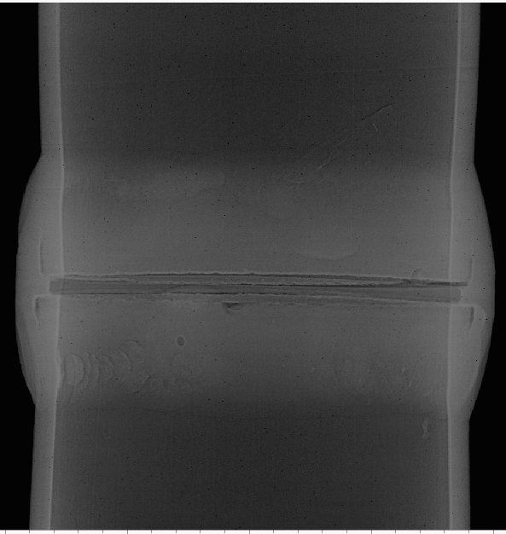
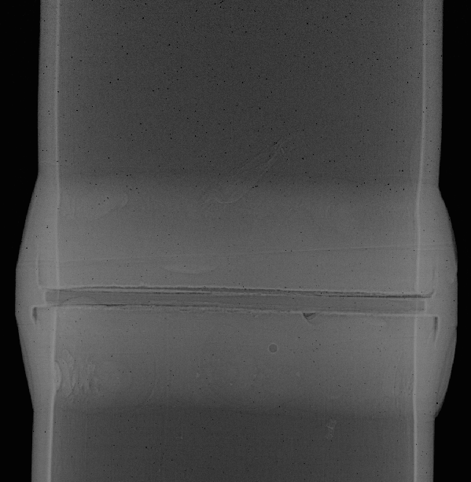
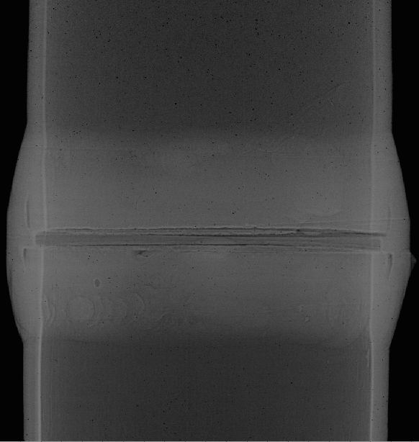
Laser Welded Samples
0mm
2mm
4mm
For this sample, there was little changes which could be tracked from the tomography, apart from a slight change in shape

Slide 17
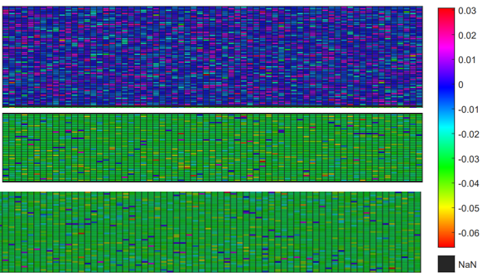
Laser Welded Samples
Strain maps
0mm
Strain (%)
2mm
4mm

Slide 18
Laser Samples Comparison
Inner insert
Outer Insert
Residual stresses focused on each side of joint
Residual stresses evenly distributed

Slide 19
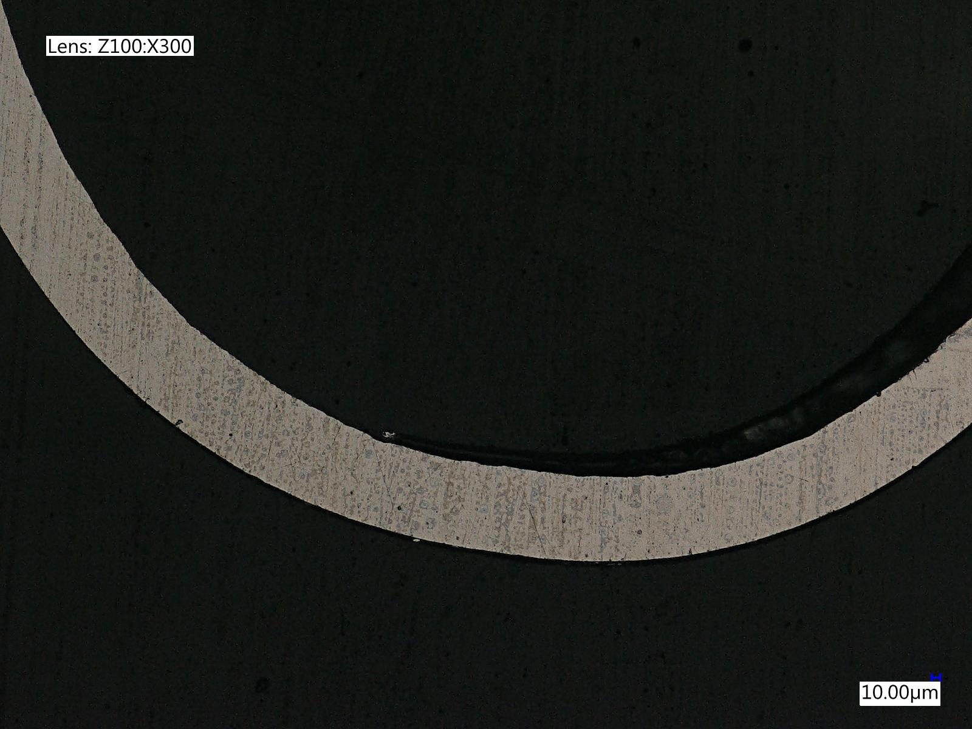
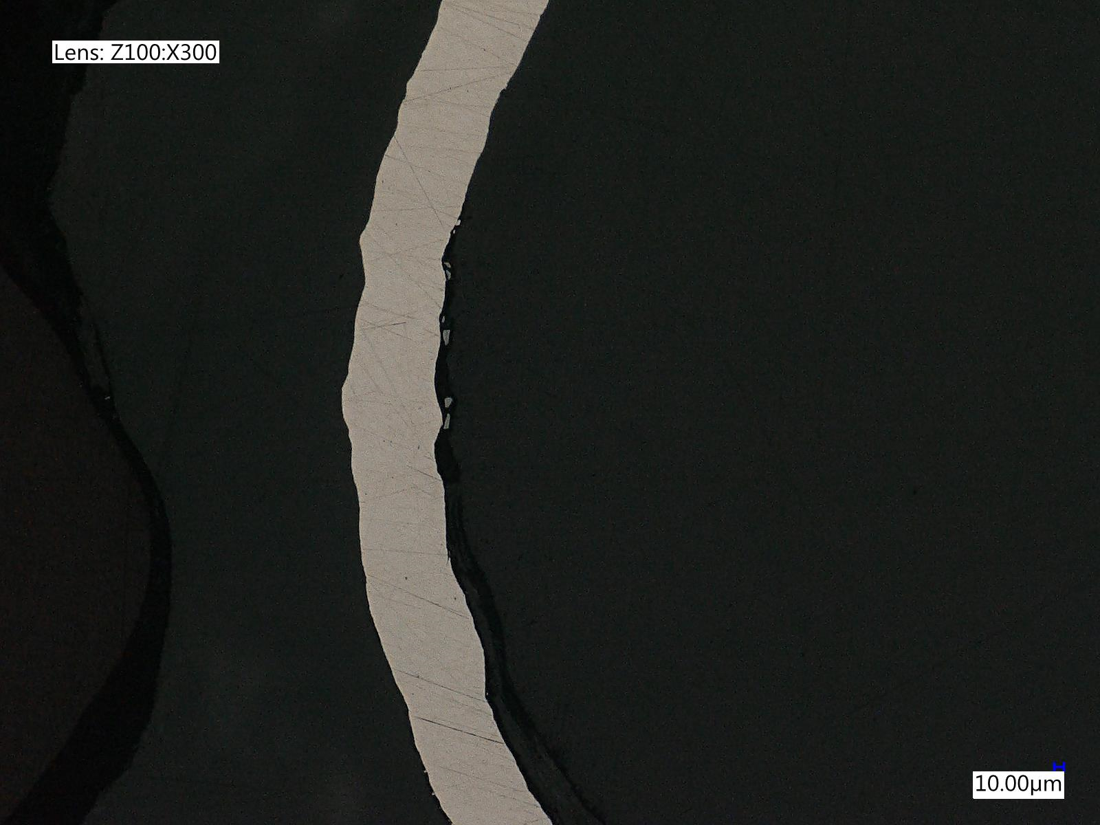
Optical Microscopy Images
Change in cross section before and after tension loading

Slide 20
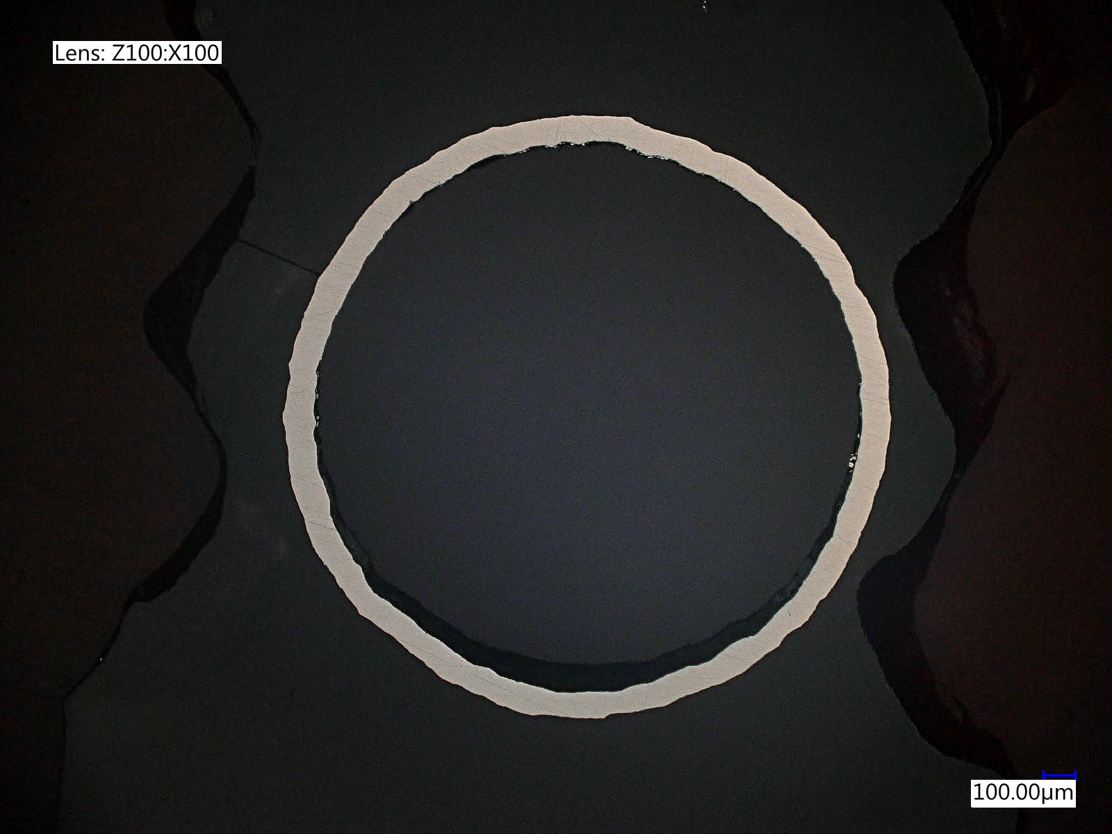
Optical Microscopy Images
Can see clear misshapen features
Surface texture changes as well as changes in width/dimensions

Slide 21
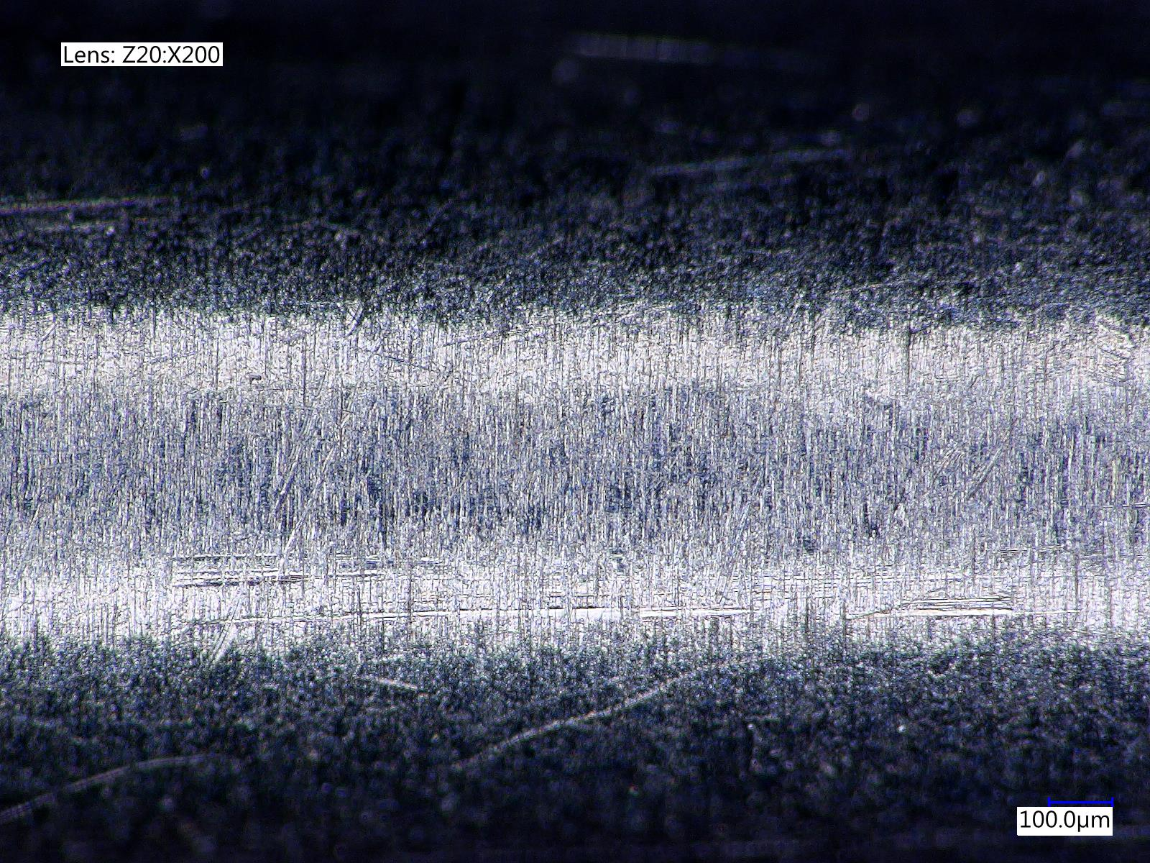
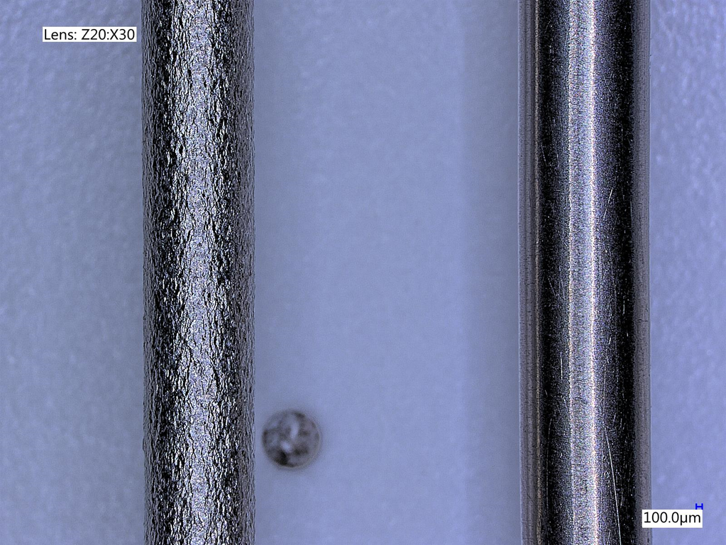
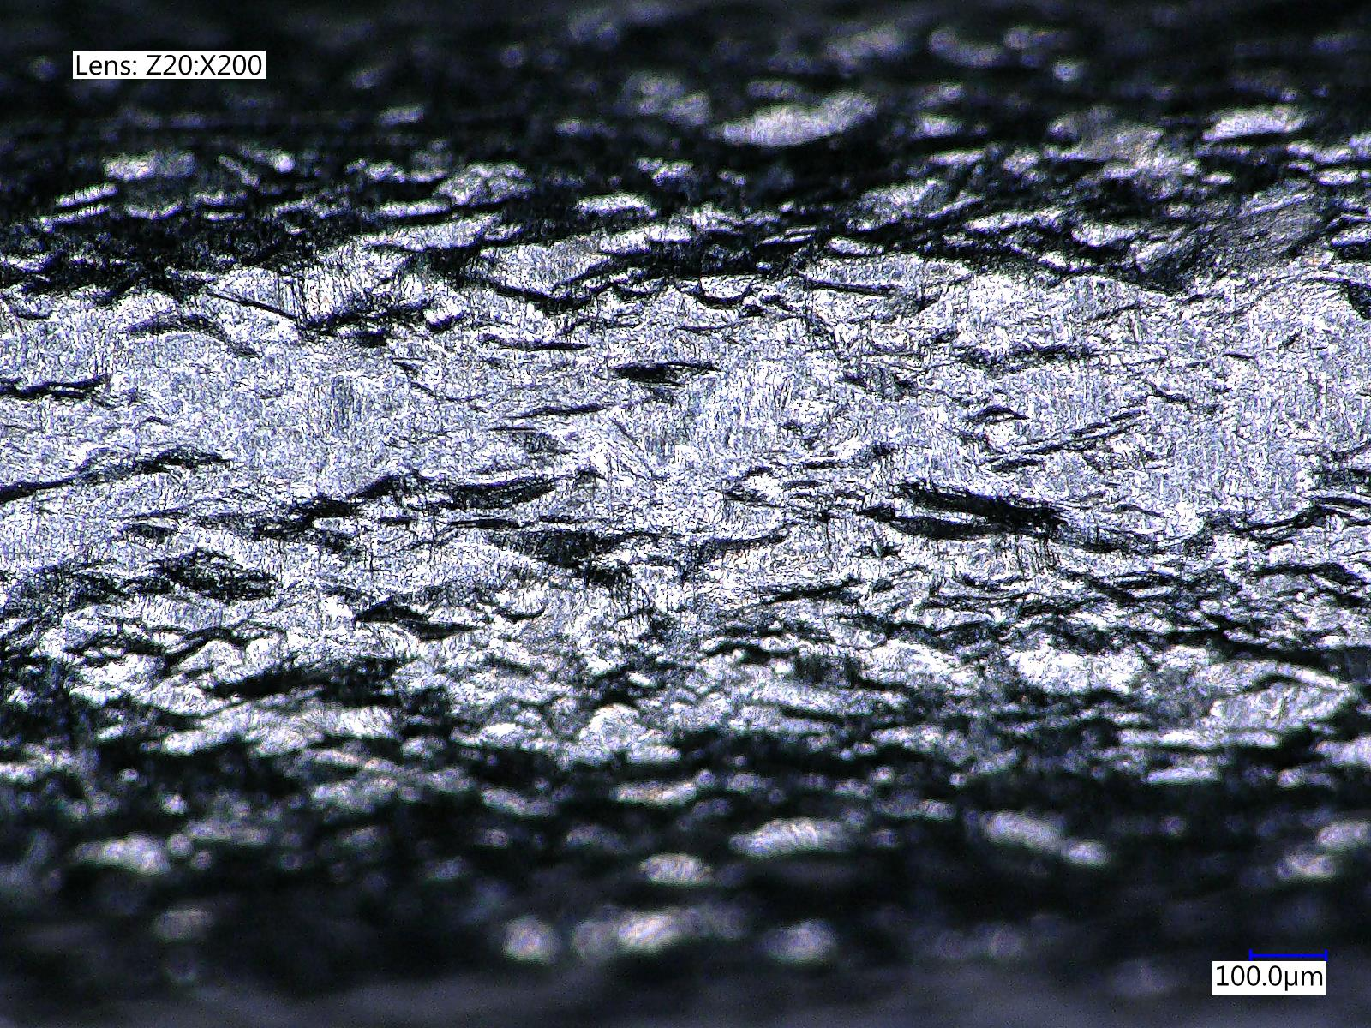
Optical Microscopy Images
Before
After
Changes in surface texture after tensile loading

Slide 22
Conclusions
Changes in designs of the same type of joining can dramatically change the residual stresses of the unloaded sample, and how stresses are carried during loading
While tomographic images showed crack propagation through voids, there wasn’t much evidence of stress concentration in these areas from the XRD
Stress concentrations are more likely around areas where residual stress is high from the joining process, such as the heat input on the TBPS samples
Even without complete joint failure, significant changes in surface texture often occurs

Slide 23
Thank you!
Speaker: Sophie A. M. McNair
University of Bath, GB
Contact: samw20@bath.ac.uk

