Slide 1
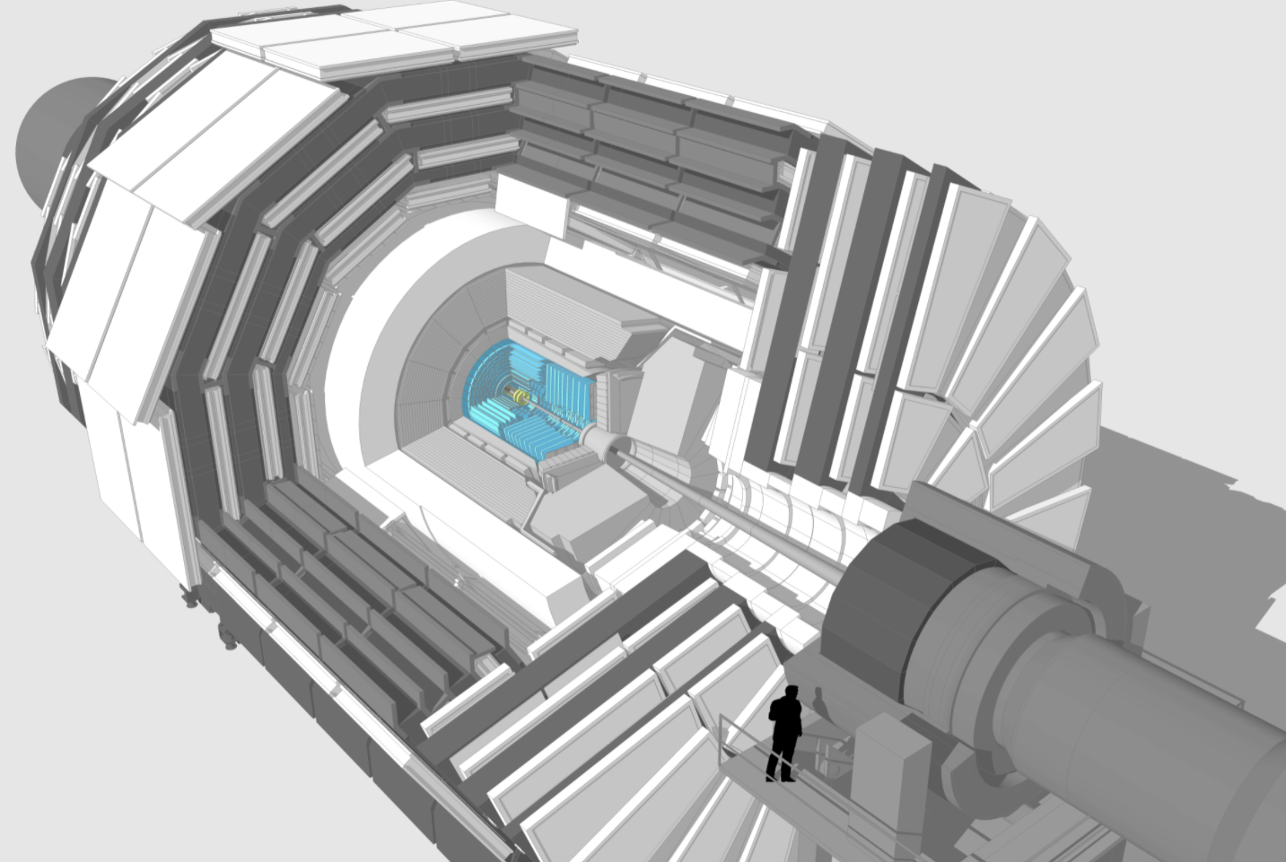
Forum on Tracking Detector Mechanics 2022
Tilted TBPS Ring Mechanics for
CMS Tracker Upgrade Phase II
Introduction
Al-CF Anomalies
Al-CF Investigation
Ring Production
09 June 2022
https://indico.cern.ch/event/853861/
Speaker : Pierre Rose (CERN)
Main contributors : EP-DT group (CERN)

Slide 2
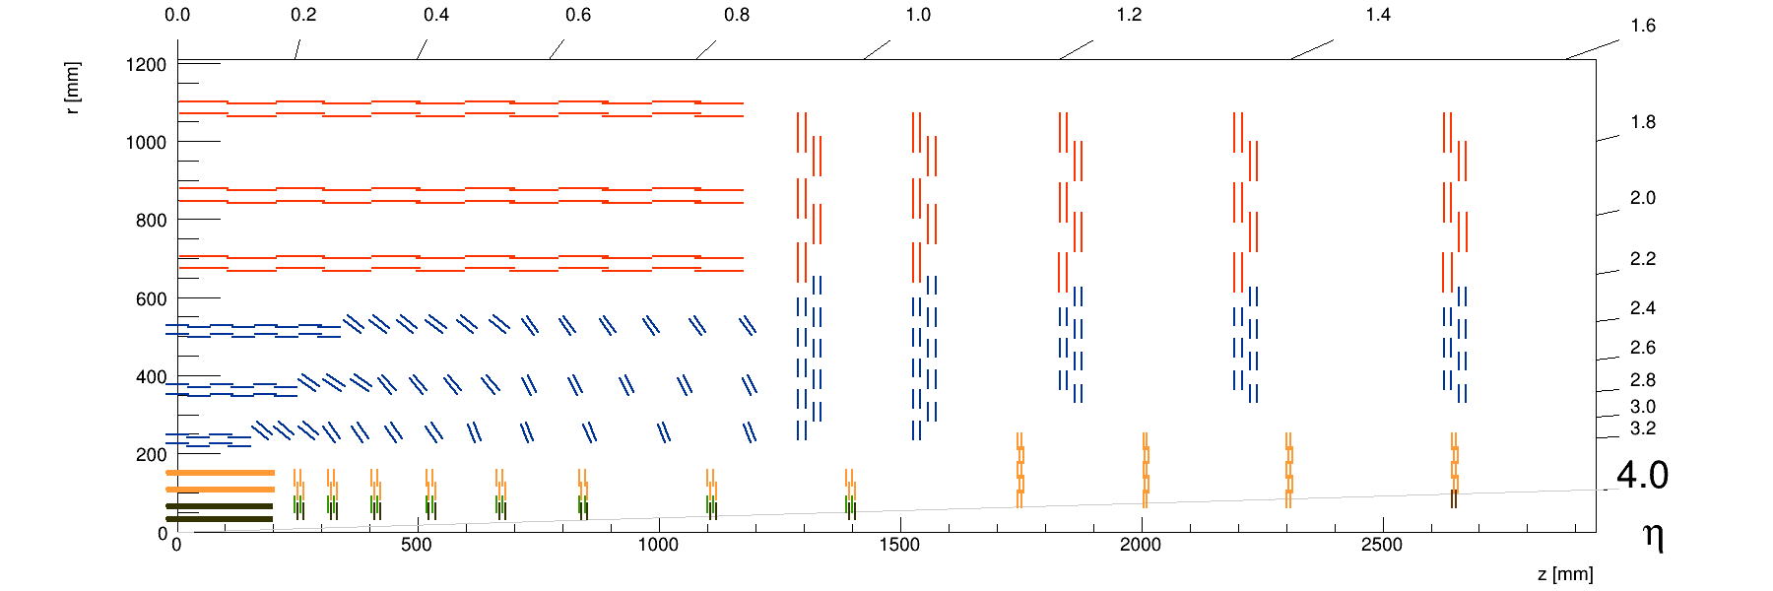
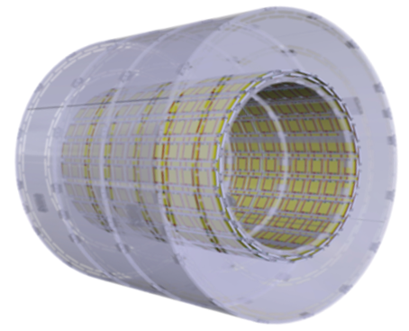
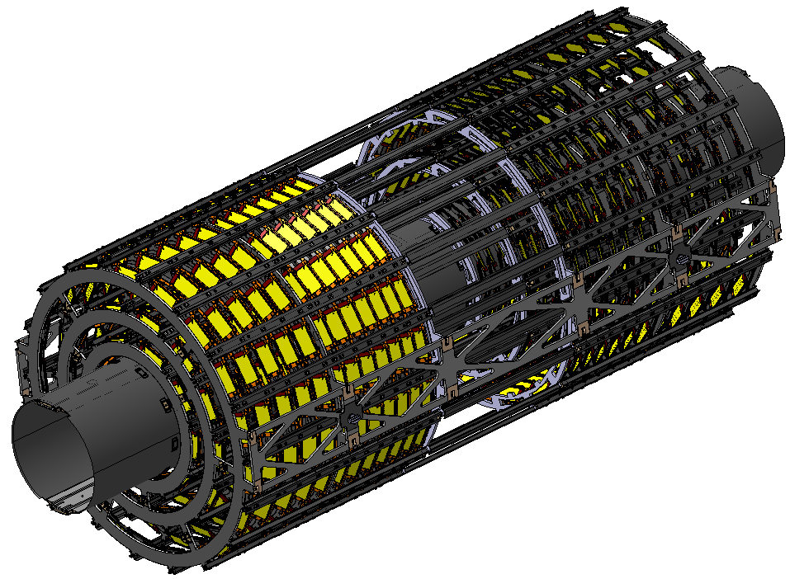

Introduction –
CMS – Outer Tracker Description
TB2S
TEDD
Flat TBPS
Tilted TBPS
Existing CMS Tracker will be replaced by a completely new one in LHC LS3 (2025)
Will use new Module types capable of selecting high momentum tracks (>2-3 GeV)
And innovant light-weight structures as the TBPS Tilted Rings.
See Kamil Cichy’s talk in Cornell University (2019)
“Prototyping of ‘tilted’ Rings and design of global structures and assembly sequence for the TBPS”
https://indico.cern.ch/event/775863/

Slide 3
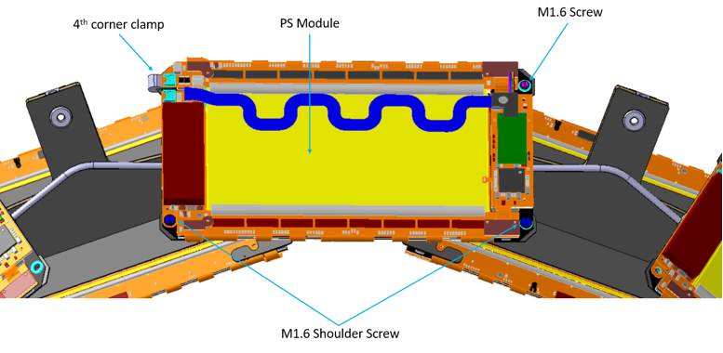
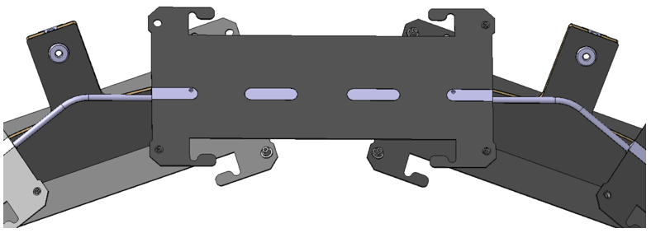
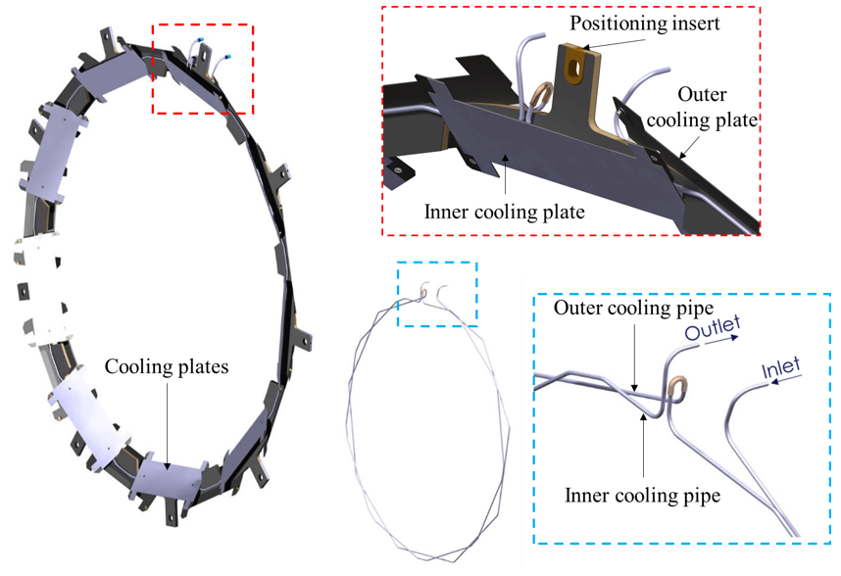
Introduction –
CMS – Outer Tracker Description
Cooling Plate Assembly
Cooling Adaptor
Anomalies reported
in this presentation
TBPS Tilted Rings:
3 layers (Ø600 – Ø850 – Ø1150)
12 Rings per layer per end
72 Rings in total, of 8 different types
Component | Material
Sandwich Plate Ring | M55J/DT120 carbon-fibre/epoxy + Airex R82.80
Cooling Plate | K13D2U/EX-1515 carbon-fibre/cyanate ester
Cooling Adaptor | Al-CF 4ppm
Cooling Pipe | Stainless steel 316L
Cooling Pipe conn. | Cu-Ni 70/30
Cooling U-tube | Cu
Positioning inserts | PEI

Slide 4
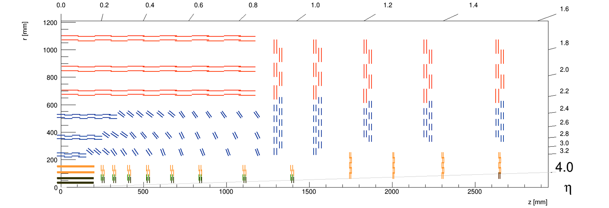
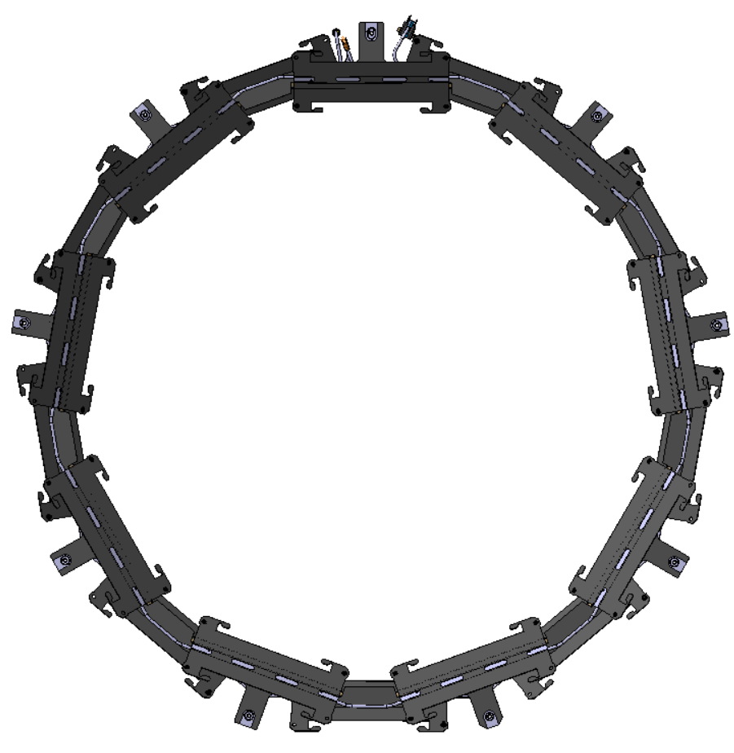
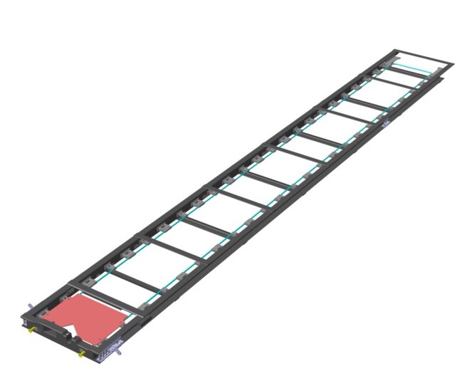
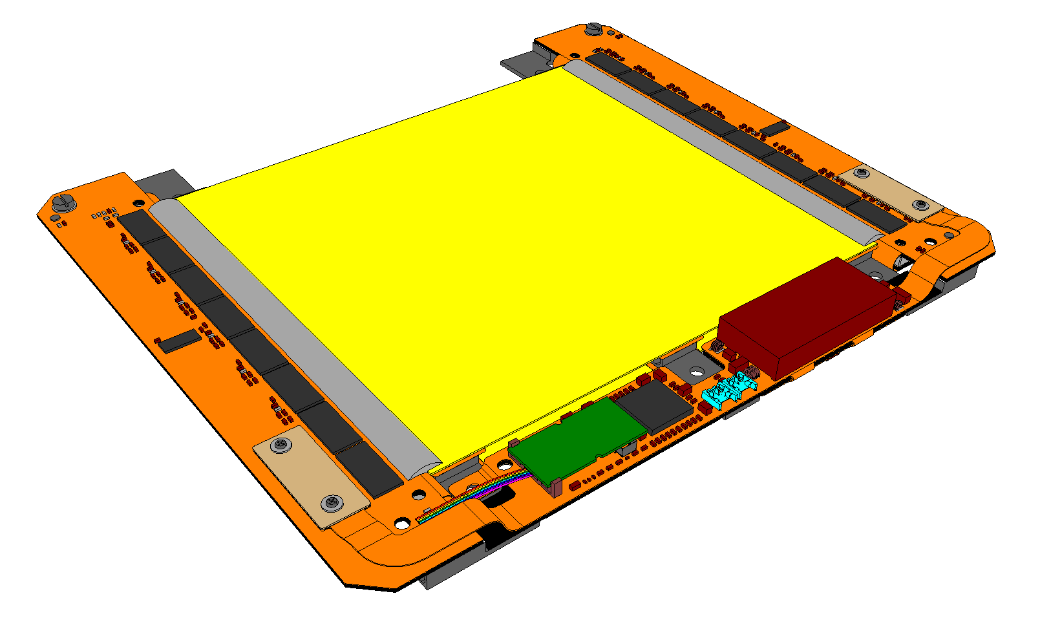
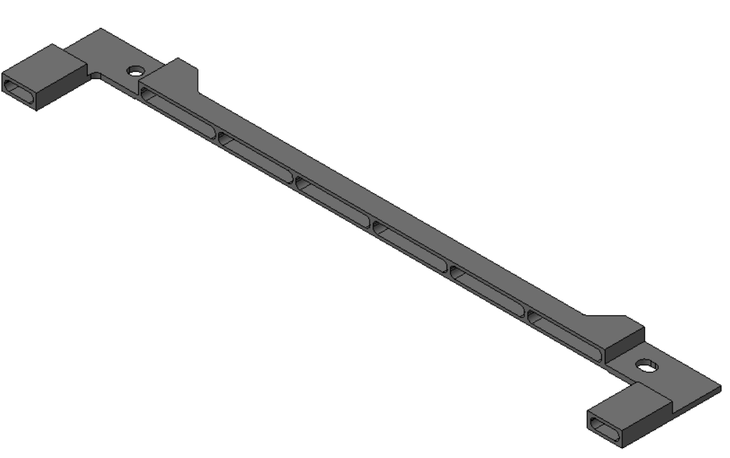
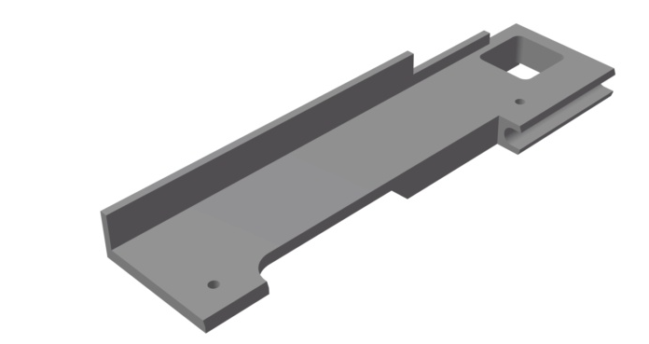
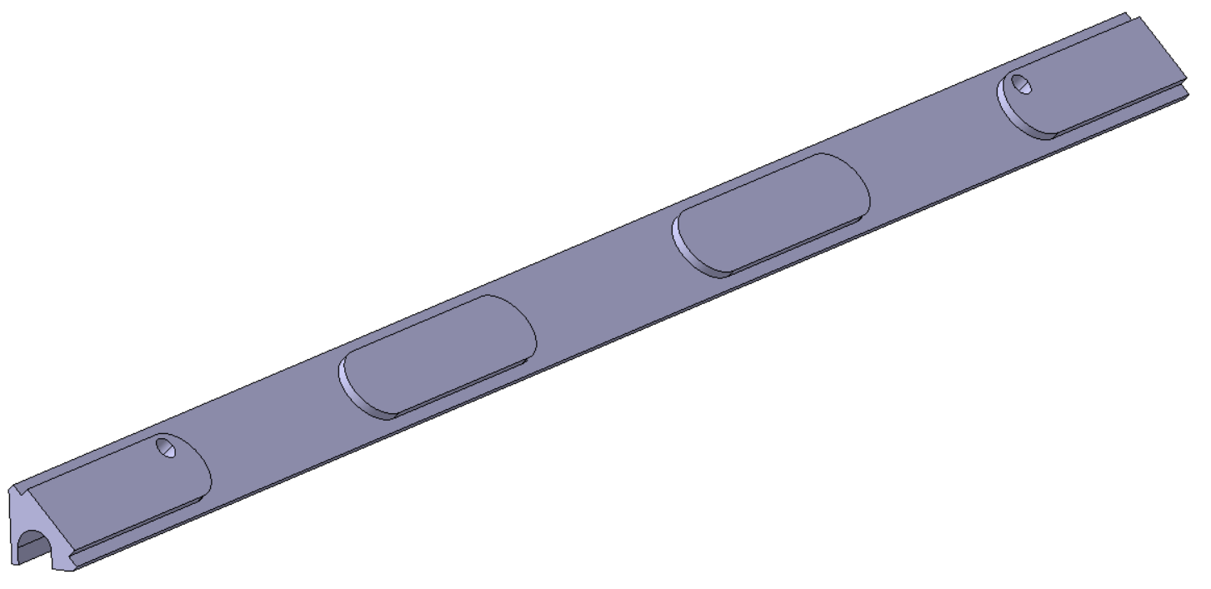
Introduction –
Al-CF components inside the Outer Tracker
TB2S Ladder
Special Inserts
at Module #1 (x368)
2S Modules
Spacers (x15216)
TBPS Ring
Cooling Adaptors (x1920)

Slide 5
Al-CF Anomalies

Slide 6
Al-CF Anomalies –
Al-CF Material
Al-CF material from a Manufacturer (here called “MA”) has been used since the beginning of the CMS OT developments ~2012.
Second Manufacturer (here called “MB”) proposes Al-CF since ~2018 with “nominally same” material properties as MA.
Manufacturing process for material production is different:
MA : Induction Melting Process => Casted Al-CF
MB : Sintering Process => Sintered Al-CF
MA delivers Round disk shapes – not ideal for our use, early deliveries contained Al veins, but this aspect has been solved – They are considering to produce rectangular blocks.
MB delivers rectangular blocks – ideal for use and no veins

Slide 7
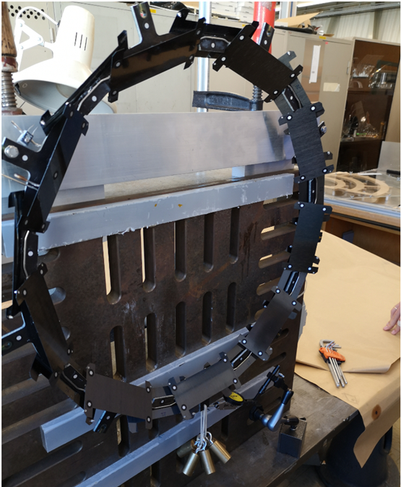
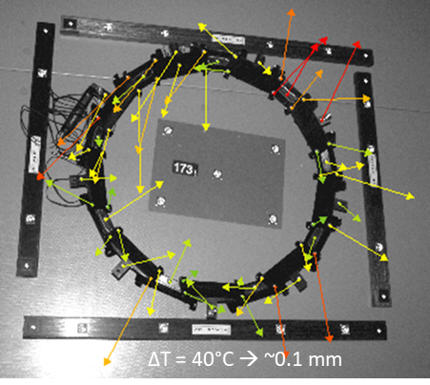
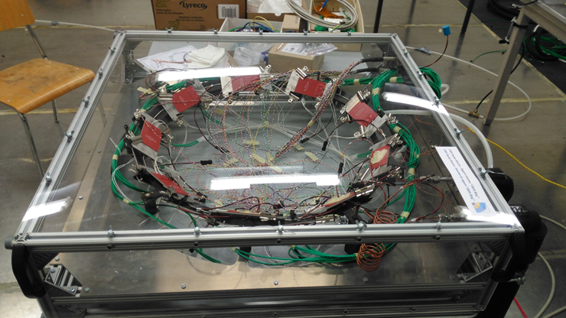
Al-CF Anomalies –
TBPS Ring Prototyping -2019
Full-size TBPS Ring prototype was successfully made and tested in 2019, and validated the design, manufacturing method and material choices (including Al-CF material)
Casted Al-CF was used (from MA)
Deformation at D40◦C
Thermal test using dummy modules
Mechanical load measurements
Geometry within specifications
Cooling performance validated
Deformations due temperature change: < 100 µm after ΔT of 40°C.
Deformation under mechanical load: 65 µm under 1 kg (2-point support, full load concentrated in one point).
Electrical continuity : 25-230 Ω between module supporting Cooling plates.

Slide 8
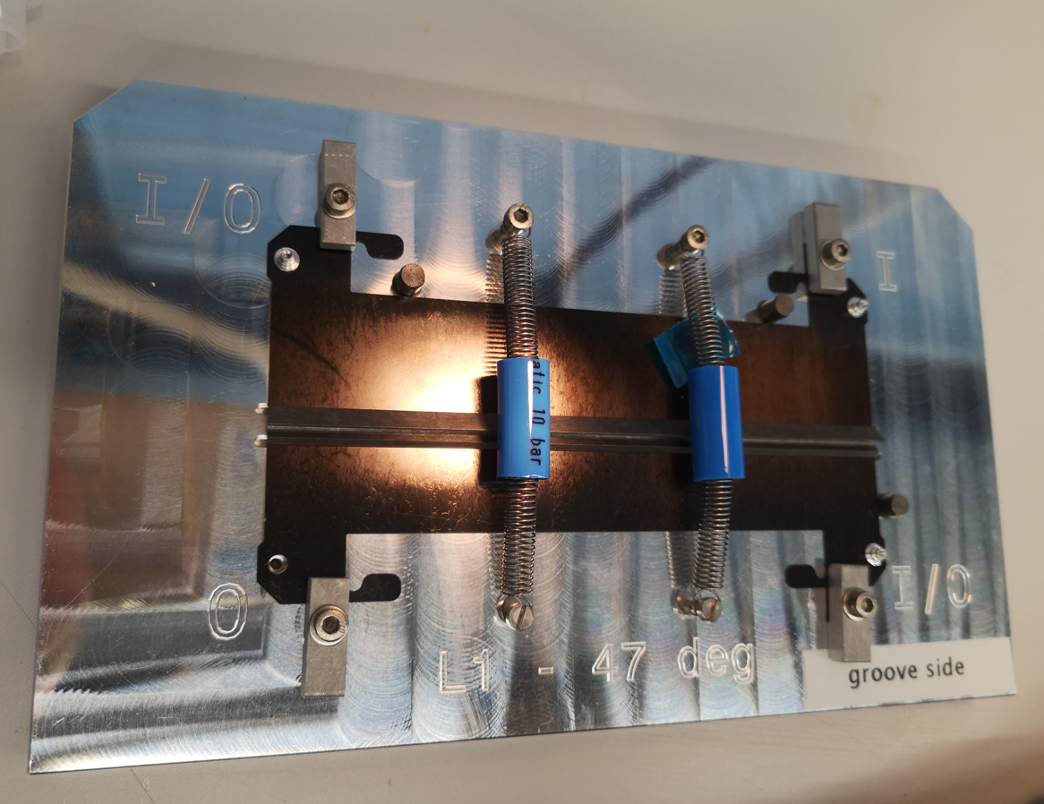
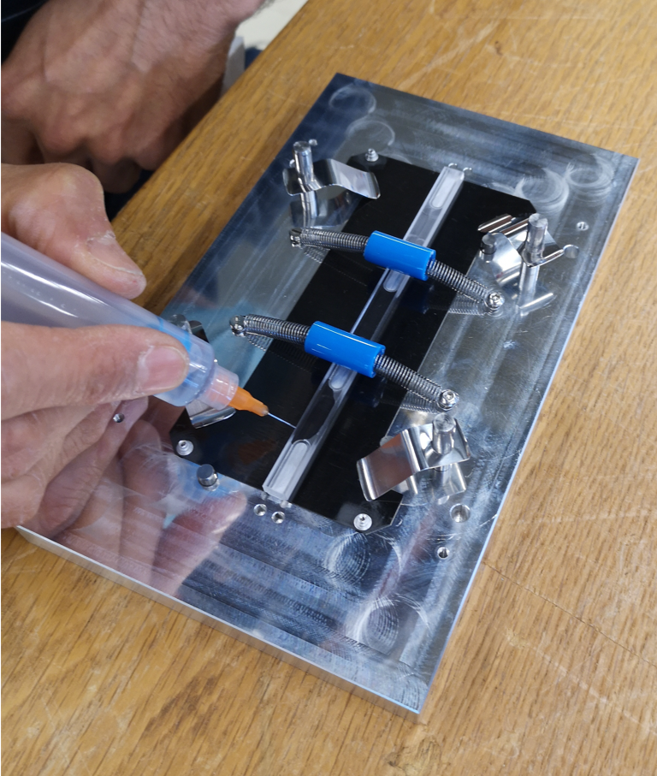
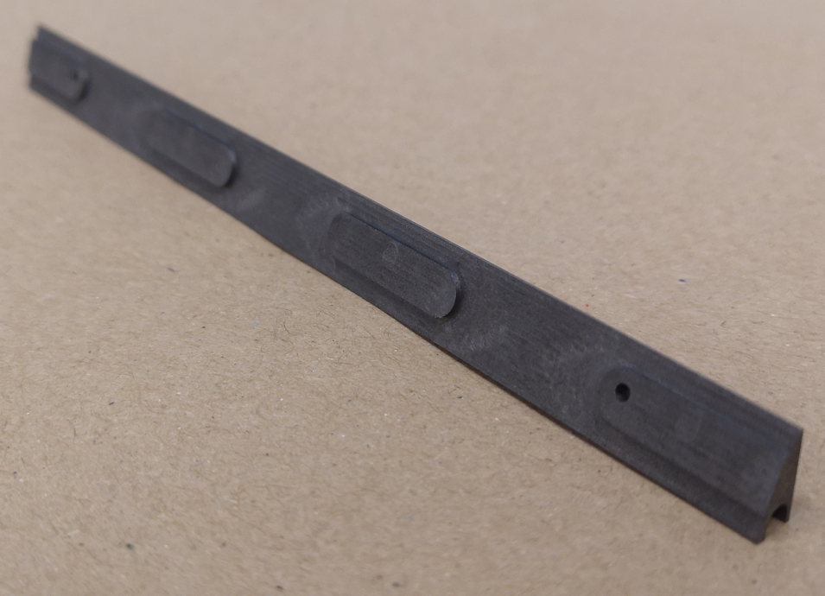
Al-CF Anomalies –
TBPS Ring Production – 2021
Sintered Al-CF cooling adaptor
Cooling Plate gluing jig
Cooling Plate Assembly
Design of the Cooling Adaptor was updated by adding 4 pads to increase the thermal efficiency of the cooling assemblies
The assemblies were made in July 2021
Cooling Plate Gluing Jigs are used for both Inner and Outer Cooling Plate assemblies
- CF Cooling Plate (Five plies of 120 gsm K13D2U/EX1515 UD carbon-fibre / cyanate ester prepreg laminated to ~0.5 mm thick flat plates with [0, 90, 0, 90, 0] layup) + Sintered Al-CF Cooling Adaptor made from MB material + Al Inserts
Polytec EP 601-LV glue used
48h of curing at laboratory Temperature: ≈25°C with ≈50% Rh
22 Cooling Plate assemblies were glued for the Layer 1 Ring (nominal : 18)

Slide 9
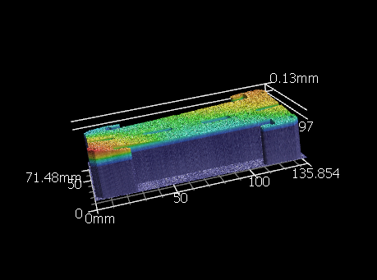
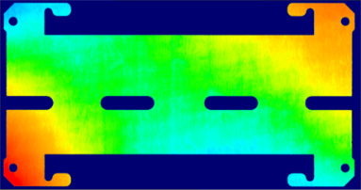
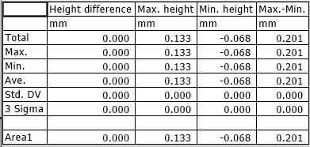
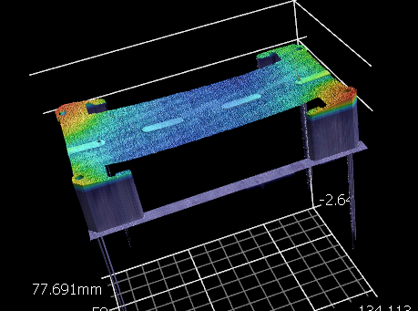
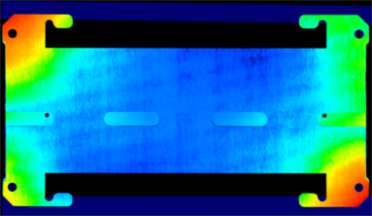
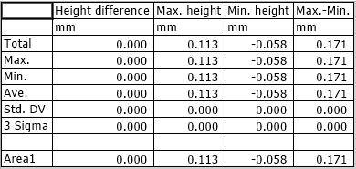
Al-CF Anomalies –
TBPS Ring Production – 2021
Flatness of every Cooling Plate was measured with Laser VR Keyence microscope in July 2021 before and after the gluing with the Al-CF adaptor (from MB)
Plate flatness measured to between 120 µm and 200 µm both for single Cooling Plates as for Cooling Plate + Al-CF Adaptor assemblies
All the assemblies were stored in a cupboard in a lab with no thermal/humidity control from July to October, with temperatures from +18°C to +35°C, as the lab air-conditioning was off (due Covid reasons)

Slide 10
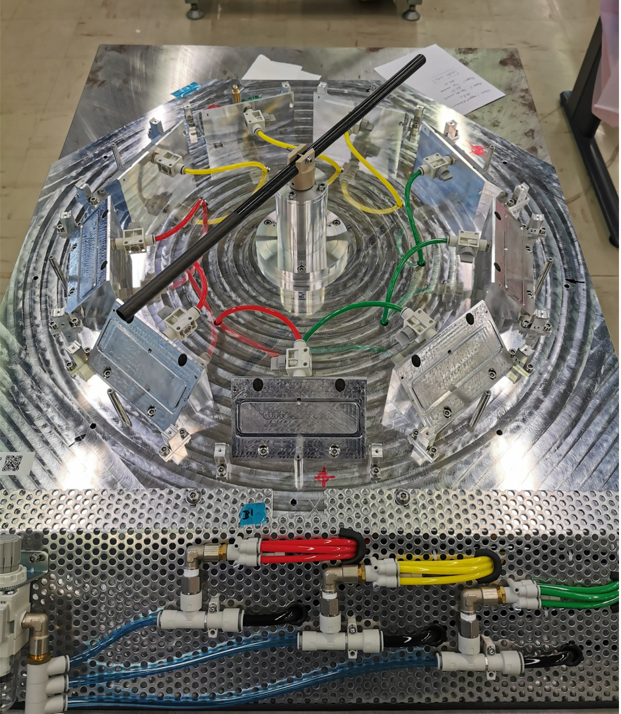
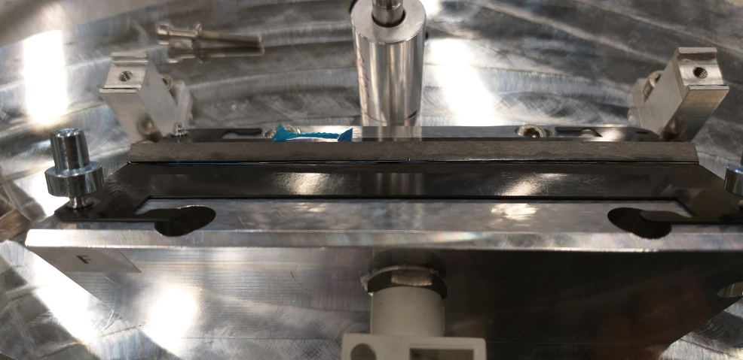
Al-CF Anomalies –
TBPS Ring Production – 2021
L1 - Inner Assembly jig
Gap= 0.35/0.40mm
Before 0.17mm
In parallel, the Assembly Jigs were produced and adjusted, and delay occurred on the delivery of the Sandwich Plate Rings
Finally, the Ring production “started” at the end of October 2021 (3 months after the gluing of the cooling plate assemblies)
But the cooling plate assemblies were not as flat as before ! Factor 2 of deflection was observed on all the cooling plate assemblies
A bi-metallic effect was observed, but why did it occur now ? (and was never observed before (2019))
The assemblies are not as stable as we thought
Influence of the humidity ? Or influence of the design itself ? (Casted Al-CF cooling adaptors didn’t have the 4 pads)
Problem with the CF cooling plate ? Problem with the Temperature ? Some other problem that we cannot imagine ?

Slide 11
Al-CF Investigation

Slide 12
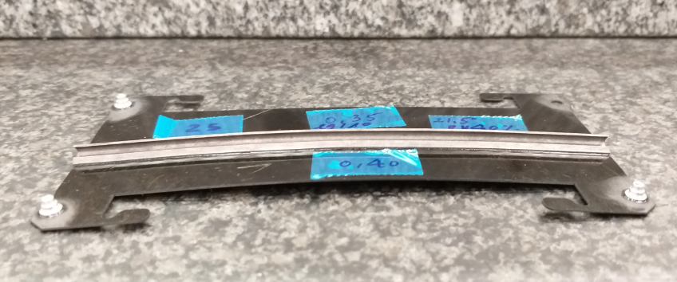
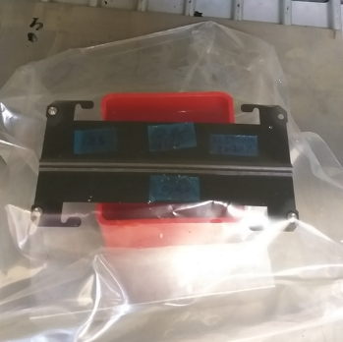
Al-CF Investigation –
Al-CF behavior
Temperature change (CTE) was quickly removed as a potential source of the deformation problem. Changing the temperature of the Cooling Plate assembly within 10°C range did not lead to any measurable deformations
Humidity influence ?
A 1st test was done on a Cooling Plate Assembly with Sintered Al-CF (From MB)
Test conditions:
Temperature: 70°C
Humidity: 100%
Time: 60 hours (weekend)
Deflection of 3.2mm !
CP assembly inside a sealed bag with water

Slide 13
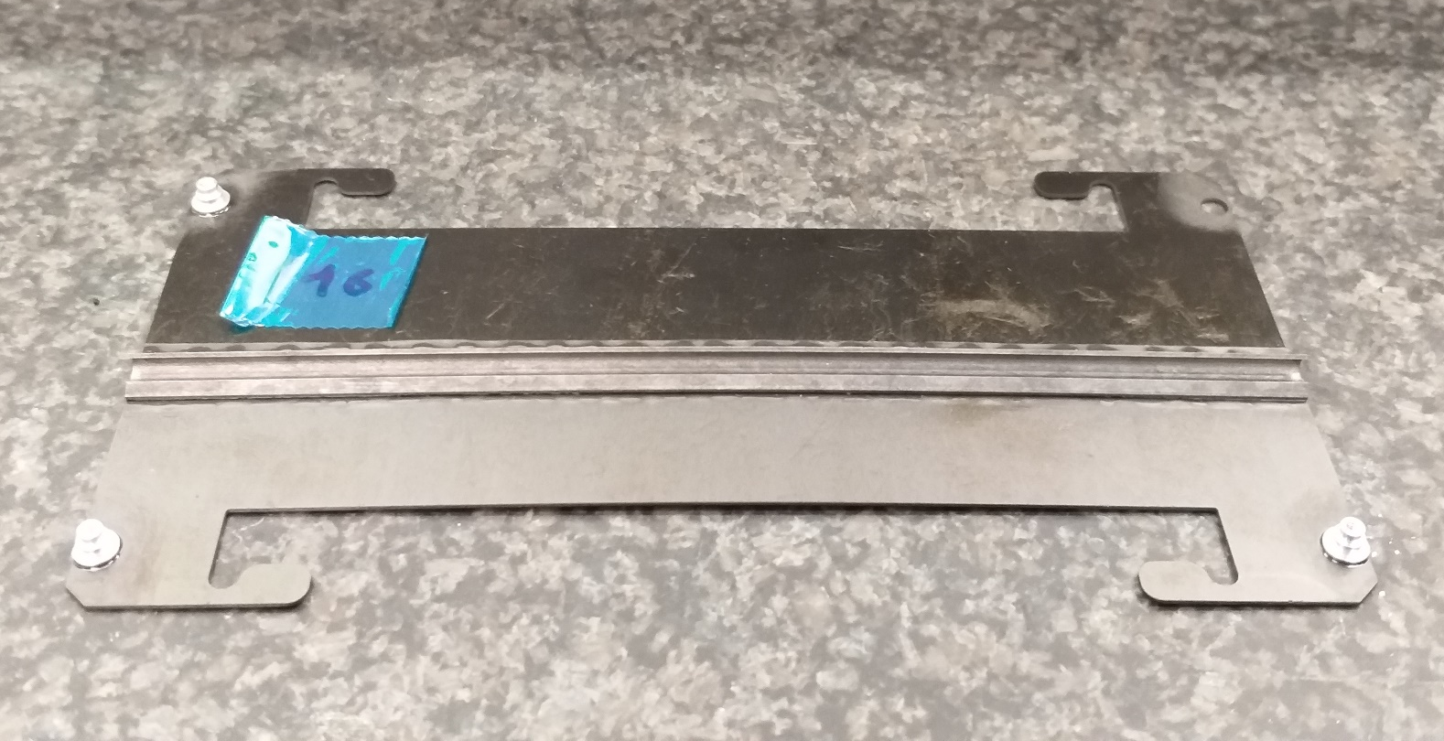
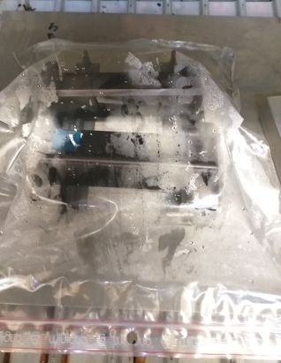
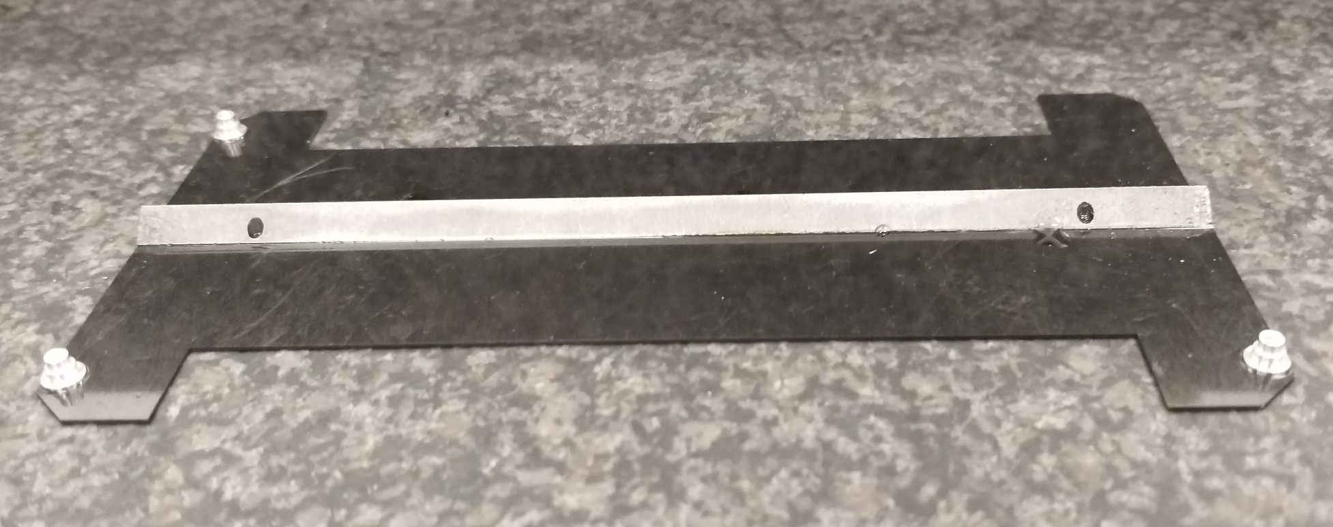
Al-CF Investigation –
Al-CF behavior
Humidity influence ?
A 2nd test was done with a MB Cooling plate assembly and a MA one (glued 3years ago)
Test conditions:
Temperature: 70°C
Humidity: 100%
Time: 18 hours
Sintered Al-CF (MB): Deformation from 0.35mm to 0.80mm
Casted Al-CF (MA): No visible deformation
It seems that the moisture affects only the Sintered Al-CF,
but as the Al-CF adaptor geometries in the two assemblies are not the same, could the source be the geometry ?

Slide 14
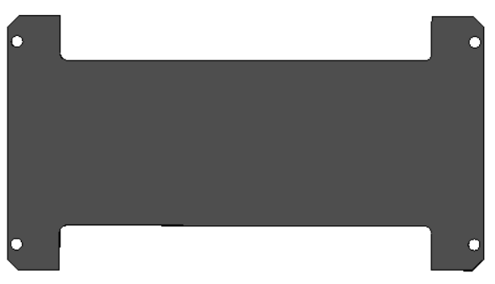
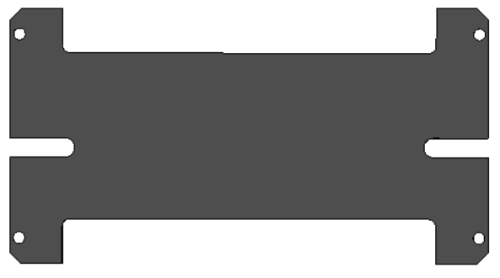
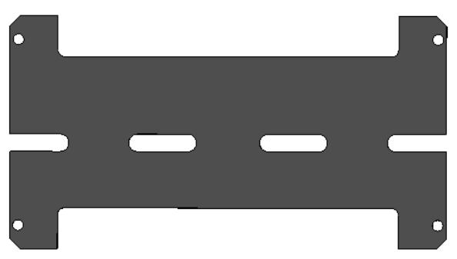
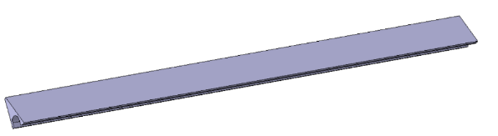
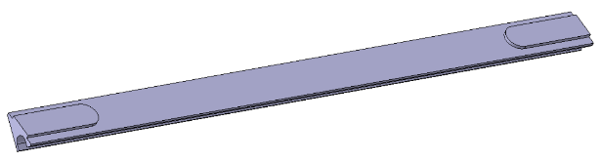
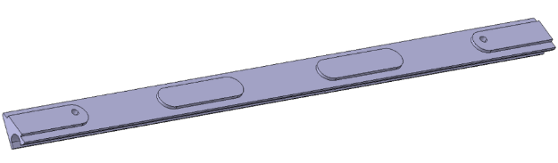
Al-CF Investigation –
Al-CF behavior
Geometry influence ?
Tests were performed using 6 Casted and 6 Sintered Al-CF assemblies,
with 3 different geometrical designs (number of notches).
Design #1, no notched
Design #2, 2 notches
Design #3, 4 notches
Test conditions:
50°C and 100% RH for days.

Slide 15
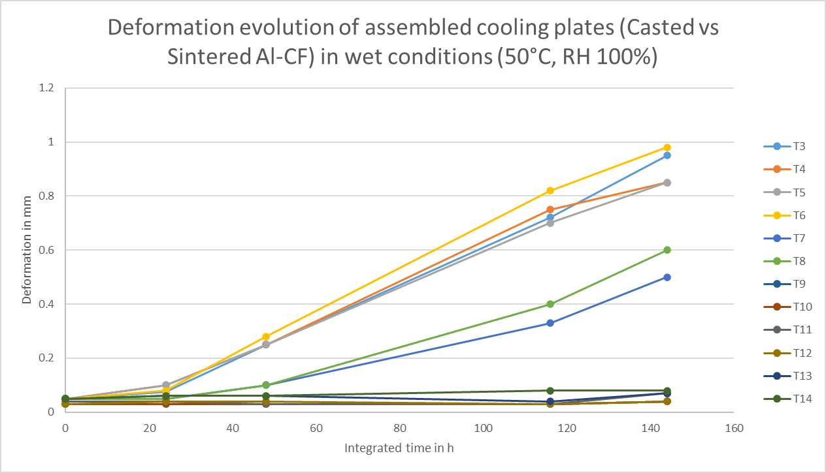
Al-CF Investigation –
Al-CF behavior
Geometry influence ?
Tests were performed using 6 Casted and 6 Sintered Al-CF assemblies,
with 3 different geometrical designs (number of notches).
Sintered Al-CF
Casted Al-CF
There is no direct correlation between deformation and design (presence or absence of notches)
The bi-metallic effect is directly due to the Al-CF material itself, and visible only with the Sintered material.

Slide 16
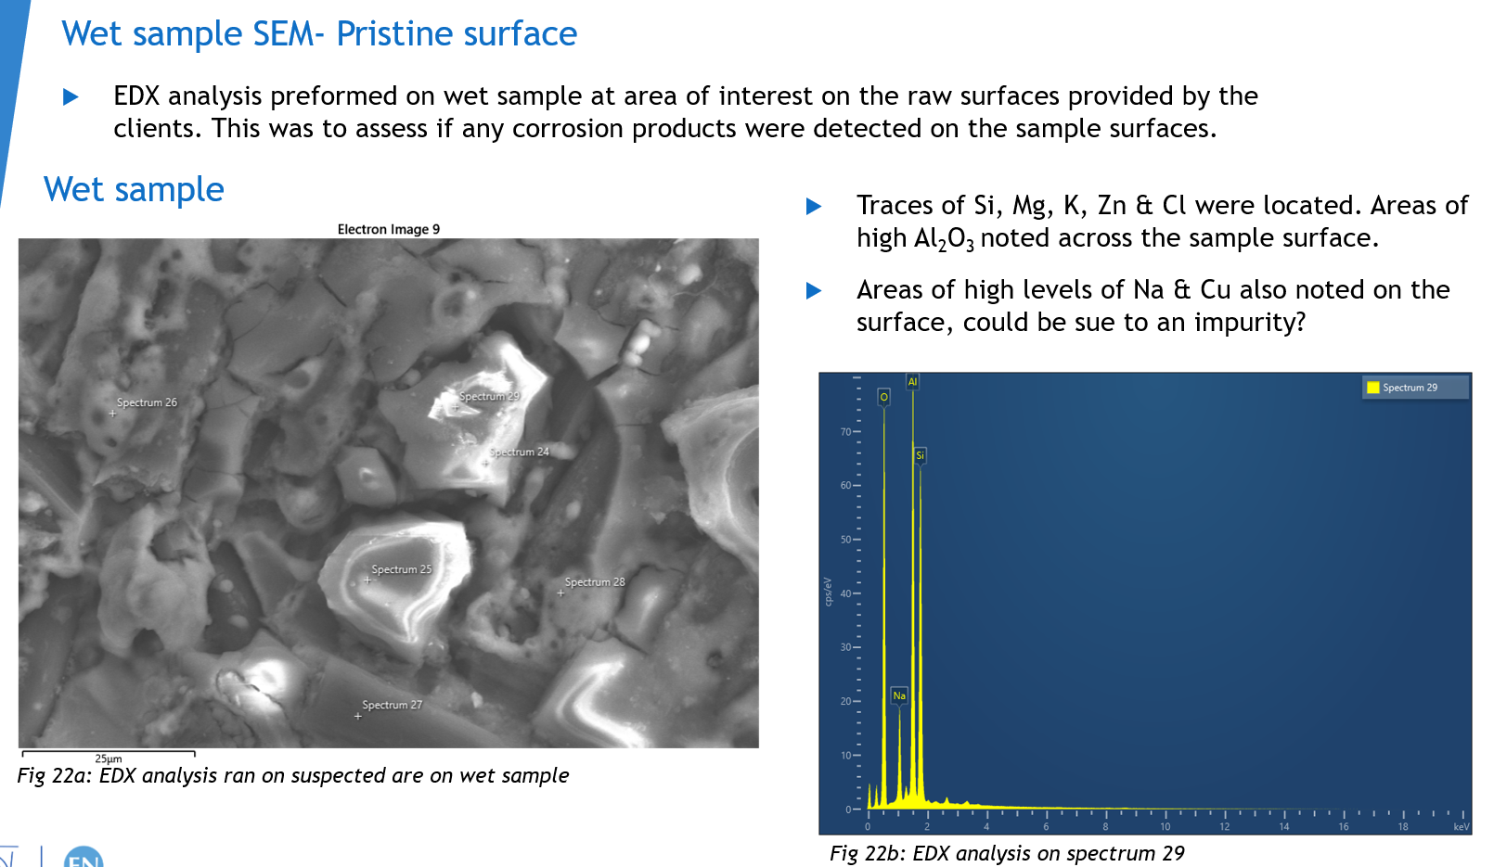
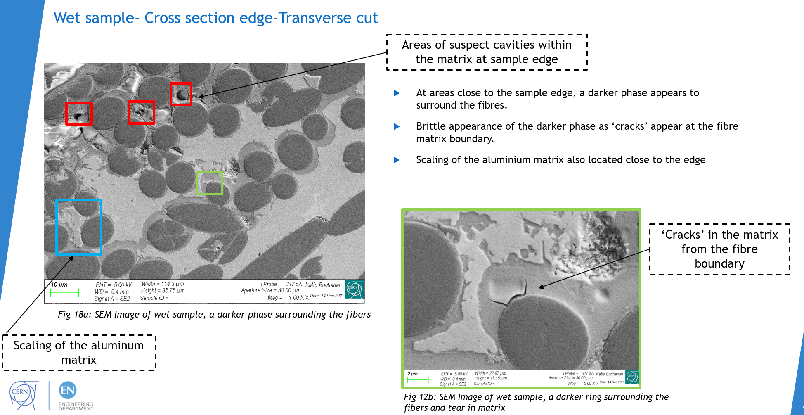
Al-CF Investigation –
Material Inspection
Samples that had been exposed to high level of humidity were analyzed at the EN-MME-MM group at CERN
(Materials, Metrology and Non-Destructive Testing)
The samples were test with EDX analysis (Energy Dispersive X-Ray) and SEM (Scanning Electron Microscope)
Their conclusion: “observed degradation of the MB wet sample the underwent extreme condition is understood to have extreme moisture sensitivity due to degradation induced by active galvanic corrosion phenomenon happening between the carbon fibre and aluminium matrix. This may be related to the more open structure due to the fabrication route of powder metallurgy”
“MA samples has slight breakdown on the outer surface of the pristine sample and not in the bulk material of the wet sample”
Contact persons : katie.elizabeth.buchanan@cern.ch Stefano.Sgobba@cern.ch

Slide 17
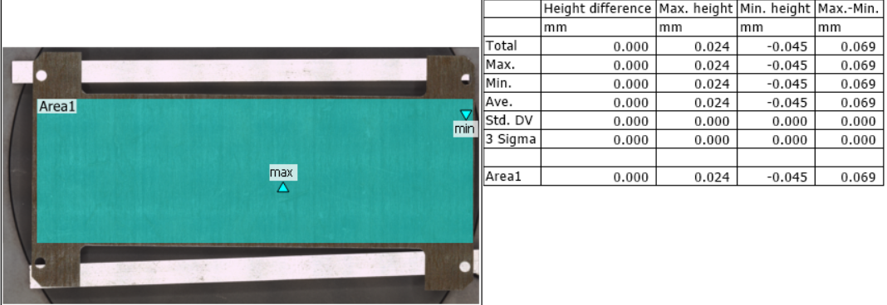
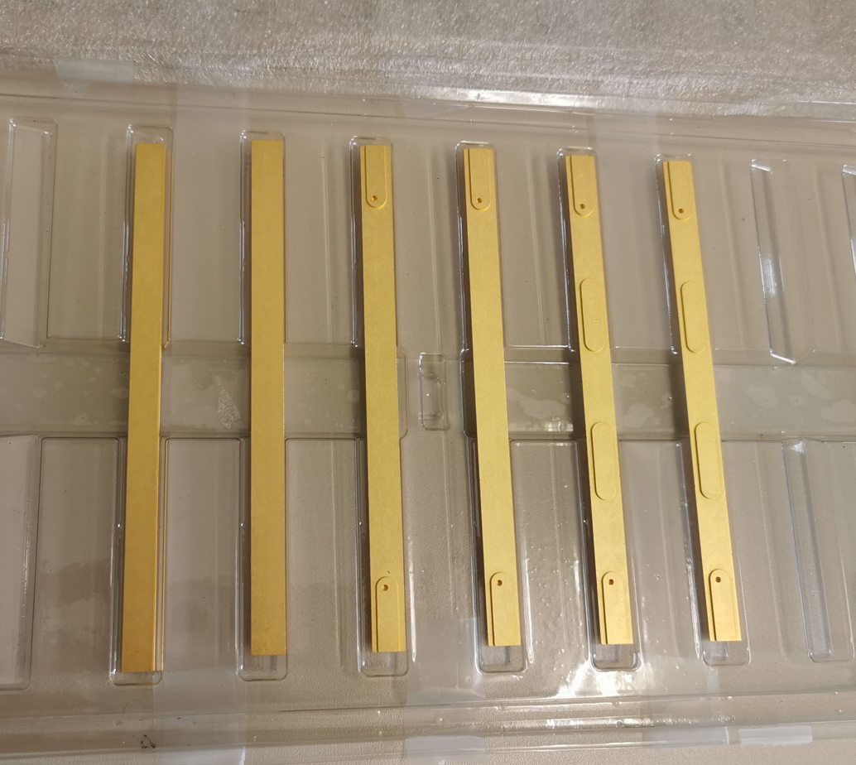
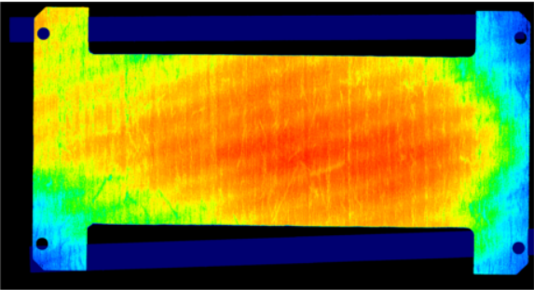
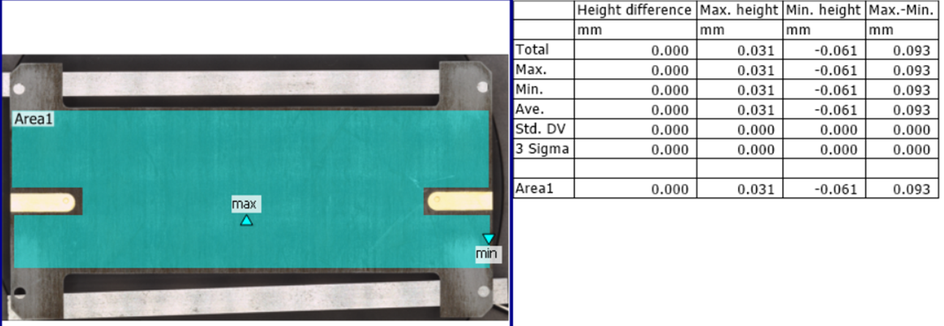
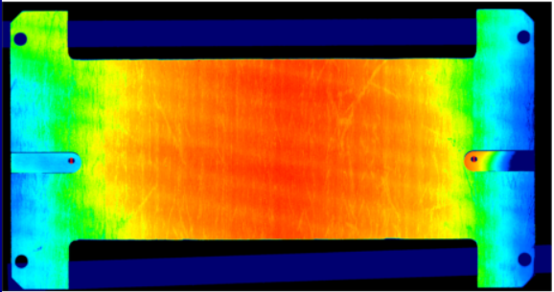
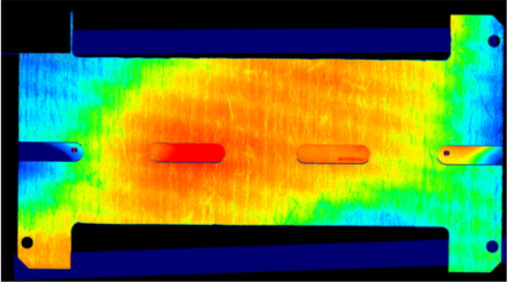
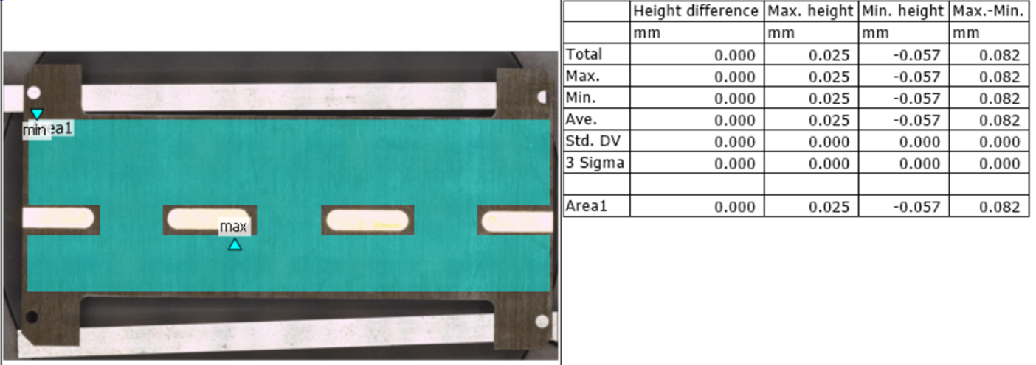
Al-CF Investigation –
Coating Measurements
MB was informed about this moisture issue with their Sintered material
They proposed to “protect” the material by adding a coating on the adaptors as they usually coat all the pieces they sent to electronic consumers.
They propose to perform more moisture tests with coated adaptors (with coating of 12µm of Ni and 0.2µm of Au)
6 samples were produced, and the 3 best parts were tested
3 cooling plate assemblies were done with flatness below 100µm
Sintered Al-CF coating adaptors

Slide 18
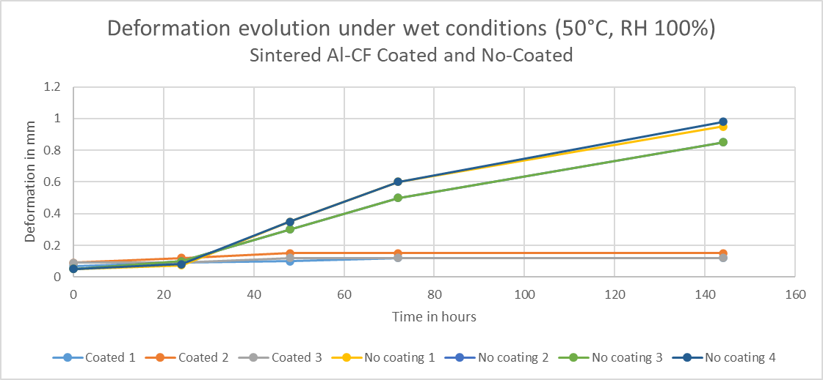

Al-CF Investigation –
Coating Measurements
No- Coated
Coated
Coating does protect the pieces from the moisture absorption effect.
Coated pieces are acceptable for TBPS Ring production but do increase the radiation length of the parts by 15%.
EN-MME-MM did analysis too :

Slide 19
Ring Production

Slide 20





Ring Production –
Ring Assembly Building
Ring Assembly Zone
Layer 3 Ring Assembly Jig
L1 – Pipe Bending Jig
The Tilted TBPS mechanics is constructed in CERN EP-DT facilities.
Temperature controlled space (288 m2) has been setup in 2021 and is the key facility for high-precision assembly gluing operations. The facility benefits of high-precision machining workshop, laboratory and office spaces in the same building cluster
Ring Production
Building layout
Cooling Plate Assembly Jig

Slide 21


Ring Production –
Ring L1-47°
Casted Al-CF Cooling Adaptor
L1-47° Ring
For the 1st Ring L1-47°, Casted adaptors have been machined and installed in the Ring
Ring assembly was OK, pressure tested, metrology tested
Currently thermal tested, preliminary results look fine.

Slide 22



Ring Production –
Ring L2-68°
L2-68° Outer Assembly jig with Ring
L2-68° Ring
L2-68° Ring – on metrology machine
For the 2nd Ring L2-68°,Sintered coated Al-CF adaptors have been machined and used
Ring assembly was OK, Cooling Plates assemblies behaved as expected.
Currently at the metrology lab

Slide 23
Conclusion
Discovery of the moisture effects on Sintered Al-CF at the beginning of the Ring Production. Material behaviour now better understood and considered in the further production plans
Controlled lab conditions (+22°C and Rh<60%) seem to have no effect
(at least in the time period of few months) for the Sintered Al-CF material, but any excursions to higher humidity levels must be avoided
TBPS Ring pre-production now started with 2 Rings assembled
(Layer 1 and Layer 2) and the first Ring Layer 3 Ring due this summer. Need to ramp-up production to full speed (1 Ring per week) by spring 2023.

Slide 24
Thanks !

Slide 25
Spare Slides

Slide 26





Al-CF behavior
Casted Al-CF piece on 15/12/2021
Sintered Al-CF piece on 15/12/2021
The “raw” materials acting differently on wet conditions (50°C – 100% RH) – 11days
Casted Al-CF +0.015% of length , +0.8% of mass
Sintered Al-CF +0.285% of length, +2.2% of mass

