Slide 1



Hybrid cycle with Krypton for cooling of future silicon detectors in HEP
10th June
Luca Contiero (NTNU)
Armin Hafner, Krzysztof Banasiak, Pierre Barroca, Yosr Allouche (NTNU)
Bart Verlaat & Paolo Petagna (CERN)

Slide 2
Abstract
The Large Hadron Collider (LHC) will soon deliver much more radiation after LS4. The level of radiation has already pushed the current CO2 cooling unit to its limit, represented by the triple point (≈ -56°C). To sustain the harsh requirements imposed in terms of radiation, temperature levels and mass minimization the sensors should be maintained at a temperature sufficiently low to prevent the thermal runaway while at the same time the heat load generated inside in the readout electronics and sensor must be removed. The refrigerant Krypton stands out as the most promising coolant thanks to the best thermal performance with the smaller cooling pipes inside the detector and to the highest resistance to radiation, being a noble gas. As side-effect to reach temperature levels unattainable by CO2, higher radiation length is expected due to the larger atomic number and lower liquid-vapor density ratio. Besides investigating the work done so far on thermal management design aimed to reduce the temperature difference sensor – coolant it is crucial to ensure a stable and controlled cooling rate without shocking the detector.
Krypton being a high-working pressure fluid is able to remove efficiently the heat generated inside the detector via the use of small tubes, with less impact in terms of space compared to others low-temperature working fluids. The same silicon sensor technology currently used with two-phase CO2 flowing in titanium tubes located close to the heat source (electronics & sensors) will be adopted. A much lower critical and NBP temperatures compared to CO2 require a completely new cooling cycle. In fact, the vapor phase at room temperature imposes a gentle supercritical cool-down process to avoid the shock of the detector. A special cycle technology is also needed to work either in sub or supercritical state, covering a very large temperature range. A specific control logic must be implemented to cool down gently the detector while maintaining an acceptable temperature gradient along the detector. Different components are activated according to the operating conditions in terms of working envelope (either sub or supercritical), as well as according to the temperature levels.

Slide 3
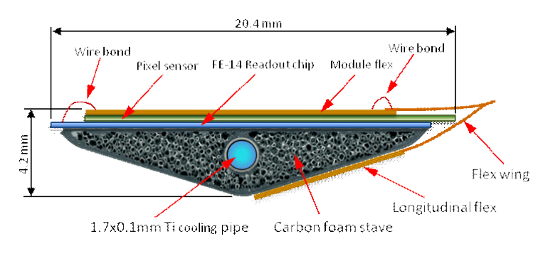
Why the need of a colder coolant ?
Power
∞ conductance
Stable cooling with a colder coolant
Power dissipation in the detector is a function of the temperature
Thermal runnaway → the T° increases faster than what the unit can cool down
Two things must be considered:
High thermal conductance (low ΔT) and light weight of the structure surrounding the cooling pipe
Need to go much colder to be stable
More radiation → Higher power dissipated → colder fluid !
Thermal runnaway
Larger ΔT along the thermal path requires more cooling
Thermal conductance
Coolant Temperature
T [°C]

Slide 4
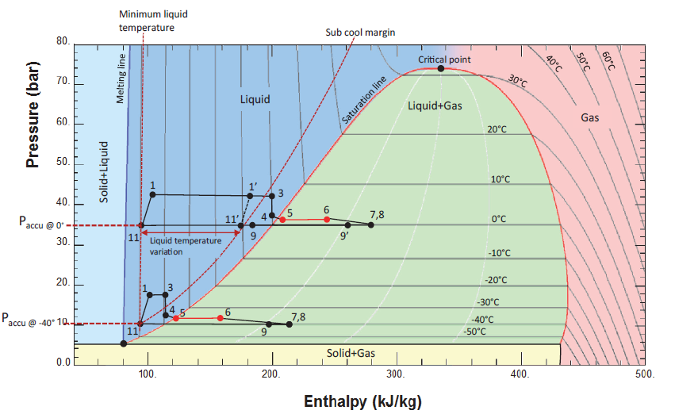
Why the need of a colder coolant than CO₂ ?
CO₂ triple point around -56°C → lowest possible evaporating temperature
The current limit is around -45°C (around -50°C on the primary chiller side)
Existing 2PACL needs a certain subcooling at the inlet of the pump
The condensation of the returning two-phase flow is done via a primarly chiller with CO₂
New temperature domain expected to be around -60 to -80°C → New environmental-friendly refrigerant!
https://indico.cern.ch/event/957057/page/23281-the-roadmap-document

Slide 5
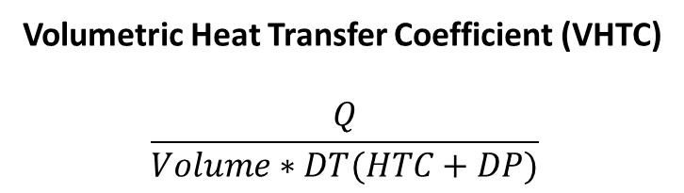
Selection of the best natural cooling choice in HEP
https://indico.cern.ch/event/233332/contributions/1546088/
In a detector cooling application the choice of the coolant is twofold:
Having the best thermal performance with the smallest possible cooling pipe
Avoid an uneven temperature distribution along the silicon sensors
Volumetric Heat Transfer Coefficient (VHTC)
$$\frac{Q}{Volume∗DT(HTC+DP)}$$
T_{wall} as low as possible, considering the DT along the pipe structure
Low T_{wall} because of the better HTC
T
T
Trade-off
By decreasing the diameter
T_{wall}
_{f(HTC)}
T_{wall}
DP
T_{fluid}
Length
DP ↑
T_{fluid}

Slide 6
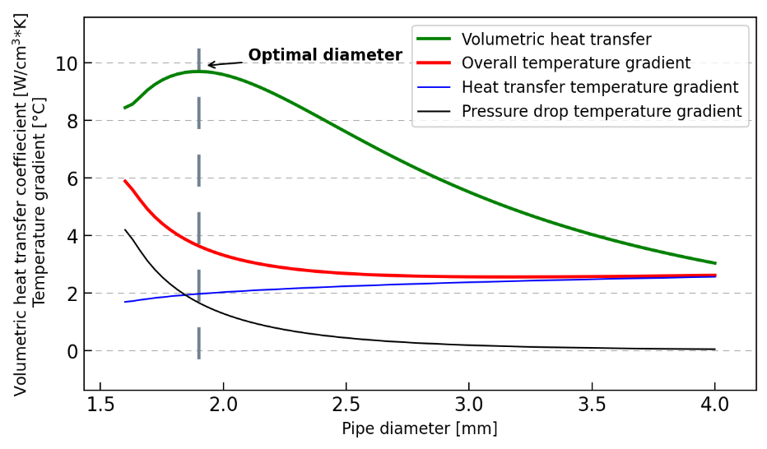
Selection of the best natural cooling choice in HEP
Optimum tube diameter in terms of thermal performance and material saving achieved with the peak of the VHTC (trade-off process)
Length = 2 [m]; Q = 200 [W] ; Vapor quality change = 0-35%; T = -80 [°C] ; Fluid = Krypton

Slide 7
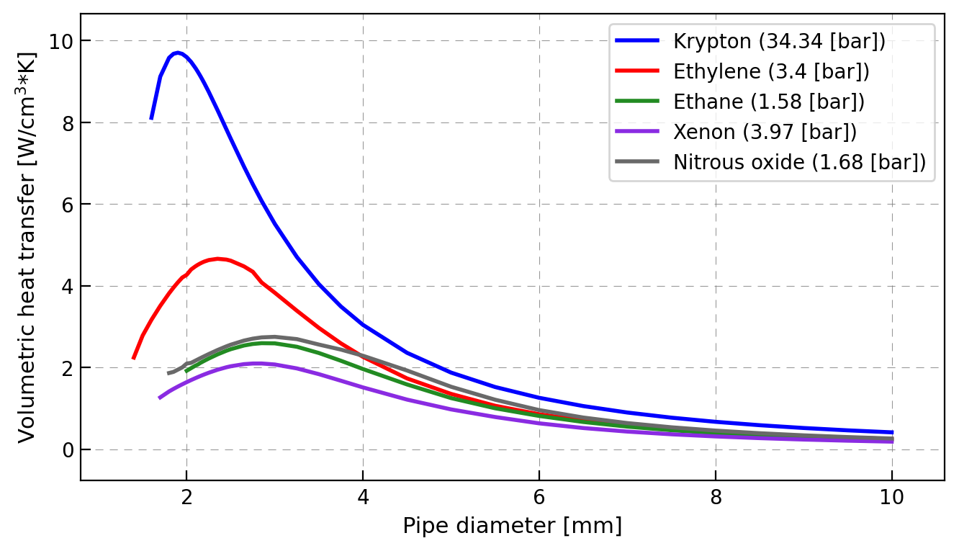

Selection of the best natural cooling choice in HEP
Bart presentation Cornell,2019: https://indico.cern.ch/event/7758
Larger diameters unaccepatble for low-mass detector design
High pressure fluids are less sensitive to pressure changes, which is beneficial for stable temperature systems
Clausius-Clapeyron
Pressure losses acceptable (for same DT) for Krypton up to 7 times those occuring with Xenon, HCs or N₂O
Larger DP are acceptable with Krypton, resulting in higher velocities in the evaporator and thus better HTC
Krypton as the most promising coolant for the future in HEP
T | Xenon | N₂O | Ethane | Ethylene | Krypton
[°C] | [K/Pa]
-70 | 6.12e-5 | 1.13e-4 | 1.3e-4 | 6.65e-5 | 9.47e-6
-80 | 4.59e-5 | 7.63e-5 | 9.14e-5 | 4.87e-5 | 7.55e-6
Length = 2 [m]; Q = 200 [W] ; Vapor quality change = 0-35%; T = -80 [°C]

Slide 8

What about the support structure around the tube ?
The study of the overall performance of the thermal system would require to consider the structure around the cooling pipe:
Heat transfer and pressure drops in the evaporator (pipe) → VHTC
Conductive mechanism across the support structure
Fixed controlled volume
Carbon foam
Fluid
Parameter | Value
Tube thickness [mm] | 0.1
λ_{tube} [W/m*K] | 7.2
λ_{foam} [W/m*K] | 35
λ_{glue} [W/m*K] | 1.02
ρ_{glue} [kg/m³] | 2400
ρ_{foam} [kg/m³] | 200
ρ_{tube} [kg/m³] | 4500
Glue
Titanium wall

Slide 9
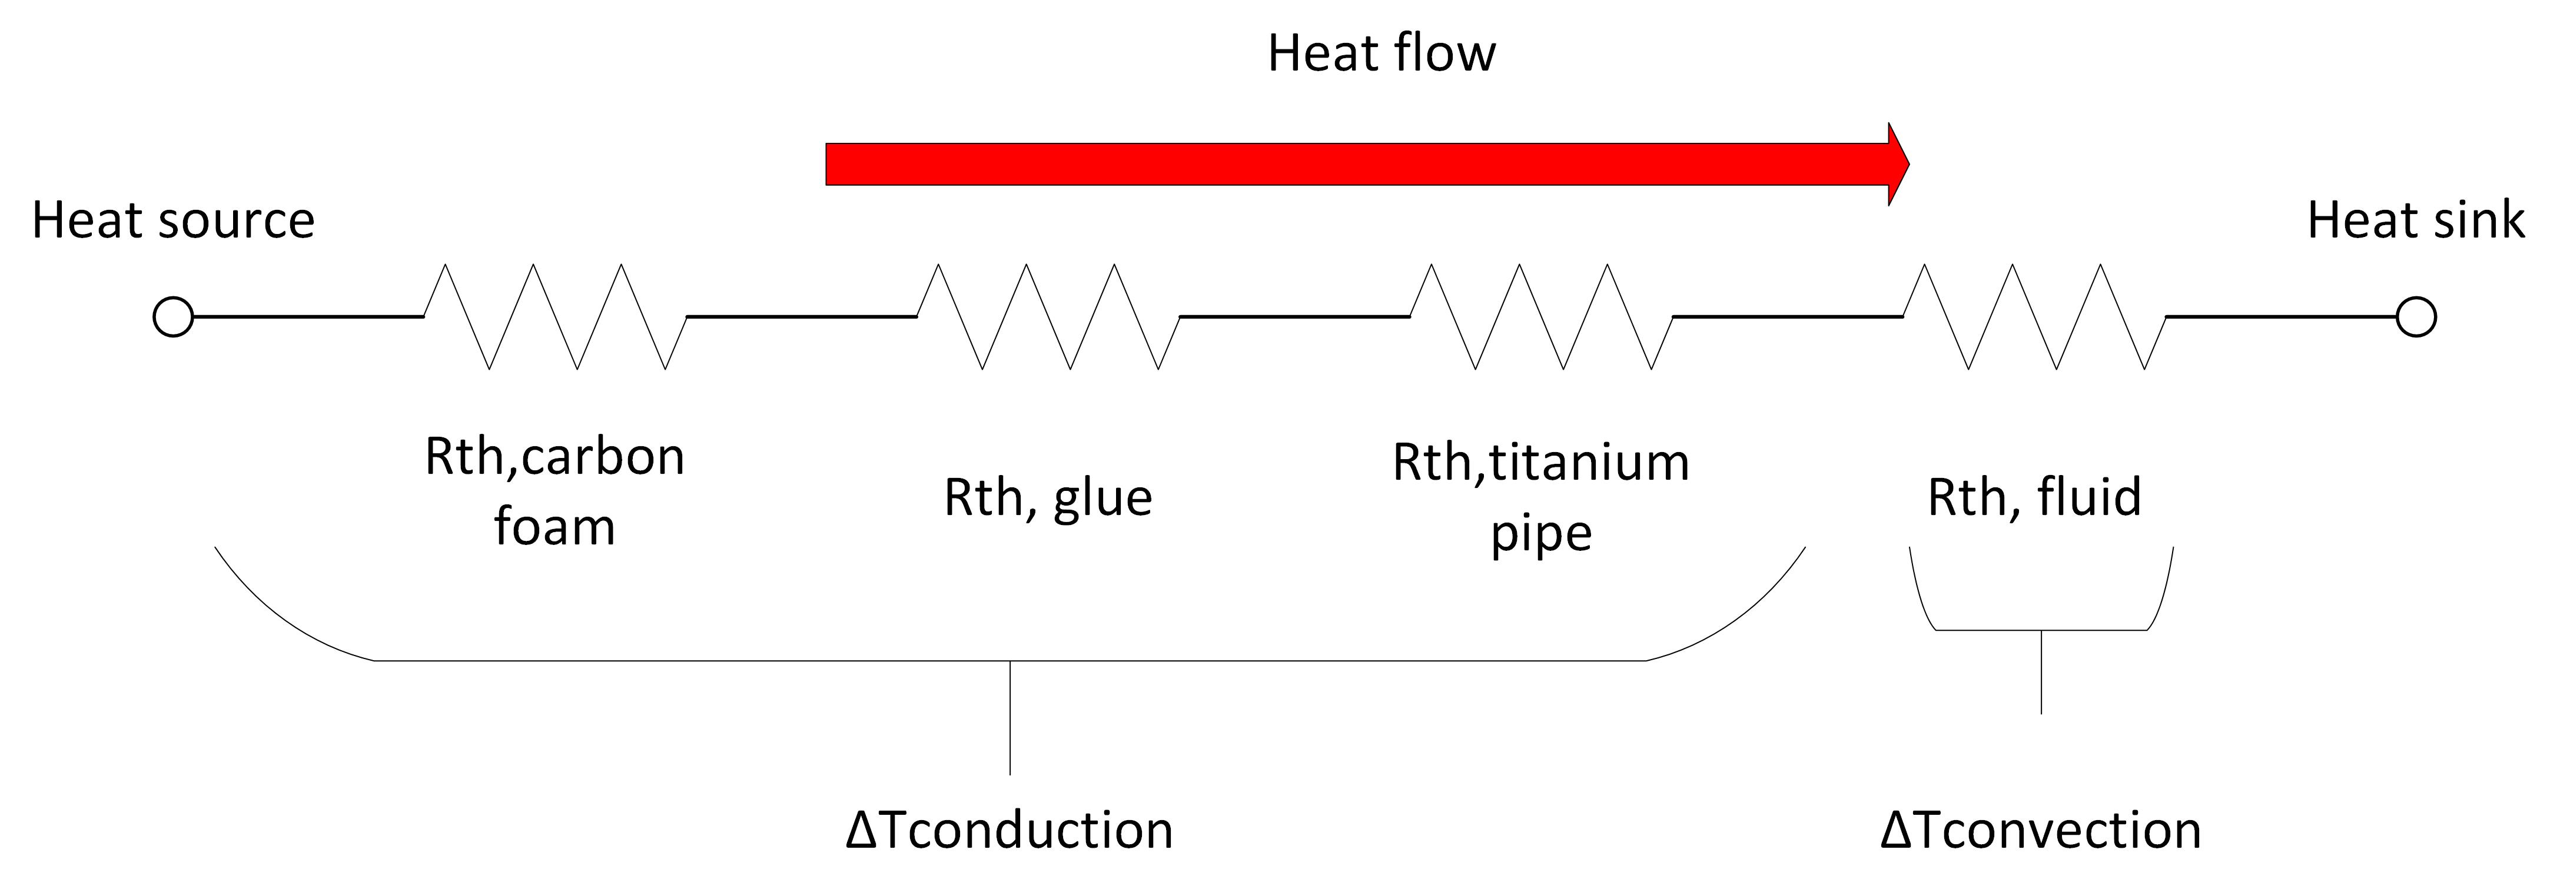
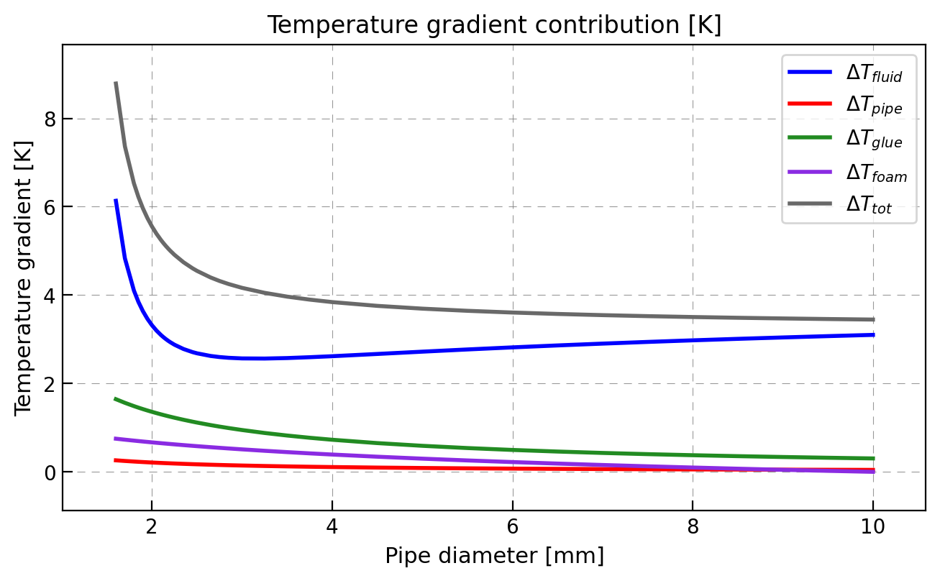
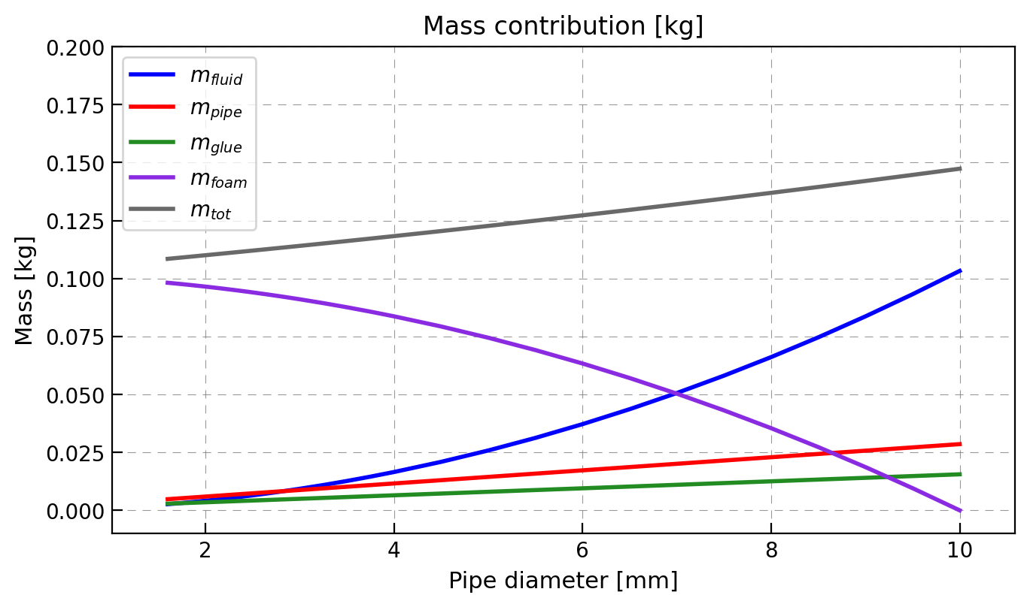
Overall heat transfer for the full picture
For a given fluid temperature, we can identify the cross sectional DT → identify the warmest spot
Different gradients among the modules generated by combination of DP and HTC → VHTC

Slide 10
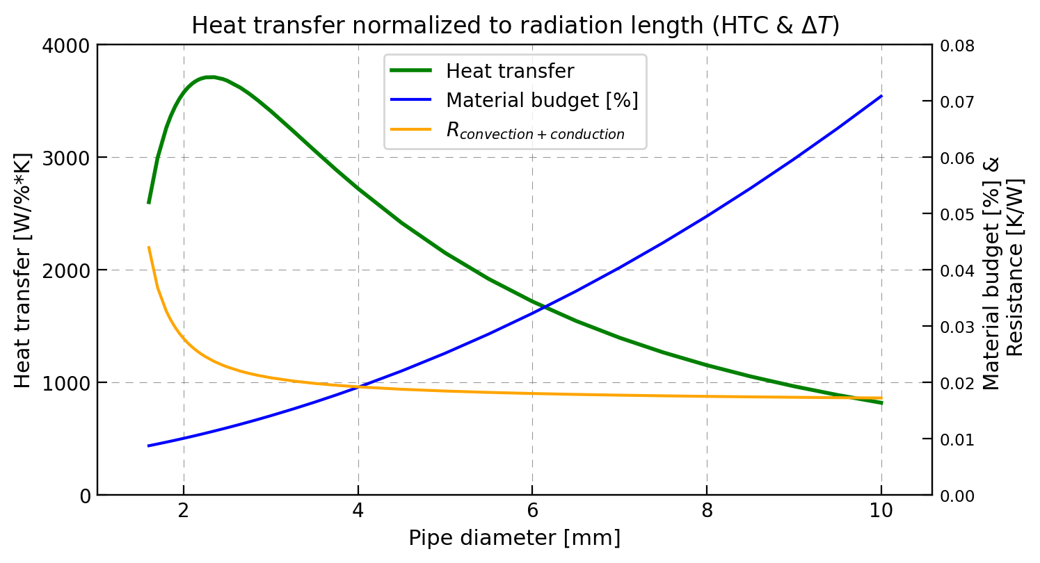
Overall heat transfer for the full picture
The optimal diameter is slightly different (Still considering the same inputs taken from https://cds.cern.ch/record/2784893)
This new heat transfer is incorporating the performance of the fluid and the impact on the tracking process
It allows to give a better overview of the optimal range where we should play
This analysis should be used to have a guideline - input for the design of the cooling unit
Radiation length for Krypton worst but we can reach temperature levels unattainable compared to CO₂ (atomic weight – density as main factors)

Slide 11
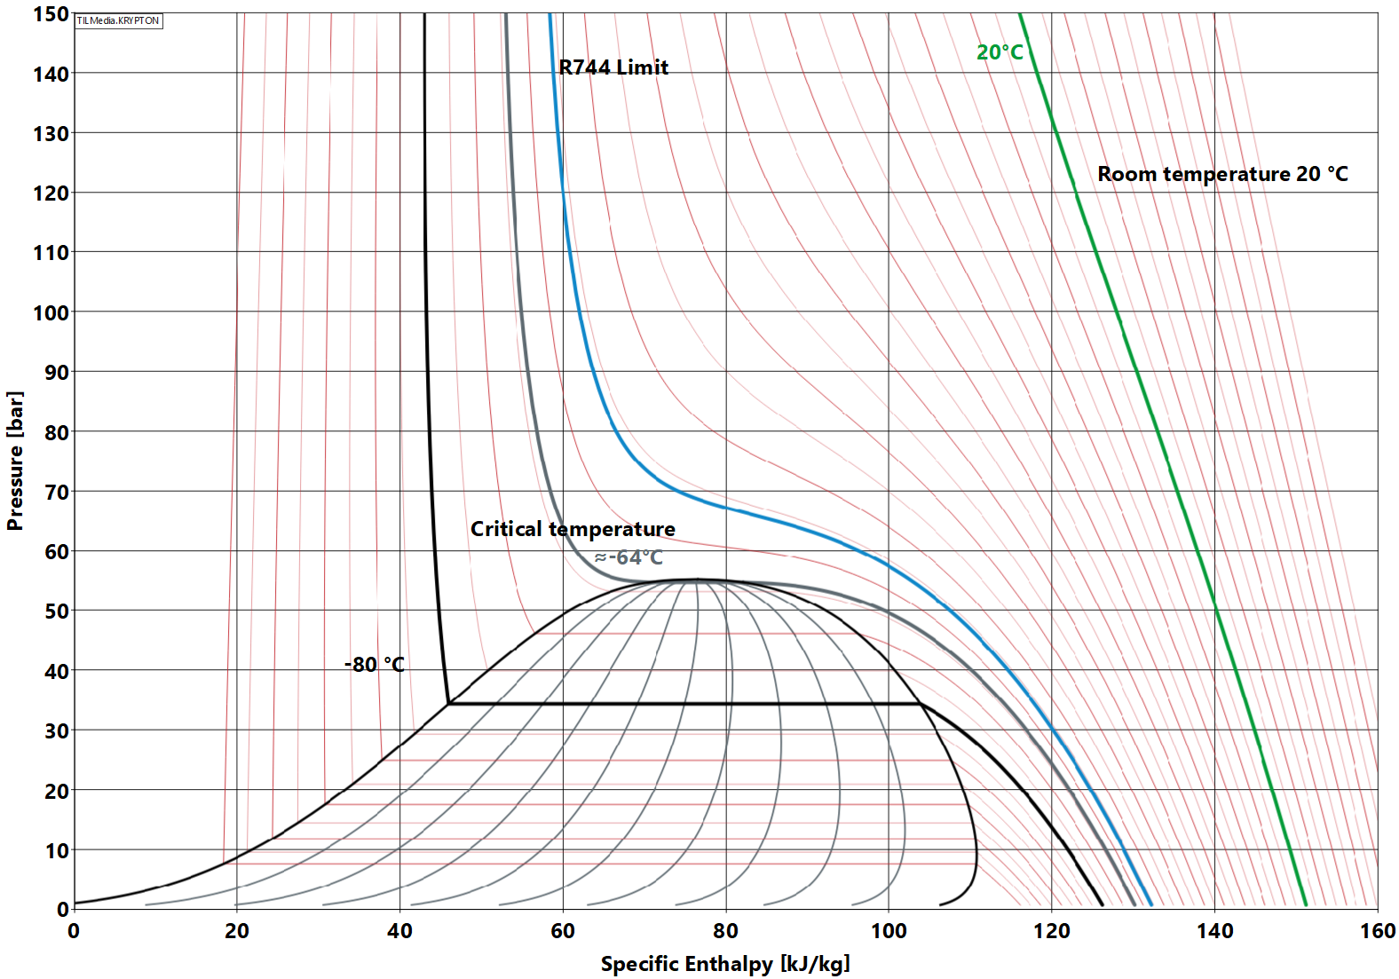
Challenges with Krypton cooling unit
Starting in gas phase (room temperature) requires a special cycle
Supercritical cooldown to avoid thermal shock inside the detector
Delicate components must be cooled down slowly → at high pressure nearly vertical isothermal lines
Oil-free machine must be used (turbocompressors)
Supercritical coodown required

Slide 12
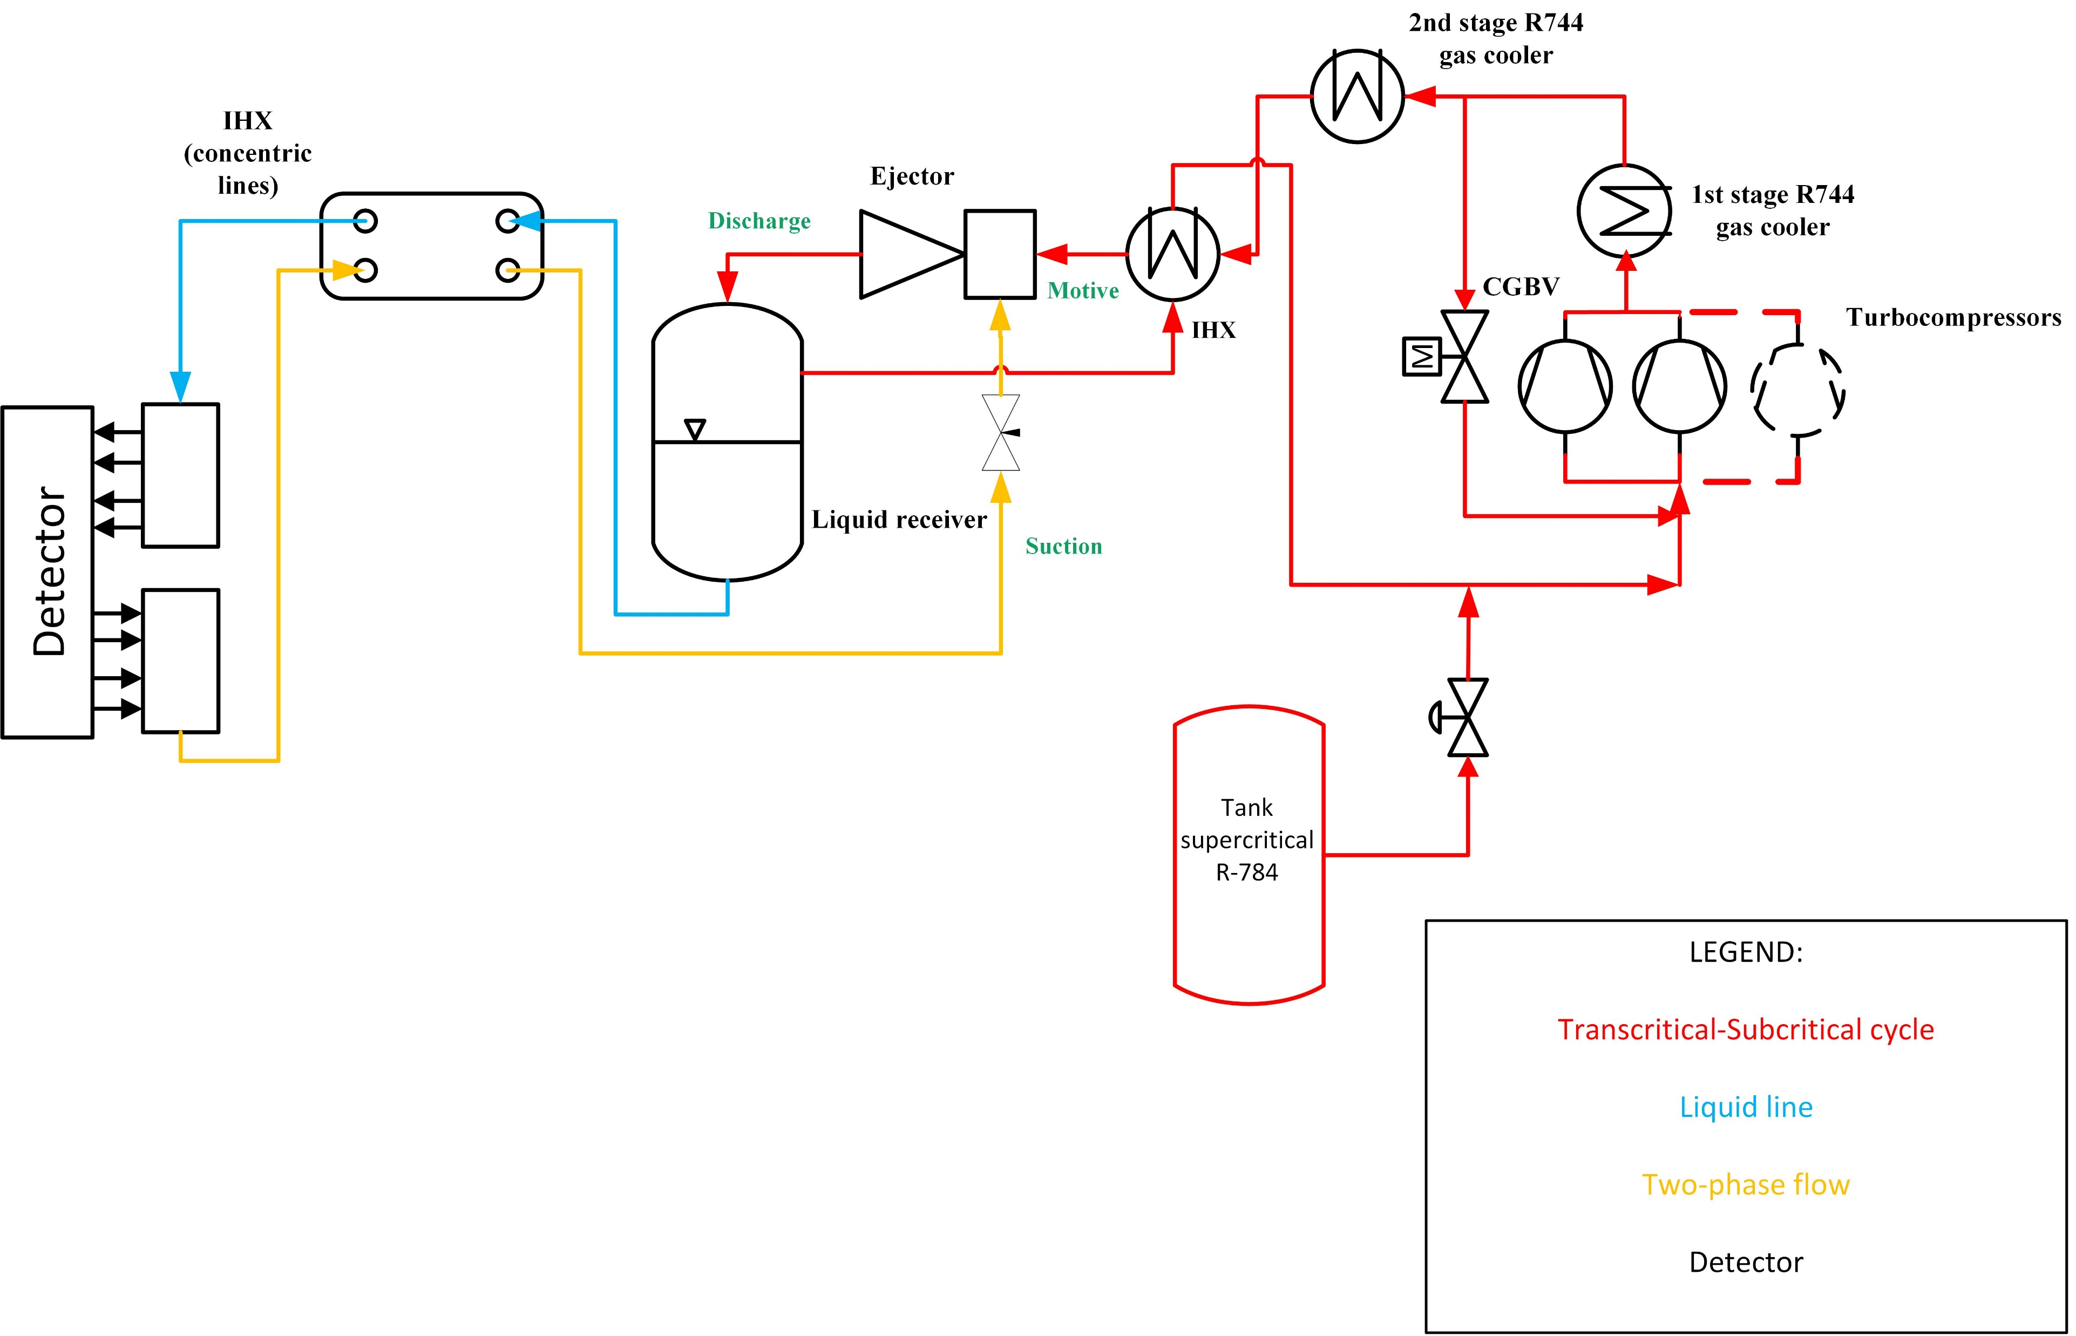

PID Hybrid cycle with Krypton
Heat rejection via CO₂ primary chiller + IHX
No active components in the non-accessible area
Ejector is a passive device used for liquid recirculation
Flow distribution via capillary (no active valves) ←→ Ejector design
Long distances covered by using concentric lines (avoiding double insulation)
No accessible area

Slide 13
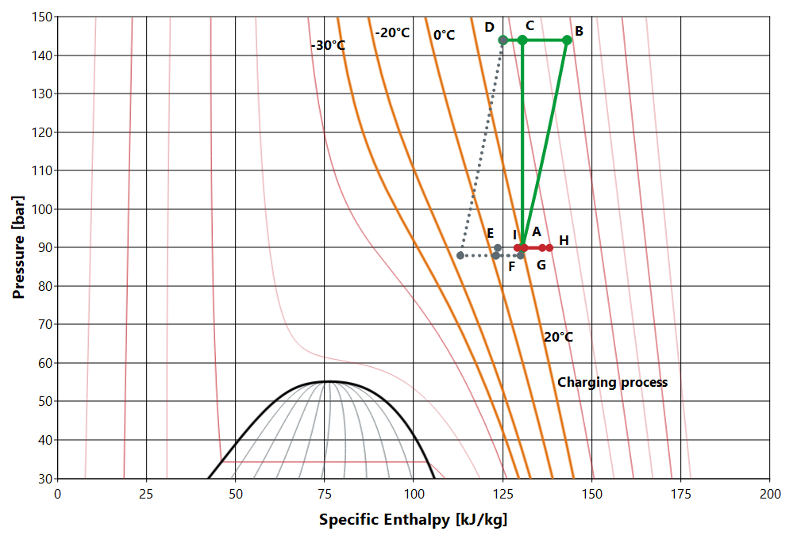
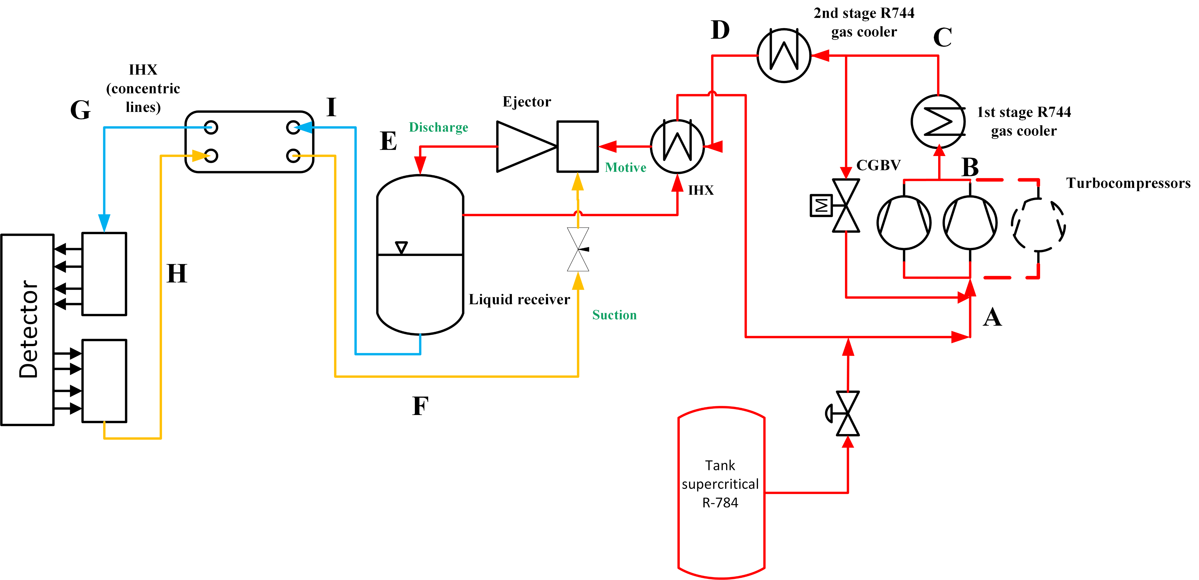
Supercritical cooldown process
Unit’s charging to the desired pressure level
Operating at high-pressure
Concentric line as safety against fast overcooling
Simultaneous charging during the cooldown process to operate in the zone of nearly isothermal lines

Slide 14
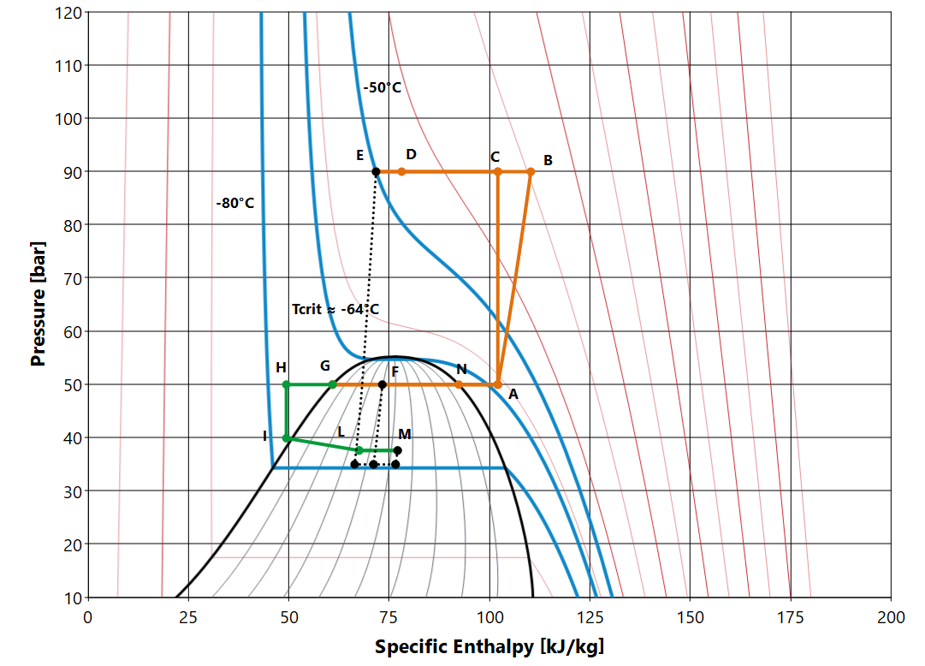

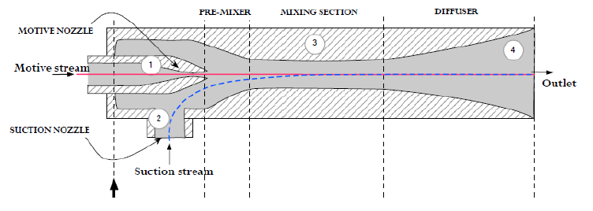
Transcritical – subcritical cycle
1
Capillary
4
3
2
Detector

Slide 15
Conclusion and future work
Krypton stands out as the most performant coolant for the future particle infrustructure at CERN
Same pressure level of CO₂, diameter expected to be in the same range
A special hybrid cycle is under design to accomplish the harsh requirement imposed by the detector (gentle cooldown, thermal runnaway, etc..) → supercritical cooldown cycle to liquefy Krypton to the desired temperature
But we need real data and then model appropriately the cycle, so:
Plan to build up a setup at CERN to test HTC and DP of Krypton (subcritical – supercritical)
In Trondheim (Norway), building a small setup to prove the cooling concept of the Krypton cycle → need of a more manageable refrigerant , idea of using Xenon for the following reasons:
A) Xenon is another noble gas, with same pressure level of Krypton and CO₂ → similar cooling construction
B) Critical temperature ≈ 17°C, rejecting heat by using water/or CO₂
C) Getting experience with ejector design for an extreme dynamic system

Slide 16
Thanks for your attention

Slide 17
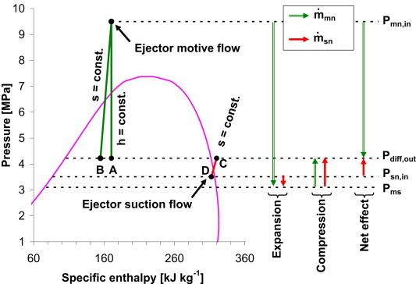
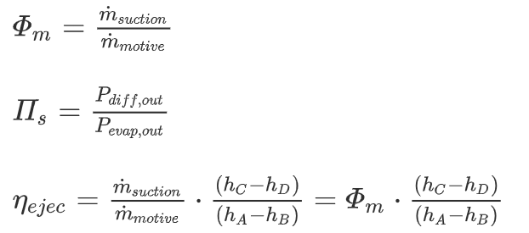
Backup slide

