Slide 1
Testing Cable Assemblies
Jens, Mike, Pepe

Slide 2
Why perform cable tests?
E.g. previous cable assemblies for IBL came from the manufacturer with incorrect stripping of the CCA wires, hence had trouble with resistance
  Only noticed on reception of first cables, could have led to massive problems later (And has, for the solution was to go to solid copper…)
We’re handling cables after delivery, need to make sure that they work before plugging in

Slide 3
How to perform Cable tests
Through test:
  Needs leads for each side of the cable, connected to the testing device
  Test leads need checking, whenever a cable fails
Single sided tests:
  TDR: Expensive, not good for resistance, forget it
  Shorting plug/Resistive network at one end:
    Cable tester gets connected to the other, can still figure out connectivity, round trip resistance and possibly even individual resistances through measuring lots of pairs of connections (resistor network)

Slide 4
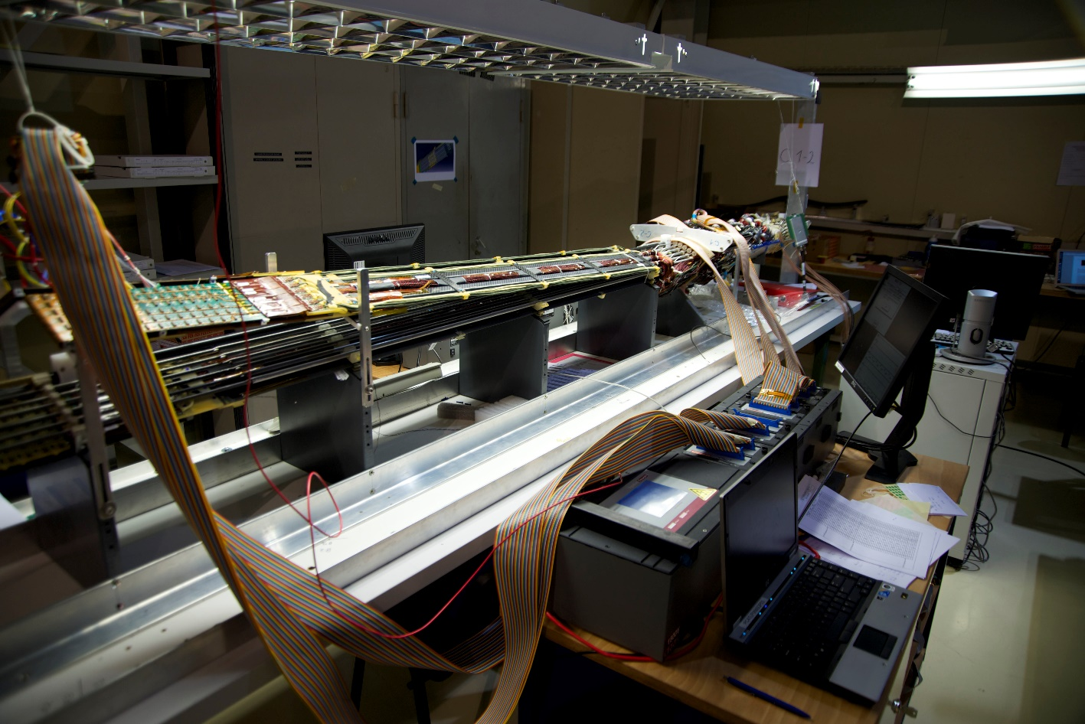
What was done in the past
Cirris Signature Touch 1 series cable testers used for Pixel/nSQP/IBL
  Used for checking all service panels (10k solder joints per panel) for Pixel/nSQP project
  IBL cables tested with these as well as some connecting components
Special test assembly generated for a services test
  Contained a programmable load and some DMMs, allowing the plug an adapter into a service chain and ramp up the services as if an active device was connected, testing overvoltage protection, maximum load currents and so on
    Extremely heavy and quite hard to use, hence if we decide we need this, we may well want to make sure it’s a bit more plug & pray!

Slide 5
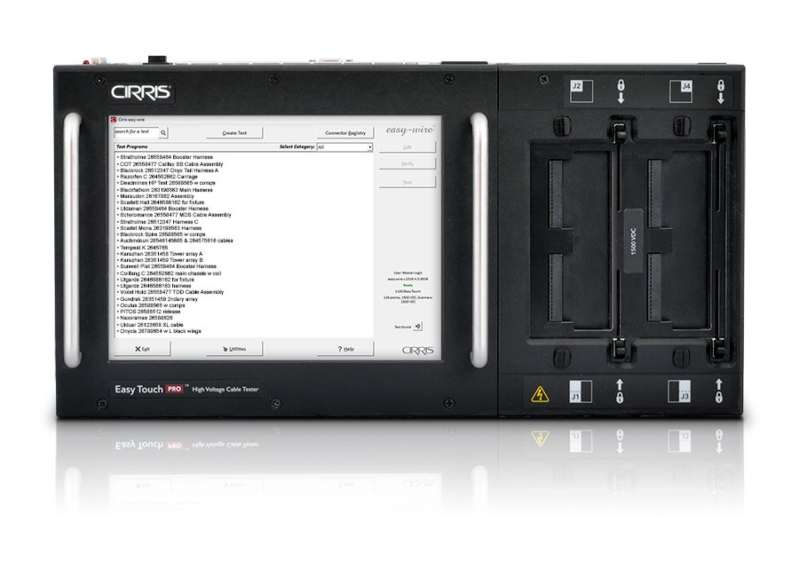
The future
Checked with Cirris, new Touch Pro device has equivalent, if not better capability compared to the (now 15+ years old, DOS based) Touch 1
  About 10k for the device with 128 test points – can measure 64 individual pairs or perform 32 full four point tests
  Extendable by add-ons up to 512 channels – could even do more, but then there are other devices to do so
  Up to 2kV voltage, energy limited, checking for HVIR and leakage
  Up to 1A current in 4-point measuring mode
  Can actually measure capacitance around 5nF to 100 uF
  Can check correct pairing of twisted pairs

