Slide 1
New Co-cure Jig
Y-Distortions (banana)
New co-cure jig to ensure tape is straight after co-cure

Slide 2
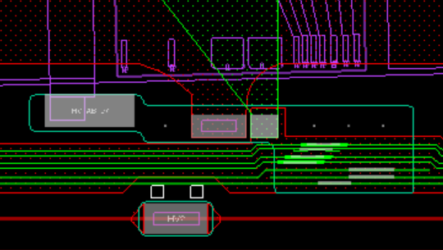
Tape Dimensions
Lock points added wrt MFFs.
  Modules mounted wrt lock points.
In y-direction
  If distortion too large silicon sensor will be too close to LV pads on either the data or the power side of the stave.
  Outer HV line too close to edge of stave.
MFF1
MFF2
y
x
1.5 mm

Slide 3
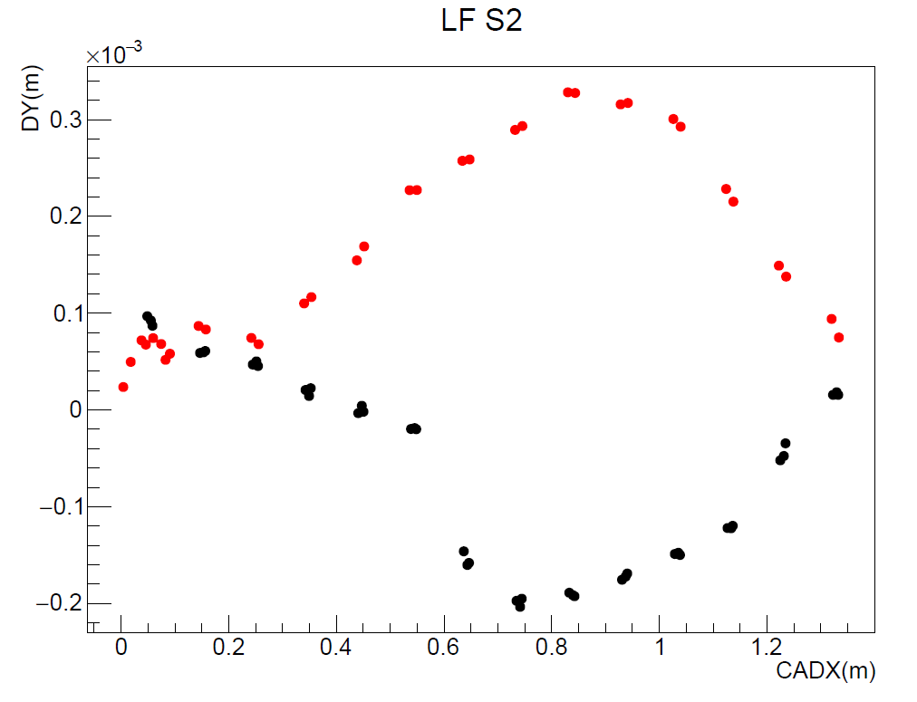
Y-distortion
Cut |DY| < 300 mm
Use local fiducials
Line from MFF1 to MFF2
Calculate distance d_{i} from LFID_{i} to line.
Plot d_{i} measured – nominal vs x for two sides of tape
Low y
High y
y
MFF1
MFF2
x
LFID_{i}
d_{i}

Slide 4
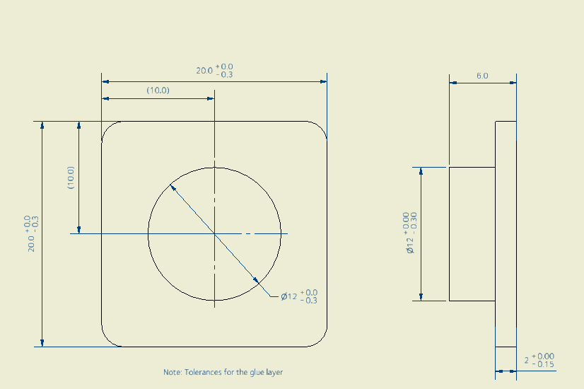
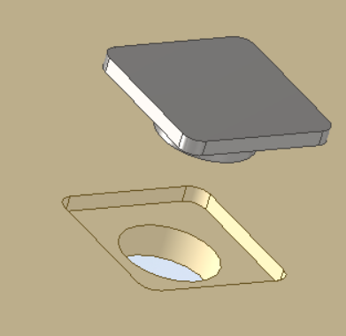
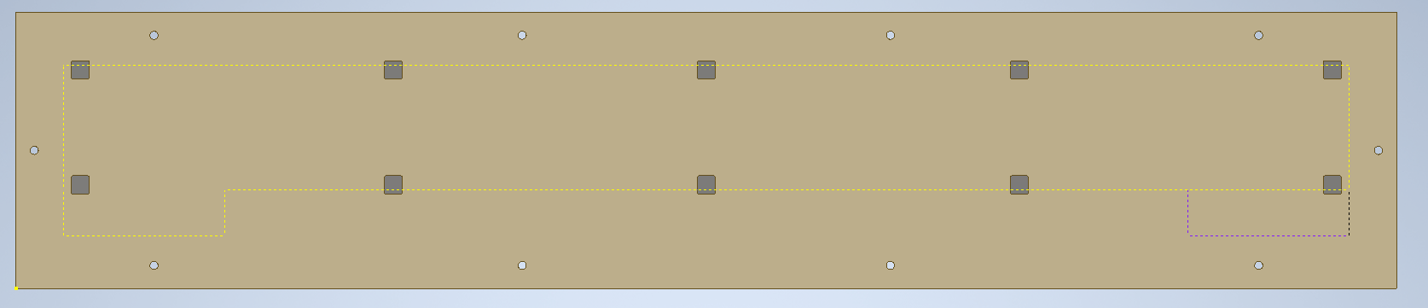
INVAR inserts
10 off 6mm dowel holes drilled after the inserts are glued.

Slide 5
Insert locations on Jig/Holes in tape
340
340
340
340
A
59.5
59.5
C
B
A
B
C
340
340
340
340
Tape centre line

Slide 6
Tape holes: slots to allow for expansion/contraction.
6
L
All holes radius semi-circles = 3.0 mm
Length L
A: 0.0
B: 0.68
C: 1.36
Allows for 1mm/m expansion/contraction.

