Slide 1

Update on ISOLDE Front-Ends and start-up plans for 2020
J. VOLLAIRE (EN-STI-RBS)
(future) ISOLDE Technical Coordinator
86 ^{th} ISCC meeting 5th November 2019

Slide 2
Outline
Production and commissioning of new Frontends
Overview of other LS2 activities (low energy and high energy beam lines)
Information on ISOLDE commissioning planning approval (hardware and stable beam)
A few other highlights (target lifecycle)
Conclusions

Slide 3
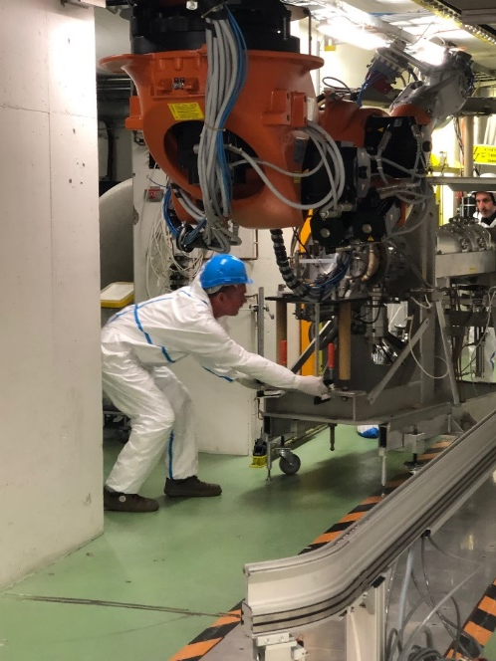
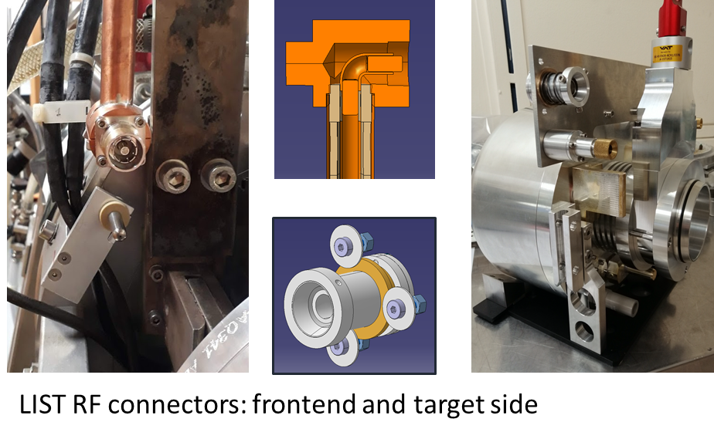
Front Ends in LS2 (reminder)
Replacement of two Front Ends during LS2:
  Old Front Ends successfully removed
  Front End production delayed due to several issues (quality of parts produced abroad, problem with new extraction electrode design..)
New features:
  Replacement of all cabling in faraday cages
  New chamber at back of FE
  2 RF connectors on each Frontend
Objectives for after LS2:
both Frontends will be compatible to LIST
2 RF lines reduce complexity of the target
LIST delivers very pure beams at ISOLDE
LIST offered as standard ion source to users
(J.Cruikshank, R.Heinke, S.Rothe, S. Marzari, T. Giles)

Slide 4
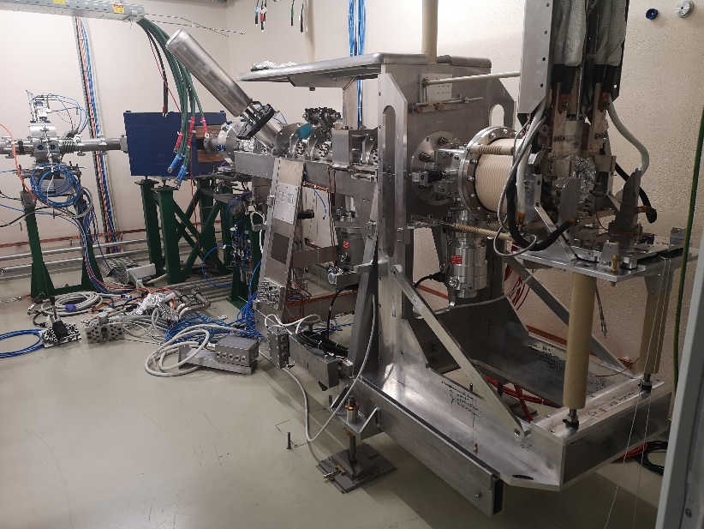
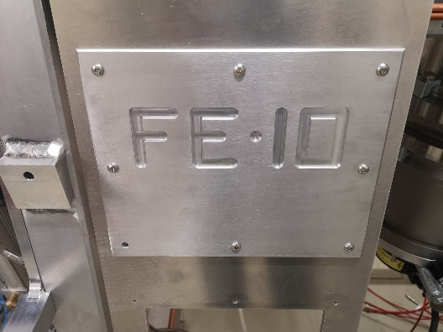
Front End Production: FE#10
Very good progress since last report (July):
  Mechanical assembly completed and beam diagnostics integrated
  FE#10 moved to offline2 (in place of FE#8)
  Fiducialization and alignment done
FE#10 almost ready for beam tests in offline2
  Plan for 9 weeks of beam tests in offline2
FE#10 transfer to target area (on GPS side) scheduled for end of January 2020
Tests in target area could start as of February 2020 (confirmed with Cooling & Ventilation)

Slide 5
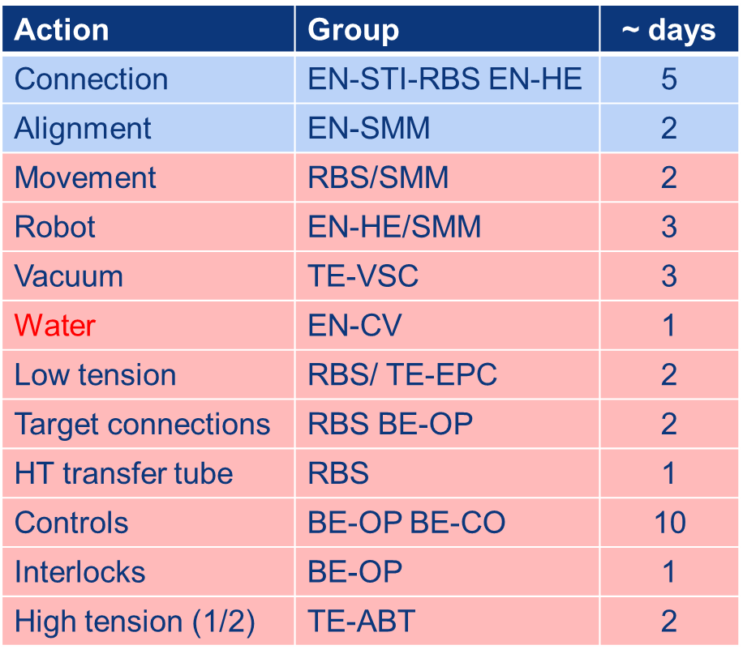
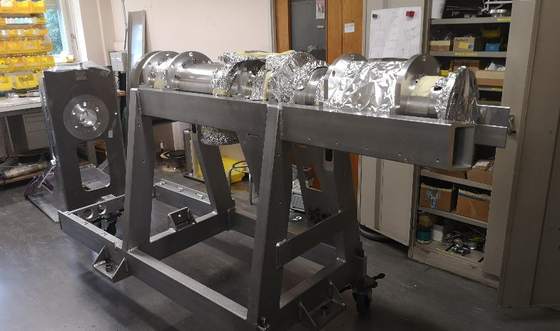
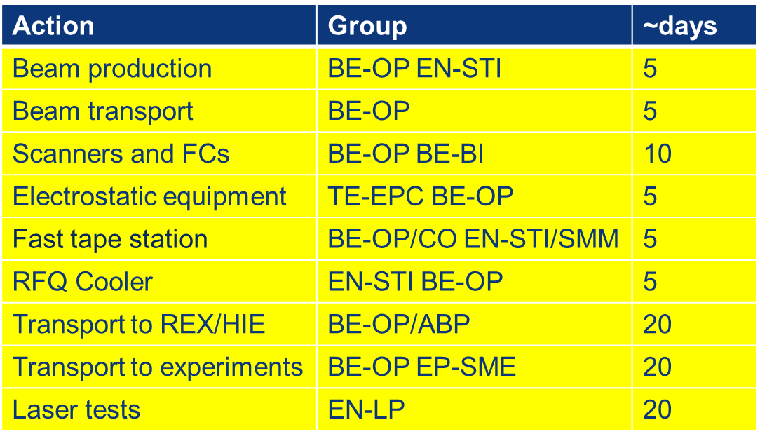
Front End Production: FE#11
All pieces are ready and assembling has started
Experience with FE#10: assembly will be faster
FE#11 will be tested on offline2 as FE#10
Transfer to the target area in spring 2020 (coordination with civil engineering work for nano-laboratory)
~7 weeks per FE for HW commissioning (in target area)
Stable beam commissioning (~18 weeks)

Slide 6
Outline
Production and commissioning of new Frontends
Overview of other LS2 activities (low energy and high energy beam lines)
Information on ISOLDE commissioning planning approval (hardware and stable beam)
A few other highlights (target lifecycle)
Conclusions

Slide 7
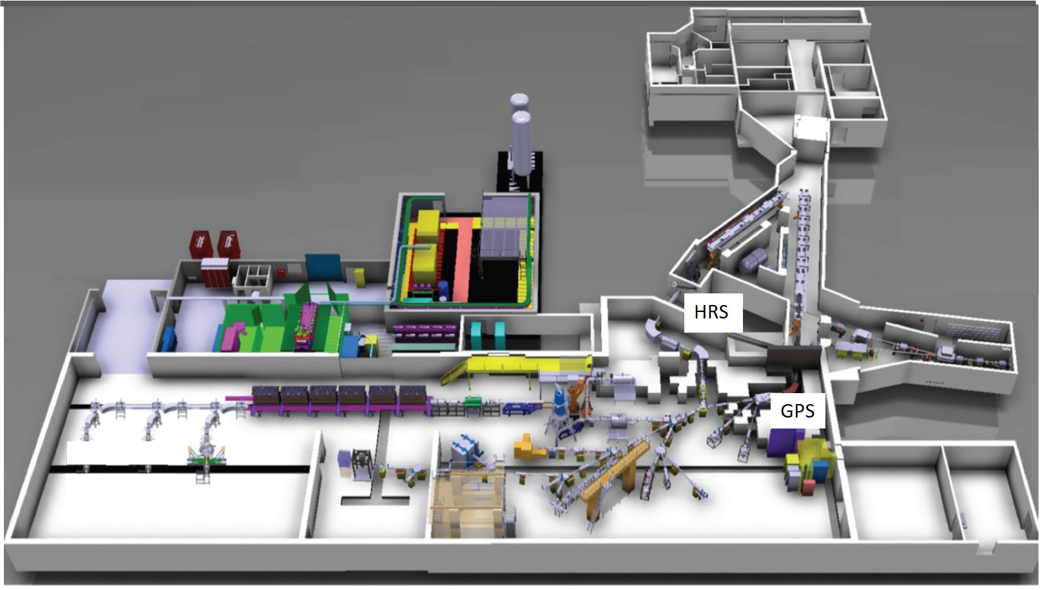
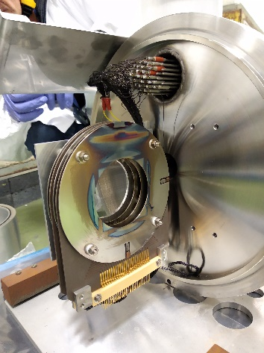
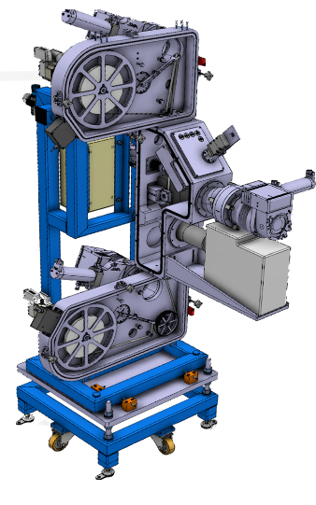
Readiness ISOLDE Low Energy
New SEMGRID production foreseen in 2020 (to be ready for proton beam tuning in 2021)
New Front-Ends:
Catching up delay caused (See detailed above)
GLM & GHM area:
Refurbishment to comply to modern legislation for the manipulation of open sources
Ready for start-up in 2020
HT modulators:
High Precision 60kV DC HV power supplies installed on HT 1 & 2
Target Modulators, HT fast recovery systems, installed on HT1 & 2
FESA3 compliant control system deployed
On site test load and HT calibration tools installed
Ready for commissioning at start-up in 2020
REX / HIE ISOLDE:
See next slide
New fast Tape-Station:
Installed in the CAO beamline
Operational at start-up in 2020
Courtesy of E. Siesling

Slide 8
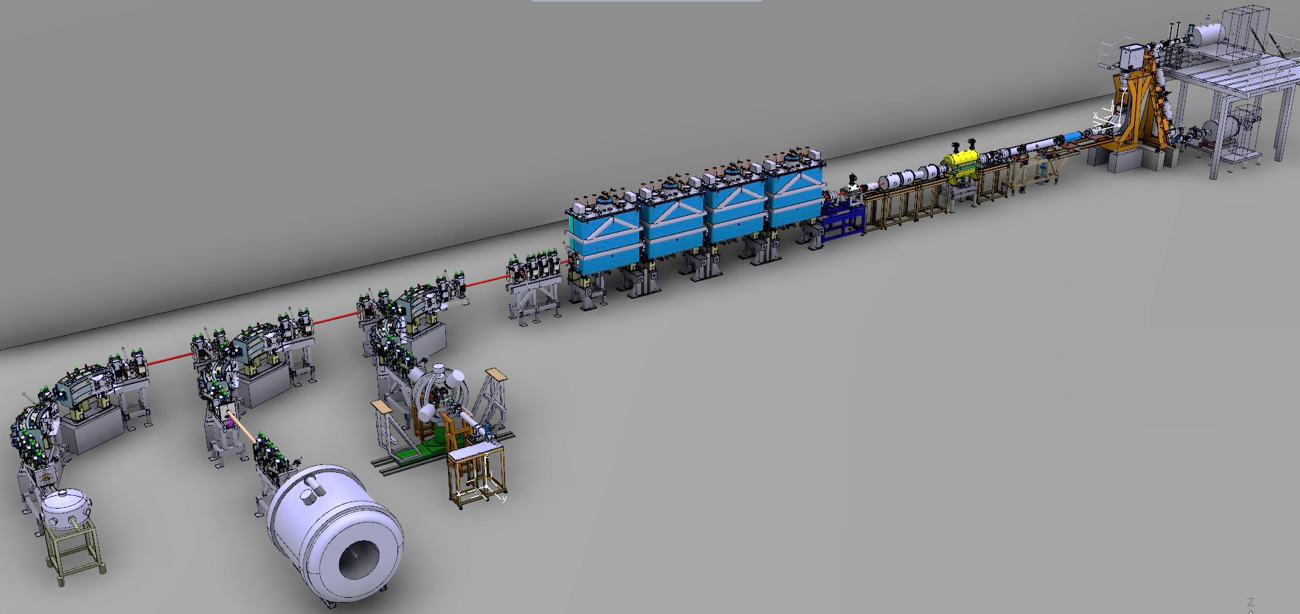
Readiness REX & HIE ISOLDE
Status:
All REX / HIE ISOLDE LS2 tasks are on track
Aiming for early start-up as planned (ISOLDE planning dec 2018) for a REX / HIE ISOLDE re-commissioning, test & development run in 2020 (Schedule approval pending).
REX TRAP
& EBIS
REX NC LINAC
REX TRAP & EBIS:
TRAP maintenance and electrodes repair done. To be tested 2020
EBIS new electron gun under development. To be ready for tests 2020
HIE SC LINAC
HIE SC LINAC:
HIE ISOLDE Cryo plant preventive and corrective maintenance being carried out through 2019. Ready for cooldown and re-commissioning 2020
Cryo Module 4 repair carried out. Tests ongoing in SM18. Transport to ISOLDE January 2020.
Re-commissioning CM1-4 with stable beam from EBIS foreseen as of May 2020 as per ISOLDE planning
REX NC LINAC:
REX RF consolidation and maintenance done. First RF tests carried out. Ready for 2020 re-commissioning
Production additional 3 Diagnostic Boxes going as planned. Installation early 2020 followed by commissioning and test
REX vacuum maintenance ongoing. To be ready for 2020 re-commissioning
ISS
SEC
Cooling & Ventilation:
HIE ISOLDE CV building 199 modification finished. Beneficial for both the 199 cryo plant as well as the 508 CV/airco system (user labs).
508 CV/airco upgrade finished and labs are up to user specs.
Miniball
Courtesy of E. Siesling

Slide 9
Outline
Production and commissioning of new Frontends
Overview of other LS2 activities (low energy and high energy beam lines)
Information on ISOLDE commissioning planning approval (hardware and stable beam)
A few other highlights (target lifecycle)
Conclusions

Slide 10
Planning 2020/2021
The decision to start the ISOLDE facility as early as summer 2020 in preparation for the physic’s run in 2021 is still under discussion.
A justification/planning will be presented to the IEFC this friday for information prior to the Research Board in December 2019.
Constraints for FE’s
  Finishing and testing
  Access due to nano lab construction
Constraints for HIE-ISOLDE
  Operation costs – estimated at 130kCHF
  Both installations and the facility have an intense commissioning program…

Slide 11
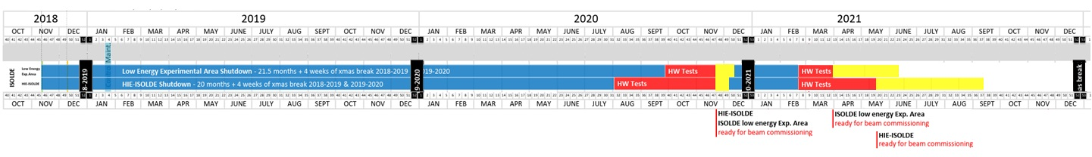
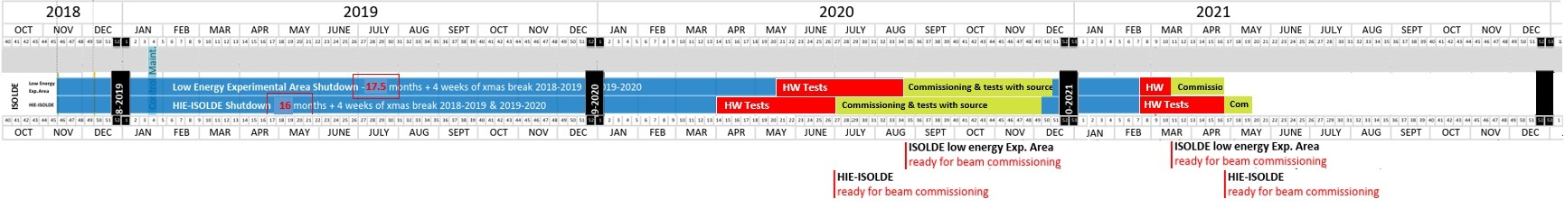
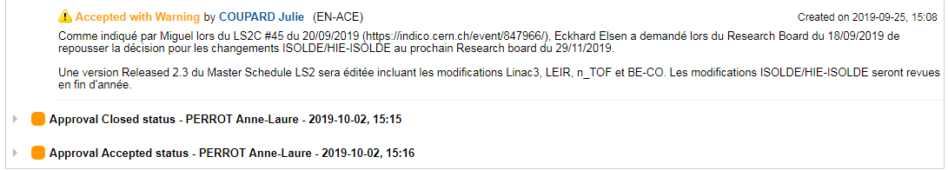
LS2 Schedule V 2.3: No early start-up in 2020 (since Oct. 2019):
HIE-ISOLDE
Physics start
As requested: Early start-up in 2020:
ISOLDE low energy
Physics start
HIE-ISOLDE
Physics start
No early start-up 2020:
Low E Physics start June 2021
HIE-ISOLDE Physics start mid-Sept 2021
Early start-up 2020:
Low E Physics start end April 2021
HIE-ISOLDE Physics start mid-May 2021
ISOLDE low energy
Physics start
Gain:
~ 4 months HIE ISOLDE Physics, ~1 month Low Energy Physics
Better performing machine, better understanding of the machine parameters resulting in higher quality beams and shorter set-up times
Courtesy of E. Siesling for BE-OP-ISO

Slide 12
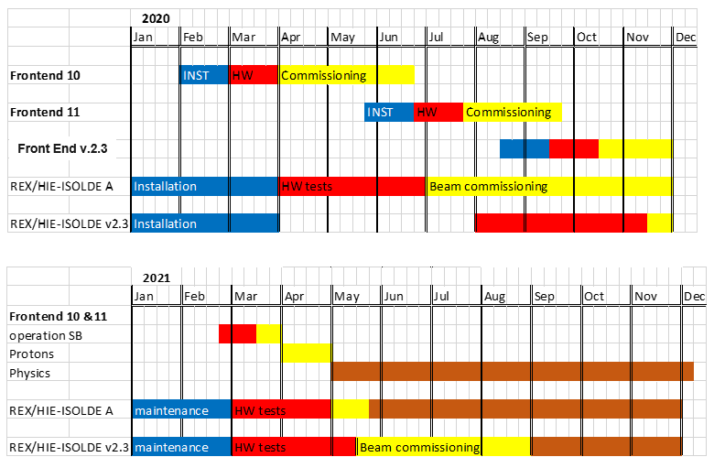
Planning details (MS 2.3 vs request)
Next: R. Catherall will present and defend the request to the IEFC (resources and services available, management need to endorse proposal and approve cost of anticipate restart)

Slide 13

Beam Commissioning 2020:
New or heavily refurbished hardware:
New steerers and diagnostic boxes: FCs, slits, attenuators, collimators and silicon detectors (wks. 28, 29, 30)
New electron gun in the REX-EBIS charge breeder (contaminant characterization: wks. 29, 31)
REX RF amplifiers (wks. 30-32)
Phasing of refurbished cryomodule 4 (CM4) (wk. 33)
Two additional silicon detectors (wk. 34)
New software or major upgrades:
Beam instrumentation applications suite (wks. 28-30, 34)
New slow extraction application (wk. 30)
Fast Beam Investigation tool (wks. 31, 32)
Beam optimizer for injection into experiments (wks. 37, 38)
Energy / energy spread application (wk. 31)
Automatic SRF phasing (wk. 33)
New electron gun
Additional silicon detectors
Three new diagnostic boxes and steerers
CM4 repaired
Miniball
Experimental stations:
Stable beams (wks. 37, 38, 45, 46)
SEC / OTPC
ISS
Courtesy of J.A. Rodriguez for BE-OP-ISO

Slide 14
Machine Studies 2020:
Machine development:
Energy and energy spread measurement in three HEBT lines (wk. 34)
Transverse and longitudinal phase space characterization and validation of optics models (wks. 35, 43)
Machine A/q scalability studies (wk. 41)
Development of beam-based energy gain measurement (wk. 42)
Beam improvements requested by users of the facility:
Charge breeder slow extraction to 1.8 ms (wk. 30)
Feasibility study for low A/q beams. Stability of REX RF (wk. 36)
Energy spread minimization at secondary target (wk. 44)
Slit-based emittance reduction with limited beam losses (wk. 44)
Slow extraction (1.8 ms)
Train extraction
Stability REX RF for low A/q beams
Bunch length stretching
Energy spread minimization
Beam size minimization
New REX separator optics
Preparation for potential future upgrades:
Alternative REX separator optics with beam waist before RFQ (wk. 28)
Development of train extraction from the REX-EBIS charge breeder (wks. 28, 38)
Bunch length stretching at secondary target (wk. 43)
Miniball
SEC / OTPC
ISS
Courtesy of J.A. Rodriguez for BE-OP-ISO

Slide 15
Outline
Production and commissioning of new Frontends
Overview of other LS2 activities (low energy and high energy beam lines)
Information on ISOLDE commissioning planning approval (hardware and stable beam)
A few other highlights (target lifecycle)
Conclusions

Slide 16
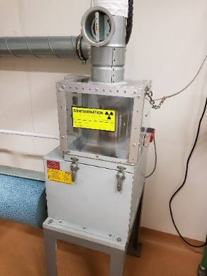
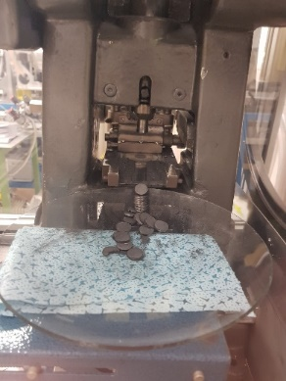
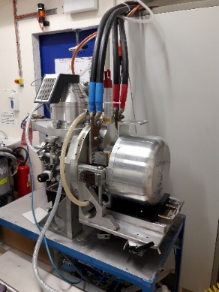
Optimisation of UC_{x} production
Annual production: 10-12 batch
Production rate: 1 batch / week
Current method
2100°C
1920°C
1300°C
1580°C
2 x 10⁻⁴ mbar
Mixing
Pressing
Carburization
1.5 hours
2.5 hours
120 hours
New method
Increase of pressure limit
→ 2 mbar
NEXT STEP:
Control and Validation of new method
Microstructural characterisation of UC_{x}
Isotope release tests online
Mixing
Pressing
Carburization
1.5 hours
2.5 hours
15 hours
(N.-T. Vuong, M. Owen, S. Rothe)

Slide 17
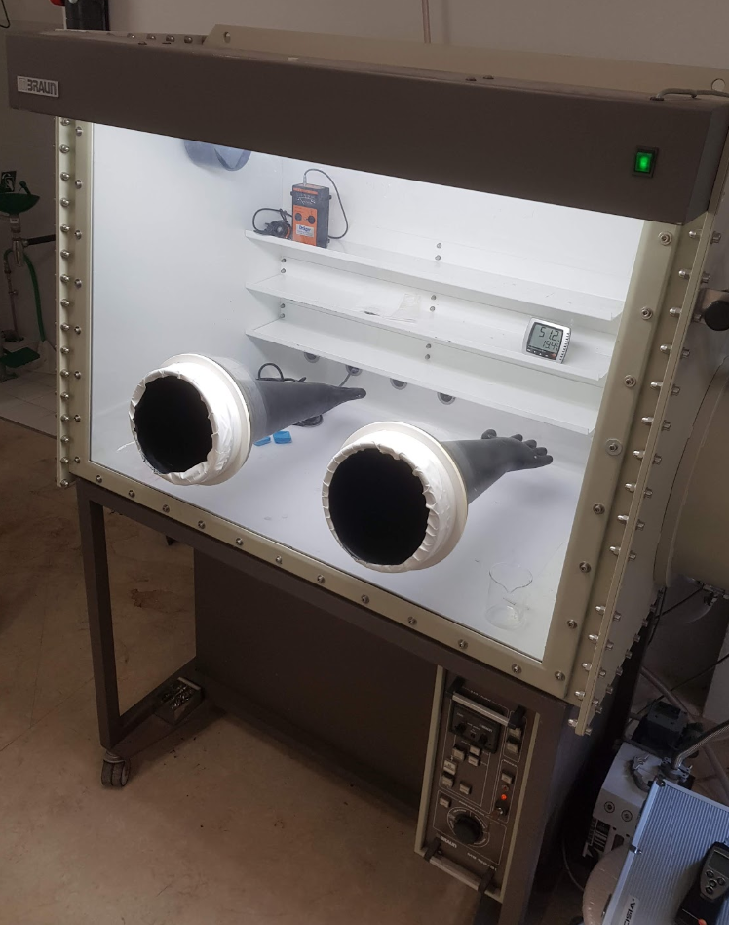
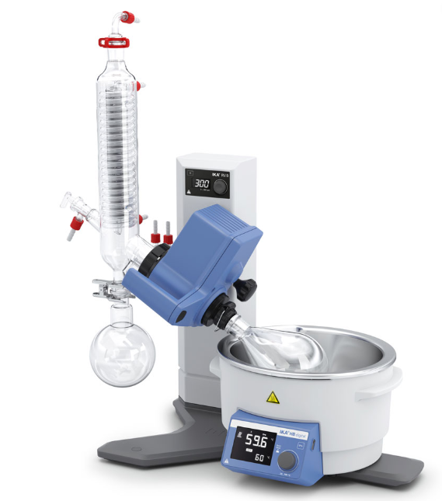
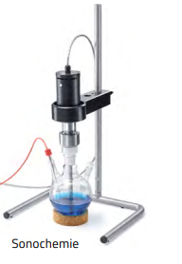
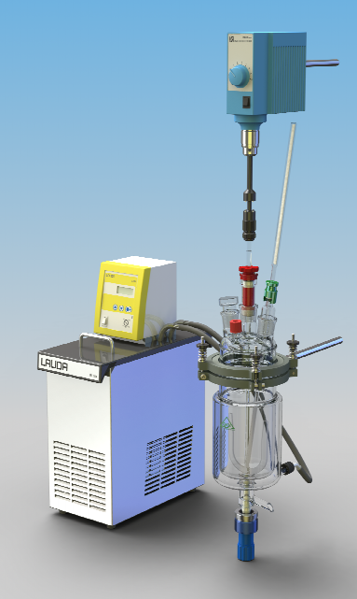
Restart of non-actinide nano materials
  Requirement for development towards actinide nano materials. Equipment purchase ongoing.
  Old Glovebox to be refurbished in Chemical lab Bat.26
  New extraction system for hydraulic press: design phase
  Dry tests and documentation with HSE planned for Q4 2019
  After LS2: Ensure safe production of MWCNT and other non-actinide nano targets in-house
Glovebox underpressure test
(B.Crepieux, R.Martins, S.Rothe)

Slide 18
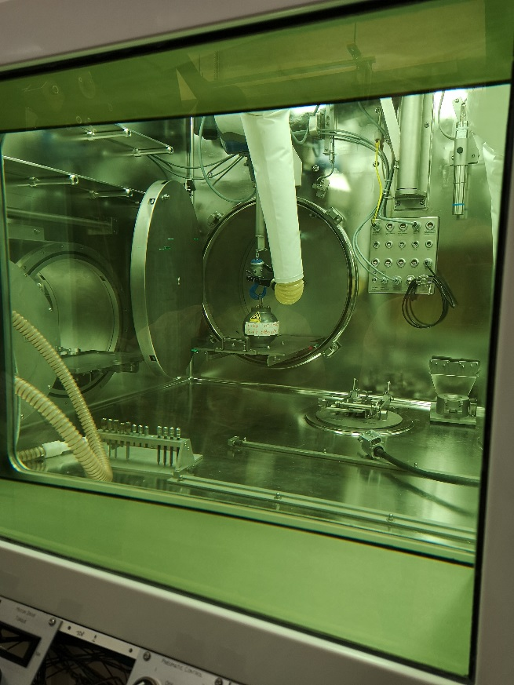
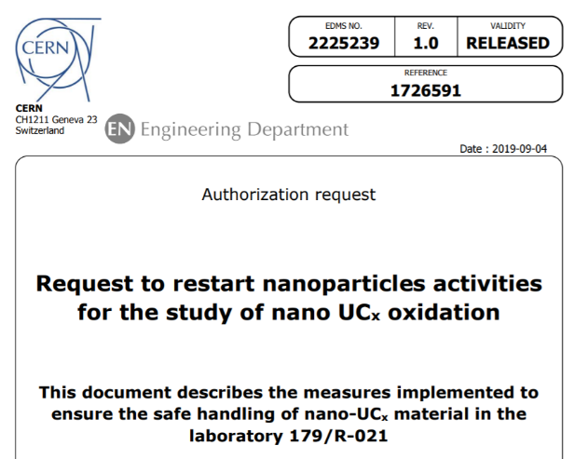
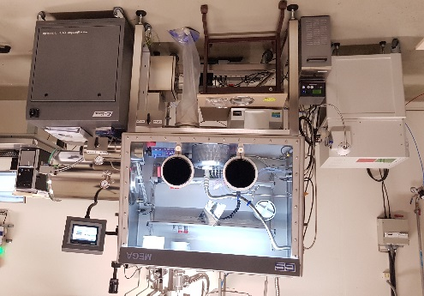
Target disposal activities
Hot Cell commissioning
  Dismantling of cold targets in representative conditions to start soon
  Operational procedure are being developed (good progress)
  Oldest tantalum targets with surface ion source first candidates for dismantling
  Co-60 source (15 mSv/h @ 10 cm) introduced into the hot cell. Source used to validate the shielding efficiency
Oxidation of nano-size Uranium Carbide
  New glove box operational in Building 179
  Batch of UCx nano-particles produced in 2014 will be used for tests – authorization from HSE unit received
Co-60 source shielding
New glove box

Slide 19
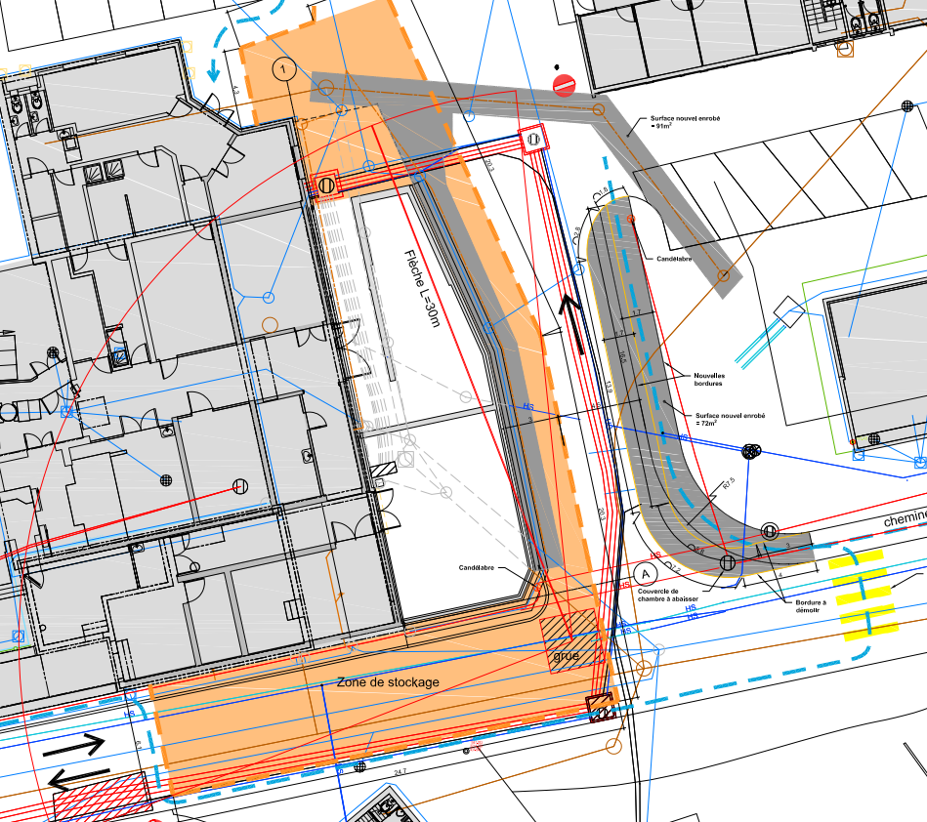
Civil engineering (Nano-Lab)
As from January 2020, the worksite will be closed off as shown.
Access to B. 179 for “big” material will be difficult between Feb and May.
Ventilation of the labs (not the tunnel) will be stopped for ~5 months starting Jan 2021
  Impact on actinide target production

Slide 20
Conclusions
Very good progress with production of Front Ends
Many activities inside the experimental hall executed according to planning (low energy and high energy sides)
Planning elaborated to allow a restart with stable beams (from the EBIS or targets) in summer 2020:
  Test of many systems modified or installed during LS2 (new DB boxes, controls, CM4 repair…)
  Perform very important machine development studies (important to decide on future possible upgrades)
  Important gain for physics readiness in 2021
Decision by CERN management expected at the next RB (additional cost of 130 kCHF)

Slide 21
Thank you for your attention !

