Slide 1
Recap: Beam diagnostics
Hao Zhang (hao.zhang@Cockcroft.ac.uk）

Slide 2
Outline
Why beam Diagnostics?
Challenges in Diagnostics?
Instrumentation type
  Beam position monitoring
  Beam profile monitoring
  Emittance measurement
  Beam current monitoring
  Beam energy monitoring
  Beam halo monitoring

Slide 3
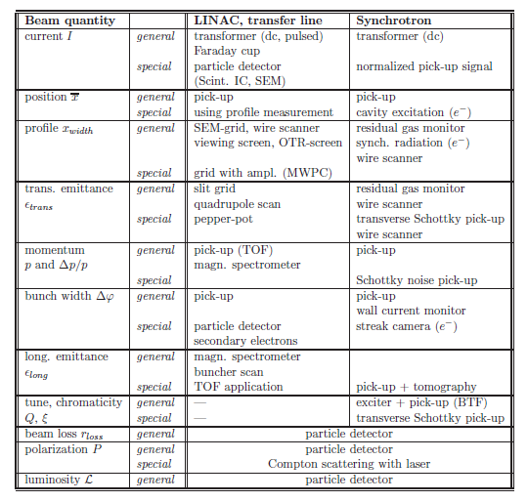
Demand for beam diagnostics
Essential for any accelerator
‘Organ of sense’
Deal with real beam with imperfections
Three categories
  Reliable, quick measurements for general functionality, e.g. current transformer
  For a daily check of performance and stability, e.g. profile determination
  Complex instrumentation, e.g. Emittance measurement
P. Forck, Lecture Notes on Beam Instrumentation and Diagnostics, Joint University Accelerator School, January – March 2012
Notes:
Reliable, quick measurements to determine the basic parameters of a machine setting used as a fast check of the general functionality
Instrumentation built for a daily check of performance and stability, or for the control of wanted parameter changes in the accelerator setting.
Complex instrumentation for the commissioning of a new accelerator component, for the
development of higher performance and for solving more serious problems in case of a malfunction.

Slide 4
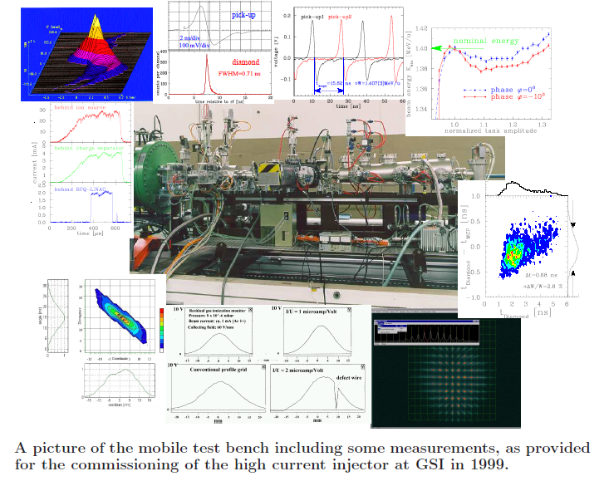
A ‘typical’ Accelerator Diagnostics
Material sciences
Thermodynamics
Electro-Magnetism
Optics
laser technology
Mechanics
Electronics
Nuclear Physics
Vacuum science
…
Slit-grid emittance
Pick-up
transformer
transformer
Residual gas monitor
Pick-up
Faraday cup
Pepper-pot
Multi-disciplinary field !
SEM-grid

Slide 5
Challenge in beam diagnostics
Better resolution (time/space)
(single) photon resolution
Improved radiation hardness
invasive
Able to cover variety of beams

Slide 6
Beam Position Monitoring

Slide 7
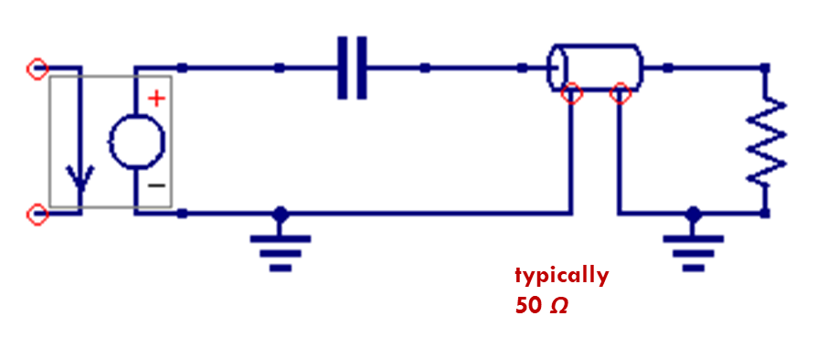
Capacitive Pickups
The Capacitive Pickups are based on symmetry
  The beam displacement x is detected by a pair of symmetrical arrange electrodes
x
d
–
Examples:
Shoebox type
Buttons
Striplines
courtesy O.R. Jones

Slide 8
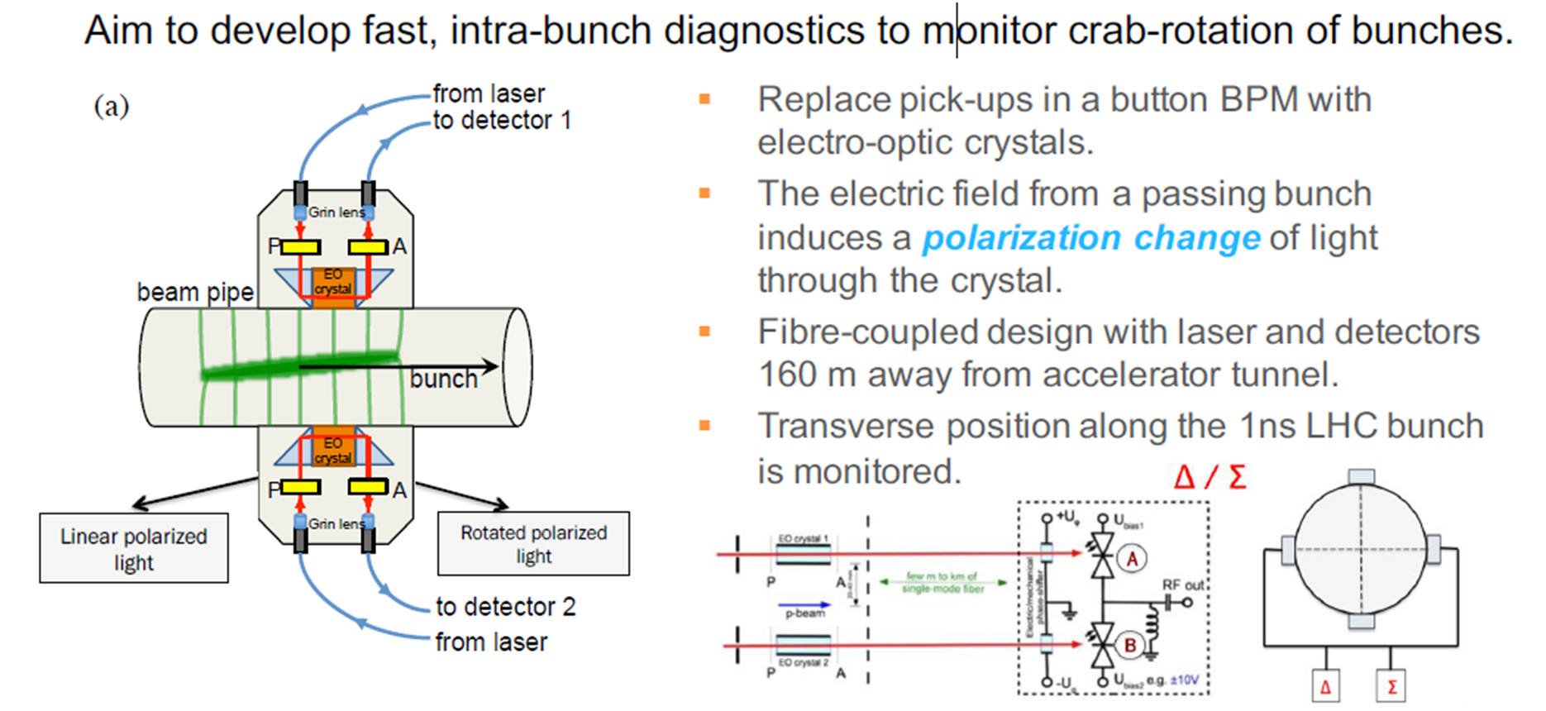
Electro-Optic Beam Position Monitors
courtesy S. Gibson

Slide 9
Beam Current Monitoring

Slide 10
Faraday cup
The Faraday Cup destructively intercepts the beam
DC coupled! (With just a resistor the signal is Vout = Ibeam*R)
Low current measurements possible e.g., USR fA!
Problem with secondary electrons:
  Use long cup or voltage suppression or magnetic field
If not properly terminated ‐> very high voltage (beam potential)
Must process beam power
Notes:
ultra-low energy electrostatic storage ring
Limitations:
▪Beam energy ?
▪Sensitivity/noise ?
▪Antimatter ?

Slide 11
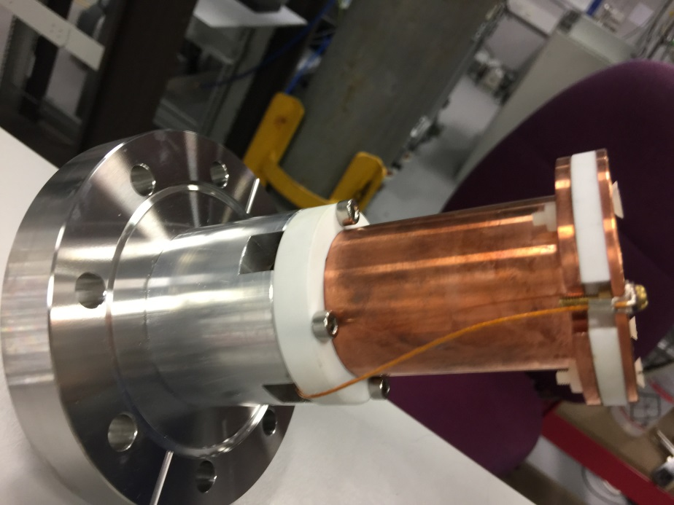
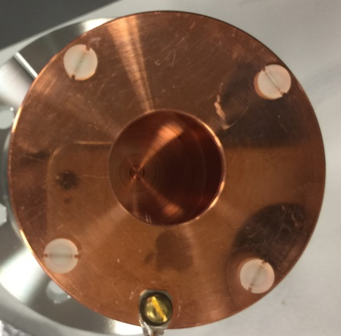
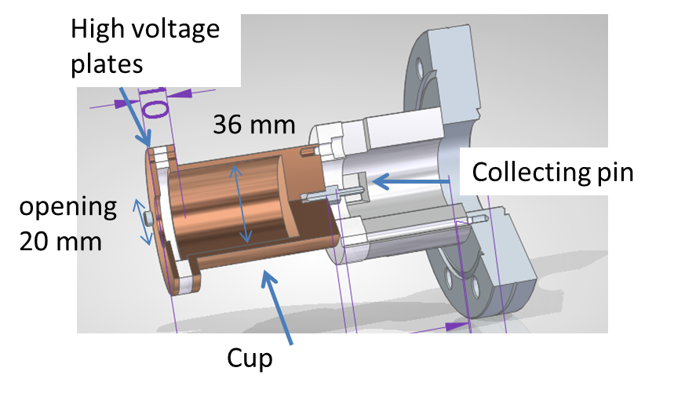
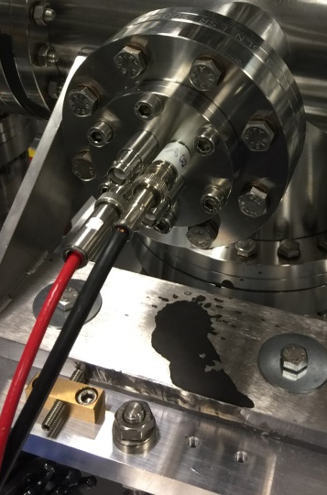
Faraday cup examples
For higher intensities
water cooling may be needed
Simple faraday cup in my lab

Slide 12
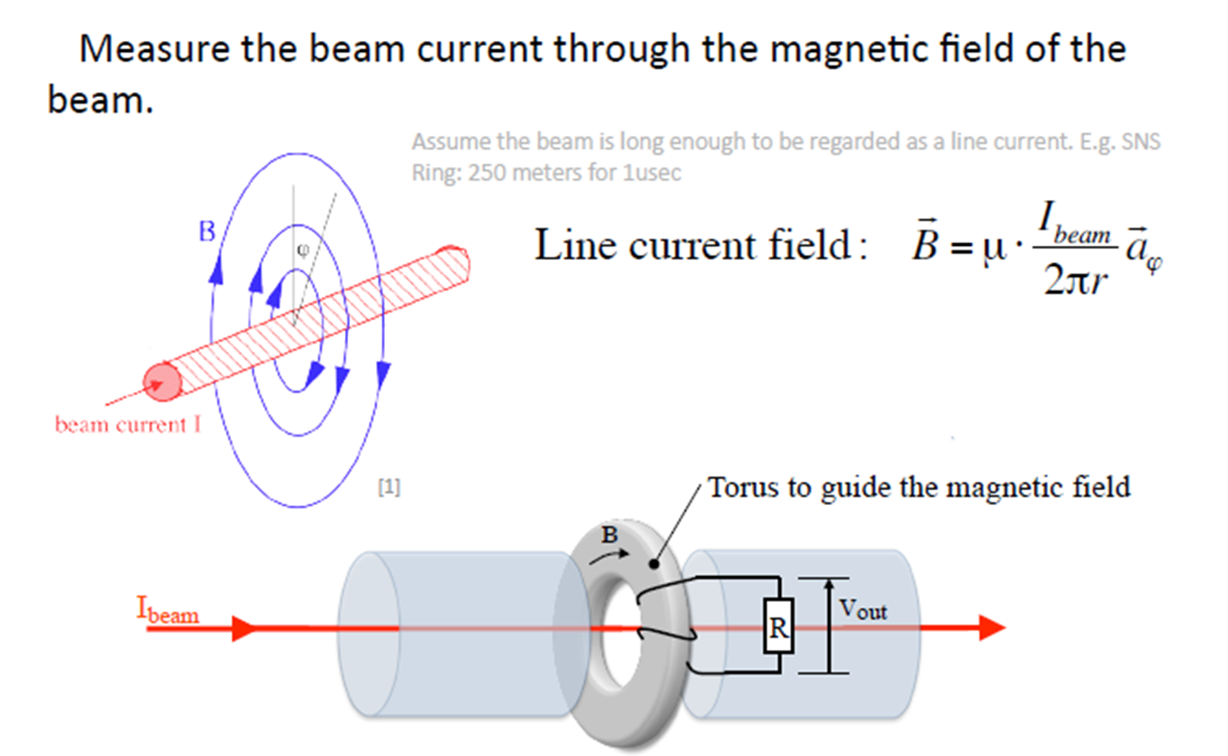
Beam transformer
Courtecy: W. Blokland

Slide 13
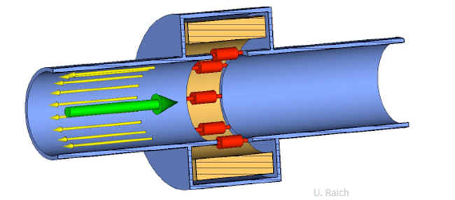
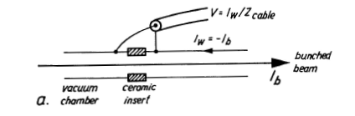
Wall-Current Monitors
The image current accompany the beam current.
A voltage proportional to beam current can be measured across the resistors
Also the noise issue will limit the resolution

Slide 14
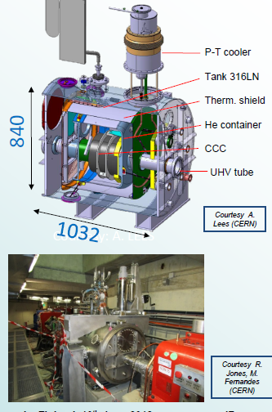
Cryogenic Current Comparator (CCC)
Non-destructive measurement device for low intensity beams (between 1 nA to 10 μA)
The CCC consists of:
  Cryogenic device
  SC pickup coil,
  Highly efficient SC shield,
  High performance SQUID
  measurement system.

Slide 15
Beam Profile Monitoring

Slide 16
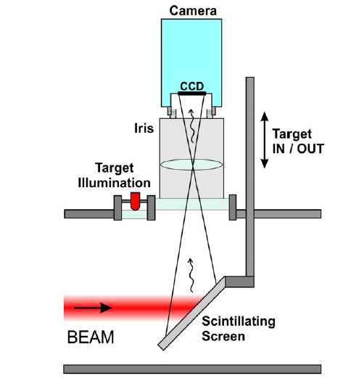
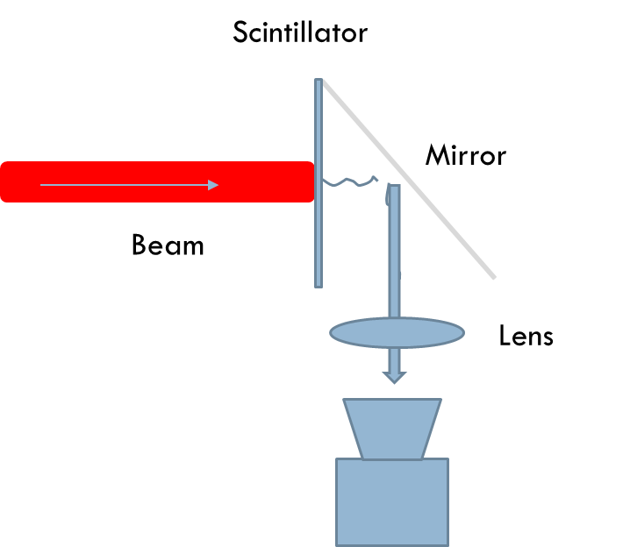
Scintillating screen
Simply
Cheap
Effective
Credit: B. Walasek-Höhne, GSI and G. Kube, DESY
Notes:
Linked to ionisation
• Photons are emitted by the deexcitation
of atomic states
populated by the passage of
the particle
• Emission time ns to hours

Slide 17
Scintillating materials
Notes:
Phosphors have very high light yields, but can only be
used as thin coating on a rigid support and get damaged
very quickly
• Normally used only for very low intensity beams
• Ceramics, glasses and crystals are a more popular choice
in high energy accelerators
• CHROMOX (Al2O3:CrO2, Aluminium Oxide) is a very
common choice because it is a very robust ceramic
• YAG (Y3Al5O12) is also a very frequent choice (fast)
18

Slide 18
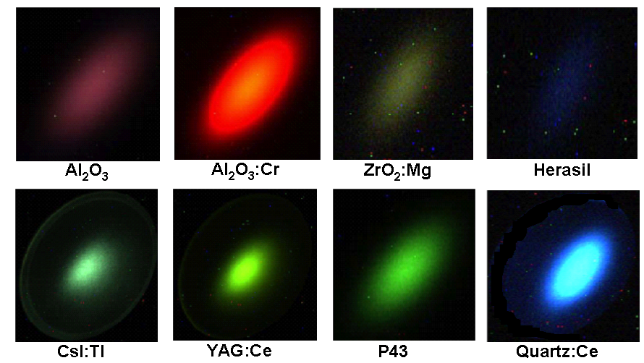
Some example of scintillating light
Notes:
Caesium iodide dotted with Titanium
YAG dotted with Cerium
aluminum oxide dotted with Chromium
Zirconium oxide dotted with Magnesium

Slide 19
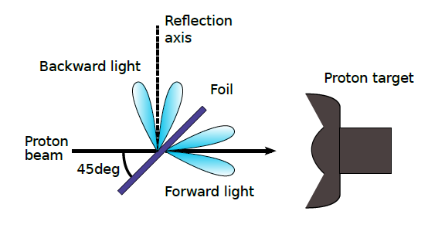
Optical Transition Radiation
Radiation is emitted when a charged particle crosses the boundary of different dielectric properties
Radiation has defined angular distribution
Radiation is radially polarised
Credit: D. Morris, et al., TRIUMF
E. Bravin, Cern Accelerator School on Beam Instrumentation
2-15 June 2018, Tuusula, Finland
Notes:
Radiation is emitted when a charged particle crosses the
boundary of different dielectric properties
• Radiation has defined angular distribution
• Radiation is radially polarised
• Thickness of radiator not important

Slide 20
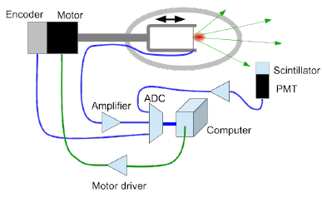
Wire scanner
SLAC SLC high resolution 3 axis scanners
Scans a thin wire or a needle across the beam. Detects secondary emission current or high energy secondary particles (scintillator + PMT)
CERN “flying wires”
E. Bravin, Cern Accelerator School on Beam Instrumentation 2-15 June 2018, Tuusula, Finland
Notes:
• Secondary emission
• Good for low energy beams (no high energy secondary)
• Small signal
• If the wire becomes too hot it can start emitting thermionic electrons
spoiling the measurement
• High energy secondary
• No problem with wire heating (well...)
• Strong signal
• Detection may be non homogeneous leading to distorted profiles

Slide 21
SEM Grid
Similar to wire scanner
The SE current from each wire or strip is acquired independently
Wire spacing down to a few hundreds' microns
Single shot measurement

Slide 22
slit scanner
Similar to wire scanner
Beam pass through a slit and then the intensity is measured by faraday cup or scintillator.
Slit could be vertical or horizontal
Useful for low energy and low intensity (I>> I_{SEM})
Notes:
Pass a thin slit across the
beam and detect the beam
current passing trough the slit
• Similar to wire scanner
• Useful for low energy and low
intensity (I>> ISEM)
• Detector typically is a Faraday
cup, but could also be a
scintillator, silicon or diamond
detector.
38

Slide 23
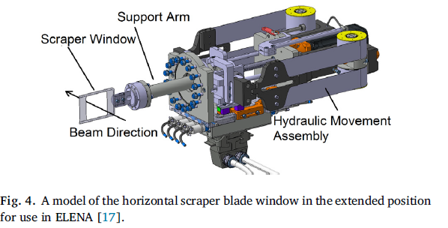
Scraper
Similar to wire scanner
But deal with lower intensity
Measured CDF instead of PDF
J. Hunts, et al., NIMA, Vol 896, Pages 139-151.

Slide 24
Beam profile of high intensity beams
Energy deposition
  Signals are often proportional to the deposited energy
  Energy deposition can cause damage to the instrument
Ideally: Non-invasive.
Damaged SEM Grid
Damaged screen
Damaged OTR screen
Notes:
Energy deposition is probably the most important aspect
for all intercepting devices
• The Bethe-Bloch formula describes energy losses for
many of our cases
• The energy lost by the particles is not necessarily
deposited in the sensor

Slide 25
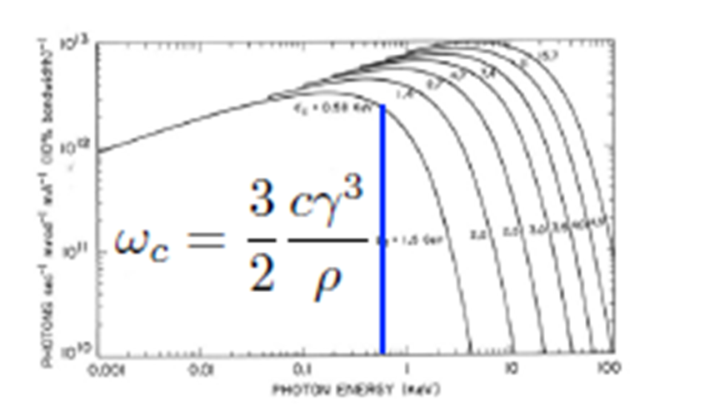
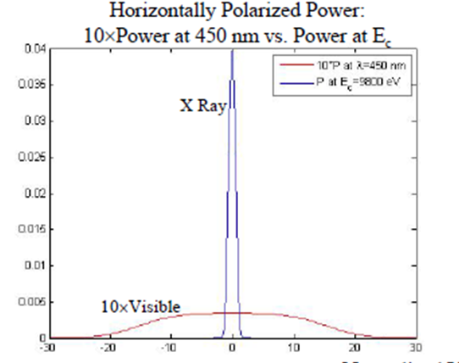
Synchrotron radiation
Synchrotron radiation is broad band.
Visible wavelength
  Optical component is easy to implement.
  diffraction limits the resolution at longer wavelengths when the beam is small
X-ray
  Better resolution
  Hard to form an image
    Pinhole camera
    Zone plates

Slide 26
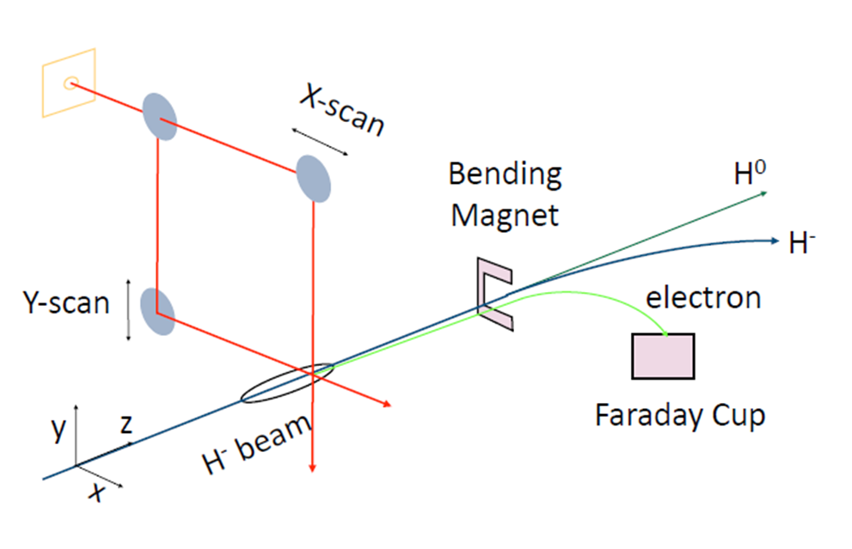
Laser wire
First ionization potential for H‐ ions is 0.75eV.
Photons with λ<1500nm can separate H‐ ion into free electron and neutral H.
The H‐ ion has no excited states so the electron is removed into the continuum.
Laser can be used to mark a portion of beam by neutralization.
Once a porton of the beam is marked, measurements can be made on the neutral beam, the removed electrons, or the reduced beam current with beam current transformer or BPM stripline.
T. Shea, Laser Diagnostics for H- beams, , Accelerator Beam diagnostics, USPAS 2009

Slide 27
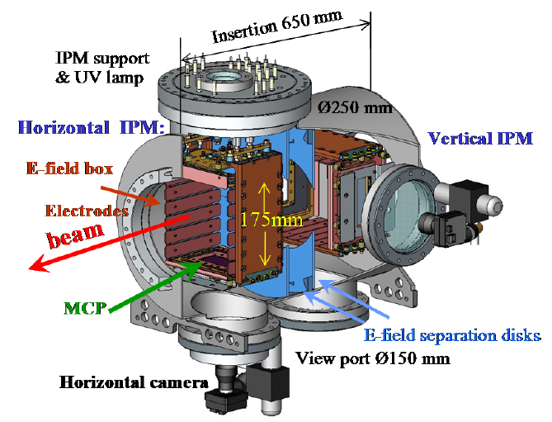
Residual gas based Ionization Profile Monitor
Credit: P. Fork, GSI

Slide 28
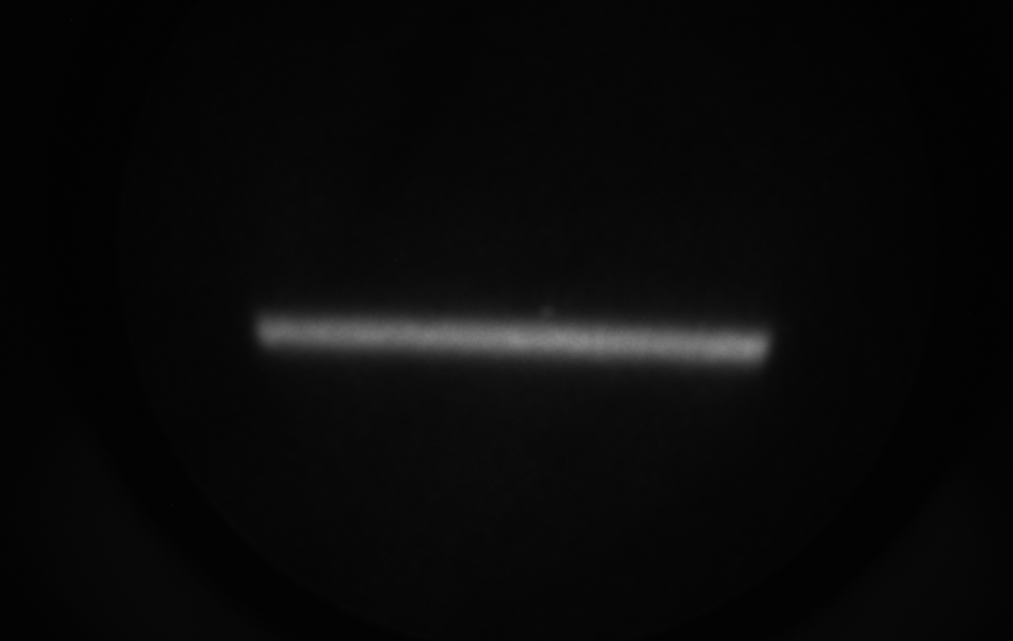
Residual gas image of a electron beam
Secondary ions or electrons are collected.
Magnetic field are used to compensate the profile distortion by self space charge force or wake fields.
Secondary particles are collected by electronics or optical (scintillator plus MCP)
E-Beam direction
Give you a one-dimensional profile!

Slide 29
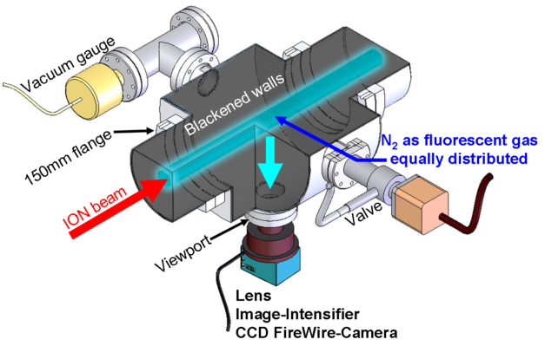
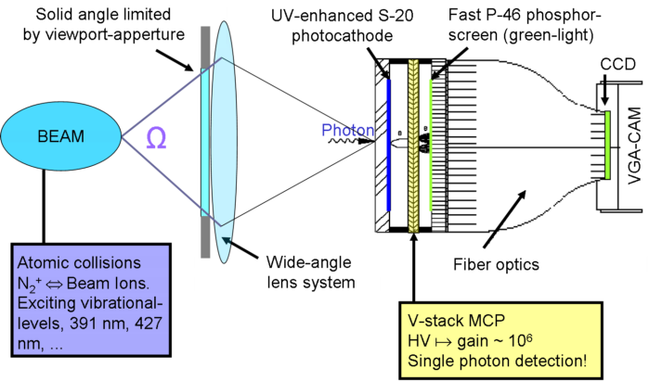
Beam induced fluorescence (BIF)
Schematic drawing of the BIF-monitor as installed at GSI UNILAC. *
BIF detection principle - How the beam induced fluorescence light is imaged, intensified and detected.*
*Credit: GSI, http://www-bd.gsi.de/dokuwiki/doku.php

Slide 30
IPM and BIF
The cross section for impact ionization and fluorescence dependent on the beam energy, residual gas species, and certain fluorescent wavelength.
BIF has longer integration time due to lower cross section and viewed at certain solid angle.
Might need gas injection using a leaking valve to increase the local pressure.
Normally N₂ has higher cross section, other gases such as Ne, Ar has been used.
Using Supersonic gas jet！

Slide 31
Motivation to use gas jet
Low temperature
High directional jet
Non-invasive or minimum-invasive
Not dependent on beam species, energy and intensity
No damage threshold
Not affect the vacuum very much

Slide 32
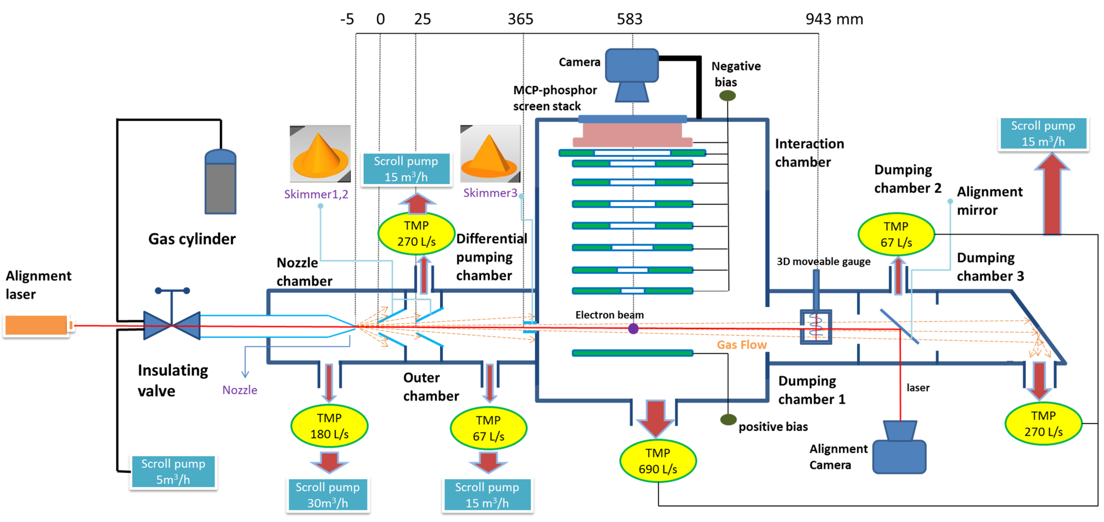
Gas jet profile monitor in Cockcroft institute

Slide 33
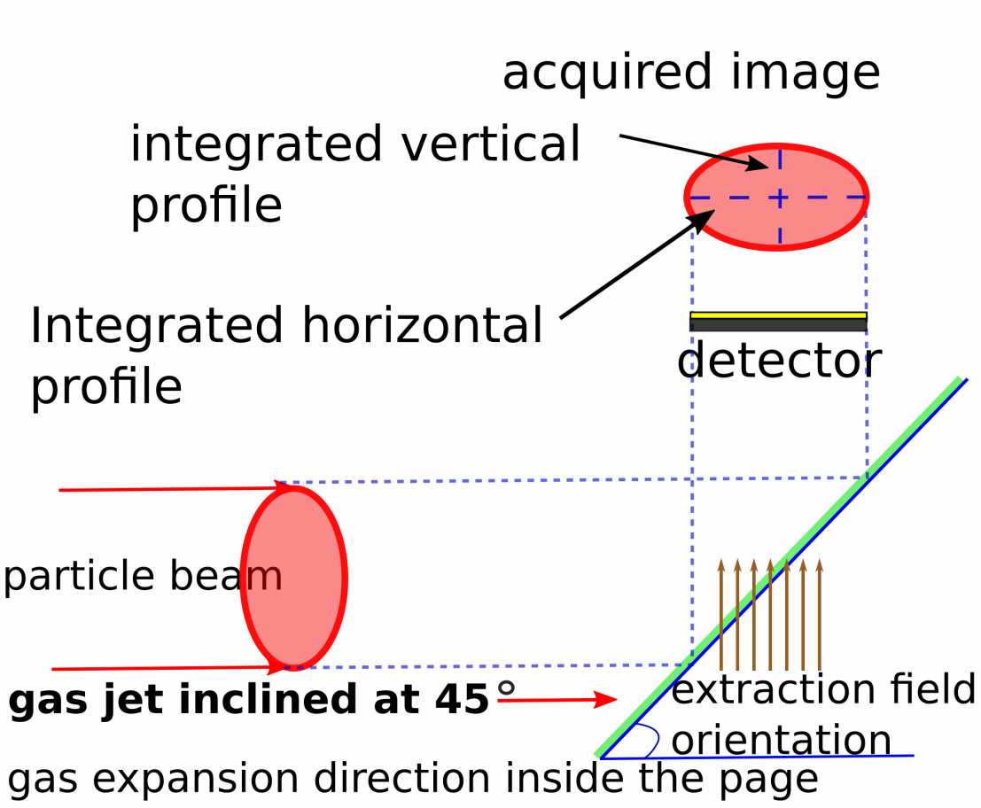
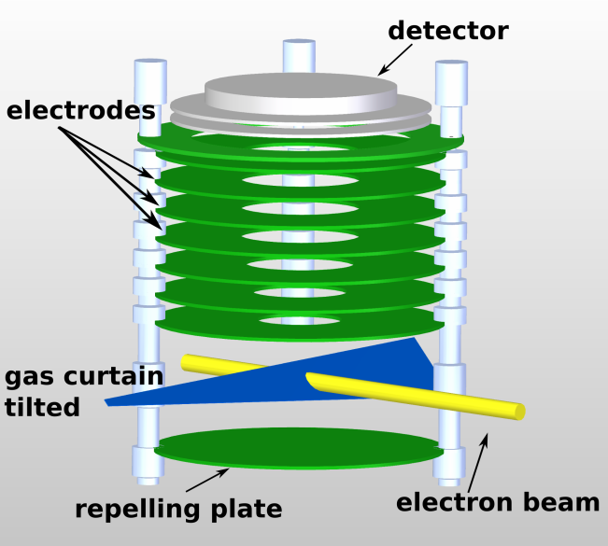
Gas jet beam profile monitor
Visible light
Phosphor screen
Estimated jet property
MCP
Parameter | Value
Density | 2.5*10¹⁶ particle/m³
Thickness | 0.5 mm
Vertical size | 5 mm
Ions extraction
Ionization
Estimated integration time = 1 ms

Slide 34
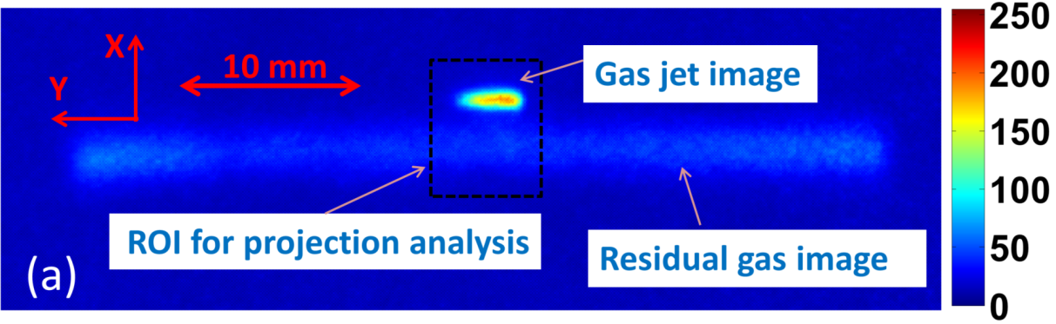
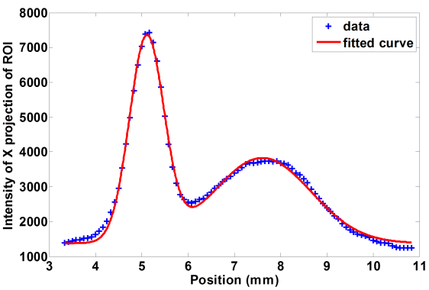
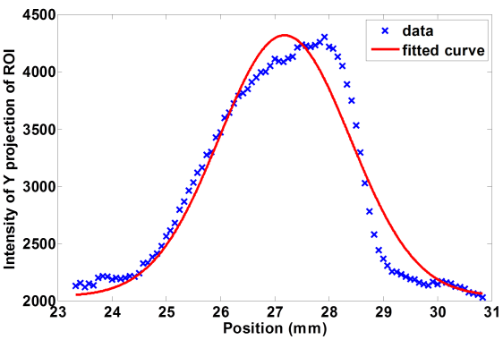
Typical results at CI
Setting | Value
Energy | 3.75 keV
Current | ~5.0 μA
External field | 7.5 kV/m
Exposure | 70 ms
size | Value
Xrms | 0.42
Yrms | 1.23
Xrms from residual | 1.01

Slide 35
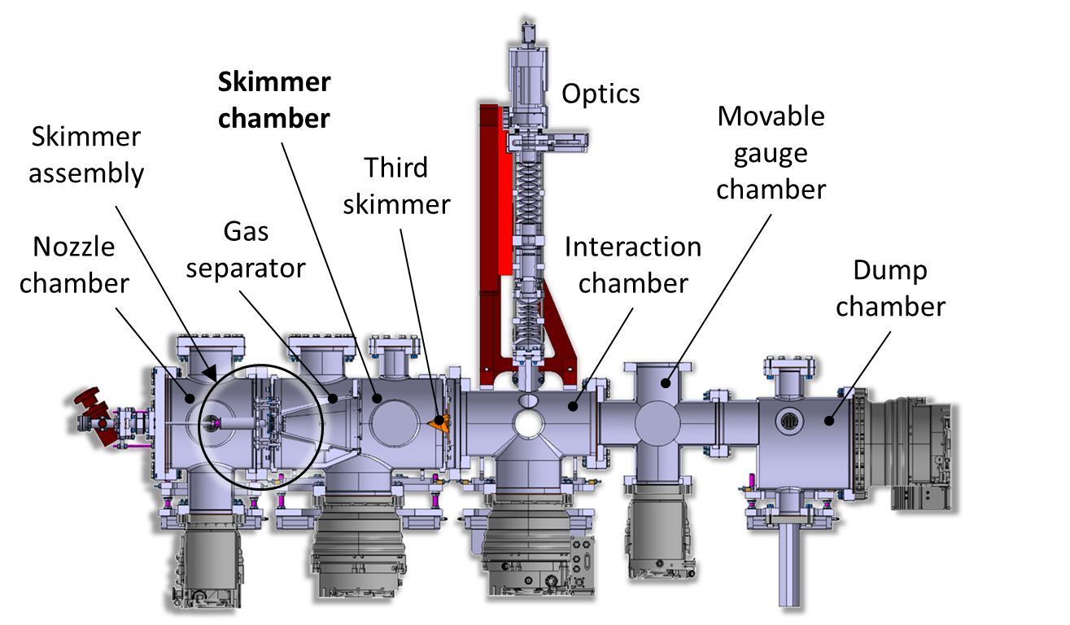
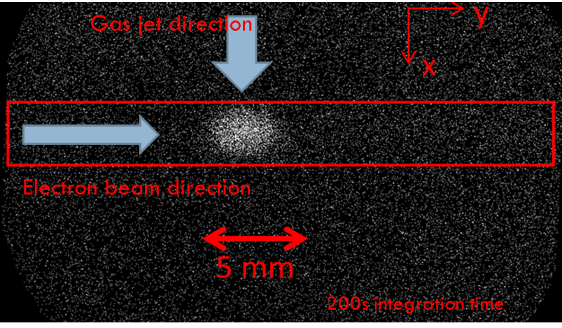
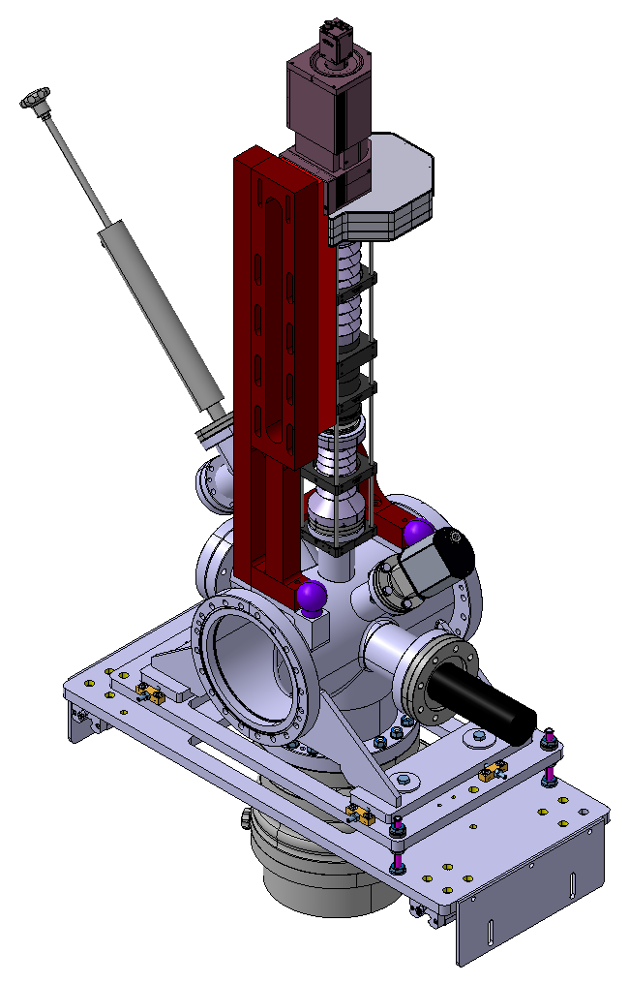
Using gas jet to measure LHC proton beam
Imaging System
Skimmer Chamber
Skimmer Assembly
Moveable Gauge Chamber
Third Skimmer
Gas Separator
Interaction Chamber
Nozzle Chamber
Dump Chamber
HIPACE 300L/S
Turbo-molecular pump
HIPACE 700L/S
Turbo-molecular pump

Slide 36
Emittance measurement

Slide 37

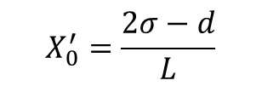
Multi-slit measurement
$$X_{0}^{′}=\frac{2σ−d}{L}$$
(X₀, X₀’)
L
Slit size = d
Beamlet rms size = $σ$

Slide 38
Pepper pot
Notes:
Measure angular spread of the beam and beam profile at the same time.
▪One option: ‘pepperpot’ and screen.
▪Blockthe beam apart from a few small holes.
▪Reduces space charge dominated beam to emittance-dominated beamletsthat drift to screen.

Slide 39


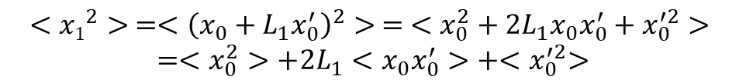


3 profile measurement
Transfer matrix
$$<{x1}^{2}> =<{\left(x_{0}+L_{1}x_{0}^{′}\right)}^{2}> = <x_{0}^{2}+2L_{1}x_{0}x_{0}^{′}+x_{0}^{′2}>$$
$$=<x_{0}^{2}>+2L_{1}<x_{0}x_{0}^{′}>+{<x}_{0}^{′2}>$$
$$\left[\begin{matrix}1 & L \\ 0 & 1\end{matrix}\right]$$
$$<{x0}^{2}>$$
L1
$$<{x1}^{2}>$$
L2
$$<{x2}^{2}>$$

Slide 40
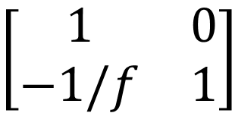

Quadrupole scan
f
$$<x^{2}>$$
L
Thin lens approximation
$$\left[\begin{matrix}1 & 0 \\ −1/f & 1\end{matrix}\right]$$

Slide 41
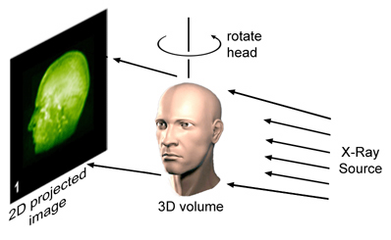
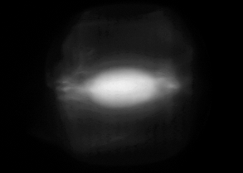

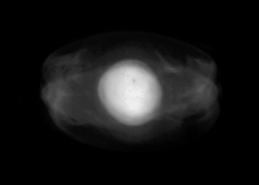

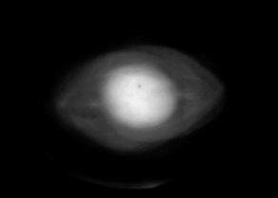

Tomographic Phase Space Reconstruction
Lens
Screen
Experiment
RC3
y
x
y’
RC6
RC9
Projected / Slice, using Quadrupoles / Solenoids
with Space Charge
D. Stratakis, R.A. Kishek, S. Bernal, et al., Physics of Plasmas 17, 056701 (2010).
Notes:
space charge
solenoids
time-resolved
emittance growth and halo

Slide 42
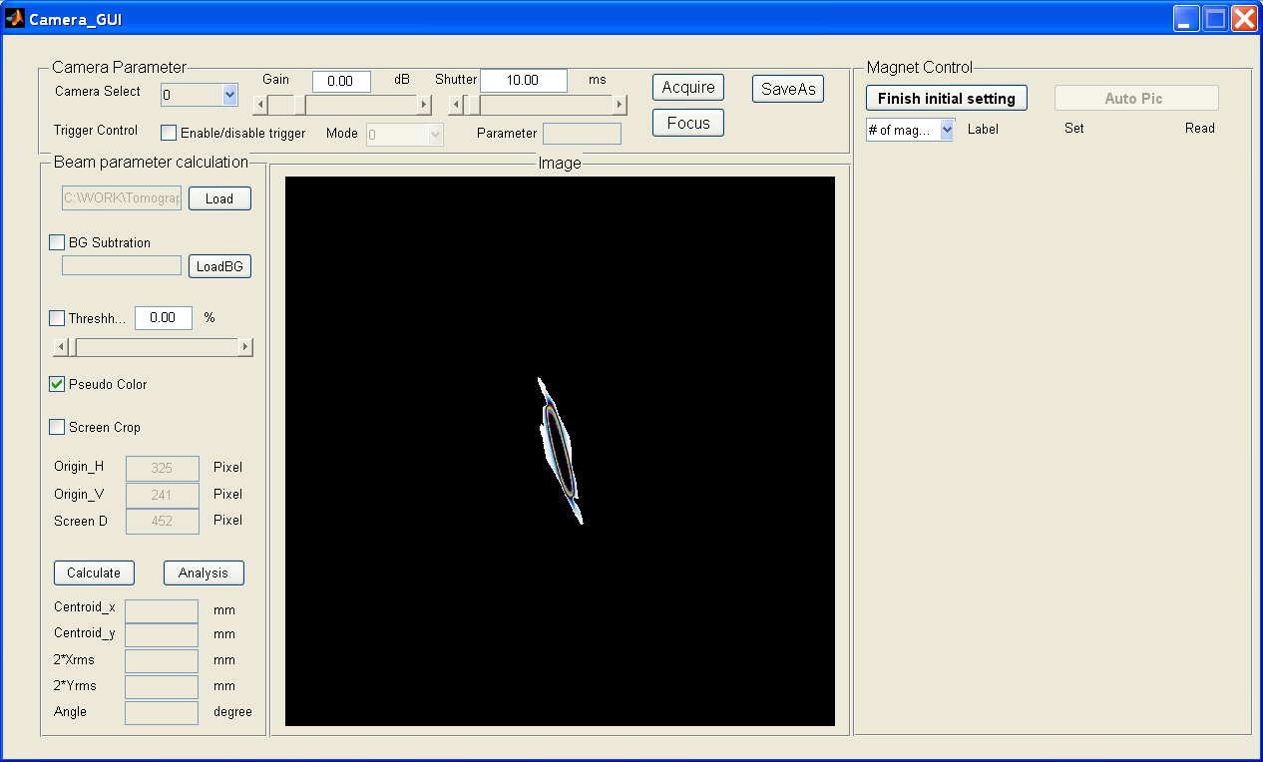

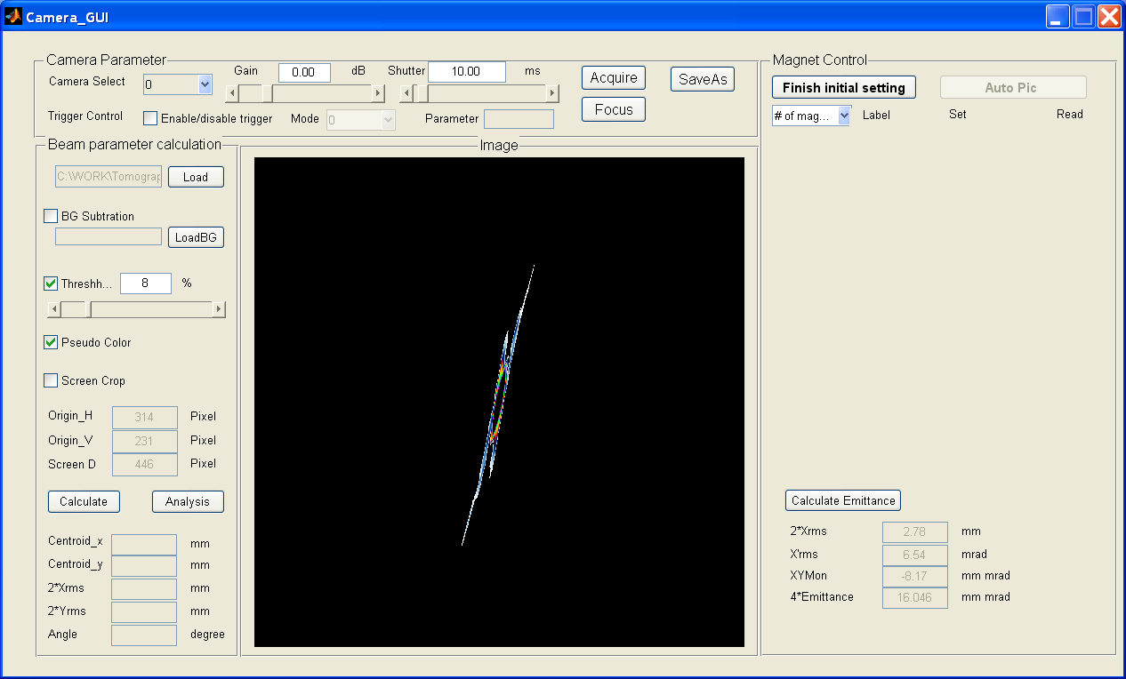



Phase space tomography to study halo
1
0.9
0.8
20 mrad
x’
20 mrad
0.7
x’
x
x
0.6
5 mm
5 mm
20 mrad
0.5
20 mrad
0.4
0.3
0.2
y
5 mm
5 mm
y
y
0.1
x
x
0
Matched
Y’
Mismatched
H. Zhang, PhD thesis, university of Maryland, 2014

Slide 43
Transverse emittance measurement methods
Technique | Pros | Cons
Basic Optics | Simple to implement. Linear space charge OK. Small or large beams. | RMS emittance only. No phase-space.
Pepper-pot | Simple to implement. Space charge OK. No beam optics. | Coarse phase-space. Impractical for small beams.
Quad Scan | Different schemes. Easy computation. | Space charge limits. No phase-space. Linear optics assumed.
Slit-Wire | Phase space info. Integrated or t-resolved. Space charge OK. | S/N problems. Hard to implement. Comp. intensive.
Tomography | Detailed phase space info. Linear optics/sp. charge. | More beam manipulation required. Computationally intensive.

Slide 44
Beam energy Monitoring

Slide 45
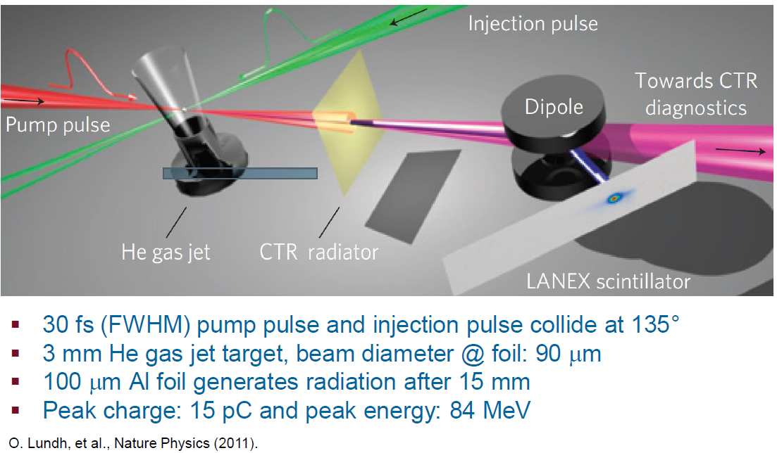
Using magnets

Slide 46
Other methods
Faraday cup
Segmented Dump

Slide 47
Beam halo Monitoring

Slide 48
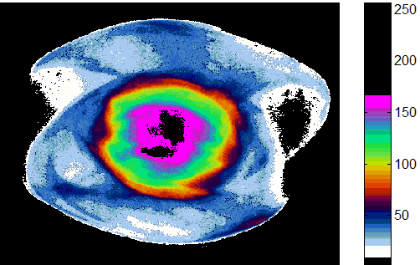
Halo Formation and Negative Effects
Causes of Beam Halo
Nonlinear forces due to space charge
Parametric resonances
Scattered Laser Light in Photo-cathodes:
Misalignment, Magnet error, noise
Beam Halo has many negative effects
  Nuclear Activation of The Transport Channel
  Emittance Growth
  Emission of Secondary Electrons
  Increasing Noise in The Detectors
Notes:
Beam halo is group of particles outside the beam core.
Beam halo can be caused by parametric resonances or nonlinear forces due to space charge [2], as well as field emission, light scattered on photo-cathodes, or by numerous other phenomena
It brings many negative effects such as emittance growth, emission of sencondary electrons and so on. Because of this negative effects, we want to avoid halo by study the phenomenon.
Experimentally, the challenge to measure faint halos is we need a method with high dynamic range about 10_5 or 10_6. people using image system to detect the halo using coronagraphy method, the mask usually is not adaptive when the beam core shape changes.
Today, we will introduce an adaptive mask method to measure halo using a device call DMD().

Slide 49
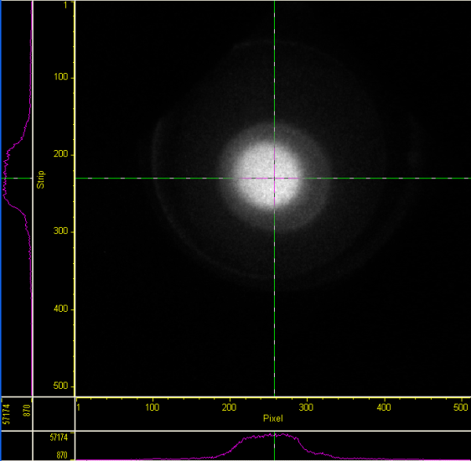
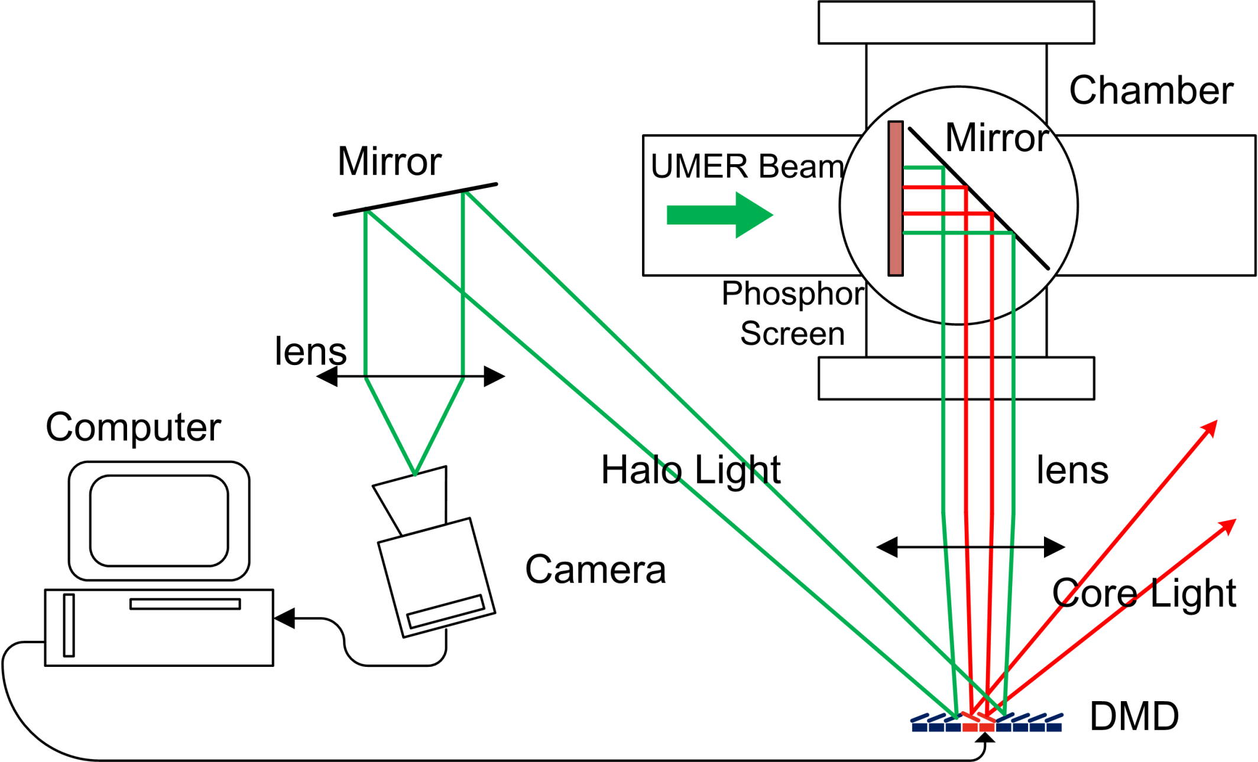
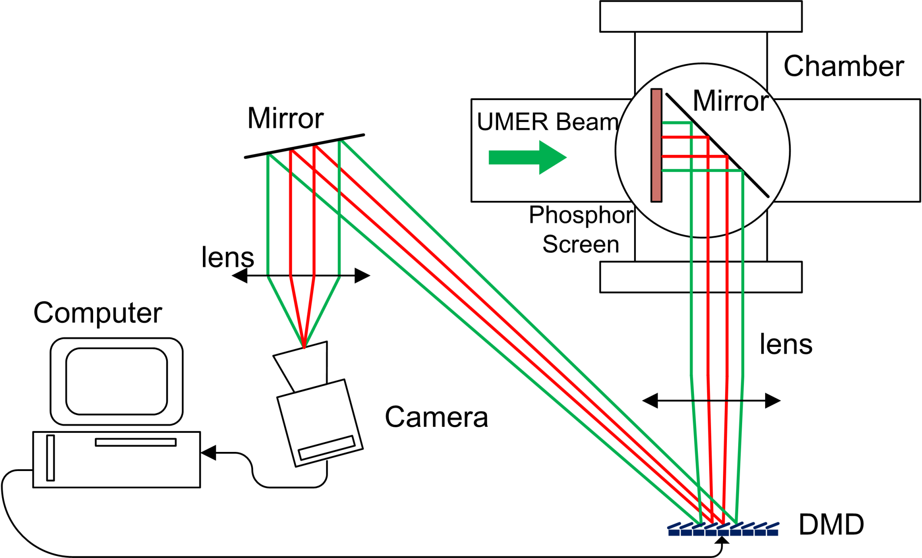
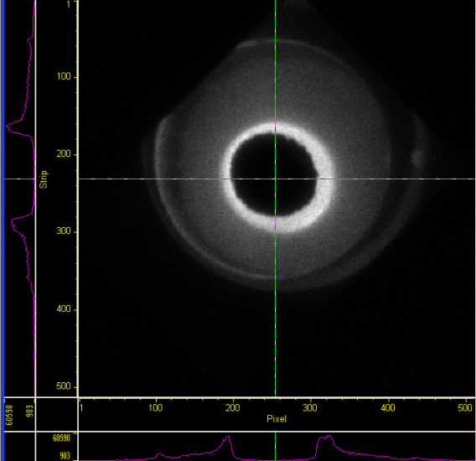

Optics System and Image process
32 mm
12⁰
180 Frames
32 mm
C.P. Welsch et al.,
Proc. SPIE (2007)
J. Egberts, et al.,
JINST 5P04010 (2010)
H. Zhang, et al.,
Phys. Rev. STAB 15 (2012)
B. Lomberg, et al.
Proc. IBIC (2013)
900 Frames

Slide 50








Demonstration of Adaptive Masking on UMER
Quadrupole Current
I_{Q}
82.9%I_{Q}
66.3%I_{Q}
49.7%I_{Q}
32mm
(a)
y
x
70
45
45
60
Different Beam / Different Mask Shape
(b)
280
640
660
250
6mA beam

Slide 51
Conclusion
Without beam diagnostics
  it is not possible to even operate a accelerator!!
Non-invasive, single shot, real-time measurement is demanded.
New concept adapted from other field is hugely popular
  Example: laser, non-linear optics, advanced algorithm, machine learning,…
User-based development specifically target to project
  OMA, AWA, EuPRAXIA, EuroCirCol, AWAKE, HLLHC, etc. projects
Also: Good prospects for commercialization (D:Beam).

Slide 52
Any Question?

Slide 53
Reference
Workshops, conference and schools
  BIW, IBIC
  DITANET, OPAC, USPAS, JUAS, JAS, CAS
J. Harasimowicz et al., Rev. Sci. Instr. 81 (10), 2010
H. Koziol, BEAM DIAGNOSTICS FOR ACCELERATORS
P. Forck, Lecture Notes on Beam Instrumentation and Diagnostics, Joint University Accelerator School, January – March 2012
J. Hunts, et al., NIMA, Vol 896, Pages 139-151.
U. Raich, Accelerator Beam Diagnostics, USPAS, Albuquerque NM, June 23-26, 2009
D. Stratakis, R.A. Kishek, S. Bernal, et al., Physics of Plasmas 17, 056701 (2010)
H. Zhang, PhD thesis, university of Maryland, 2014
E. Bravin, Cern Accelerator School on Beam Instrumentation 2-15 June 2018, Tuusula, Finland
C. Welsch, Beam Diagnostics, CIPAS, 2015
J. Harasimowicz, et al., PRSTAB, 15, 122801 (2012)
S. Bernal, Emittance and Emittance Measurements, USPAS08, Beam Dynamics Experiments on the University of Maryland Electron Ring

