Slide 1
Laser and Penning Traps
Richard Thompson
Quantum Optics and Laser Science Group
Department of Physics
Imperial College London
www.imperial.ac.uk/ion-trapping

Slide 2
Aims of the lecture
I hope that at the end of this lecture you will:
Understand the principles of trapping atomic particles
Understand the basic physics of traps for neutral atoms
Know what a Penning trap is in more detail:
  understand the mathematical description of the trapping mechanism
  have an intuitive understanding of how the Penning trap works
  know what features of the Penning trap make it attractive for certain types of applications
Have a sufficient understanding of trapping mechanisms and practicalities to give a suitable background to the work presented in this School

Slide 3
Outline of the lecture
The benefits of particle trapping
Atom and ion traps
The Penning Trap
  Principles of Operation
  Properties of the trapped ions
  Design considerations
  Advantages and Disadvantages
  Practical Aspects
Conclusion

Slide 4
Trapping of atomic particles
Why is it desirable to trap atomic particles for precision experiments?
Interaction time
  Most precision studies involve a measurement of frequency
  The relative precision of a frequency measurement is related to Δν/ν so for high precision we need high ν and small Δν
  But Δν is limited by the time taken by the measurement, T, and typically Δν~1/T so we need long T
  Therefore we need a long interaction time, i.e. particle trapping
Absence of perturbations
  For a precision measurement, the system must be isolated, stable and free of perturbations, e.g. collisions

Slide 5
How a trap works
To trap particles, we need a restoring force to push them towards the centre of the trap.
  This has to act in all three dimensions
For neutral atoms, we can use the pressure of light
  This is a relatively weak force and gives very shallow traps (~ a few kelvin)
  We must cool the particles before they are trapped
For charged particles, we can use electric and magnetic fields that act on the charge
  This is a strong force and gives deep traps (~eV or more)
  We can cool the particles once they are trapped

Slide 6
Traps for atoms
When an atom interacts with light, two effects arise which can both be used for trapping
Radiation pressure
  When an atom absorbs a photon, it also absorbs the momentum carried by the photon (hc/λ), but it reradiates in a random direction
  Therefore there is a net pressure on the atom in the direction of the laser beam
  This force is also used for laser cooling of atoms and ions
Dipole force
  The light field polarises the atom and changes its energy
    this is the AC Stark effect
  This gives rise to an effective potential for the atom that can lead to trapping

Slide 7
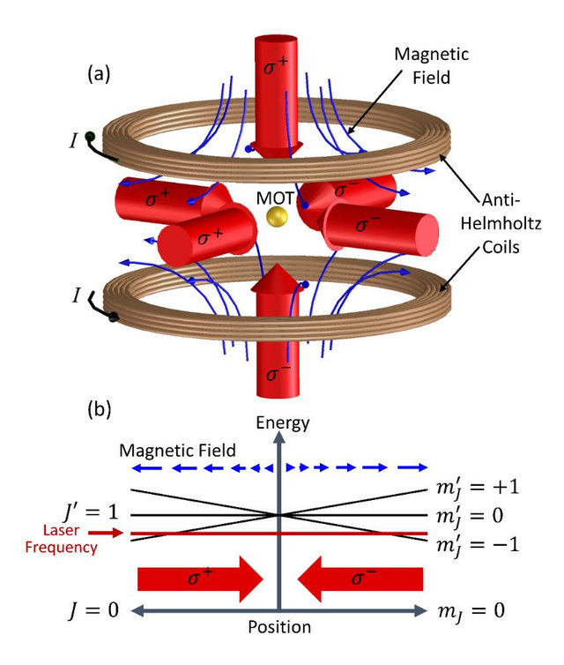
Magneto-optical trap (MOT)
Six laser beams along ±x, ±y, and ±z directions
All the beams are circularly polarised
Magnetic field is used to control the light pressure via the Zeeman shift
Anti-Helmholtz configuration has zero field at centre
https://www.researchgate.net/publication/283334697_Bright_focused_ion_beam_sources_based_on_laser-cooled_atoms/figures?lo=1

Slide 8
Magneto-optical trap (MOT)
Six laser beams along ±x, ±y, and ±z directions
If an atom is displaced in e.g. the +x direction, it is pushed back by the −x beam, because the position-dependent magnetic field brings it into resonance
This gives a 3D trapping force
https://www.researchgate.net/publication/283334697_Bright_focused_ion_beam_sources_based_on_laser-cooled_atoms/figures?lo=1

Slide 9
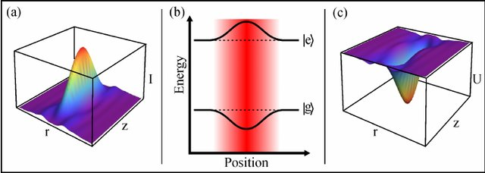
Dipole trap (optical tweezers)
ff
Intensity profile of a tightly-focussed laser beam travelling in the z-direction
Energy shift of the ground state of the atoms as a function of position in the beam
Resulting 3D potential well that traps the atoms in 3D
https://www.researchgate.net/publication/51947675_Scalable_Architecture_for_Quantum_Information_Processing_with_Atoms_inOptical_Micro-Structures/figures?lo=1

Slide 10
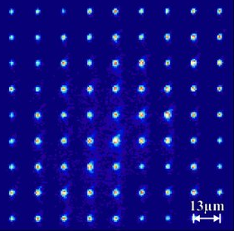
Summary of atom traps
Atom traps have a relatively low trap depth
  Typically a few kelvin
The atomic density in the traps can be very high
  Typically 10¹⁰ atoms per cm³ in a MOT
  Typically 10¹⁴ atoms per cm³ in a dipole trap
There are other variants of these traps
  Arrays of dipole traps
  3D optical lattices in crossed laser beams
  Magnetic traps for Bose-Einstein Condensates
All of these are compatible with laser cooling techniques

Slide 11
Trapping ions
In order to trap a charged particle we would need a quadrupole electrostatic potential with a three-dimensional minimum:
with A, B and C all positive
However, Laplace’s equation requires that
So three-dimensional trapping is not possible with static fields
Two ways around this:
  Add a magnetic field – the Penning trap
    This lecture
  Use oscillating fields – the Radiofrequency (Paul) trap

Slide 12

Trapped Charged Particles textbook
This graduate textbook is based on the lectures from the Les Houches Winter School on Trapped Charged Particles
  https://www.worldscientific.com/worldscibooks/10.1142/q0004
Chapters on many of the topics covered this week at this School
The first chapter (on Penning Traps) is available free on Amazon
  https://www.amazon.co.uk/Trapped-Charged-Particles-Solutions-Textbooks/dp/1786340127

Slide 13
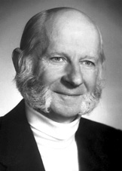
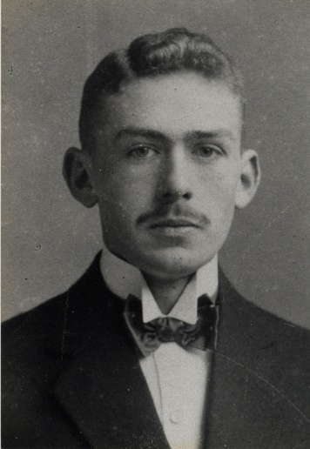
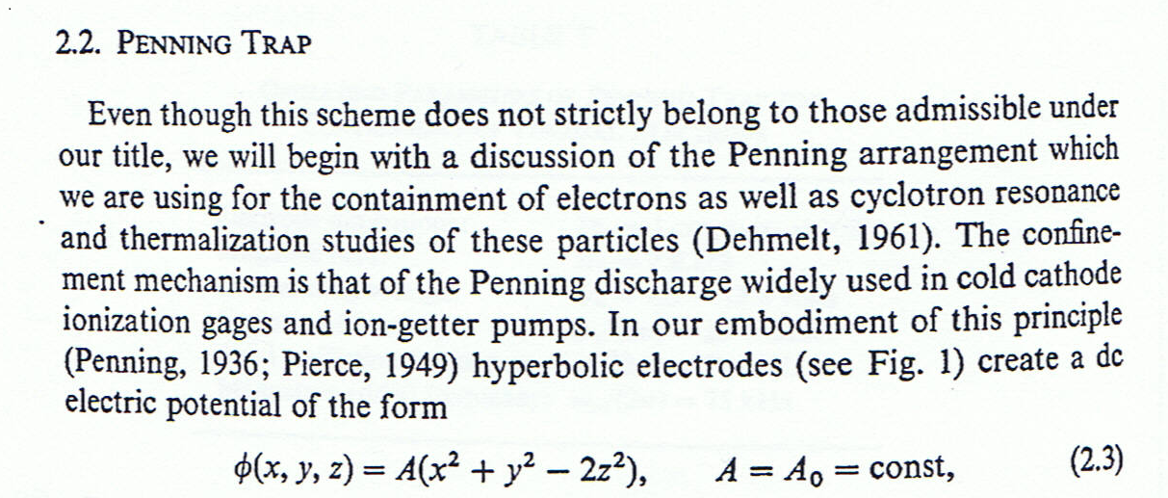
History of Penning Traps
The name “Penning trap” was coined by Hans Dehmelt
  Penning (1936) didn’t actually trap charged particles
  Electrons confined in discharges with B-field present

Slide 14
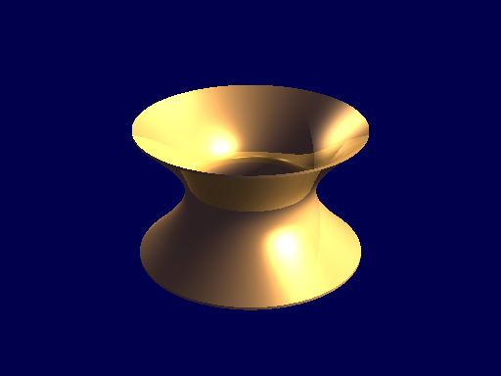
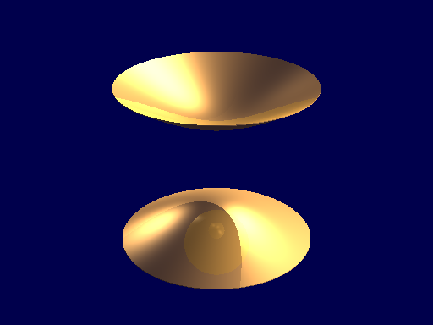
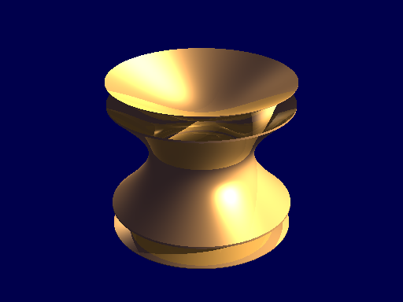
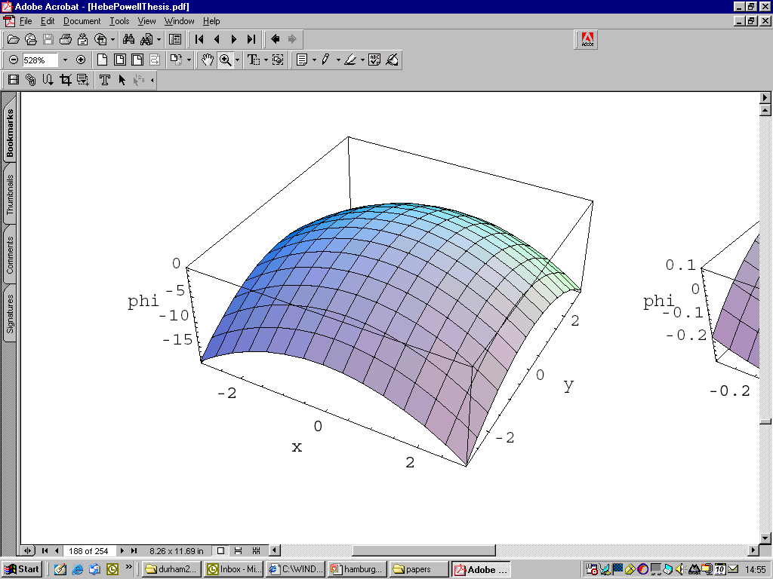
Principles of operation
Three electrodes
  Hyperboloids of revolution
  Generate pure quadrupole potential
DC potential applied between endcaps and ring
  Traps ions in the axial direction
  Radial motion unstable
Strong B field applied along the axis
  provides radial confinement (ions forced into cyclotron loops)
Requires ultra-high vacuum
  Avoids collisions leading to ion loss due to instability of radial motion
B
Radial potential

Slide 15
Ideal Penning trap electrodes
Endcap 1
r₀
Ring
Ring
z₀
Endcap 2
The desired potential is
This can be generated with electrodes the shape of the equipotential surfaces of this potential, i.e. hyperboloids of revolution
With r₀ and z₀ defined in the diagram we obtain

Slide 16
Equations of motion
The Lorentz force on a charged particle in E and B fields is
Here where .
The equations of motion for a single particle are therefore
here ω_{c} = eB/m and ω_{z}² = 4eV/mR² where R² = r₀² + 2z₀².
For the radial motion it is convenient to write this in complex form:
where u = x + iy

Slide 17
Motion in the Penning trap
We end up with three types of motion:
  Axial motion
    oscillation between the endcaps (~200 kHz)
  Modified cyclotron motion
    orbit around a magnetic field line (~500 kHz)
  Magnetron motion (E×B drift)
    slow orbit around trap centre (~50 kHz)
    This motion is unstable (negative total energy)
These values are for an atomic ion in a field of ~1 T
Classical derivation but all motions can be treated quantum mechanically
Axial motion
Radial motion

Slide 18
Invariance theorem
From the expressions for the three oscillation frequencies, we find:
ω_{c} = ω’_{c} + ω_{m}
and
ω_{c}² = ω’_{c}² + ω_{z}² + ω_{m}²
The last equation (discovered by Gabrielse) is still true for any small angle misalignment of the trap or quadratic imperfections of the field
  It is therefore very important for experiments where highly accurate measurements of the true cyclotron frequency are necessary
This is what allows very high precision mass comparisons and g-factor measurements to be made in a Penning trap

Slide 19
Potential and kinetic energy – axial
For the axial motion the average potential energy and the average kinetic energy are equal
E = ½ [mz²ω_{z}² + mv_{z}²]
= ½ mz₀²ω_{z}²
(z₀ is amplitude of motion)
The usual principle of equipartition of energy applies (<E_{pot}> = <E_{kin}> = ½kT_{z})
In Quantum Mechanical terms: E_{z} = n_{z}ħω_{z}
E
z

Slide 20
Potential and kinetic energy – cyclotron
For the cyclotron motion the average potential energy and the average kinetic energy are not equal
E = − ¼ mr_{c}²ω_{z}² + ½ mv_{c}²
= ½ mr_{c}²ω’_{c}(ω’_{c} − ω_{m})
Equipartition of energy does not apply here
We define a “kinetic temperature” through <E_{kin}> = ½ kT_{c}
In Quantum Mechanical terms: E_{c} = n_{c}ħω’_{c}
E
r

Slide 21
Potential and kinetic energy – magnetron
For the magnetron motion the potential energy and the kinetic energy are not equal
E = −¼ mr_{m}²ω_{z}² + ½ mv_{m}²
= −½ mr_{m}²ω_{m}(ω’_{c} − ω_{m})
Equipartition of energy does not apply here and the total energy is negative
We define a “kinetic temperature” through <E_{kin}> = ½ kT_{m}
In Quantum Mechanical terms: E_{m} = −n_{m}ħω_{m}
E
r
The negative magnetron energy has several consequences for the applications of the Penning trap

Slide 22
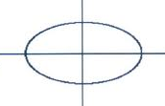
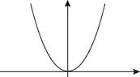
Space charge
When large numbers of ions are present, the cloud of ions behaves like a plasma
  Referred to as a non-neutral plasma or single-component plasma
The main properties of this plasma are:
  It has a uniform density n
  It has sharp edges (at low temperature)
  It has an ellipsoidal shape
  It rotates at a uniform rate about the z axis
  Typical density 10⁸ ions per cm³
We can think of the plasma as “filling up” the quadratic potential well
The whole plasma moves at the centre of mass oscillation frequencies
It has several internal modes of oscillation
y
x
E
r

Slide 23
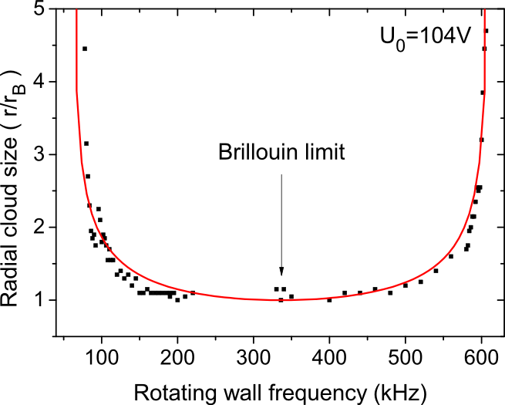
Brillouin flow
When cold, the plasma behaves like a solid body rotating at a frequency ω_{R} and this is linked to the number density of the plasma n:
This means that the maximum density is achieved when ω_{R} = ω_{c}/2 and then
This is called Brillouin flow.
An interesting fact:
At Brillouin flow, the total relativistic energy density of the particles (nmc²) is equal to the energy density of the magnetic field (B²/2μ₀)

Slide 24
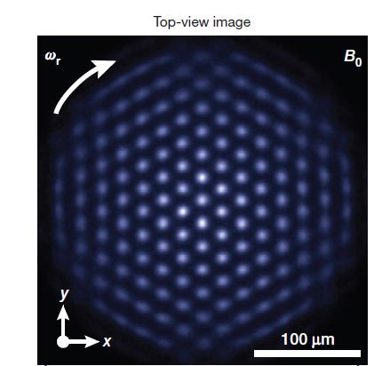






Ion crystals in Penning traps
At low energies, the ions fall into a regular structure – an ion Coulomb crystal
The plasma parameter Γ determines whether crystallisation takes place
  Γ is a ratio of electrostatic to thermal energy
  For Γ > 170 we expect a crystal structure
Predicted bcc lattice if infinite
Other structures for smaller clouds
  Planar triangular crystal lattice
  Ion string at low axial potential
NIST group
Low axial potential
High axial potential
B
Imperial College group
Side image
String Zigzag Diamond Offset Square
Square

Slide 25
Design considerations
The standard electrode design is hard to manufacture and has limited access for light and ion beams
The design can be simplified for easier manufacture and better access
Many groups now use a carefully-designed stack of hollow cylindrical electrodes for easy access in a superconducting magnet

Slide 26
Experiments that use Penning traps
“Classical”
  Mass spectrometry
  Electron g−2
  Non-neutral plasmas
  Antihydrogen production
Laser cooling
  Doppler cooling
  Sideband cooling
  Sympathetic cooling
  Spectroscopy
  Ion Coulomb crystals
“Quantum”
  Quantum jumps
  Quantum optics
  Quantum information
Frequency standards
  Ultra-high resolution spectroscopy
  Microwave and optical frequency standards

Slide 27
Advantages and disadvantages
Penning traps offer a very unusual environment for experiments.
They are well suited for experiments on fundamental particles or atomic ions, with one particle or many particles
They allow some experiments to be performed that would be difficult or impossible in other systems.
What are the particular advantages and disadvantages that they offer?

Slide 28
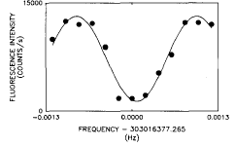
Advantages of Penning traps (1)
An isolated and stable environment
  The particles do not interact with the container walls or residual gas
    This means that exotic particles can be trapped
      e.g. positrons, antiprotons, highly charged ions…
  Only static electromagnetic fields are used
  Free of unwanted perturbations
This RF Ramsey spectrum was taken with a 550 s interaction time giving a central fringe width of 1mHz (NIST)
It demonstrates that coherence between two HFS Zeeman states is preserved for very long times

Slide 29
Advantages of Penning traps (2)
Tight localisation of the particle(s)
  One particle or many particles
  Particles remain at the centre of the trap and cannot escape
  Long interaction times possible
    Especially after laser cooling
Magnetic field
  Provided usually by a superconducting magnet
    Very uniform and stable field
  Very important for mass and g-factor measurements etc
Image of two ions in a Penning trap after Doppler laser cooling
The axial separation of the ions is about 30 μm

Slide 30
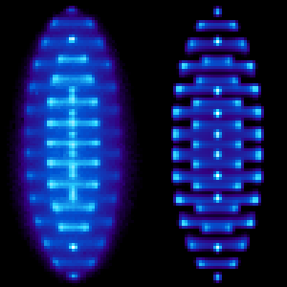
Advantages of Penning traps (3)
Cooling
  There are lots of different cooling techniques available
  Increases lifetime of particles
  Reduces or eliminates Doppler effect:
    ultra-high resolution spectroscopy in optical domain
Plasma physics studies
  A cloud of ions in a Penning trap is a “non-neutral plasma”
  The plasma has a uniform density in a quadrupole trap
  At very low temperatures, ion Coulomb crystals are formed
Penning-Malmberg trap
Ion Coulomb crystal

Slide 31
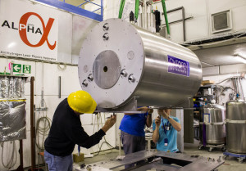
Disadvantages
Magnetic field is expensive to provide
Access to the ions is difficult
  Superconducting magnet limits access severely
  Trap electrodes make optical access difficult
  Any holes in electrodes distort the quadratic potential
Vacuum system needs to be good for UHV (<10⁻⁹ mbar)
Magnetron motion is unstable
  The energy associated with this motion is negative
  Collisions and perturbations all tend to make the radius increase
  Hard to cool efficiently
  Leads to a rotation of the whole plasma

Slide 32
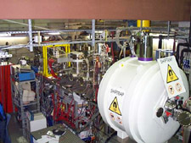
Trap environment
Magnetic field
  We need a field of 1-10 T – generally requires a superconducting magnet
Cryogenic environment
  Some experiments require the whole trap to be at a few K
Ultra-High Vacuum
  Collisions will lead to heating up or loss of ions, so the trap has to be held under UHV conditions (<10⁻⁹ mbar)
  This also means that the trap components must be very clean to prevent outgassing and contamination of the vacuum

Slide 33
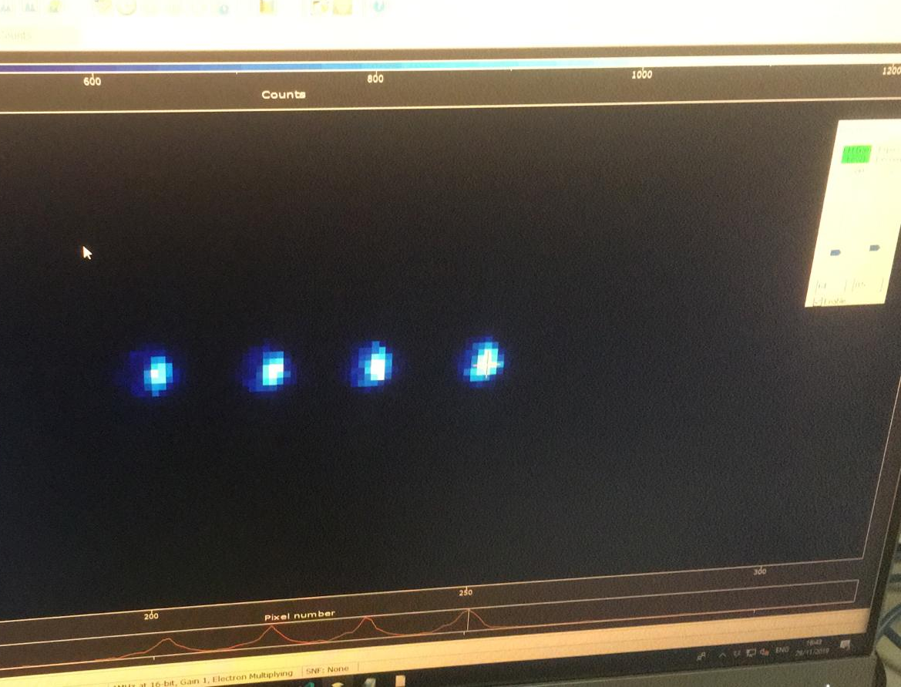
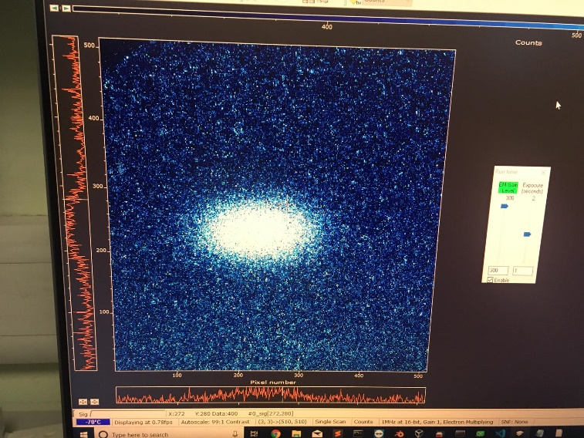
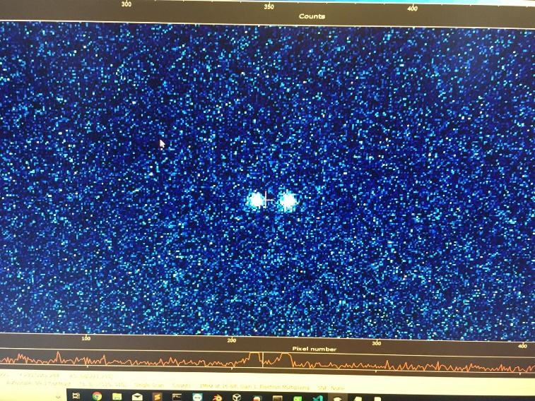
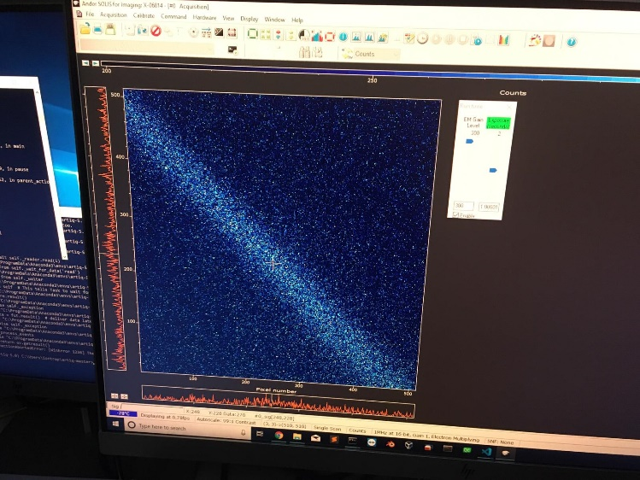
Loading of ions into the trap
Ions can be loaded into the trap in two ways:
Transport the ions into the trap from elsewhere
  Requires an external ion source
  Trap potential on one electrode needs to be changed rapidly for efficient trapping
    Lower the potential to let ions in
    Raise it again before the ions have ‘bounced’ back
Create the ions inside the trap so ions are trapped instantly when created
  Electron impact on a neutral atomic vapour
  Ablation from a surface using a pulsed laser
  Photoionisation of neutral atoms
Trapping scheme for “SpecTrap”

Slide 34
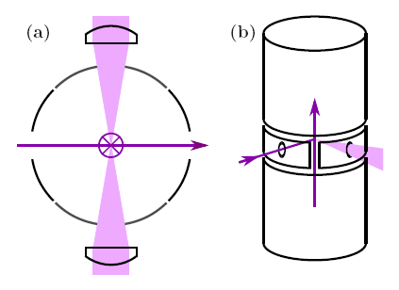
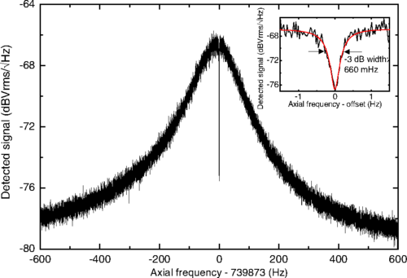
Detection of ions
To CCD camera
Three main ways to detect ions in a trap:
Detect the light that they emit when excited by a laser
  Sensitive and non-invasive
  But needs an ion with a suitable transition
Detect induced currents in external circuit
  Sensitive at cryogenic temperatures
Detect particles by ejecting them from the trap to a detector (e.g. MCP)
  Destructive but works for all particles
To Photomultiplier tube (PMT)
BASE experiment

Slide 35
Cooling
Several ways to reduce the energy of trapped particles:
Buffer gas cooling
  Allow the ions to interact with an inert buffer gas at room temp.
  Works for cyclotron and axial but not magnetron motion
Radiative cooling
  For electrons/positrons at high energy for the cyclotron motion
Resistive cooling
  Extracts energy from the ions when they induce currents in an external circuit (mainly axial and cyclotron)
  can cool to a few K if apparatus is at liquid helium temperature
Laser cooling
  Very effective if suitable transition available
  Can cool to ~1mK or lower
Sympathetic cooling
  Ions mixed with a laser-cooled species are cooled through collisions

Slide 36
Optical sideband spectroscopy of a Ca⁺ ion
Motional sidebands on optical transitions can be seen in ion traps
  Transitions between the states of the quantum mechanical simple harmonic oscillator
This is much harder for the Penning trap than for RF traps
  This is the first step towards sideband cooling to motional ground state
Red sideband
Blue sideband
This indicates a temperature of < 1mK
after Doppler cooling
The ‘Doppler width’ is less than 1 MHz

Slide 37
Demonstration of optical sideband cooling
Red sideband
Blue sideband
Absence of red sideband indicates that ion is in the ground vibrational state (n=0).
We find that ň ~ (RSB amplitude) / (BSB amplitude) ≈ 0.02
Motional ground state occupation is >98%

Slide 38
Rabi oscillations
We can see Rabi oscillations for ground-state cooled ions
  This shows that we can perform coherent manipulations of our system
The optical coherence time is ~0.8 ms
Spin-echo techniques can be used to increase coherence time to a few ms

Slide 39
Coherence measurements
10 μs
10 ms
At small T we see fringe visibility ~1
After 1 ms the optical coherence is lost and the visibility drops to ~0.5
Motional coherence is preserved out to ~100 ms

Slide 40
Summary of the Lecture
Trapping techniques are very important for many precision measurements with fundamental particles, atoms and ions
In particular, the Penning trap is an elegant device with many excellent features for experiments in physics
  Especially precision measurements, due to the extreme isolation
It makes possible experiments that would otherwise not be possible
  Especially those involving delicate quantum effects
In the rest of the School you will see some of the different areas of physics where they are used.

