Slide 1
Backup and DR with Large Datasets
Fergus Kerins
fergus.kerins@switch.ch
Copenhagen 27/01/2020

Slide 2
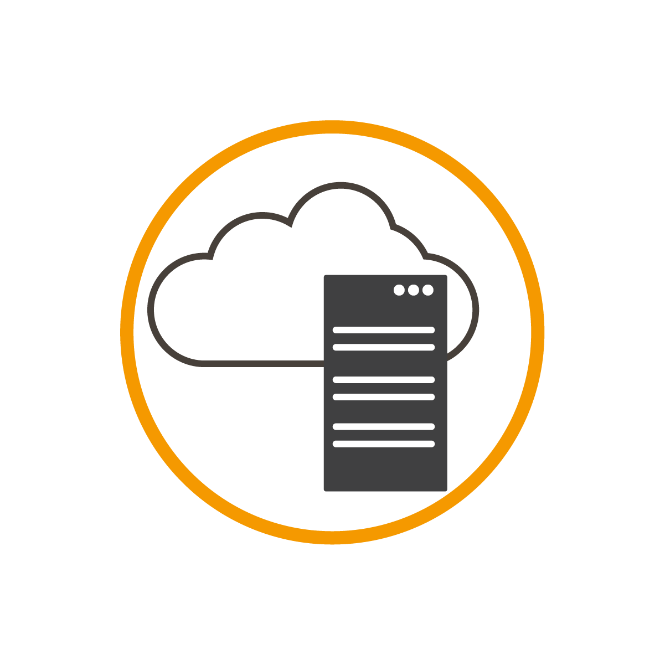
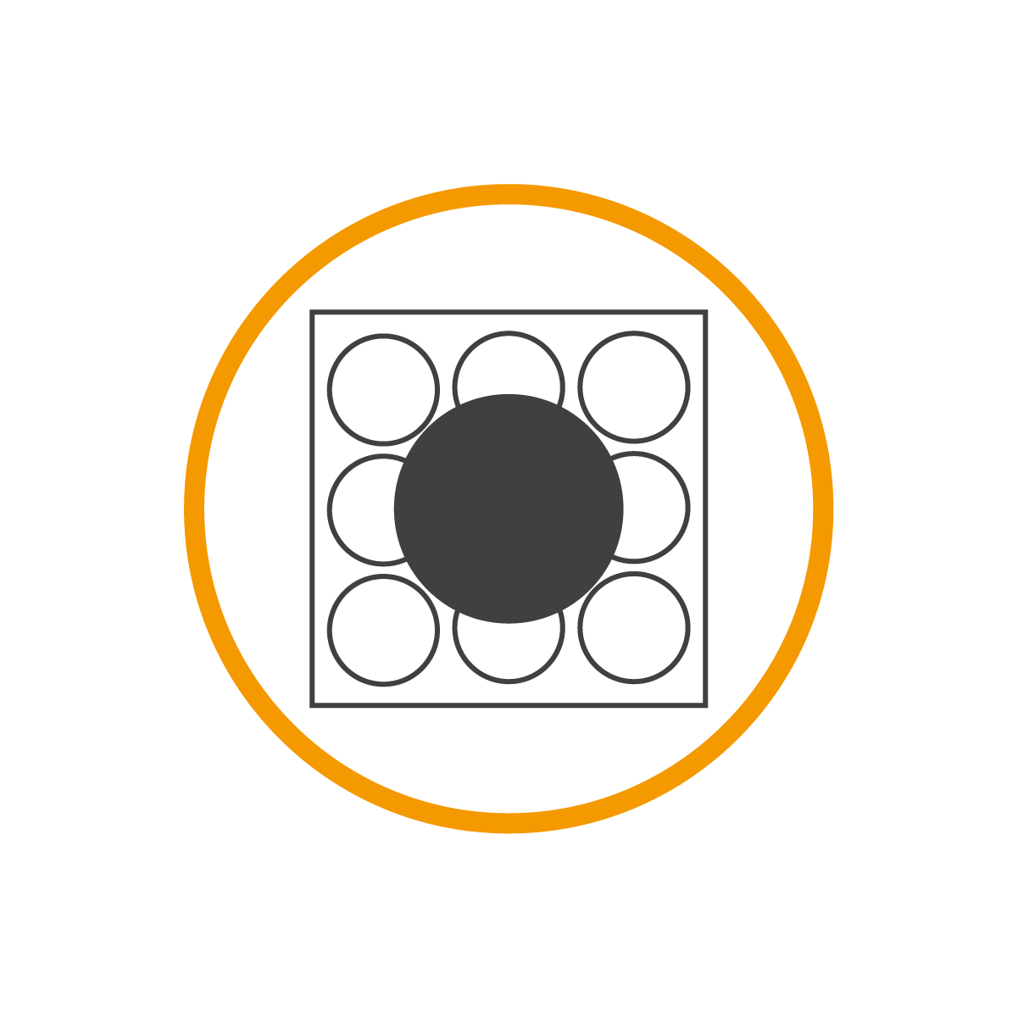



Our customers
Higher education
Cantonal universities
ETH domain with research institutions
Universities of applied sciences
  Universities of teacher education
  University-related organizations
  Spin-Offs
  Research institutions
  eLearning Center
  University hospitals

Slide 3
Our offer
  SWITCHengines
  SWITCHdrive

Slide 4
SWITCHdrive
  Owncloud 10.3.2
Infrastructure
CEPH
Openstack
2 Datacenters / 2 Clusters / 2 Regions
RBD volumes
6 NFS Servers
85 x 5TB disks
Storage
  280 TB of Data
  237 Million files
  20 K unique Users a month

Slide 5
Our Challange
  We would like to provide offsite Backup and DR for our Customers
  Our Dataset is quite large and not really suited to the classic backup, of a full backup weekly and a daily Incremental

Slide 6
Options
  CEPH
  rbd-mirror
  3rd Party
  “scripts” rclone
  backy2 / benji

Slide 7
Plan
  We have done some basic testing and seen some positive results with using rclone to backup to s3 objectstore
  Due to our Data (relatively static)

Slide 8
Call to the Community
  Any Experiences or Comments would be very welcome

