Slide 1
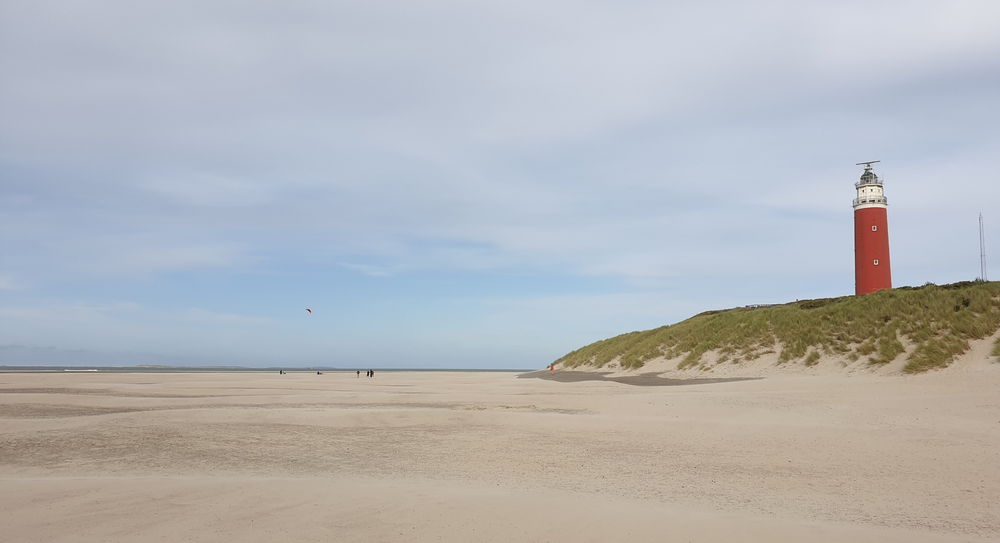
iRODS and Sync & share, getting the best out of both worlds
Ron Trompert

Slide 2



Research Drive Recap
Once upon a time there was……
Flexible Research data sharing
Personal sync-and-share

Slide 3


Research Drive Recap
Research Drive attracted a lot of attention from universities and other higher education
Why?

Slide 4
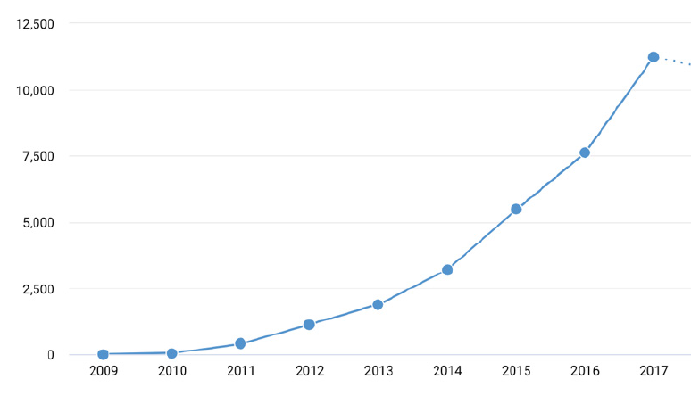
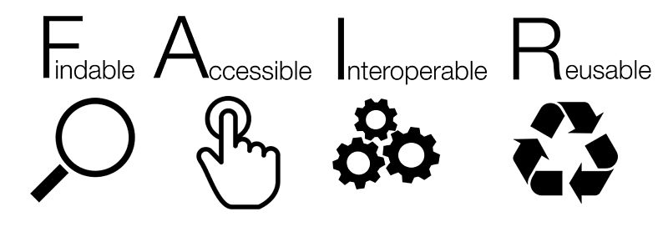

Research Drive Recap
Lots of data
Lots of attention, lots of ambition
‘The hockey stick graph indicates the exponential growth of datasets that are being made available.’ The State of Open Data 2018, Digital Science Report
Data citations
Year
Research becomes more data-intensive and more interdisciplinary – and researchers need the right tools to do their job (in a way that complies with their institute’s policies & guidelines)
The FAIR Principles and Open Science are on the agenda of university boards, funders and the government.

Slide 5
Research Drive Recap
Lots of data
Lots of attention, lots of ambition
‘The hockey stick graph indicates the exponential growth of datasets that are being made available.’ The State of Open Data 2018, Digital Science Report
Data citations
This means universities and faculties experience a sense of urgency – both top-down and bottom-up – to offer better support for RDM on all levels (policies, support, technology, etc.)
Whole data life-cycle is relevant, but long-term archival and publication of data are often seen as a priority.
Year
Research becomes more data-intensive and more interdisciplinary – and researchers need the right tools to do their job (in a way that complies with their institute’s policies & guidelines)
The FAIR Principles and Open Science are on the agenda of university boards, funders and the government.

Slide 6
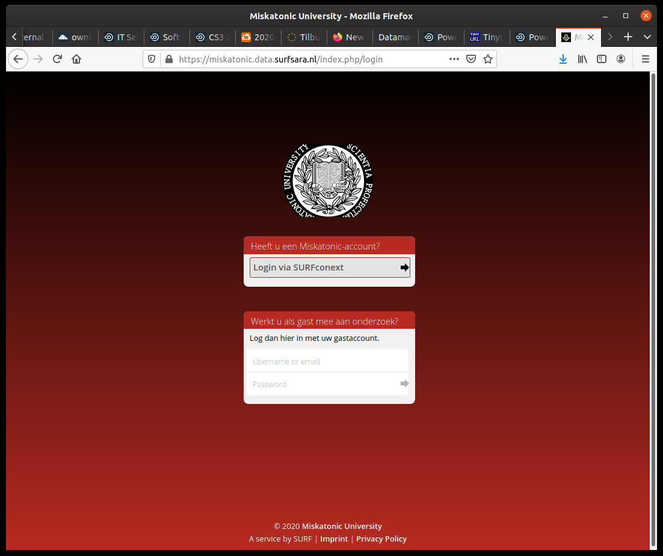
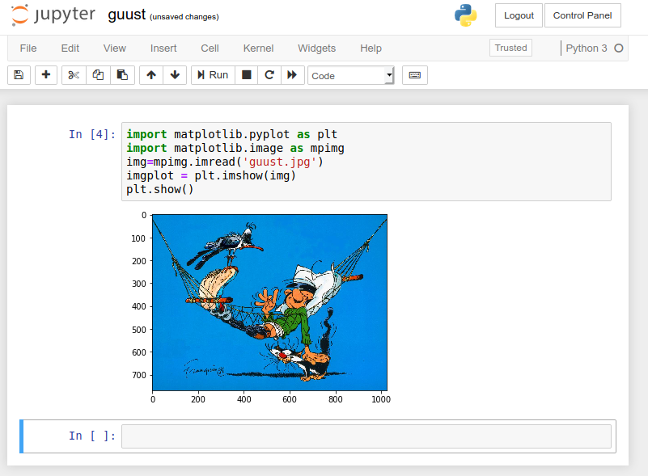
Research Drive Recap
Sync-and-Share Service with focus on the needs of
the research community
  Owncloud-based
  Features
    Your own branding
    Sharing outside of the organisation.
    Multiple AUTHN methods
    Integration with external storage systems
    Functional accounts supporting data stewardship
    Quota as large as you can afford
    Collaborative editing
    Jupyter
    Pay per TB and not per user
More details, see last years talk: https://tinyurl.com/rtvpvhe

Slide 7
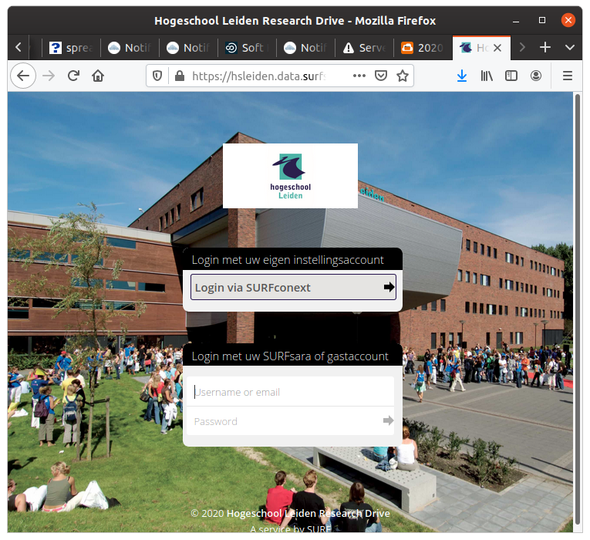
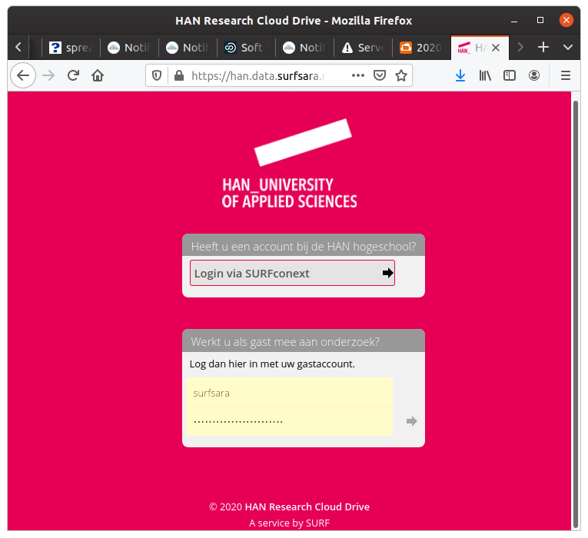
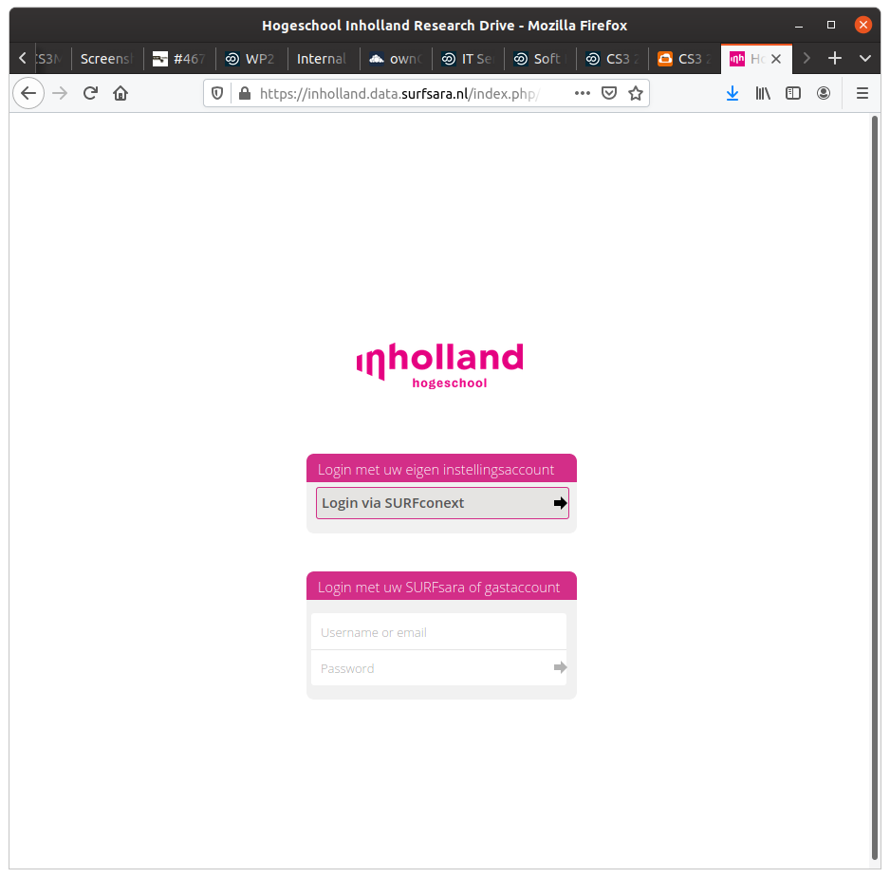
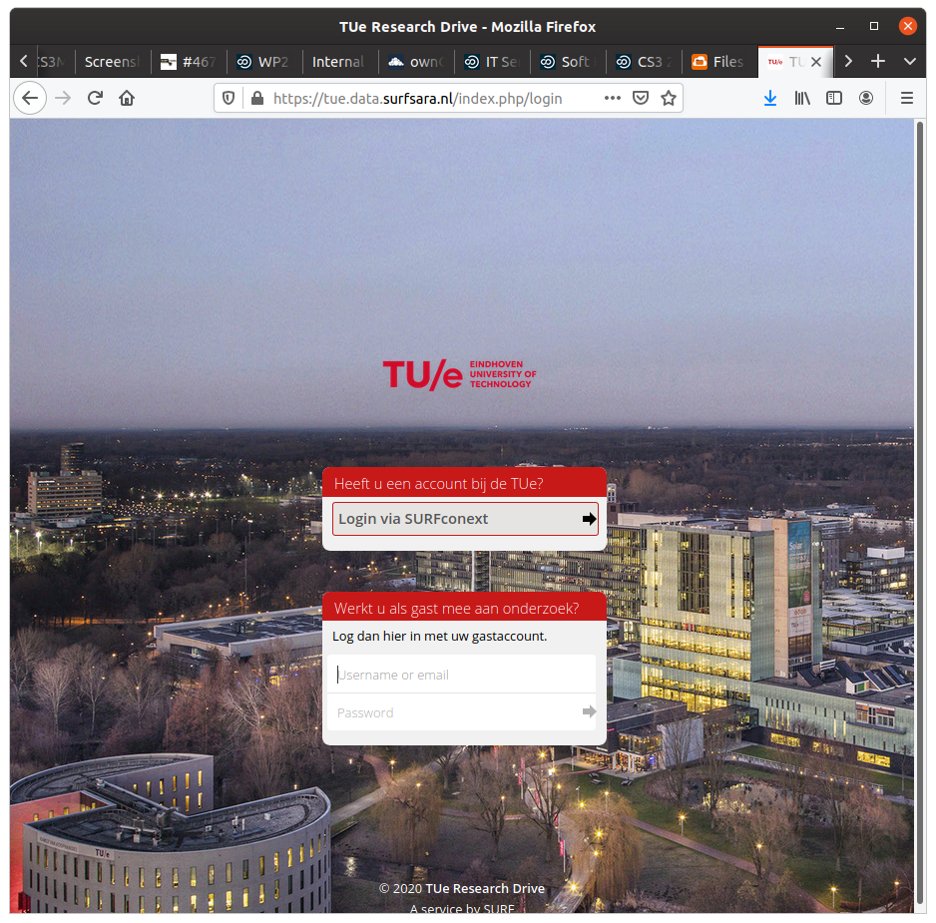
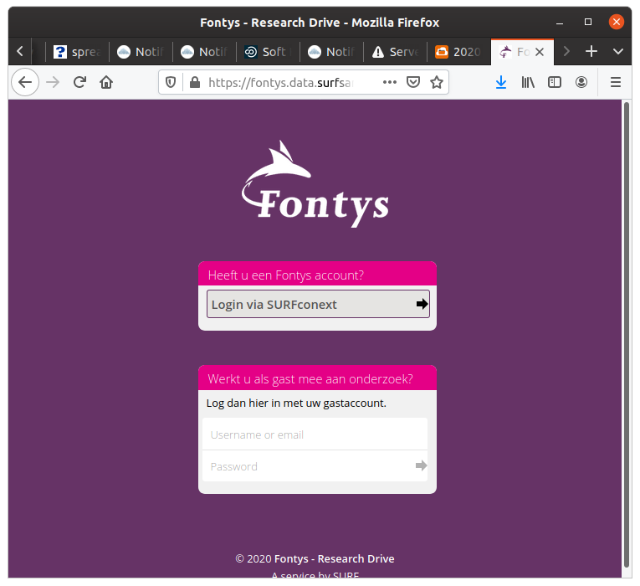
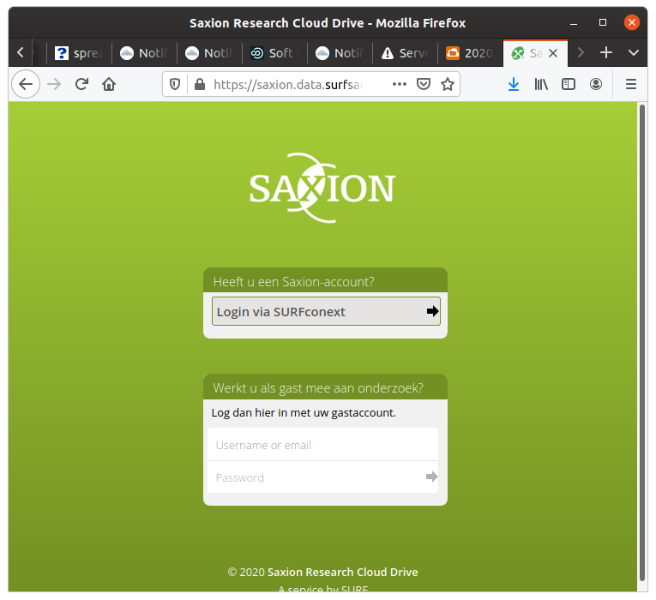
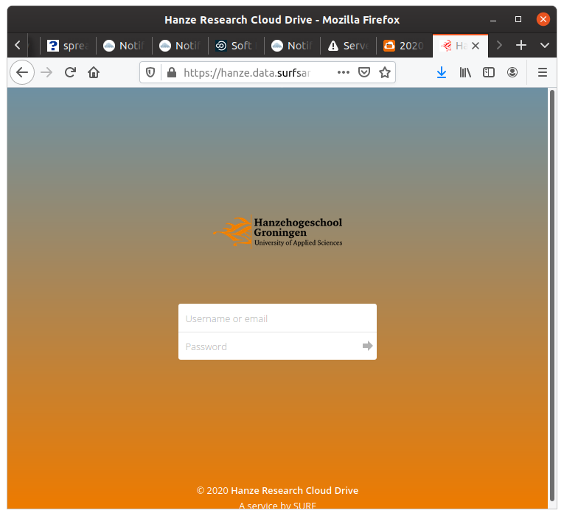
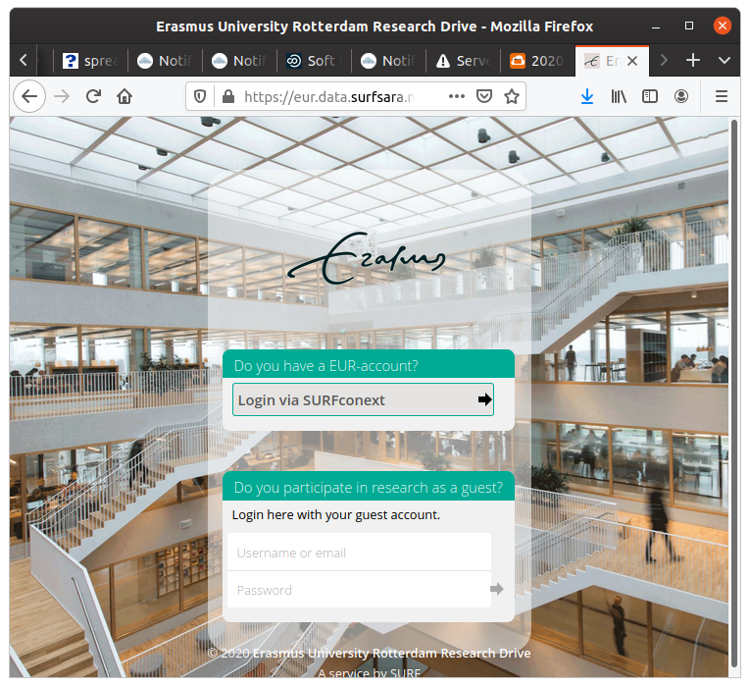
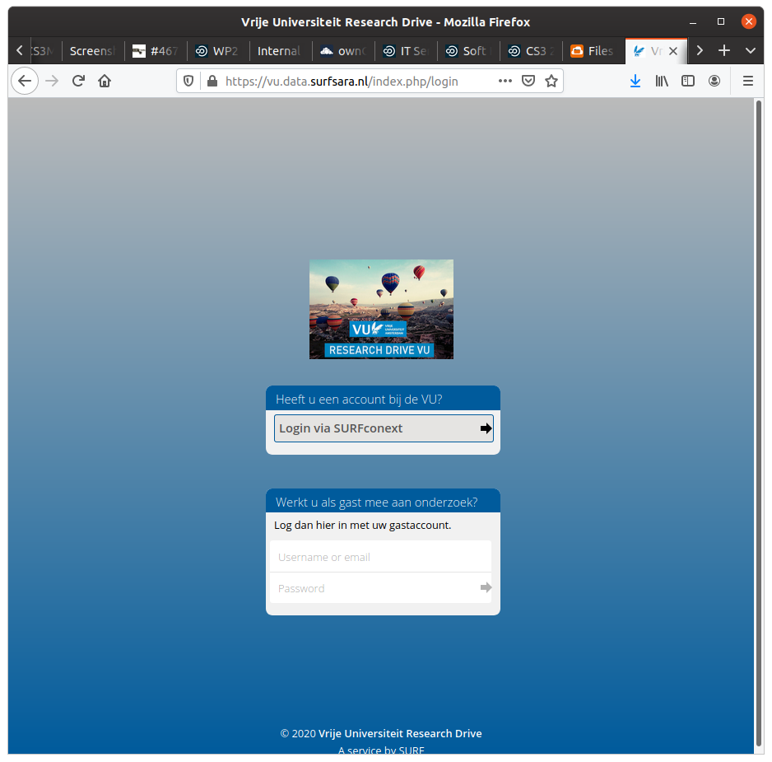
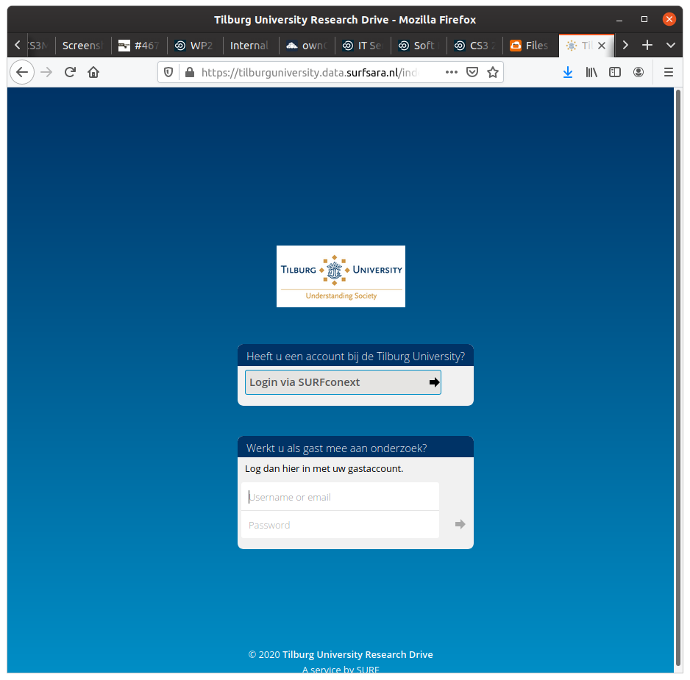
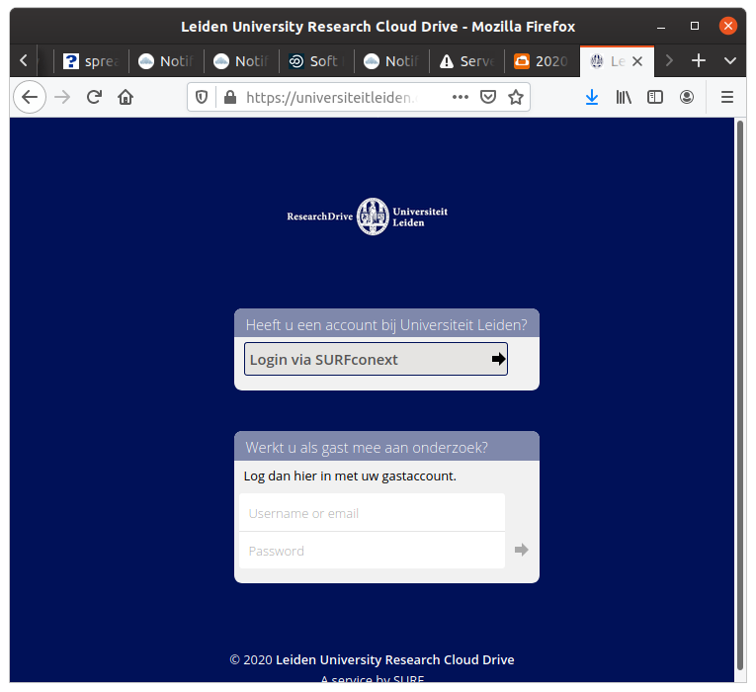
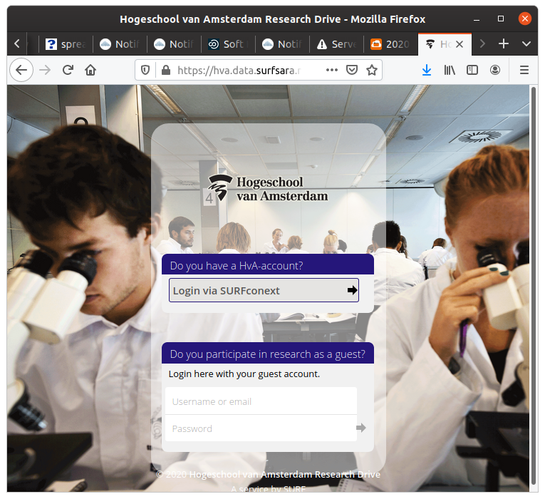
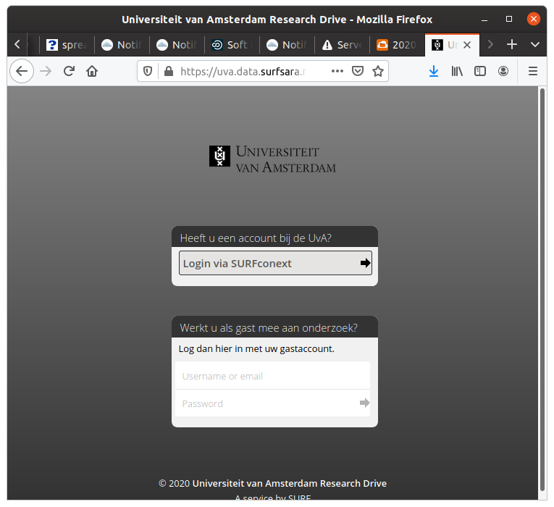
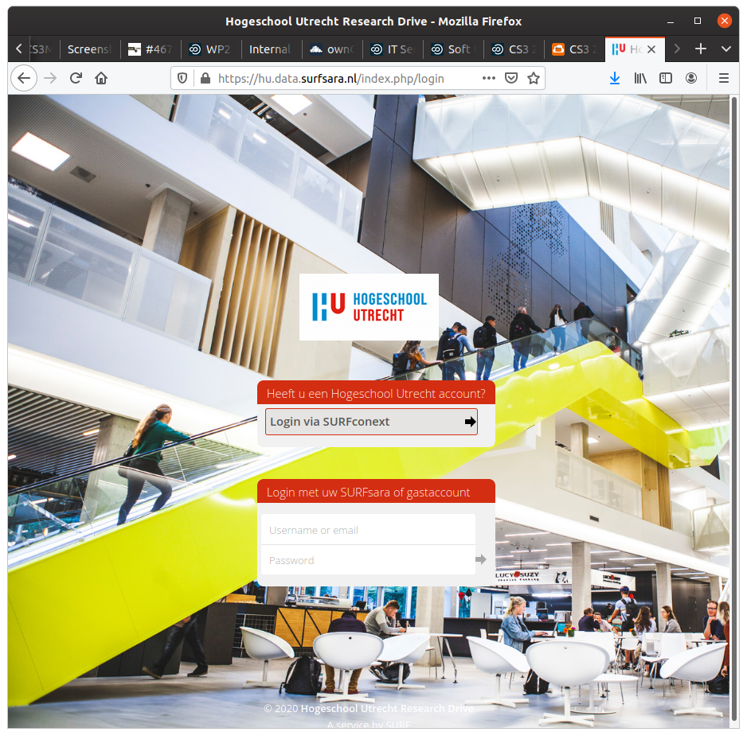
Branded instances

Slide 8


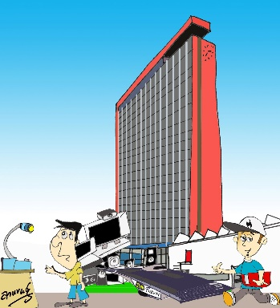




Research Drive Roles
University purchases an amount of storage capacity (cake)
Hands out parts (piece) of it to faculties
Faculties hand out parts of their amount of
storage to people responsible for project data
Different roles and capabilities are needed
Supports internal billing

Slide 9
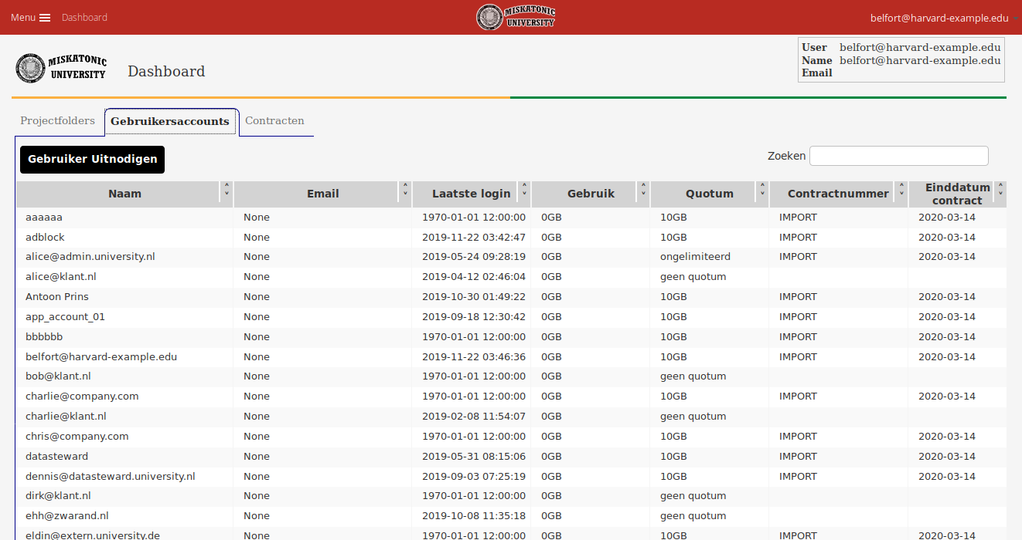
Dashboard

Slide 10
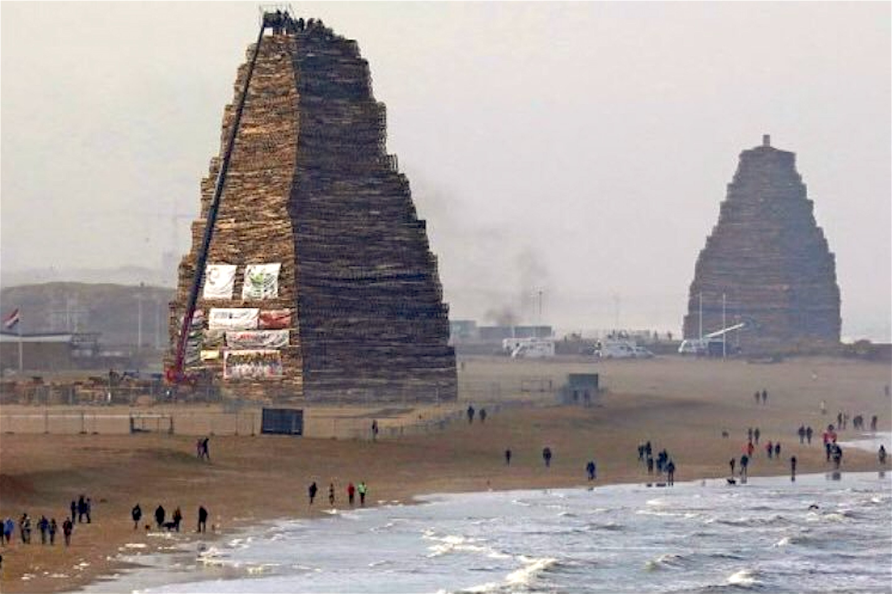
Moving up higher in the stack
Sync-and-Share is not just about storage
  Collaborative editing
  Research interfaces
    Jupyter, Spark, iRODS
  Data repositories

Slide 11
iRODS
Data Management Software
  Metadata
  Storage virtualization of different types of storages
  Logical namespace across storage locations
  Rule engine to automate data management according to defined policies
  Federation of iRODS instances
User interface
iRODS
Data Servers
Irods rule
engine
Irods metadata
Catalog database

Slide 12


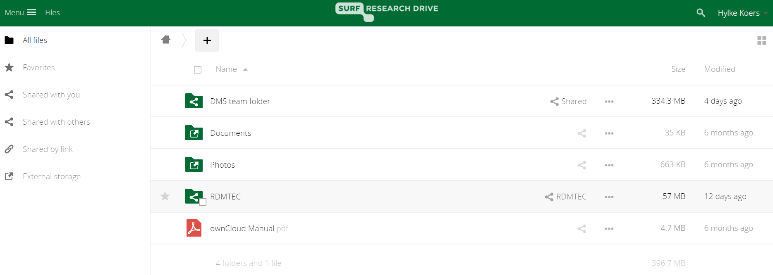

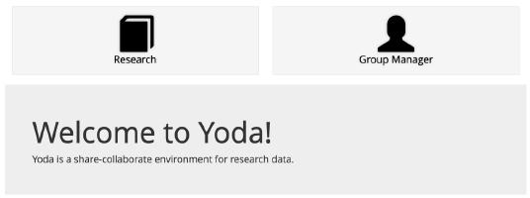

An RDM framework that addresses the needs of all actors
Data import, sharing & collaboration
User interface
Data pipeline
GUI person
Commandline trooper
Policies
Data management hub: metadata, PID, provenance, data virtualization
Integration with trusted value-add services
VRE, data processing & analysis
Metadata schema
Storage virtualization
Data steward
Data publication
Publish to data repository
Local storage
Object store
Data Archive
Data storage & archiving

Slide 13
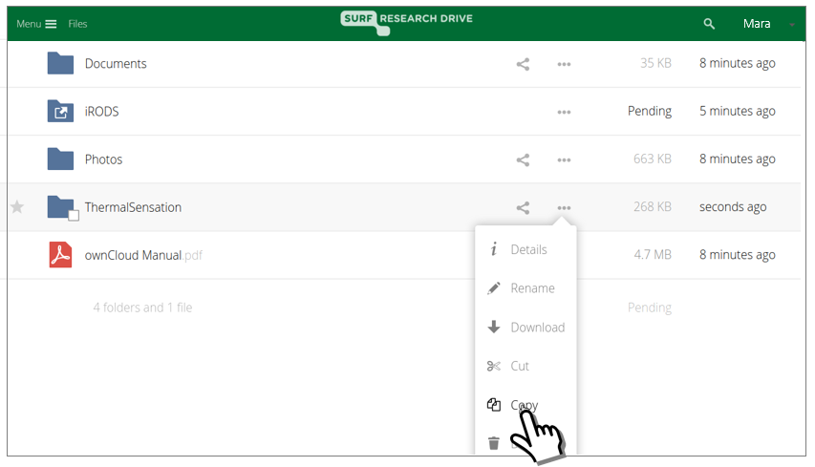
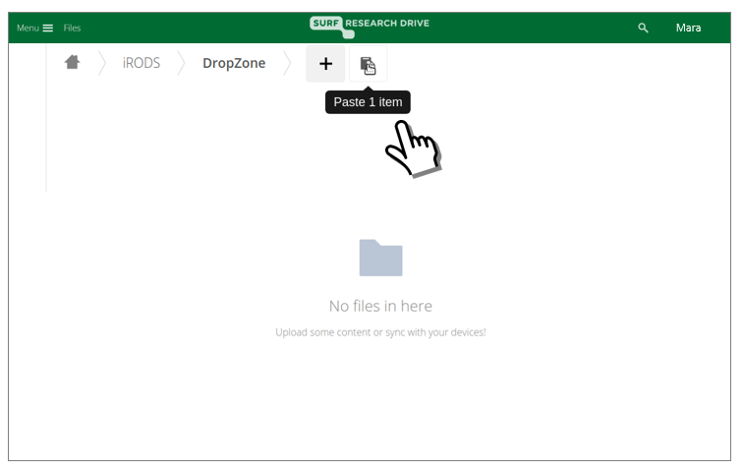
Researcher copies folder into iRODS drop zone
Notes:
Live demo (slides are back up)

Slide 14
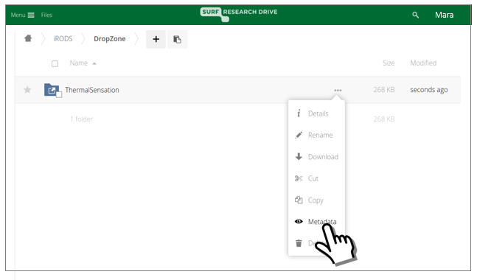
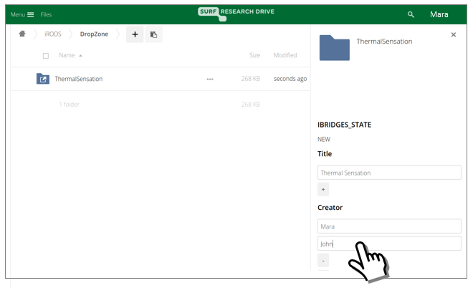
Researcher selects folder for submission and proceeds to add metadata

Slide 15
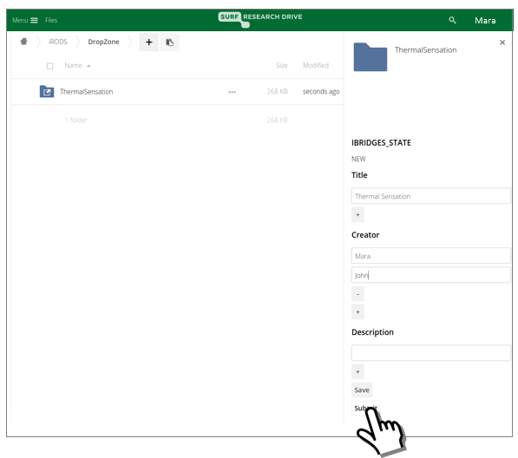
Researcher submits collection to Archive

Slide 16
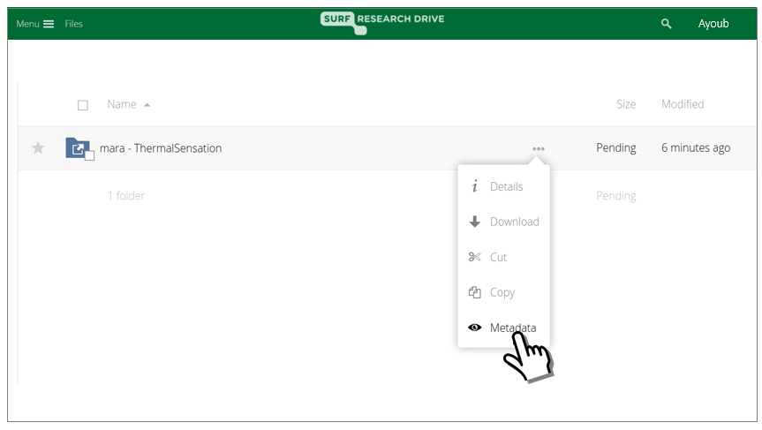
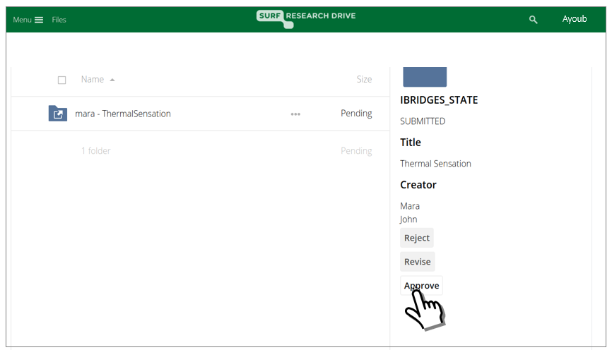
Data steward selects submitted collection

Slide 17
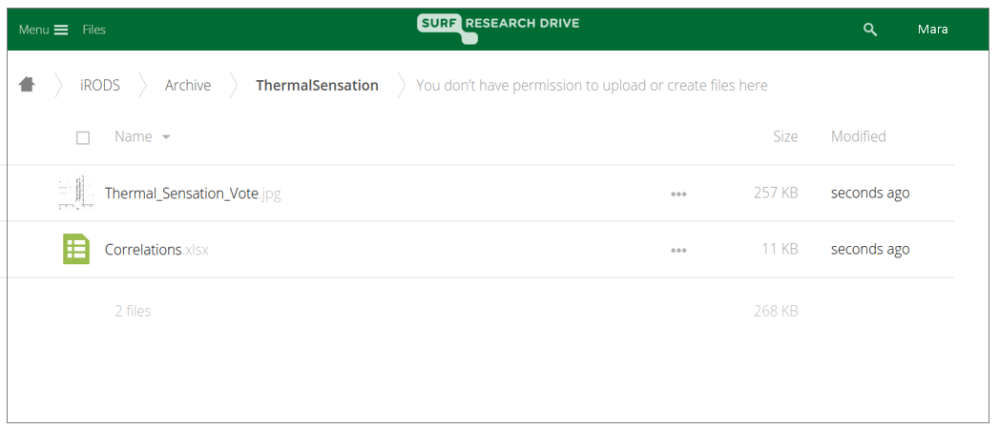

Researcher checks that the data collection in now in the Archive

Slide 18
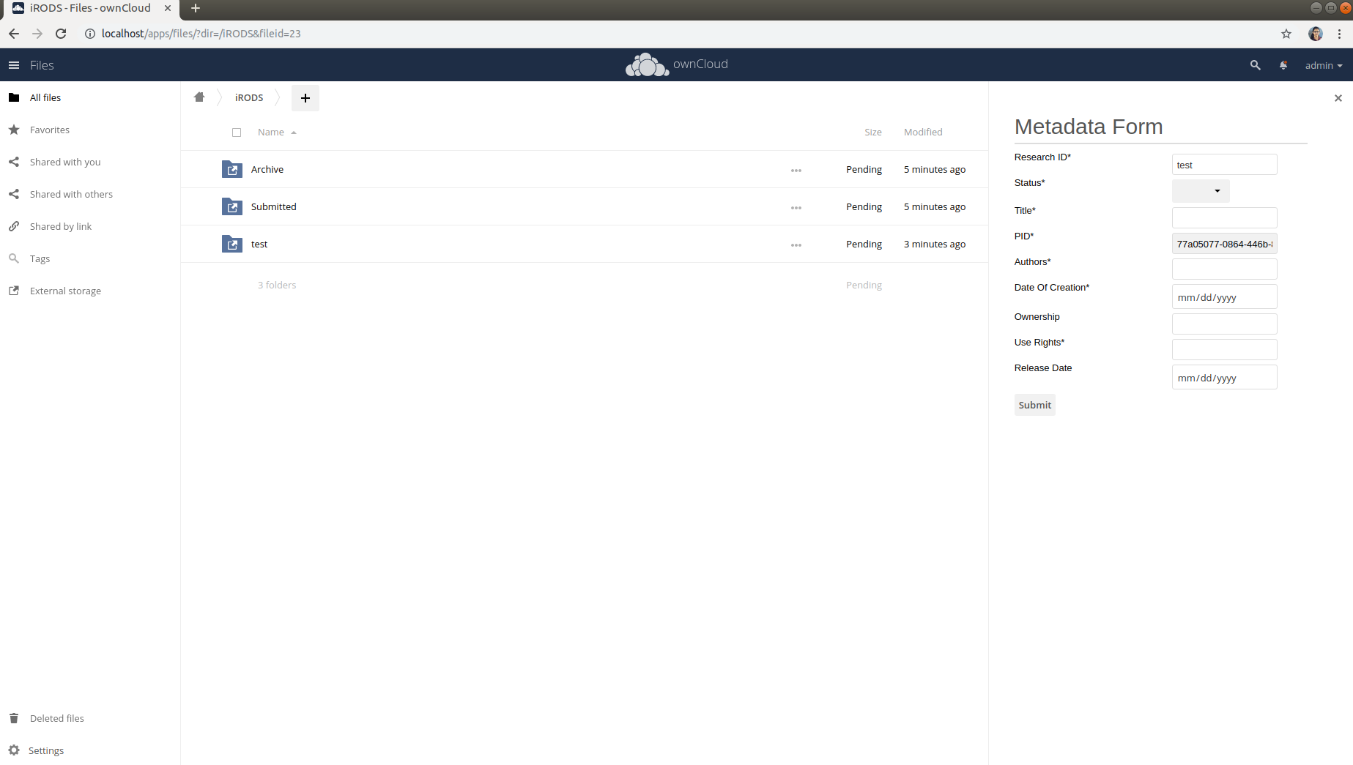

Slide 19


iRODS and Owncloud are integrated
Files and metadata inserted into iRODS through Owncloud is visible and accessible through iRODS CLI and API
Files and metadata inserted into iRODS directly is visible and accessible in Owncloud
Metadata is configurable per customer

Slide 20
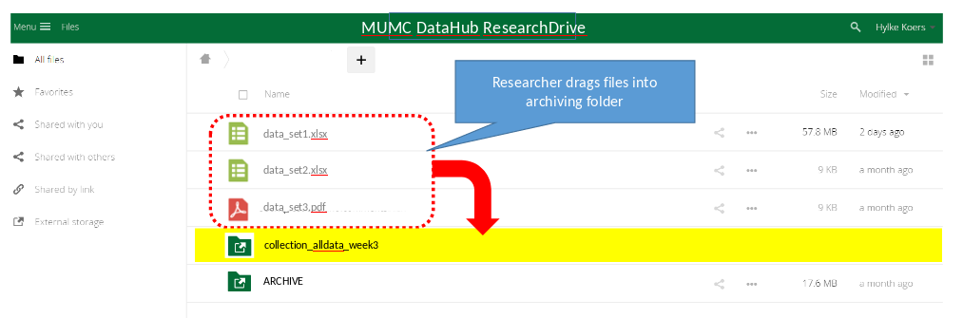
iRODs
Pilot with Saxion and Maastricht UMC
  Integration with local archiving solutions

Slide 21
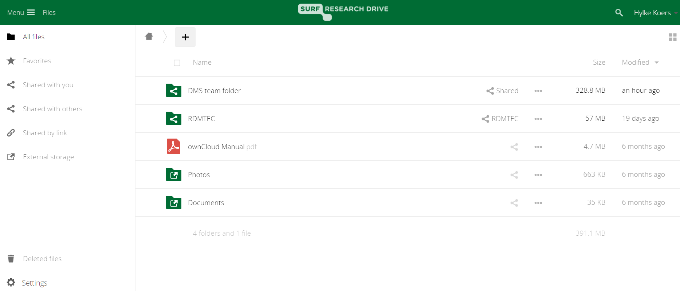
SURF Research Drive & iRODS – combining the best of both
So, we set out to extend Research Drive by integration with iRODS:
User Experience:
  User can add metadata from within the Research Drive environment.
  Use can ‘archive’ or ‘publish’ from the Research Drive environment.
Behind the scenes, Research Drive is integrated with iRODS
  iRODS maintains the ‘source of truth’ metadata records
  iRODS serves as point of integration to ensure consistent user experiences between Research Drive users , iRODS command-line users , and institutional data steward
‘Archival’ and ‘Publication’ workflows codified in Apache Airflow, working in unison with iRODS rule engine
&
= happy ( )

Slide 22
Acknowledgements
Stefan
Tom
Wybrand
Jean-Marie
Thirsa
Tasneem

Slide 23
