Slide 1
CS3 2020, Kopenhagen, bwSync&Share
Karlsruhe Institute of Technology, Steinbuch Centre of Computing,
Klaus Scheibenberger, 27.01.2020
- www.scc.kit.edu

Slide 2
Operational Aspects
bw = Baden-Württemberg, Germany
bwSync&Share = country-wide
Sync&Share Service for Institutions (edu)
Service control
(strongly based on AAI
(bwIDM = SAMLbased IdPs
=> scaling), e.g.:
registration („Ack“ of „terms of use“),
de-/provisioning of accounts, ...
- „Ack“ of sharing, ownership transfer, ...
Documentation: service description, FAQ, ...
(Coincide with other aspects
=> next slide)
n
Software
Actual Powerfolder
Imminent migration to Nextcloud
Some Standardtopics
Webediting: OnlyOffice
Merging of accounts (several mailing addresses)
Ownership transfer
Server based / E2E encryption
Monitoring
S3/NFS, ...
bwSync&Share
Service
Service
Processes
40 Institutions
40.000 Accounts
60TB Data
OnlyOffice
Function

Slide 3
Administrative Aspects
We are NO privacy OR legal, NOR finance experts!
Intensive communication neccessary with legal, finance privacy departments! Building a common understanding to match adminitrative/legal and functional demands („time intensive for both sides")
Usage Conditions
Costs/Y, Month
Liability,
Notice period, …
Set up „Usage Contract“ (with institution not users)
Money transfer! Essential for finance/billing!
Personal Data
Processed where, why, how?
Set up „Privacy Contract“
General Data Protection Regulation (EU) 2016/679 ("GDPR"/"DSGVO")
Inspection measures, e.g.:
  Access to serverrooms, on servers, on data medium, data, separation of user data and (user's) personal data, ...
  Also support contracts to be regarded
  Encryption: Access to data for users, admins, supporter, ...
n
Legal
Privacy
bwSync&Share
Service
Costs
Systemsinfrastructure
(Storage, Virtualization, …)
Commercial SW-Support
Personnel Ressources
Set up „Cost Model“
account per year/month
vs. flatrate per institution
accounting/billing
procedures have to be regarded
Transition from a sponsored project
to a „self-feeding“ service
Function
40 Institutions
40.000 Accounts
60TB Data
OnlyOffice
Finance
Service
Proceses

Slide 4
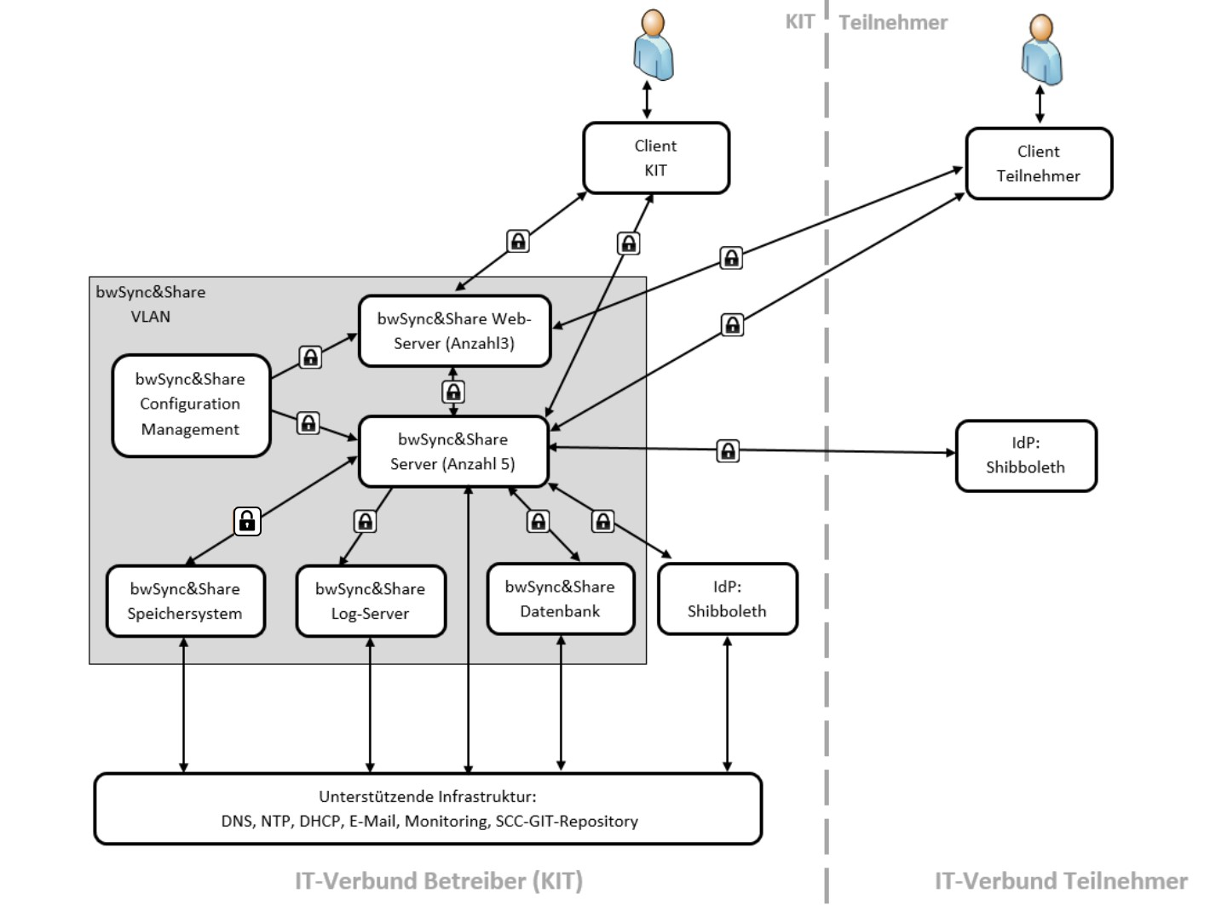
Structural Overview
Service staff bwSync&Share:
Overall about 2,5-3 persons (FTE) for operations, 2nd-level support and „organizational“
administration
+ aditional personnel for basic services, infrastructure (storage, virtualization, ...)
IDM (bwIDM, AAI) all over Baden Württemberg (since 2013):
SAML-IdPs of the institutions using bwSync&Share;
S&S users use their local credentials

Slide 5
Thank You For Your Attention!
Any Questions?
- www.scc.kit.edu

