Slide 2
The importance of Open Source
(in delivering large storage services)
Alberto Pace (alberto.pace@cern.ch)
CERN, Geneva, Switzerland

Slide 3
Why open source ?
Many known reasons:
  Control – in control of your business
  Flexibility – license allows modify the code
  Reliability / security – as development is shared, code is reviewed widely, fewer bugs
  Cost – little entry cost, you pay the modifications
  Longevity – you decide when drop it or when upgrade it

Slide 4
Why open source ?
… in addition it empowers collaboration
  Collaboration is hard !
  The existence of an established authority eases decisions … until you disagree
    With proprietary software you have an authority …
    With open source it is harder
  Governance is essential for the success
    Linux foundation, Apache foundation, WLCG (Worldwide LHC Computing Grid), …

Slide 5
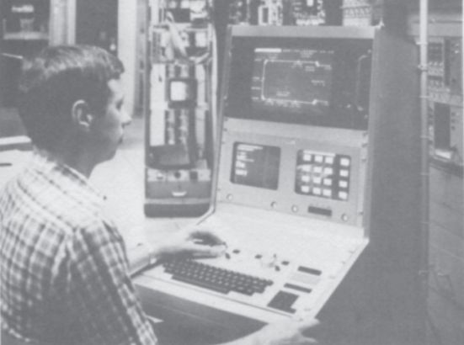
Why open source ?
It has took many years to acknowledge the importance of software
  Heard only few yeas ago: “Software is so flexible that can be done in the last minute … by a student”
Using proprietary software is outsourcing
  You outsource something that is not important

Slide 6
When is it effective to outsource ?
3 requirements (apply to all fields, not just computing):
  The activity is not strategic / core business
  The activity has clear established standard (interfaces / protocols)
  There are multiple independent vendors implementing these standards.
If any of these 3 requirements is not satisfied, you are exposed to problems
  Lock-in, business or service failure, blackmailing

Slide 7
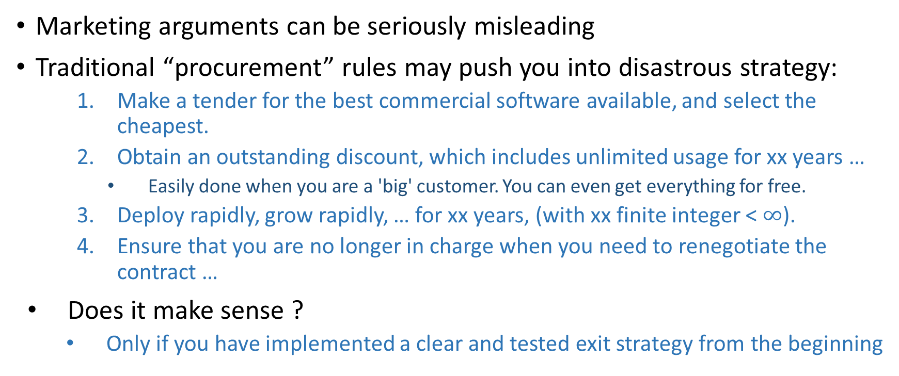
Proprietary software, when you are ‘big’
Marketing arguments can be seriously misleading
Traditional “procurement” rules may push you into disastrous strategy:
  Make a tender for the best commercial software available, and select the cheapest.
  Obtain an outstanding discount, which includes unlimited usage for xx years …
    Easily done when you are a 'big' customer. You can even get everything for free.
  Deploy rapidly, grow rapidly, … for xx years, (with xx finite integer < $∞$).
  Ensure that you are no longer in charge when you need to renegotiate the contract …
Does it make sense ?
  Only if you have implemented a clear and tested exit strategy from the beginning

Slide 8
Today, things have changed for storage
Software in storage
  In many scenario software can be the most strategic component
  When you are 'big', software should have a fixed-cost only
Storage Hardware
  If the "software" problem is correctly handled, the Hardware + Energy is where variable-costs are concentrated – scale out is possible at minimal ‘marginal’ cost.
With this approach …
  the cost of adding a PB of storage is limited to the cost of a PB of HW
  the cost of operating an additional PB of storage is limited to the cost of the required energy and hardware amortisation
  If you do not have the critical mass …. cooperation is the solution

Slide 9
Storage services strategy at CERN for software
Three rules define the strategy:
  Use only commercial software that implements well understood functionalities on well established standard interfaces. There must be implementations from multiple independent vendors with demonstrated interoperability.
    License cost should be fixed (volume and usage independent) and should not expire.
    Must have the perpetual right to continue to use the 'old' software in case you could not accept or afford buying renewed version of the software
  Use Open Source software that has no license cost associated. Fund the necessary software development costs through separated software maintenance or development contracts.
  Self-develop core software components. In open source.
All three approaches are successfully being applied for the storage service strategy at CERN

Slide 10
History repeats itself !
Same story already heard:
  1990’s Software: “is so flexible that can be done in the last minute …”
  2010’s Data: “Why care about data? Just put It in the cloud (for free)”
This introduces the need for data sovereignty
  Vendor lock-in has a huge impact: access to your data is at stake
    Companies fails
    Contract fails
    Law changes
    Subject to remote jurisdictions
    Loss of your own data, not just access to software
  Cannot be bought !

Slide 11
Conclusions
The more critical a component is to your business, the more marketing pressure you will receive to outsource it (i.e. use proprietary sw)
Outsource standard activities, well defined and interoperable
  Do not outsource your own business
Insource what is specific to you, and your critical activities
The open source approach is the best practice to insource your critical activities at a minimum cost
  This will guarantee fixed cost for software.
  No license cost proportional to data volumes, or number of nodes, or cores, or disk, or data transferred.
  This is why CERN has a Storage group

