Slide 1
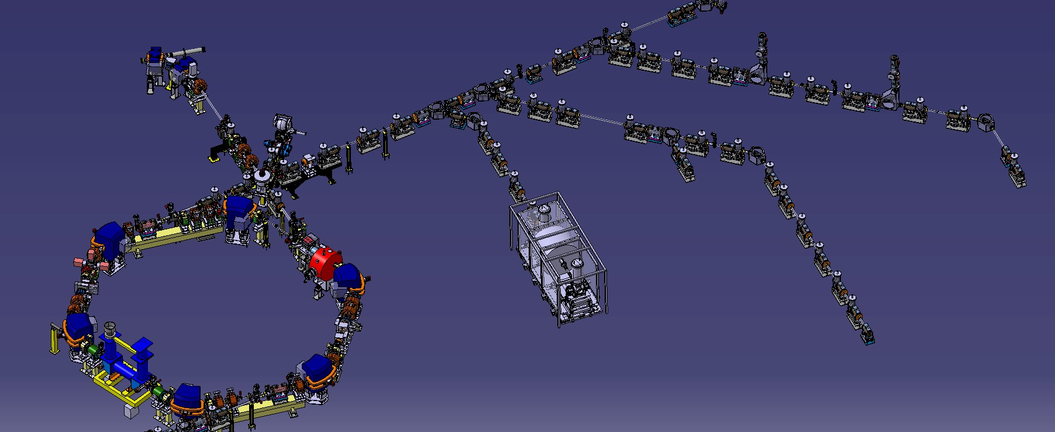
Progress on ELENA development 2019 and plans for 2020
C. Carli on behalf of the ELENA Team AD Users Committee, 10th December 2019
Situation about a year ago
Installation of transfer lines
Source and Isolation Transformer
Issues with Tune Kicker Repair
Electron Cooler
Profile Monitors
Analysis of Observations
Plans for 2020 and beyond
Summary and Outlook

Slide 2
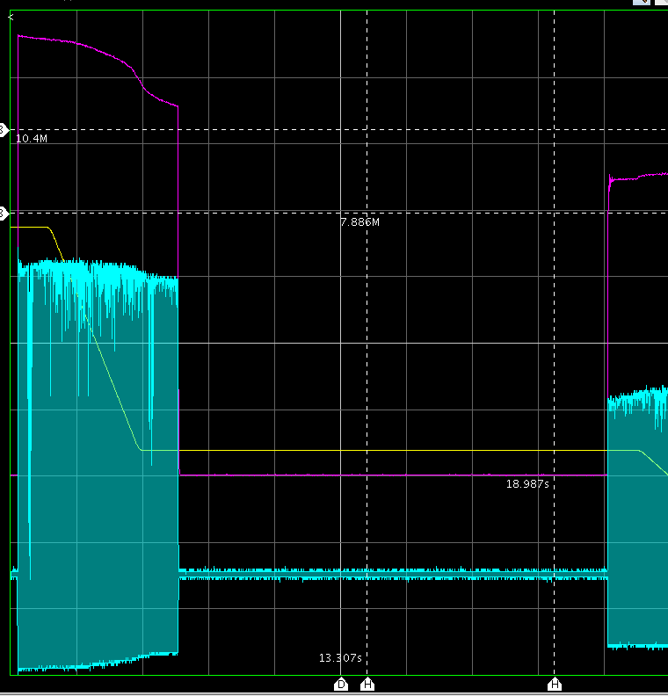
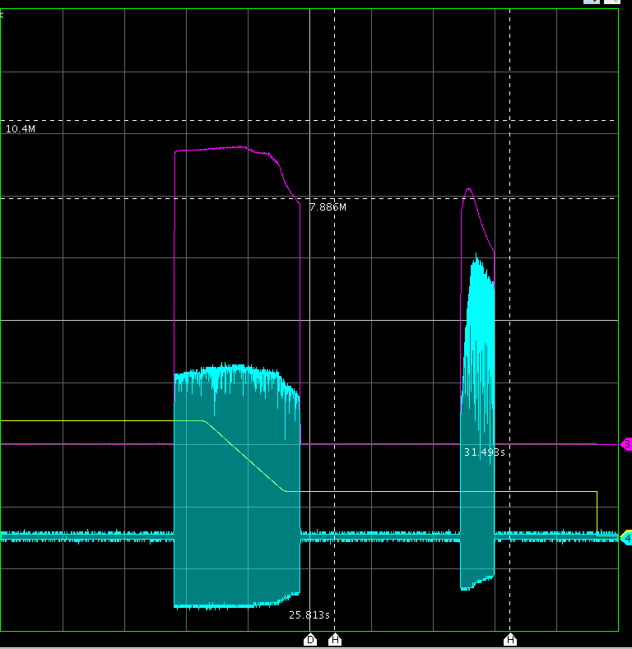
Situation about a Year ago
Finally promising results from commissioning with beam
  Not yet nominal beam parameters (in particular larger transverse emittances)
  Most progress made with antiprotons and not, as expected, with H⁻ from source
  Performance a clear improvement for experiments and potential for further improvements
  Whole ELENA cycle with beam (combining two acquisitions, 2nd with slightly higher intensity)
Decision to go ahead with installation of lines formally agreed at ADUC on 30th October 2018
Probably real loss – 2nd ramp not
priority during last weeks
Bunched beam
electron cooling
(increases pick-up
peak signal)
Cycle
Intensity estimate
from RF electronics
Peak signal of
pick-up sum signal
Four bunches generated
and extracted
2 s/div

Slide 3
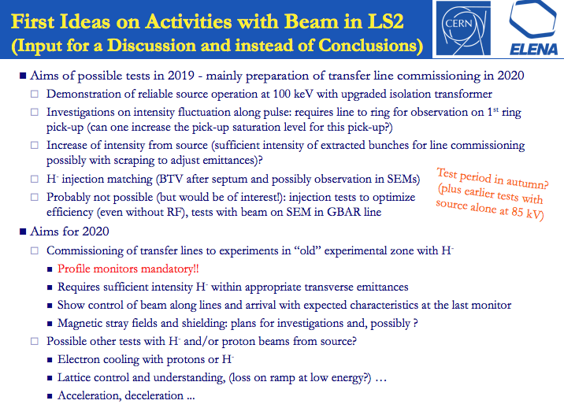
Situation about a Year ago
From an extended ECC meeting on 7th March
(https://indico.cern.ch/event/803767/)

Slide 4
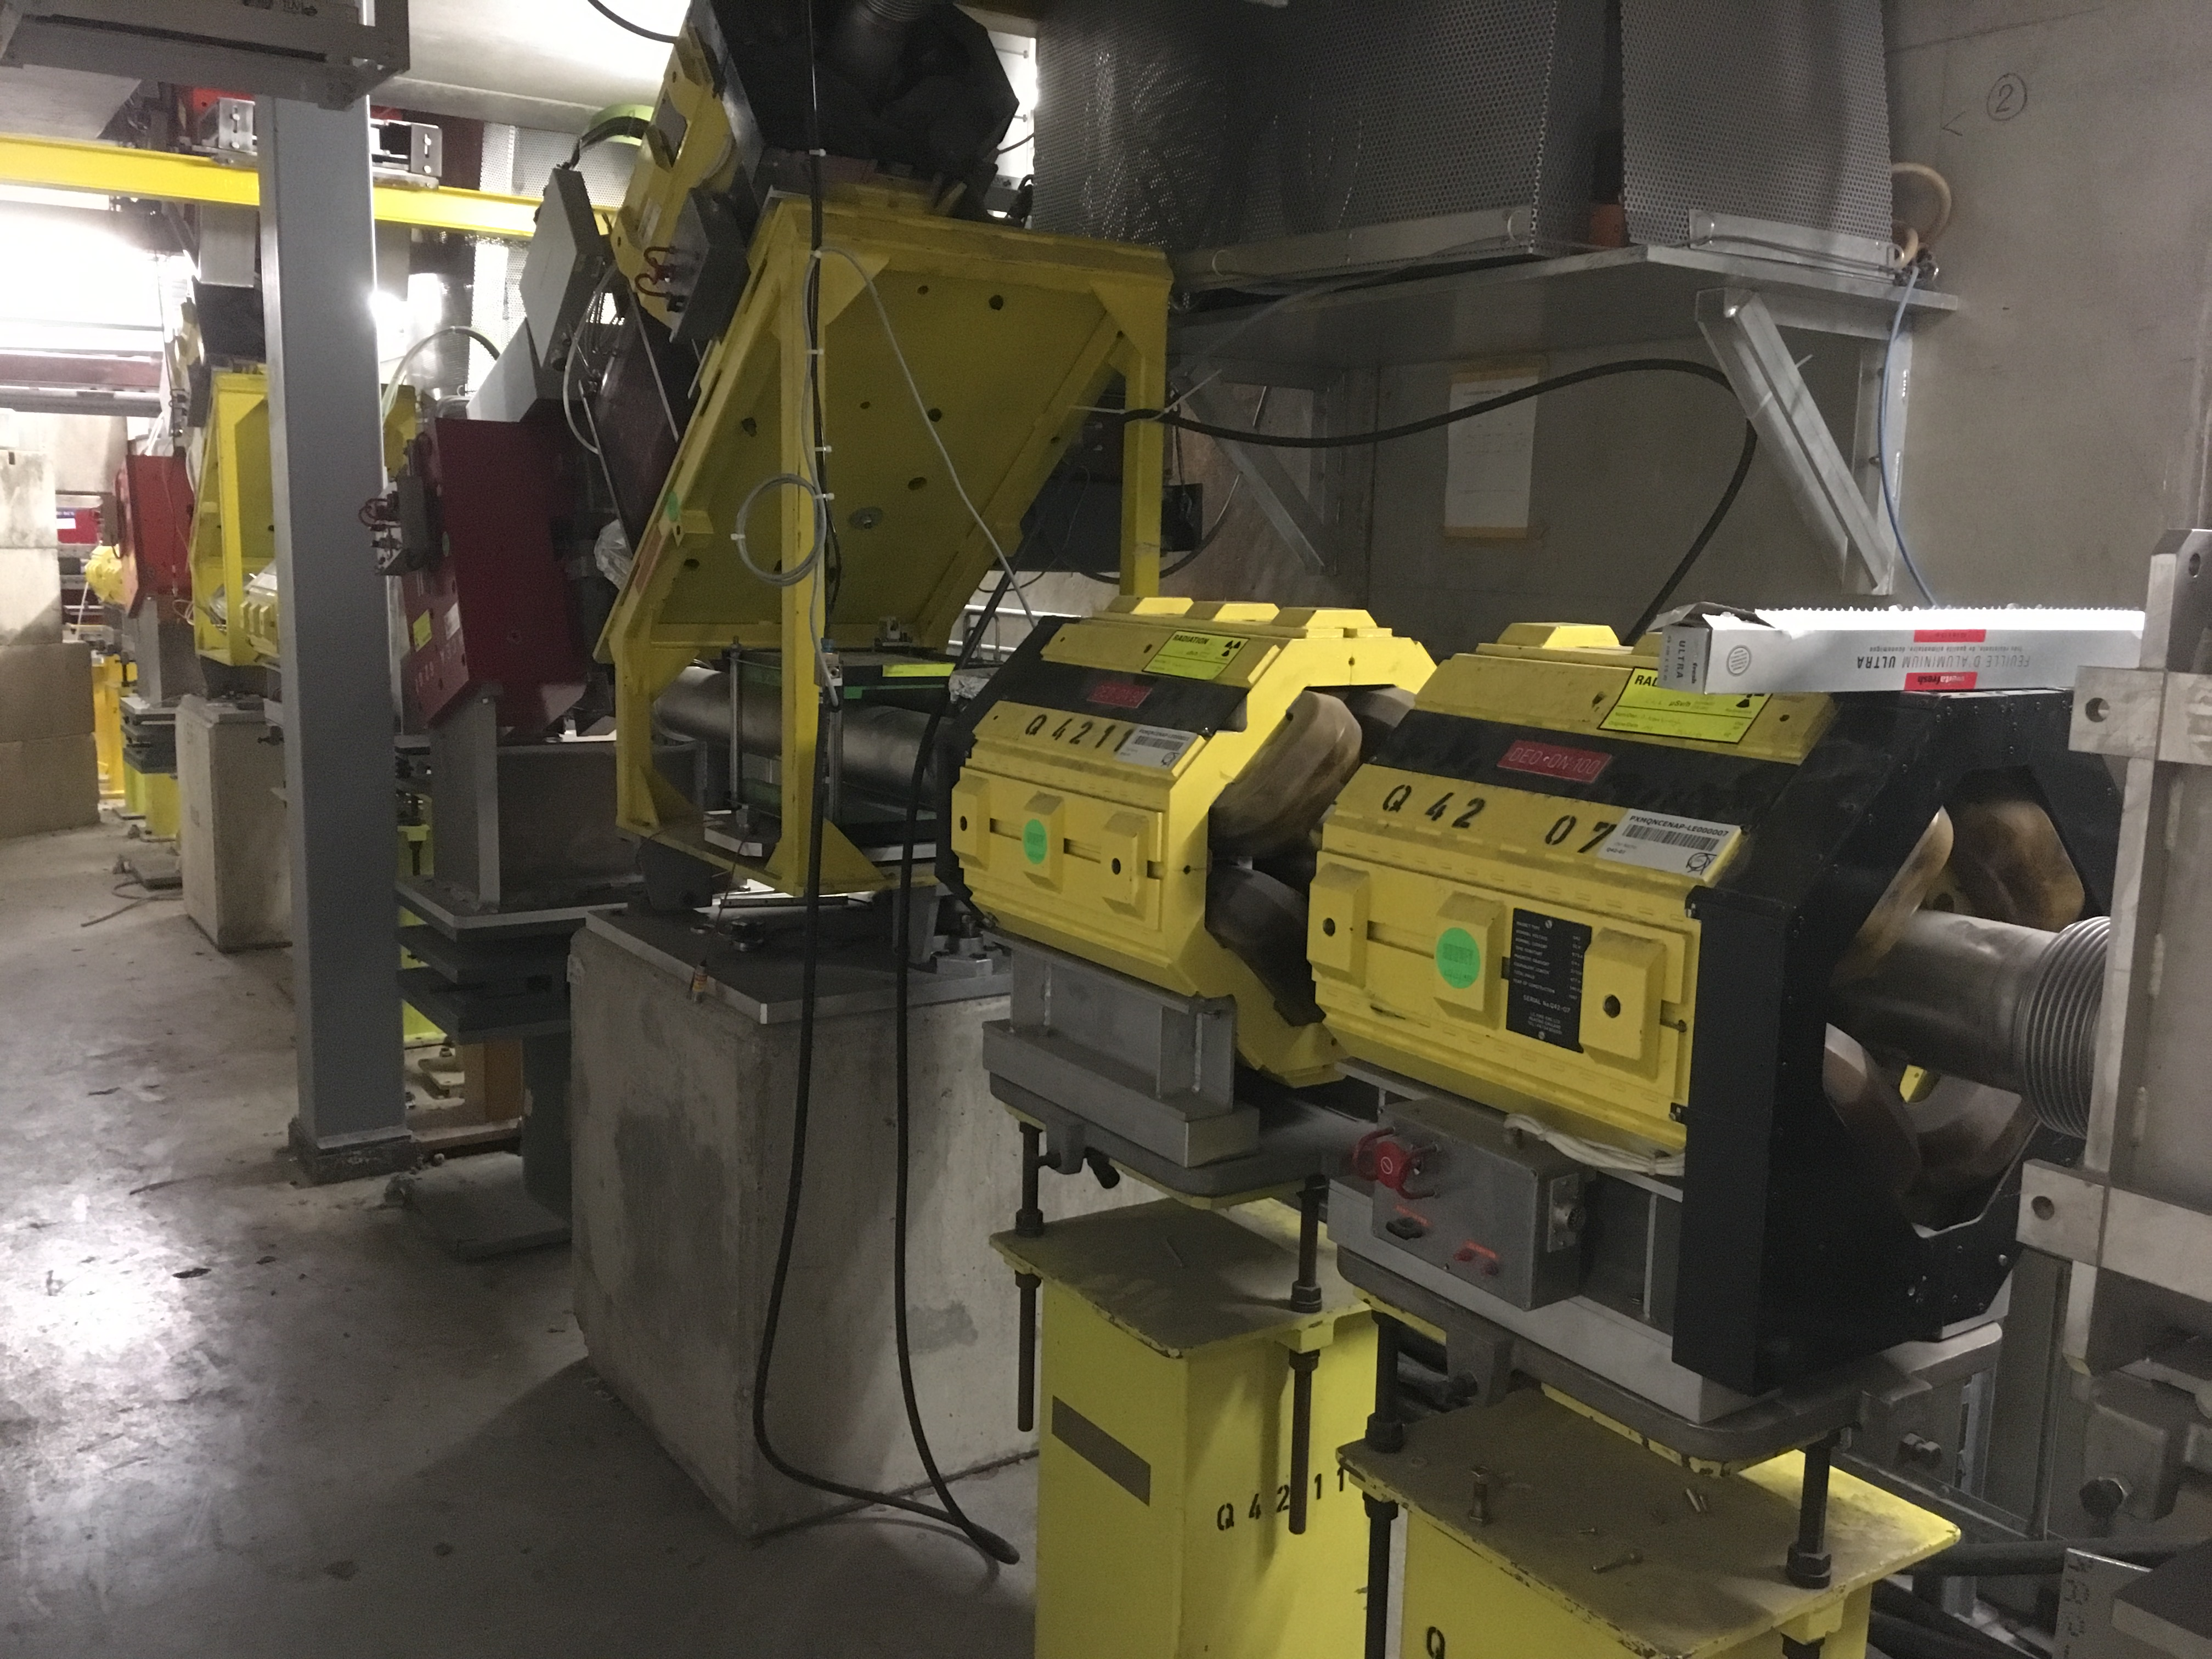
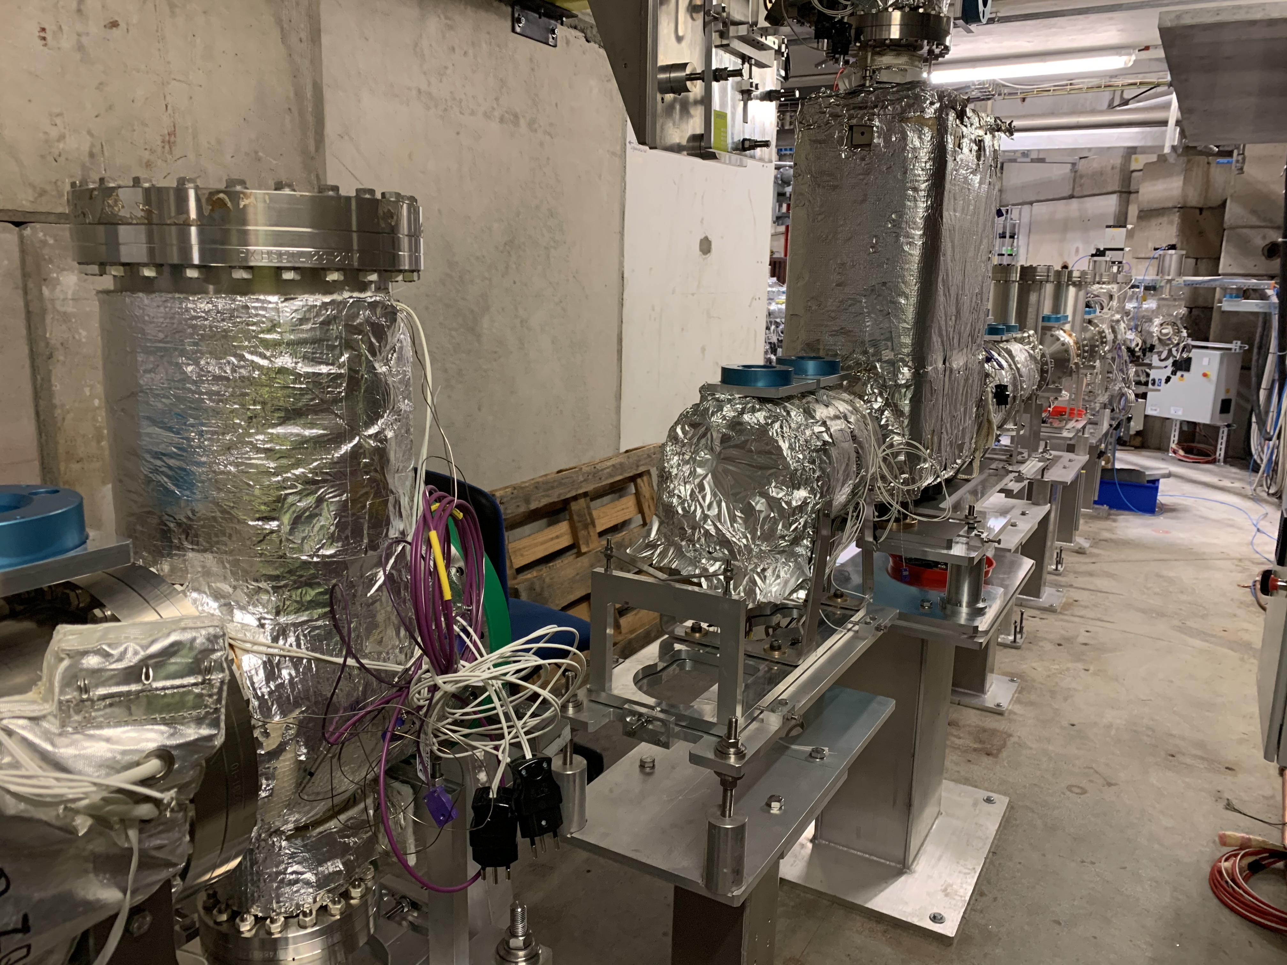
Installation of transfer lines
Beginning of 2020 with magnets
still installed
For all details, see dedicated
presentation by Francois
Autumn 2020 – most equipment
Installed, several profile monitors
missing
Main activity this year
Progressing well in spring
Some delay in autumn,
=> installation of many profile monitors and most bake-outs moved to 2020

Slide 5
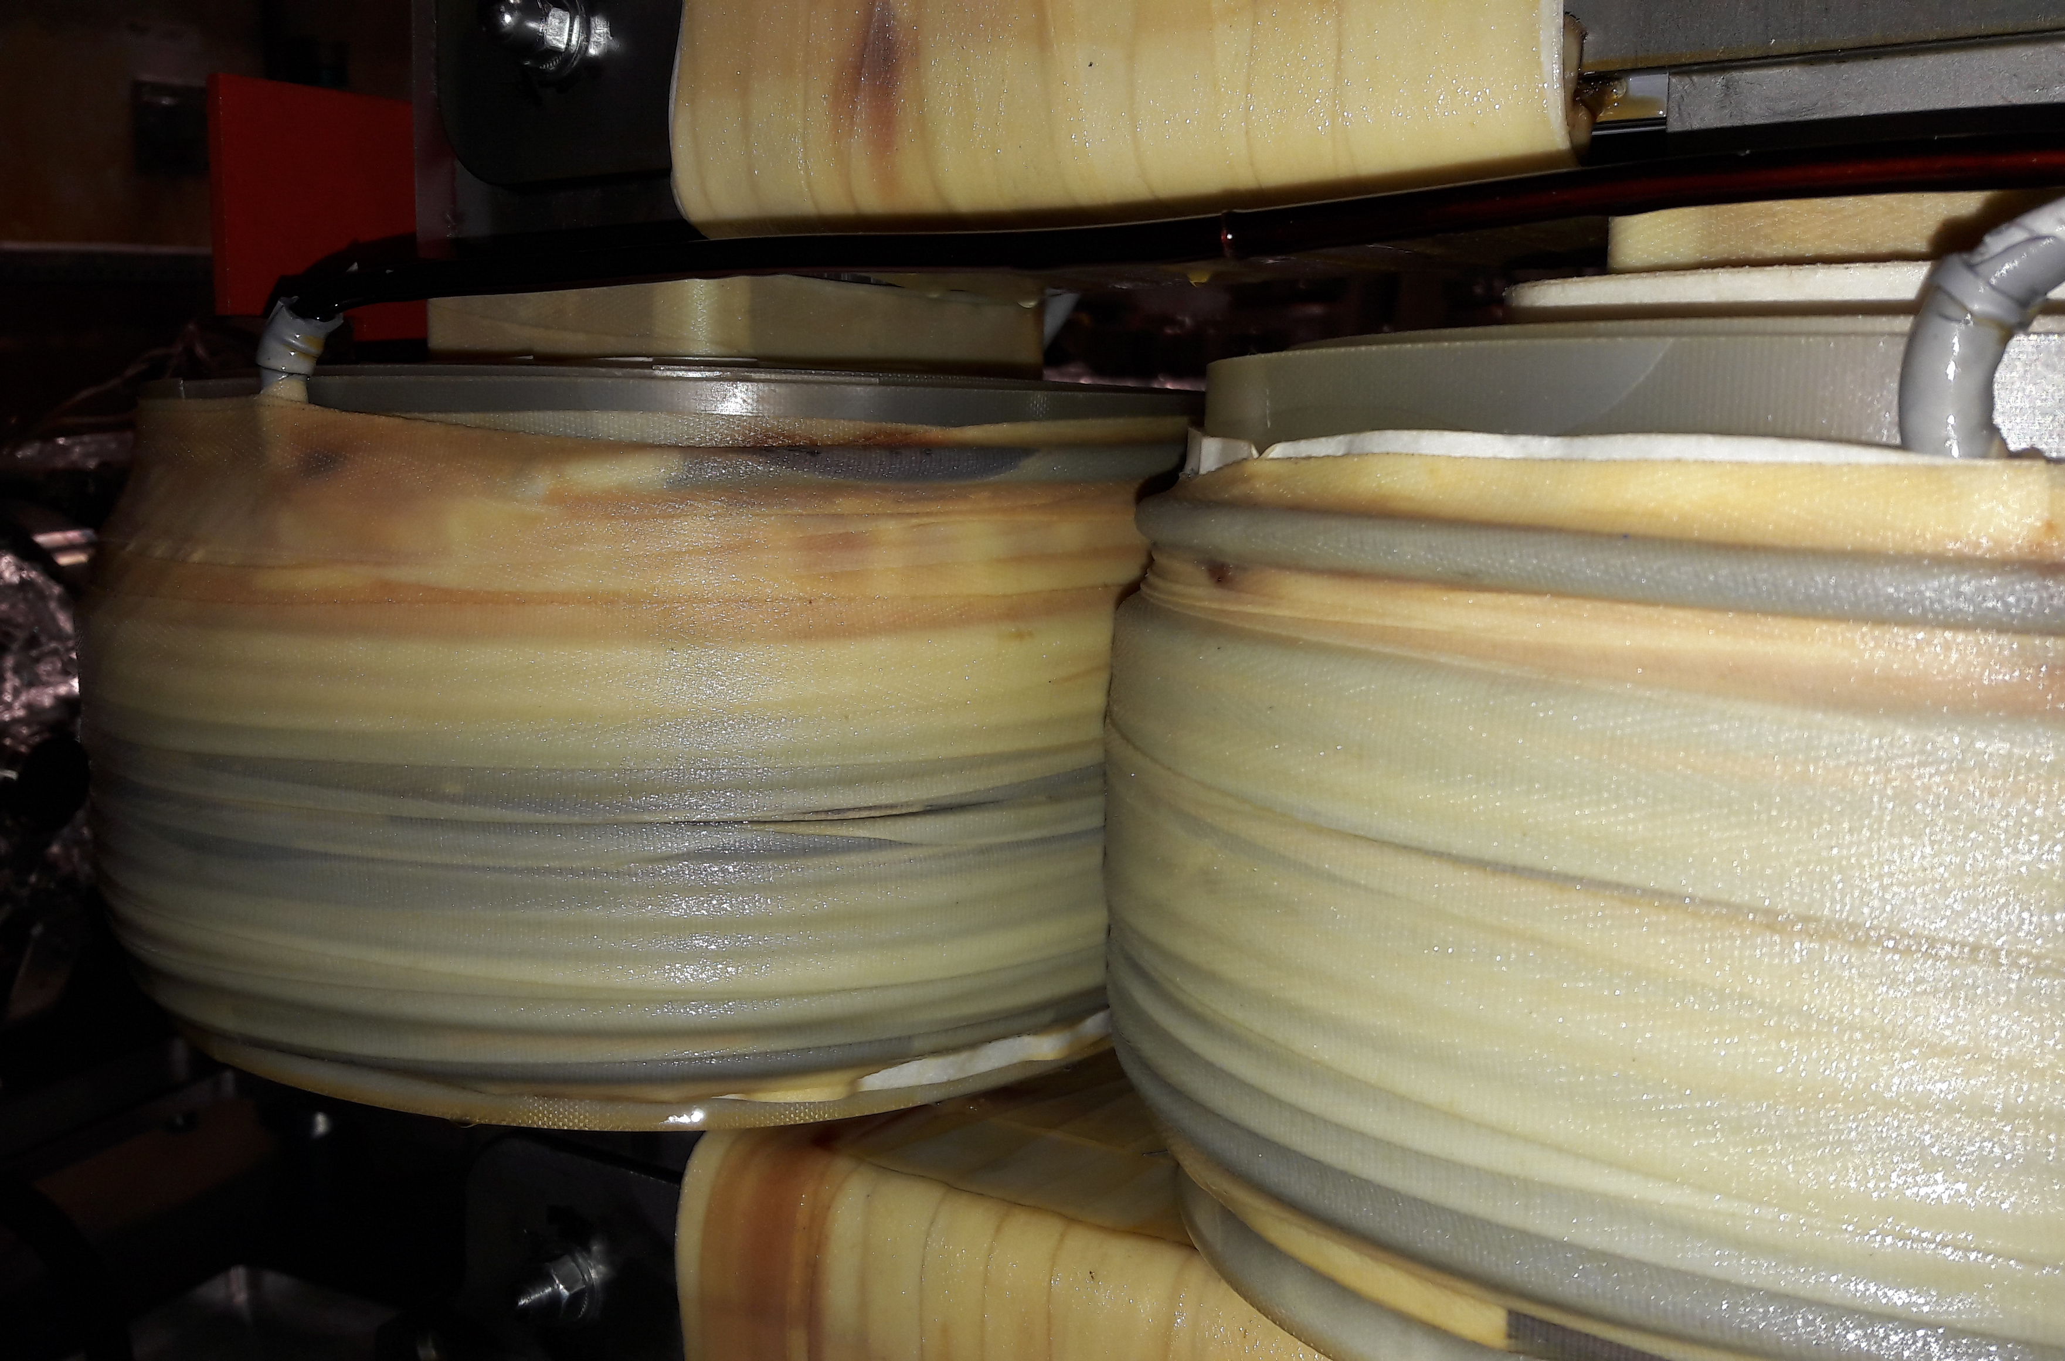
Source and Insulation Transformer
Many contributions by D. Aguglia, D. Gamba,
R. Gebel, B. Lefort, C. Machado, F.Wenander ….
Two more iterations with an insulation
transformer in an oil bath
Beginning of summer:
  New isolation transformer (design by
  company following CERN instructions)
  After first good results, sparks again
  (probably between secondary and yoke)
  Issue with last two windings of secondary
  Pulsing the HV shown to work to generate
  100 keV H⁻ and used for profile monitor tests
Since last week
  Another transformer arrived and installed
  Used already this week to generate beam in DC mode foreseen (recommendation by CERN experts), HV pulsing as back-up in case of troubles
Many studies, improvements and important findings on the ion source
Fluctuations along pulse from source seen last year confirmed
Studies on increase of beam current and fluctuations
along pulse with different source settings
Last winding closer to yoke than
expected – traces of carbonization?
For all details, see dedicated
presentation by Davide

Slide 6
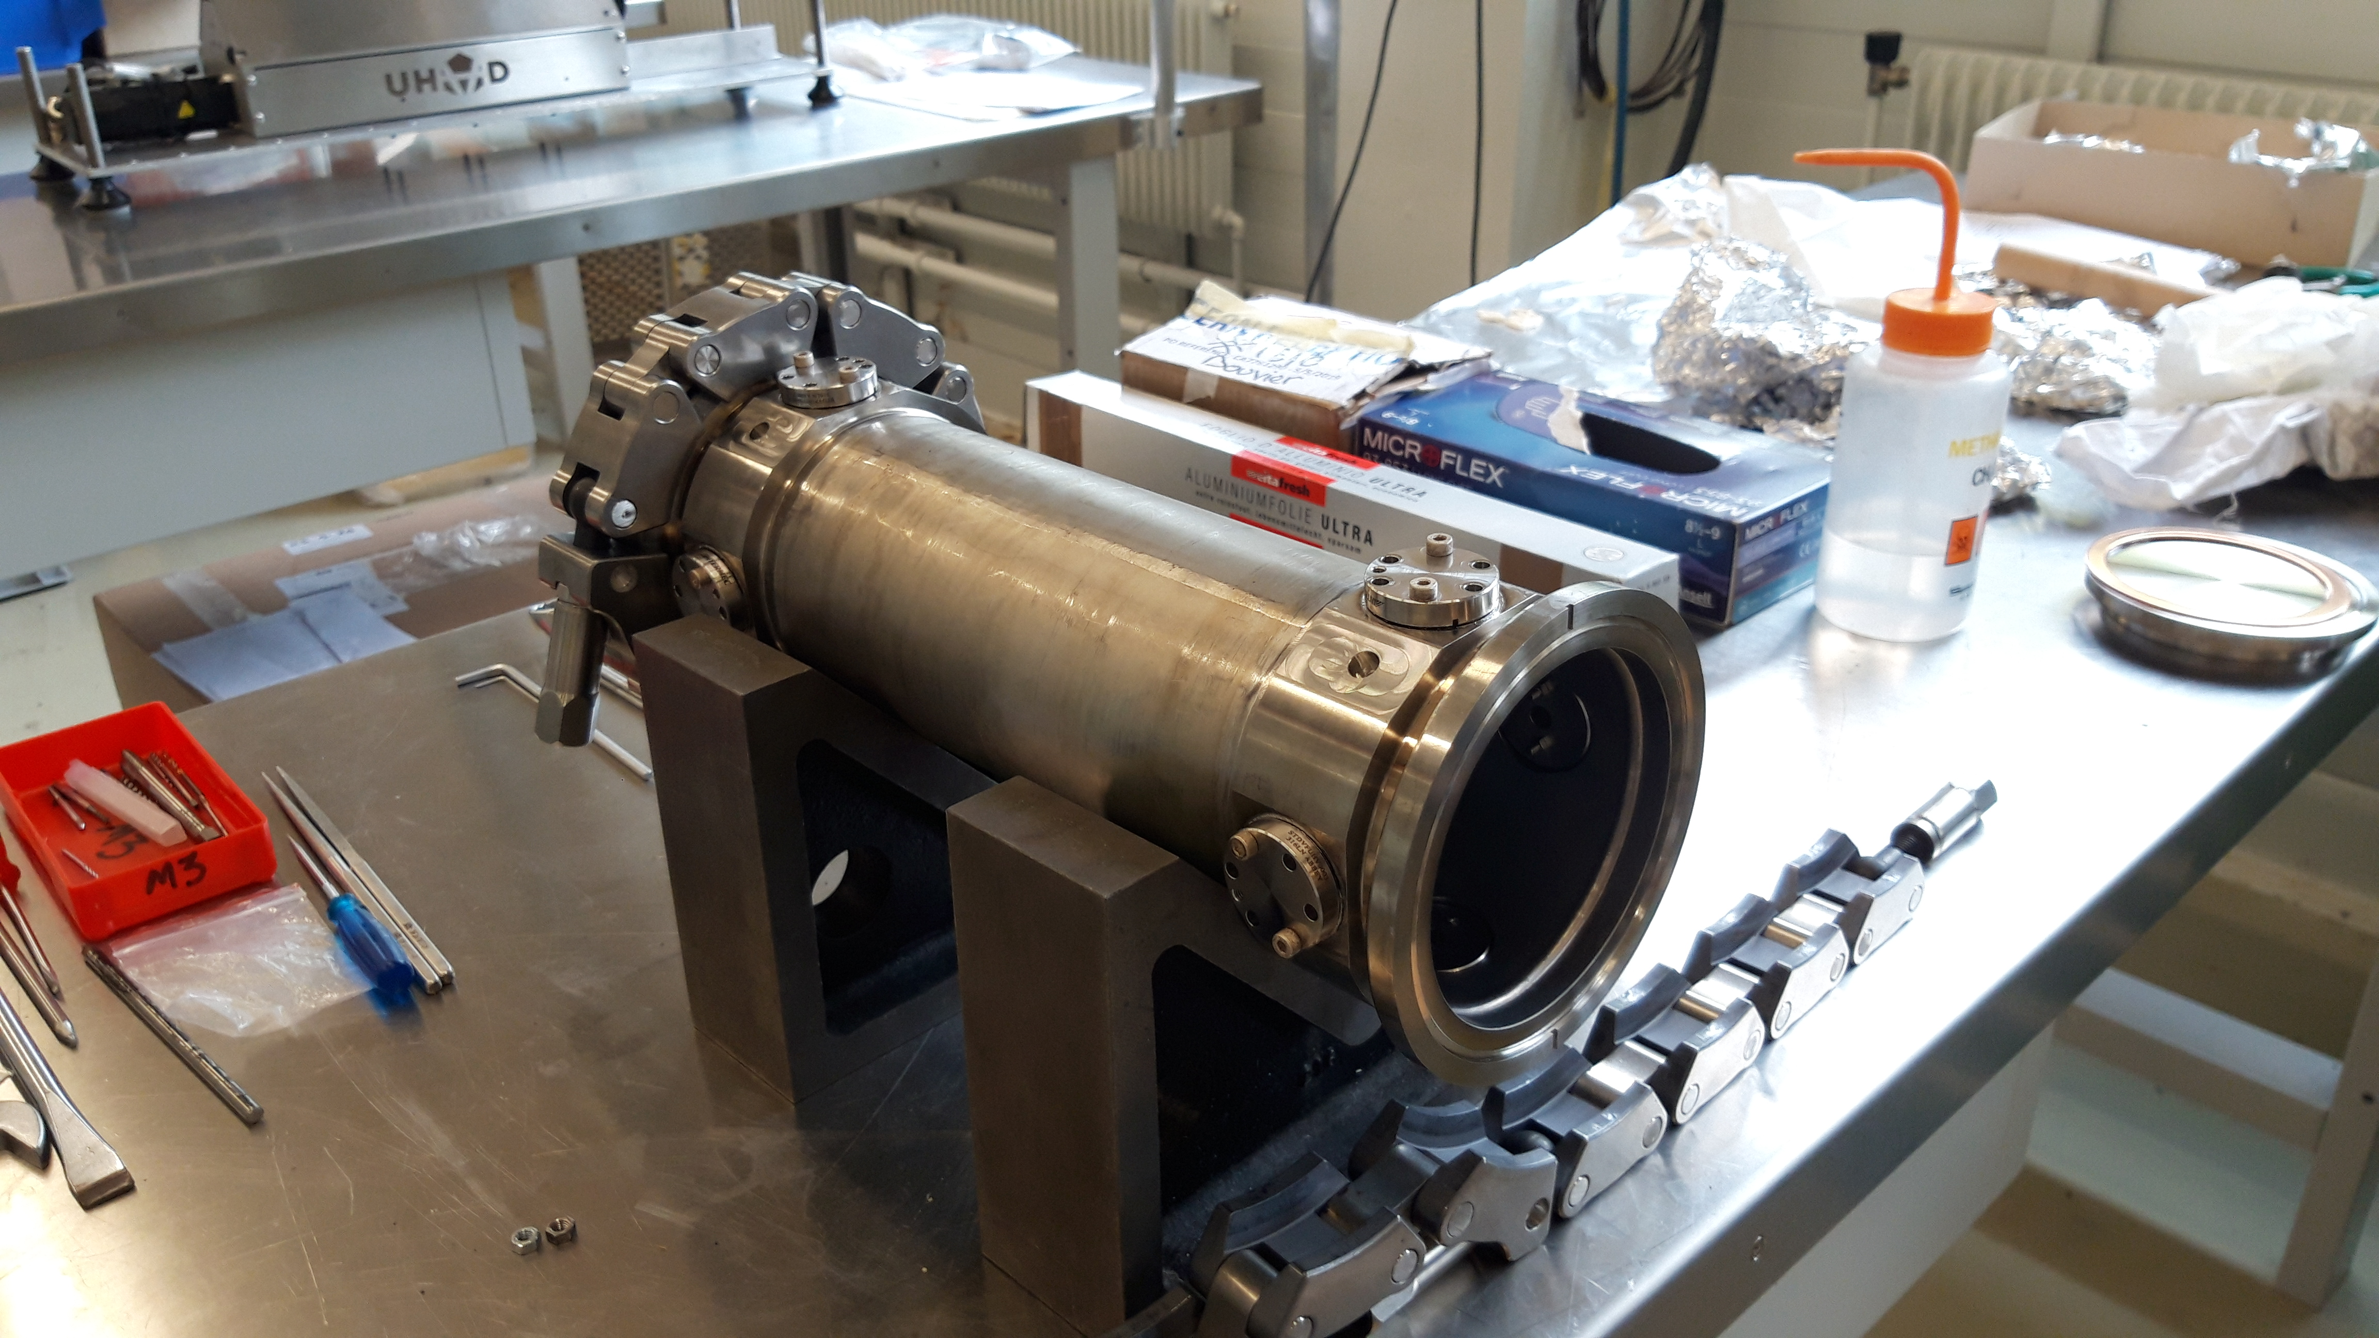
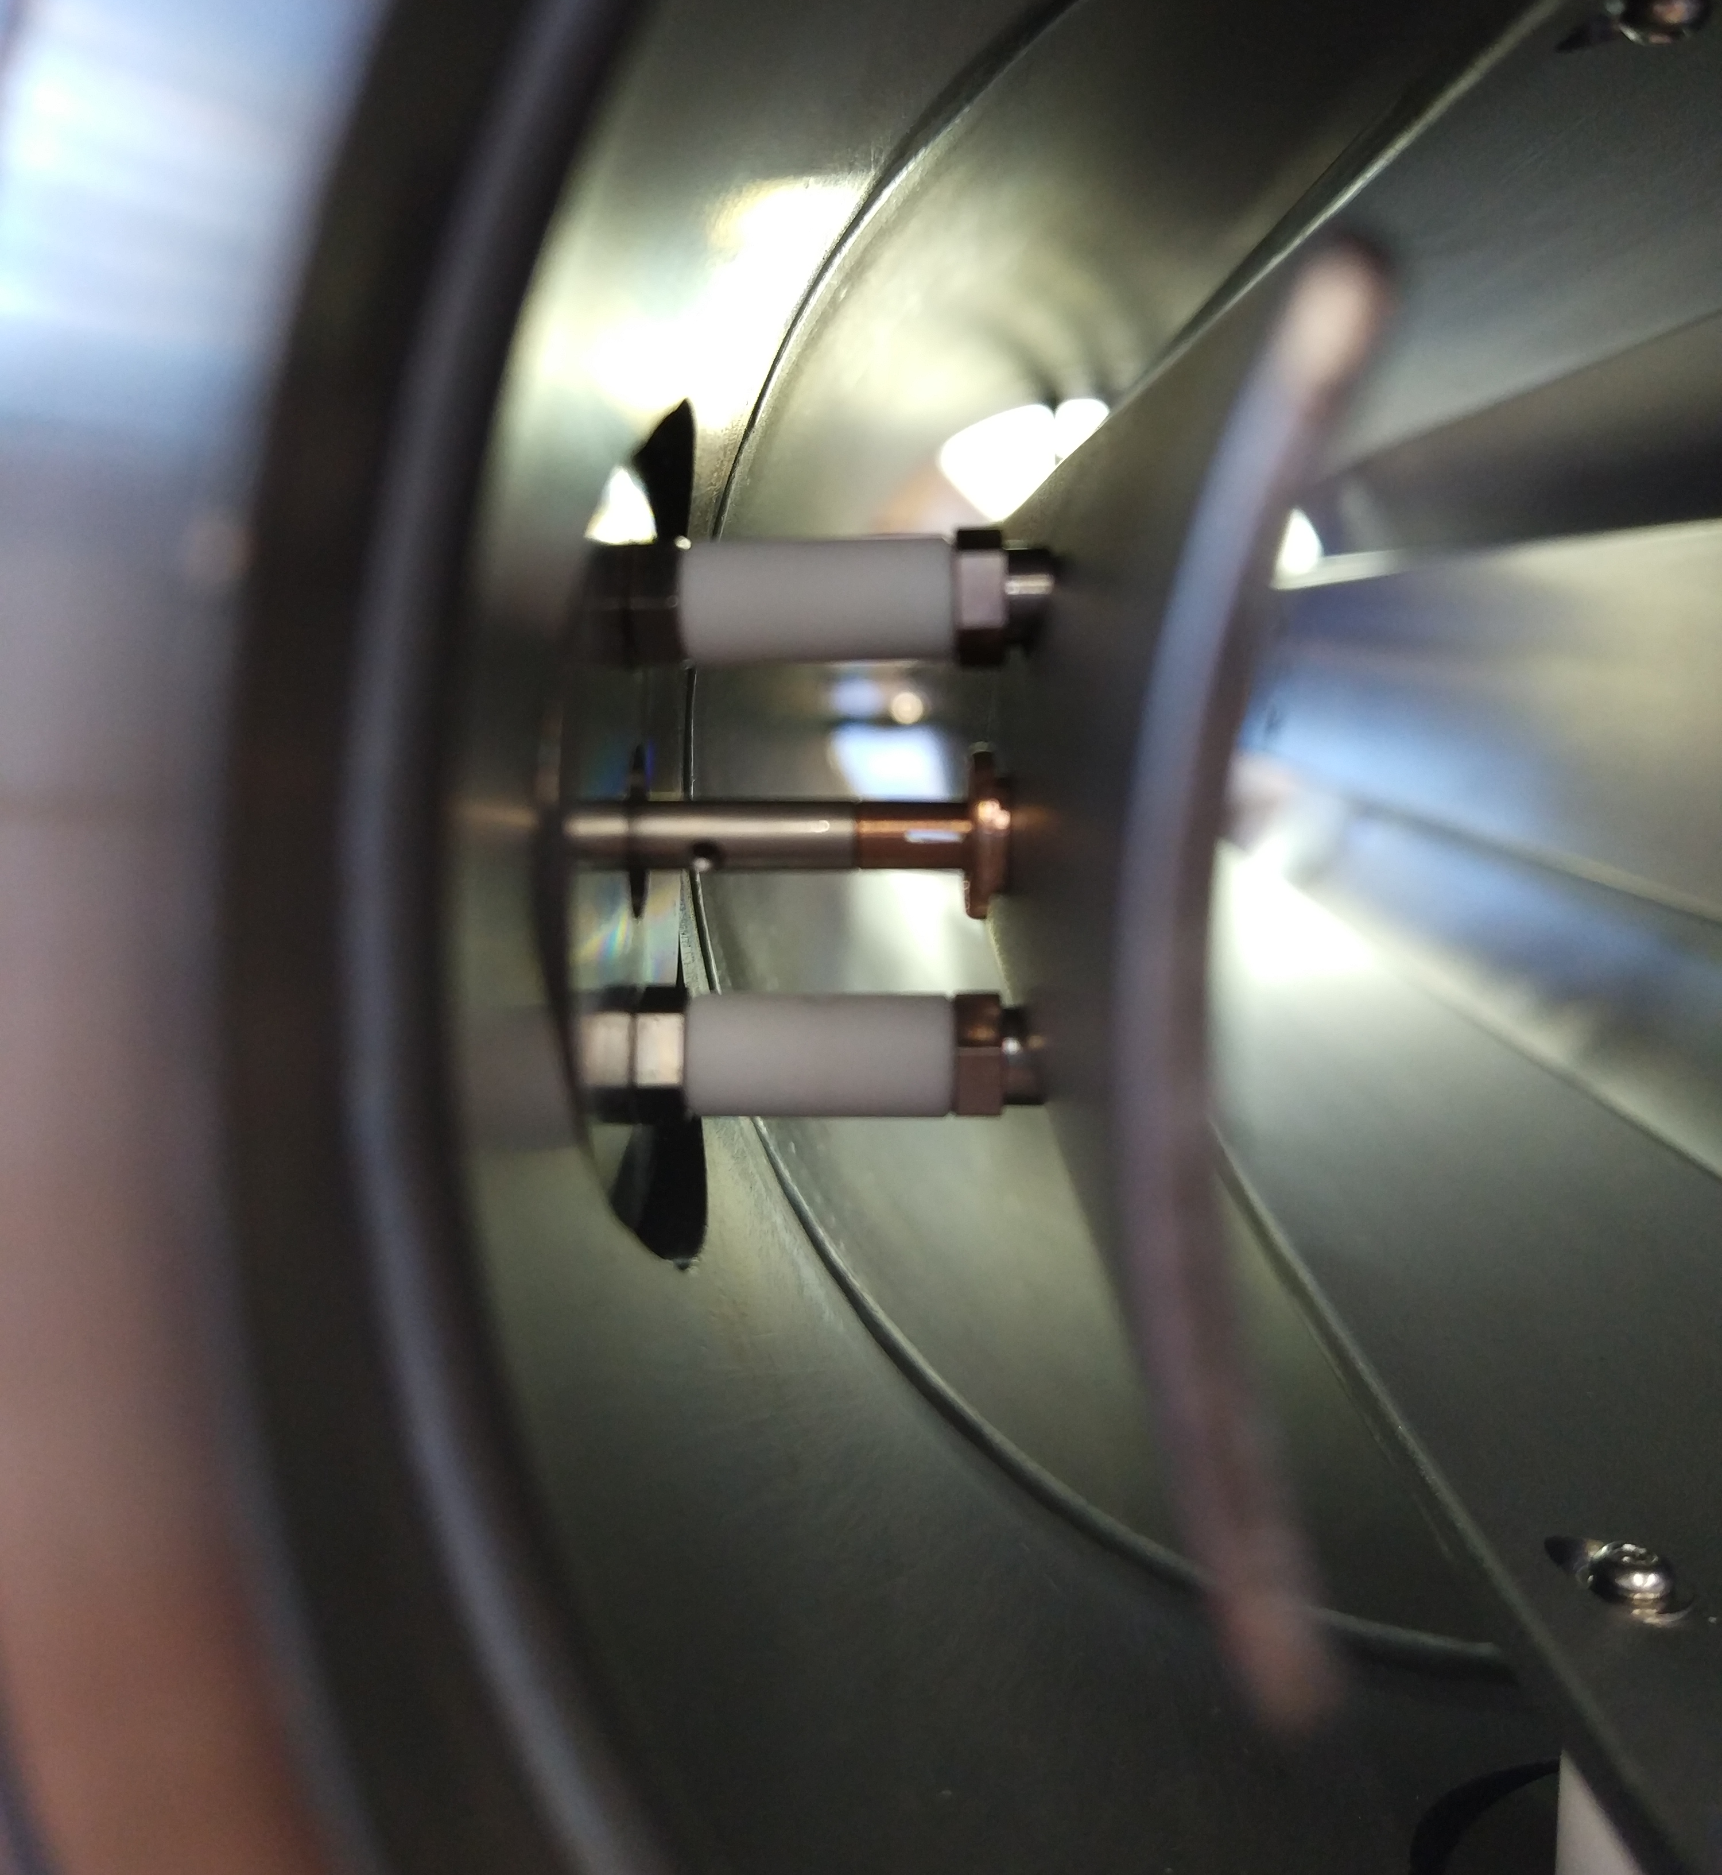
Issues with Tune Kicker Repair
Taken out for repair to replace electrode supports
(one electrode had detached from support)
  Incident (tap broken & stuck in threaded hole)
More series repair required (collaboration BE/BI, TE/VSC and main workshop
  Removal of piece and re-welding
  Was known to be risky for NEGs, pollution by hydrocarbons identified in vacuum acceptance tests
Repair, installation and bake-out completed since last Friday
  Ring closed and available again, but without RF system for RP
  Tune kicker finally available earlier than replacement chamber prepared in parallel!

Slide 7
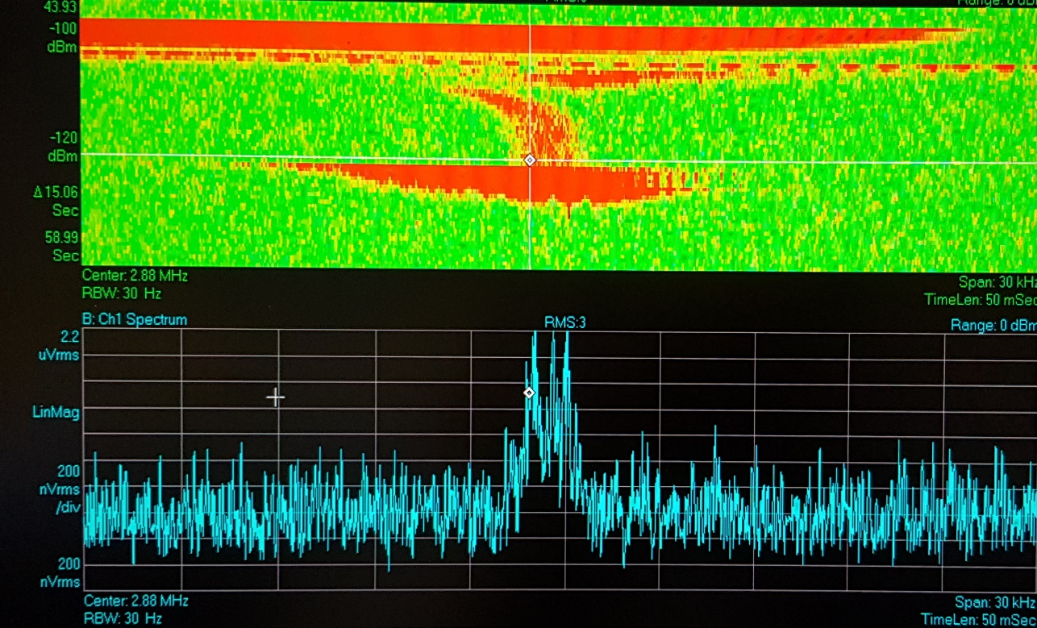
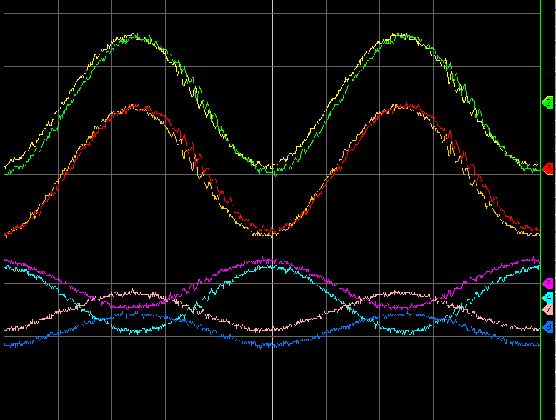
Electron Cooler
Recap: Cooling in all three planes and
at both energies observed in 2018
  Fundamental to show that ELENA
  is an improvement for experiments
  Lack of time for thorough (empirical)
  optimizations (more effort than expected
  required for magnetic cycle)
  Potential for performance improvements
  (compared to 2018 results)
Electron position
measurement implemented
during 2019
  Modulation of electron beam
  Electron beam position from ratio
  between sum and difference signals
  =>Beam position of circulating beam and
  electrons measured with same PU
  =>More efficient alignment (position
  and angle) of circulating pbars w.r.t.
  electron beam from next restart on
Time
Duration ~ 5s
Frequency or momentum
Long.Schottky spectrum during cooling @ 100 keV
PU sum signals with electron
beam modulation - all four
(two planes at two locations)
signals similar
PU difference
signals
2 us/div

Slide 8
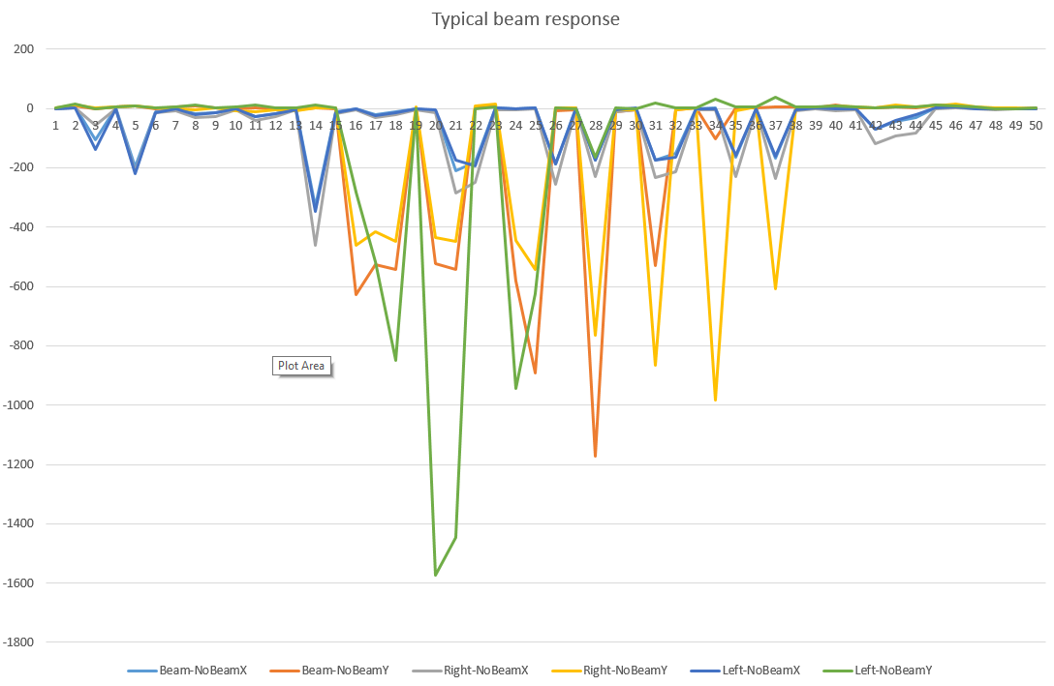
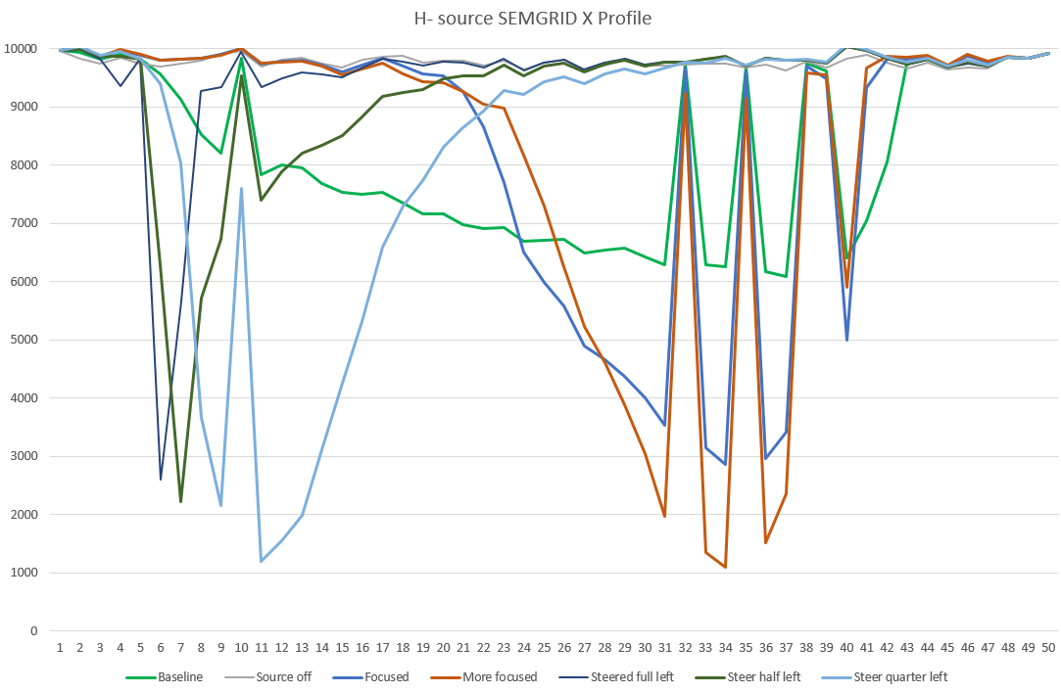
Profile Monitors for Lines
Recap:
  Technically very interesting and impressive in-kind contribution
  More and more taken over by BE/BI
    Starting with the mounting of the monitors,
    Recently contributions to to electronics, revision of FPGA code, tests with beam, …
Tests with beam using the second but last front-end electronics prototype
Example of profiles measured (on a monitor in the line from the source to the ring)
  Signal generated by beam (effect of steering, beam on/off, quads settings seen )
  Many missing channels for monitor in GBAR and two monitors in source to ring lines
  Two monitors in GBAR have few missing channels (similar to last year)
Still a lot of work to be done: completion and installation of monitors, test of last prototype front-end electronics, electronics mass productions, missing channel issue, testing of installed monitors
See dedicated
presentation by Mark
Expertise to use and
program electronics
now in BE/BI ☺

Slide 9
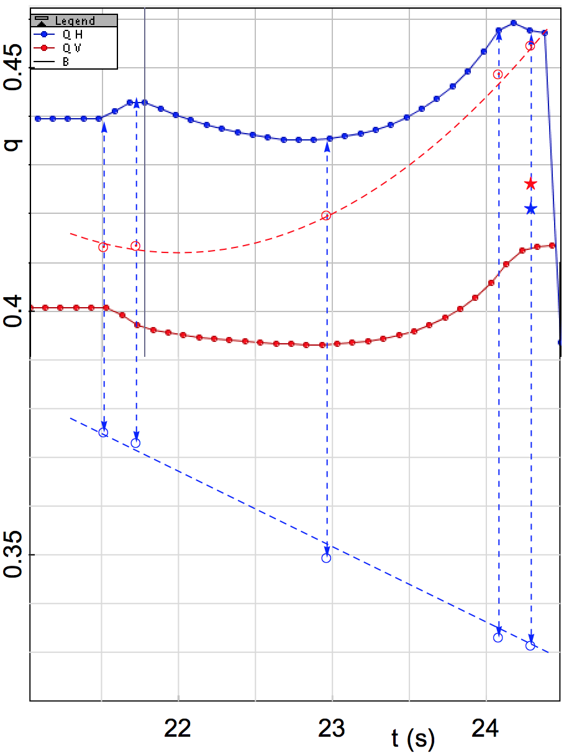
Analysis of observations and improvements of tools
Q_{H}=2.444, Q_{V}=1.397
Q_{H}=2.457
Q_{V}=1.413
From currents plus about 5 times
the expected Hysteresis
Q_{H}=2.439
Q_{V}=1.401
Q_{H}=2.459
Q_{V}=1.412
Q_{H}=2.435
Q_{V}=1.393
Offset between measured and expected (from model) tunes increase along 2nd ramp
  Possibly due to hysteresis (even though expected hysteresis not sufficient)?
  Larger effect at 100 keV than seen in 2016 with H⁻ coherent injection oscillations
  Dispersion from model increases as well from about 1m to about 1.7 m …
Many discussions on magnetic cycle editing with a new program available
  Programming directly tunes
  Very flexible!
From programmed currents
and model without hysteresis
(added to plot from Q-meter)
Comparison of tunes from measurements (on last beam day by Laurette) with expectations from currents

Slide 10
Plans for 2020 and beyond
Plans for 2020
  January to March: cabling campaign - other activities (bake-outs, tests with beam) unlikely
  April to June: bake outs (TE/VSC manpower needed) and cable connections
    Compatible with tests with beam of source, injection … (probably no RF at most/all of the time)
  July until end of year: transfer line commissioning with H⁻
    Details to be worked out (extended ELENA Commissioning Committee meeting again?)
    Profile monitors mandatory (review of situation by March)!!
    Show control of beam along lines and arrival with expected characteristics at the last monitor
    Sufficient H⁻ intensity within appropriate emittances (studies on increase of current from source)
    Magnetic stray fields and shielding: investigations and, if needed, implementation of shielding
    Optional depending on progress: other tests to better understand machine optics and cooling
Beyond 2020 (dates from 1st version of LHC injector schedule 2021)
  Restart of ELENA with H⁻ ions on 1st February
    Depending on progress made in 2020, completion of
    commissioning of lines, acceleration/deceleration,
  AD production beam on target on 22nd March
    Commissioning of new target and AD re-commissioning after a long shutdown
  Antiproton beam to ELENA on 19th April
  Start of physics with 100 keV antiprotons from ELENA on 10th May
Discussions on schedule
for 2021 starting
=> dates preliminary

Slide 11
Summary and Outlook
Aims for 2019: preparation of transfer line commissioning in 2020
  Most installation work for transfer lines done, some delays due to, amongst others, profile monitors
    Most bake-outs delayed to next year
  Two more iterations of isolation transformer in oil bath – solid solution implemented (?)
  Less tests with beam due to various issues (mainly isolation transformer and tune kicker)
    Nevertheless interesting observations on source (fluctuations, intensity, …) and profile monitors
    Still some hope for studies this week (injection matching, few turns in ring … profile monitor …)
Aims for 2020
  Completion of preparations for transfer line commissioning (cabling, bake-outs ..)
  Commissioning of transfer lines to experiments in “old” experimental zone with H⁻
    Profile monitors mandatory!!
    Show control of beam along lines and arrival with expected characteristics at the last monitor
    Magnetic stray fields and shielding: plans for investigations and, possibly ?
  Possible other tests with H⁻ and/or proton beams from source?
    Electron cooling with protons or H⁻
    Lattice control and understanding, (loss on ramp at low energy?) …
    Acceleration, deceleration ...
First 100 keV antiprotons from ELENA for experiments expected in May 2021

