Slide 1


AD-CONS / ELENA Projects
AD- CONS project status

Slide 2
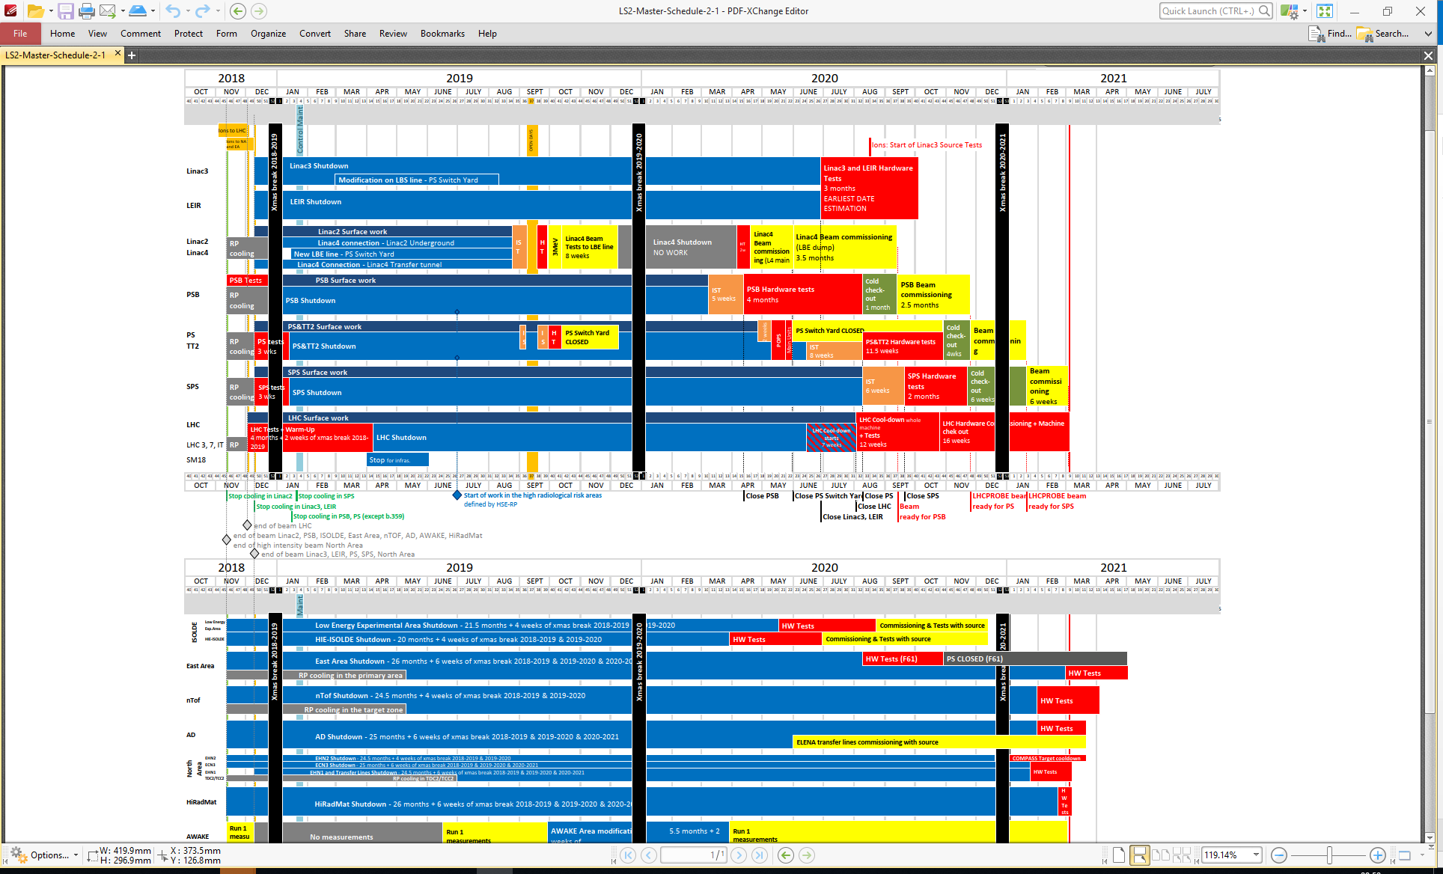
PS / AD target / AD ring / ELENA ring / TLs coordination
Mid March 2021
PS beam on AD target
Early May 2021
Start of Physics
PS
AD
July 2020
Start of ELENA
TL’s commissioning
Feb 2021
AD target HW test
Mid April 2021
Pbars in ELENA
LS2 works critical path items:
AD ring : new e-cooler collector / vacuum bake-out
ELENA ring: ion source / HV transformer
ELENA transfer lines: Secondary Emission Monitors (SEM)

Slide 3
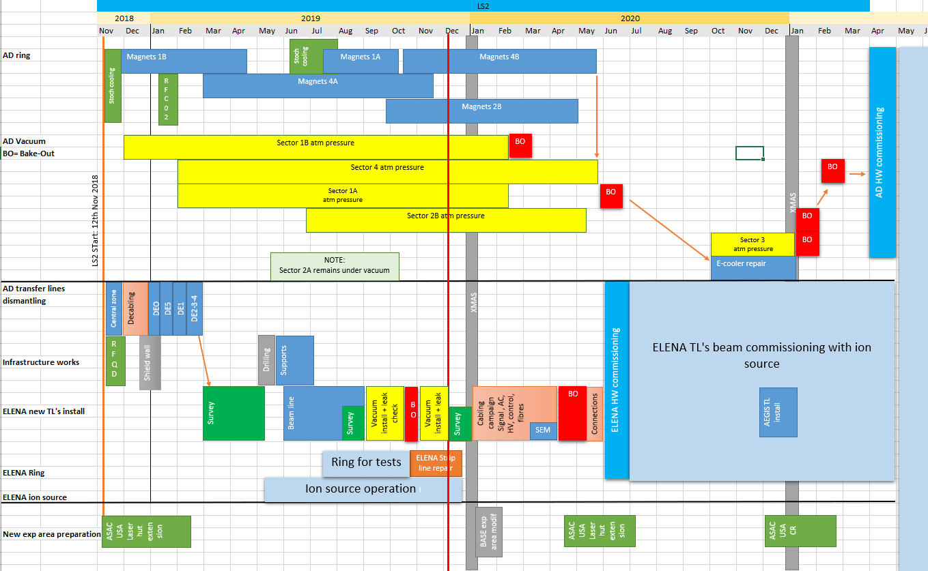
LS2 simplified schedule

Slide 4
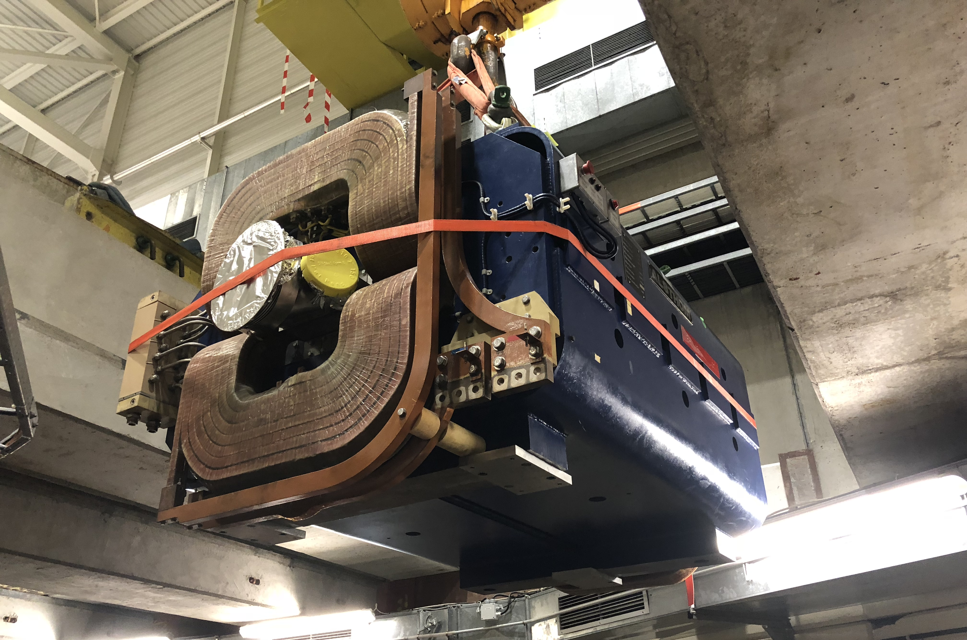
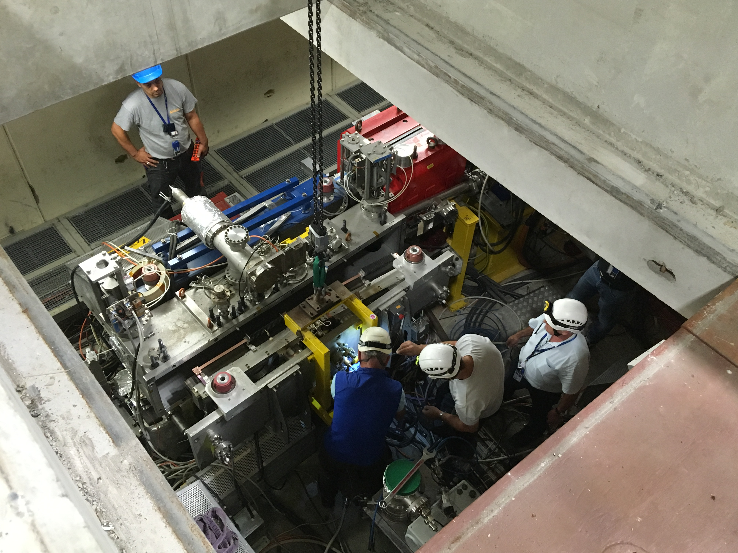
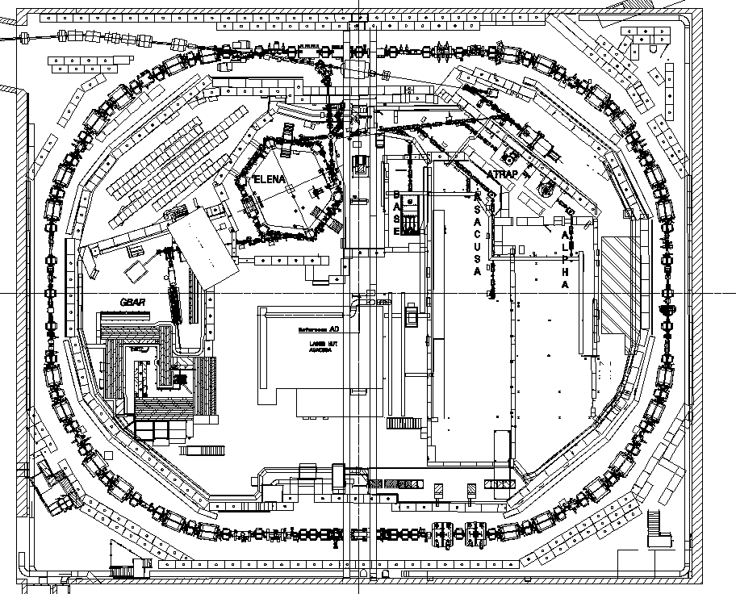
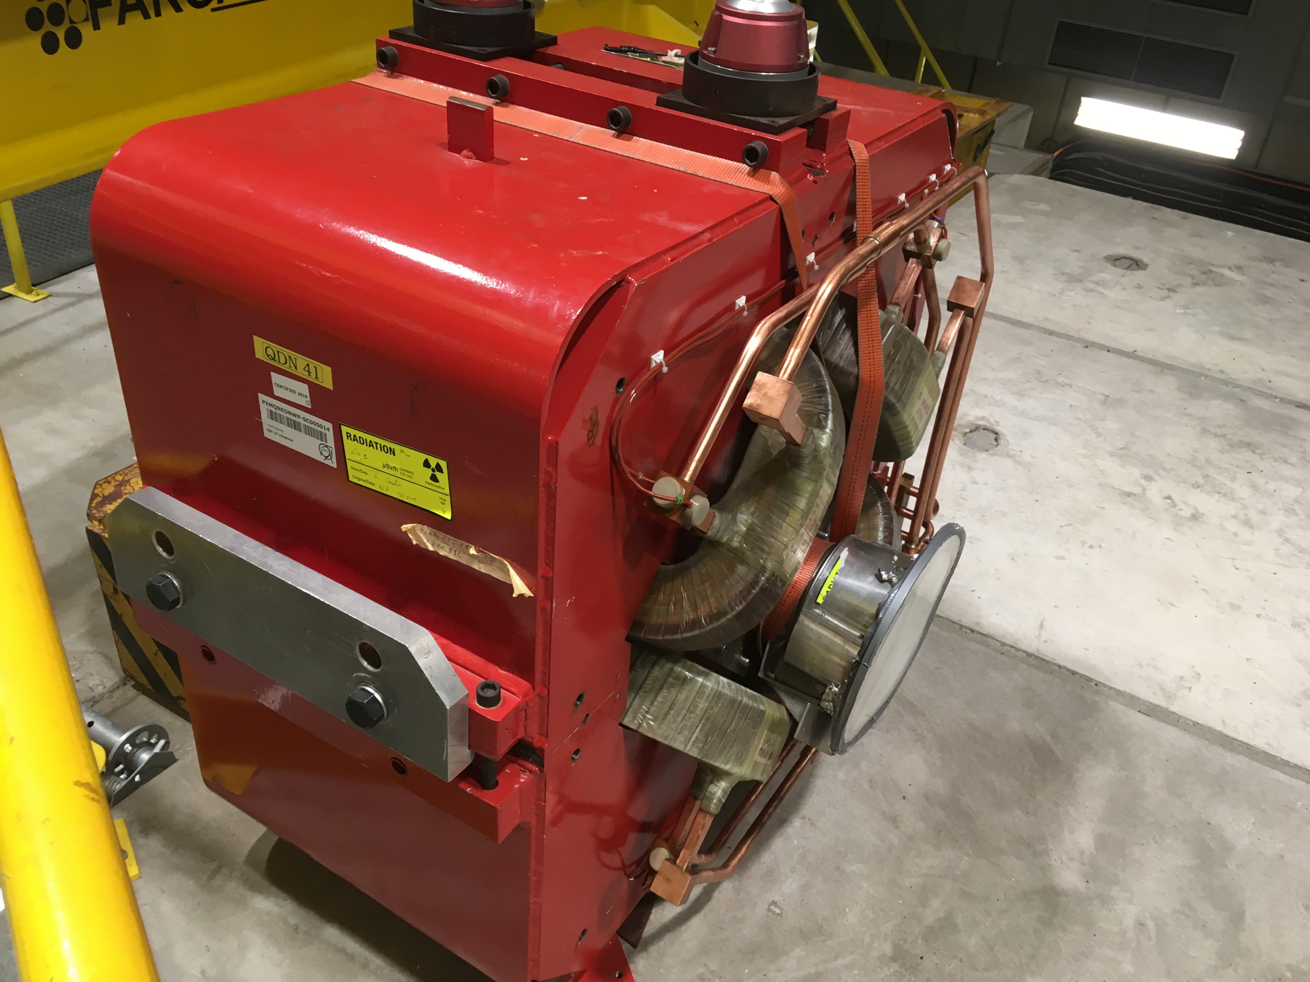
LS2 AD-CONS program (1)
1 bending + 1 quad + 1 septum
1 Beam stopper + 2 slits removal
RF C02 cavity swap
1 bending + 4 quads
1 bending + 1 quad
3 quads
1 bending
3 weeks ahead of schedule
See https://indico.cern.ch/event/867869/
2 bending
1 (2 ?) bending
E-cooler collector swap

Slide 5
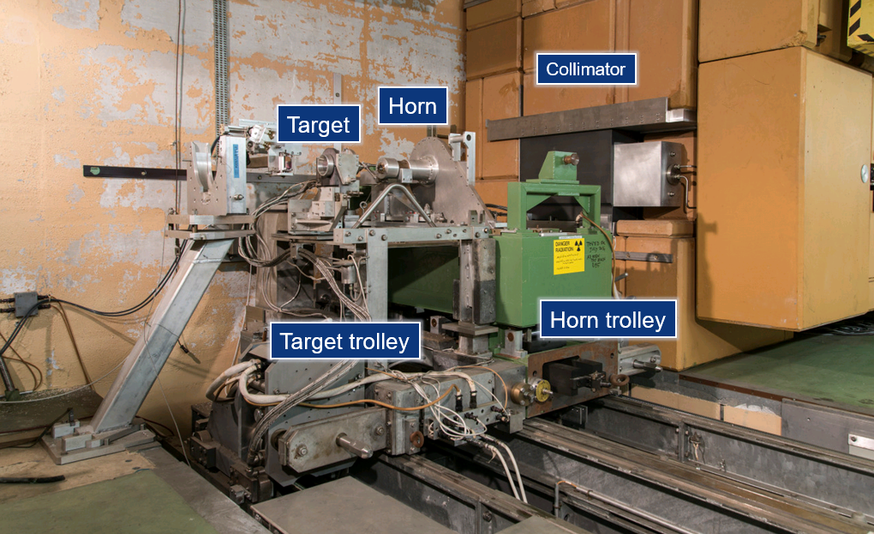
LS2 AD-CONS program (2)
AD target: good progress
Details: https://indico.cern.ch/event/867025/
BEAM FROM PS
Courtesy: S. De Man

Slide 6
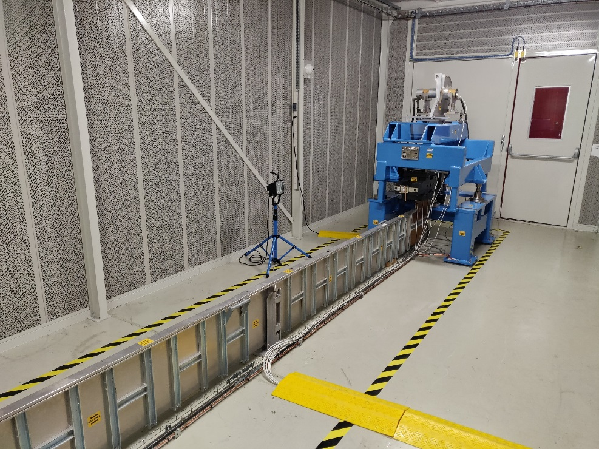
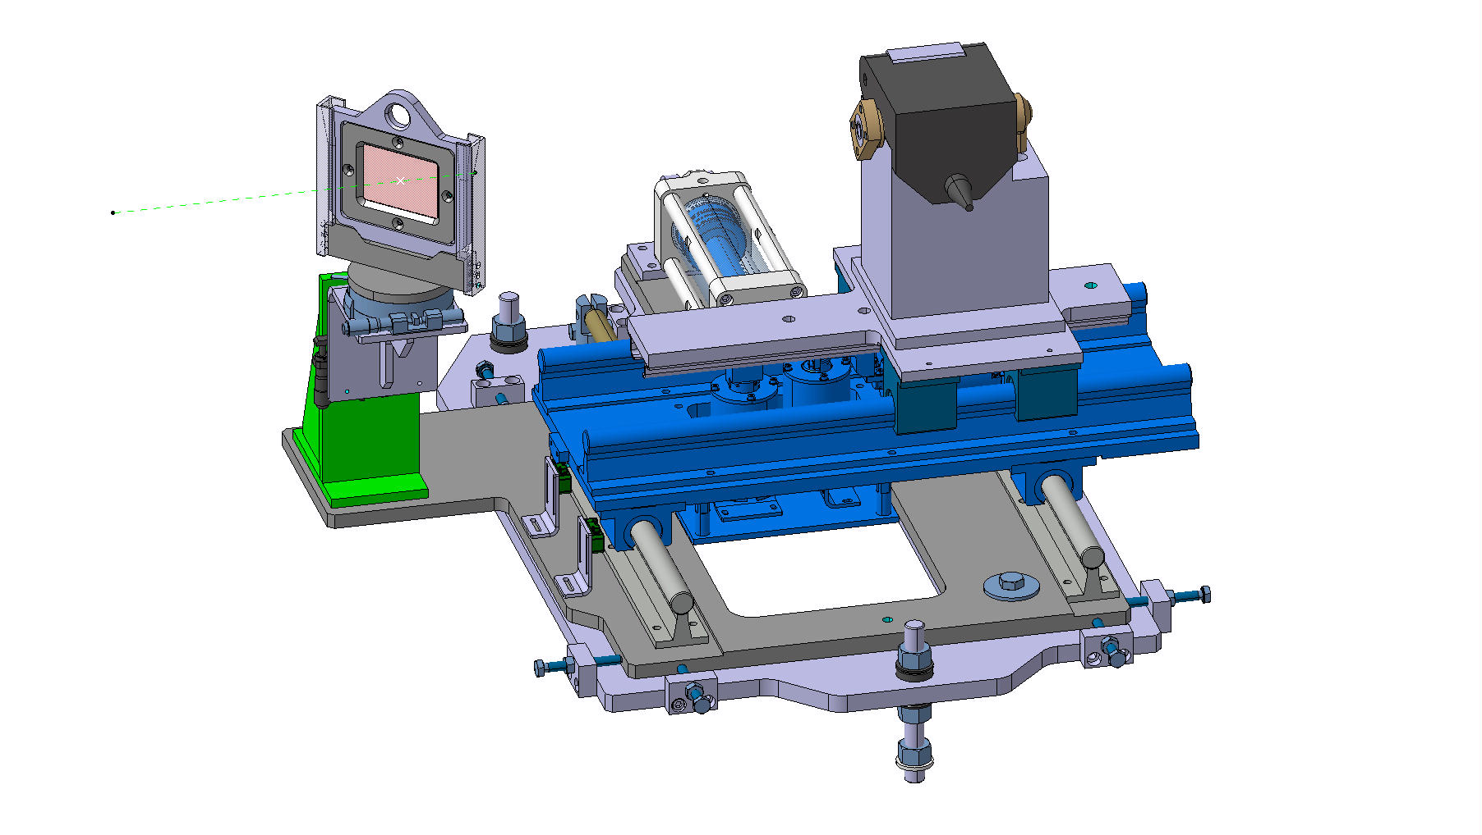
LS2 AD-CONS program (3)
Horn testbench
Instrumentation: new BPM
+ BCCCA consolidation
p Beam

Slide 7
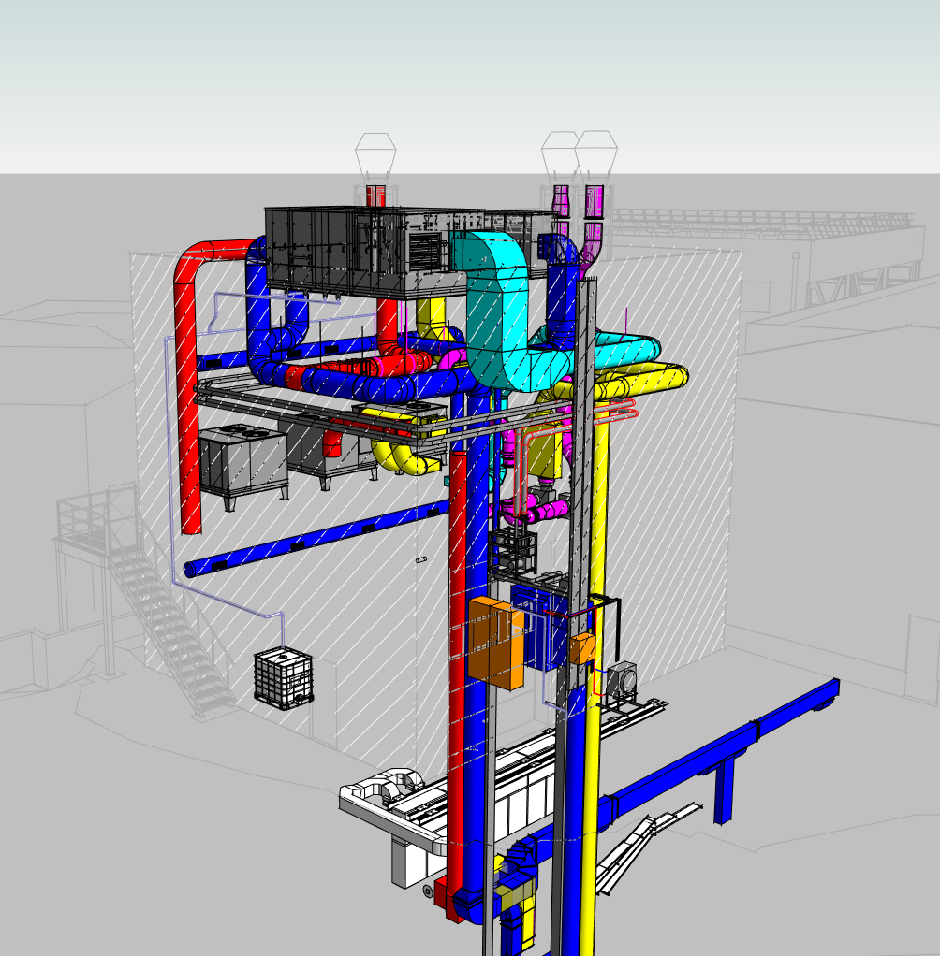
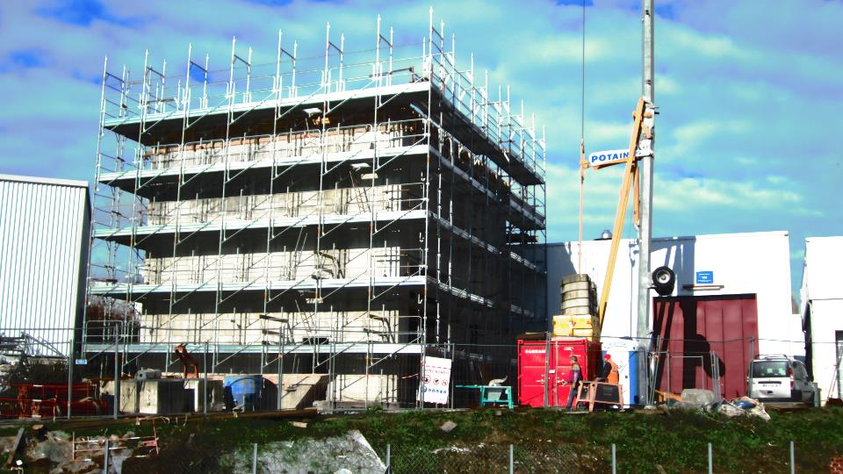
LS2 AD-CONS program (4)
CV : AD target cooling in 2020. AD hall ventilation upgrade: LS3 ?
Bdg 196

Slide 8
LS2 AD-CONS program (5)
HLRF CO2 cavity replaced by Finemet, remains to be connected (Vac + cabling: Jan –March 2020)
LLRF Radial loop, Cavity servoloop, gap relay control: syst production, development and lab tests till Oct 2020, then HW commissioning
Power convertors: Upgrade to Megadiscap and Maxidiscap convertors planned for Spring 2020
Vacuum upgrade complete (minor items remaining for LS2: ion pumps, dammaged alu flanges…)
Kickers: repair feedthroughs (done)

Slide 9
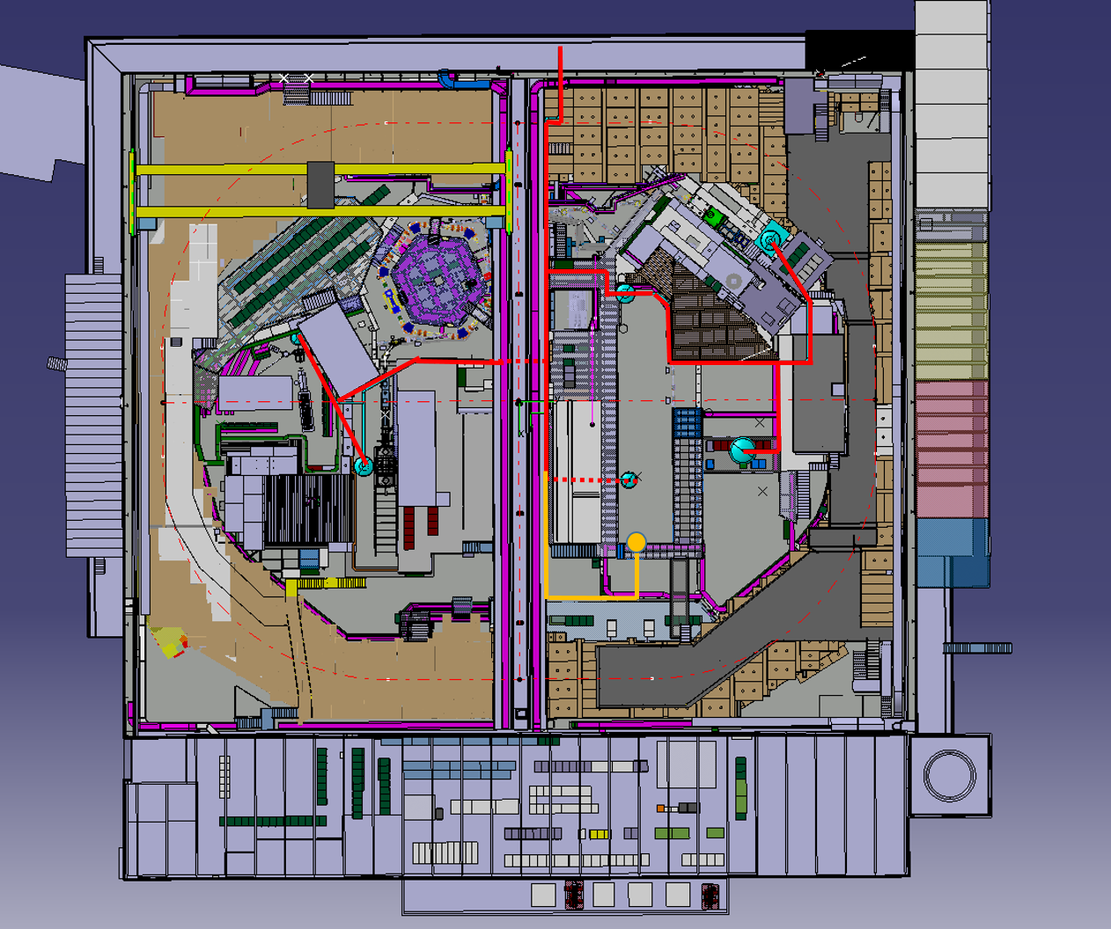
LS2 AD-CONS program (6)
Cryogenic distribution in AD hall:
-Pre-study done in
2018
-Installation planned
for 2021
-Financially not
approved yet

Slide 10
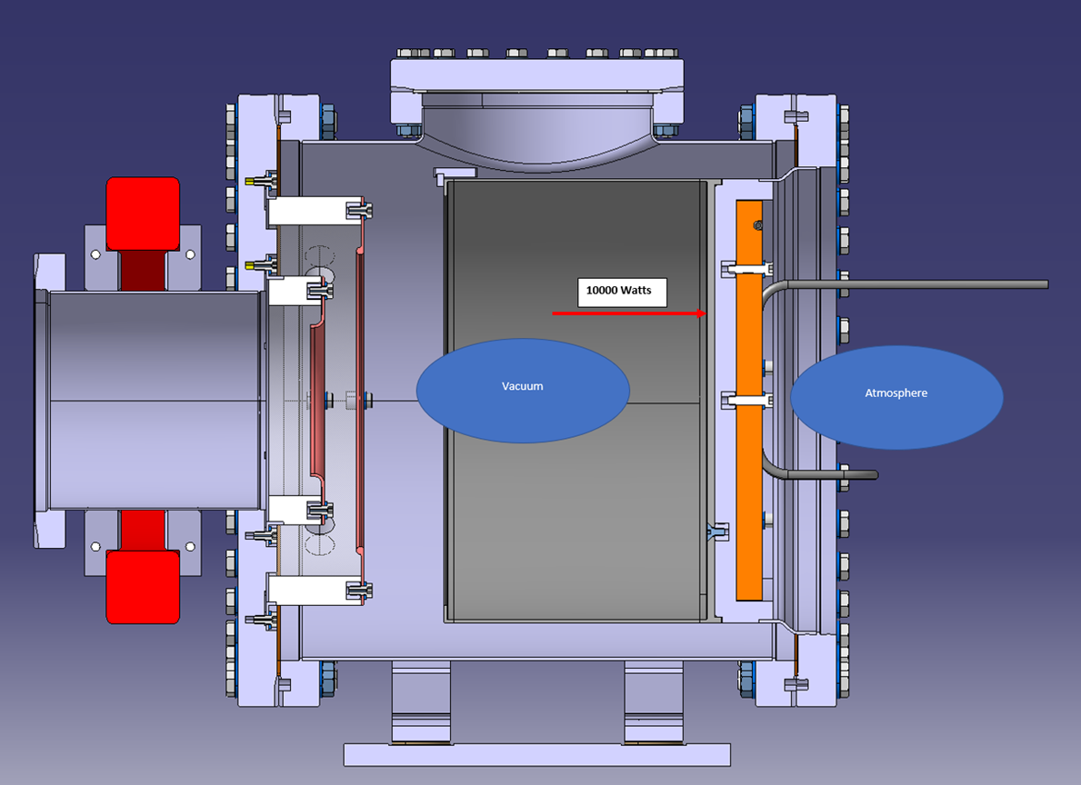
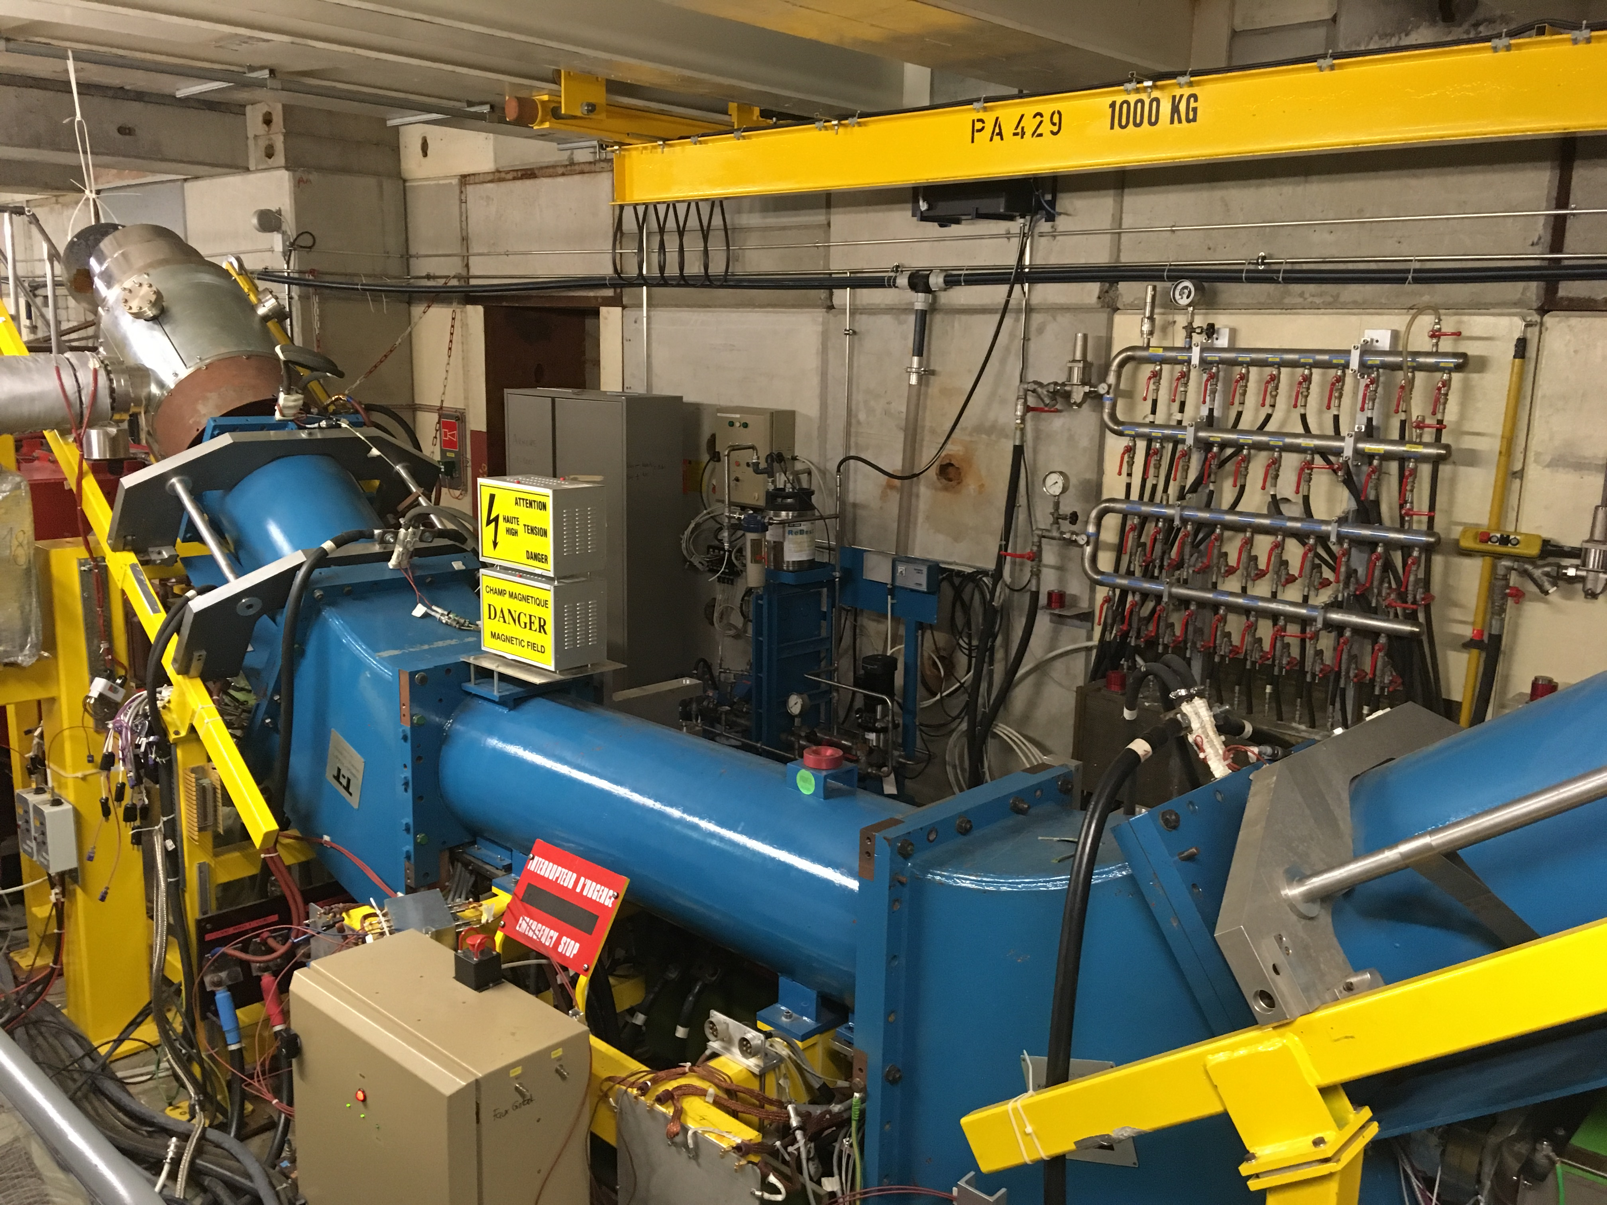
LS2 AD-CONS program (7)
AD e-cooler: the decision to build a new e-cooler for 2023 was confirmed 6 Dec 2019.
A new collector is planned to be produced and installed during LS2. Design is in progress, installation is planned for Oct- Dec 2020.
Electron cooler
collector

Slide 11
Conclusions
AD-CONS program well on its way
AD e-cooler collector on critical path – recovery plan is to keep existing one
Cryo distribution line not funded yet (again…)
A number of re-organizations are getting prepared, in addition to existing baseline, owing to experiment related changes

