Slide 1







Plans of the BASE collaboration after LS2 and far future
Stefan Ulmer
Christian Smorra
RIKEN,
Ulmer Fundamental Symmetries Laboratory
2019 / 12 / 08

Slide 2
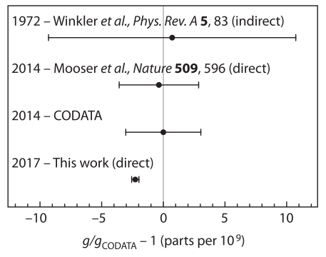
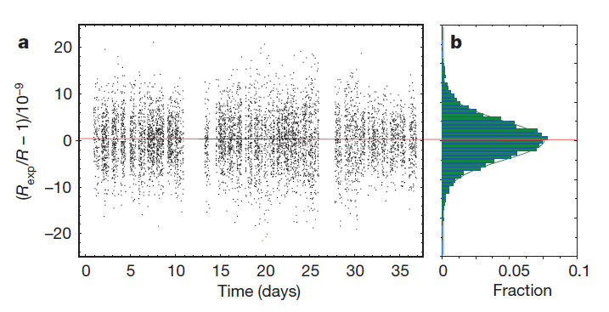
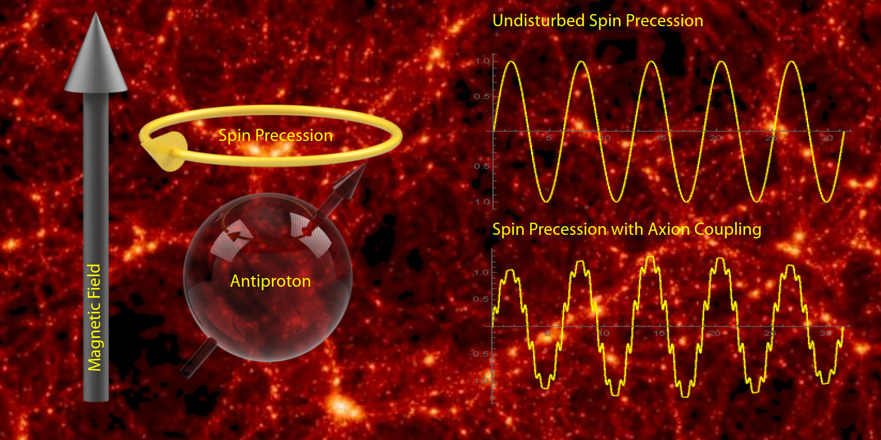
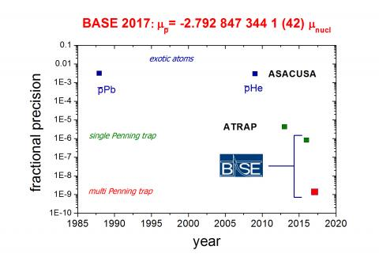
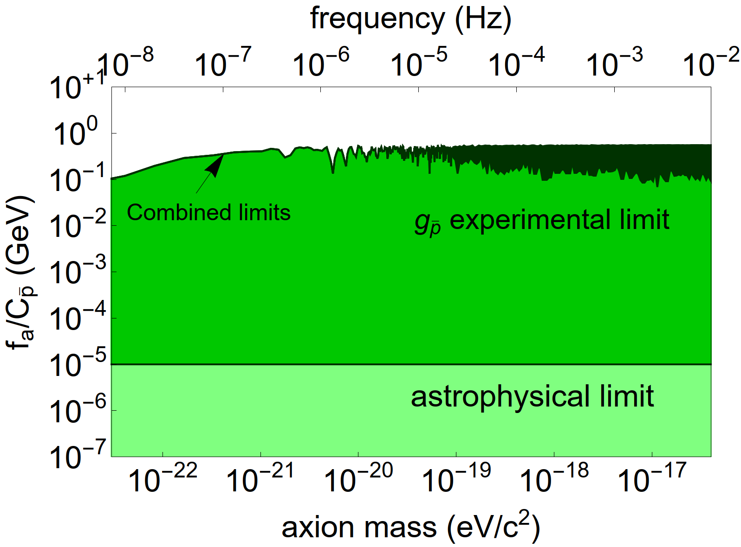

BASE since 2014
Most precise
proton g-factor measurment
Precise CPT test with baryons
Most precise antiproton
g-factor measurment
Limits on
antiproton / dark matter coupling
S. Ulmer, et al., Nature 524, 196 (2015)
H. Nagahama, et al., Nature Comms. 8,
14084 (2017)
C. Smorra et al., Nature 575, 310 (2019)
C. Smorra et al., Nature 550, 371 (2017)
Time-base analysis of antiproton g-factor resonance allows to constrain antiproton/axion coupling
$1+\frac{{(q/m)}_{\overline{p}}}{{(q/m)}_{p}}$ $=1\left(69\right)×{10}^{−12}$
g/2 = 2.792 847 350 (9)
Rexp,c = 1.001 089 218 755 (64) (26)
A. Mooser et al., Nature 509, 596 (2014).
To be improved by another factor of 10 to 100
g/2 = 2.792 846 5 (23)
First direct high precision measurement of the proton magnetic moment.
Sixfold improvement compared to previous measurement
Reservoir trap for antiprotons
g/2 = 2.792 847 344 1 (42)
C. Smorra, et al., Int. Journ. Mass Spec. 389, 10 (2015).
g/2 = 2.792 847 344 62 (82)
350-fold improvement compared to previous measurement
Idea: Enable operation with antiprotons independent of accelerator run times.
5-o.o.m. improved constraints compared to astrophysics limits
G. Schneider et al., Science 358, 1081 (2017).
Partly comparable work by J. DiSciacca, G. Gabrielse et al.. (ATRAP/TRAP collaboration)

Slide 3
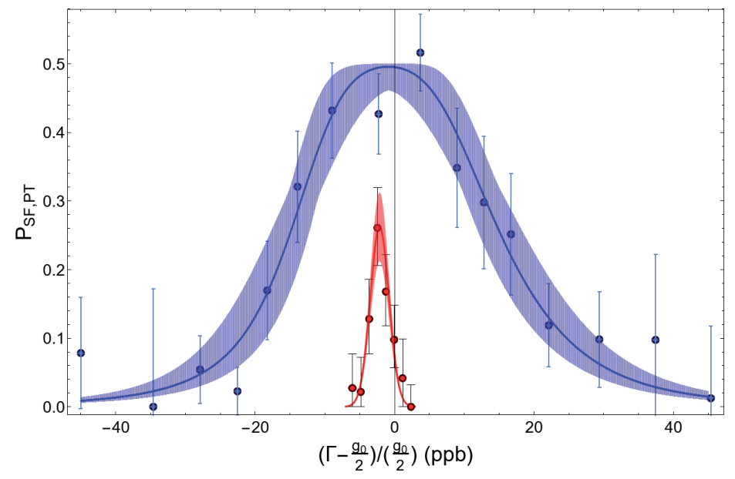
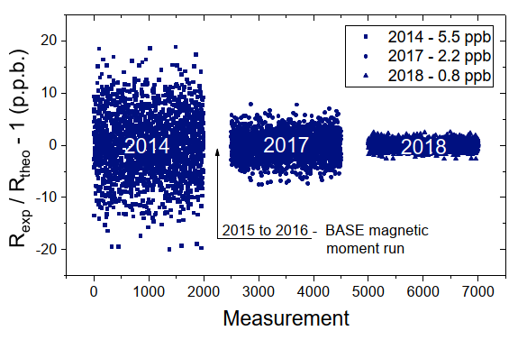
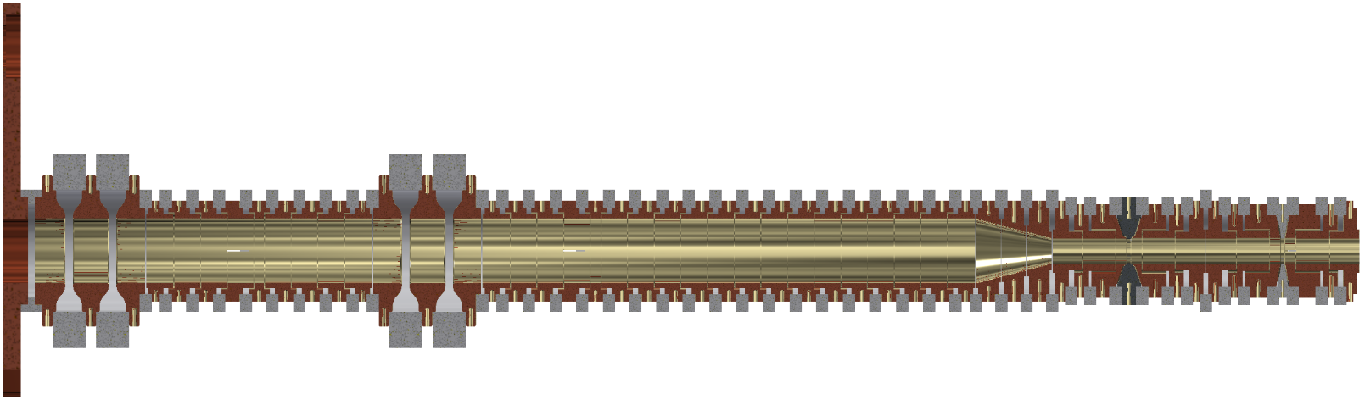


After LS2: Improved g-factor measurement
Measure faster in at reduced systematic effects
Recent developments at CERN
  Improved axial frequency measurements
  Advanced magnetic shielding system
  Improved magnet stability
  Implementation of local magnets
  Better cyclotron detector
  New trap stack -> cooling trap
$$\frac{g_{\overline{p}}}{2}=2.792 847 344 1 \left(42\right) (1.5 p.p.b)$$
Deliberately saturation broadened / systematics at 1 p.p.b., imposed by magnetic inhomogeneity
$\frac{g_{p}}{2}=2.792 847 344 62 (82)$ (0.3 p.p.b.)
Quite confident that measurement at a level of 100 p.p.t to 200 p.p.t. are in reach (at higher axion band-witdh) -> Plan for runs after LS2 (2 years at least).
Mainz measurement: Limited by sideband method, magnet stability, magnet homogeneity and statistics

Slide 4
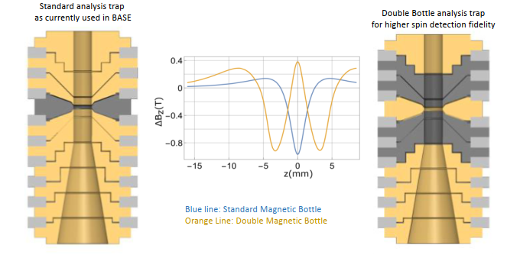


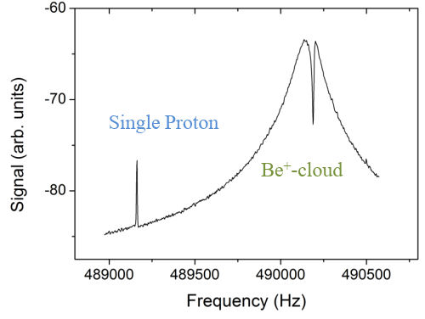
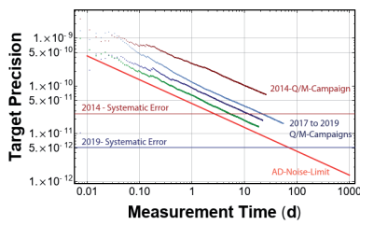

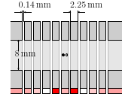
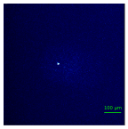
Additional Developments
Implementation of hyperpolarized ³He probes for magnet stabilization.
Advanced trap geometries
Implementation of laser cooling techniques for higher sampling rate cycles at reduced systematic effects.
New Method
Effort at University of Mainz
Whatever we do, we will eventually be limited by background magnetic field fluctuations
Couple protons/antiprotons sympathetically to laser cooled ⁹Be⁺ ions and imprint Doppler temperatures to the antiproton
5 trap design implemented and simultaneous detection of ⁹Be⁺ ion and proton in common endcap trap was demonstrated.
Publication: K. R. Brown, C. Ospelkaus, Y. Colombe, A. C. Wilson, D. Leibfried, D. J. Wineland, Nature 471, 196 (2011).
Was demonstrated for ⁹Be⁺ ions in Paul traps – implement same in Penning traps
C. Smorra, A. Mooser, M. Bohman, M. Wiesinger et al.
Effort at University of Hannover and PTB
Recent dramatic progress: Detection of a single laser cooled ⁹Be⁺ ion, in a Penning trap system which is fully compatible with the BASE trap system at CERN
Green: reached precision Red: AD limit
M. Niemann, J. M. Cornejo, C. Ospelkaus et al.

Slide 5
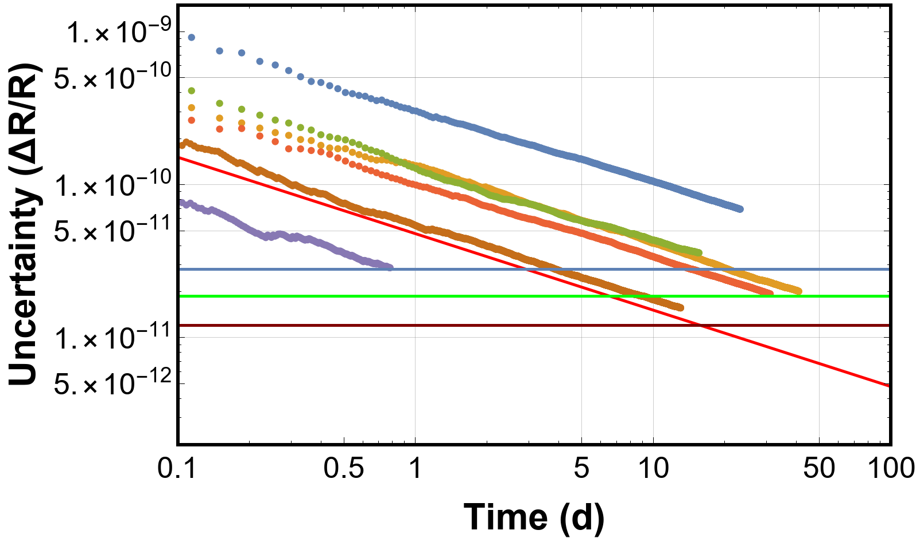
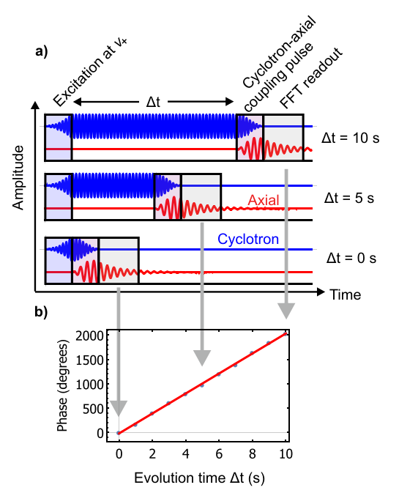
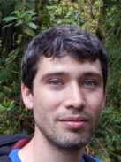
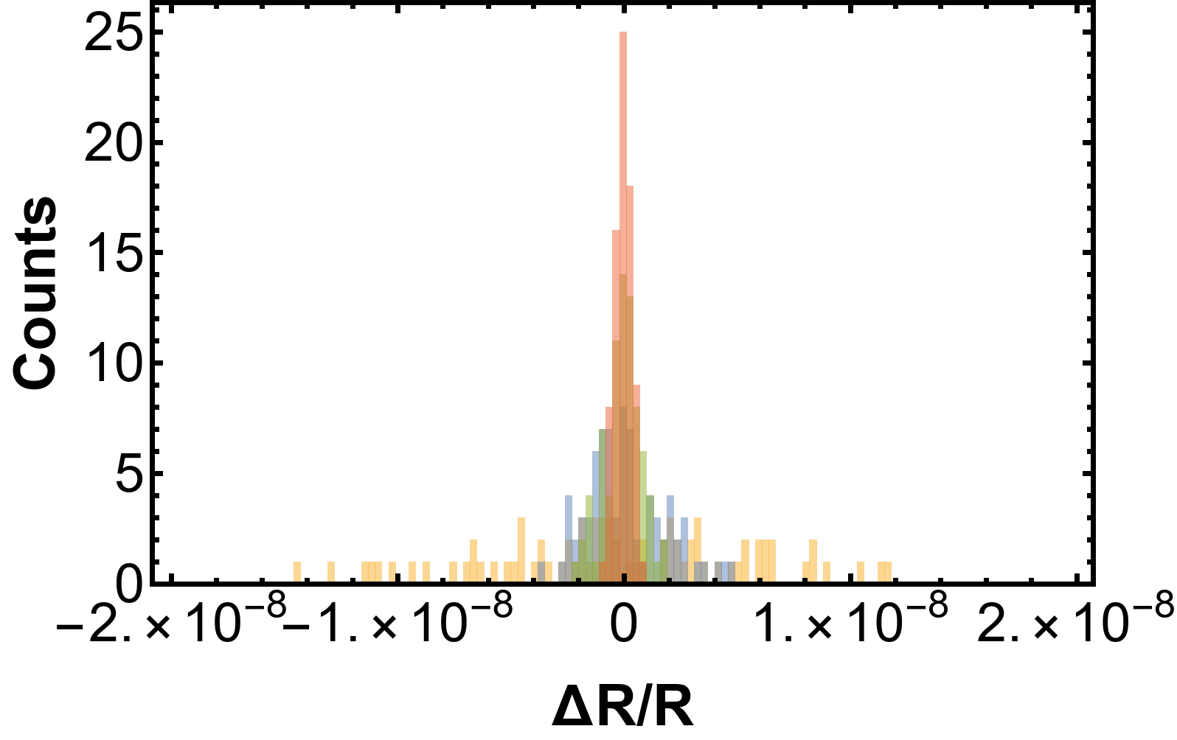
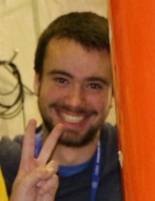
Improved Charge-to-Mass ratio measurement
Given the current data situation -> need to reach 1 p.p.t. precision level
2014 Q/M ratio
Recent developments: Implementation of phase sensitive methods.
2018 Q/M ratio
2019 phase methods
AD noise limit
J. Devlin
CERN/RIKEN
2014 BASE Sideband
2019 BASE Sideband
AD Background noise
2019 BASE Phase
M. Borchert
Hannover/RIKEN
-> Long term: Need to move out of the AD hall (after LS3)

Slide 6
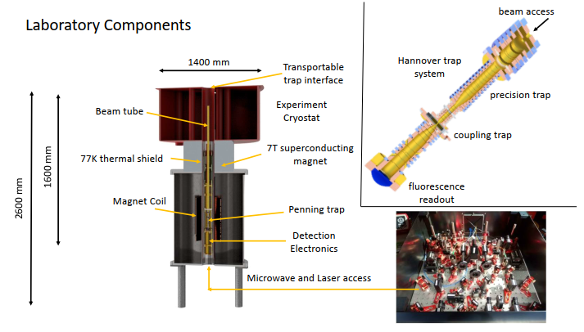
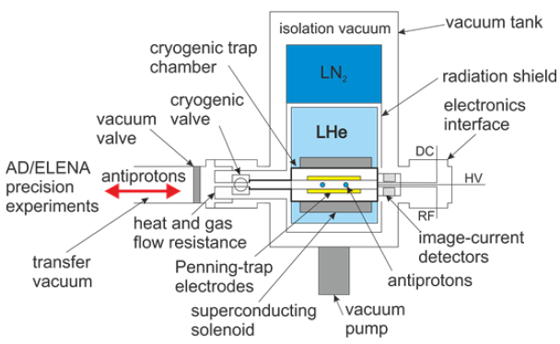










Recent Proposal -> applied for offline lab space
-> Transportable trap (BASE/STEP)
-> BASE II / offline lab
C. Smorra
RIKEN

Slide 7
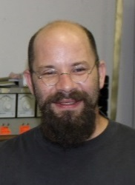
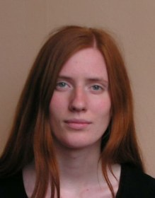



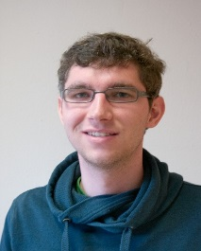
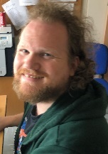
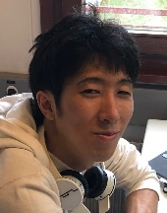




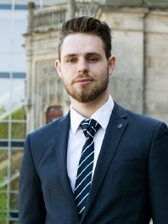
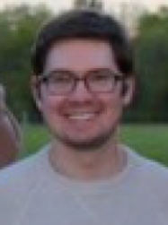
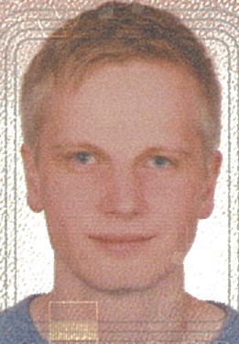
Thanks for your attention!
S. Ulmer RIKEN
J. Devlin
RIKEN
E. Wursten
CERN / RIKEN
J. Harrington
MPIK/RIKEN
M. Borchert
Hannover/RIKEN
S. Erlewein
MPIK/RIKEN
M. Fleck
RIKEN/U. Tokyo
M. Sato
RIKEN/U. Tokyo
K. Blaum, Y. Matsuda,
C. Ospelkaus, W. Quint,
J. Walz, Y. Yamazaki
J. Warncke
Hannover/RIKEN
C. Smorra
RIKEN
M. Bohman
RIKEN/MPIK
M. Wiesinger
RIKEN/MPIK

