Slide 1







ADUC Meeting 2019
ATRAP

Slide 2
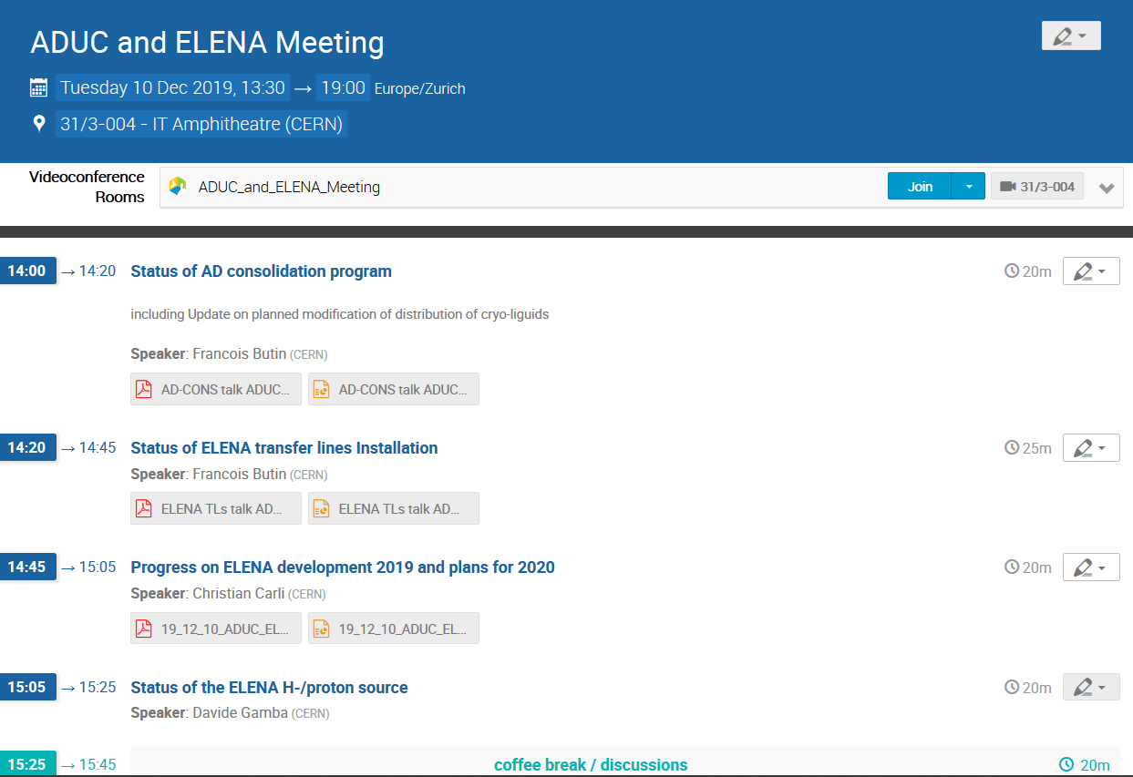
Welcome to the ADUC meeting 2019
…and thanks very much for joining the event.
Part 1:
Progress update AD consolidation
ELENA

Slide 3
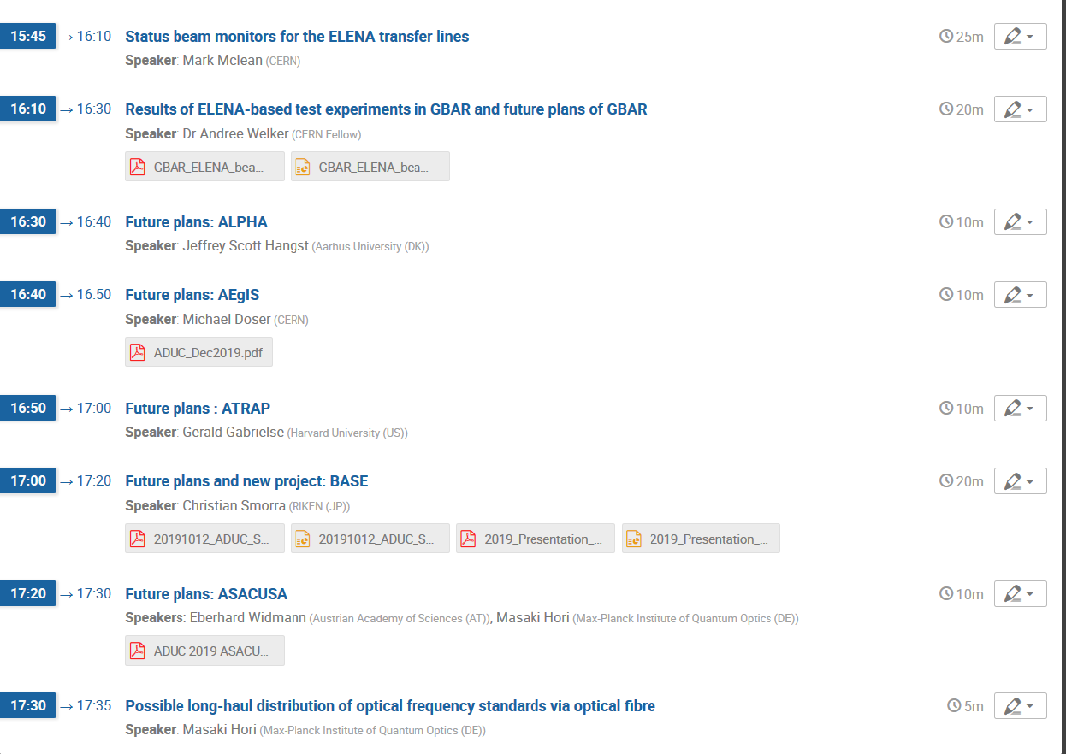
Part 2
Requested by CERN teams to update them on future plans of the users which are operating in the facility.
Roughly 10 minutes per collaboration

Slide 4
Reply from Eckhard Elsen
Some users were asking for a statement on CERN’s longer term timeline of AD operation beyond LS2.
The spirit I would like to convey for ADUC is
Full recognition of the successes of the experiments
Invitation for next generation of experiments (see SPSC call). This is encouraged by the new infrastructure that is being put in place
Assessment of how to best deal with the future precision requirements
All the best
Eckhard
Will ask for a more explicit and slightly more practical statement, to be made at 2020 SPSC meeting.

