Slide 1
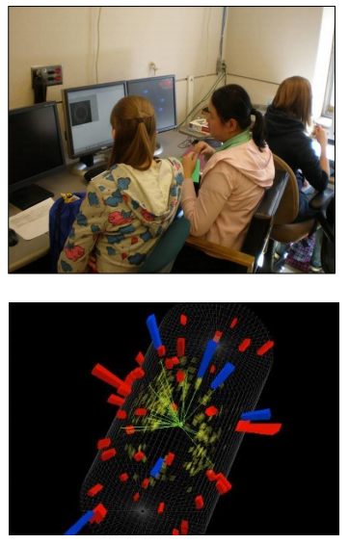
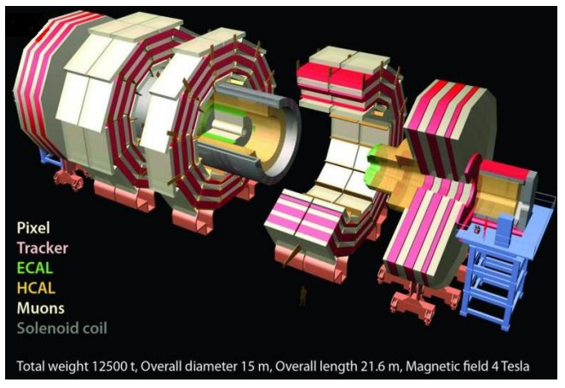


CMS WZH Masterclass

Slide 2
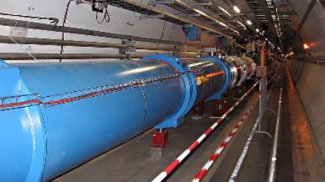
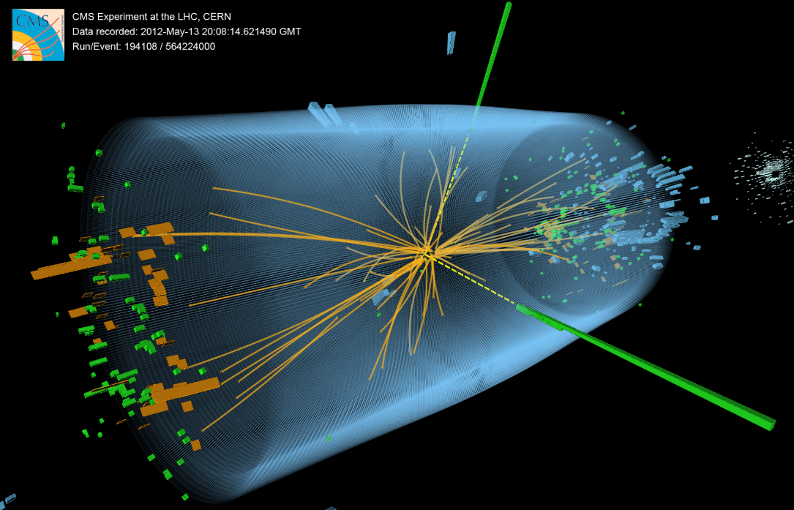
The LHC and the new physics
It is a time of exciting new discoveries in particle physics.
The Large Hadron Collider at CERN has been operating for almost 10 years and had not only shed new light on the Standard Model but discovered new particles, including the cornerstone Higgs boson.

Slide 3
The LHC and the new physics

Slide 4
The LHC and the new physics

Slide 5
The Compact Muon Solenoid (CMS)
Let’s take a closer look at the real thing.

Slide 6
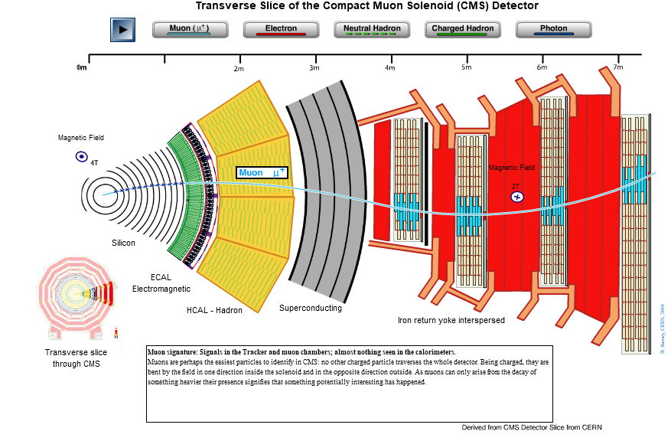
Leptons in CMS

Slide 7
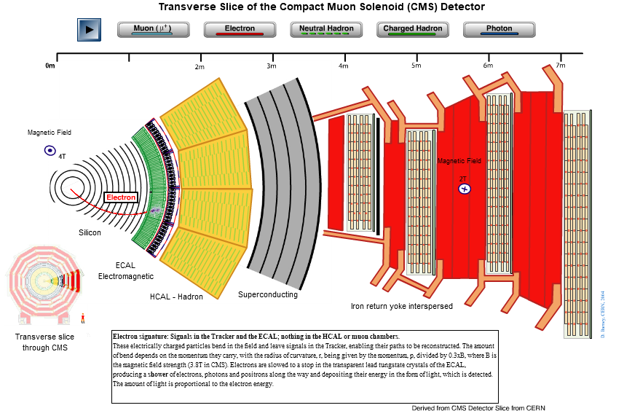
Leptons in CMS

Slide 8
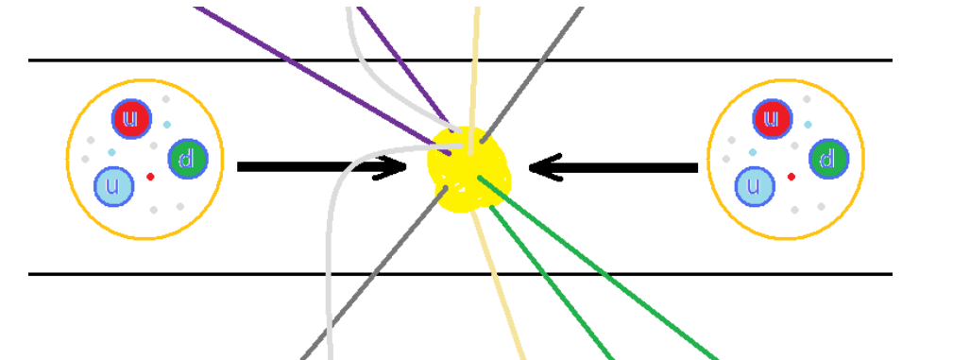
Protons collide inside CMS
The LHC accelerates protons to as much as 6500 times the energy equivalent of their mass. The protons circulate in opposite directions and collide in the center of CMS.
But protons are not just particles: they are more like bags of quarks and gluons. When they collide, anything can happen. And we are looking something specific.

Slide 9
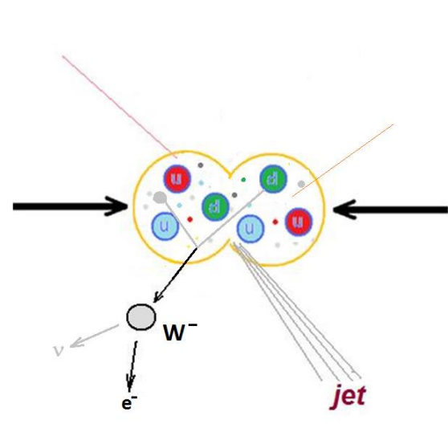




One-lepton events
The + or – charged W boson enables radioactive decay by transforming neutrons into protons.
It decays into a neutrino and another lepton. Since CMS cannot detect the neutrino directly, we can call this a one-lepton event.

Slide 10
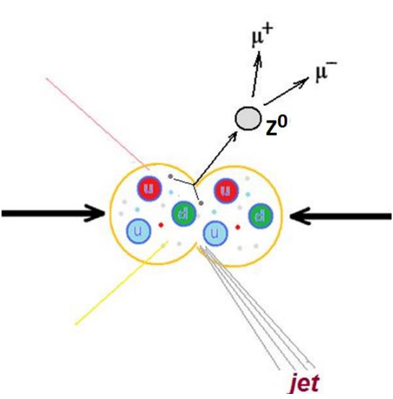


Two-lepton events
The Z boson is a neutral cousin of the W. It enables the “weak neutral current”.
It decays into two leptons of the same type but opposite charge – electron and positron or muon and antimuon. It has other decay paths but we are not looking for these.

Slide 11
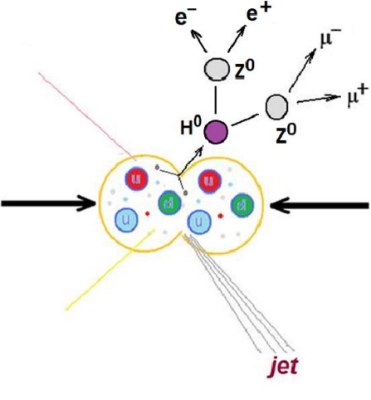
Four-lepton events
The Higgs boson is an expression of the field that gives other particles mass.
One decay mode of the Higgs is into two Z bosons, which themselves promptly decay. Thus we can get 2 muons and 2 electrons or 4 muons or 4 electrons.

Slide 12
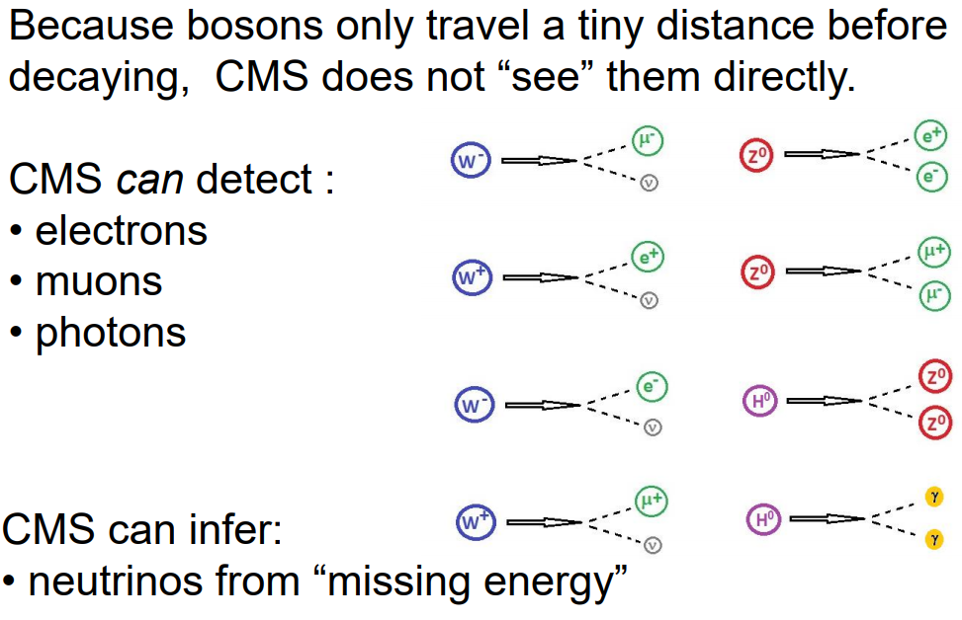
Decay summary

Slide 13
iSpy event display for CMS

Slide 14
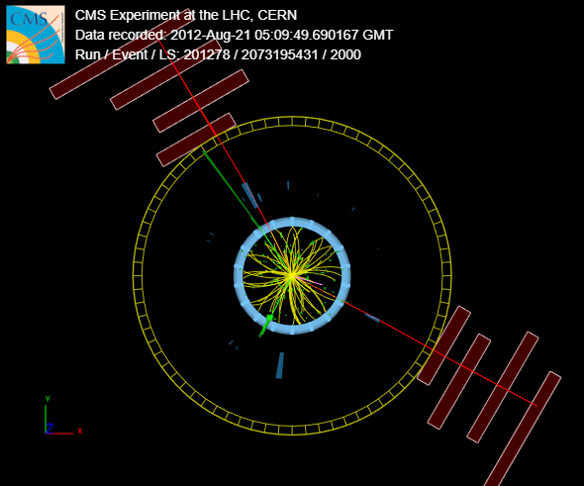
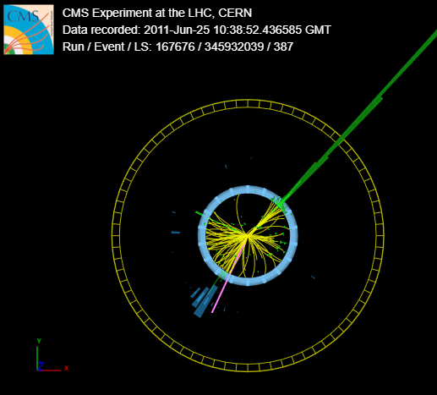
1, 2, or 4 leptons?
Which of these events is 1-, 2-, or 4-lepton? Which flavors of leptons? What else do you see?

Slide 15
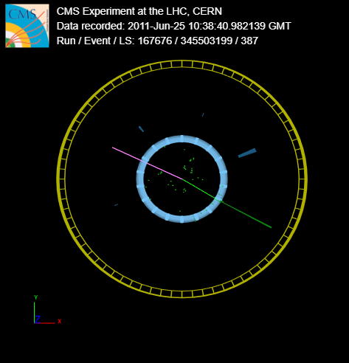
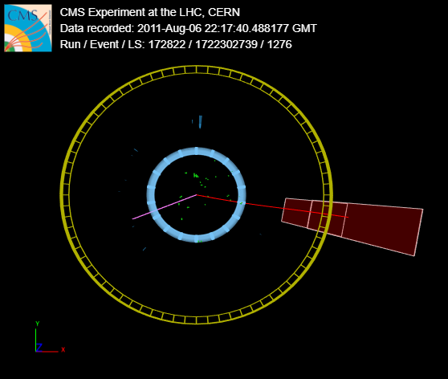
1, 2, or 4 leptons?
Which of these events is 1-, 2-, or 4-lepton? Which flavors of leptons? What else do you see?

Slide 16
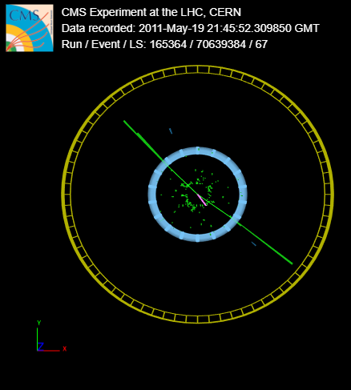
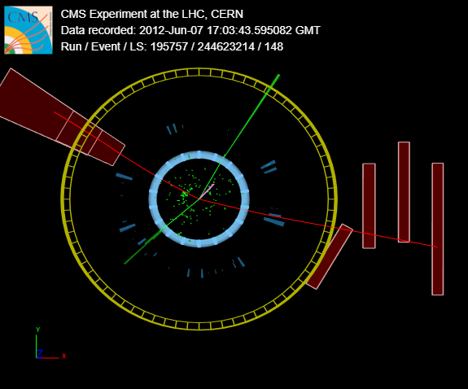
1, 2, or 4 leptons?
Which of these events is 1-, 2-, or 4-lepton? Which flavors of leptons? What else do you see?

Slide 17
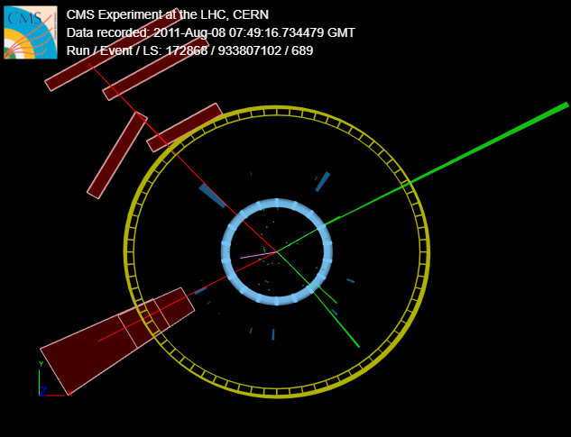
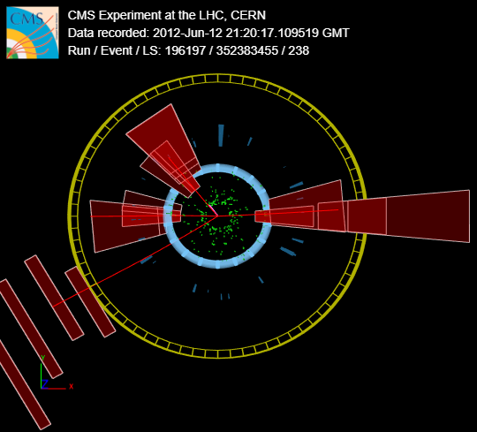
1, 2, or 4 leptons?
Which of these events is 1-, 2-, or 4-lepton? Which flavors of leptons? What else do you see?

Slide 18
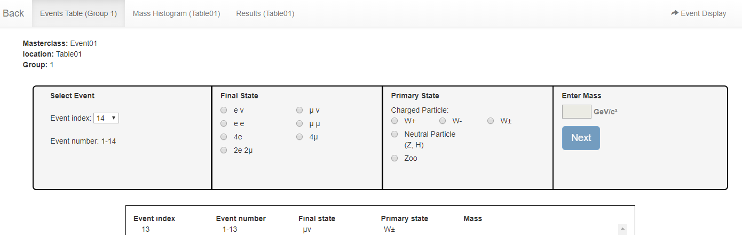
CMS Instrument for
Masterclass Analysis (CIMA)
Enter data on each event:

Slide 19
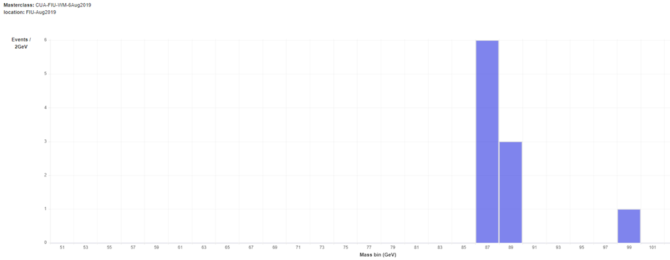
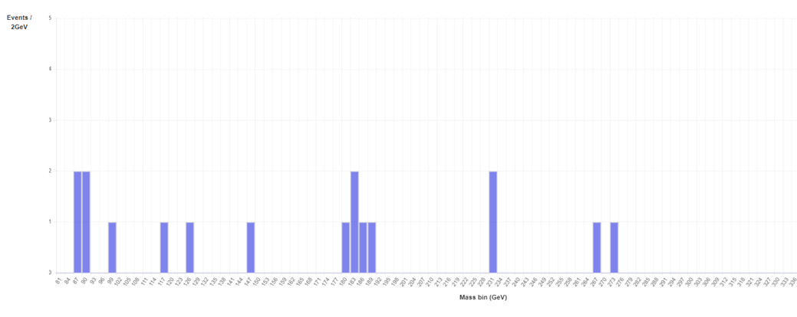
CMS Instrument for
Masterclass Analysis (CIMA)
CIMA makes mass histograms automatically:

Slide 20
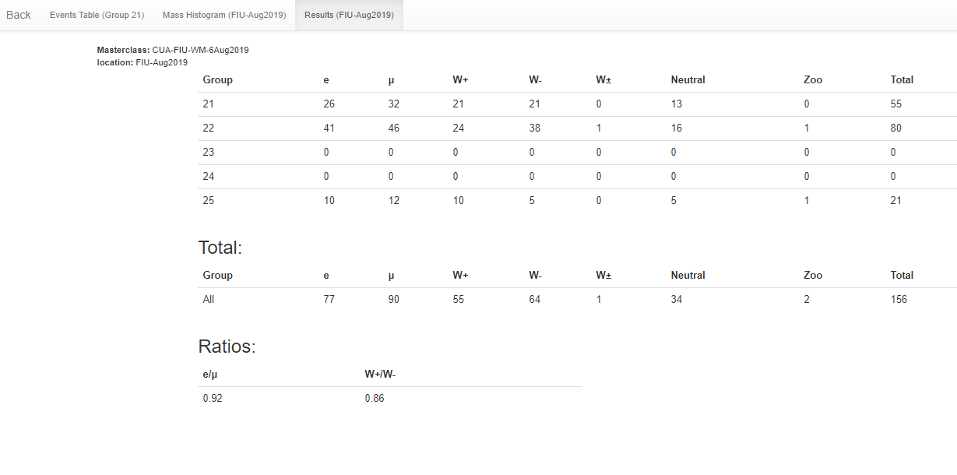
CMS Instrument for
Masterclass Analysis (CIMA)
CIMA tabulate data for key ratios:

Slide 21
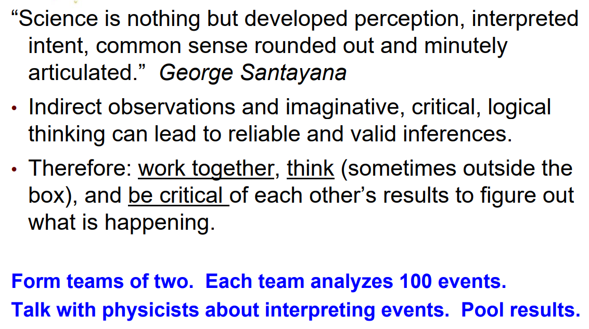
Parting words…

