Slide 2
Progress report
Performance of BSW magnets powering for PSB injection chicane
T. Todorčević and D. Aguglia
TE-EPC-FPC
Acknowledgments: Luis Miguel de Paco Soto and Achille Nicoletti
9th of October 2019

Slide 3
Technical requirements (original)
Absolute precision:
  ±50 ppm during flat-top (starting from when beam is injected)
  ±500 ppm during ramp-down
  125 Hz also applied at current rump-up
  Amplitude:
    BSW2, BSW3, BSW4: 3.4 kA
    BSW1: 6.7 kA
Beam injection
t_{rise} | 5 ms
t_{flat} | 2 ms
t_{fall} | 5 ms
t_{rep} | 1.2 s
t_{rise}
t_{flat}
t_{fall}

Slide 4
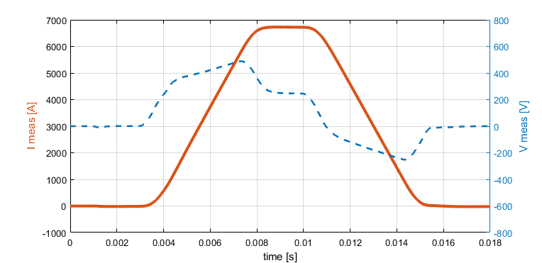
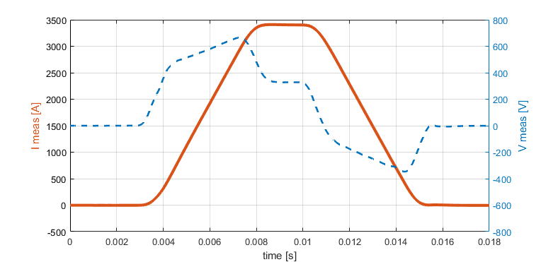
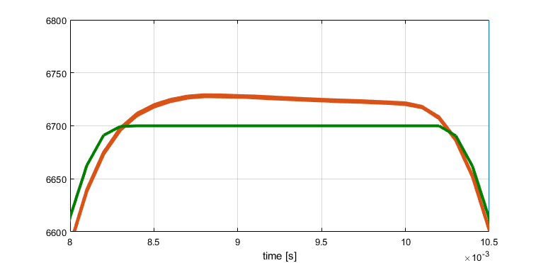
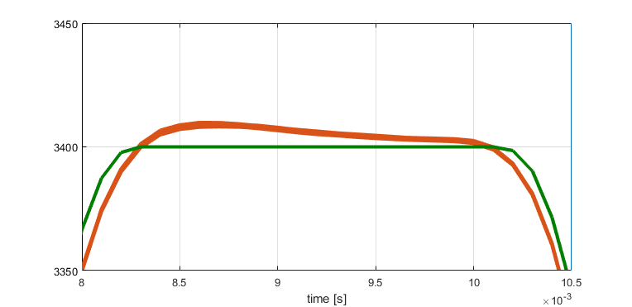
Standard controller approach
Current controller (RST type) could not deliver sufficient absolute error of the current
BSW1
BSW4
― Current reference
― Current measurements
― Current reference
― Current measurements

Slide 5
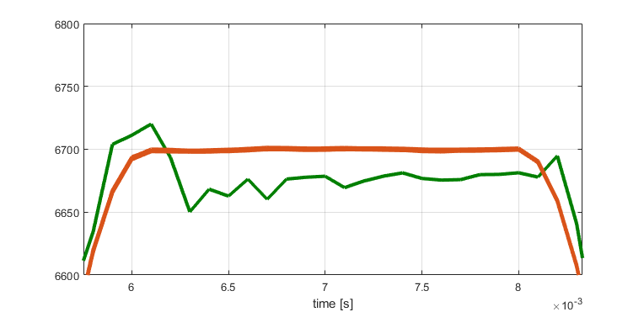
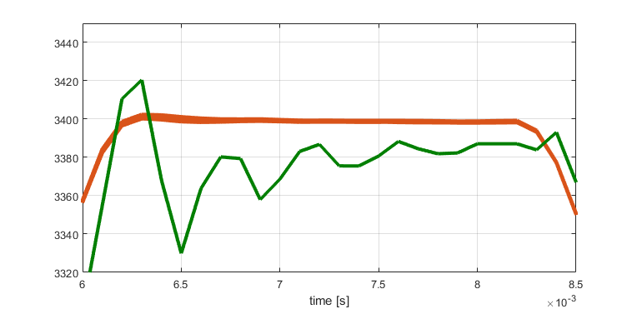
Reference modification to achieve low error
Iterative Learning Controller (ILC) applied to cope with the absolute error of the magnet current – reference adaptation method (currently offline)
BSW1
BSW4
― Current reference
― Current measurements
― Current reference
― Current measurements
ILC applied

Slide 6
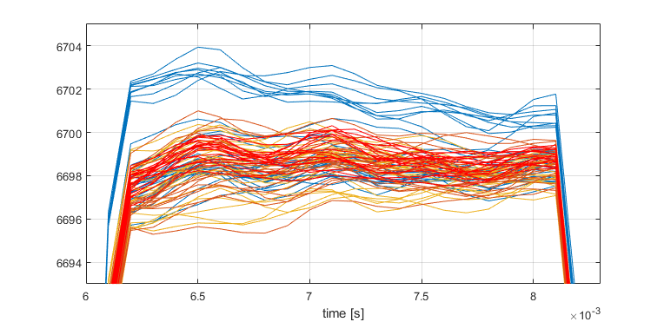
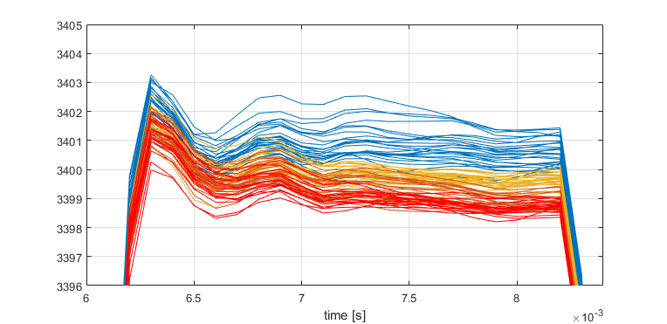
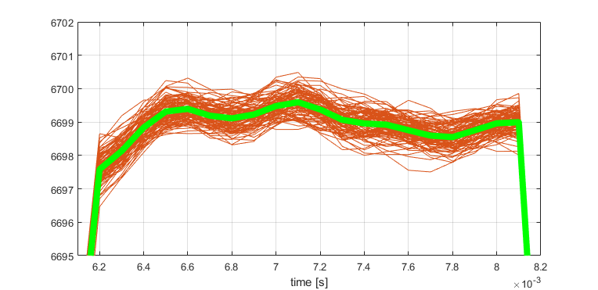
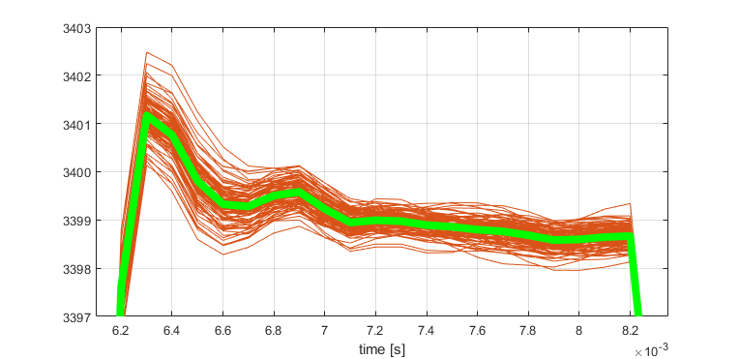
Temperature drift effect on current
Iterative Learning Controller (ILC) can be also applied to solve error due to temperature drift, or its simplified form (simple to implement and test)
BSW1
BSW4
samples over 6 hours
99 waveforms
samples over 5 hours
99 waveforms
samples over 7 minutes
mean waveform
samples over 7 minutes
mean waveform
99 waveforms
99 waveforms

Slide 7
Precision requirements revisited
BSW1 delivers more that 97% of samples in “new” +/-125ppm spec. during flat-top second half (significant for injection)
BSW4 delivers more that 93% of samples in “new” +/-125ppm spec. during flat-top second half (significant for injection)
BSW1
BSW4

Slide 8
Conclusions
Iterative Learning Controller (ILC) is able to deliver low absolute error, including error due to temperature drift
ILC doesn’t have to be implemented in its sample-to-sample form – heavy for the controller and implementation, but rather as a simple correction factor applied on the flat-top
Achieved precision for BSW1 is in range of +/-150ppm (>97% in +/-125ppm spec.) for the 2nd half of the flat-top; and +/-240ppm over the entire current pulse
Achieved precision for BSW4 is in range of +/-200ppm (>93% in +/-125ppm spec.) for the 2nd half of the flat-top; and +/-420ppm over the 2nd half of the current pulse
Voltage measurement to be checked deeply for effect on current repeatability

