Slide 1
Present simulations on the influence of more relaxed BSW specifications on the production of HL-LHC beams
E. Renner, C. Bracco
Acknowledgments: H. Bartosik, F. Antoniou, F. Asvesta, V. Forte

Slide 2
Outline
“The obtained result for the BSW pulse to pulse repeatability is 250 ppm (+- 125ppm), compared to the specified +-50ppm. (See Todor’s presentation)
Is this increased specification for the flat-top reproducibility problematic for the production of the HL-LHC beam?”
Assumed simulation set-up for HL-LHC beams.
Including BSW errors in simulation set-up
Simulation results
Outlook

Slide 3
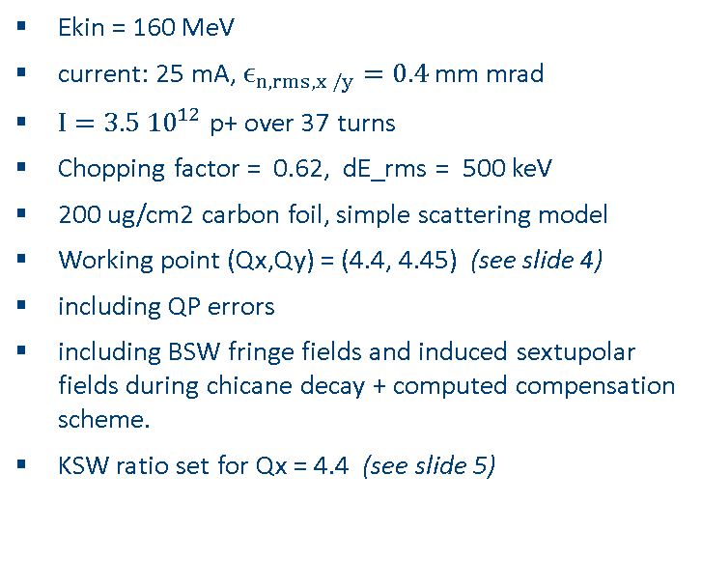
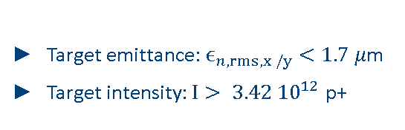
Simulation set-up for HL-LHC beams
Ekin = 160 MeV
current: 25 mA, $ϵ_{n, rms,x /y}=0.4$ mm mrad
$I=3.5 {10}^{12}$ p+ over 37 turns
Chopping factor = 0.62, dE_rms = 500 keV
200 ug/cm2 carbon foil, simple scattering model
Working point (Qx,Qy) = (4.4, 4.45) (see slide 4)
including QP errors
including BSW fringe fields and induced sextupolar fields during chicane decay + computed compensation scheme.
KSW ratio set for Qx = 4.4 (see slide 5)
Target emittance: $ϵ_{n, rms,x /y}<1.7 μ$m
Target intensity$:I> 3.42 {10}^{12}$ p+
see https://indico.cern.ch/event/832290/
for descriptions of simulations set-up

Slide 4
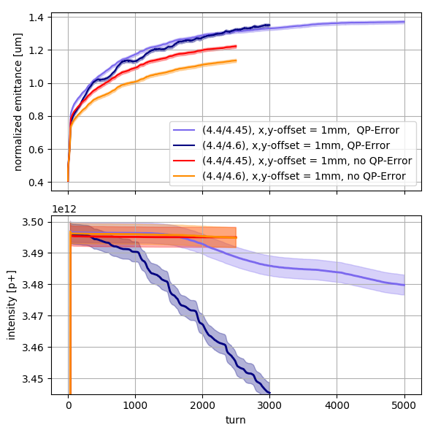
Working Point
Previous simulations conducted for (Qx,Qy) = (4.43,4.46), (V. Forte, WEP2PO007, HB2018)
but without quadrupole errors
Suggestion from ABP: stay below half integer resonance in both planes.
Assumed WP for those studies: Qx,Qy = (4.4,4.45)

Slide 5
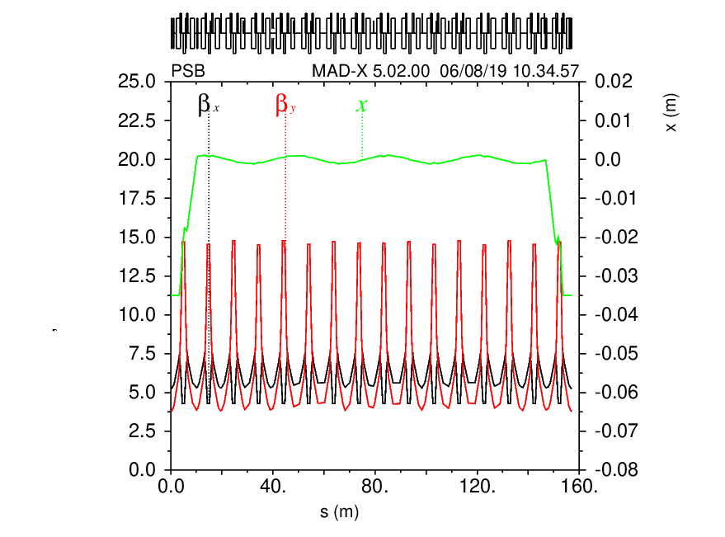
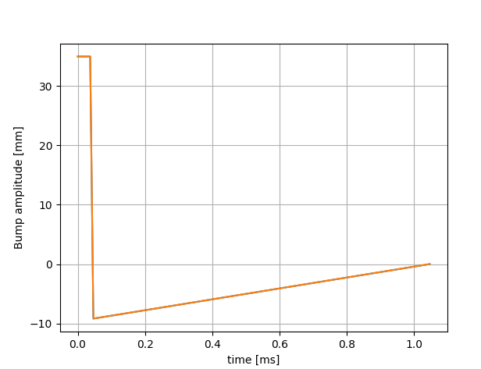
KSW Settings
KSW ratio
Ratio of KSW optimized for Qx = 4.4
Considering hardware limits, orbit cannot be closed for Qx = 4.4.
Ratio is chosen to keep closed orbit with x = 81mm, px = 0 at foil
KSW decay
No painting, 37 turns at max. current with subsequent fast decay

Slide 6
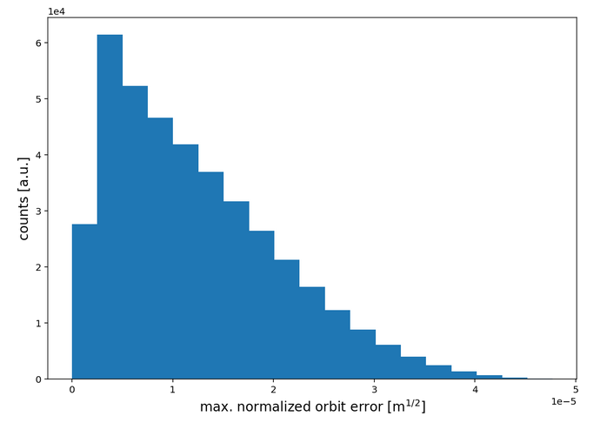
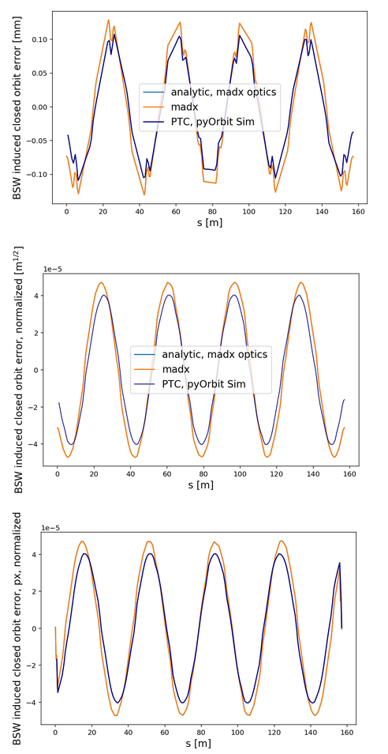
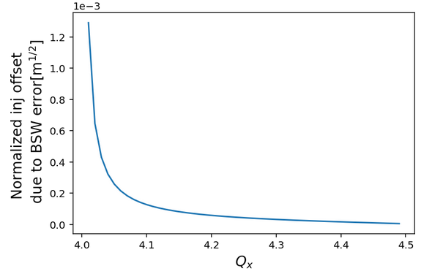
Including BSW Errors in Simulations: Present + Future Plans
For now:
Max. closed orbit error due to BSW flat top error is considered (very pessimistic)
  BSW1: +125 ppm
  BSW2: - 125 ppm
  BSW3: -125 ppm
  BSW4: +125 ppm
assumed constant flat-top during injection of 1 ring
BSW decay in 5ms, independent of varying flat top current
additional injection offset of +-1mm considered
Histogram of max. closed orbit deviation (normalized phase space), considering uniformly distributed errors between +-125 ppm for all 4 BSW
Future studies:
Create model with randomized errors from various sources, including BSW (distribution?)
Note: Impact of BSW2 error on injected beam not yet considered in presented results
Normalized max. closed orbit error depending on tune
Induced orbit error. Mad-x vs. pyOrbit

Slide 7
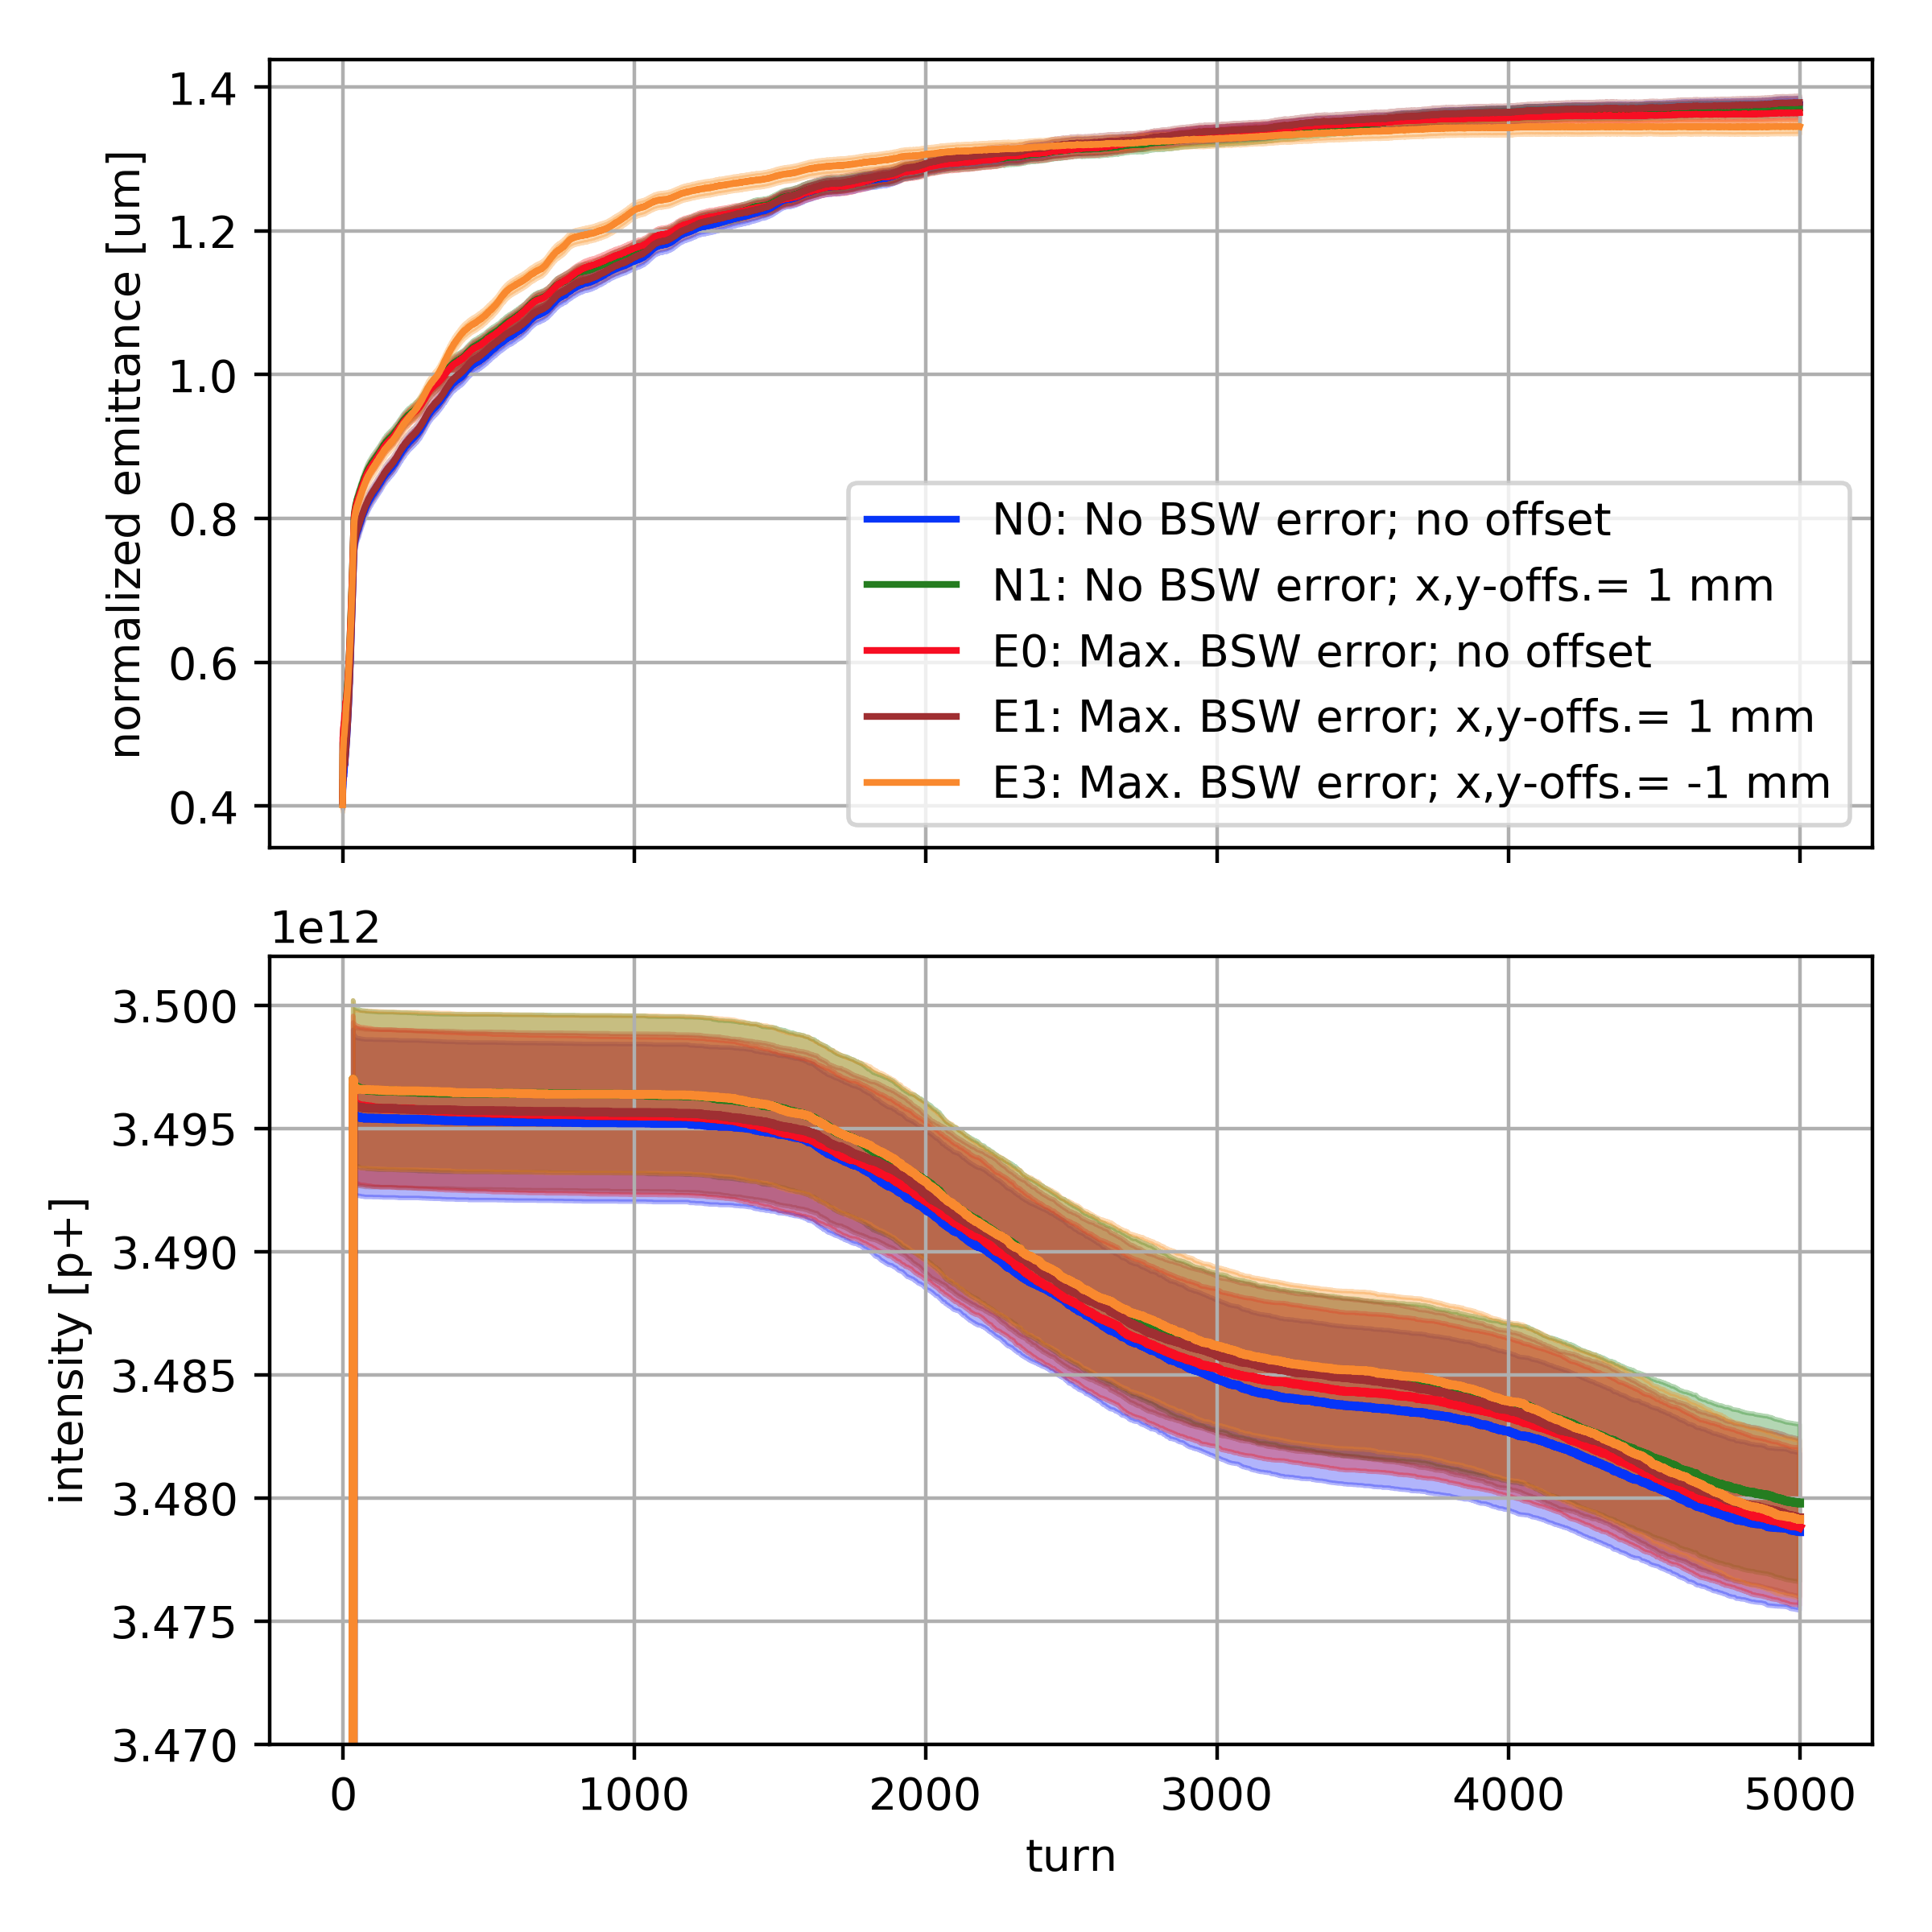
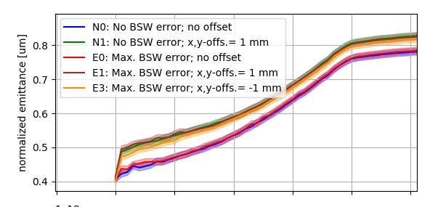
Simulation results I – average rms emittance
No significant emittance increase due to BSW shot-to-shot reproducibility of +- 125 ppm
+- 125 ppm shot-to-shot error acceptable

Slide 8
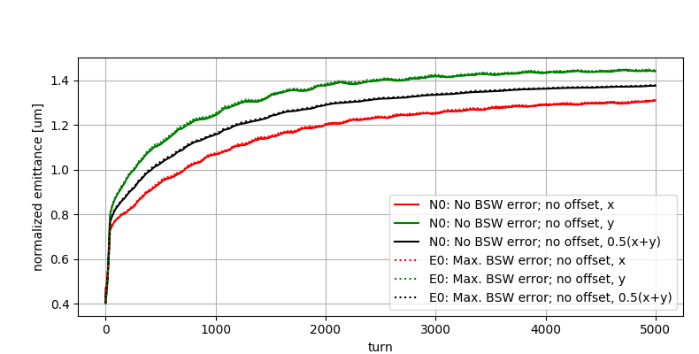
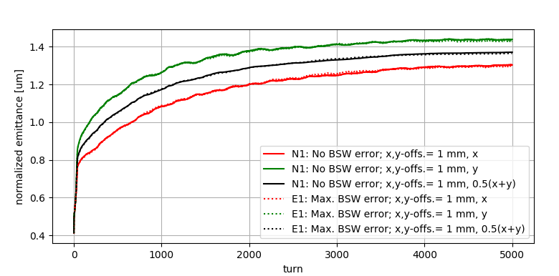
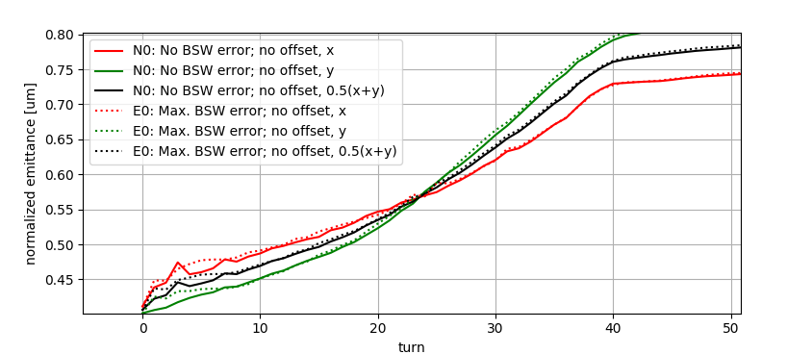
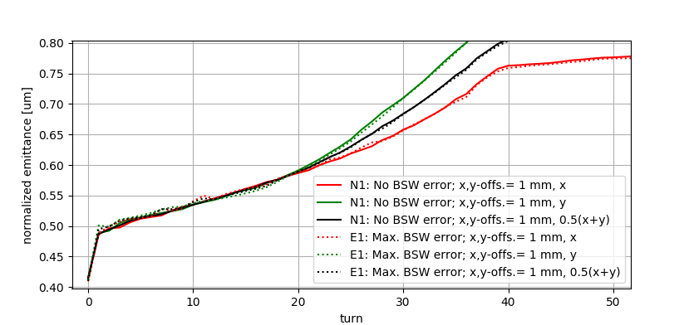
Simulation results II
BSW error with no additional injection offset
BSW error with additional injection offset of 1 mm in x and y.
No additional r.m.s emittance increase during first turns
Increased r.m.s emittance due to BSW error only during first ~10 turns

Slide 9
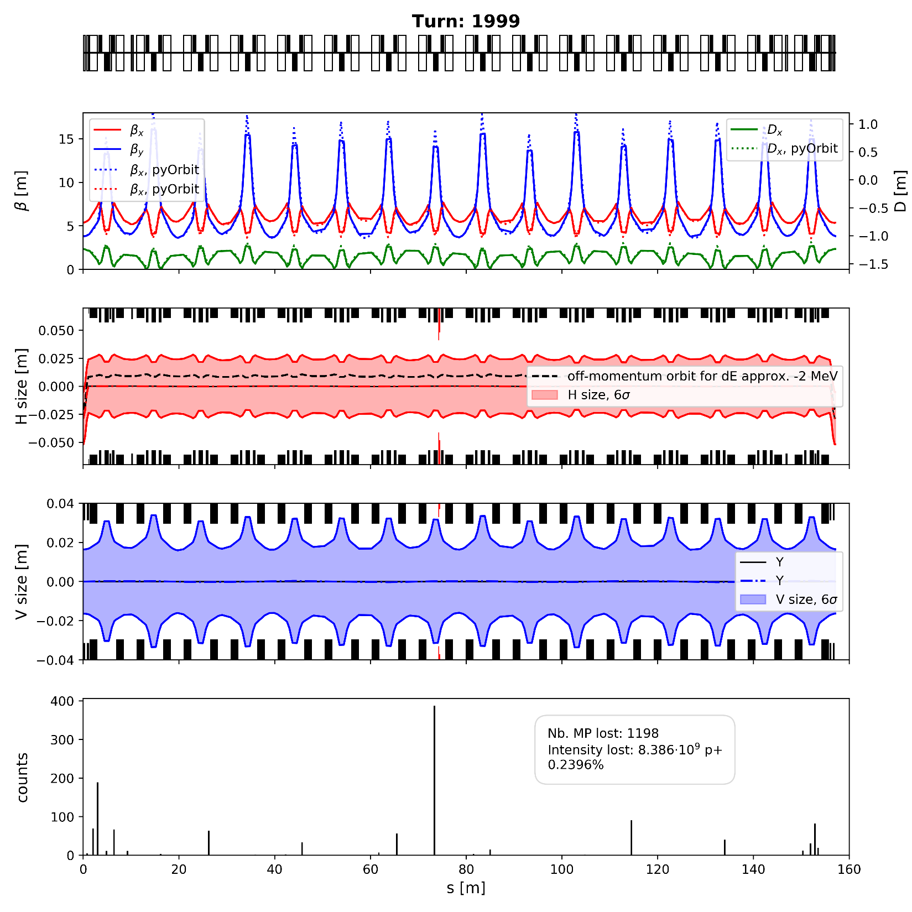
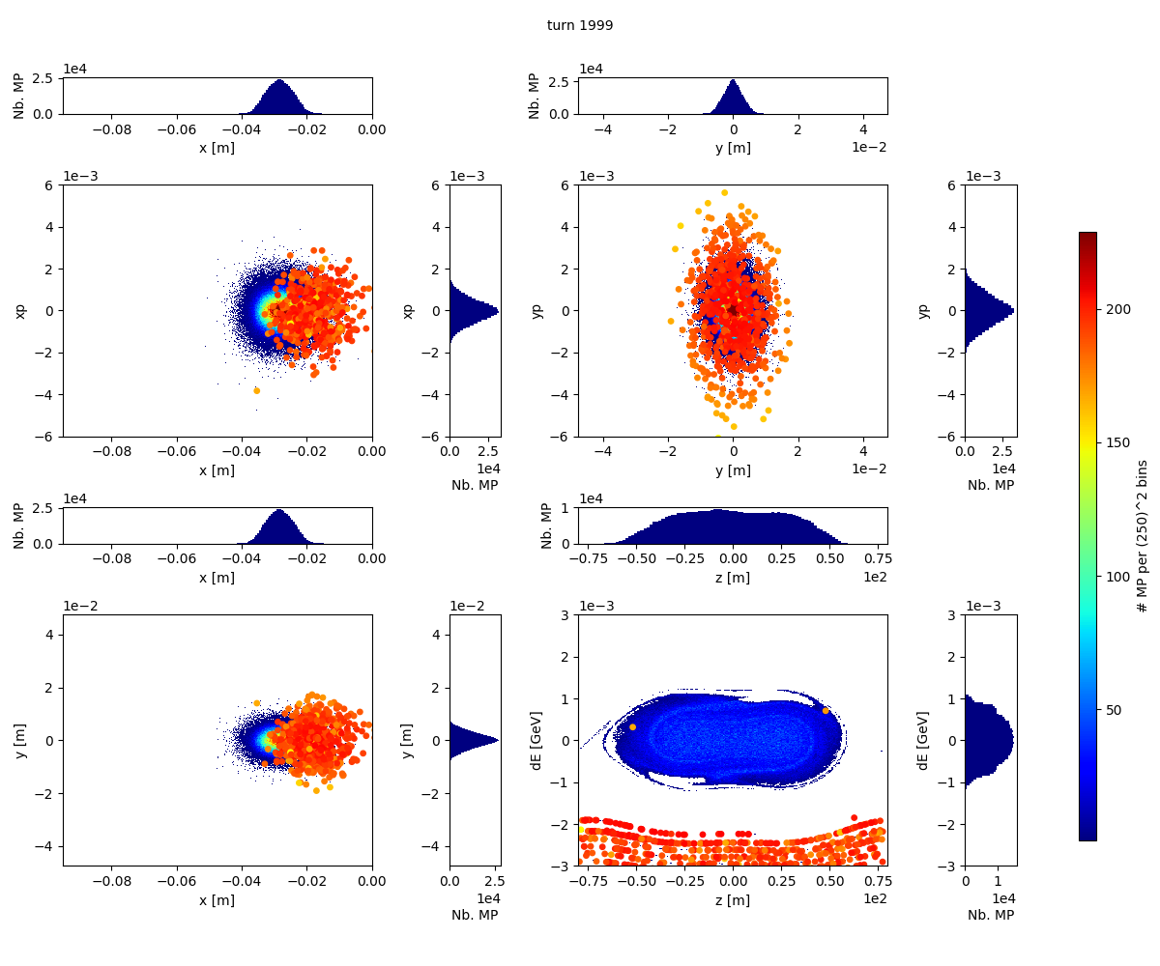
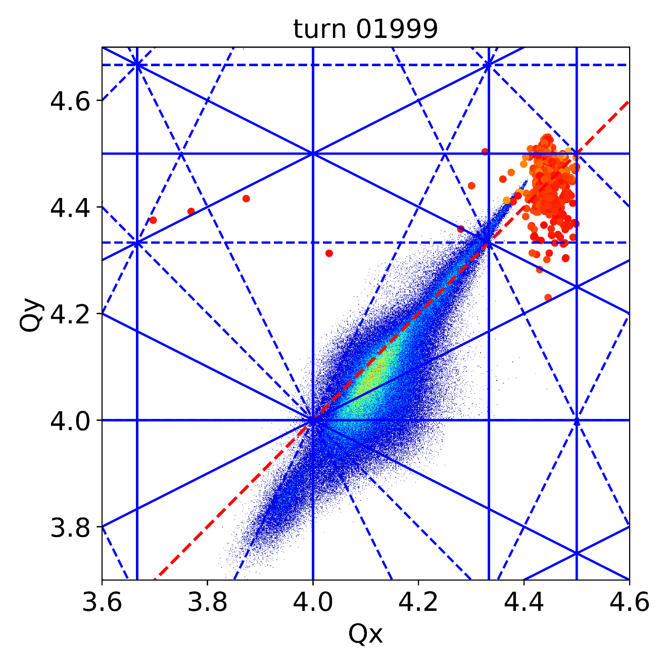

Simulation results III - Losses HL-LHC Beam
Total losses after turn 5000 ~ 0.6%
Obviously, no difference due to +- 125 BSW flat top reproducibility

Slide 10
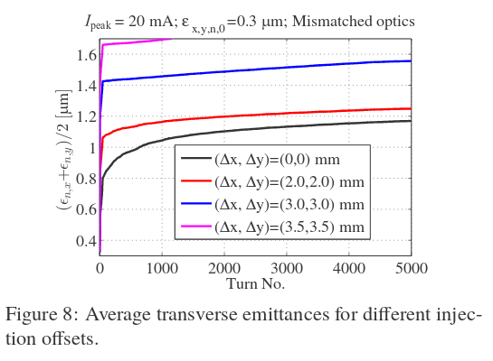
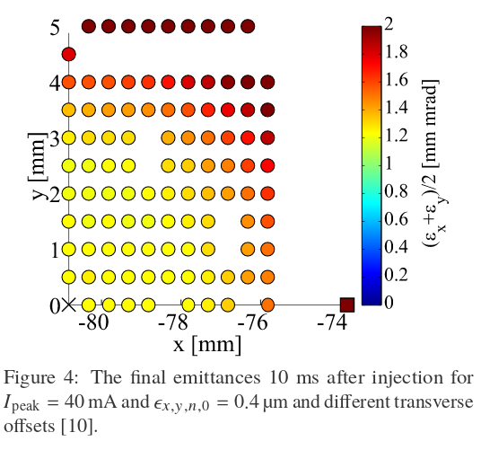

Going beyond +-125 ppm?
No simulations for BSW errors > +-125 ppm conducted
First, other error sources have to be included in simulation set-up.
Further margin required for unforeseen error sources, to stay below $ϵ_{rms,x /y}=1.7 μ$m
The specs should not be increased to > +-125ppm shot to shot reproducibility, as margin needs to be kept for other error sources.
V. Forte, Multi-particle Simulations of the future CERN PSB Injection Process with updated LINAC4 Beam Performance, WEP2PO007, HB2018

Slide 11
Plans and conclusion
The most pessimistic combination of BSW errors (+,-,-,+ 125 ppm) was considered to estimate the impact of a worst case scenario for the emittance of the HL-LHC beam.
Future studies will include randomized BSW errors
From current point of view, a shot to shot reproducibility of +-125 ppm is acceptable for achieving the brightness targets of the HL-LHC beam.
Other error sources need to be estimated and included before theoretical impact of BSW reproducibility > +- 125ppm could be looked at.
The specs should not be increased to > +-125ppm shot to shot reproducibility, as margin needs to be kept for other error sources.

Slide 12
Appendix

Slide 13
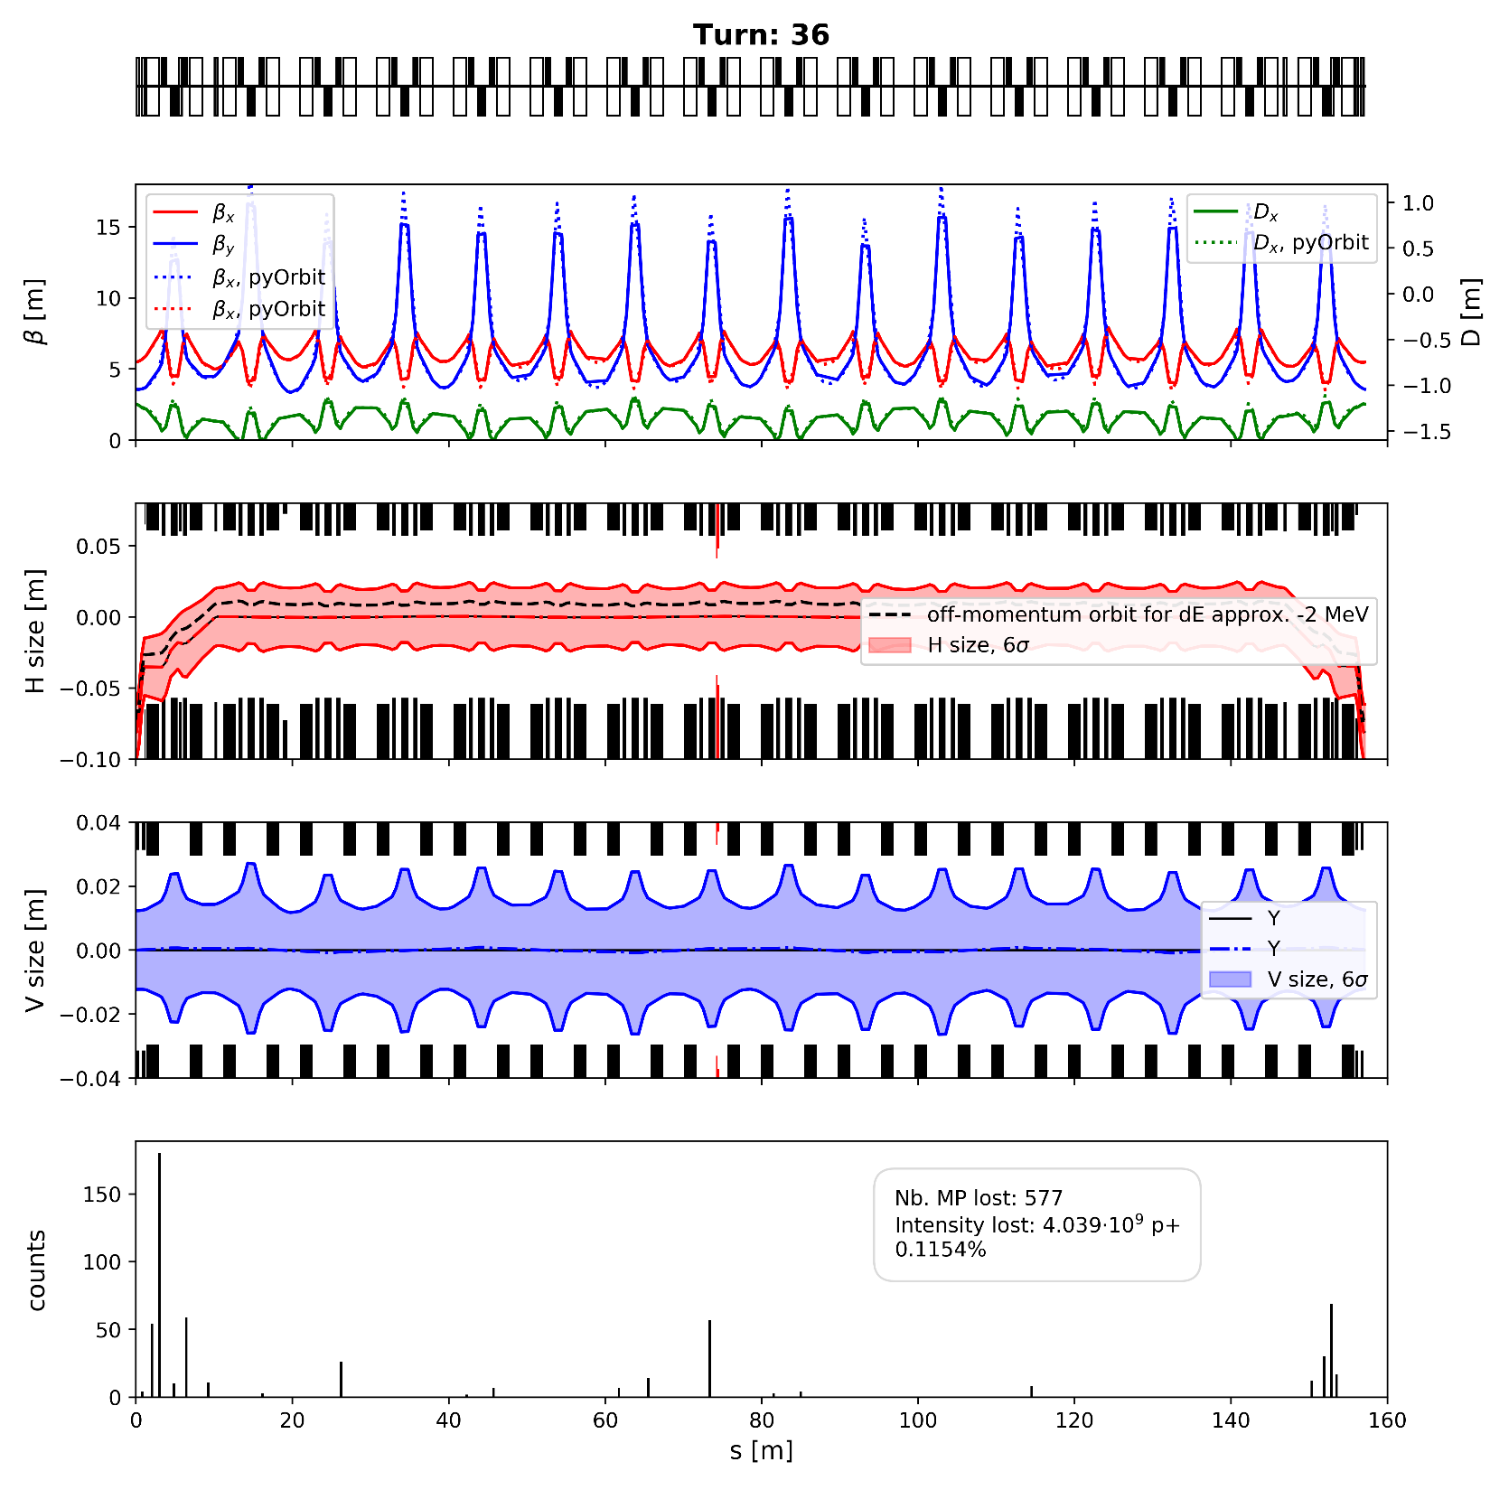
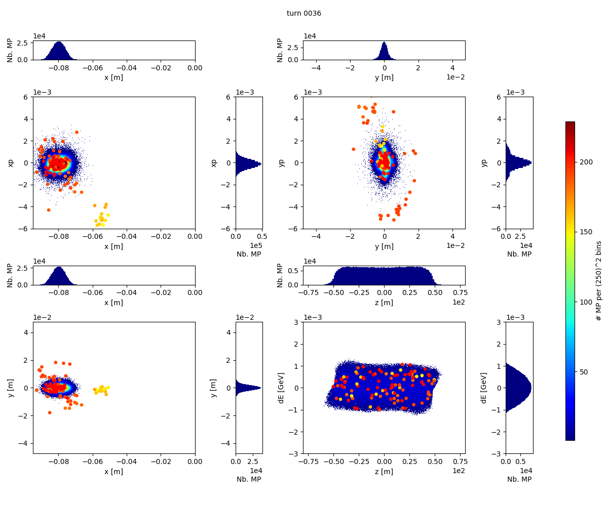
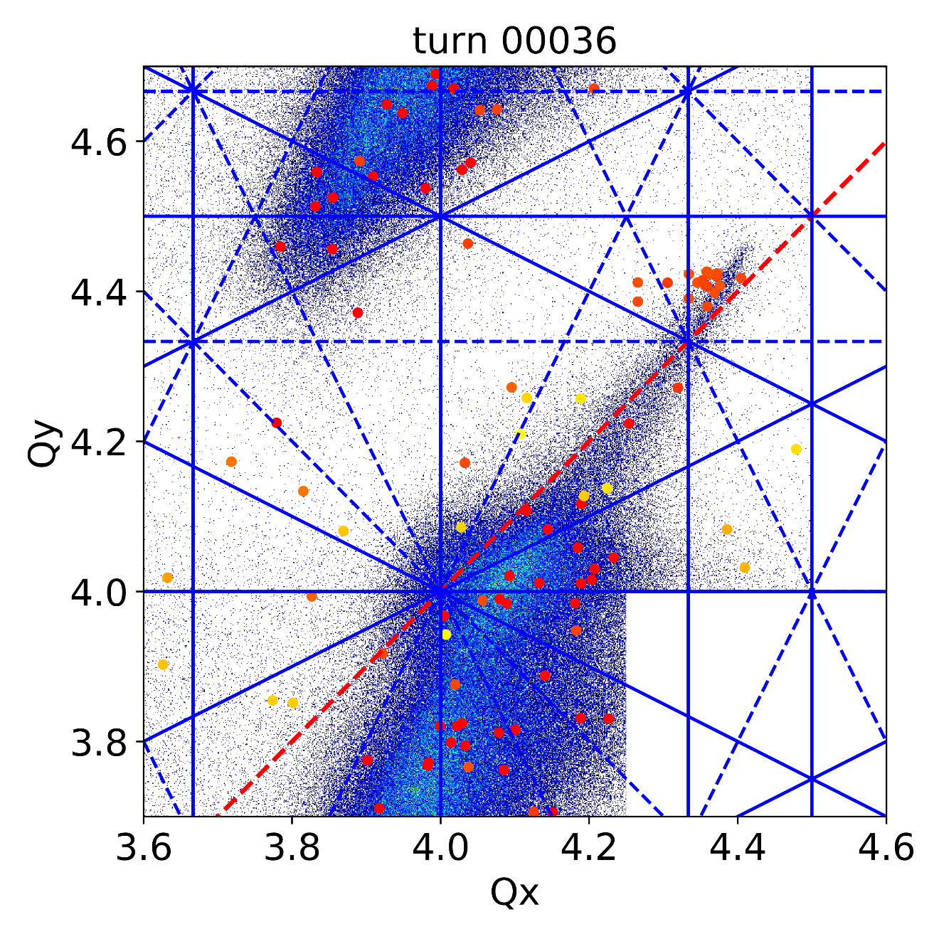
Simulation results III - Losses HL-LHC Beam
Scattering losses during first ~50 turns in injection region

Slide 14
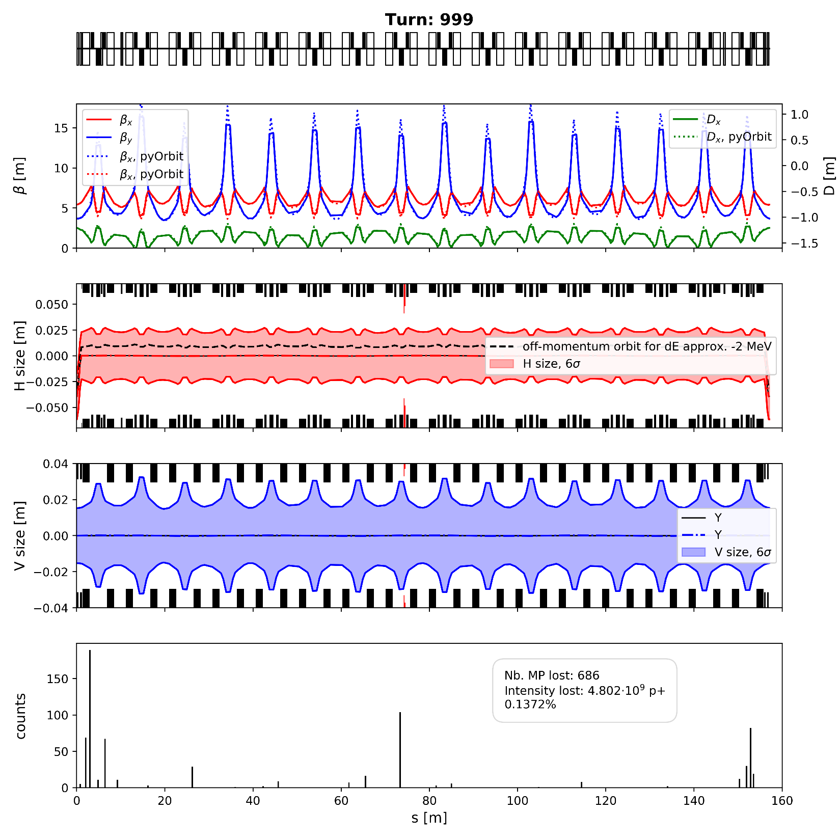
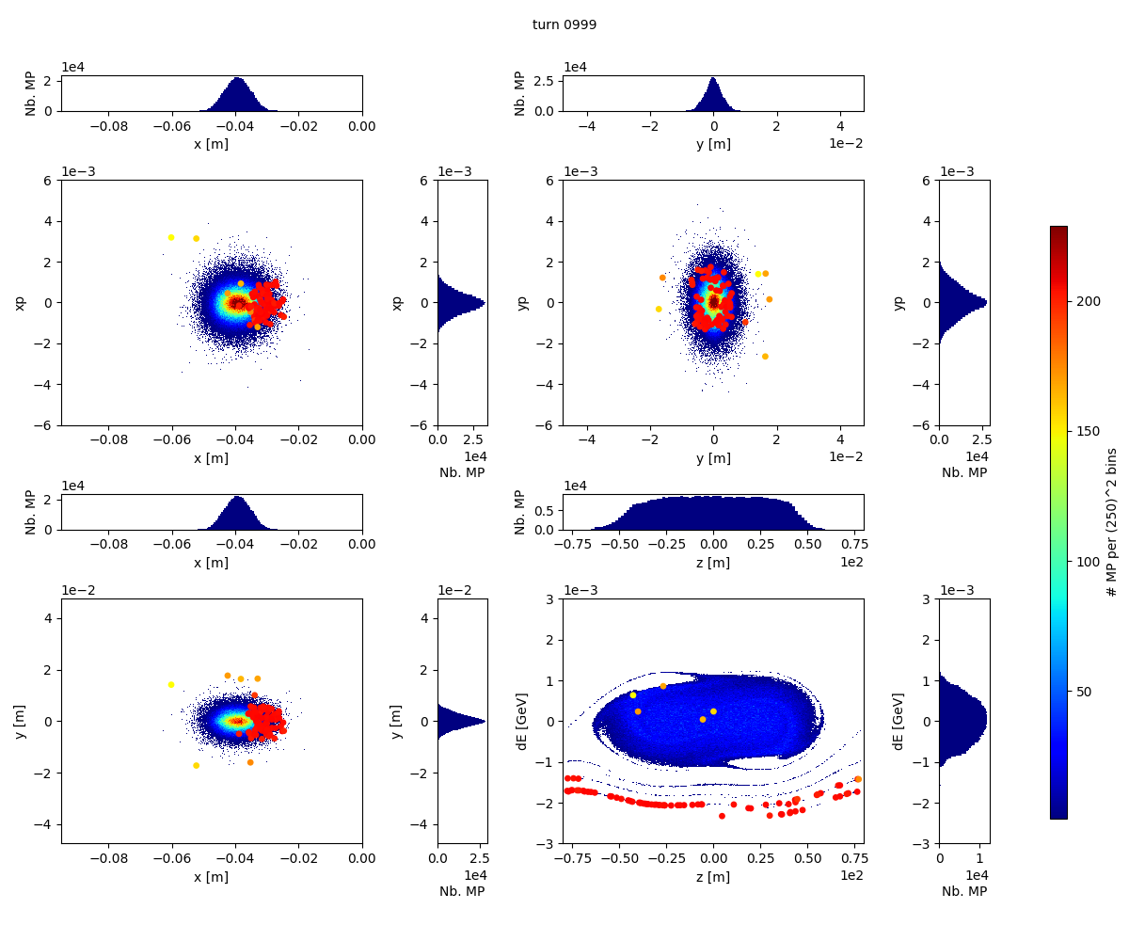
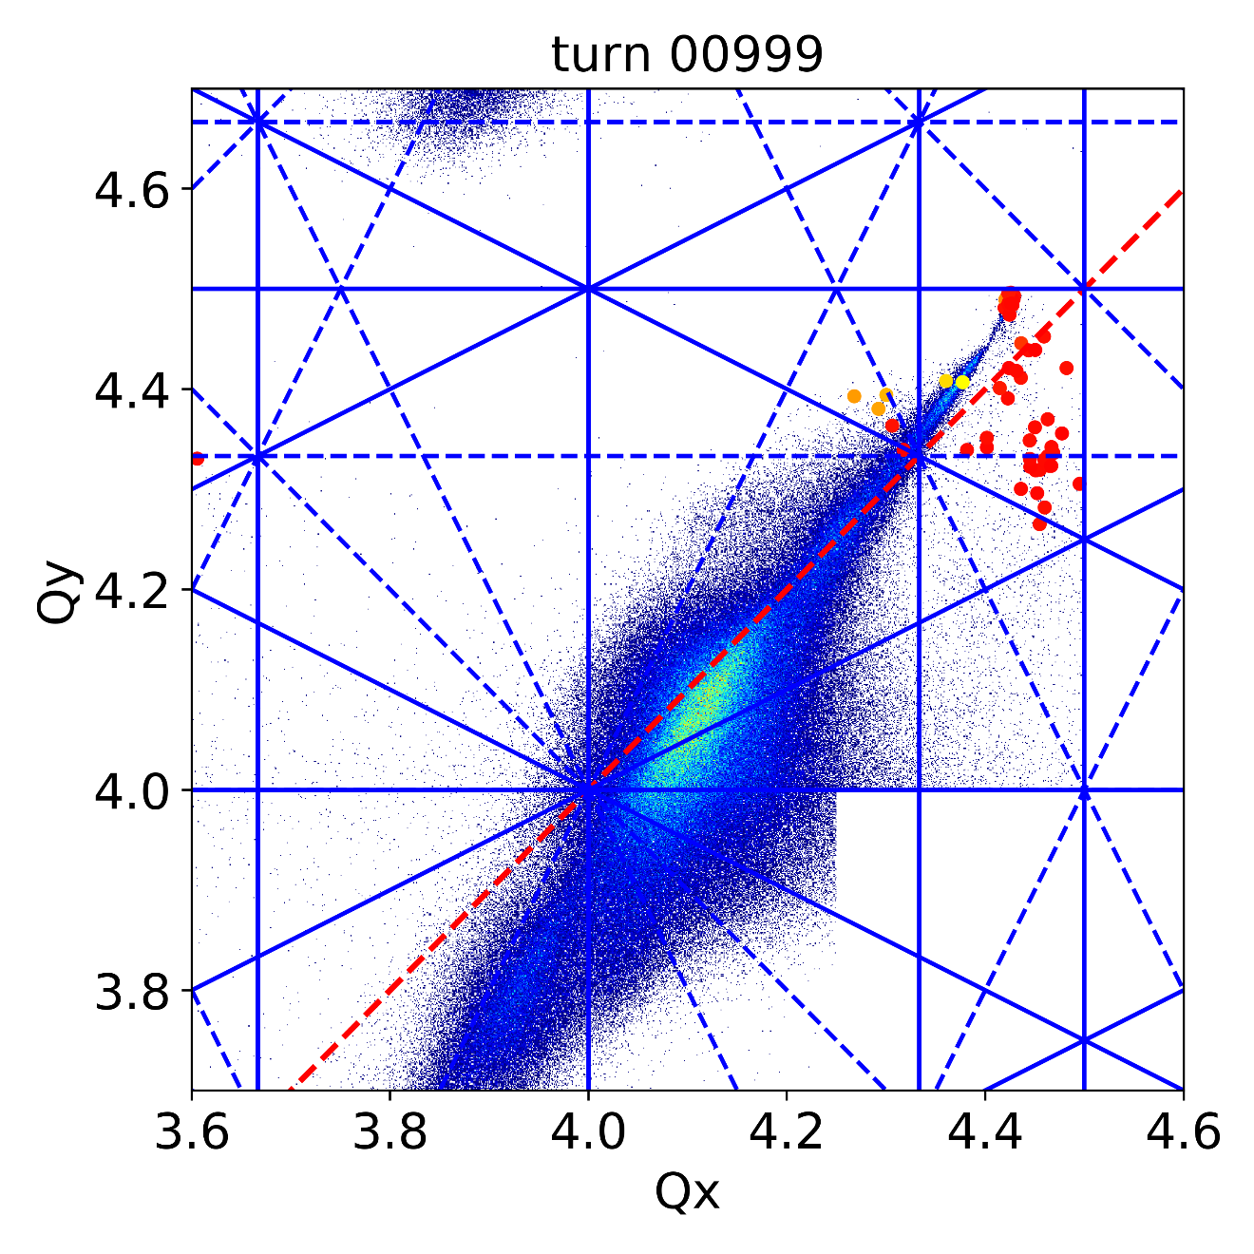
Simulation results III - Losses HL-LHC Beam
After turn 1000: off momentum losses at absorber

Slide 15
Simulation results III - Losses HL-LHC Beam
Total losses after turn 5000 ~ 0.6%
Obviously, no difference due to +- 125 BSW flat top reproducibility

Slide 16
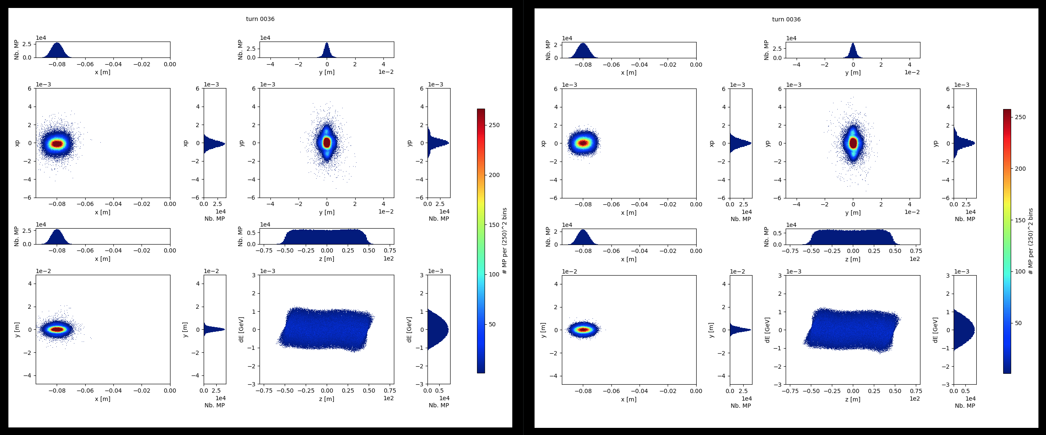
Simulation results III - Open points + Discussion
Open:
Emittance increase in x and y between turn 500 and 2000 for BSW error and x / y offset + -1mm?
BSW error, no offset (red)
BSW error, x- / y-offset = -1mm (yellow)

Slide 17
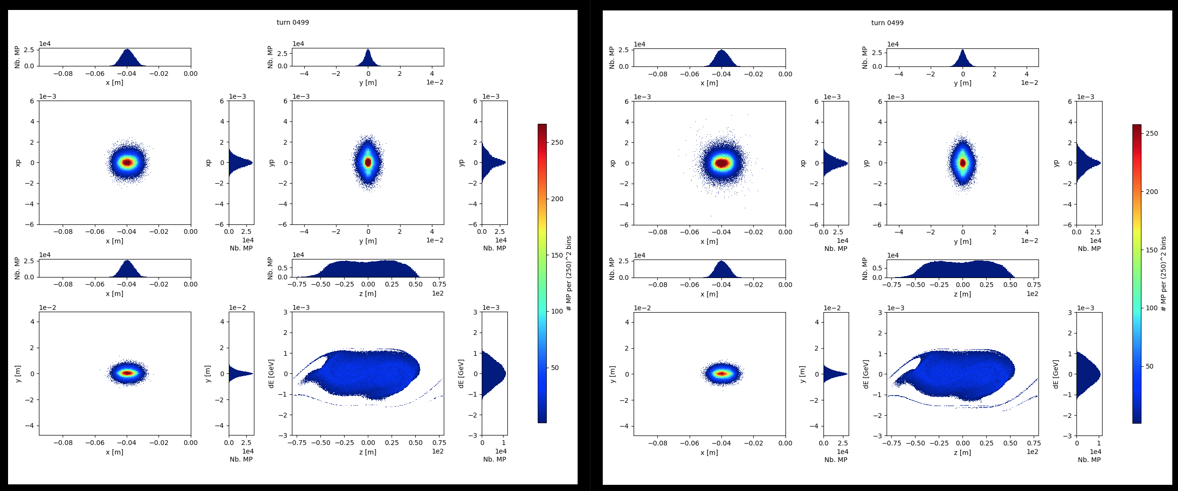
Simulation results - Open points + Discussion
Open:
Emittance increase in x and y between turn 500 and 2000 for BSW error and x / y offset + -1mm?
BSW error, no offset (red)
BSW error, x- / y-offset = -1mm (yellow)

Slide 18
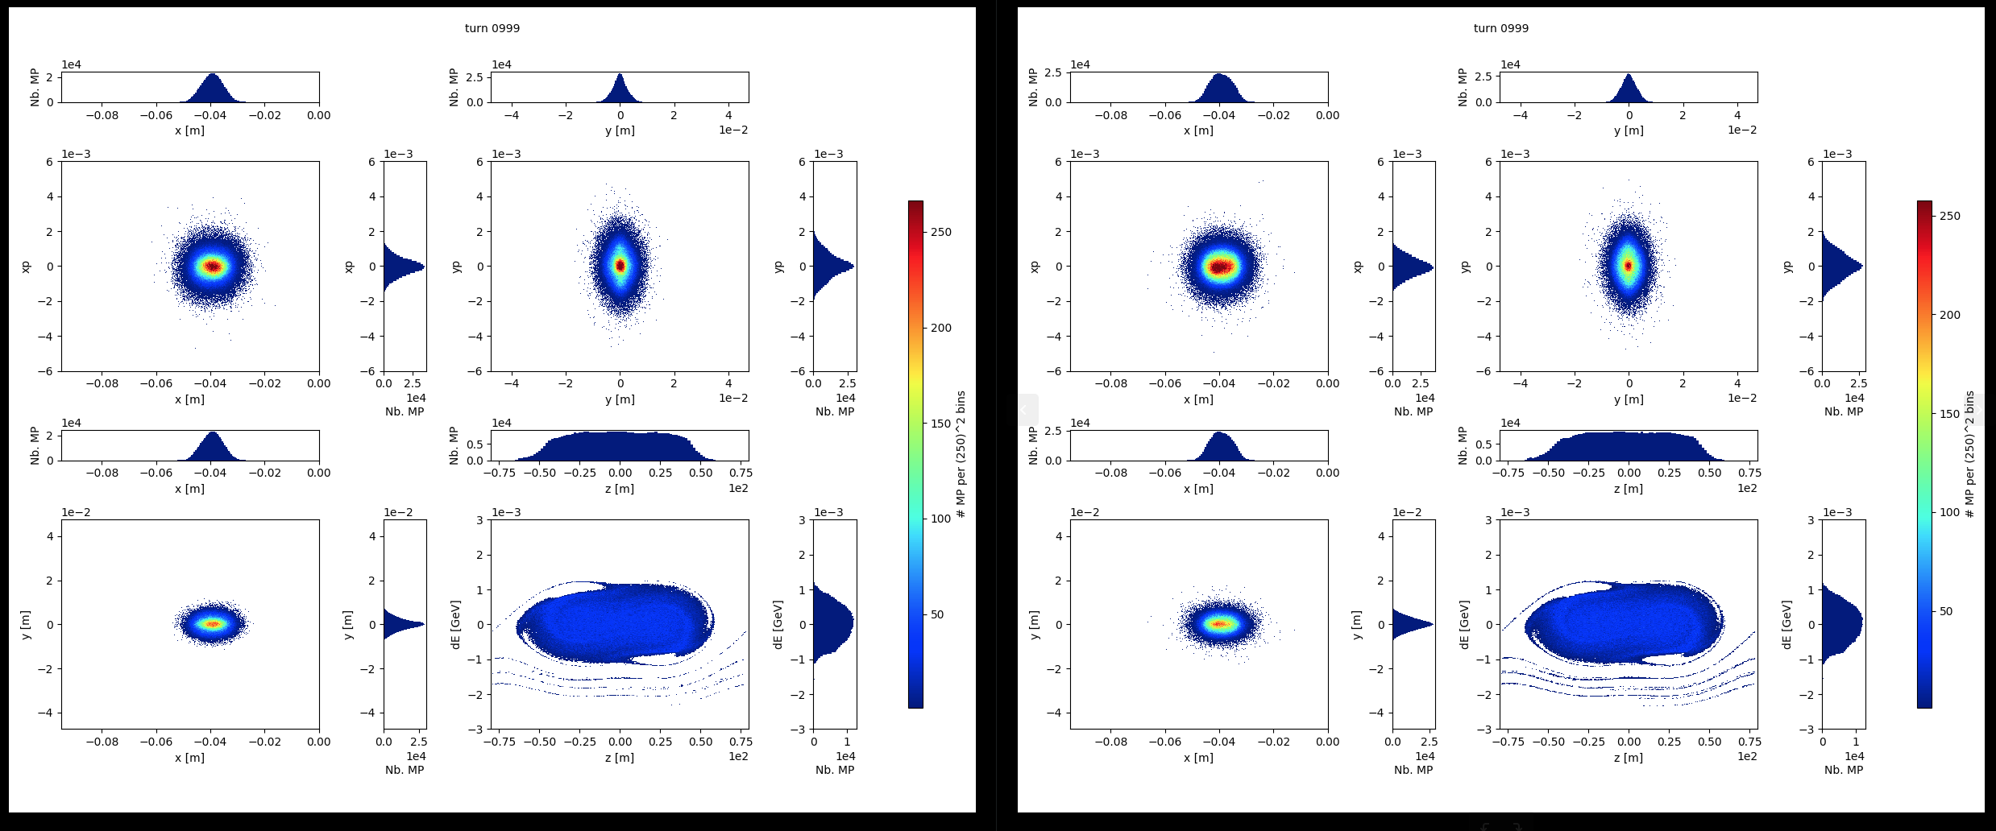
Simulation results - Open points + Discussion
Open:
Emittance increase in x and y between turn 500 and 2000 for BSW error and x / y offset + -1mm?
BSW error, no offset (red)
BSW error, x- / y-offset = -1mm (yellow)

Slide 19
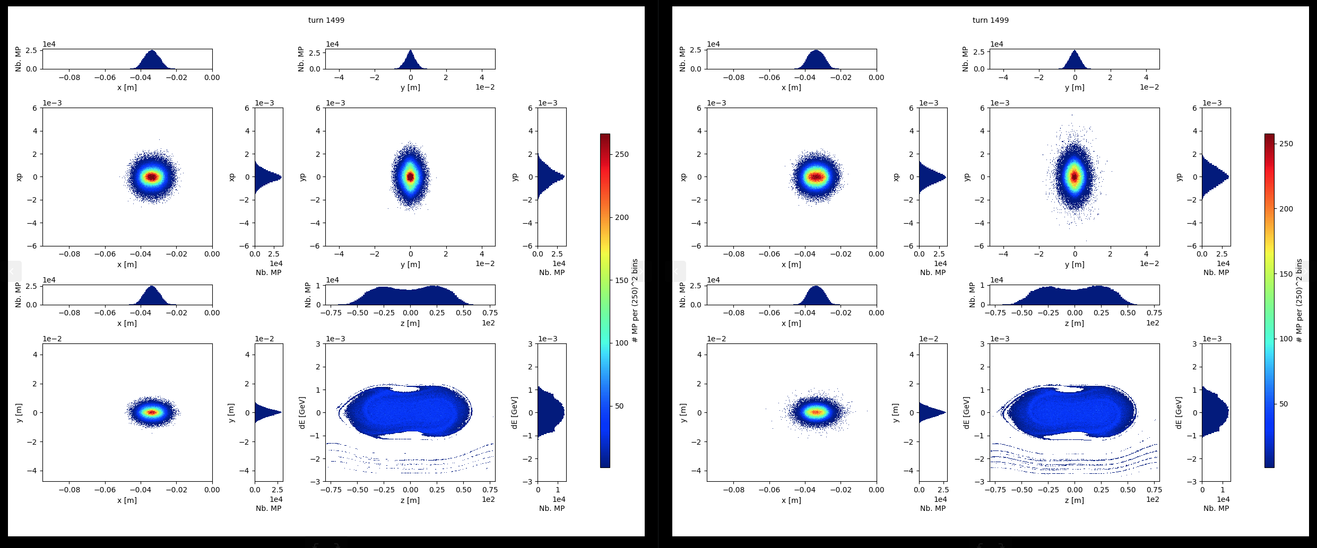
Simulation results - Open points + Discussion
Open:
Emittance increase in x and y between turn 500 and 2000 for BSW error and x / y offset + -1mm?
BSW error, no offset (red)
BSW error, x- / y-offset = -1mm (yellow)

Slide 20
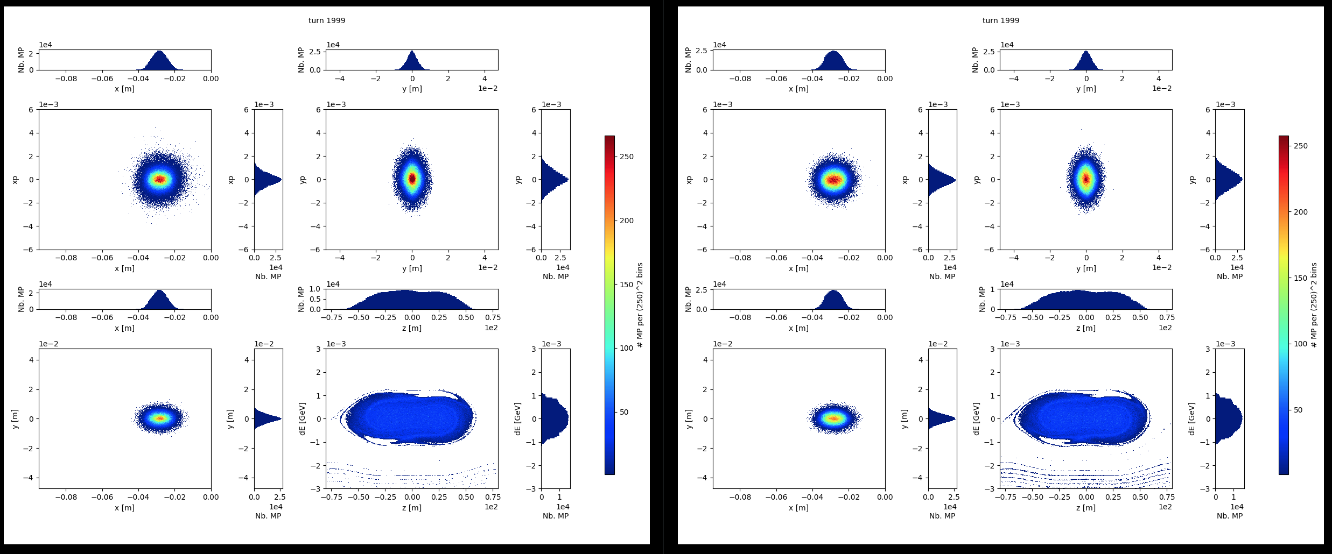
Simulation results - Open points + Discussion
Open:
Emittance increase in x and y between turn 500 and 2000 for BSW error and x / y offset + -1mm?
BSW error, no offset (red)
BSW error, x- / y-offset = -1mm (yellow)

Slide 21
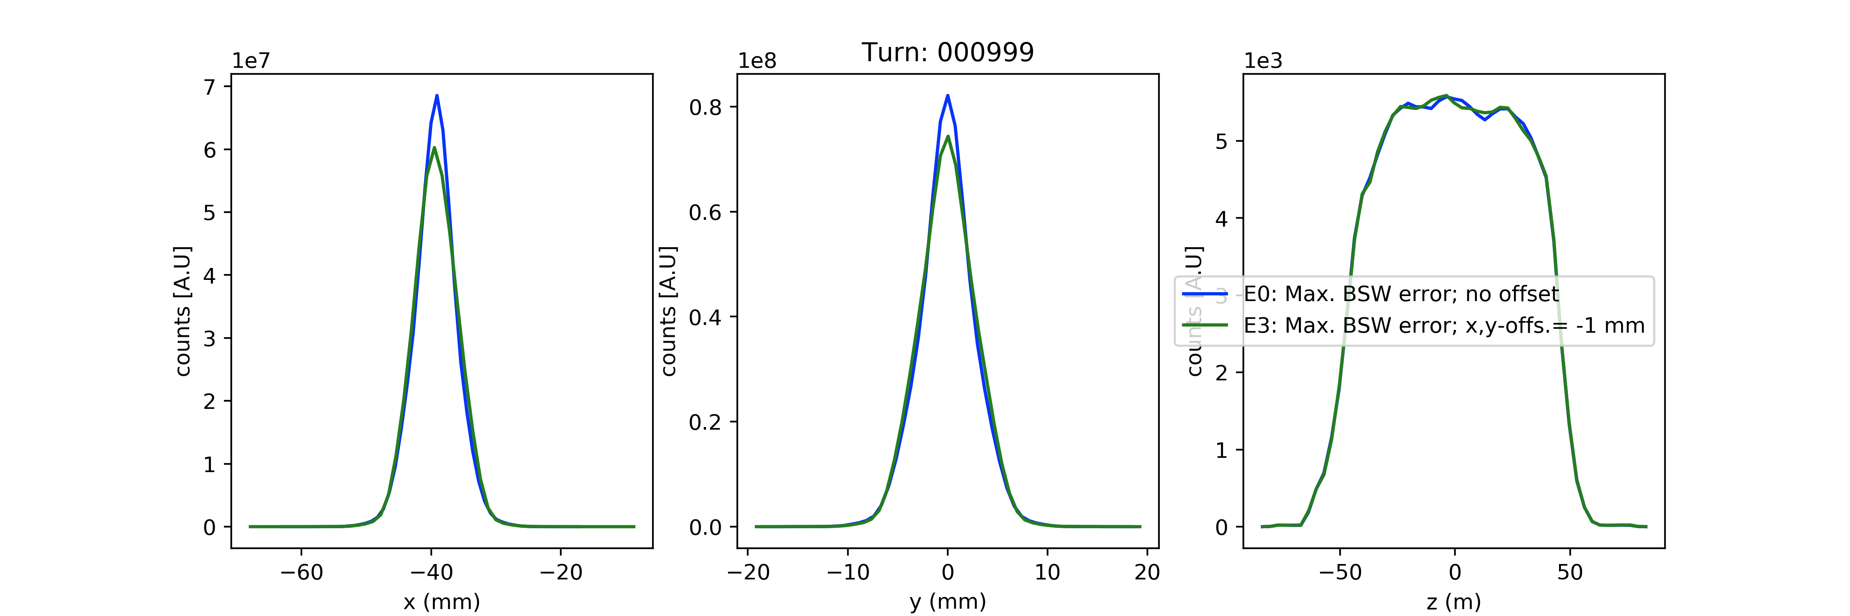
Simulation results - Open points + Discussion
Open:
Emittance increase in x and y between turn 500 and 2000 for BSW error and x / y offset + -1mm?

