Slide 1
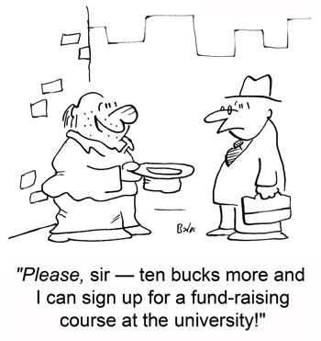
Fast know-how workshop on initiating
EU proposals
Module 0:
What is a proposal?
Pablo Garcia Tello (EU Office)

Slide 2
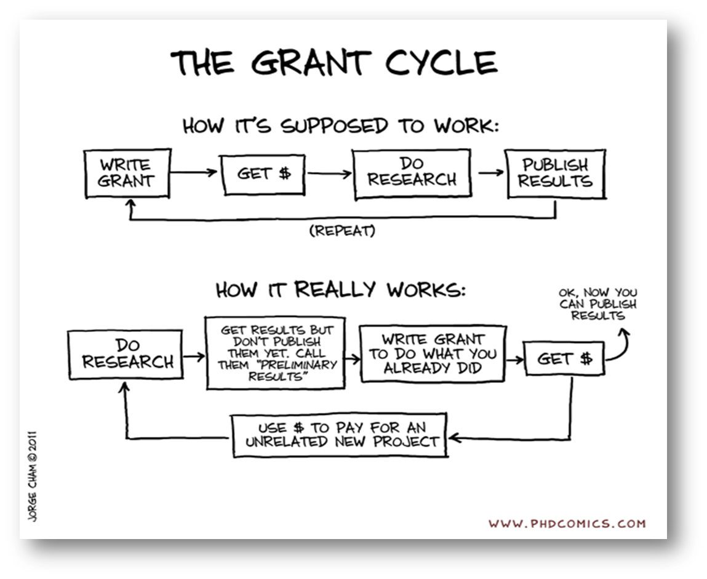
WHY DO YOU WANT TO SUBMIT A PROJECT PROPOSAL?
Money (alone) is NOT a good reason.
Some good reasons:
I want to co-fund activities that anyway I will do.
I want to work with partners that I normally will not work with.
I want to initiate a new R&D&I line.
It is important that you find your own good reason…because submission requires dedication and project realization even more

Slide 3
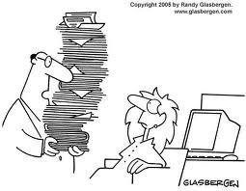
OK…but what is a project proposal…really?
It is a document that resumes:
What you want to do
With who
How and for how long
How much is going to cost
Why it is important
…and that if convincing enough
somebody can give you money….

Slide 4
…and who evaluates them…
…therefore who should you have in mind when you write a proposal…
THE BUREUCRAT
Is it eligible?
THE EXPERT
Is it innovative?
THE POLITICIAN
Is it worthy?

Slide 5
…what are the criteria…
(Example Horizon 2020)
Excellence | Impact | Implementation
Clarity of the objectives; Soundness of the concept, including trans disciplinary considerations; Credibility of the proposed approach; Progress beyond the state of the art. | The expected impacts listed in the work programme Enhancing innovation capacity and integration of new knowledge; Strengthening the competitiveness and growth of companies by developing innovations meeting the needs of European and global markets; …measures to, disseminate and exploit the project results,… communication. | Coherence and effectiveness of work plan, … allocation of tasks, resources; Competences, experience and complementarity of the individual participants, as well as of the consortium as a whole; Appropriateness of the management structures and procedures….risk management.
REMEMBER:
each one is equally IMPORTANT and must score above threshold

Slide 6
What scientists are good/regular/bad at usually
Excellence | Impact | Implementation
Clarity of the objectives; Soundness of the concept, including trans disciplinary considerations; Credibility of the proposed approach; Progress beyond the state of the art. | The expected impacts listed in the work programme Enhancing innovation capacity and integration of new knowledge; Strengthening the competitiveness and growth of companies by developing innovations meeting the needs of European and global markets; …measures to, disseminate and exploit the project results,… communication. | Coherence and effectiveness of work plan, … allocation of tasks, resources; Competences, experience and complementarity of the individual participants, as well as of the consortium as a whole; Appropriateness of the management structures and procedures….risk management.
☺
☺
😐
😐
😐
☺
😐
😐
☹
☹
☺
disseminate
☹
exploit

Slide 7
Nothing
Idea
Project
Funding
Execution
Benefit
Finishing with a serious note:
a good project proposal helps you a lot when realizing the project
…so invest time on it.
Project Value Chain
Generate Ideas and validate them.
Structure your ideas and make them executable and competitive.
Identify and secure your funding sources.
Manage effectively your project solving challenges.
Exploit the results for your benefit.

Slide 8
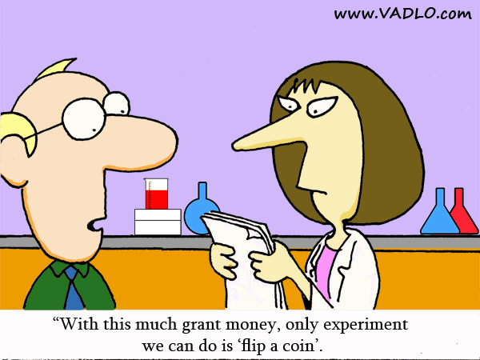
Module 0: General key messages…
Your proposal is read by different people….keep that in mind.
ALL Evaluation criteria are worth the same.
A good project proposal helps you manage your project.

Slide 9
Questions?

