Slide 1

ISOLDE Technical Report
Richard Catherall EN-STI-RBS
ISOLDE Technical Coordinator
62nd INTC meeting 6th November 2019

Slide 2
Outline
Target Development and Disposal
Medicis
Nanolab
Status of work in experimental hall
Frontends
HIE and FE Commissioning

Slide 3
Outline
Target Development and Disposal
Medicis
Nanolab
Status of work in experimental hall
Frontends
HIE and FE Commissioning

Slide 4
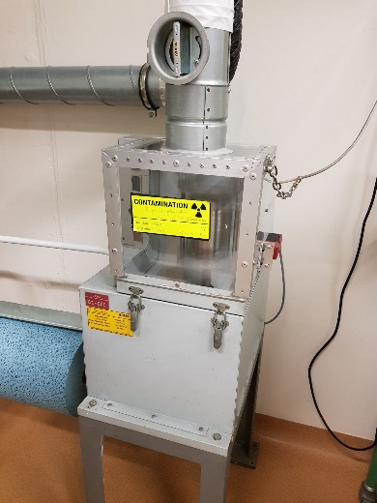
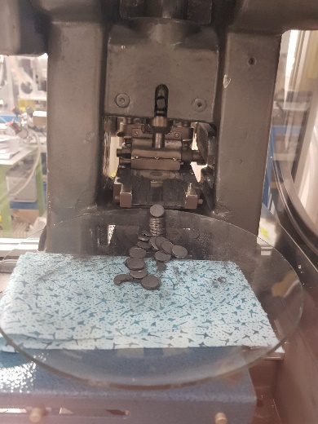
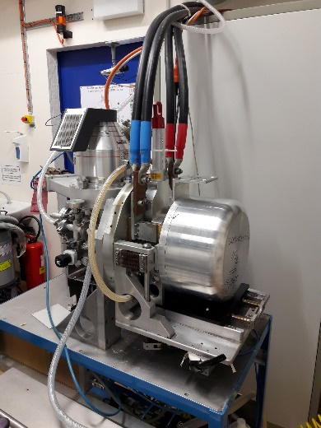
Optimisation of UC_{x} production
Annual production: 10-12 batch
Production rate: 1 batch / week
Current method
2100°C
1920°C
1300°C
1580°C
2 x 10⁻⁴ mbar
Mixing
Pressing
Carburization
Heating speed is limited by vacuum level (max. 2 x 10⁻⁴ mbar)
1.5 hours
2.5 hours
120 hours
New method
Increase of pressure limit
→ 2 mbar
NEXT STEP:
Control and Validation of new method
Microstructural characterisation of UC_{x}
Isotope release tests online
Mixing
Pressing
Carburization
1.5 hours
2.5 hours
15 hours
(N.-T. Vuong, M. Owen, S. Rothe)

Slide 5
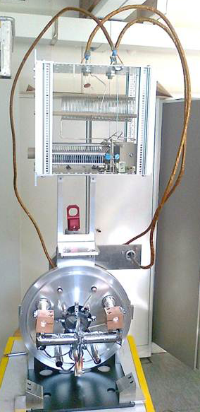
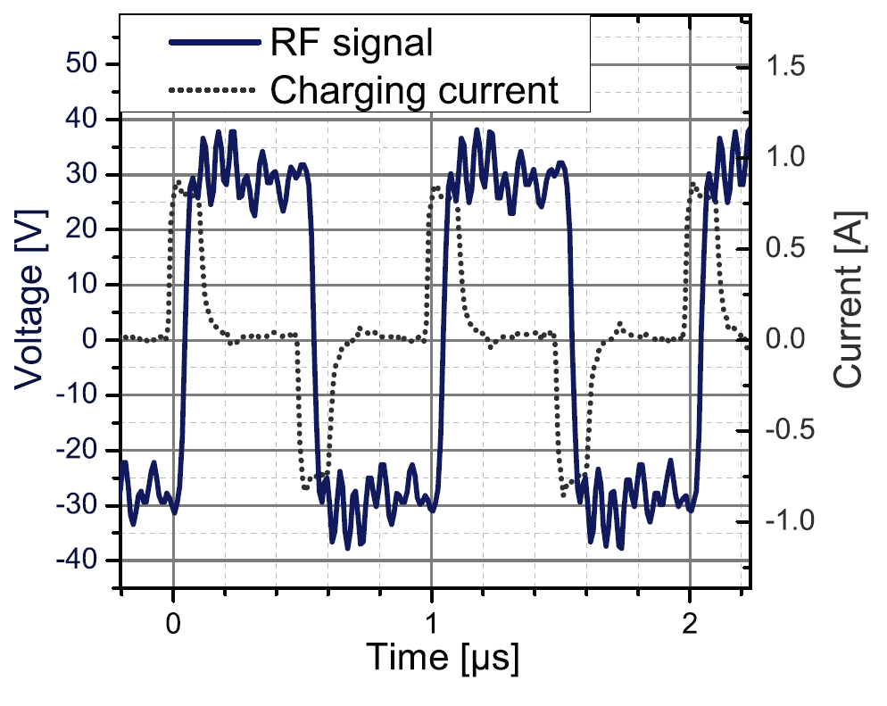
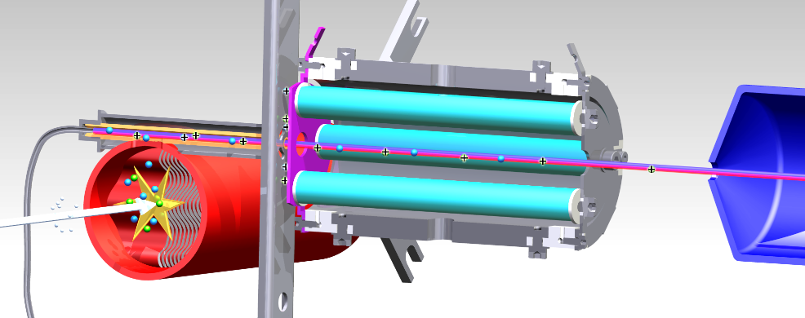
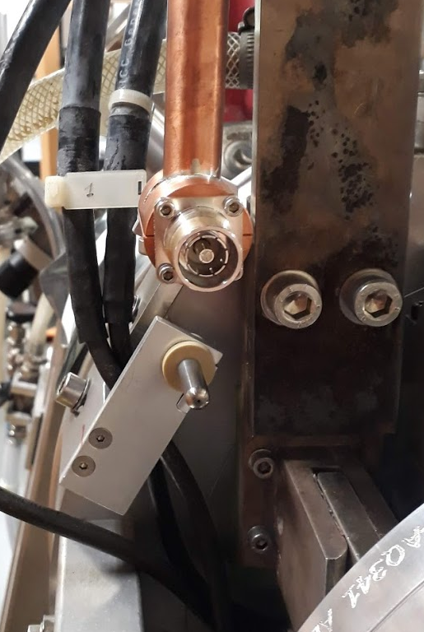
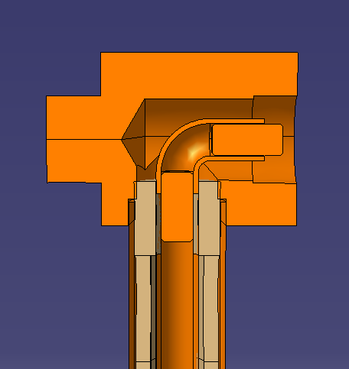
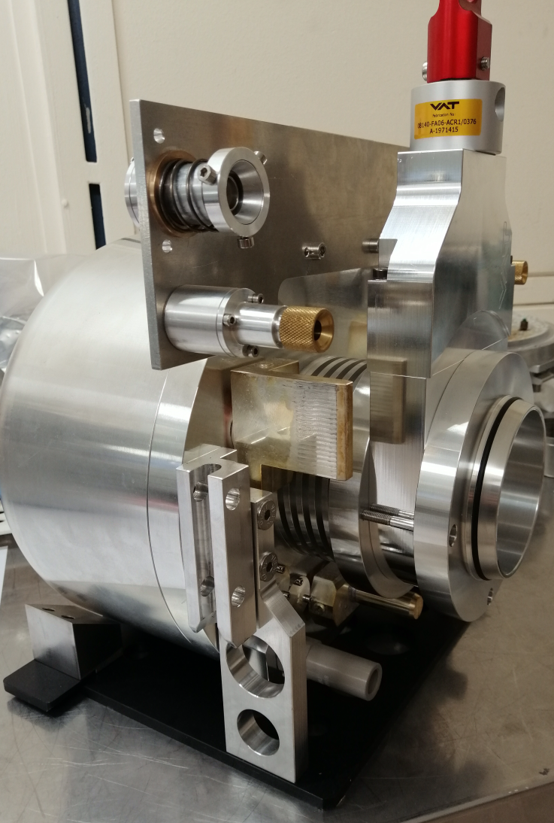
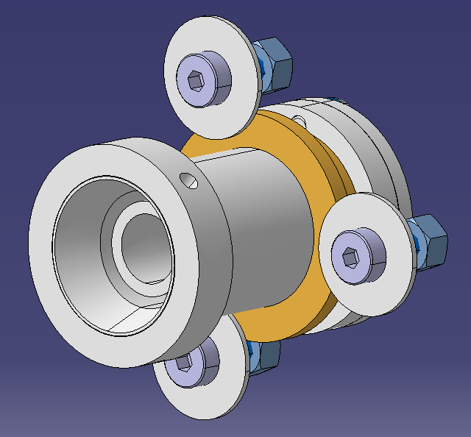
LIST @ Frontend 10,11
S. Raeder et al., Rev. Of Sc. Instr. 85, 033309 (2014)
  LIST delivers very pure beams at ISOLDE: More and more requests
  LS2: More reliable rad. hard RF connector designed, integrated to FE
  Square wave driven RFQ needs to be verified, respective hardware purchased and installed
  Objectives for after LS2:
  both Frontends will be compatible to LIST
  2 RF lines reduce complexity of the target
  LIST offered as standard ion source to users
LIST RF connectors: frontend and target side
(J.Cruikshank, R.Heinke, S.Rothe)

Slide 6
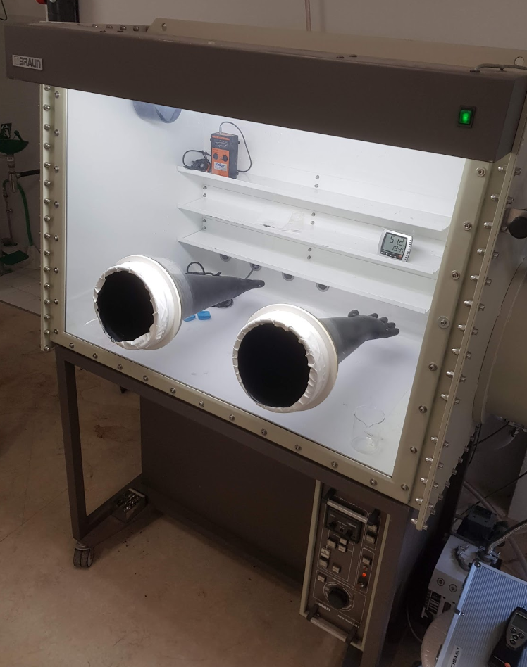
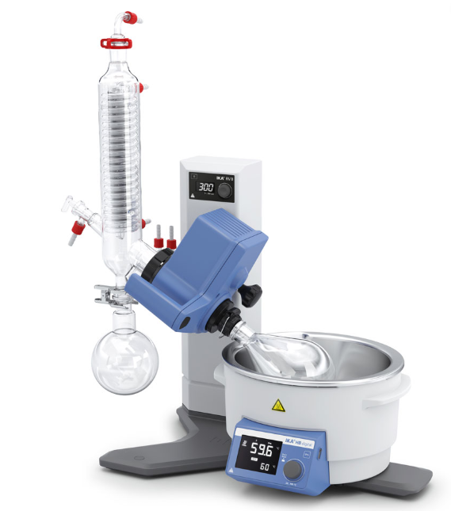
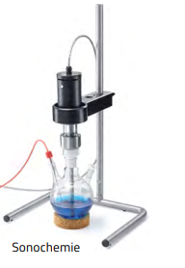
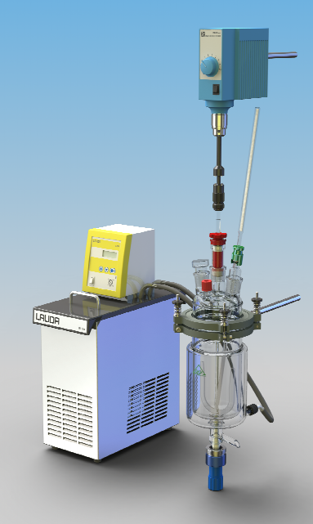
Restart of non-actinide nano materials
  Requirement for development towards actinide nano materials. Equipment purchase ongoing.
  Old Glovebox to be refurbished in Chemical lab Bat.26
  New extraction system for hydraulic press: design phase
  Dry tests and documentation with HSE planned for Q4 2019
  After LS2: Ensure safe production of MWCNT and other non-actinide nano targets in-house
Glovebox underpressure test
(B.Crepieux, R.Martins, S.Rothe)

Slide 7
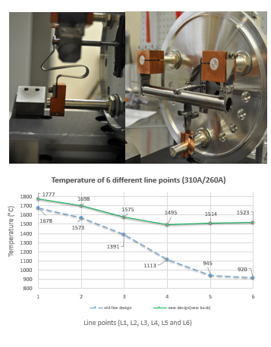
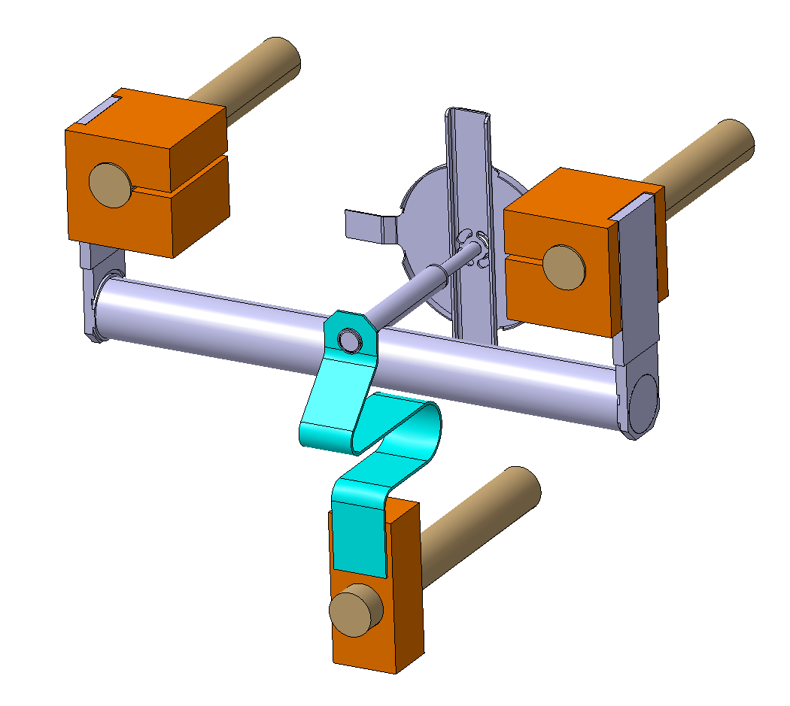
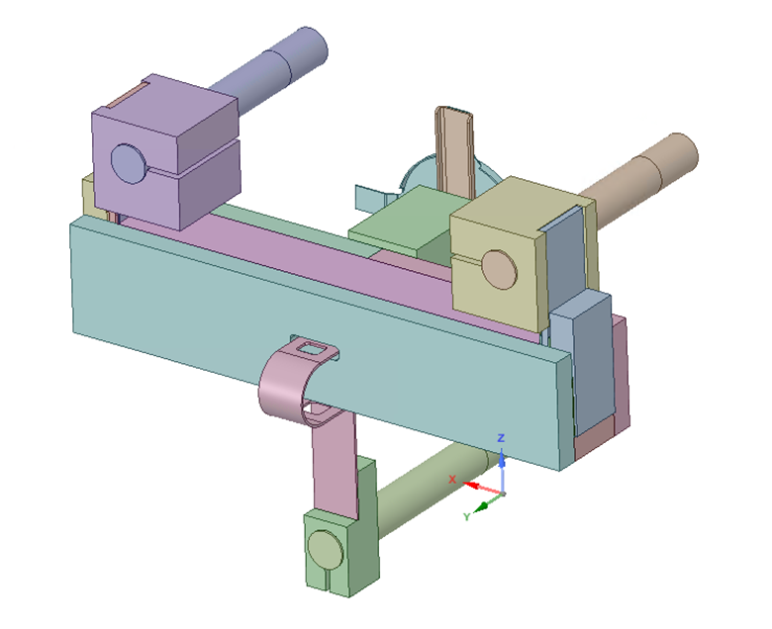
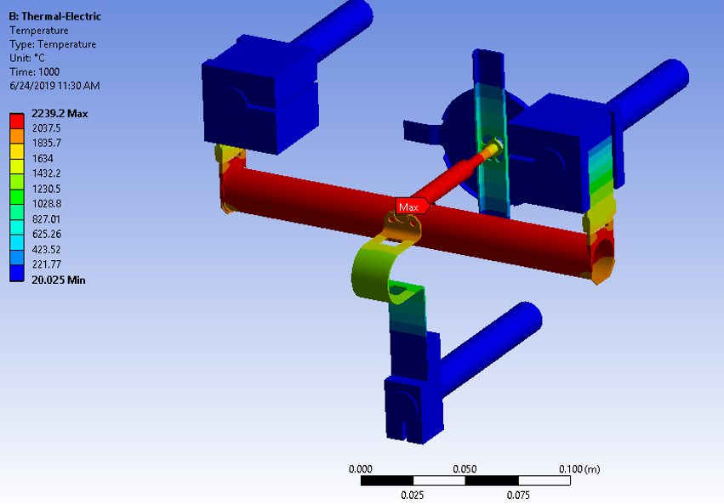
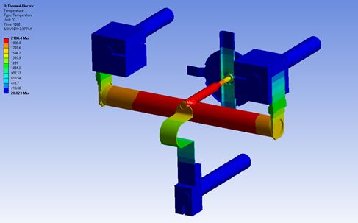
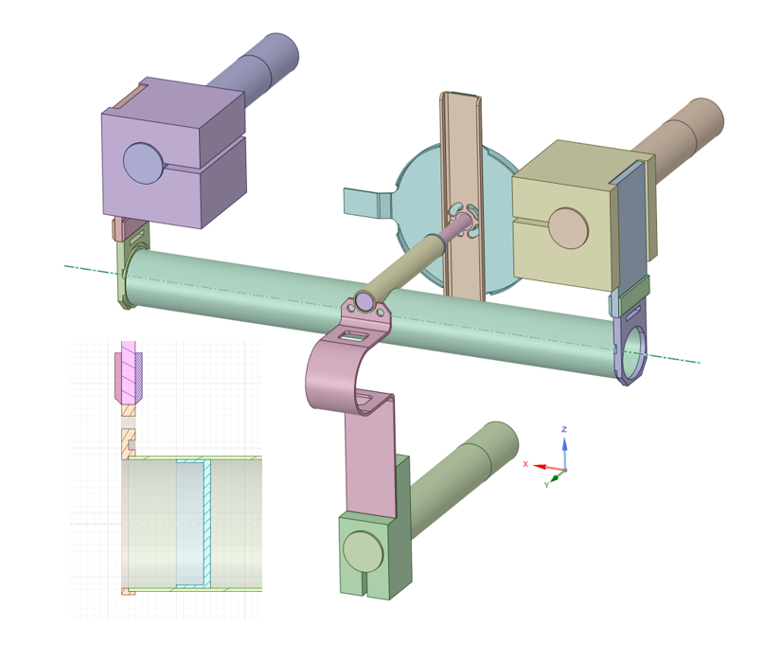
Improved target and ion source heating
  Main goal is to remove cold spots in the target, which reduce yield
  CAD design and ANSYS ready, waiting for prototype
First exp. results: New line heating reduces ΔT
1) Transfer line heating from the back
2) SIGRATHERM® MFA as a new thermal insulation
Simulated concept
new
old
new
3) New optimized cap design
New caps design + 50% less material in the container extremities
DT<150°C
old
(V.Samothrakis, S.Marzari, S.Rothe)

Slide 8
Outline
Target Development and Disposal
Medicis
Nanolab
Status of work in experimental hall
Frontends
HIE and FE Commissioning

Slide 9
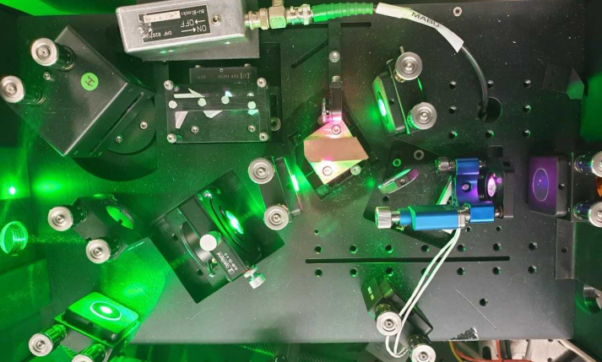
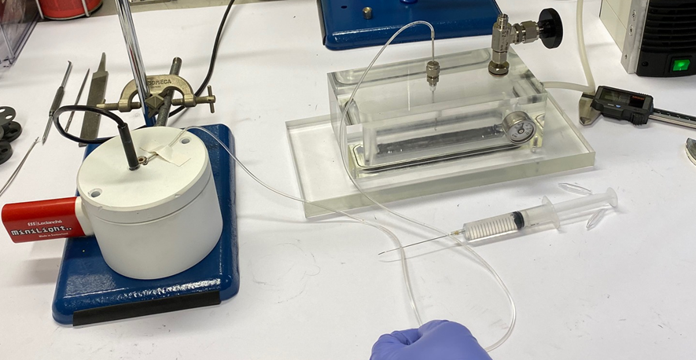
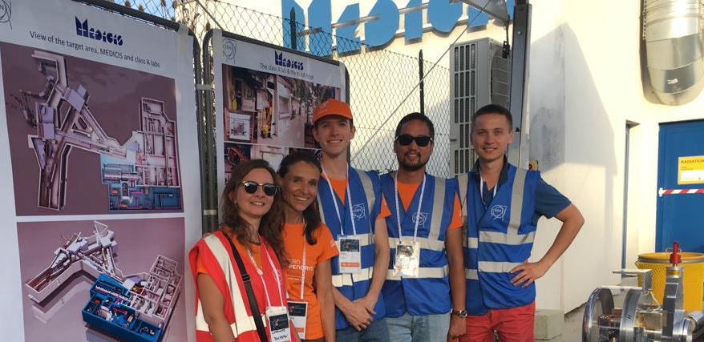

MEDICIS Status Report
Laser beam in MELISSA laboratory
Successful first collections using external sources and first ever laser ionized beam used during collection
  7x Er-169 → 288MBq Total
    Ampoules imported from ILL, delivered to PSI and NPL
  4x Yb-175 → 519MBq Total
    Ampoules imported from ILL, delivered to PSI : 1st results for medical experiment MED-18 already achieved.
  2x Tb-155 → 0.2MBq Total
    Target imported from Arronax, delivered to NPL and SCK/KULeuven
  3x Pt-195m → 450 MBq total
    Ampoules imported from ILL, 1 delivered to HUG without mass separation
New set-up for decontamination and opening of ampoules (courtesy B. Crepieux )
  Successful reduction of dose received during procedure by factor 3
    Factor 10 reduction achievable with planned development
  Well in compliance with ALARA
4th MEDICIS Collaboration Board Meeting
  Reports from collaborations and experimental status updates
  New proposals and future upgrades discussed
Latvia minister visited CERN
  Waiting for the official notification of Latvia joining up
New set-up for decontamination and opening of vials
Open Days at MEDICIS (~1400 visitors )
LP + RBS team
Slide prepared by L. Lambert

Slide 10
Outline
Target Development and Disposal
Medicis
Nanolab
Status of work in experimental hall
Frontends
HIE and FE Commissioning

Slide 11
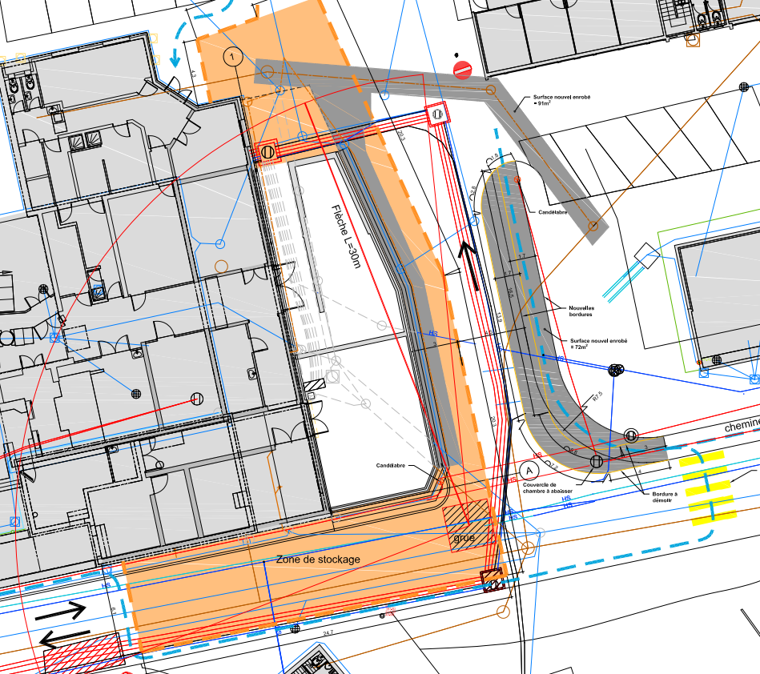
Nano-lab
As from January 2020, the worksite will be closed off as shown.
Access to B. 179 for “big” material will be difficult between Feb and May.
Ventilation of the labs (not target area) will be stopped for ~5 months starting Jan 2021
  Impact on actinide target production

Slide 12
Outline
Target Development and Disposal
Medicis
Nanolab
Status of work in experimental hall
Frontends
HIE and FE Commissioning

Slide 13
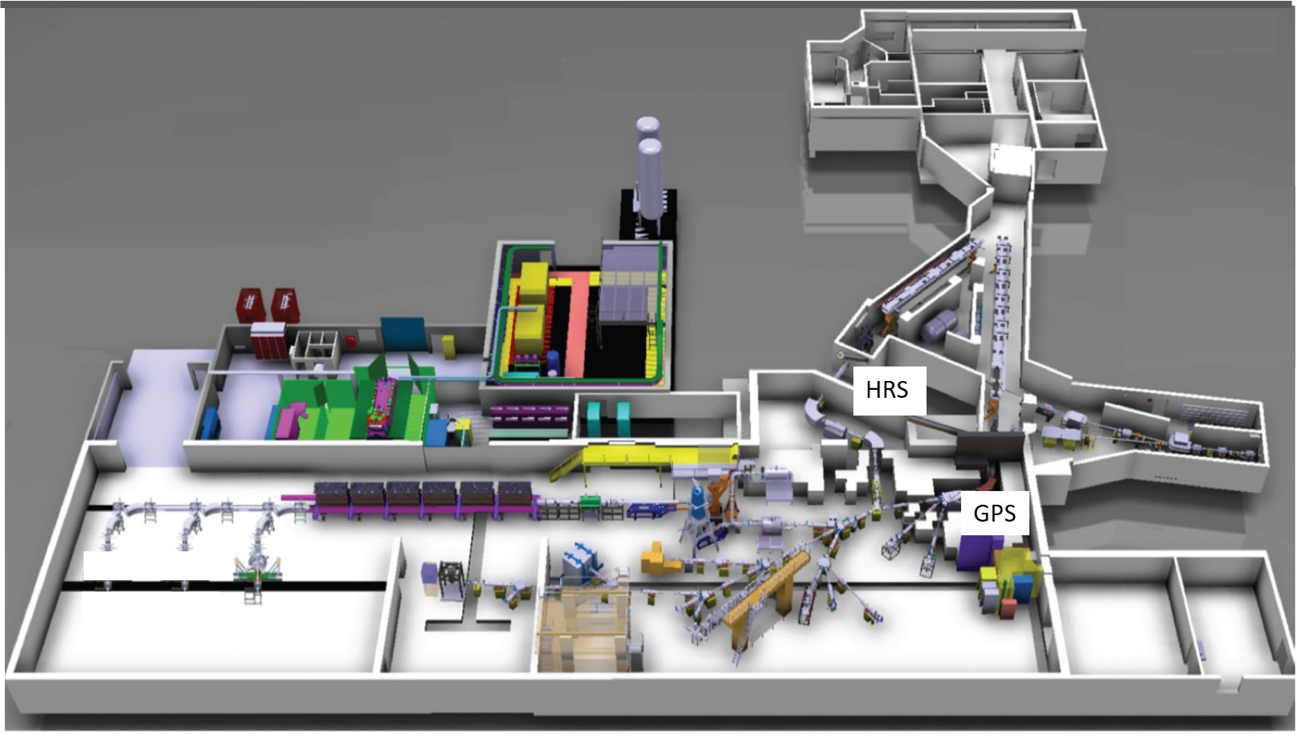
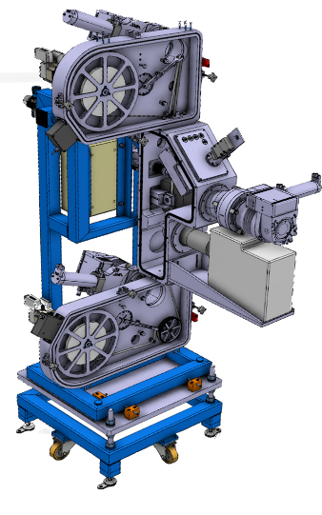
Readiness ISOLDE Low Energy
Status:
Delay on the production of the new Front-End: a lot of time has been recovered
FE10 and FE11 installation in resp. January and June 2020 followed by commissioning
New Front-Ends:
Catching up delay caused by mechanical issues (extraction electrode)
FE10 (HRS) assembly finalized. Ready for installation Jan 2020
FE11 ready for installation June 2020
GLM & GHM area:
Refurbishment to comply to modern legislation for the manipulation of open sources
Ready for start-up in 2020
HT modulators:
High Precision 60kV DC HV power supplies installed on HT 1 & 2
Target Modulators, HT fast recovery systems, installed on HT1 & 2
FESA3 compliant control system deployed
On site test load and HT calibration tools installed
Ready for commissioning at start-up in 2020
REX / HIE ISOLDE:
See next slide
New fast Tape-Station:
Installed in the CAO beamline
Operational at start-up in 2020
E. Siesling

Slide 14


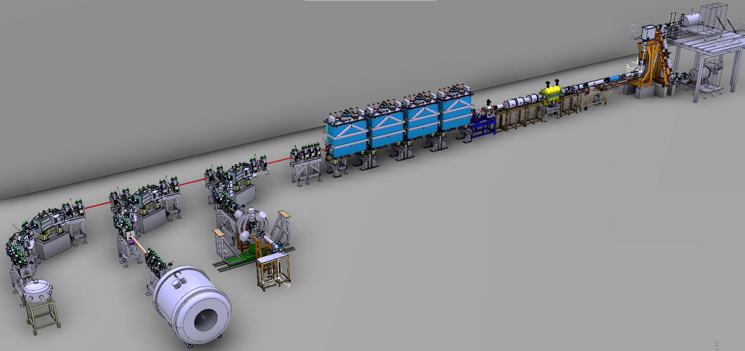
Readiness REX & HIE ISOLDE
Status:
All REX / HIE ISOLDE LS2 tasks are on track
Aiming for early start-up as planned (ISOLDE planning dec 2018) for a REX / HIE ISOLDE re-commissioning, test & development run in 2020 (Schedule approval pending).
REX TRAP & EBIS
REX NC LINAC
REX TRAP & EBIS:
TRAP maintenance and electrodes repair done. To be tested 2020
EBIS new electron gun under development. To be ready for tests 2020
HIE SC LINAC
HIE SC LINAC:
HIE ISOLDE Cryo plant preventive and corrective maintenance being carried out through 2019. Ready for cooldown and re-commissioning 2020
Cryo Module 4 repair carried out. Tests ongoing in SM18. Transport to ISOLDE January 2020.
Re-commissioning CM1-4 with stable beam from EBIS foreseen as of May 2020 as per ISOLDE planning
REX NC LINAC:
REX RF consolidation and maintenance done. First RF tests carried out. Ready for 2020 re-commissioning
Production additional 3 Diagnostic Boxes going as planned. Installation early 2020 followed by commissioning and test
REX vacuum maintenance ongoing. To be ready for 2020 re-commissioning
ISS
SEC
Cooling & Ventilation:
HIE ISOLDE CV building 199 modification finished. Beneficial for both the 199 cryo plant as well as the 508 CV/airco system (user labs).
508 CV/airco upgrade finished and labs are up to user specs.
Miniball
E. Siesling

Slide 15
Outline
Target Development and Disposal
Medicis
Nanolab
Status of work in experimental hall
Frontends
HIE and FE Commissioning

Slide 16
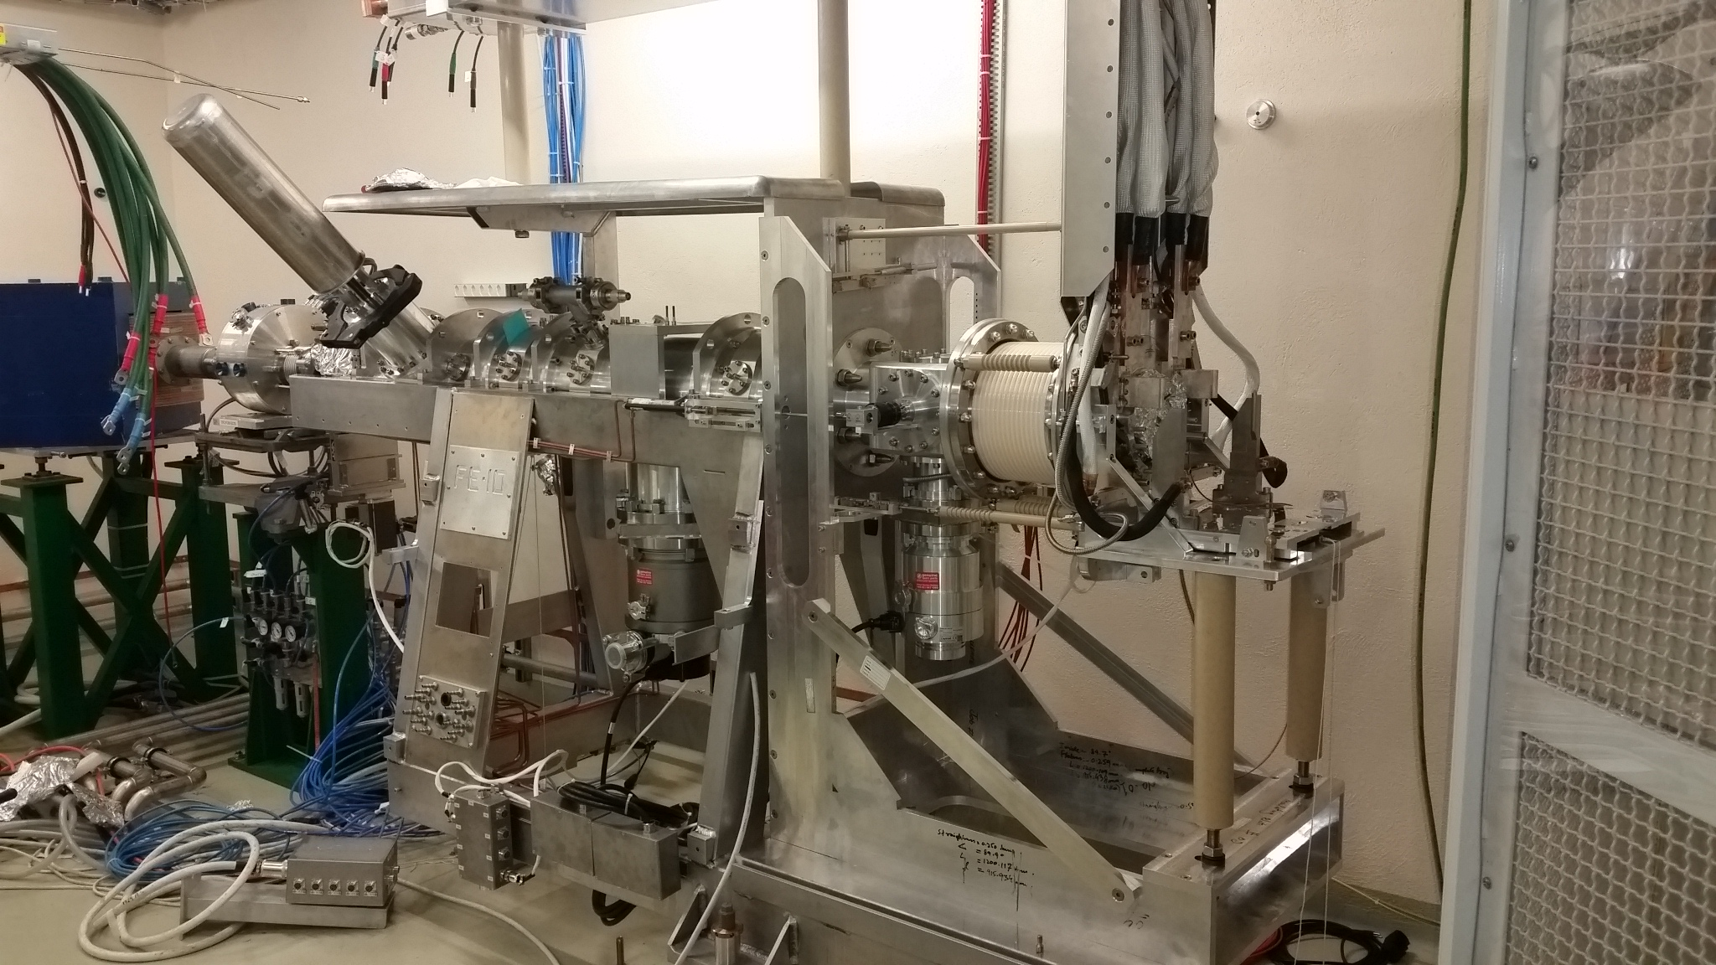
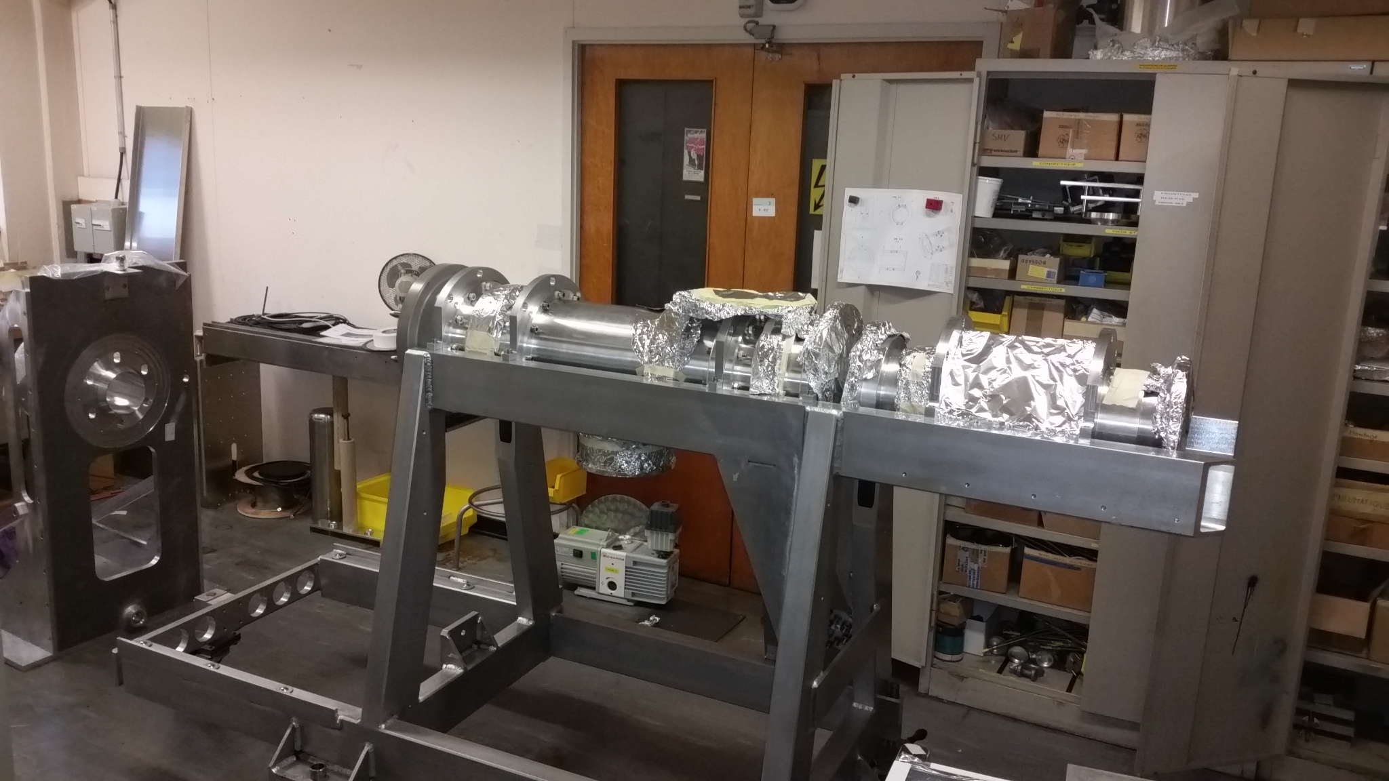
FE10 and FE 11 Production
Status of Front End 10:
  FE10 has been moved to the offline 2 for testing.
  Fudicialization and alignment done
  Objective is to have FE10 transported to the target area in January 2020
Status of Front End 11:
  All pieces are ready and assembling activities have started.
  Based on experience and duplicity of pieces, assembly should be faster
  Transfer to ISOLDE in Spring of 2020
FE10
FE11

Slide 17
Outline
Target Development and Disposal
Medicis
Nanolab
Status of work in experimental hall
Frontends
HIE and FE Commissioning

Slide 18
Start Up 2020?
The decision to start the ISOLDE facility as early as summer 2020 in preparation for the physic’s run in 2021 is still under discussion.
A justification/planning will be presented to the IEFC on the 22nd November for information prior to the Research Board in December 2019.
Constraints for FE’s
  Finishing and testing
  Access due to nano lab construction
Constraints for HIE-ISOLDE
  Operation costs – estimated at 130kCHF
  Both installations and the facility have an intense commissioning program…

Slide 19
Phases for hardware testing of FEs
Action | Group | ~Time (days)
Connection | EN-STI-RBS EN-HE | 5
Alignment | EN-SMM | 2
Movement | RBS/SMM | 2
Robot | EN-HE/SMM | 3
Vacuum | TE-VSC | 3
Water | EN-CV | 1
Low tension | RBS/ TE-EPC | 2
Target connections | RBS BE-OP | 2
HT transfer tube | RBS | 1
Controls | BE-OP BE-CO | 10
Interlocks | BE-OP | 1
High tension (1/2) | TE-ABT | 2

Slide 20
Commissioning of FE with stable beam
Action | Group | ~Time (days)
Beam production | BE-OP EN-STI | 5
Beam transport | BE-OP | 5
Scanners and FCs | BE-OP BE-BI | 10
Electrostatic equipment | TE-EPC BE-OP | 5
Fast tape station | BE-OP/CO EN-STI/SMM | 5
RFQ Cooler | EN-STI BE-OP | 5
Transport to REX/HIE | BE-OP/ABP | 20
Transport to experiments | BE-OP EP-SME | 20
Laser tests | EN-LP | 20

Slide 21

Beam Commissioning 2020:
New or heavily refurbished hardware:
New steerers and diagnostic boxes: FCs, slits, attenuators, collimators and silicon detectors (wks. 28, 29, 30)
New electron gun in the REX-EBIS charge breeder (contaminant characterization: wks. 29, 31)
REX RF amplifiers (wks. 30-32)
Phasing of refurbished cryomodule 4 (CM4) (wk. 33)
Two additional silicon detectors (wk. 34)
New software or major upgrades:
Beam instrumentation applications suite (wks. 28-30, 34)
New slow extraction application (wk. 30)
Fast Beam Investigation tool (wks. 31, 32)
Beam optimizer for injection into experiments (wks. 37, 38)
Energy / energy spread application (wk. 31)
Automatic SRF phasing (wk. 33)
New electron gun
Additional silicon detectors
Three new diagnostic boxes and steerers
CM4 repaired
Miniball
Experimental stations:
Stable beams (wks. 37, 38, 45, 46)
Long-lived radioactive beams (wks. 47, 48)
SEC / OTPC
ISS
J.A. Rodriguez, BE-OP-ISO

Slide 22
Machine Studies 2020:
Machine development:
Energy and energy spread measurement in three HEBT lines (wk. 34)
Transverse and longitudinal phase space characterization and validation of optics models (wks. 35, 43)
Machine A/q scalability studies (wk. 41)
Development of beam-based energy gain measurement (wk. 42)
Beam improvements requested by users of the facility:
Charge breeder slow extraction to 1.8 ms (wk. 30)
Feasibility study for low A/q beams. Stability of REX RF (wk. 36)
Energy spread minimization at secondary target (wk. 44)
Slit-based emittance reduction with limited beam losses (wk. 44)
Slow extraction (1.8 ms)
Train extraction
Stability REX RF for low A/q beams
Bunch length stretching
Energy spread minimization
Beam size minimization
New REX separator optics
Preparation for potential future upgrades:
Alternative REX separator optics with beam waist before RFQ (wk. 28)
Development of train extraction from the REX-EBIS charge breeder (wks. 28, 38)
Bunch length stretching at secondary target (wk. 43)
Miniball
SEC / OTPC
ISS
J.A. Rodriguez, BE-OP-ISO

Slide 23
HIE-ISOLDE commissioning
Action | Groups | ~Time (days)
Cryo commissioning | TE-CRG | 55
CM commissioning | TE-CRG | 35 (+20)
Survey | EN-SMM | 12
Beam commissioning | BE-OP | 42
Machine development | BE-OP | 40
Total |  | 184

Slide 24
2021 start – up if fully commissioned in 2020
Action | Groups | ~Time (days)
Cryo commissioning | TE-CRG | 55
CM commissioning | TE-CRG | 35 (+20)
Survey | EN-SMM | 12
Beam commissioning | BE-OP | 15
Machine development | BE-OP | 0
Total |  | 117

Slide 25
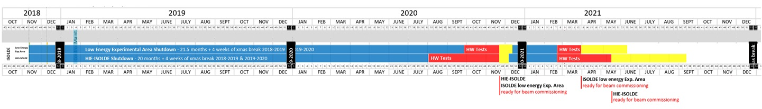
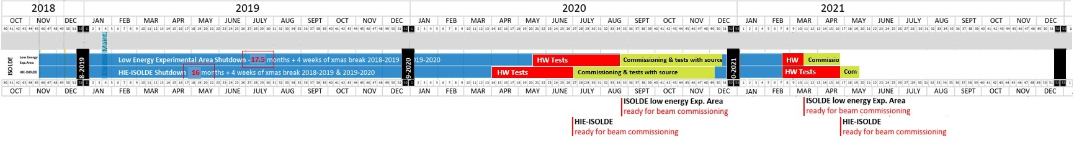
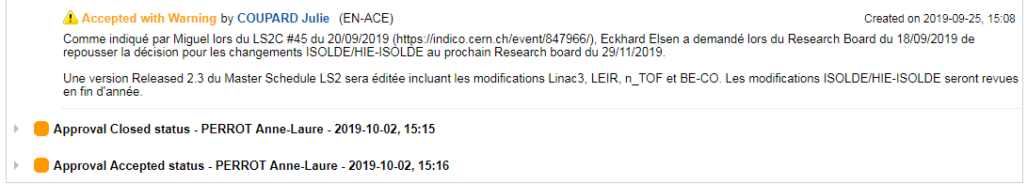
LS2 Schedule V 2.3: No early start-up in 2020 (since Oct. 2019):
HIE-ISOLDE
Physics start
As requested: Early start-up in 2020:
ISOLDE low energy
Physics start
HIE-ISOLDE
Physics start
No early start-up 2020:
Low E Physics start June 2021
HIE-ISOLDE Physics start mid-Sept 2021
Early start-up 2020:
Low E Physics start end April 2021
HIE-ISOLDE Physics start mid-May 2021
ISOLDE low energy
Physics start
Gain:
~ 4 months HIE ISOLDE Physics, ~1 month Low Energy Physics
Better performing machine, better understanding of the machine parameters resulting in higher quality beams and shorter set-up times
Courtesy of E. Siesling and J.Vollaire for BE-OP-ISO

Slide 26
Possible Planning Scenarios

