Slide 1
n_TOF Report
at the 62nd Meeting of the INTC
Daniela Macina, EN-STI-BMI
Oliver Aberle, EN-STI-TCD

Slide 2
Outlook
n_TOF organization during LS2
Main activities for LS2
  Horizontal beam line
  Target exchange
  New control room

Slide 3
n_TOF organization during LS2
n_TOF Experiment LS2 Coordination Meetings
(chair: D. Macina)
  INDICO link: https://indico.cern.ch/category/10884/
Mandate: Coordinate the LS2 activities in the experimental areas (EAR1, EAR2), in the electronics laboratory and control room
Meeting frequency: Twice a month
n_TOF Facility Technical Coordination Meetings
(chair: O. Aberle, scientific secretary: M. Barbagallo)
  INDICO link: https://indico.cern.ch/category/11206/
Mandate: Steering of global activities related to the n_TOF Facility during LS2
Meeting frequency: Every 6 weeks

Slide 4
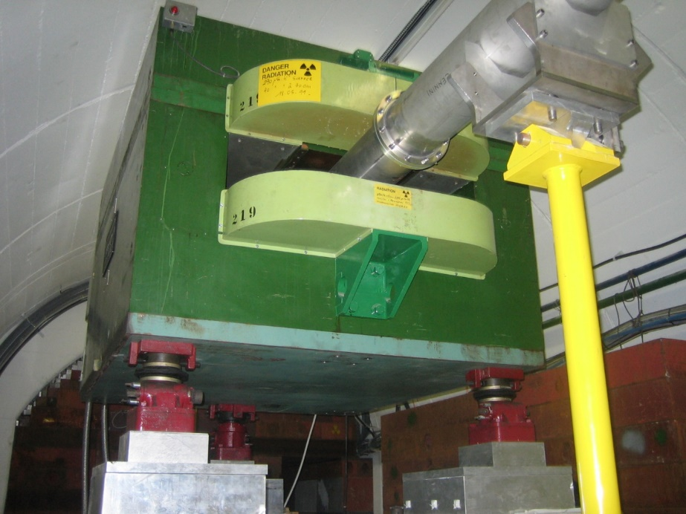
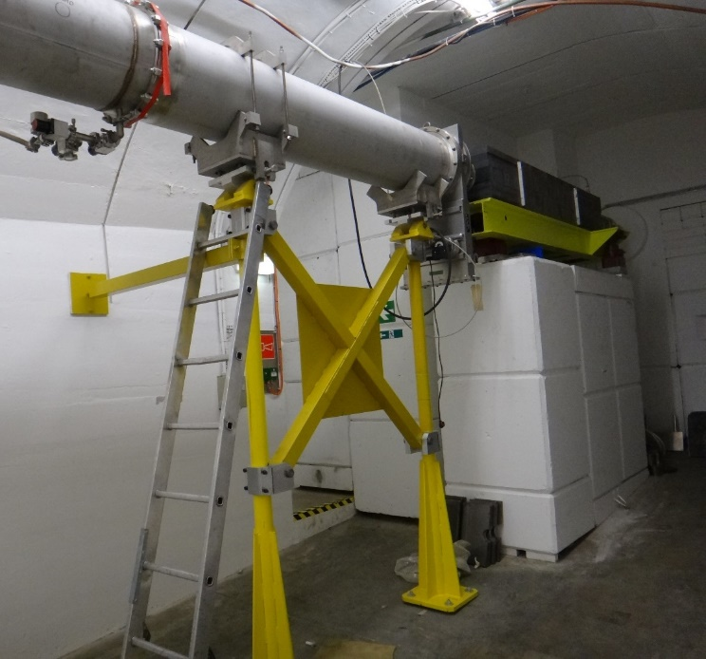
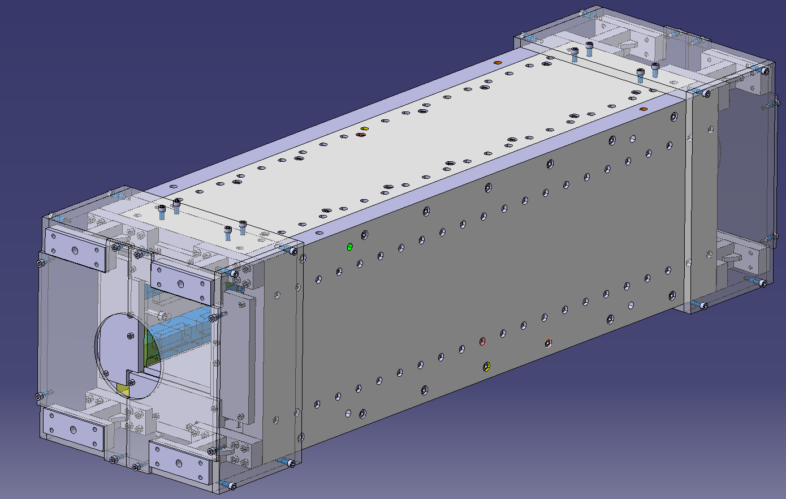
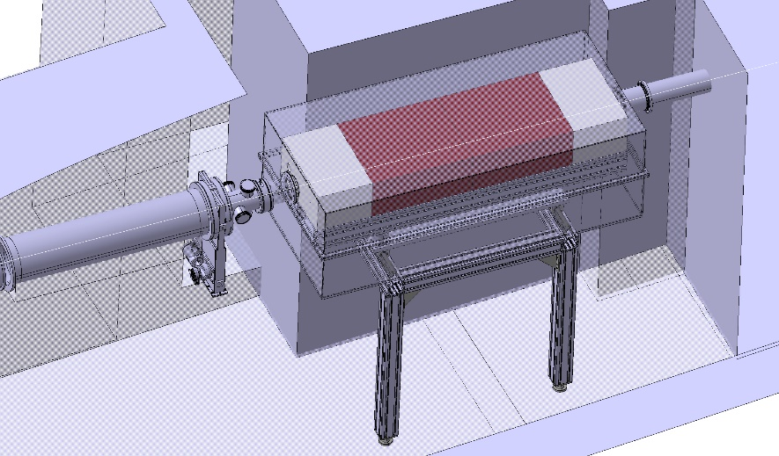
Main n_TOF LS2 activities
New sweeping magnet
Consolidation of collimator Nº2

Slide 5
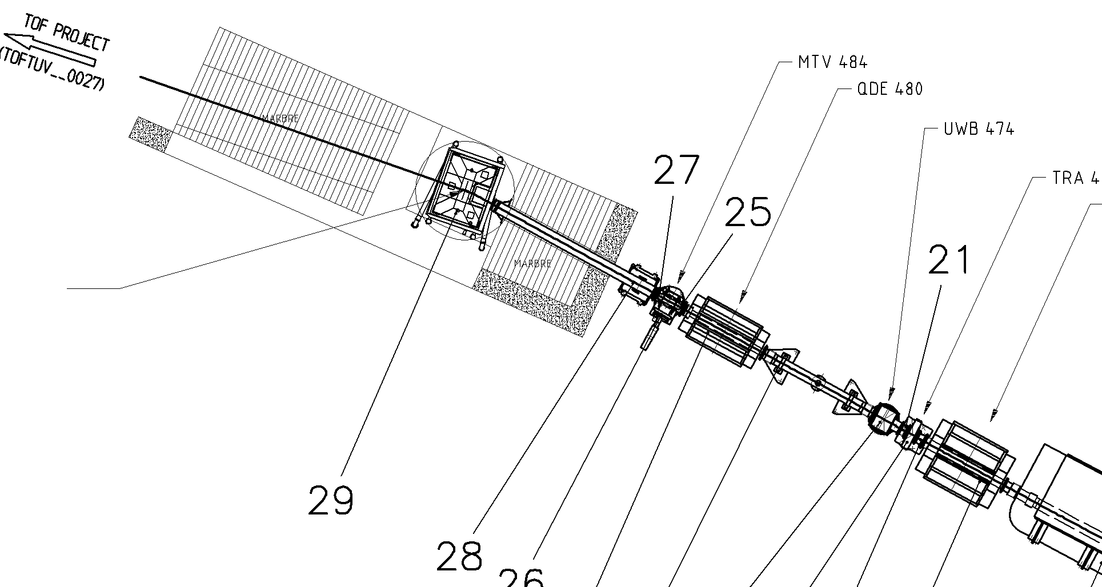
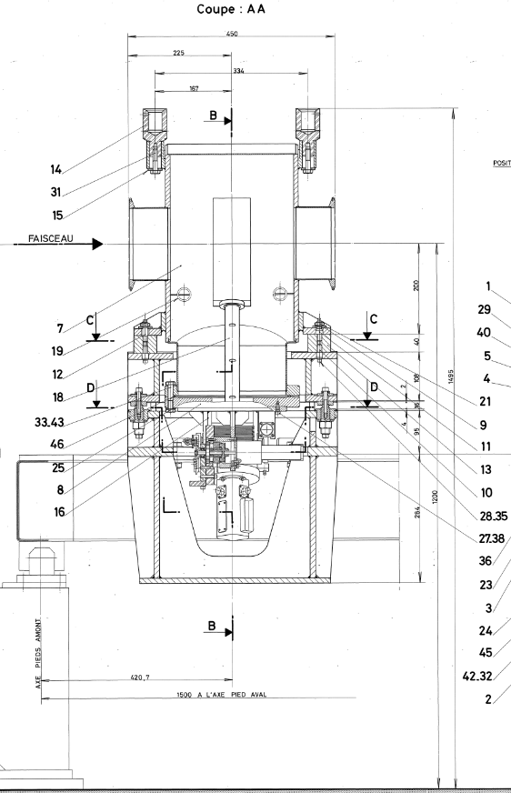
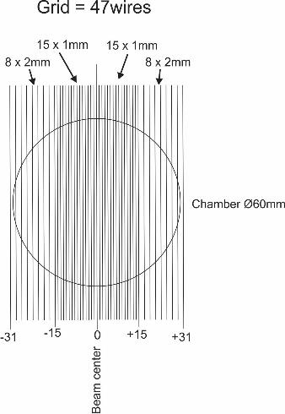
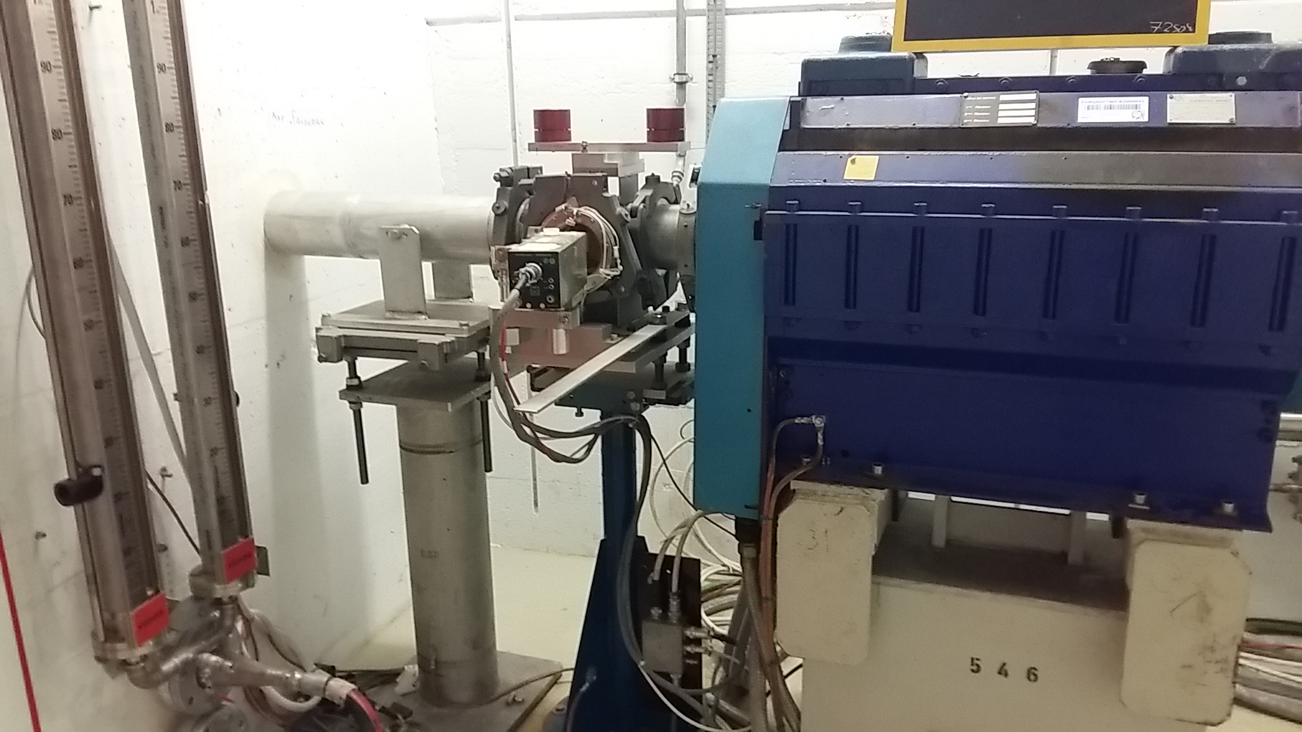
SEM grid replacing BTV (2020)

Slide 6
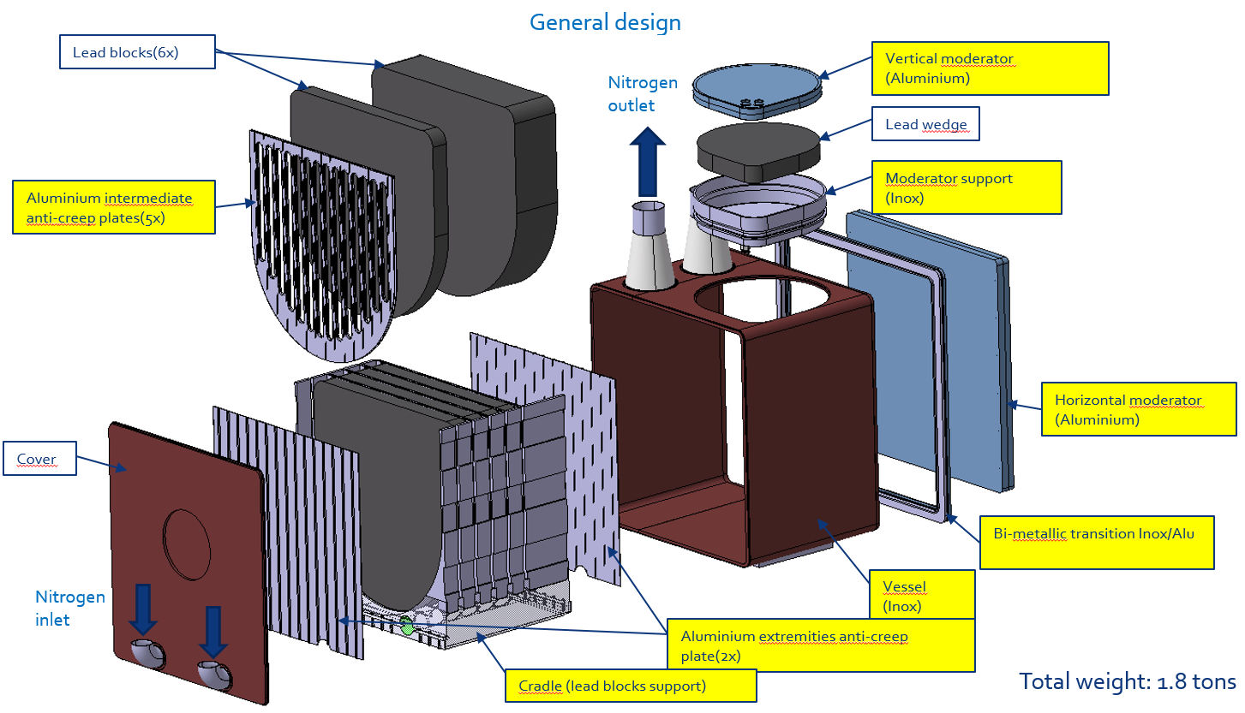
n_TOF target #3
n_TOF Target #3 Production Readiness Review, held on May 29th
https://indico.cern.ch/event/807540/contributions/3360962/attachments/1853310/3044330/n_TOF_Target_review_3.pdf
The review committee has provided a complete list of findings and recommendations.
- Go ahead, production started!

Slide 7
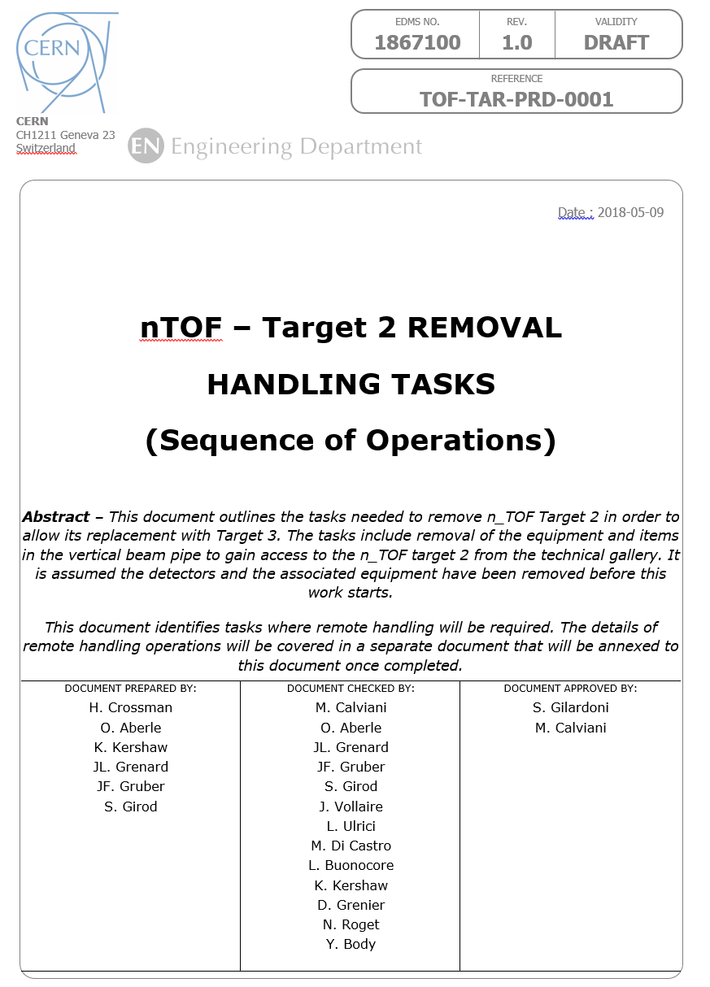
n_TOF target #2 removal
https://edms.cern.ch/document/1867100/0.4

Slide 8
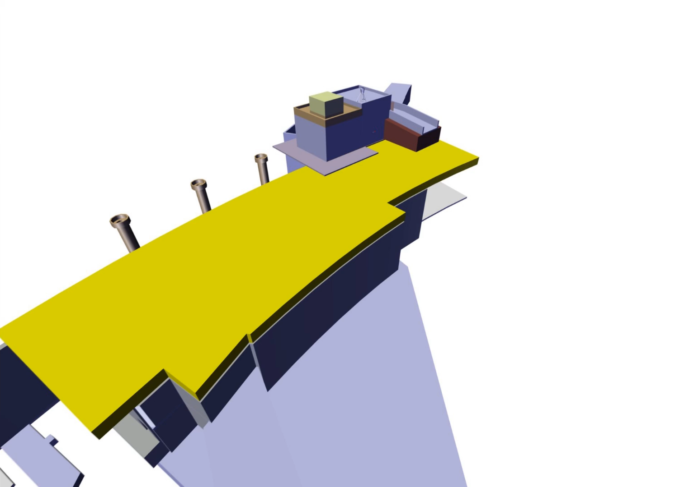
n_TOF facility
Video by Jose Maria Martin Ruiz (EN/STI)

Slide 9
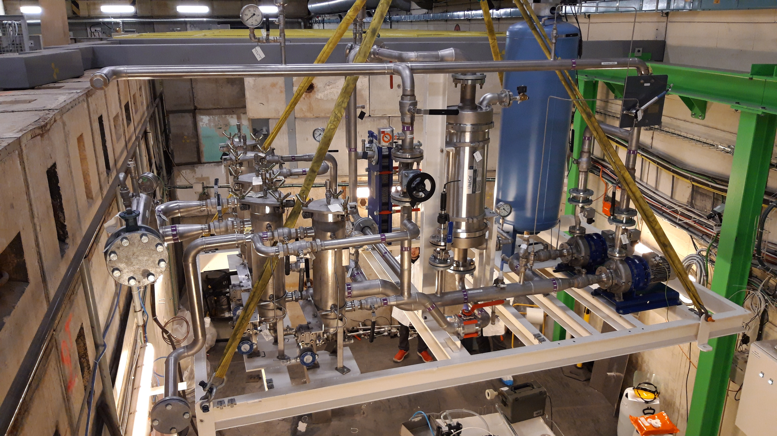
n_TOF target cooling station

Slide 10
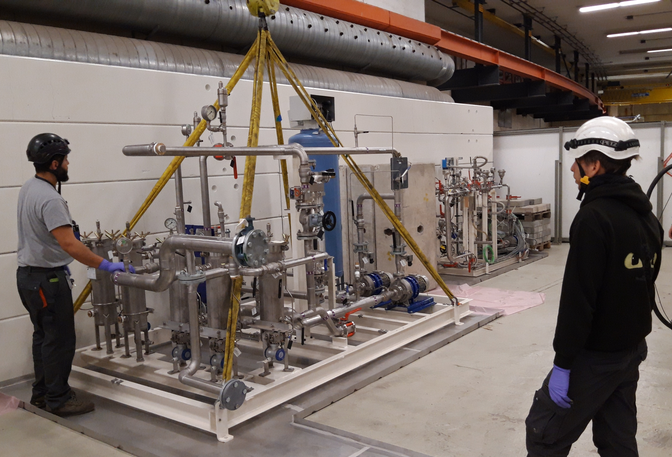
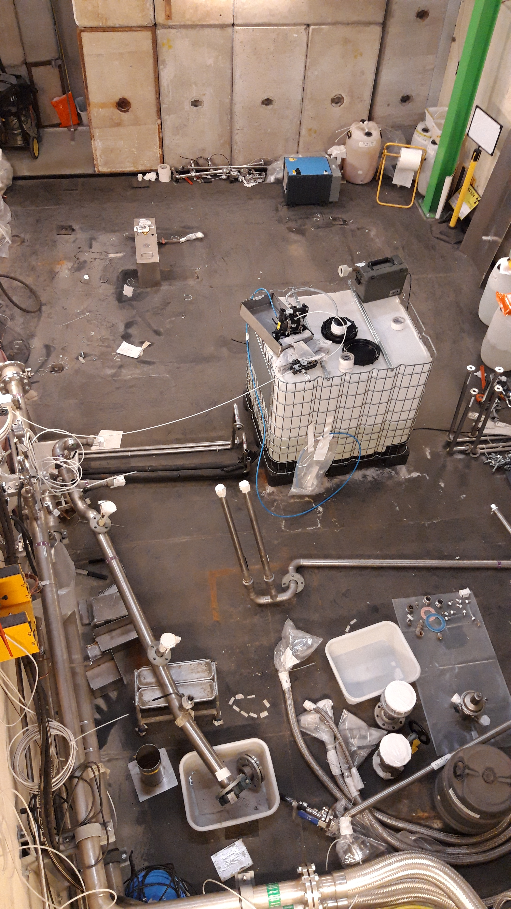
n_TOF target cooling station

Slide 11
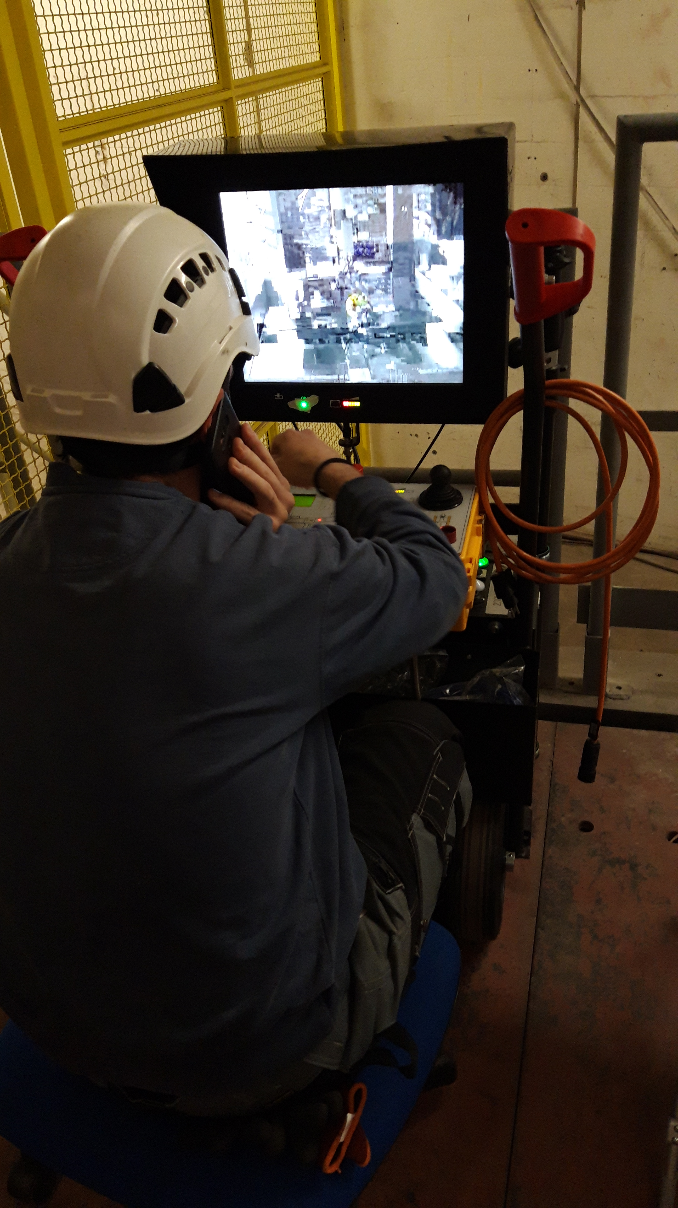
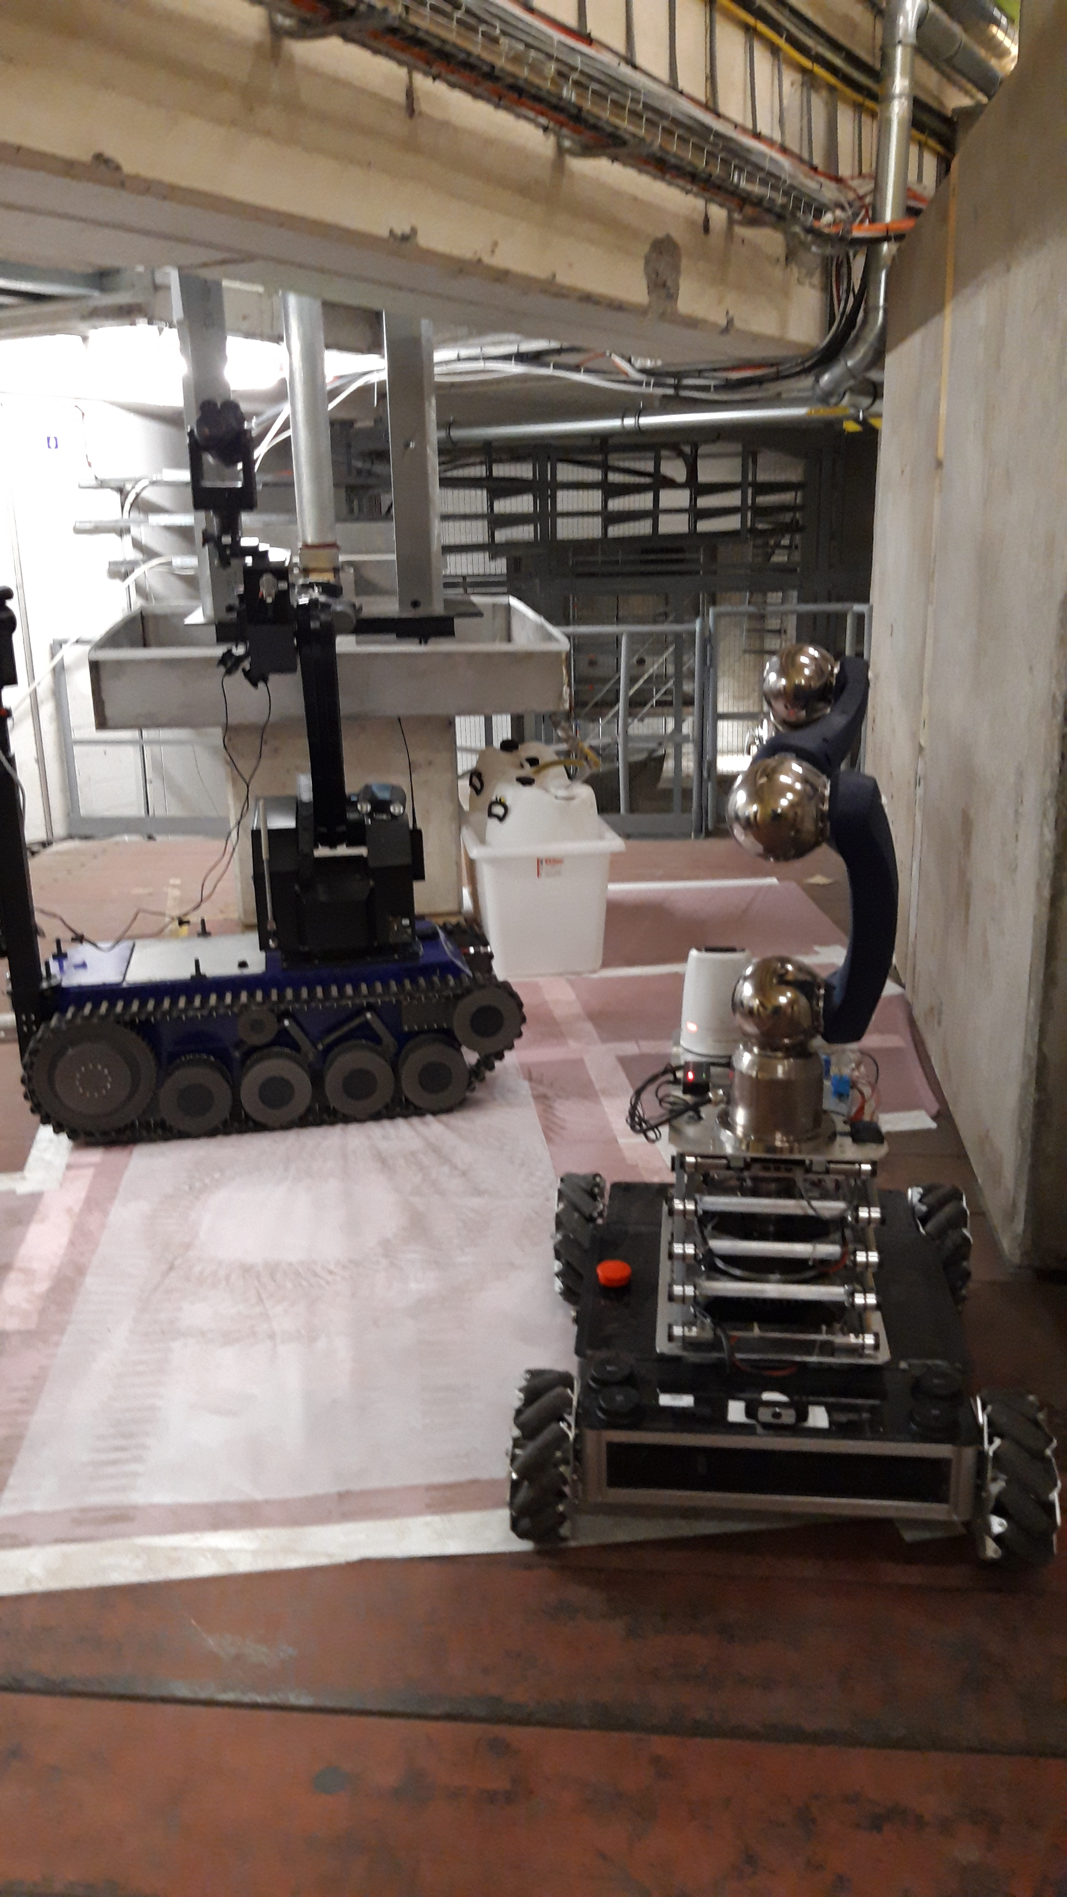
n_TOF target cooling station
Testing for remote interventions done
Preparation for the target removal this week
Removal planned week 47/48

Slide 12
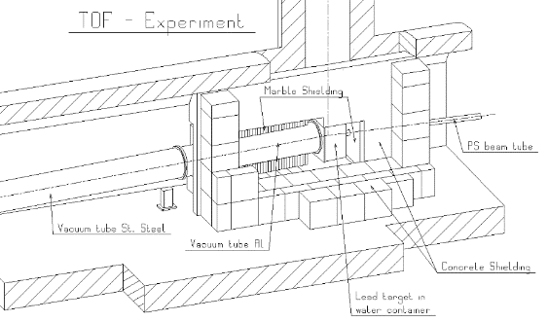
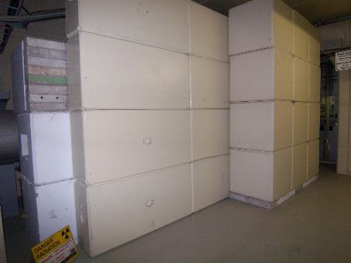
Modification of the target side shielding
Reconfiguration of the (fixed) shielding around the spallation target.
Shielding to be changed to a mobile shielding
Opening of shielding early 2020

Slide 13
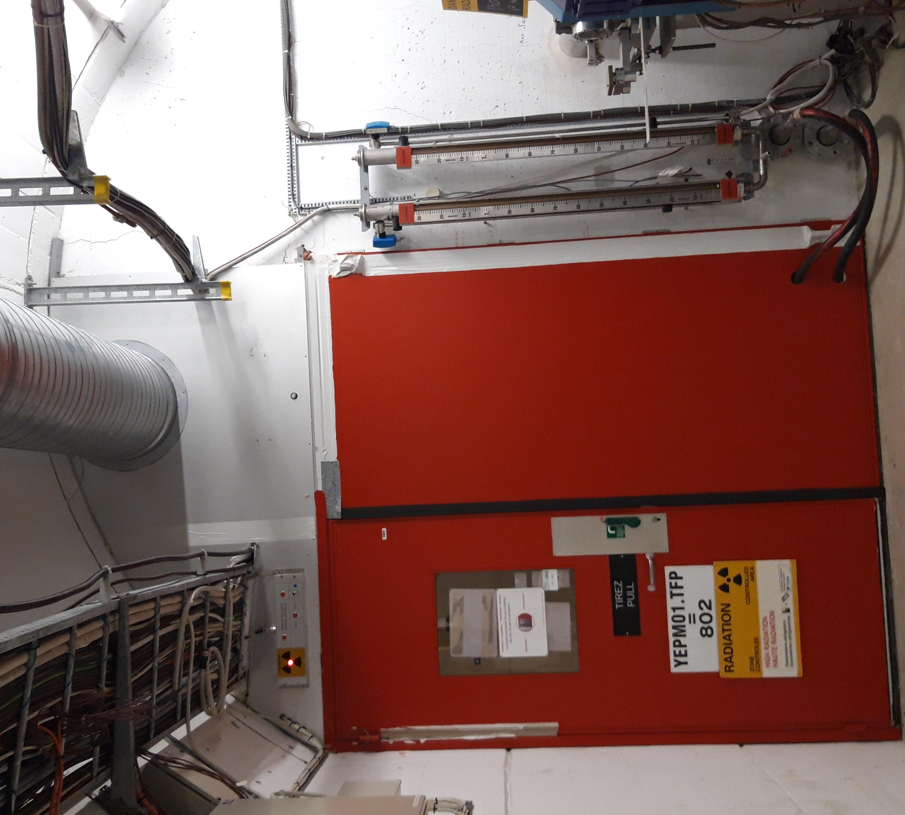
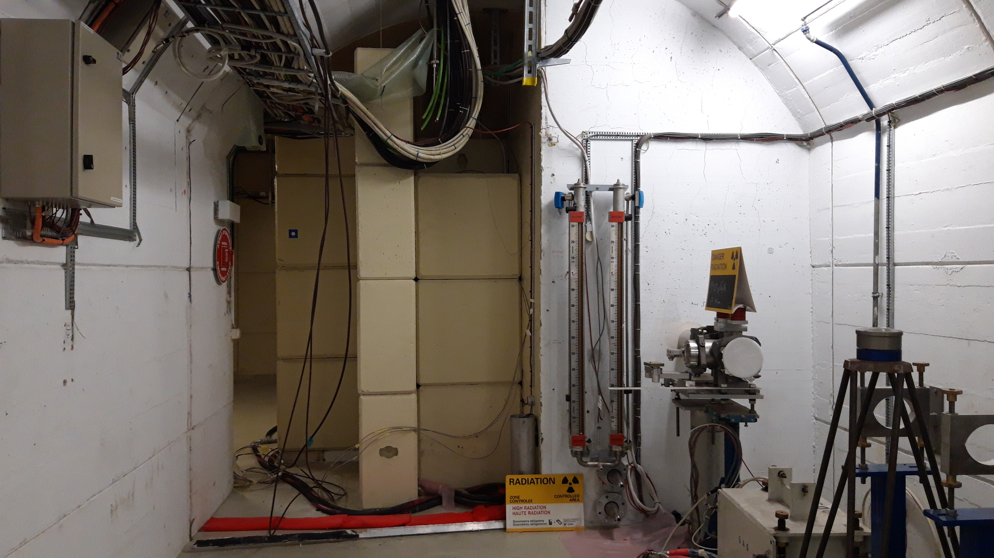
Modification of the target side shielding
Opening of shielding early 2020

Slide 14
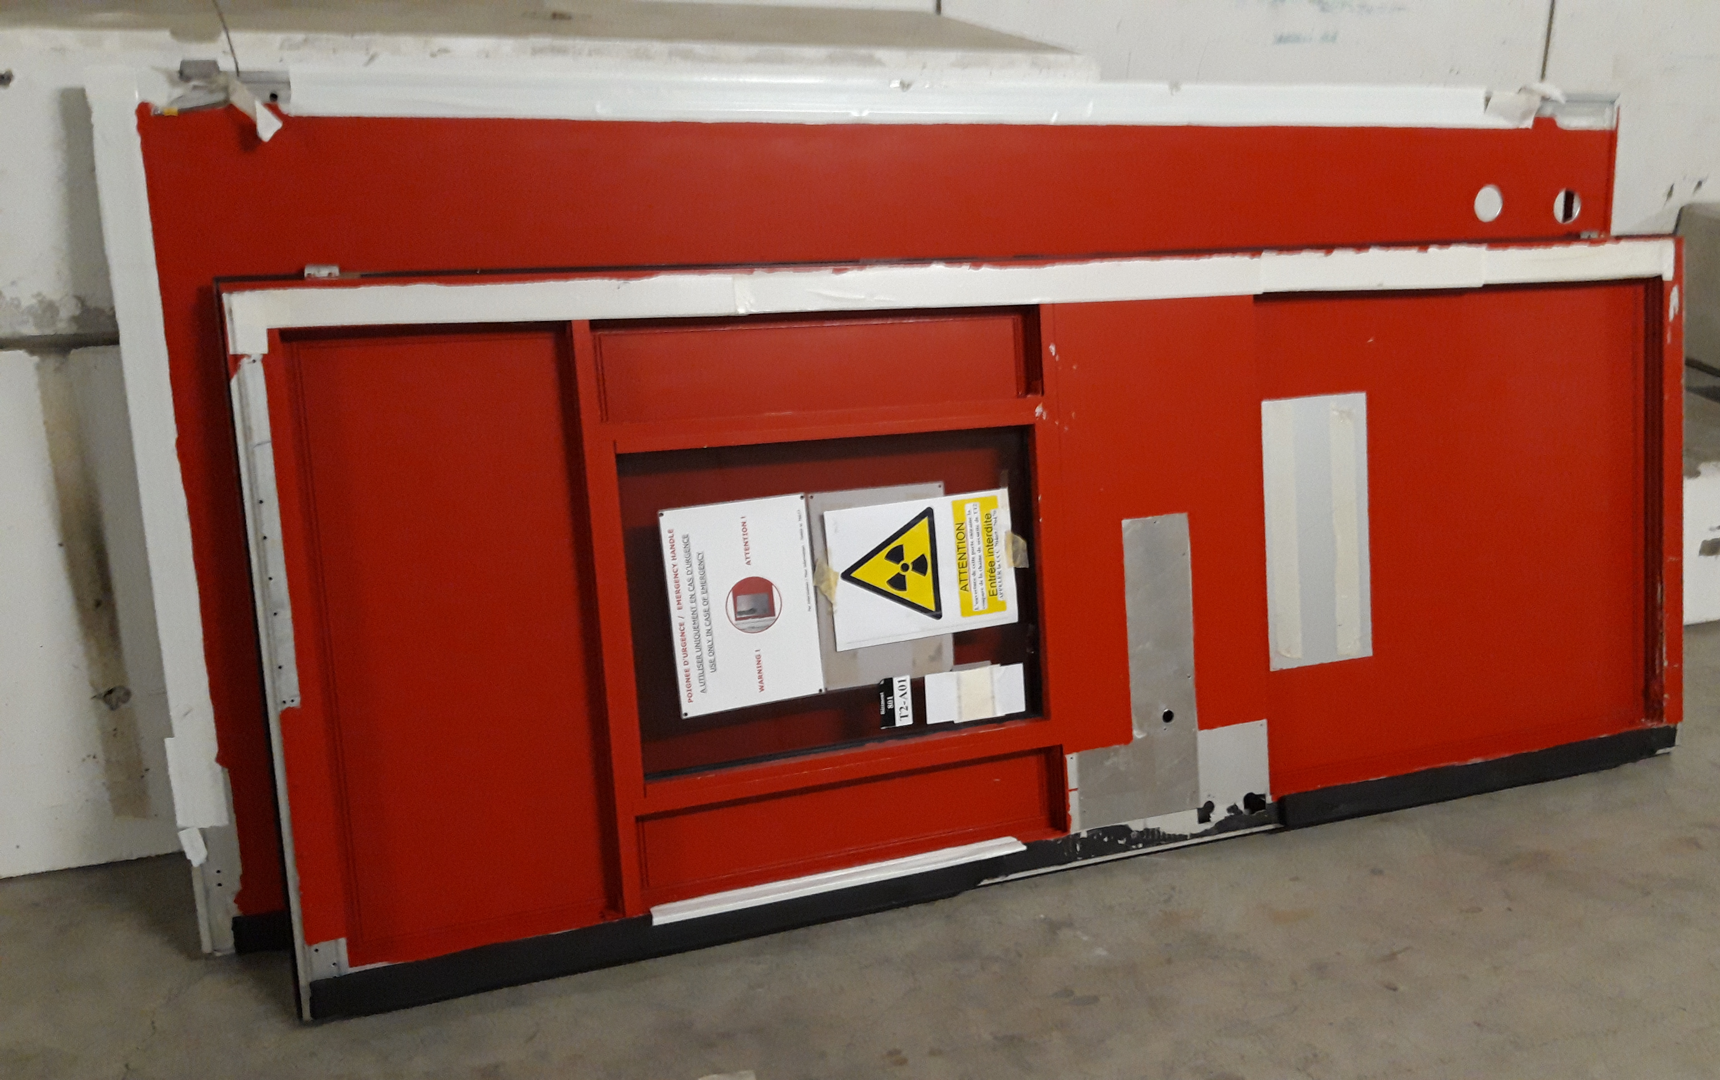
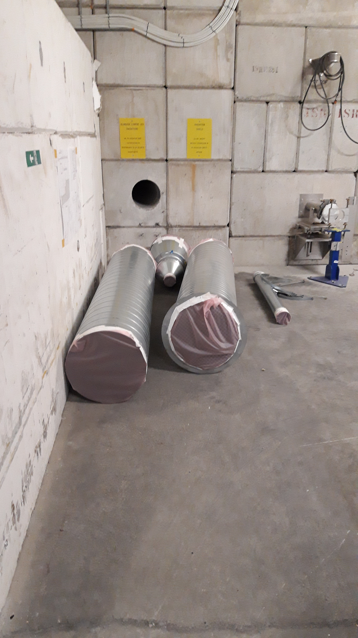

Slide 15
nTOF Experiment LS2 Coordination Meeting
Projects followed up until now:
  Experimental Areas Prepartion for the LS2 work. In particular,
    remove all radioactive samples and sources to be stored by RP
    Contamination control perfomed by RP confirms absence of contamination
  Cabling campaign in EAR1 (remove the old sweeping magnet cables, replace the detector cables in the rack/bunker area)
  Implementation of the ASN-OFSP safety recommandations in EAR2, next technical meeting in December
  Consolidation of the gas system in EAR2 – start in December
  Consolidation of the alignment system
  Upgrade of the nTOF electronics laboratory and control room
  DAQ upgrade
  Consolidation and R&D program for detectors

Slide 16
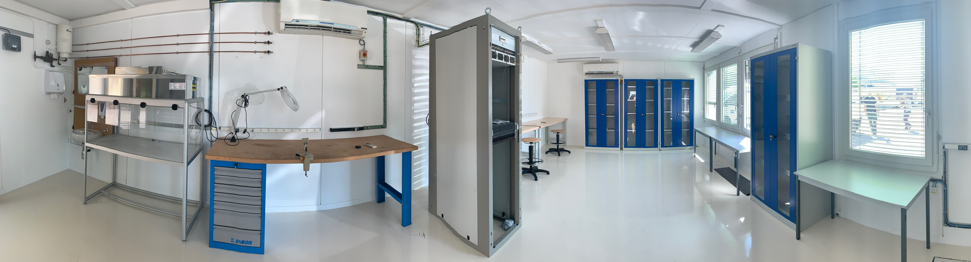
Upgrade of the nTOF electronics laboratory
Doubled the surface
Laboratory fully equipped to perform tests in parallel on two different detectors
DAQ system identical to the one used in the areas
Laboratory declared as Supervised Area to allow tests with sealed sources
New access system with dosimeter
Operational since September

Slide 17
n_TOF control room and ASN-OFSP comments
Control room in B 506
  Left B 603 last week
  After emptying B 506, work starts in week 46
  Set up of the control room with the DAQ upgrade early next year
  Temporary office space for n_TOF local staff and visitors in B 864
ASN-OFSP safety recommandations
  Possibility for a beam stop button and door opener from the bunker inside studied and solution found
  Sink for EAR 2 in place, (evacuation towards the B 506)
  Buffer zone for RP checks on exiting material

Slide 18
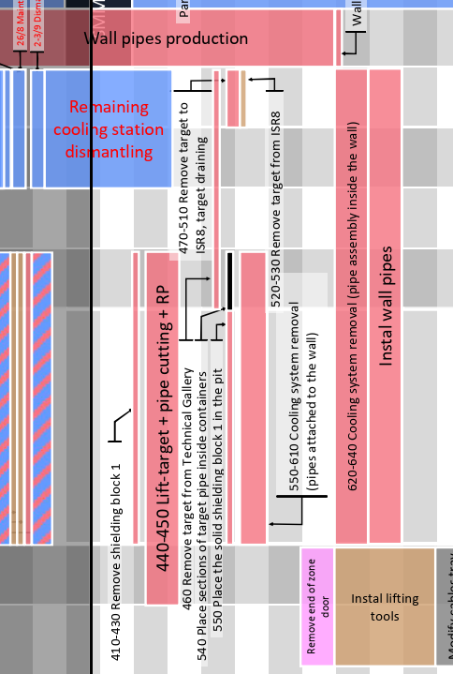
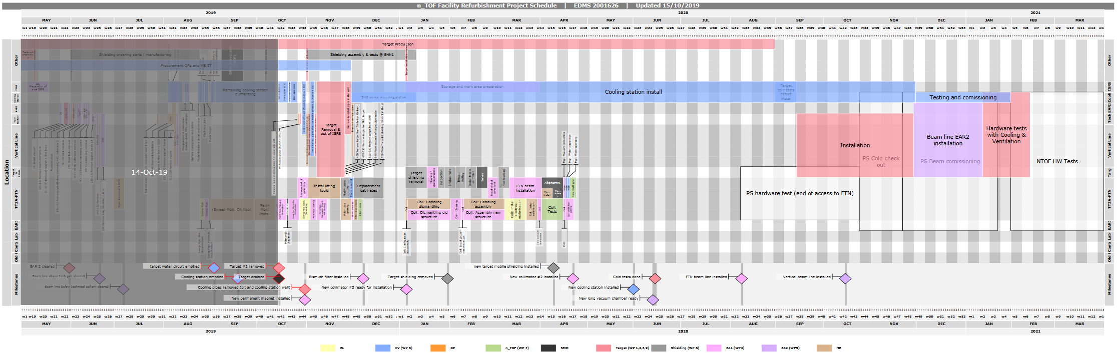
Schedule and coordination
n_TOF Facility Refurbishment Project Schedule: EDMS 2001626
Target removal

Slide 19
Summary
n_TOF organization during LS2
Main activities for LS2 - Facility
  Horizontal beam line modifications
  Target exchange
Main activities for LS2 – Experiment
  Electronic lab completed
  New control room in work
  Detector upgrade ongoing
2019 INTC reporting on the progress of activities in the beam lines and EA’s
Detector upgrade reporting on commissioning plans for 2021
new requests for the future physics program to INTC next year

Slide 20
Thank you

