Slide 1
STATUS REPORT IS584
β-decay study of neutron-rich Tl and Pb isotopes
A. Gottardo, E. Rapisarda
11 shifts assigned in 2013

Slide 2
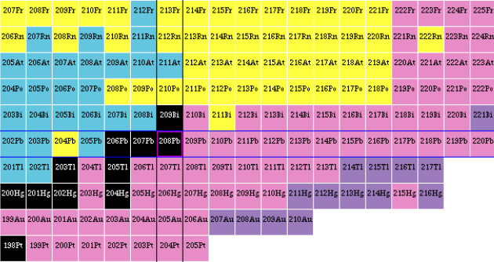
Nuclear structure beyond ²⁰⁸Pb
N=126
²⁰⁸Pb₁₂₆
N = 126
Z =82
g_{9/2}
Study the development of nuclear structure in the nuclei beyond N=126
What the position of the d_{3/2} and s_{1/2} proton orbitals?
Can we explain with shell model what we observe ?

Slide 3
The region around Z=82 and N=126
The region around ²⁰⁸Pb has been very difficult to populate experimentally due to its large A and Z.
g_{9/2}
h_{9/2}
126
Lifetime measurements in ^{211,212,213}Tl
Lifetime measurements in ^{218,219}Bi
Three high-spin isomers in ²¹¹Pb and decay scheme
Isomeric states in ²⁰⁸Hg and ²¹⁰Hg
Isomeric states in ^{212,214,216}Pb
Isomeric state in ²⁰⁹Tl (95 ns)
Isomeric states in ^{211,213}Tl
82
p_{1/2}
G. Benzoni et al., Phys. Lett. B715 (2012) 293
s_{1/2}
f_{5/2}
d_{3/2}
p_{3/2}
G.J. Lane et al., Phys. Lett. B 606 (2005) 34
h_{11/2}
i_{13/2}
N. Al-Dahan et al., Phys. Rev. C80 (2009) 061302
A. Gottardo et al., Phys. Lett. B725 (2013) 292
d_{5/2}
h_{9/2}
A. Gottardo et al., Phys. Rev. Lett. 109 (2012) 162502
g_{7/2}
f_{7/2}
N. Al-Dahan et al., Phys. Rev. C80 (2009) 061302
50
82
A. Gottardo et al., Phys. Rev. C. 109 (2019) 054326
π = 81
ν = 130
Seniority scheme
Experimental level scheme for ²¹⁰⁻²¹⁶Pb consistent with ν(g_{9/2})^{n} dominance
low-lying states in odd-mass Tl described as ν(g_{9/2})² ⊗ π(s⁻¹_{1/2}) or π(d⁻¹_{3/2})
Inclusion of effective three-body forces is essential
A. Gottardo et al. PRL109, 162502 (2012)

Slide 4
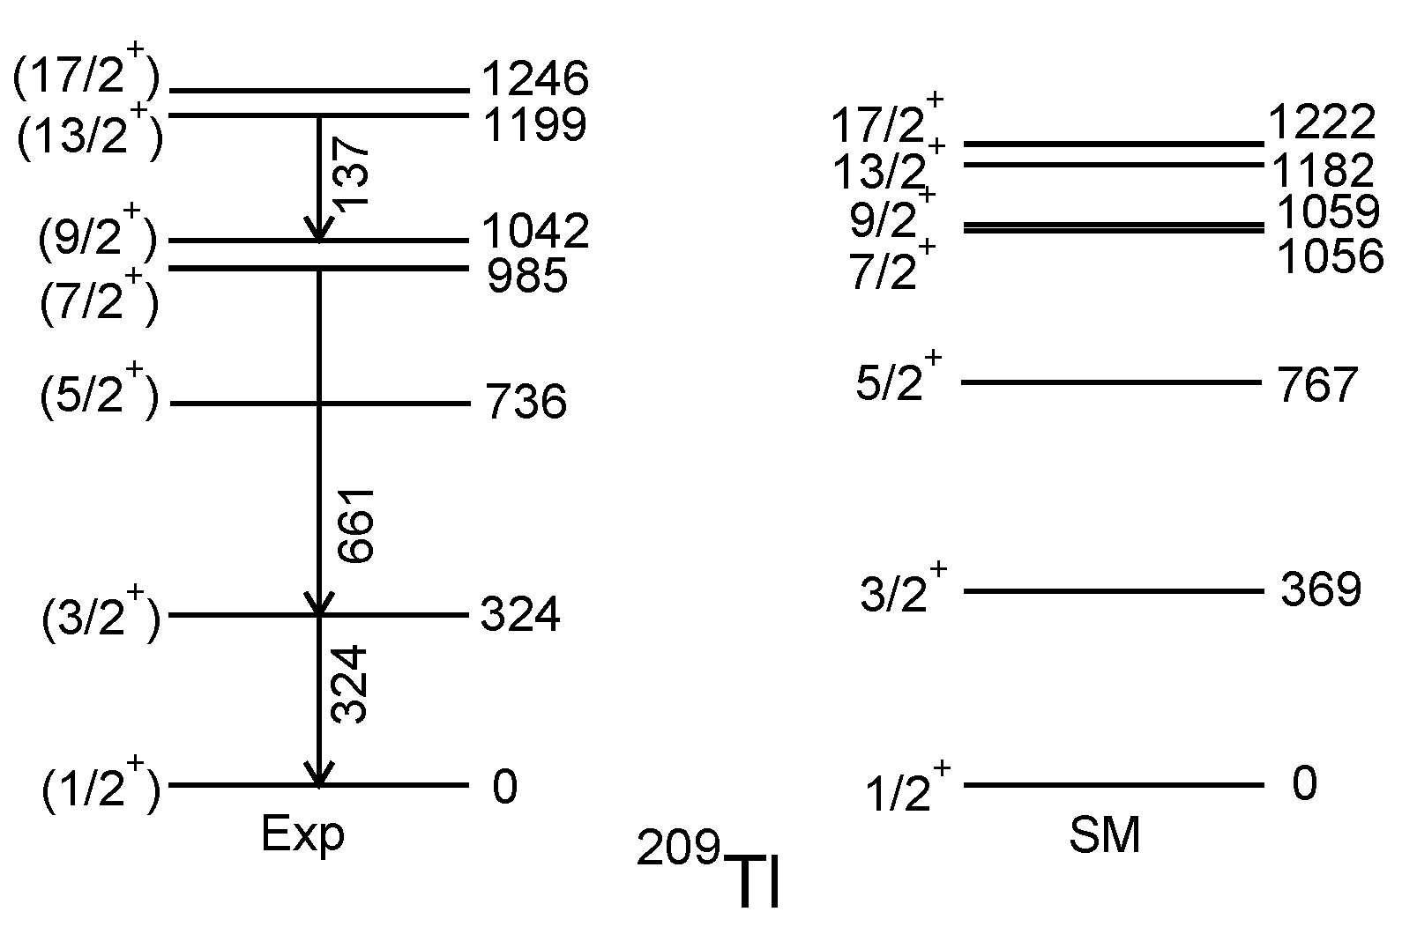
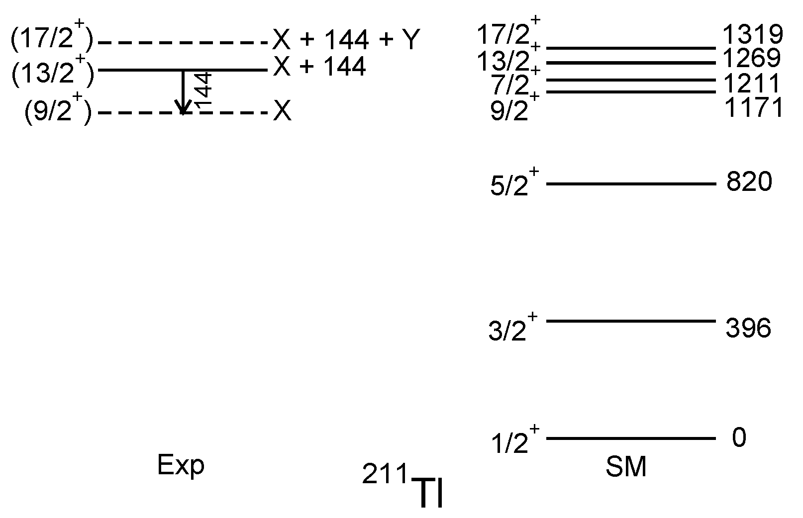
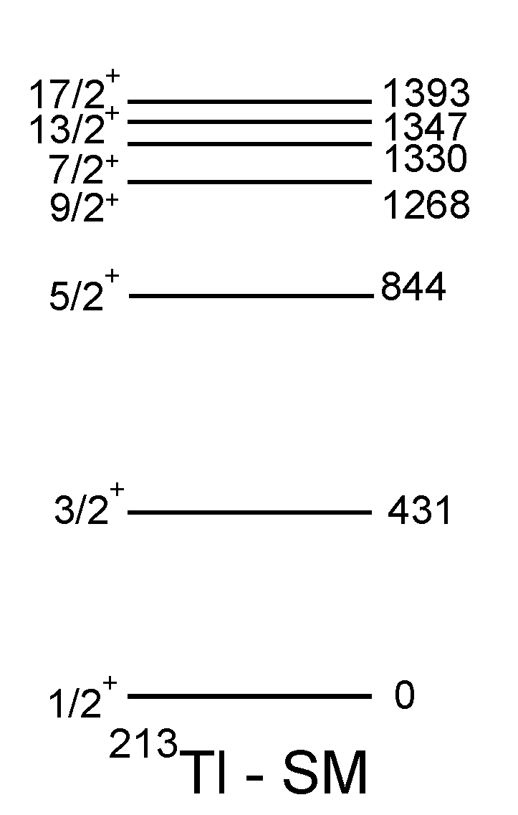
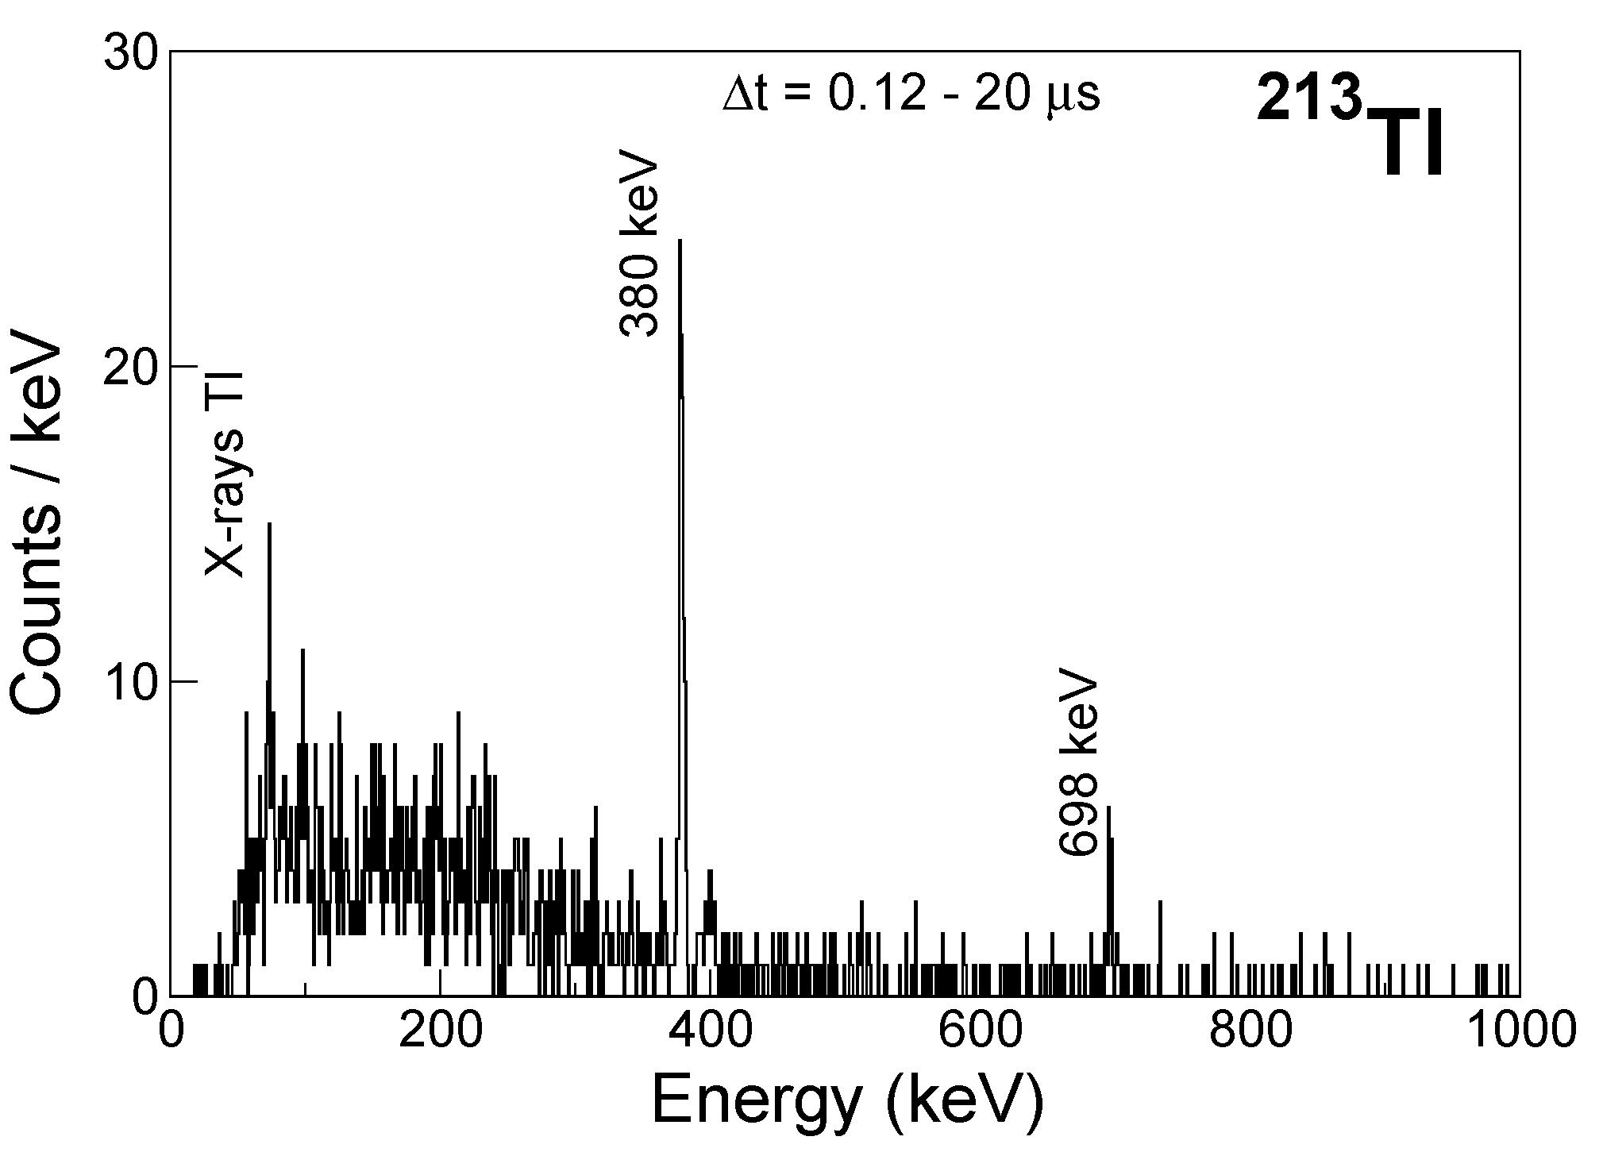
Long-living isomer in ^{211,213}Tl ?
A. Gottardo et al., Phys. Rev. C. 109 (2019) 054326
In ²¹¹Tl maybe a long-living isomer due to a spin trap;
In ²¹³Tl we do not understand what we observe: maybe a long-living isomer as well

Slide 5
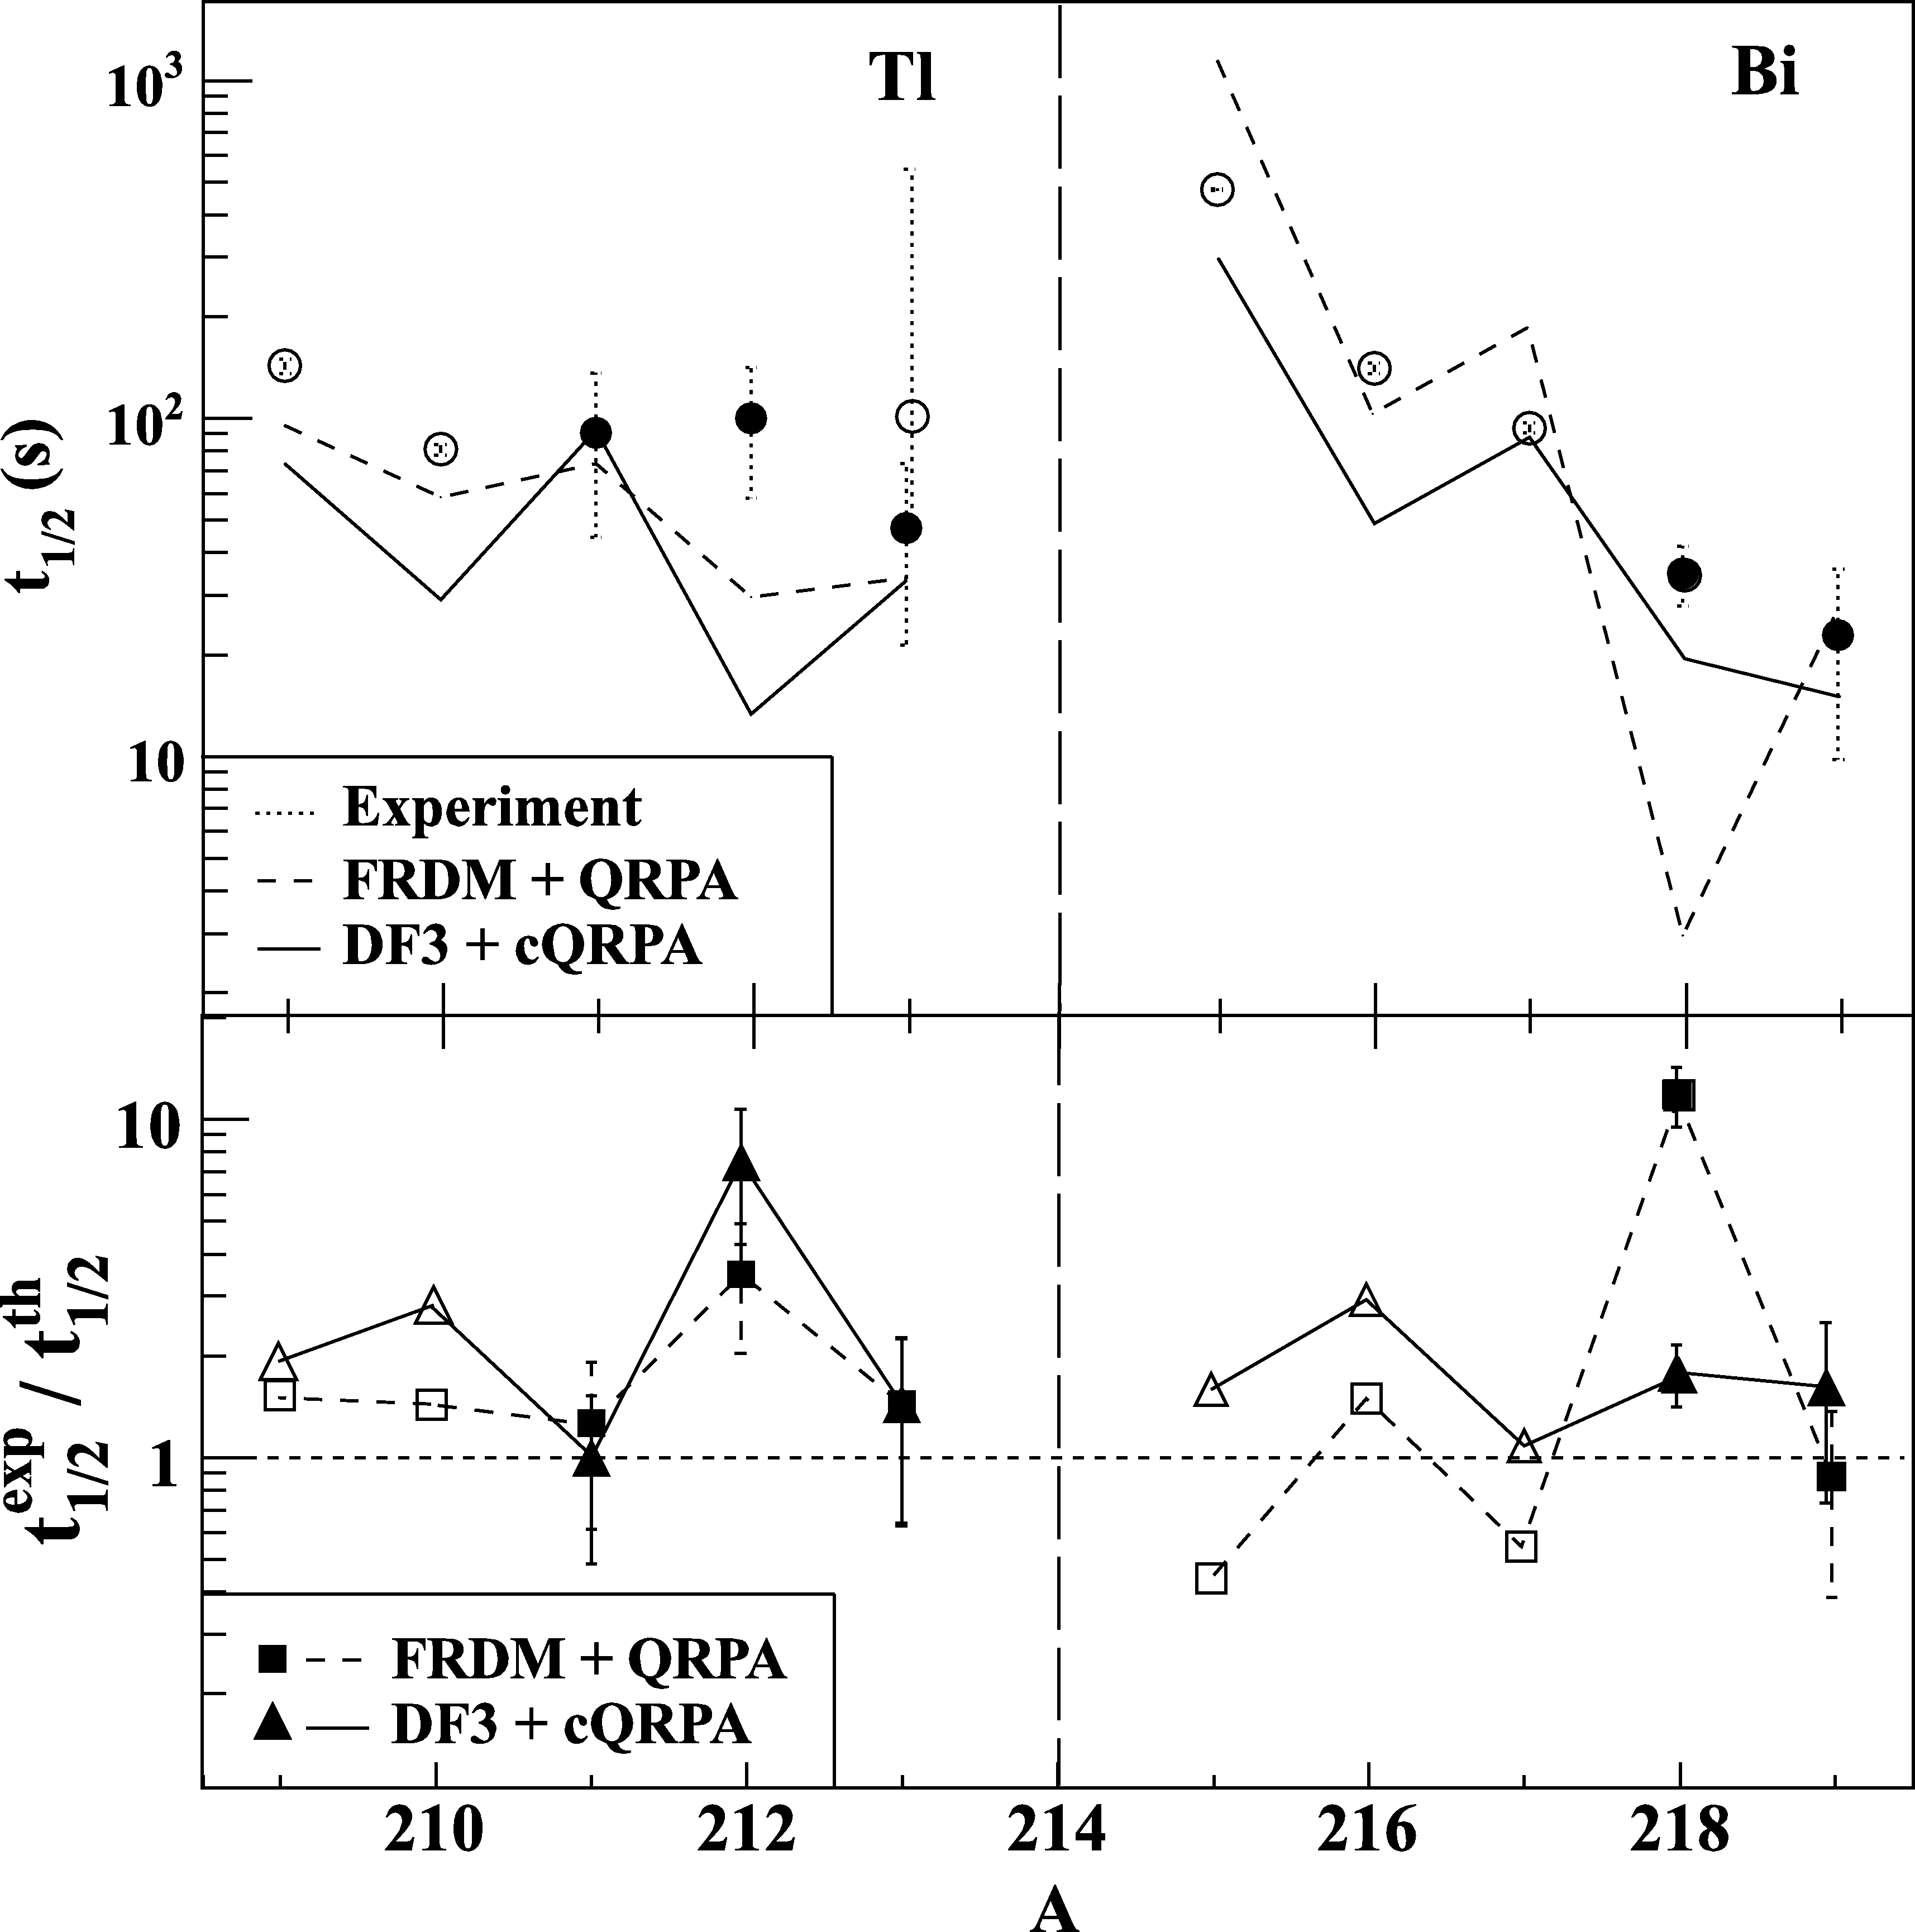
Half-life of ²¹¹⁻²¹³Tl
g_{9/2}
h_{9/2}
126
82
p_{1/2}
(1/2⁺)
t_{1/2}=88 s
s_{1/2}
f_{5/2}
²¹¹Tl
d_{3/2}
p_{3/2}
h_{11/2}
i_{13/2}
d_{5/2}
h_{9/2}
g_{7/2}
f_{7/2}
γ
50
82
γ
t_{1/2}=36.1m
π = 81
ν = 130
(9/2⁺)
²¹¹Pb
G. Benzoni et al., Phys. Lett. B715 (2012) 293
(9/2⁺)
t_{1/2}=2.14m
²¹¹Bi
²¹¹Tl t_{1/2}=88 s → 50% uncertainty
²¹²Tl t_{1/2}=96 s → 50% uncertainty
²¹³Tl t_{1/2}=46 s → 100% uncertainty
The β-decay would be dominated by high energy Gamow-Teller transitions from partially occupied neutron shells 3d_{5/2} or 4s_{1/2} above g_{9/2}
G. Benzoni et al., Phys. Lett. B715 (2012) 293
State-of-the-art models used in r-process calculations underestimate the experimental results
Low-lysing states in the daughter Pb can be populated and studied.

Slide 6
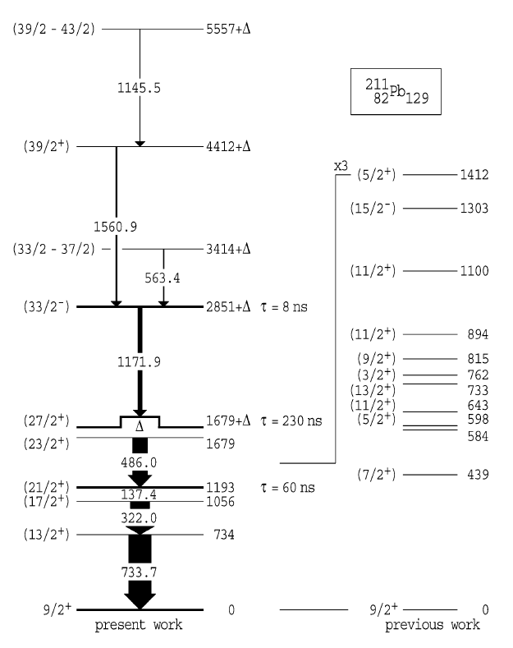
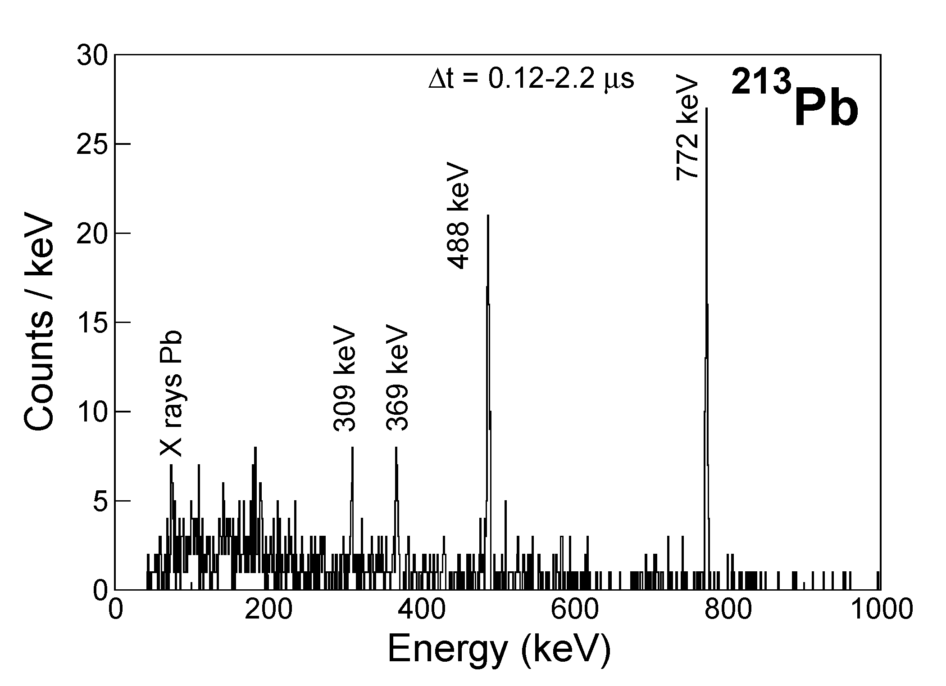
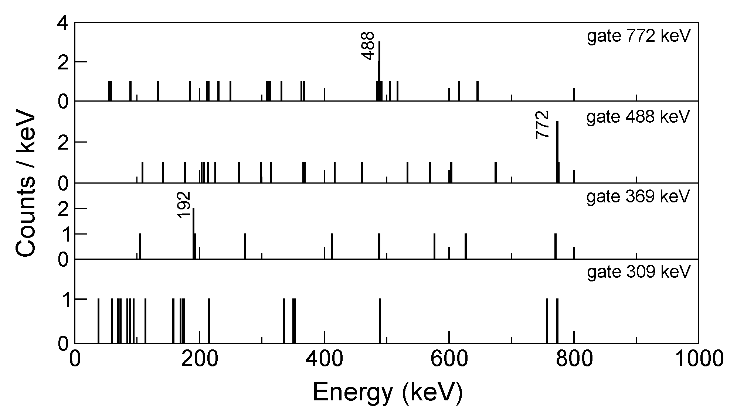
What is the situation in ²¹³Pb ?
J.J. Valiente Dobon, A. Gottardo et al., to be submitted
A. I. Morales et al. Phys. Rev. C 89, 014324 (2014):
675 keV line from
213Tl decay
G.J. Lane et al., Phys. Lett. B 606 (2005) 34
No experimental evidence of short-lived isomeric decay;
If (27/2)⁺ moves below (23/2)⁺ →SPIN TRAP → Long living isomers in ²¹³Pb ???
Observed structure is at variance with ²¹¹Pb

Slide 7
²¹³Pb: a possible level scheme
0.25 us
19/2⁺
0.25 us
309
1685
23/2⁺
1333
21/2⁺
0.21 us
1620
19/2⁺
1301
15/2⁻
192
1260
??? 15/2⁻
1222
1141
17/2⁺
21/2⁺
1098
17/2⁺
369
448
804
13/2⁺
772
13/2⁺
772
0
9/2⁺
0
9/2⁺
J.J. Valiente Dobon, A. Gottardo et al., to be submitted
²¹³Pb theo.
²¹³Pb exp.

Slide 8
²¹¹⁻²¹³Pb: low spins from beta decay
A. I. Morales et al. Phys. Rev. C 89, 014324 (2014)

Slide 9
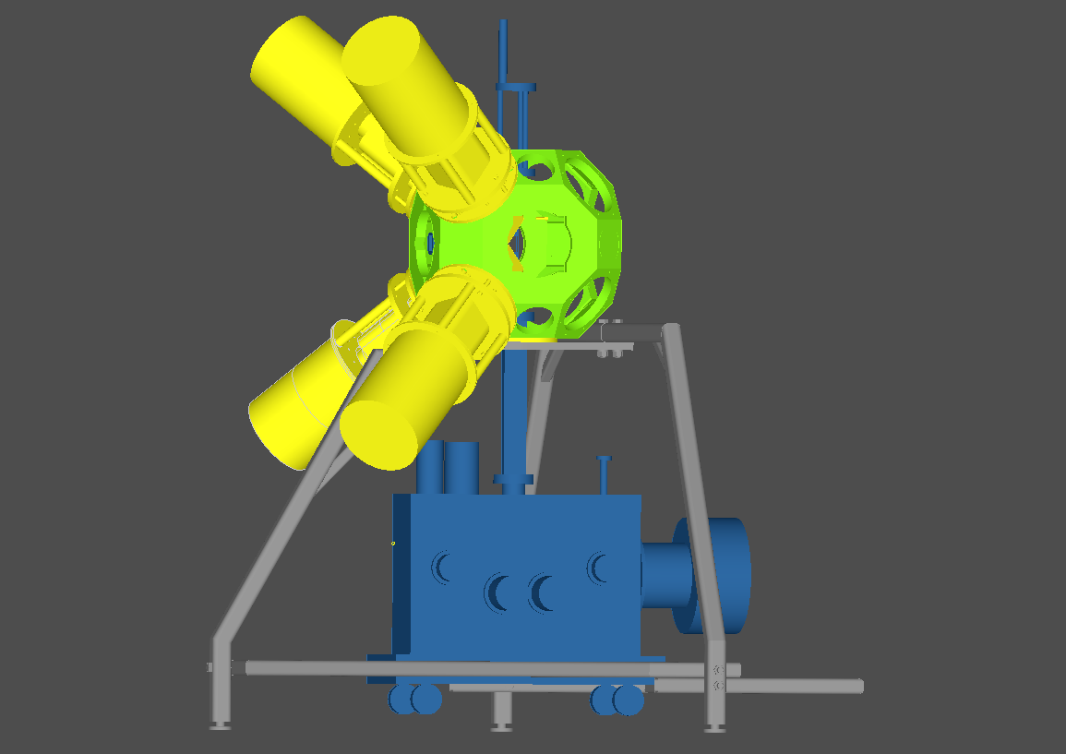
Proposed experiment
AIM identify long-living isomers in ^{211,213}Tl
and ²¹³Pb
Laser Spectroscopy
AIM
decay scheme in ²¹¹⁻²¹⁵Pb by β-decay Tl
lifetime of ²¹¹⁻²¹⁵Tl with 10% uncertainity
Decay Spectroscopy
4 Clovers
1 Miniball Triple cluster:
Total γ detection efficiency is about 8-9% at 1.3MeV
Total β detection efficiency is about 60%

Slide 10
Beam Time Approval
UC_{x} Target + quartz transfer line + LIST target
Laser Ionization: RILIS (27% and 7% for Tl and Pb respectively)
Expected strong Fr and Ra contamination
  HRS mass separator mandatory
  Pulsed-release technique
  We request therefore:
Isotope | Rate on tape /s | Time | Expected n. counts
²¹¹Tl | 540 | 1 shift | 1∙10⁵
²¹²Tl | 225 | 1 shift | 6∙10⁴
²¹³Tl | 90 | 1 shift | 3∙10⁴
²¹⁴Tl | 36 | 3 shifts | 3∙10⁴
²¹⁵Tl | 12 | 6 shifts | 2∙10⁴
²¹³Pb | 250 | 3 shifts | 2∙10⁵
²¹⁵Pb Reference | 47 (*)
2 shifts for tuning the laser to Pb and Tl
4 shifts for laser - spectroscopy
NOT approuved
6
(*) H. De Witte et al., Phys. Rev. C87 (2013) 067303
The Committee decided that authors should perform first the measurements with 211-213Tl and 213Pb, as well as the isomer search for 211,213Tl and 213Pb, and test the production of 214,215Tl. Based on the production rates for 214,215Tl, they should come-up with an addendum once the first part is completed. The committee recommended for the approval of the Research Board 11 shifts for the studies of 211-213Tl and 213Pb and yield tests of 214,215Tl.

Slide 11
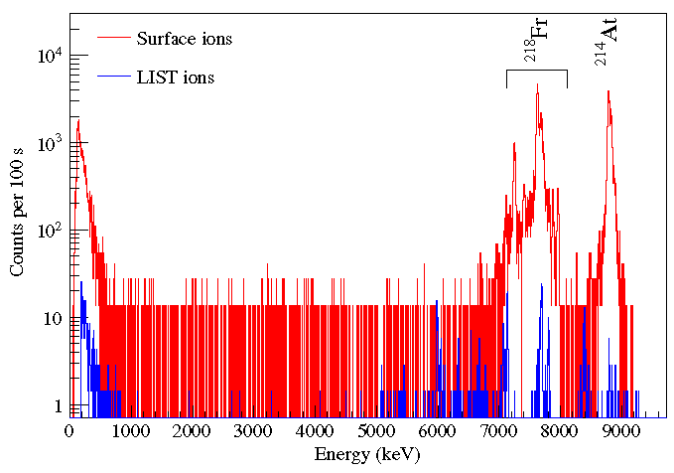
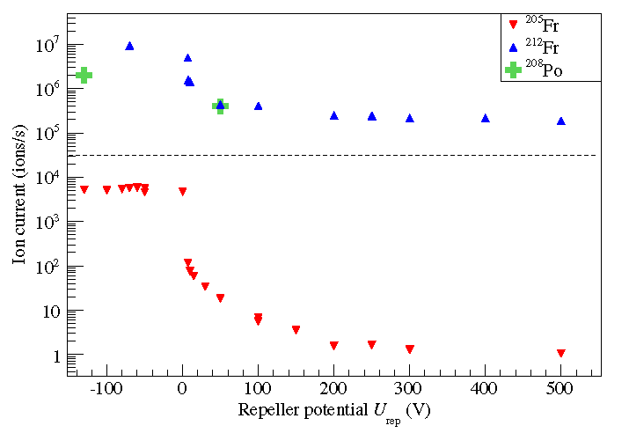
What has been done for Fr, Ra suppression
D. A. Fink et al., Phys. Rev. X 5, 011018 (2015)
At A=212 the situation is more challanging: only a factor 70
suppression, but possibility of further suppression with the mass
separator (50 eV acceptance)
Fr present only in trace in LIST mode at A=218

Slide 12
TAC report
This will require development before scheduling.
The LIST has shown 10E6 suppression for Na. However, the degree of suppression has been observed to change with isotope online with UC target. The reason for this is still not completely understood. Double repeller list may suppress e- impact ionization.
This is a TISD candidate for LIST test. Test required for Tl transmission through quartz line. In addition a technical development is needed to produce a LIST incorporating a quartz line.
After LS2 LIST available on HRS. Could this be enough to cut isobars ?
Could molecular beams be an option? (only if suppression is not enough/not enough Tl laser ionization)
Tl(I) iodide. IP 8.5eV. Boiling Point 824C
Could be tested offline. However, note that this will likely result in RaF (among others) as a contaminant.

Slide 13


Collaboration
CERN-ISOLDE, Switzerland, E.Rapisarda, J.Kurcewicz, M. Kowalska, V.N. Fedosseev, S. Rothe, , B.A. Marsh
INFN, Sezione di Padova and LNL , D. Bazzacco, S. Lenzi, S. Lunardi, F. Recchia, C. Michelagnoli, A. Gottardo, G. de Angelis, J.J. Valiente-Dobón, P. John, D. Napoli, V.Modamio, D. Mengoni,
IKS-KULeuven, Belgium, H. De Witte, M.Huyse, P.Van Duppen, R. Raabe, K.Wrzosek-Lipska, C.Sotty
Instituto de Fisica Corpuscular, Universita’ de Valencia, Spain A.Algora¹,
University of York, U.K., A.N. Andreyev, D. Jerkins
Department of Nuclear Physics and Biophysics, Comenius University, Slovakia S. Antalic³,
Petersburg Nuclear Physics Institute, Gatchina, Russia, A.E. Barzakh, D.V.Fedorov, M.D. Seliverstov,
University of Köln, Germany A. Blazhev⁶, P. Reiter, N. Warr, J. Jolii,
University of Manchester,U.K. J.Billowes, T.E. Cocolios, T. Day Goodacre, K.T. Flanagan, I. Strashnov,
University of Surrey, U.K., R.Carroll⁸, Z.Podolyak, P.M.Waker, C. Shand, Z. Patel, P.H. Regan
University of Jyväskylä, Helsinki Institute of Physics, Finland, T. Grahn, P.T. Greenlees, Z. Janas, J.Pakarinen, P. Rahkila
University of Warsaw, Faculty of Physics, Poland, C.Mazzocchi, , M. Pfützner,
Institut fur Physik, Gutenberg Universitat, Germany, T. Kron, K.D.A.Wendt, S. Richter¹⁴
Department of Physics, University of Liverpool, U.K., B.Cheal, D. Joss, R. Page,
IFIN-HH, Bucharest R. Lica, N. Marginean, R. Marginean, C. Mihai, A.Negret, S. Pascu

Slide 14
A. I. Morales et al. Phys. Rev. C 89, 014324 (2014)

