Slide 1
Probing intruder configurations in ¹⁸⁸Pb nuclei using
Coulomb excitation
Following Proposal to the ISOLDE and Neutron Time-of-Flight Committee IS494 and HIE-ISOLDE Letters of Intent I-107 and I-110
INTC meeting at CERN 6.11.2019
Janne Pakarinen, JYFL, Finland
Notes:
My presentation is part of our experimental program in studies of shape evolution in the neutron deficient Pb region.

Slide 2
Status of IS566 – relevant facts
Physics case still valid
HIE-ISOLDE still the only facility where this experiment can be conducted
SPEDE commissioned in-beam and exploited at IDS
Complementary ¹⁸⁸Pb SAGE data to be published
¹⁸⁸Pb Coulex data obtained in IS494 at REX-ISOLDE
waiting for ¹⁸⁸Pb SAGE publication

Slide 3
Outline
Physics background and motivation
Experiment description
Notes:
To clarify this proposal a little bit more. We propose to carry out simultaneous in-beam gamma-ray -- conversion electron Coulomb excitation experiment using radioactive 188Pb beam.

Slide 4
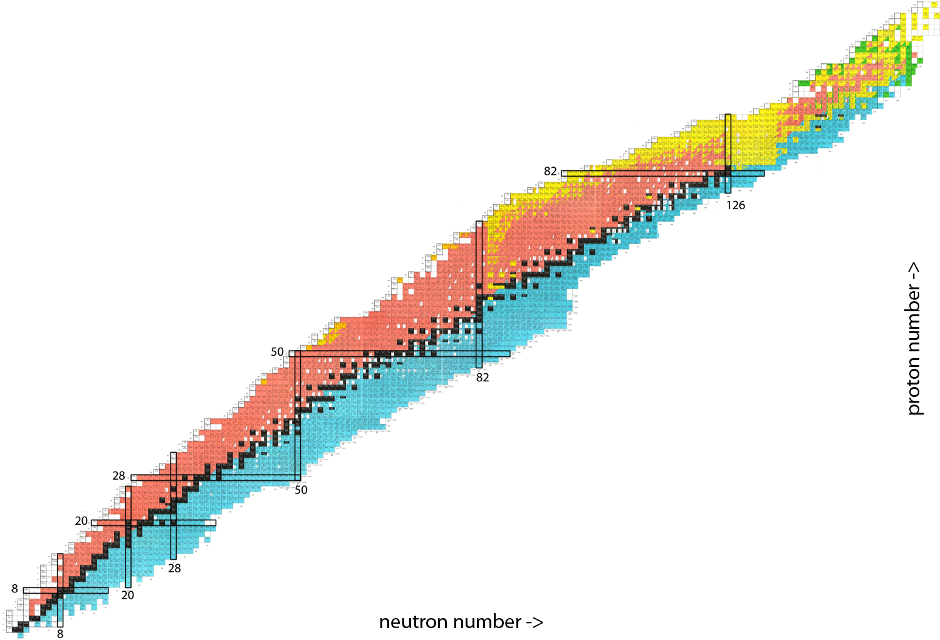
Chart of Nuclei
Notes:
I have a strong feeling you all know what this is, but just to remind myself what I’m talking about I’d like to zoom in to the region around doubly magic Pb nucleus…

Slide 5
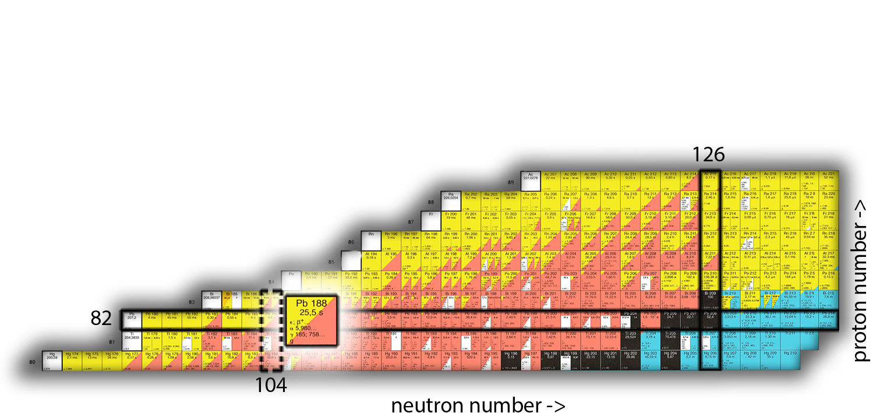
Chart of Nuclei
Notes:
…and more precisely I should concentrate on nuclei west from it. My experimental interest is mainly build on Pb nuclei around N=104 neutron midshell. That is located 22 neutrons away from the nearest closed neutron shell. You see that this part of the chart of nuclei is becoming yellowish, indicating alpha-decay, that plays big role in recoil decay tagging technique that we often use. To give some perspective, half-life of 186Pb Is ~5 seconds which is at the limit whether RDT is feasible. Unfortunately, 188Pb half-life is 25.5s, which means we could use RDT for 188Pb.

Slide 6
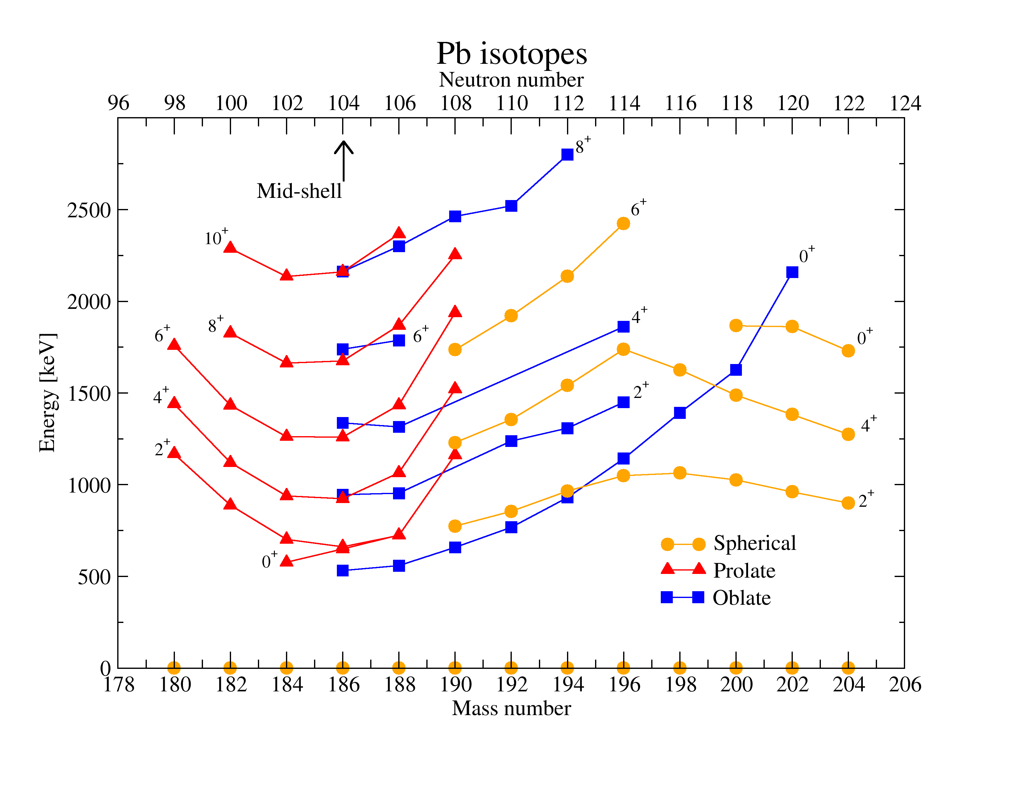
Level systematics of Pb isotopes
Notes:
Then a brief look into physics background in this region. These are the level energy systematics as we know it for even A Pb isotopes.
This plot summarizes the huge amount of effort that has been put in to understand the evolution of nuclear structure in light Pb isotopes. That includes alpha-decay fine structure measurements, beta-decay experiments, in-beam spectroscopy, laser spectroscopy and so on…
and it is not even showing different isomeric states.
Three different structures are shown in different colors
Ground state is spherical – laser spectroscopy
Deformed structures intrude down in energy when approaching the N=104 neutron mid-shell
Around midshell and beyond, these nuclei are very exotic, difficult to produce and probe. For example, fusion evaporation cross-section for 180Pb ~10nb => 300 isotopes/week

Slide 7
Level systematics of Pb isotopes
Notes:
The present work focuses on 188Pb nucleus.
The first excited state is an oblate 0+.

Slide 8
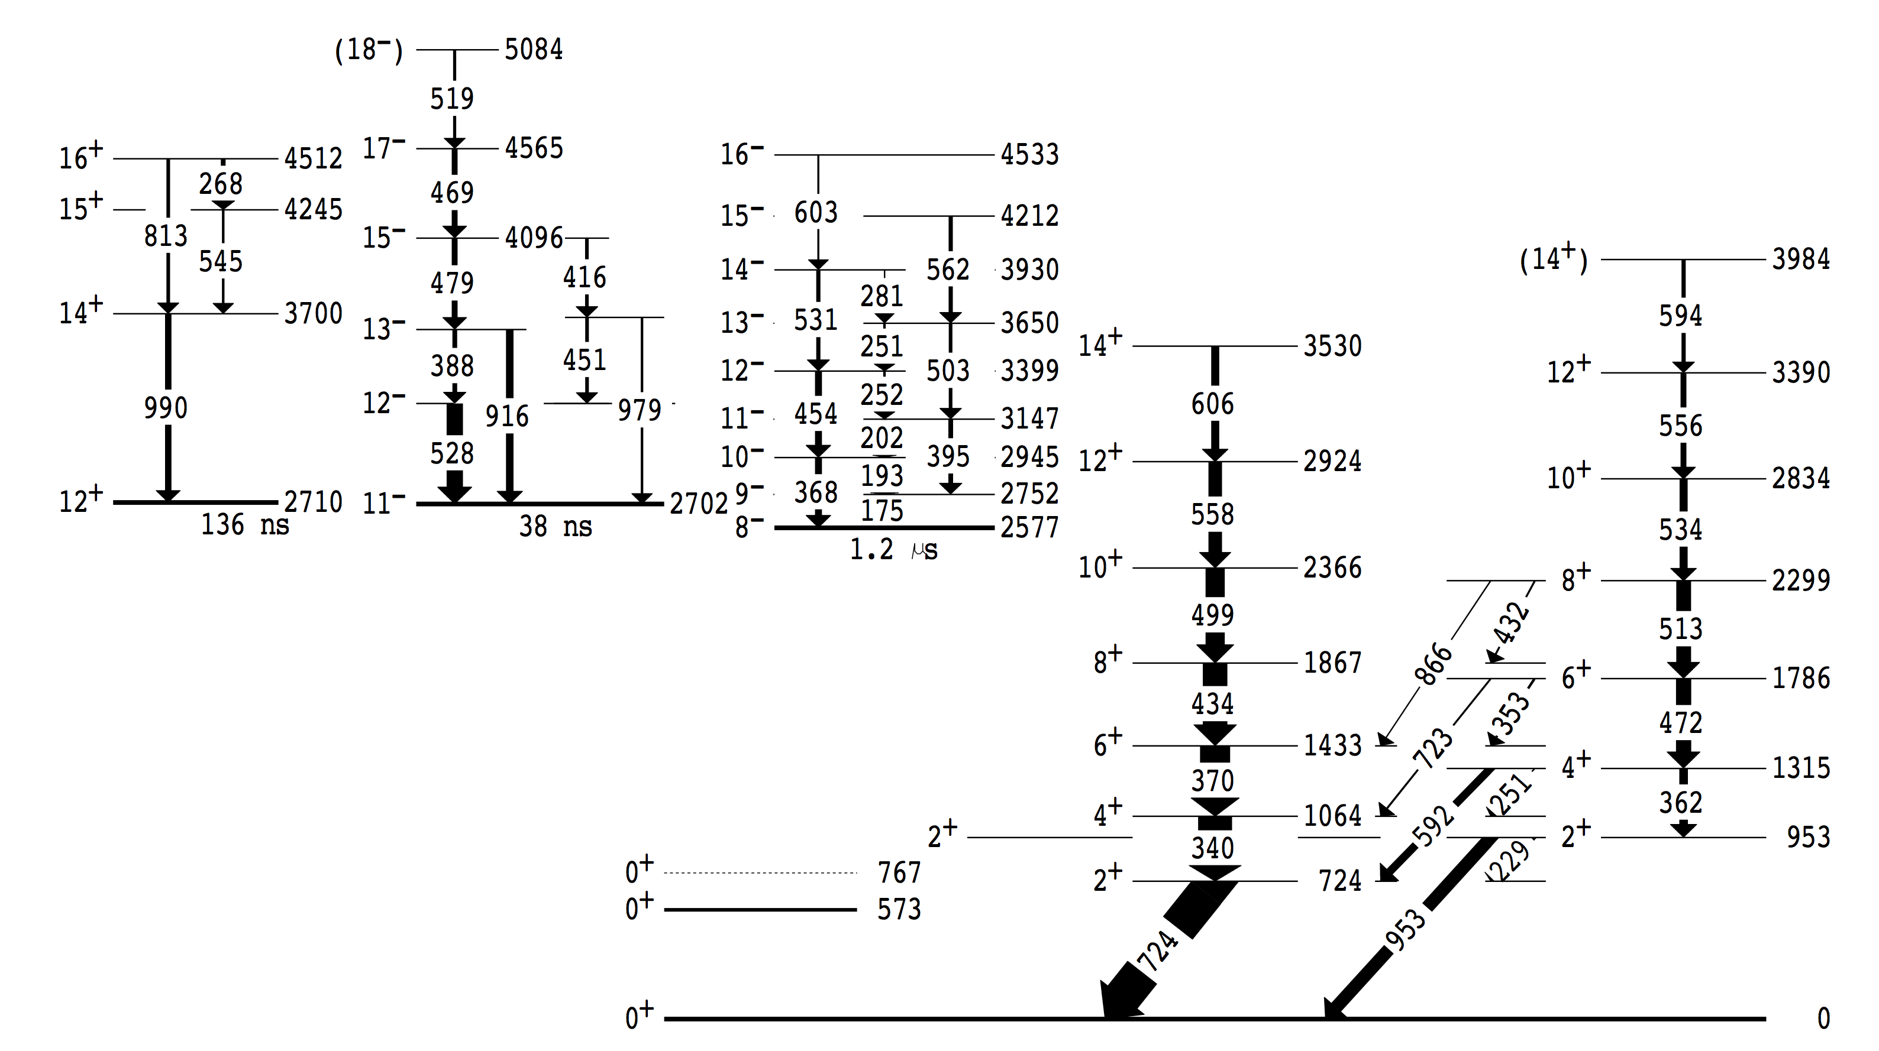
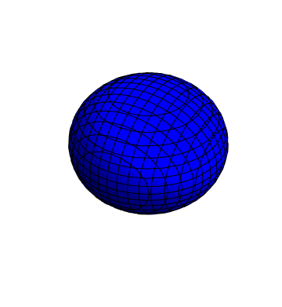

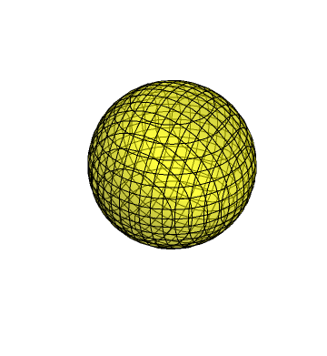
¹⁸⁸Pb level scheme
?
?
G.D. Dracoulis et al., Phys. Rev C 67, 051301(R) 2003
Notes:
The partial level scheme of 188Pb is shown here, including isomeric states that are associated with three different states. This is from gammasphere data by Dracoulis et al. By means of missing gamma-ray analysis, they extracted enhanced E0 components for the interband transitions between states with same spin and parity. E0 do not only help with spin assignments, but also carry out information of mixing.

Slide 9
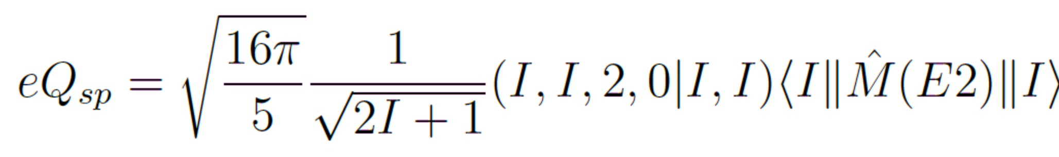
Objectives of present work - 1 direct measurement of shapes
Obtaining diagonal matrix elements for
the 2₁⁺ and 2₂⁺ states
G.D. Dracoulis et al., Phys. Rev C 67, 051301(R) 2003
Notes:
Thus, our objectives in present proposal
Directly measure shapes of the “bandhead” 2+ states
Probe collectivity of bands associated different shapes
Investigate mixing via measurement of the E0 transitions

Slide 10
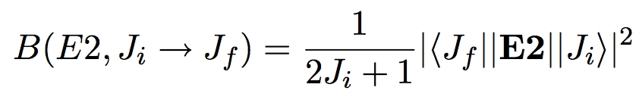
Objectives of present work - 2 collectivity of bands
Measuring transitional matrix elements for transitions on top of the 2⁺ states
G.D. Dracoulis et al., Phys. Rev C 67, 051301(R) 2003
Notes:
Thus, our obejctives in present proposal
Directly measure shapes of the bandhead 2+ states
Probe collectivity of bands associated different shapes
Investigate mixing via measurement of the E0 transitions

Slide 11
Objectives of present work - 3 measurement of the E0 transitions
Confirm recent SAGE results:
  Long-standing issue of the level energies of the excited 0⁺ states
  Directly measure the E0 components of the inter-band transitions
592
G.D. Dracoulis et al., Phys. Rev C 67, 051301(R) 2003
Notes:
Thus, our obejctives in present proposal
Directly measure shapes of the bandhead 2+ states
Probe collectivity of bands associated different shapes
Investigate mixing via measurement of the E0 transitions

Slide 12
Outline
Physics background and motivation
Experiment description
Notes:
To clarify this proposal a little bit more. We propose to carry out simultaneous in-beam gamma-ray -- conversion electron Coulomb excitation experiment using radioactive 188Pb beam.

Slide 13
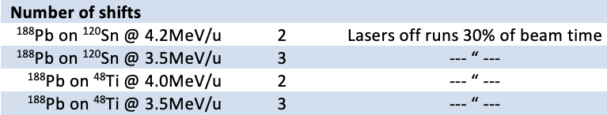
Coulomb excitation of ¹⁸⁸Pb
  UCx target + LIST/VADLIS
  HIE-ISOLDE beam ~10⁶pps @ MINIBALL
  Two energies: 3.5 and 4.1MeV/u
  Two targets: ¹¹²Cd and ⁴⁸Ti
  Typical MINIBALL set-up + SPEDE
Notes:
Proposed experiment in a nutshell

Slide 14
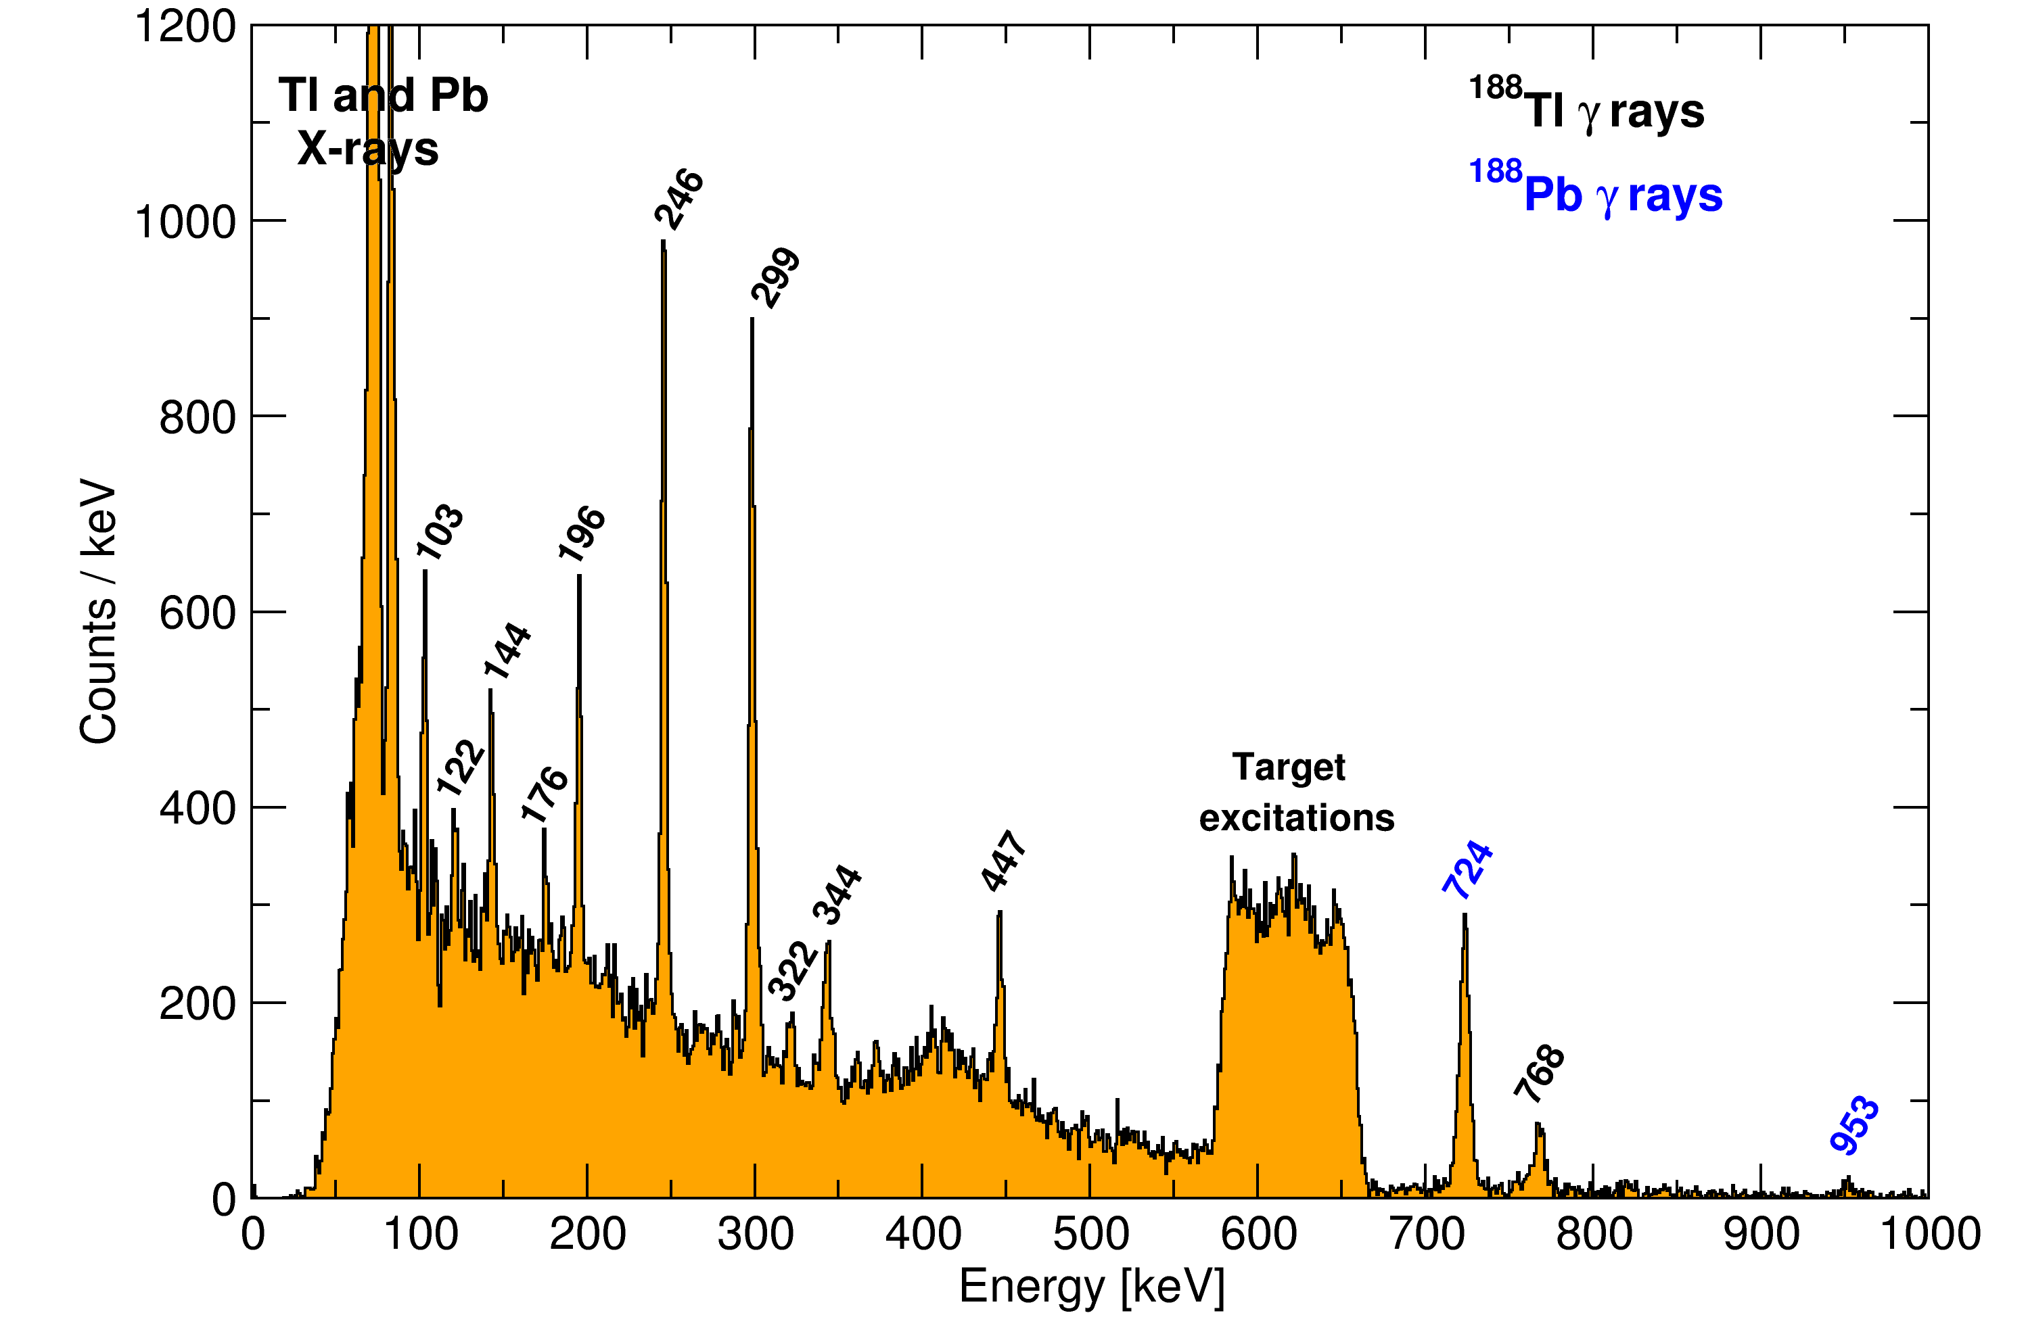
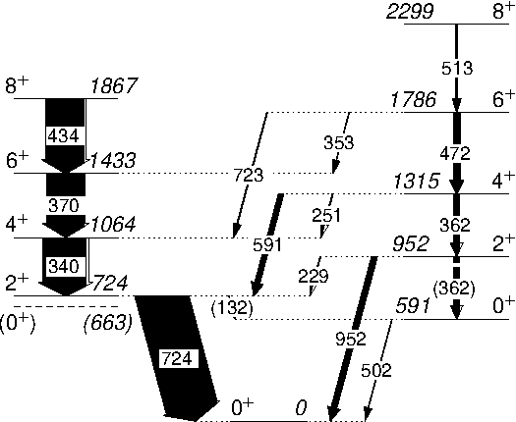
DC bgr subtracted γ-rays from IS494
Low CoM angles
Notes:
This shows that only the first excited 2+ state was populated in via Coulomb excitation. This makes analysis more straight forward.

Slide 15

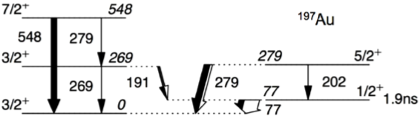
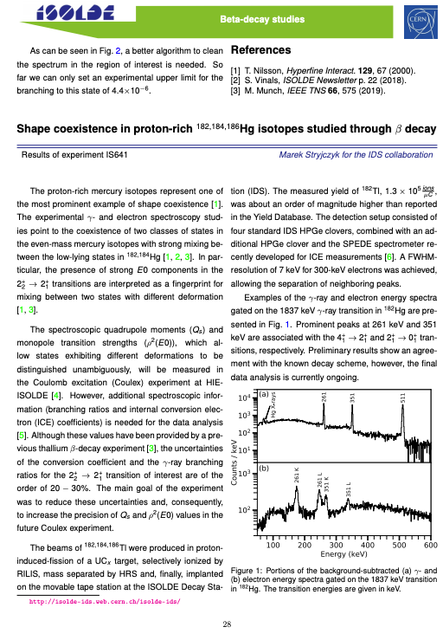
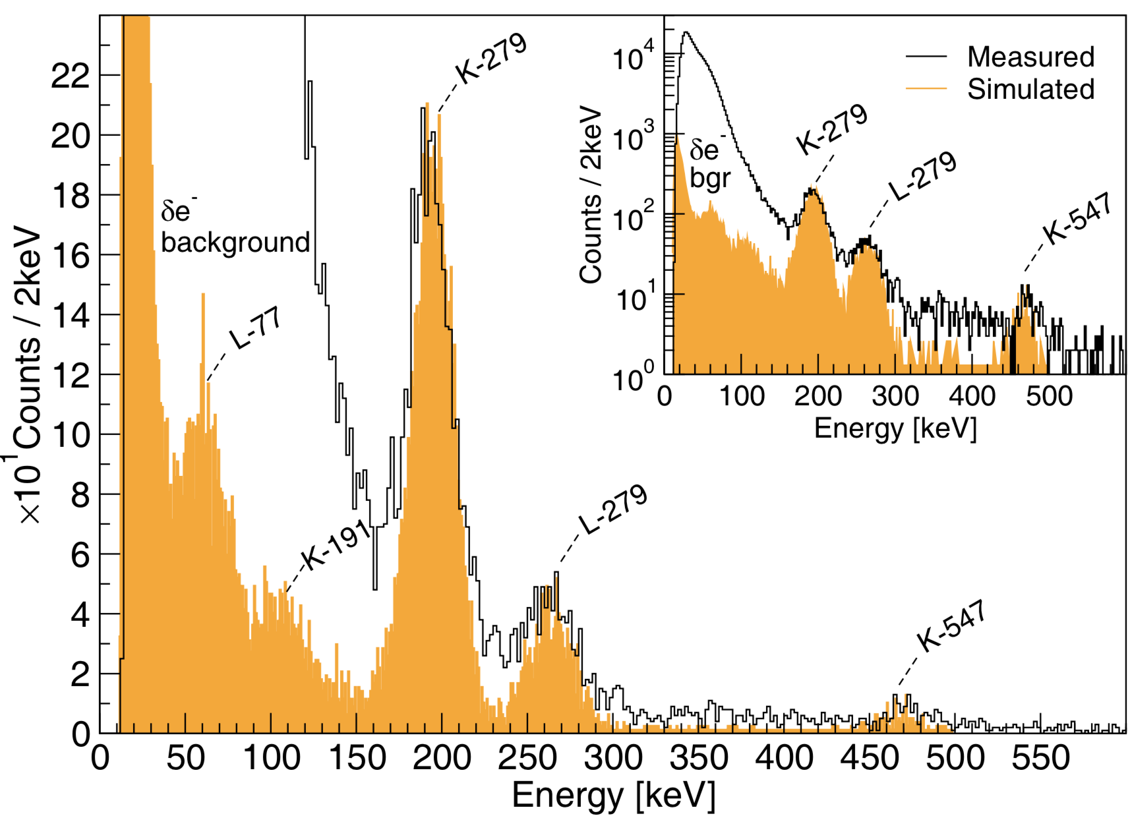
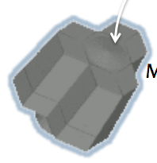
The SPEDE spectrometer
Segmented
Silicon detector
CD detector
Target
Beam
e⁻
γ-ray
Miniball array
P. Papadakis et al. Eur. Phys. J. A (2018) 54: 42

Slide 16
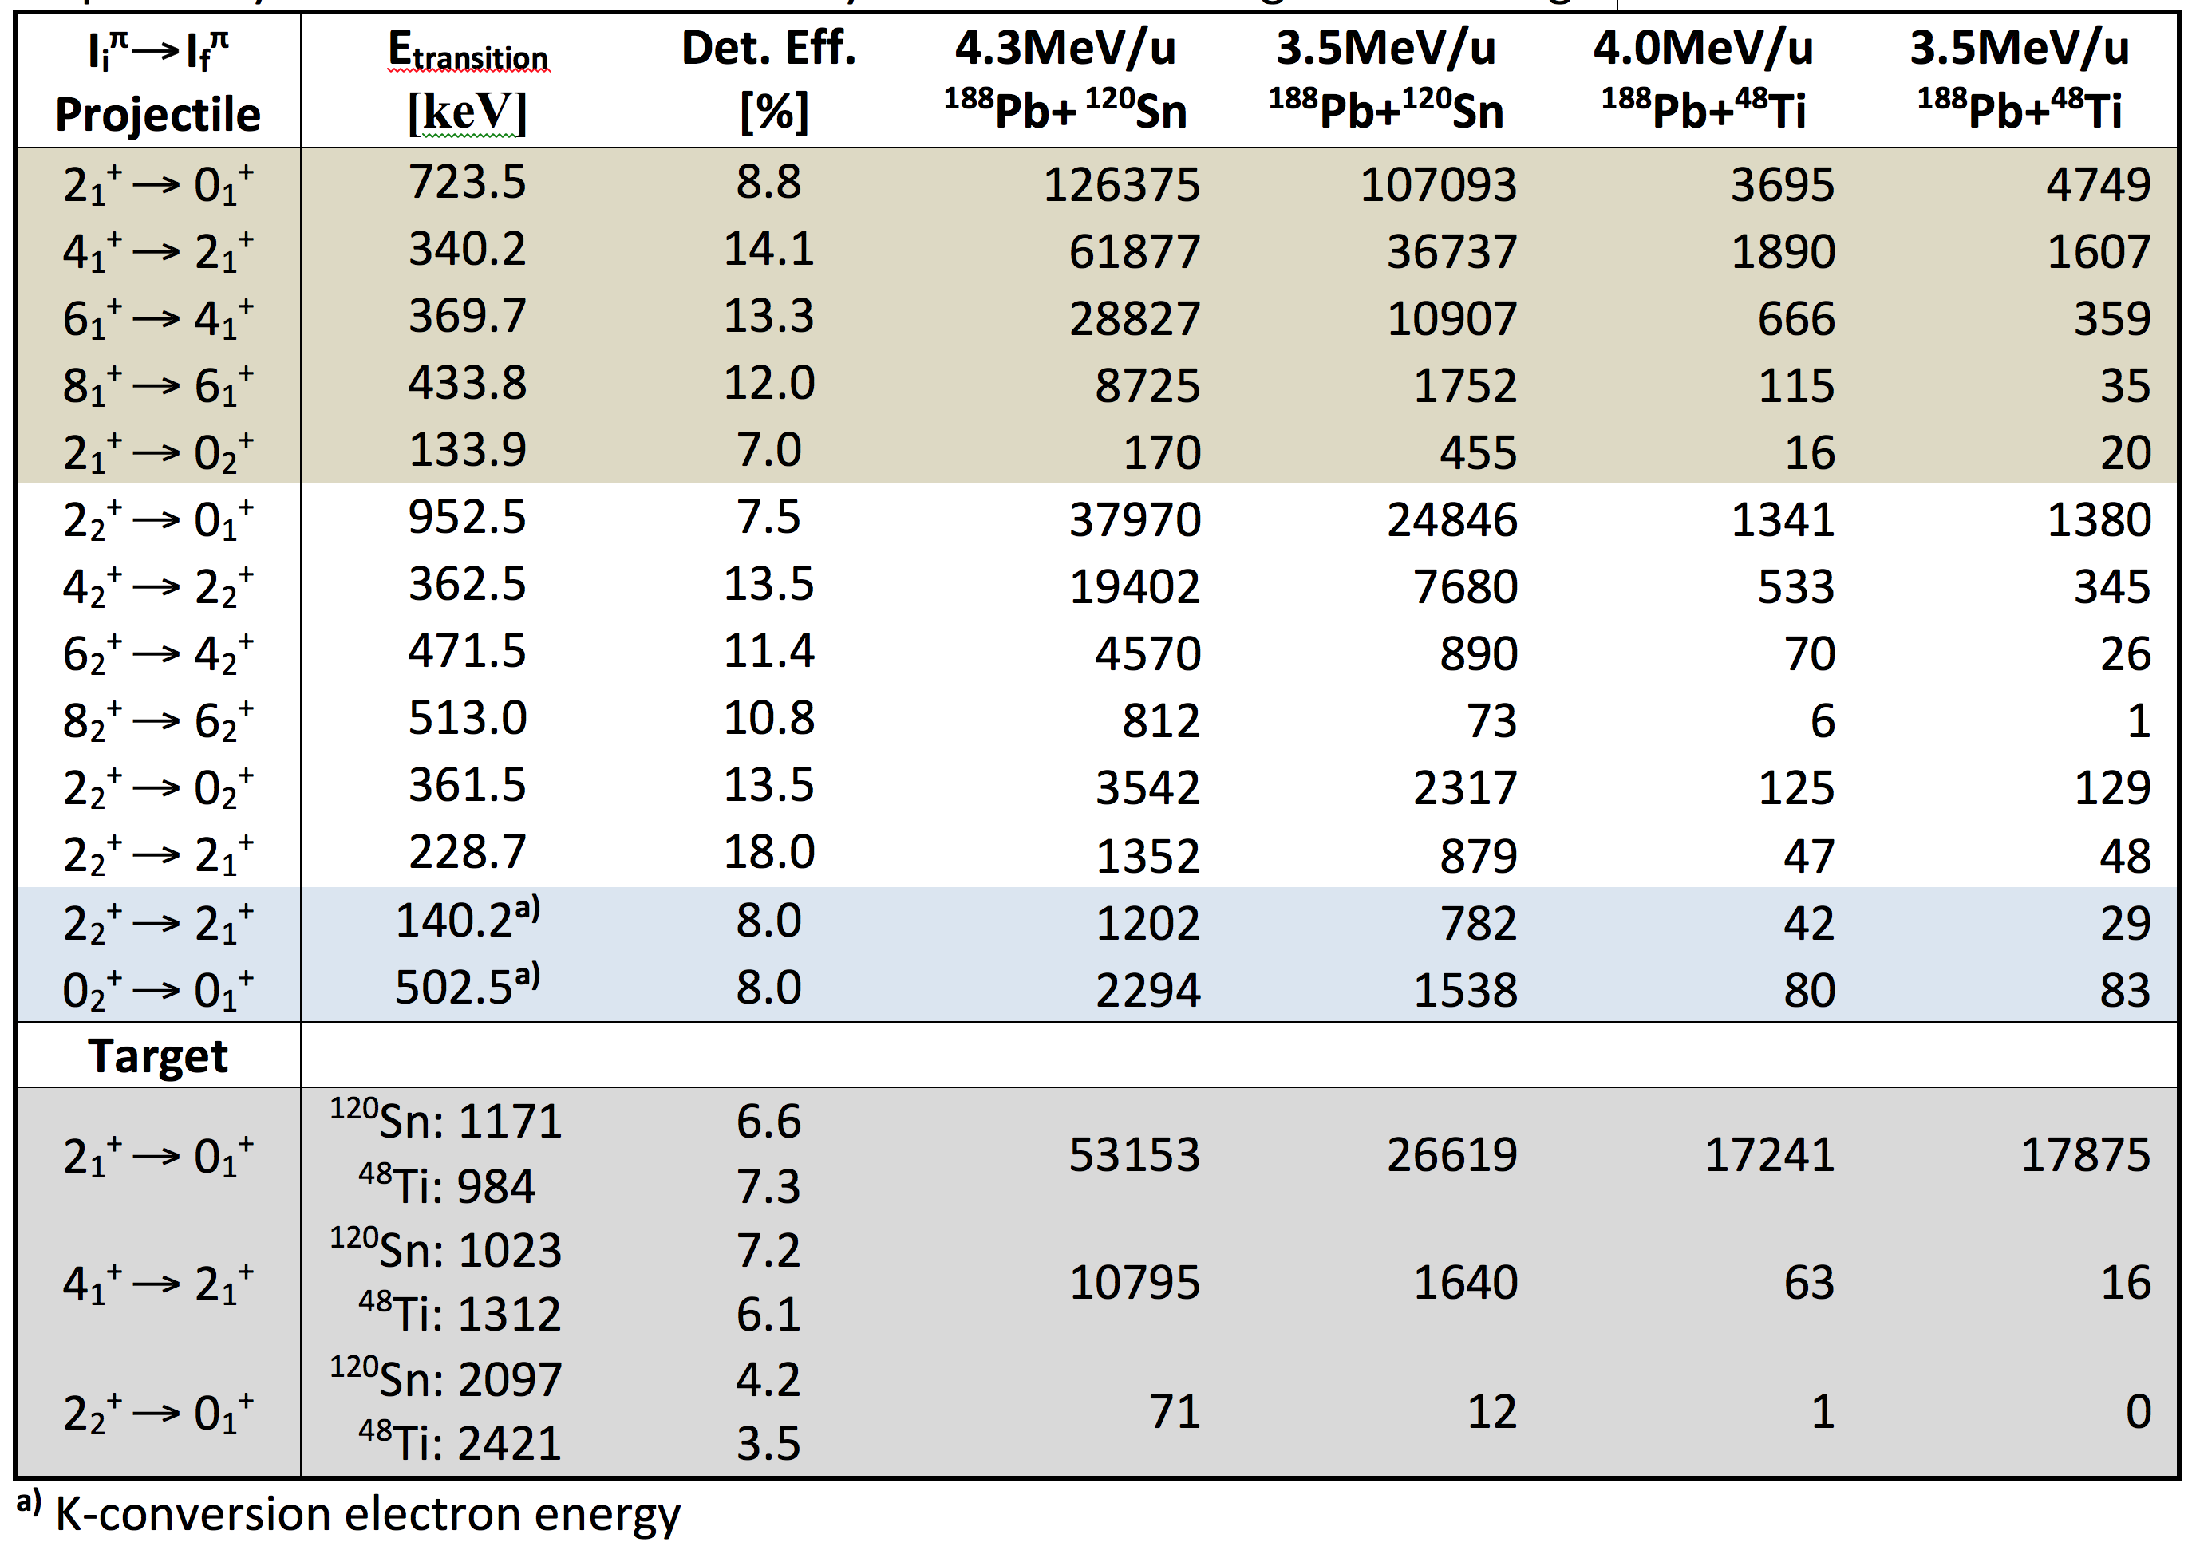
Yield estimates for ¹⁸⁸Pb
– number of shifts as in proposal –
Notes:
This table summarizes the yield estimates for 188Pb nucleus calculated using the gosia code. It should be noted that the direct population of the excited 0+ states may be become important if the <2_1|E2|0_2> is large, but it difficult to estimate, thus it was not included in calculations. In other words, the population of the 0+ states is higher in practice. However, this is the same as in the proposal, so I just wanted to include in presentation in case of related discussions…

Slide 17
Summary
Instrumentation:
Standard MINIBALL configuration + SPEDE
SPEDE ready (plans for further developments)
Complementary data obtained
Request:
  We request 10 shifts for ¹⁸⁸Pb experiment
  Yield tests (and Tl suppression)
  employing VADLIS

Slide 18








Acknowledgements

Slide 20
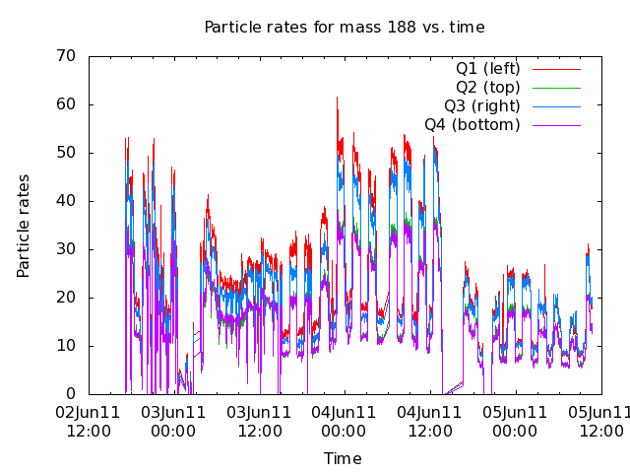
Laser on/off

Slide 21
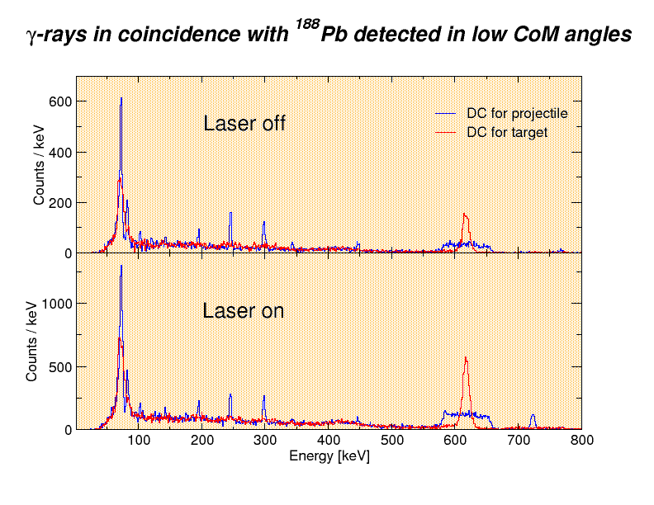
Laser on/off

Slide 22
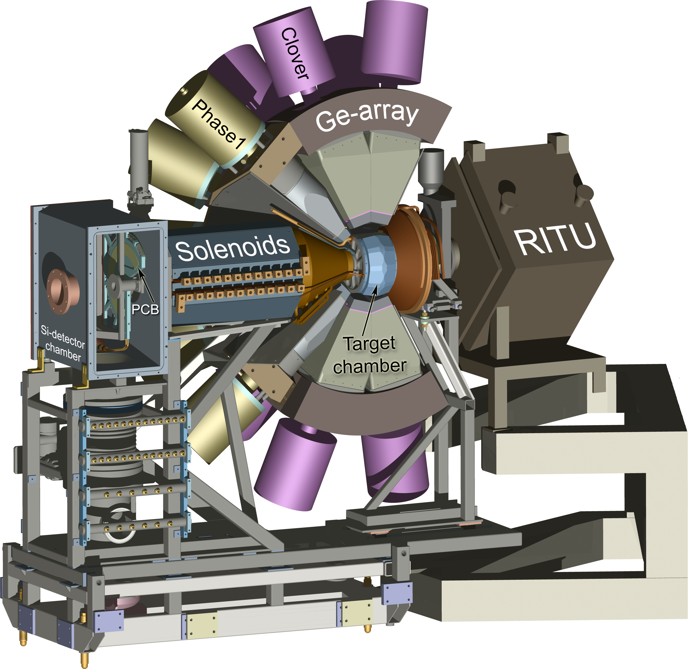
Probing conversion electrons in ¹⁸⁸Pb using the SAGE spectrometer
¹⁶⁰Dy(³²S,4n)¹⁸⁸Pb
E_{beam}=165MeV
σ ∼1100μb
I_{beam} ≈ 18pnA
7 days of beam time
SAGE+RITU+GREAT
Fully digital DAQ
Notes:
This is the experiment in a nutshell. Rodi describe SAGE this morning, so need to go in to details. I just want to stress, that recoil-decay-tagging could not be employed for 188Pb…

Slide 23
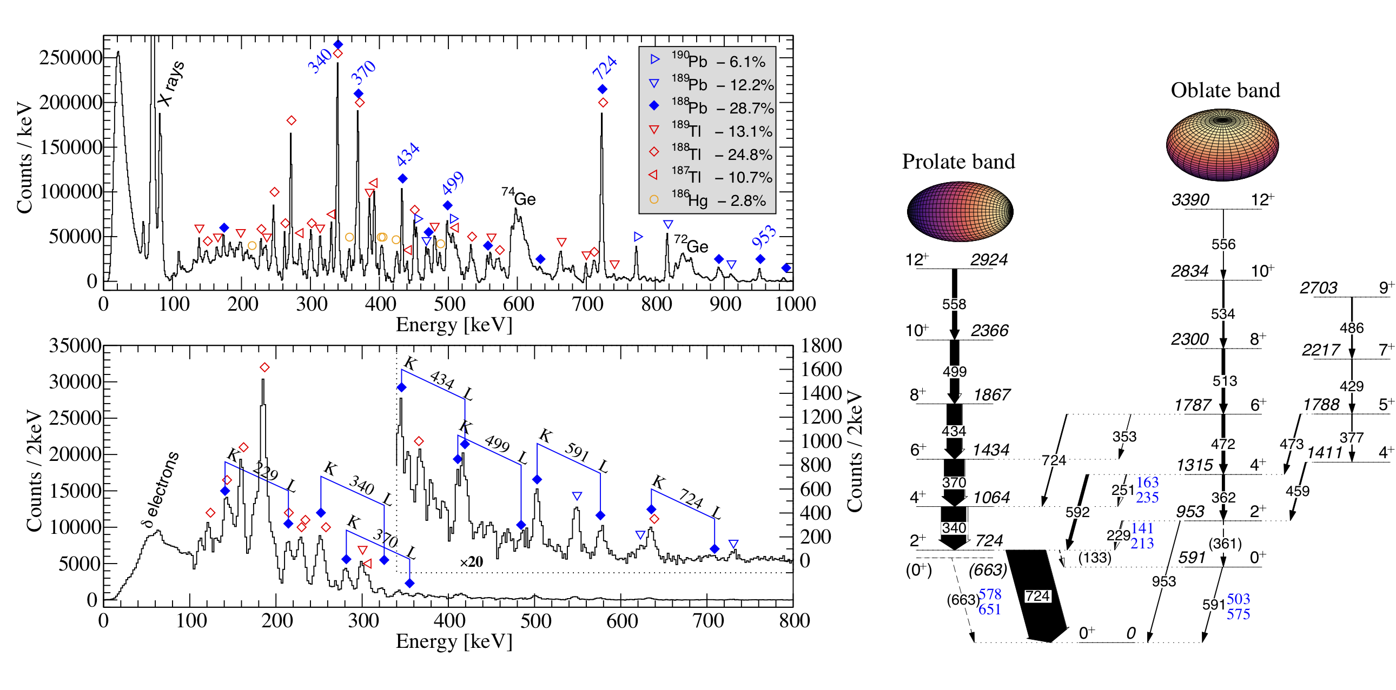
Direct measurement of conversion electrons in ¹⁸⁸Pb
Notes:
Then, looking in more details for the gammas and rebinning the spectrum, one finds out that the 362keV transition could be a doublet.

