Slide 1
Precision measurement of the half-life and branching ratio of T=1/2 mirror β decay of ³⁷K
T. Kurtukian-Nieto¹, B. Blank¹, P. Ascher¹, G. Benzoni², A. De Roubin¹, X. Fléchard³, M. Gerbaux¹, J. Giovinazzo¹, S. Grévy¹, G. Grinyer⁴, A. Husson¹, E. Liénard³, J. Liendo⁵,
J. Michaud¹, M. Pomorski¹, G. Quéméner³, J.C.Thomas⁶, M. Versteegen¹
¹ CENBG, IN2P3/CNRS/Université Bordeaux 1, BP120 F-33175 Gradignan, France
² INFN, Sezione di Milano, via Celoria 16, I-20133 Milano, Italy
³ LPC CAEN-ENSICAEN, 6 Boulevard du Marechal Juin, 14050 Caen Cedex, France
⁴Department of Physics, University of Regina, Regina, SK S4S 0A2, Canada
⁵ Universidad Simon Bolivar, Baruta. AP 89000, Caracas,Venezuela.
⁶ GANIL, CEA/DRF-CNRS/IN2P3, Bvd Henri Becquerel, 14076 Caen, France
62th Meeting of the INTC. CERN, November 6-7, 2019

Slide 2
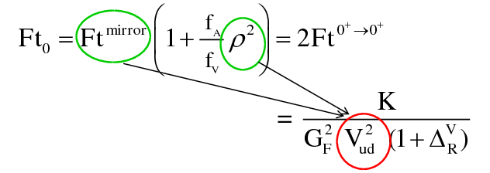
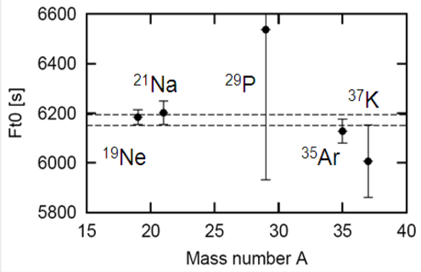
Superallowed Mixed Mirror β decay
T_{1/2}
Measurements needed :
Q_{β} value
Branching ratio of super-allowed transition
β-decay half-life
GT-to-F mixing ratio: a_{βν}, A_{β}
γ
BR
Q_{EC}
ft = f(Q_{ec}) * T_{1/2} / BR
First consistent test of CVC from a set of nuclear transitions other than super-allowed pure Fermi
O. Naviliat-Cuncic and N. Severijns PRL 102, 142302 (2009)

Slide 3
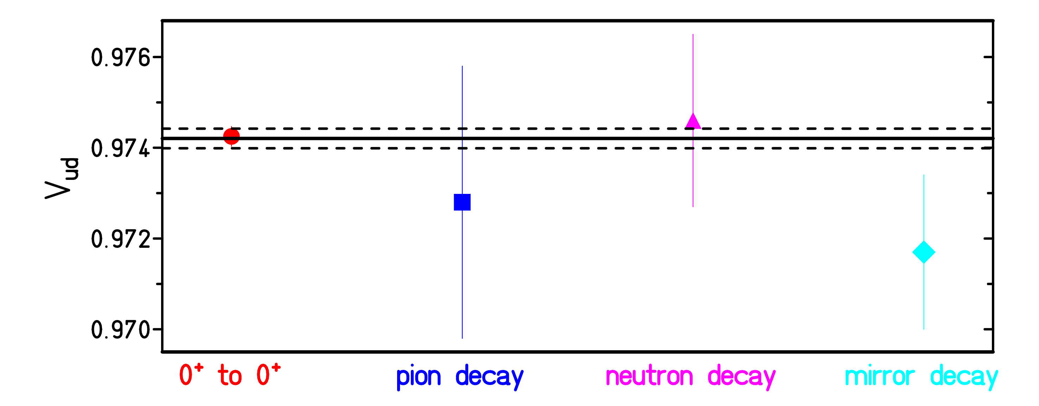
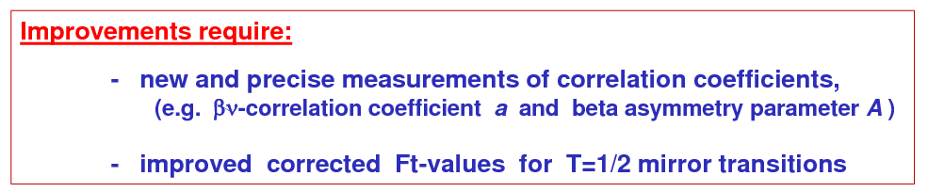
Introduction: quark-mixing matrix CKM
unitarity condition:
↓
O. Naviliat-Cuncic, N. Severijns

Slide 4
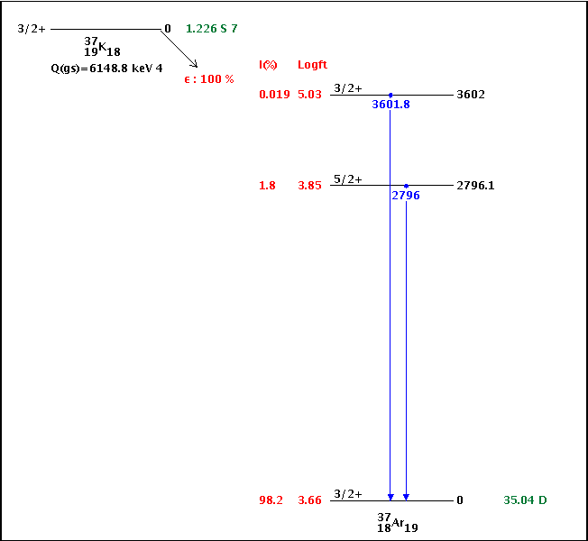
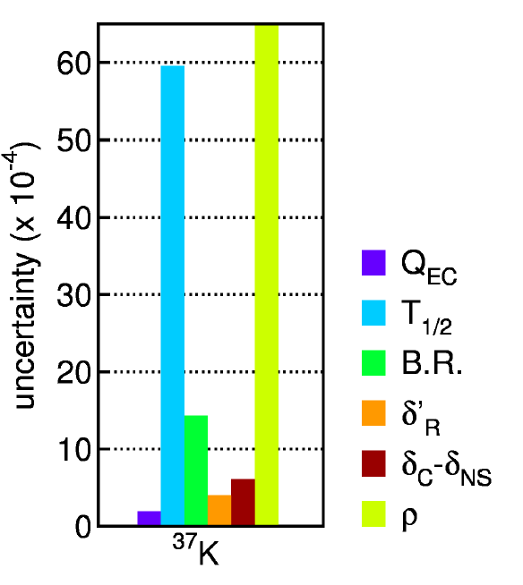
Why to re-measure ³⁷K ?
T=1/2 decay is predominantly 3/2+ to 3/2⁺ mixed Fermi/GT decay
Aim:
ΔT_{1/2} ~ 0.1 %
ΔB.R. ~ 0.1 %

Slide 5
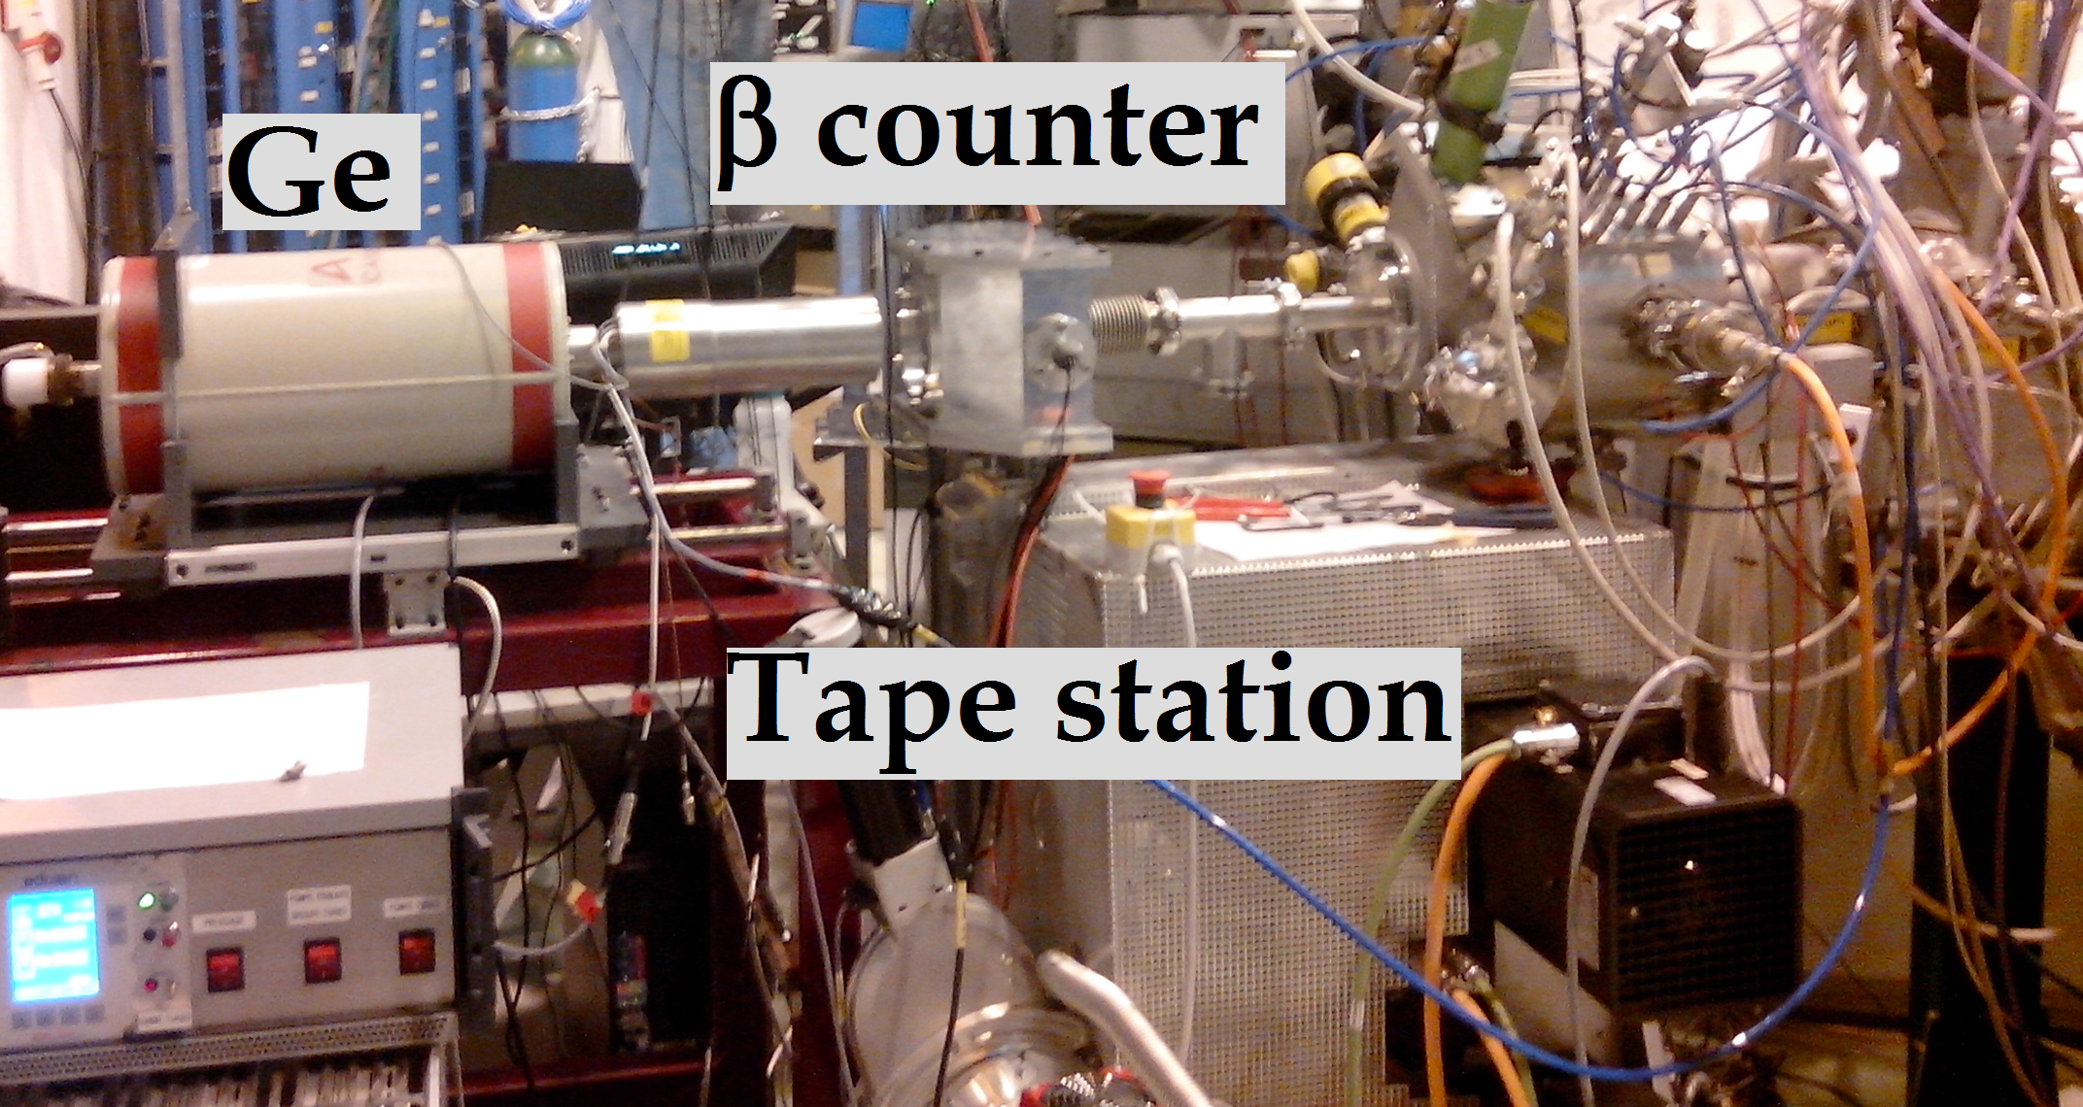
Half-life and BR measurement of ³⁷K
Detection setup at LA1 beamline
Experimental procedure:
production with CaO target
separation with HRS/GPS A=37
accumulation on tape
tape transport into setup
measurement for 3-20T_{1/2}
background
tape move and new cycle start

Slide 6
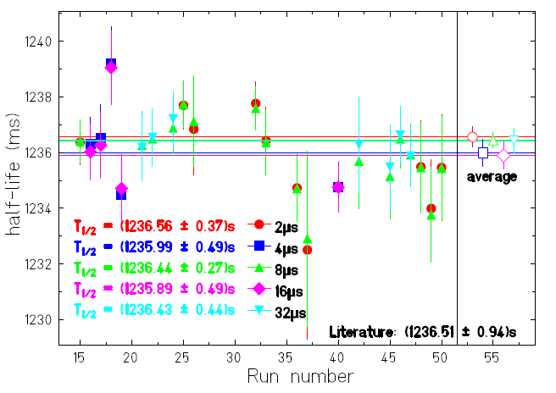
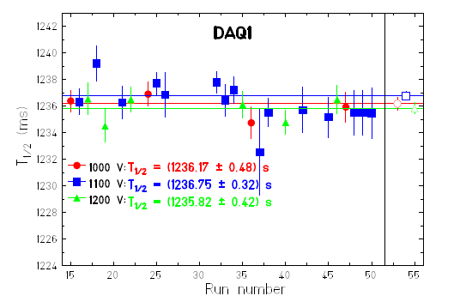
Experimental details
Measurements with
a fast DAQ system
- two electronic chains:
2, 4, 8, 16 and 32 μs fixed dead-time
a listmode DAQ system
- half-life measurement with 200μs DT
- γ-ray measurement for branching ratio
search for systematic errors:
different CFD thresholds
different detector HV
different cycle times
T_{1/2} = (1236.35 ± 0.23 (stat) ± 0.85 (sys)) ms
➔ 0.7 ‰, but…

Slide 7
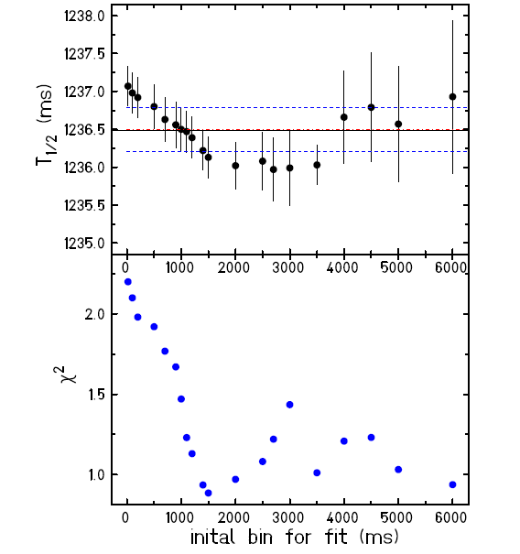
Problems encountered in 2014

Slide 8
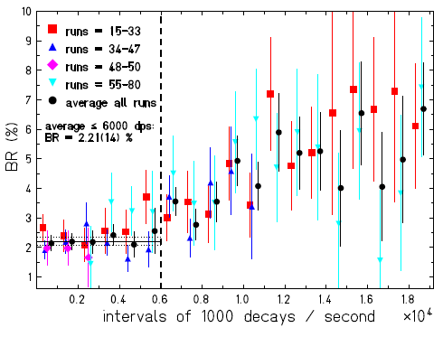
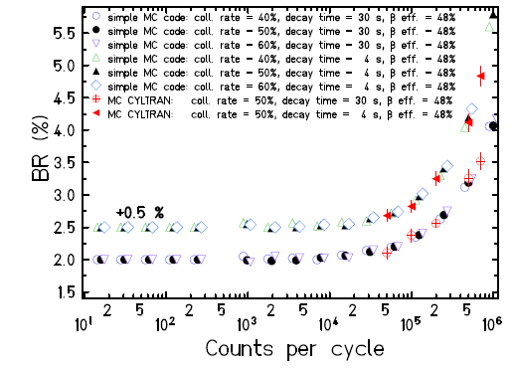
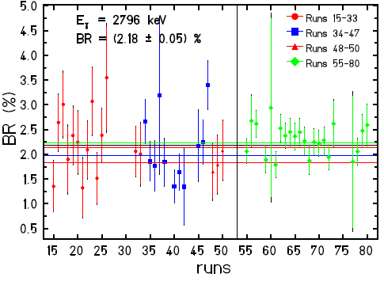
Problems encountered in 2014
Count rate limit:
BR = 2.21(19) %
MC simulations:
BR = 2.30(16) %
Final result:
2.20(17) %
BR(s.a.) = 97.96(14)%
➔ 1.4 ‰
Scaler analysis:
BR = 2.18(7) %

Slide 9
Beam request
Aim:
ΔT_{1/2} ~ 0.1 %
ΔBR ~ 0.1 %
Transport
Measuring time
background
Accumulation
long cycles: 0.3s + 1s + 10T_{1/2} + 3s +2s ~ 36 s
effective rate: 2000 ³⁷K decays detected/cycle
7 shifts of effective counting: ~ 9 million ³⁷K decays
1 shift for systematic errors (high count rate) ~ 2 million ³⁷K decays
ΔT_{1/2} < 0.1 %
with 8 long cycle shifts + 3 short cycle shifts
    ~ 1000 β-γ for 2796 keV (ε_{γ}=0.2%)
ΔBR < 0.1 %
1 shift to optimise production
-----------------------------------------------------------------------------
Total request: 12 shifts

Slide 10
Improvements
limit counting rate to 2000 cps
improve beam focusing on catcher
improve collimation in front of setup and further from the setup
use TDC between β signal and γ signal
use FASTER DAQ in addition to standard DAQ
Measurements performed since our measurement:
P. D. Shidling et al., Phys. Rev. C 90, 032501 (2014) ➔ T_{1/2} = 1.2365(9) s
B. Fenker et al., PRL 120, 062502 (2018) ➔ ρ = 0.576(6)
Foreseen in future: ρ measurement with LPCTRAP

Slide 12
Existing measurements
least known quantity: Gamow-Teller / Fermi
second least known quantity: half-life

