Slide 1





Status report on addendum IS599: β-delayed neutron
spectroscopy of ^{(52,53),54}K
Andrea Gottardo
For the IDS and VANDLE collaborations:
Robert Grzywacz
Miguel Madurga
UTK, Knoxville, TN, USA
ORNL, Oak Ridge, TN, USA
β-delayed neutrons
INTC2019 1/15

Slide 2
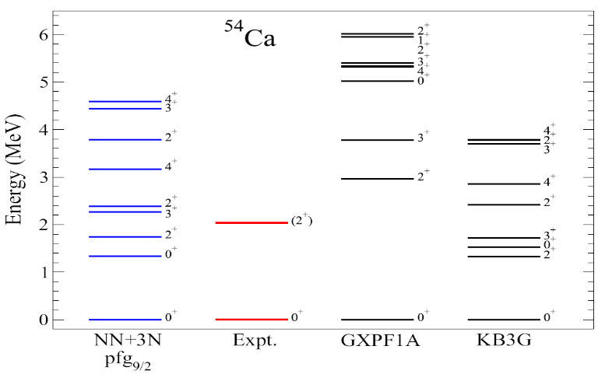
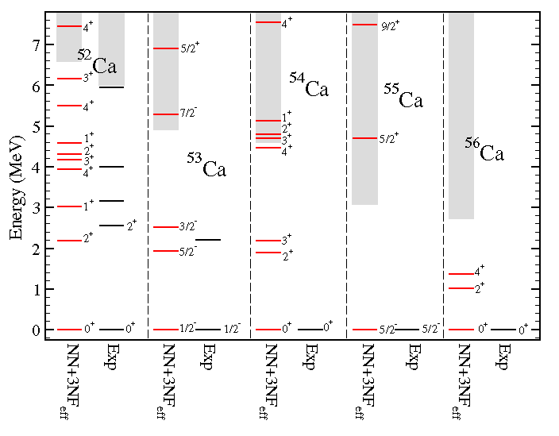
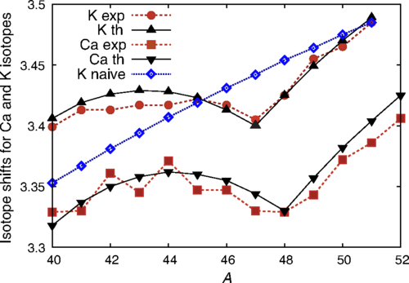
B(GT) in nuclei ^{52,53}K decay Results
B(GT) in nuclei The Calcium region Results
Neutron-rich Ca isotopes: a paradigm for shell-model
«first principle»
«renormalized to ⁴⁰Ca mass»
Large radii of Ca and K after N=28: large neutron p shell radii:
Many open questions for ⁵⁴Ca
2⁺ known only, differences for other states
Neutron emission towards ⁵³Ca: distribution of the GT (shell closures) and scattering across N=34.
Same quenching in B(GT) as ⁴⁹⁻⁵³Ca ?
J. Bonnard, S. M. Lenzi, and A. P. Zuker Phys. Rev. Lett. 116, 212501 (2016)
β-delayed neutrons
INTC2019 2/15

Slide 3
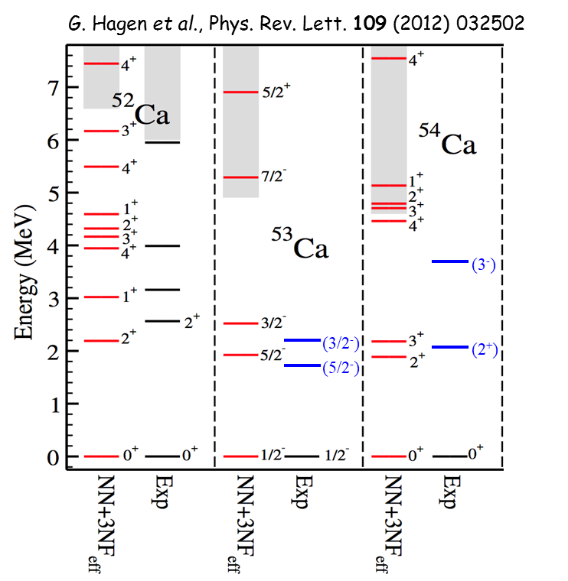
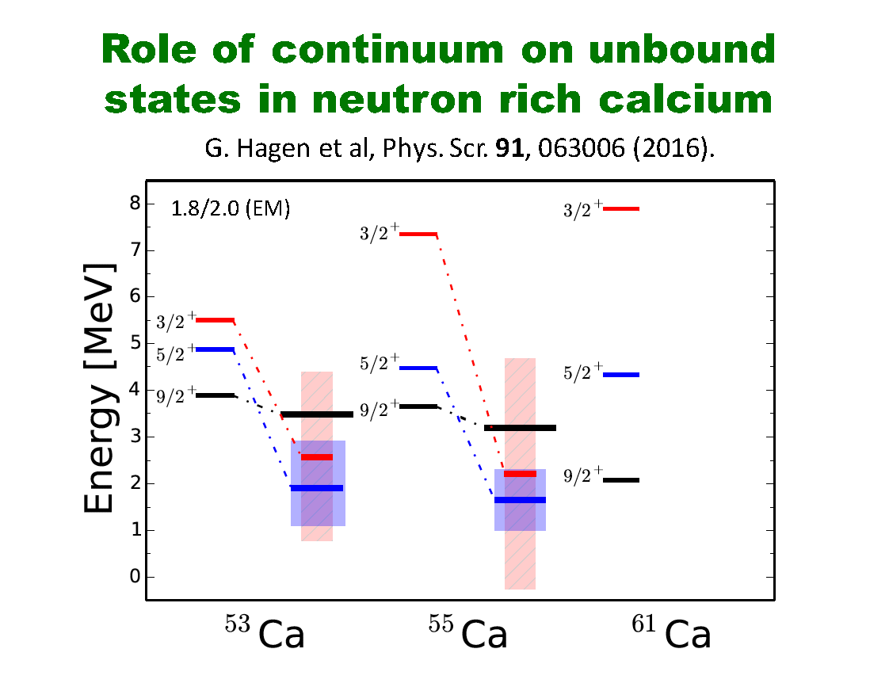
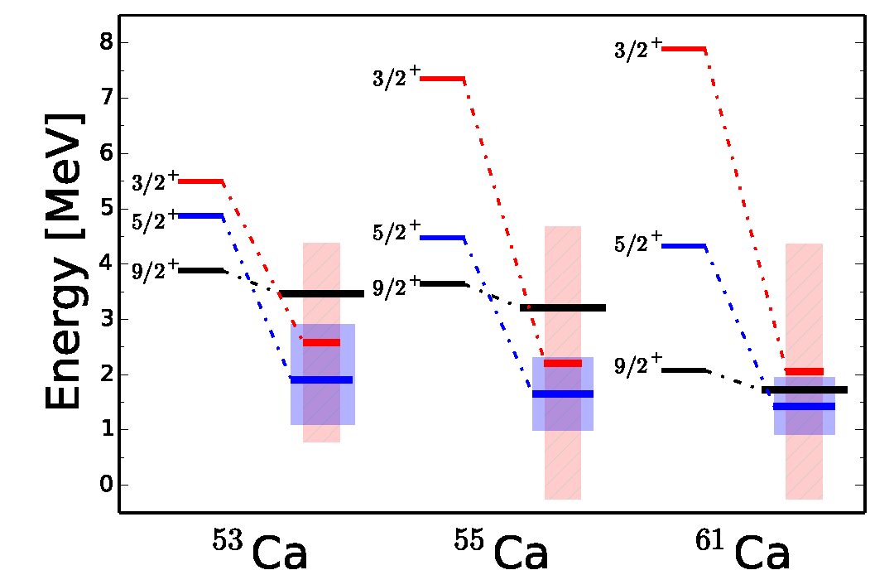
B(GT) in nuclei ^{52,53}K decay Results
The n-rich Ca region: GT across shell closures
f_{5/2}
GT
p_{1/2}
p_{3/2}
fp
N=28
Z=20
FF
f_{7/2}
sd
N=20
sd
GT
protons
neutrons
The β decay populates states below and above the neutron (and 2n) separation energy
Very large Q values 10-20 MeV
β-delayed neutrons
INTC2019 3/15

Slide 4
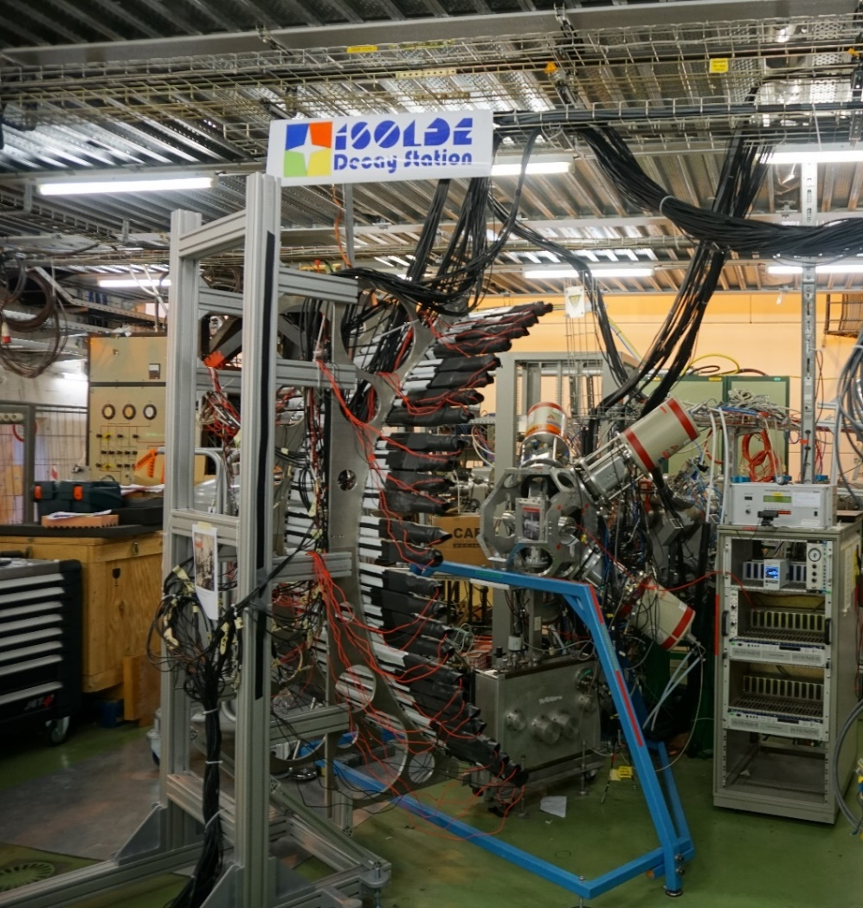
B(GT) in nuclei ^{52,53}K decay Results
The IDS-VANDLE setup
VANDLE: Versatile Array of Neutron Detectors at Low Energy: ε: 8 %; σ: 80 keV (1 MeV)
Neutron TOF EJ200 plastic scintillators
Two - four clovers
High-efficiency β detector (>80 %)
IDS tape transport
Sensitive even at low rates
VANDLE
ISOL beams
ISOL beams @ ISOLDE
^{51,52,53,54}K : surface ionization
Rates: 3-5 pps for ⁵³K, <1 pps for ⁵⁴K
Main limiting factor: T_{1/2}: 30 ms for ⁵³K and 10 ms for ⁵⁴K
IDS
β-delayed neutrons
INTC2019 4/15

Slide 5
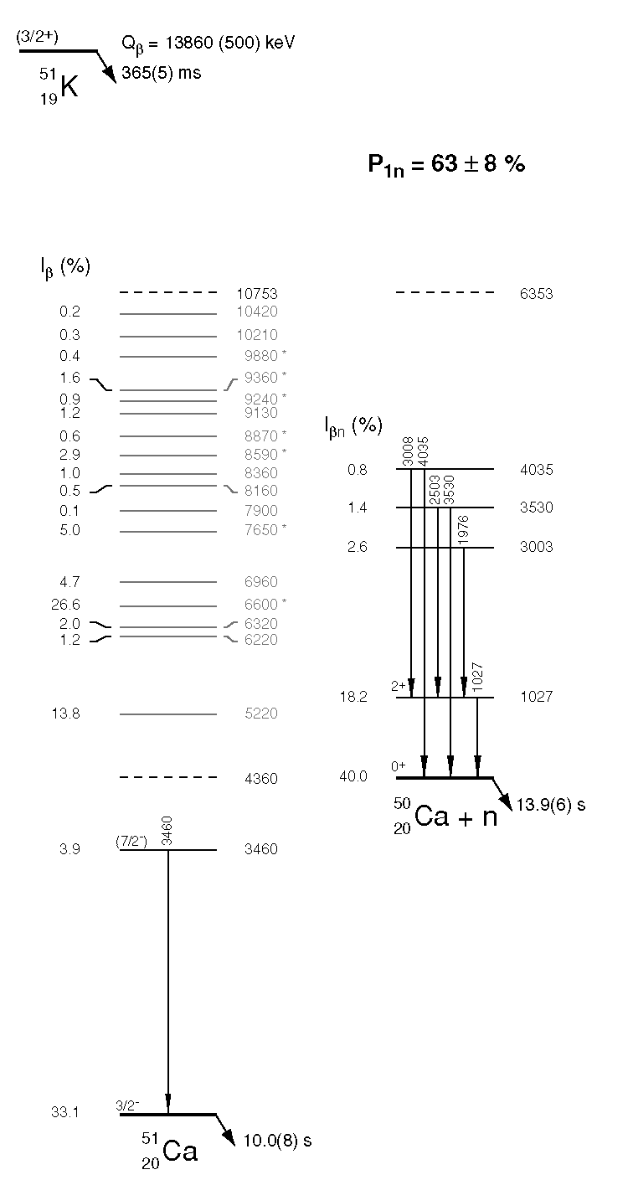
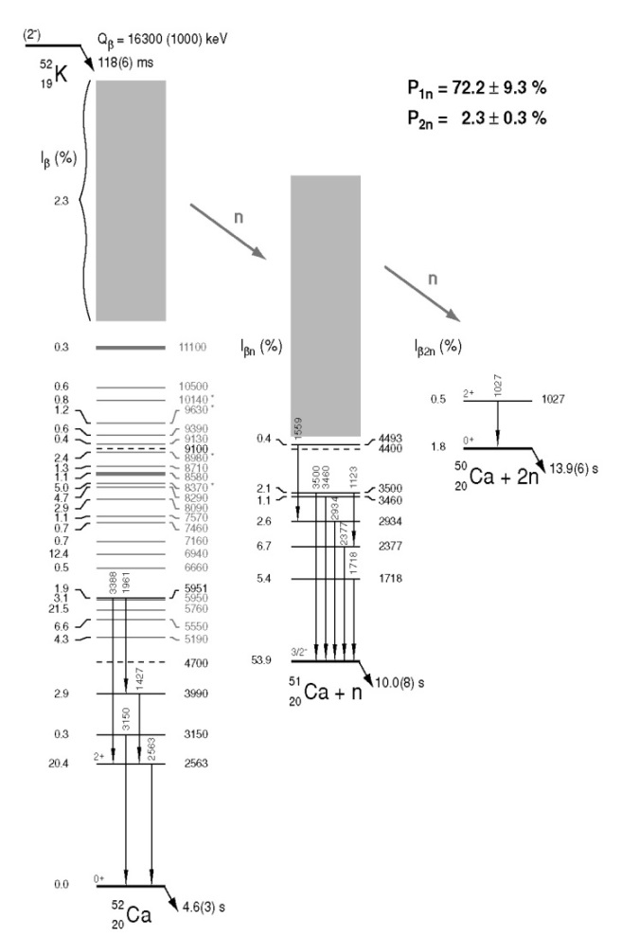
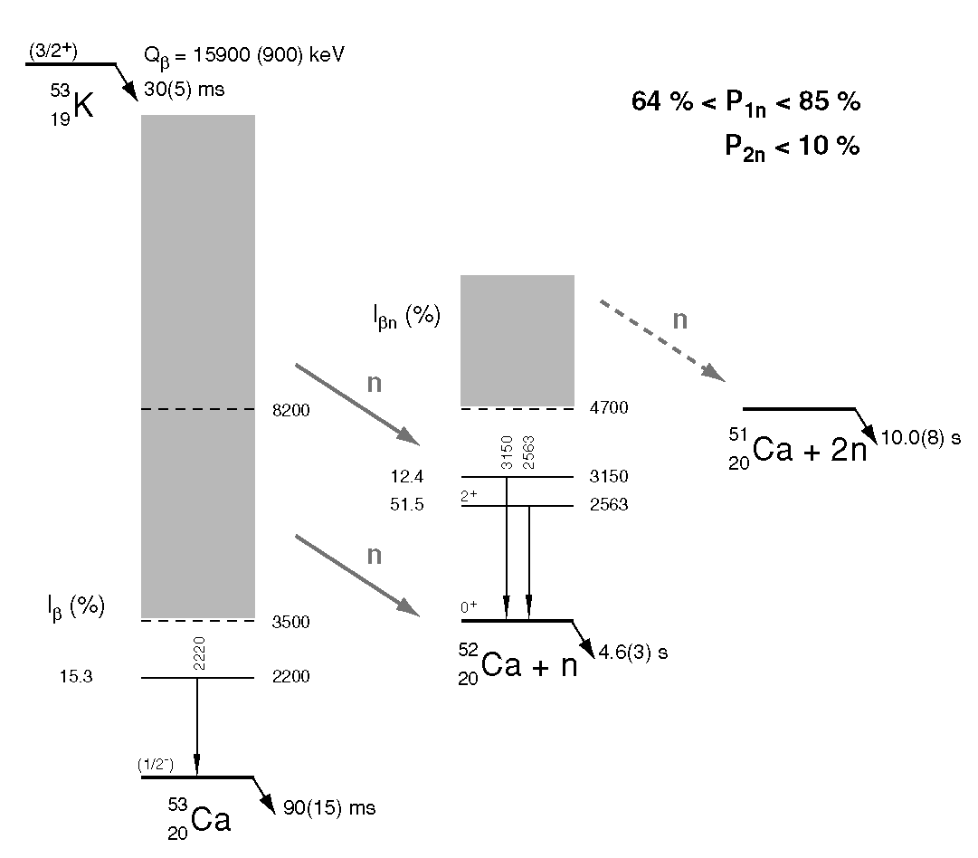
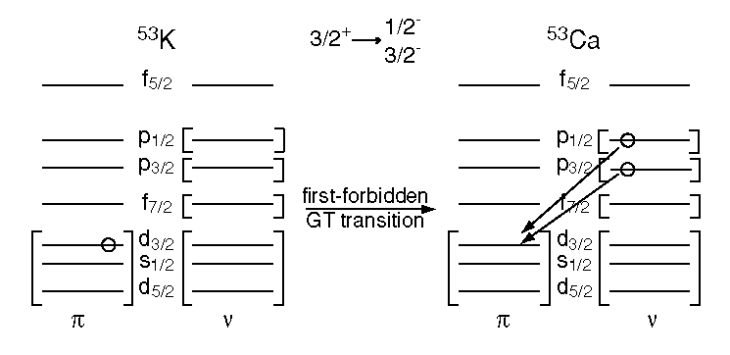
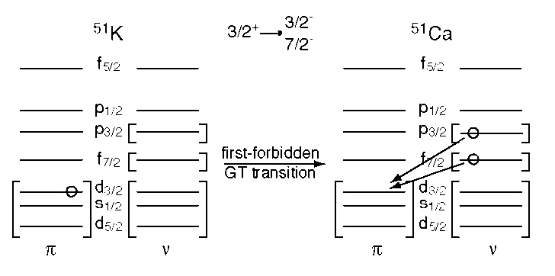
B(GT) in nuclei ^{52,53}K decay Results
Previous Tonnere experiment
F. Perrot et al., Phys. Rev. C 74 014313 (2006)
⁵¹K
⁵²K
⁵³K
Not enough statistics for ^{(52),53}Ca
Interpretation of spectra: FF due to parity-changing transitions
β-delayed neutrons
INTC2019 5/15

Slide 6
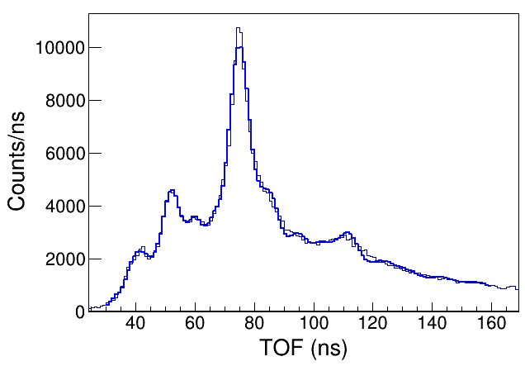
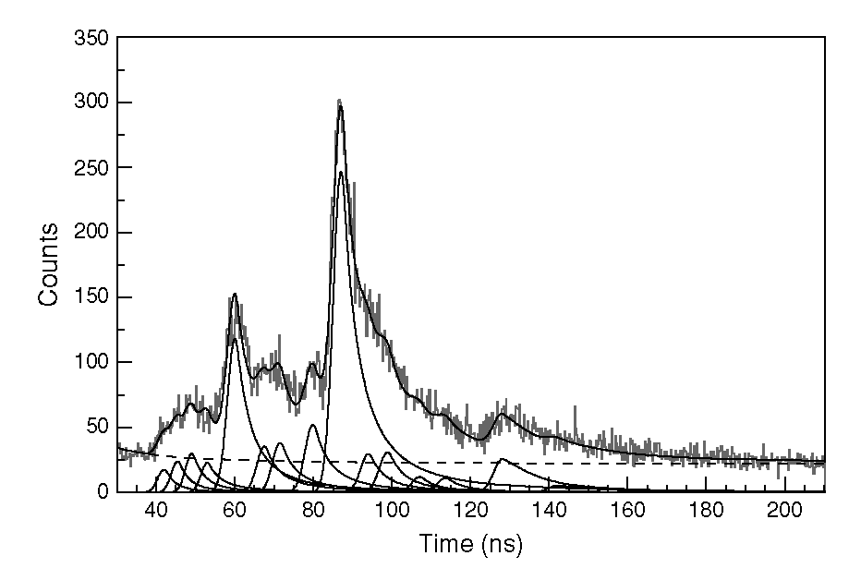
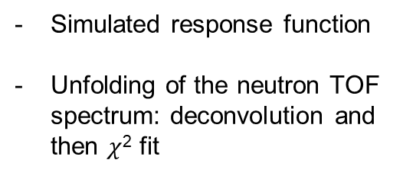
B(GT) in nuclei ^{52,53}K decay Results
⁵²K results: neutron emission
3
0.5
2
1.5
1
Energy (MeV)
neutron spetrum
VANDLE
Simulated response function
Unfolding of the neutron TOF spectrum: deconvolution and then $χ$² fit
TONNERE
β-delayed neutrons
INTC2019 6/15

Slide 7
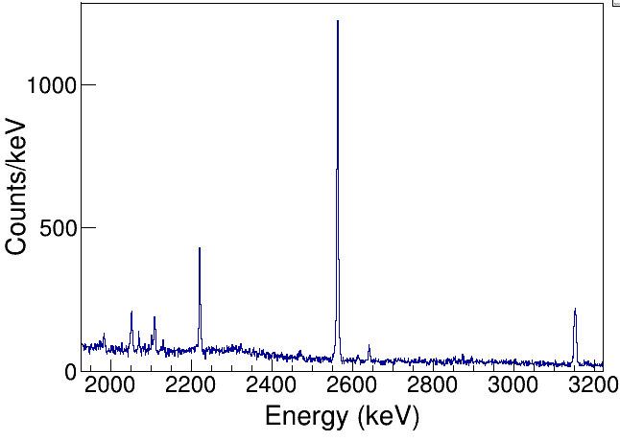
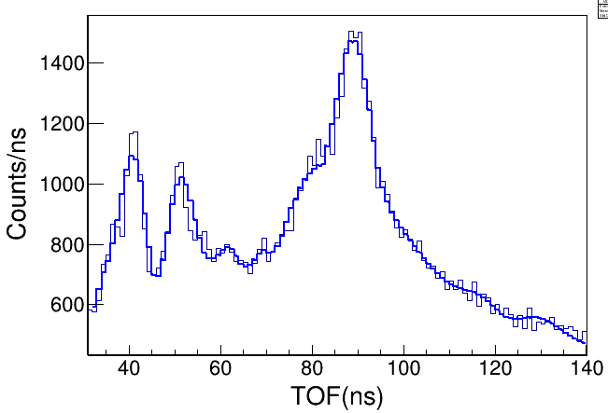
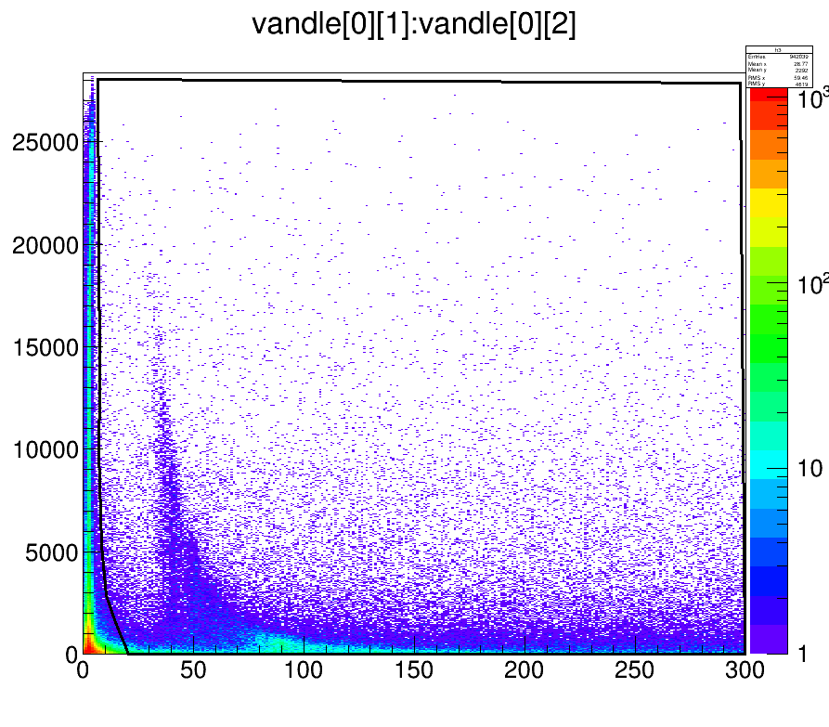
B(GT) in nuclei ^{52,53}K decay Results
⁵³K results: γ and neutron emission
2563
⁵³Ca β0n
⁵²Ca β1n
NO 2n emission observed from γ spectra (hint at 1541 keV, line not known in ⁵¹Ca)
^{52,53}Sc lines
SE 2563
2220
3
2
1.5
1
0.5
3150
Energy (MeV)
SE 3150
QDC(au)
TOF (ns)
β-delayed neutrons
INTC2019 7/15

Slide 8
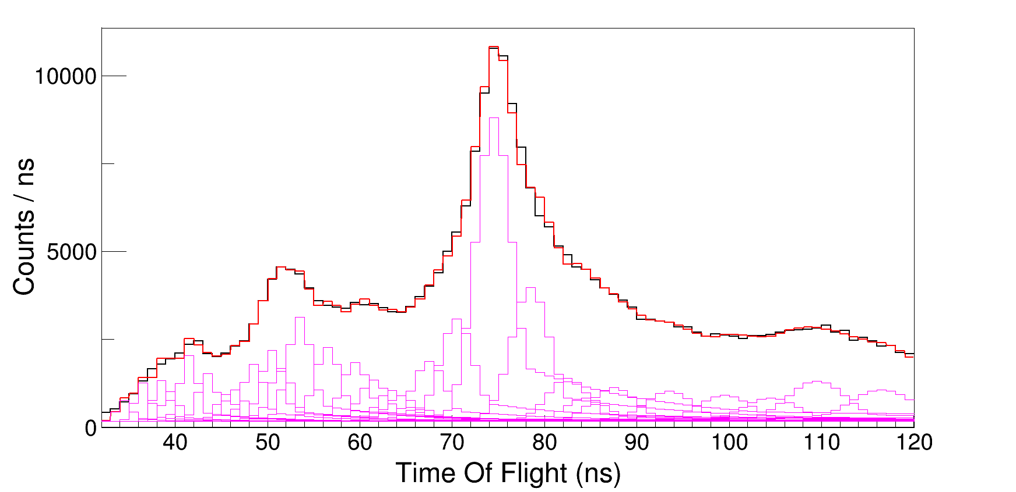
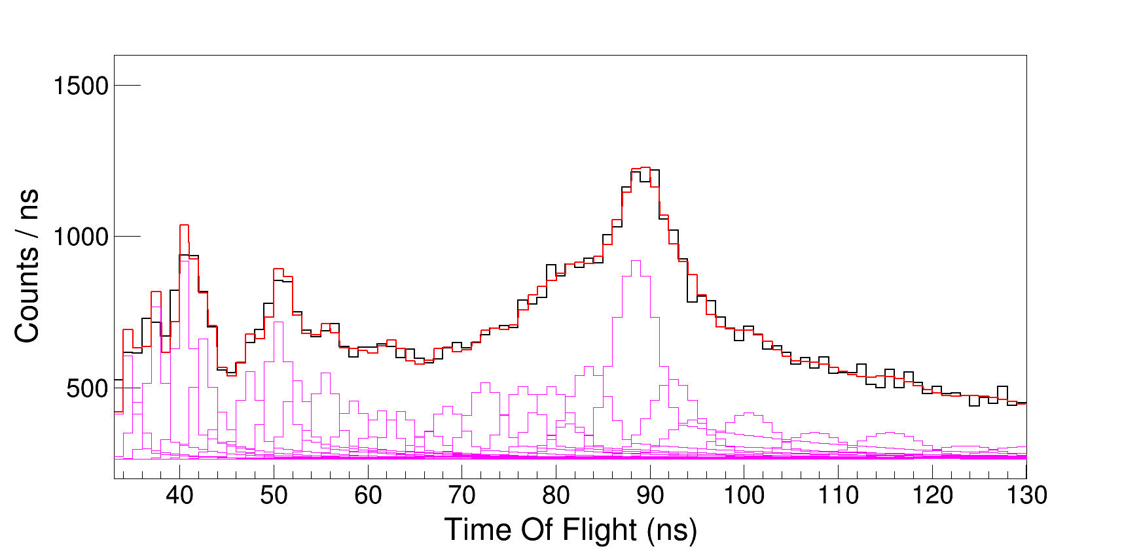
B(GT) in nuclei ^{52,53}K decay Results
^{52,53}K results: neutron emission deconvoluted
⁵²K
Simulated TOF shape verified on experiment
Fit with 20-30 peaks plus a constant background
Number of neutrons consistent with P_{n} from γ rays in ⁵²Ca, a little higher for ⁵³Ca.
⁵³K
β-delayed neutrons
INTC2019 8/15

Slide 9
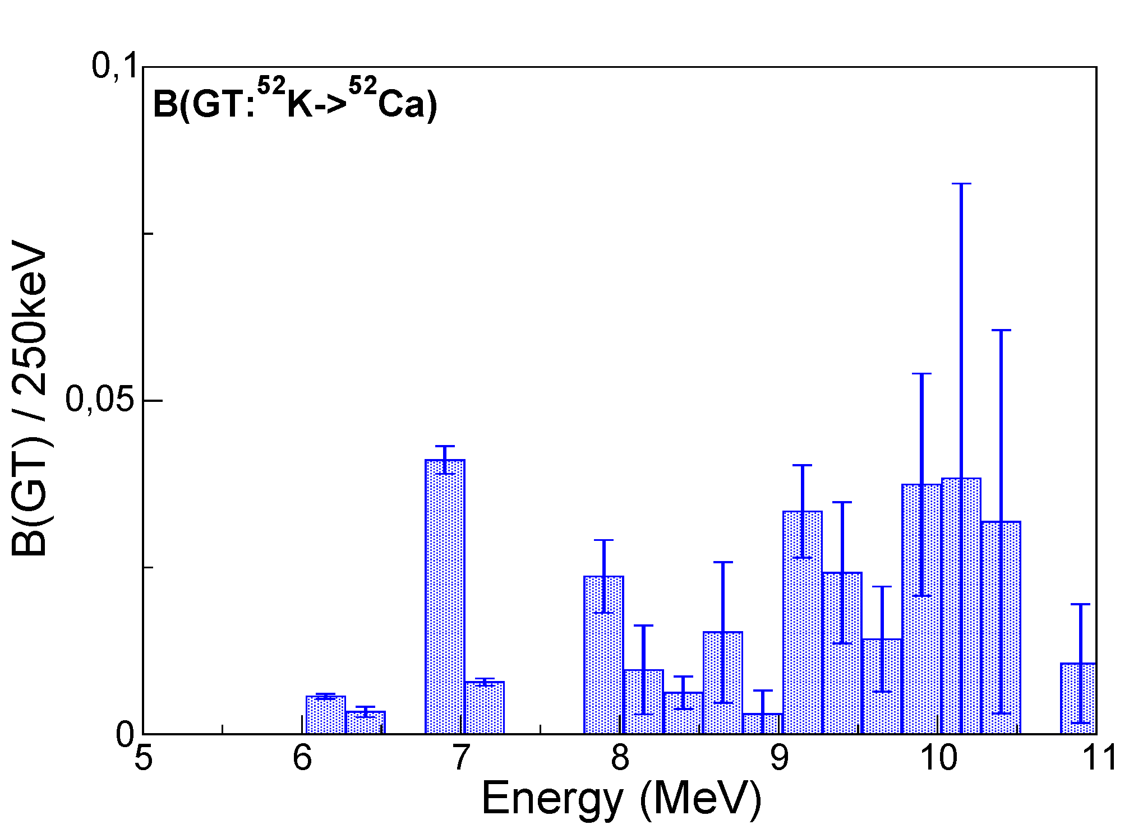
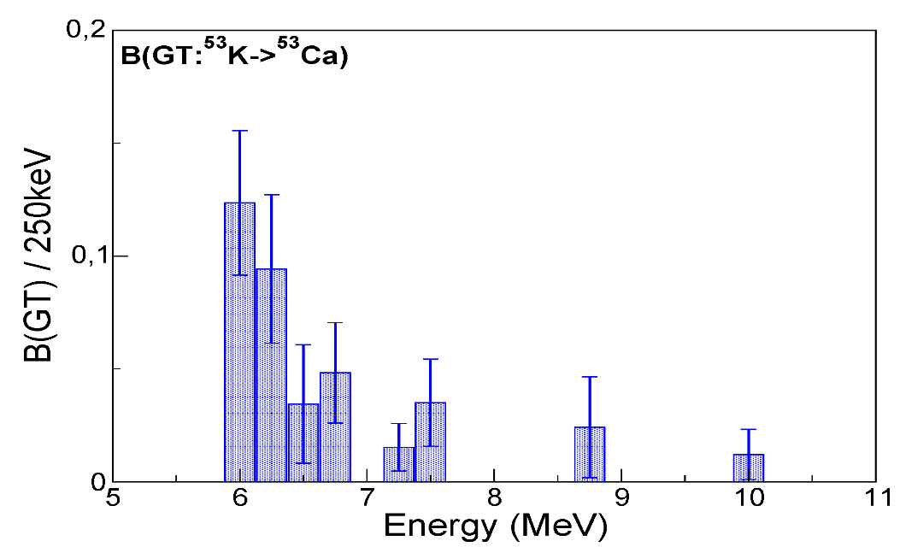
B(GT) in nuclei ^{52,53}K decay Results
⁵²K-⁵³K results: B(GT) distribution
B(GT) distribution
S_{2n}
Some FF strength at low energies
GT strength starts at around 6 MeV (logft < 6)
Peak in the GT distribution at around 6.5-7 MeV
Gradual decrease of strength towards 10 Mev
S_{n}
S_{n}
S_{2n}
β-delayed neutrons
INTC2019 9/15

Slide 10
B(GT) in nuclei ^{52,53}K decay Results
Shell-model calculations: sdpf space
B(GT) and FF
⁵²Ca
- sdpf-kb3g.a53 interaction by A. Poves, 1p-1h excitations
GT distribution: low-energy feature at 6-7 MeV: νf_{5/2} ->πf_{7/2} main component
Small B(GT) values: N=34 closure
⁵³Ca
⁵²Ca
⁵³Ca
β-delayed neutrons
INTC2019 10/15

Slide 11
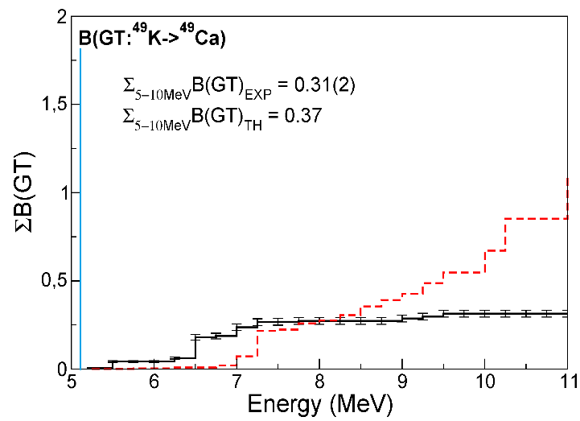
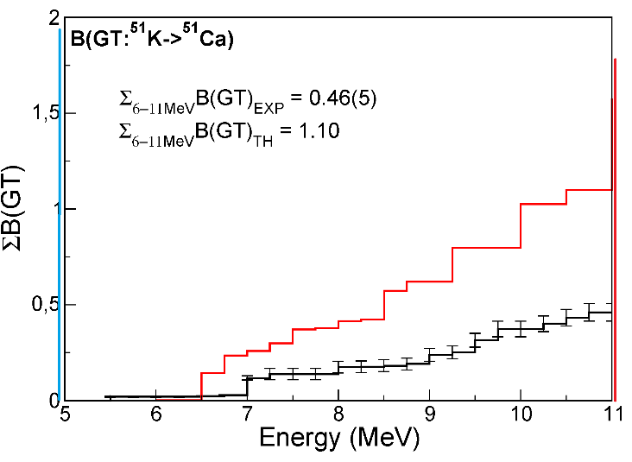
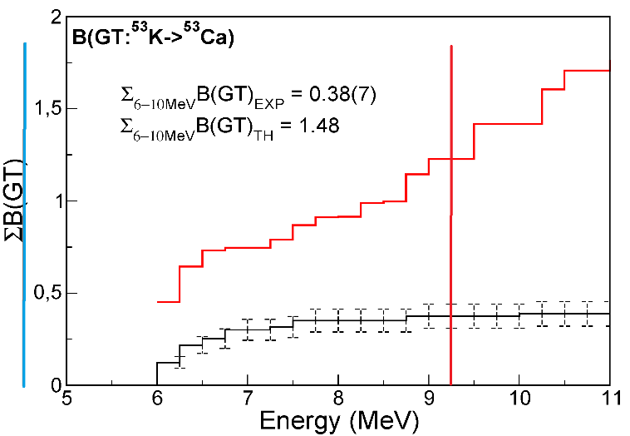
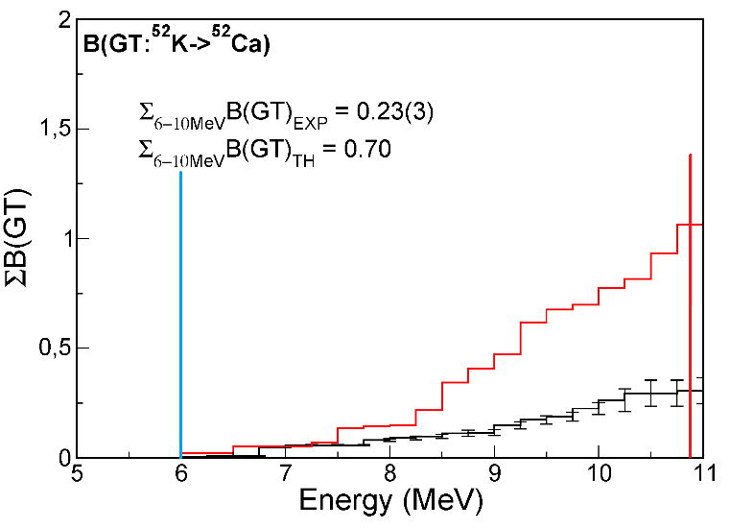
B(GT) in nuclei ^{52,53}K decay Results
Comparison with theory
Theory
Exp.
Very quenched B(GT)
Large B(GT) quenching,
GT νf_{5/2} ->πf_{7/2} due to scattering across N=34: ⁵³K ~75% closed N=34 core (85% in ⁵⁴Ca). Maybe small GT linked with large radii ? Neutron sd shells from above N=50 ?
β-delayed neutrons
INTC2019 11/15

Slide 12



B(GT) in nuclei ⁵⁴K decay Results
What we expect to see (1)
Calculations with the SDPF interaction predict a 2⁻ ground state for ⁵⁴K (also from systematics)
Shell-model calculations also predict a strong population of 3⁻ states, above the S_{n}=4.4 MeV
After GT: holes in f_{7/2}, p_{3/2}, p_{1/2} , neutrons in f_{5/2}
⁵⁴K β(GT) decay to ⁵⁴Ca
f_{5/2}
GT
N=34
p_{1/2}
fp
p_{3/2}
N=28
Z=20
GT
f_{7/2}
sd
N=20
In the n-emission daughter ⁵³Ca, which states populated ? What is the fragmentation ? -> observing 10-20 % branches
$$GT: υp_{1/2}→{πp}_{1/2}$$
⁴⁸Ca
core
$$υp_{3/2}→{πp}_{3/2}$$
$$υf_{7/2}→{πf}_{7/2}$$
⁴⁰Ca
core
β-delayed neutrons
INTC2019 12/15

Slide 13
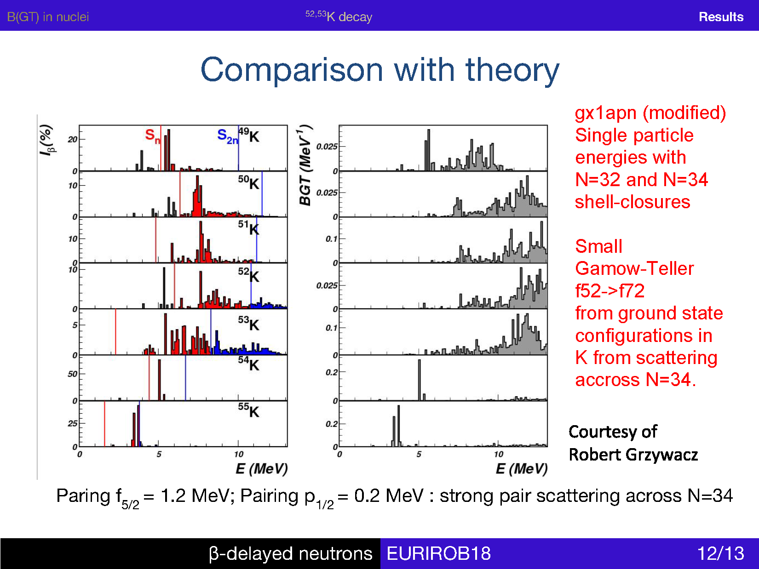
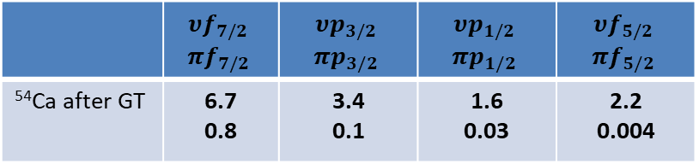
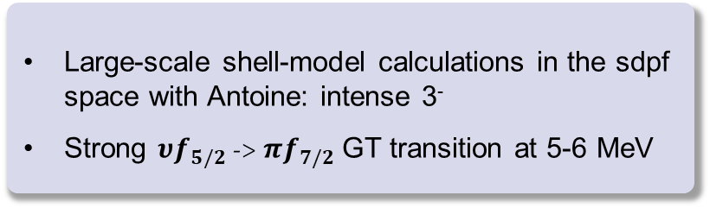
B(GT) in nuclei ⁵⁴K decay Results
What we expect to see (2)
⁴⁹⁻⁵⁴K β(GT) decay to ⁴⁹⁻⁵⁴Ca with GXPF1A
Shell-model predictions
⁴⁹K
Large-scale shell-model calculations in the sdpf space with Antoine: intense 3⁻
Strong $υf_{5/2}$ -> $πf_{7/2}$ GT transition at 5-6 MeV
⁵⁰K
⁵¹K
⁵²K
 | $$υf_{7/2}$$ $$πf_{7/2}$$ | $$υp_{3/2}$$ $$πp_{3/2}$$ | $$υp_{1/2}$$ $$πp_{1/2}$$ | $$υf_{5/2}$$ $$πf_{5/2}$$
⁵⁴Ca after GT | 6.7 0.8 | 3.4 0.1 | 1.6 0.03 | 2.2 0.004
⁵³K
⁵⁴K
Results:
From ⁵⁴Ca γ-ray spectroscopy: more detailed level scheme, comparison with different 3-body models
From neutron spectroscopy: GT distribution as a probe of N=34
β-delayed neutrons
INTC2019 13/15

Slide 14
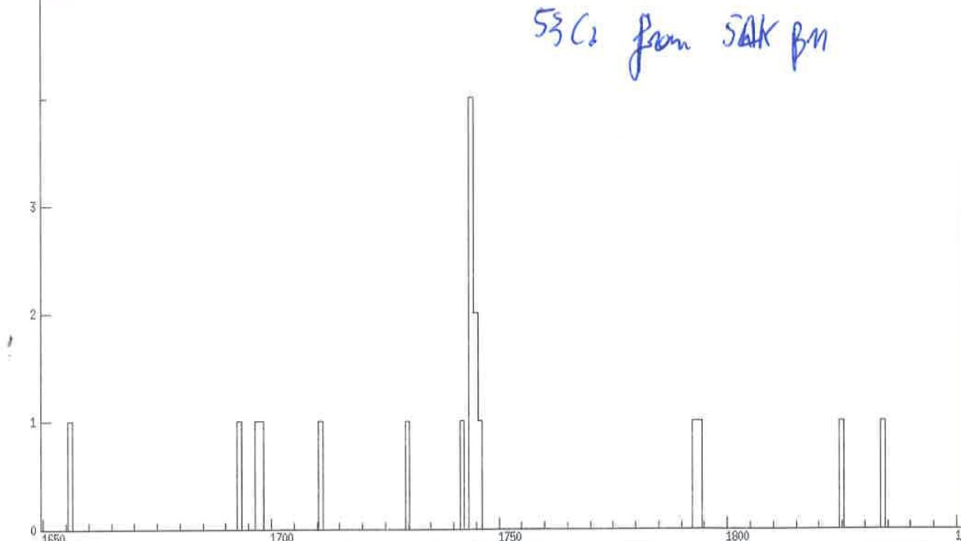
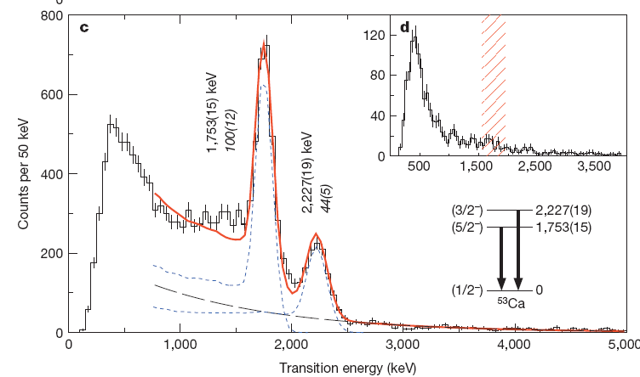
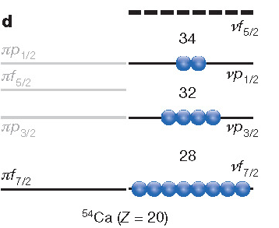
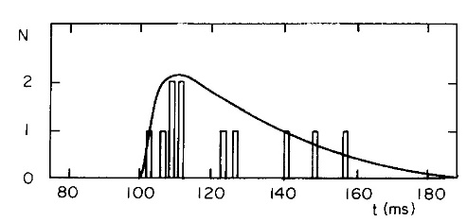
B(GT) in nuclei ⁵⁴K decay Results
What we have observed: ⁵⁴K -> ^{54,53}Ca
Q-value 20 MeV !
γ IDS – VANDLE
53Ca @ RIKEN
8 hour run !
⁵⁴K β(n) decay
T_{½}= 10(5) ms
M. Langevin et al., PLB 130, 251 (1983)
Only one γ ray observed: likely it is the 5/2⁻ state already seen at RIKEN
KB3G_POV interaction in ⁵³Ca: 5/2⁻ is 86% $(υp_{1/2}$)⁰ ($υf_{5/2})$¹
⁵⁴K: N=35 isotope. One neutron in f_{5/2} ?
Paring f_{5/2} = 1.2 MeV; Pairing p_{1/2} = 0.2 MeV : strong pair scattering across N=34
⁵⁴K 2⁻ gs (GXPF1A-BR): <f_{5/2}> = 3; <p_{1/2}> = 0.8
⁵⁴K 2⁻ gs (KB32_POV): <f_{5/2}> = 1.4; <p_{1/2}> = 1.8
β-delayed neutrons
INTC2019 14/15

Slide 15
B(GT) in nuclei ^{52,53}K decay Results
In total, 15 shifts (five days) were assigned
⁵⁴K rate (realistic, based on previous result plus some target improvements): 0.5 pps, (possible to improve with target optimized for fast release ?):
- 8% neutron efficiency, 90% β efficiency, 2 % γ efficiency
- 60-90 % neutron emission: around 10⁴ neutrons detected in 5 days (assigned by INTC)
- 10% feeding to excited ⁵⁴Ca states: around 150 γ rays from ⁵⁴Ca in 5 days; mainly 2⁺ and 3⁻, likely also 4⁺ states
- Lifetime from neutrons and gammas
A fast extraction needed for ⁵⁴K (10ms half life). With nano-UCX this can be feasible but not guaranteed, fluctuations are possible.
β-delayed neutrons
INTC2019 15/15

Slide 16

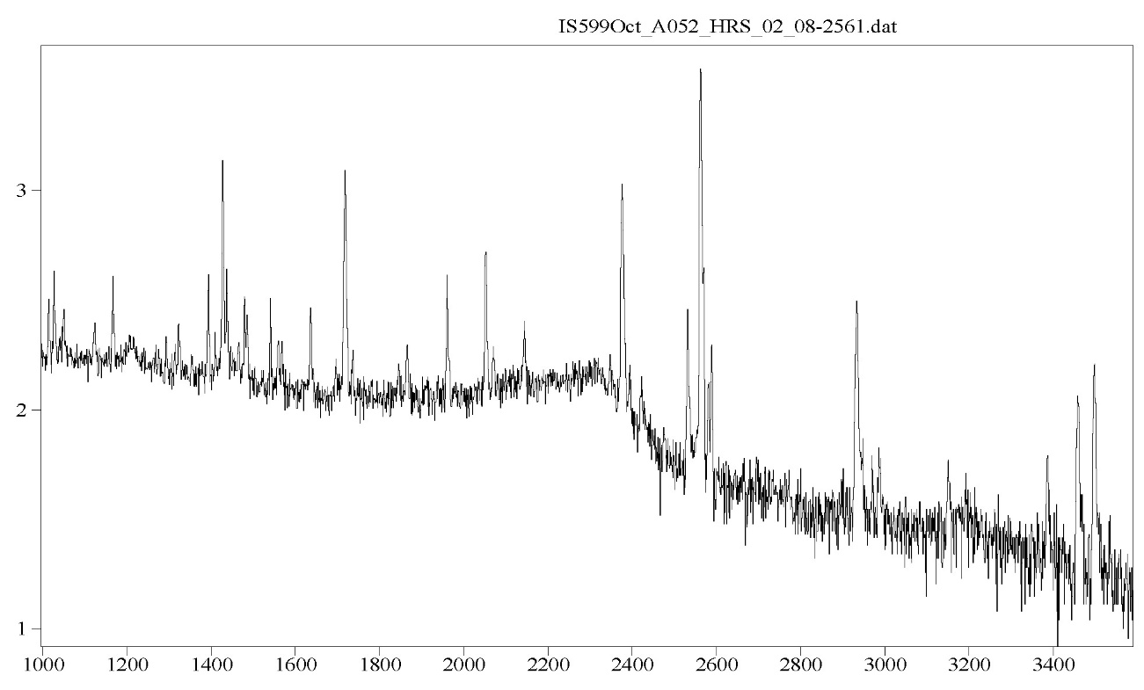
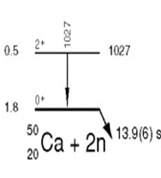
B(GT) in nuclei ^{52,53}K decay Results
⁵²K results: γ-ray spectroscopy
Partial statistics
10³
1718
2377
γ IDS- VANDLE
SE 2563
2653
1027
DE 2563
1961
2934
1427
3460
3500
3150
3387
⁵²Ca β0n
⁵¹Ca β1n
⁵⁰Ca β2n
Energy (keV)
β-delayed neutrons
INPT2019 8/14

Slide 17
B(GT) in nuclei ^{52,53}K decay Results
B(GT) in nuclei The Calcium region Results
Predominance of β-delayed neutron emission
In exotic nuclei close to shell closures one can have very large Q values
(10-20 MeV)
GT vs. FF transition competition caused by interplay of phase space and shell structure effects
Particle-hole states may provide a measure of the shell energies in exotic nuclei
The β decay can populate states below and above the neutron (and 2n) separation energy
β-delayed neutrons
INTC2019 2/14

