Slide 1
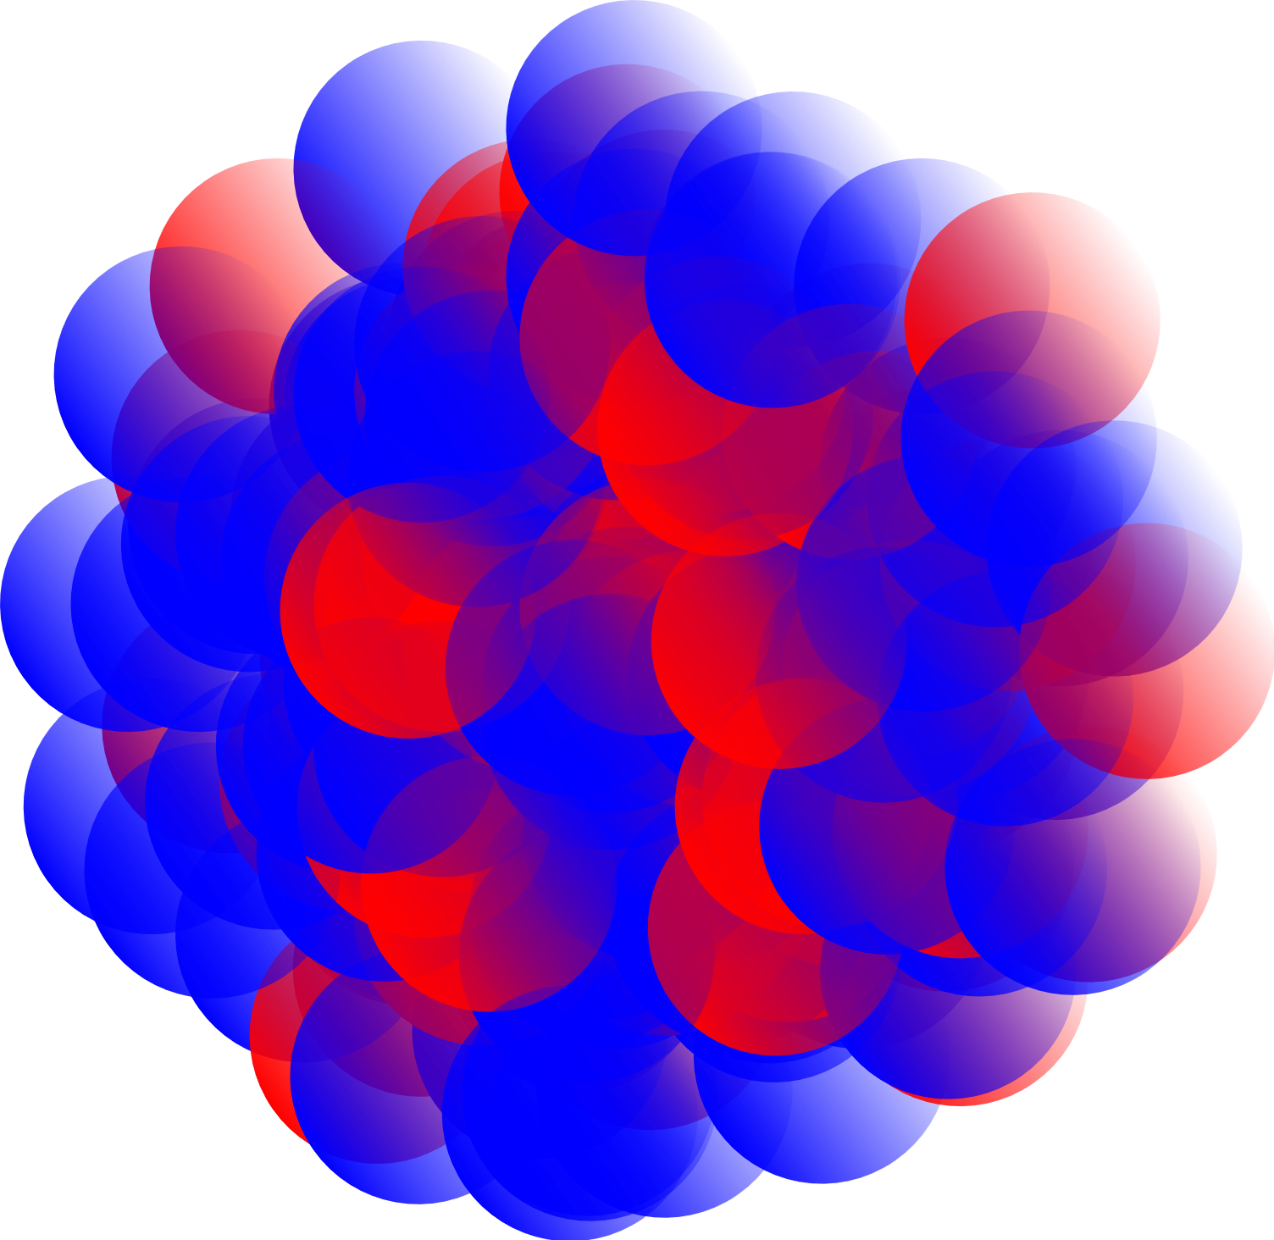
IS456
Study of polonium isotopes ground-state properties by simultaneous atomic & nuclear spectroscopy
Spokesperson: Prof Thomas Elias Cocolios
Local contact: Dr Reinhard Heinke

Slide 2
IS456: 22.5 shifts remaining
IS456 so far
  Shape evolution across the isotopic chain
  Kink and odd-even staggering
  Complementary decay spectroscopy
Remaining scientific case
  Long-lived high-spin isomers just beyond N=126
  Neutron-rich isotopes near N=136
Challenges and how to address them
  From the LIST to the 2-repeller LIST
  Detection setups

Slide 3
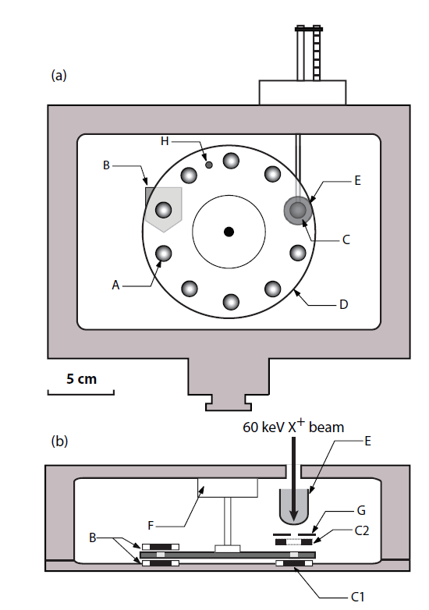
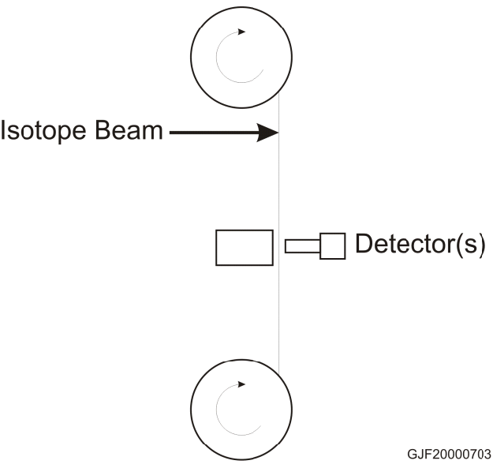
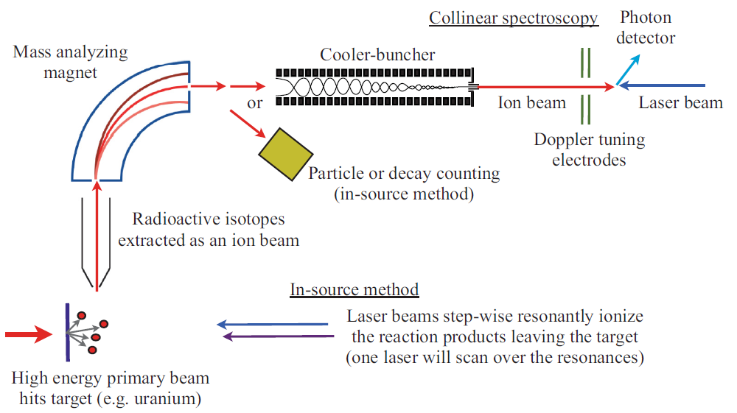
IS456: in-source laser spectroscopy
Decay spectroscopy using either
the Windmill (LA1/2 or GLM)
or the ISOLDE Tape Station (CA0)
Faraday cup
Free decay data during collection!

Slide 4
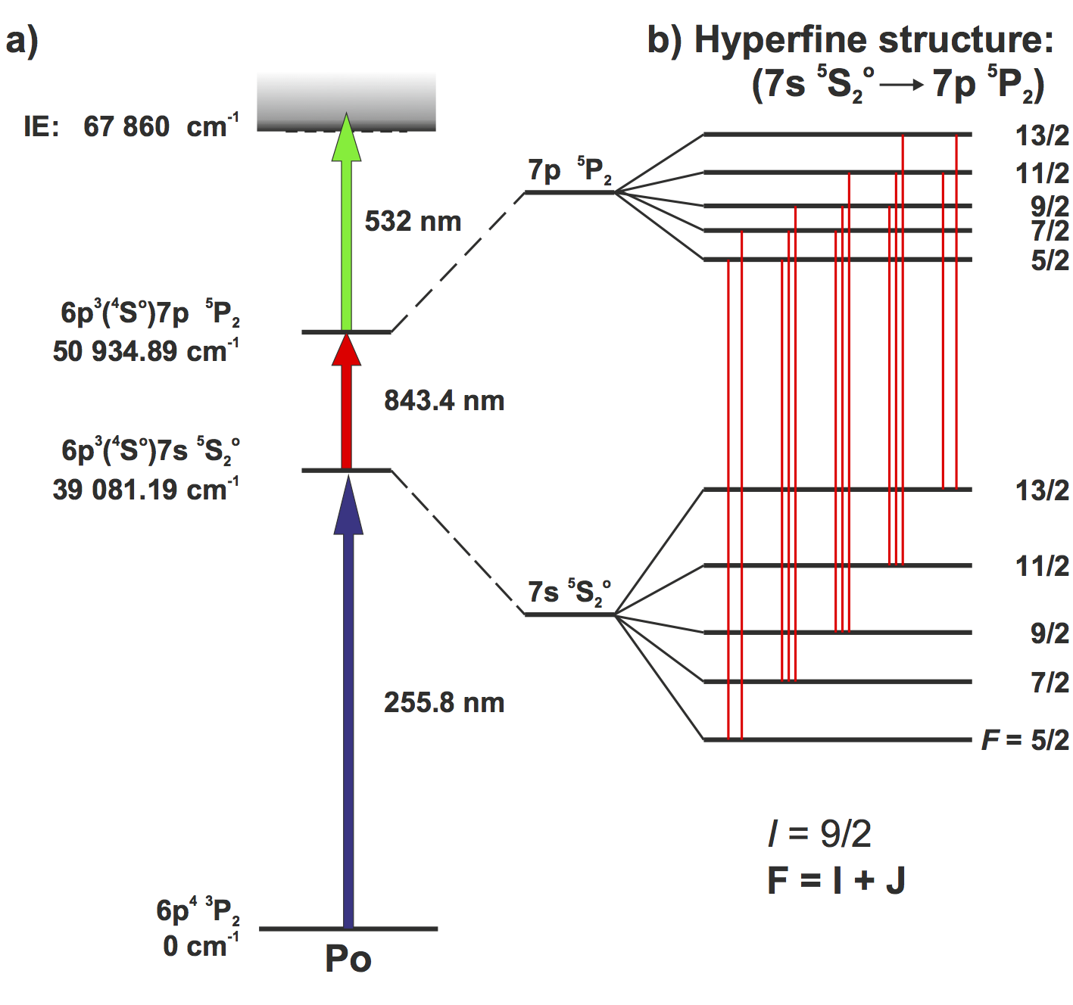
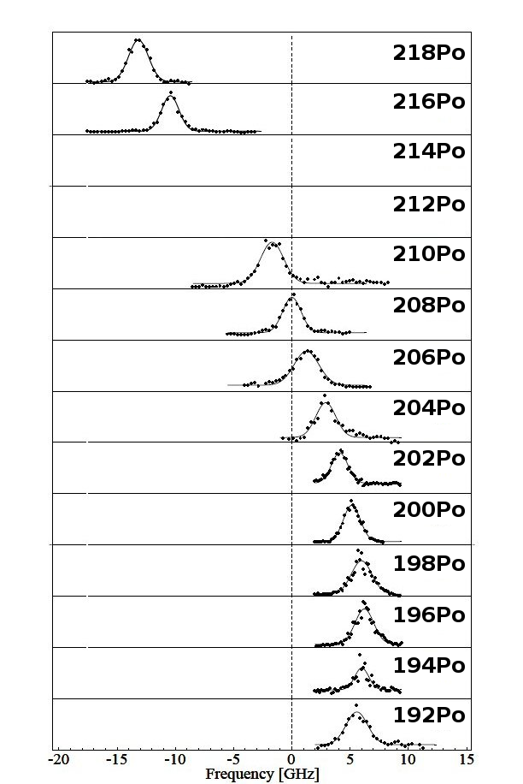
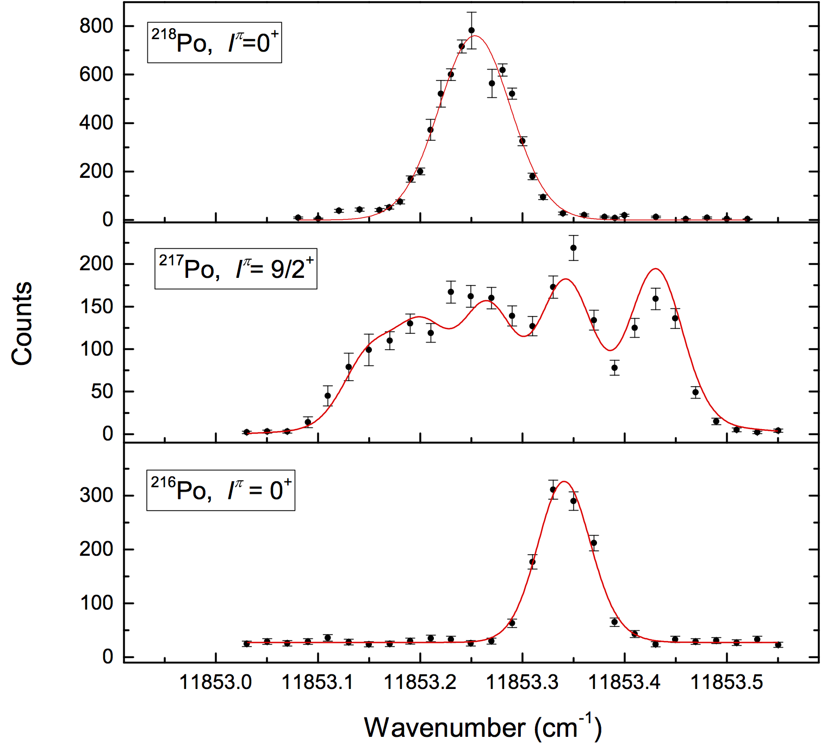
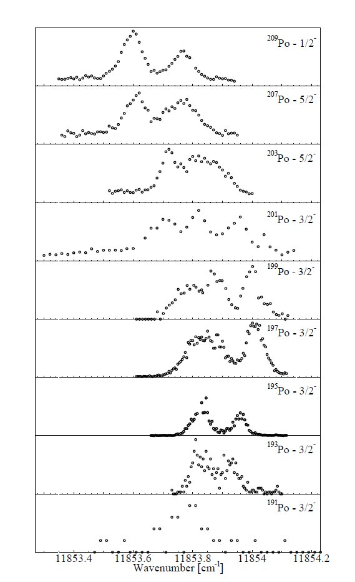
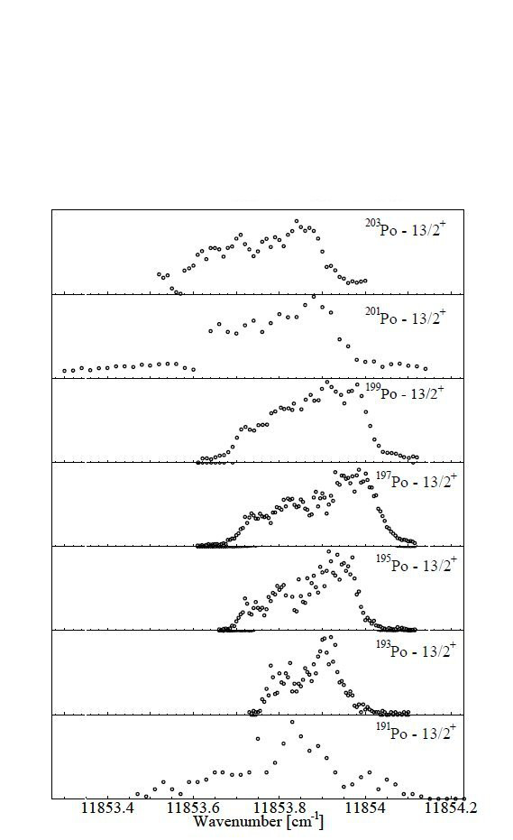
IS456: Timeline
Phase 0: 2006
First laser ionization tests
Saturation of the optical transitions
Yields of ¹⁹³⁻²⁰⁴Po
Phase 1: 2007
Simultaneous GLM / CA0 beams
Windmill: ¹⁹³⁻¹⁹⁹Po
Tape station: ^{199-200,202,204}Po
Phase 2: 2009
Repeat of key measurements
Faraday cup: ^{206,208-210}Po
Pseudo offline: ^{211g}Po
Not using GLM to reach ^{216,218}Po
Extra tape station: ²⁰¹⁻²⁰³Po
Extreme sensitivity: ¹⁹¹Po
Phase 3: 2012
LIST test
Proof-of-principle measurements
HFS: ²¹⁷Po
Alpha decay: ²¹⁹Po

Slide 5
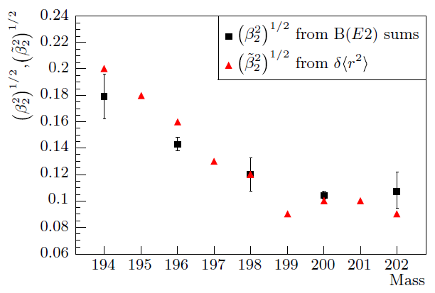
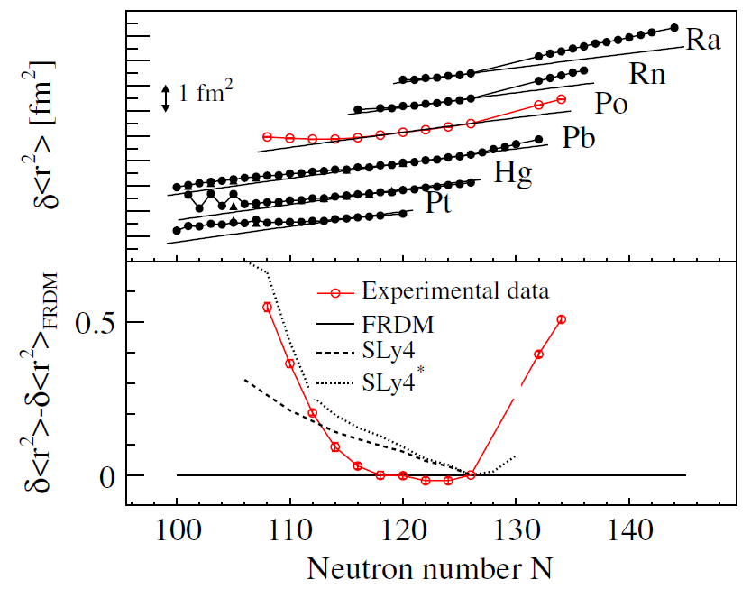
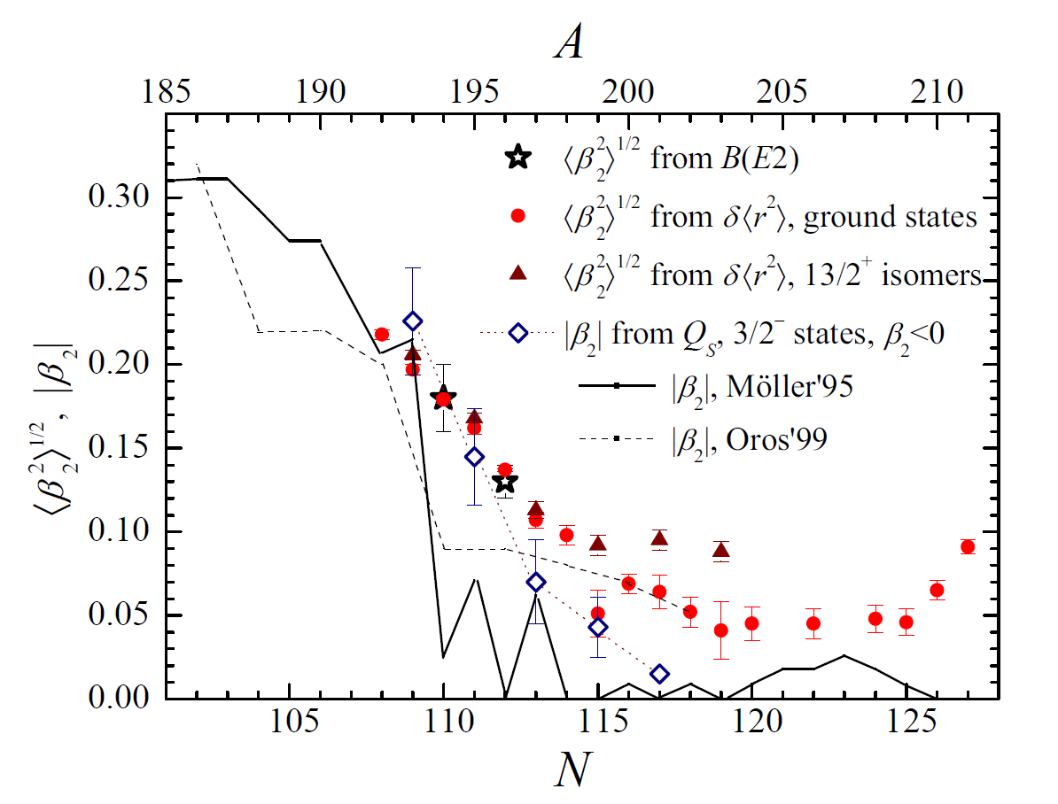
IS456: Shape coexistence near ¹⁸⁶Pb
Somewhat unexpected picture where the polonium isotopes depart steadily from sphericity, in contrast to how mercury staggers.
All observables are in agreement: dr2, moments from hfs, lifetime measure-ments and CoulEx.
T.E. Cocolios et al, Physical Review Letters 106 (2011) 052503.
M.D. Seliverstov et al, Physical Review C 89 (2014) 034323.
N. Kesteloot et al, Physical Review C 92 (2015) 054301.

Slide 6
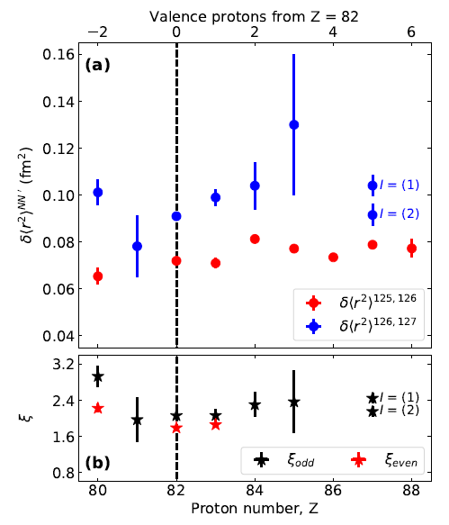
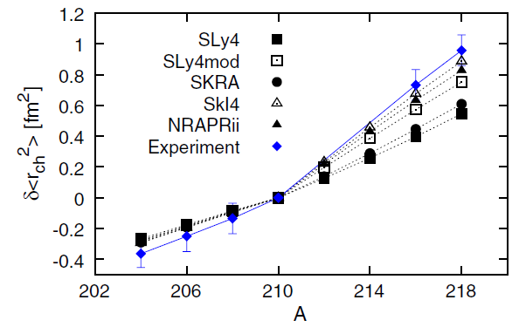
IS456: Kink at N=126
The kink at the shell closure is not in itself a surprise, however its reproduction by nuclear theory remains a challenge, as much as its experimental investigation.
P.M. Goddard, P.D. Stevenson and A. Rios, Physical Review Letters 110 (2013) 032503.
G.J. Farooq-Smith et al, PRC 94 (2016) 054305 & PhD Thesis (2019) KU Leuven.
& picture adapted from A.E. Barzakh et al, Physical Review C 97 (2018) 014322.

Slide 7
IS456: furthering the study around N=126
²¹⁰Po
Isotopes north-east of ²⁰⁸Pb are all short-lived, down to μs and even ns. This has greatly limited the study of N=127-128 isotones, especially for the understanding of the kink in dr2.
High-spin isomers exist in ²¹¹⁻²¹²Po, which could give an insight into these features.
Magnetic dipole moments will be studied to confirm the configuration.
j_{15/2}
sdg
i_{13/2}
i_{11/2}
g_{9/2}
fp
h_{9/2}
126
82
fp
i_{13/2}
s_{1/2}
d_{3/2}
Isotope | Half-life | Spin | Proton configuration | Neutron configuration
^{211g}Po | 0.516 s | 9/2⁺ | (πh_{9/2})²₀₊ | (νg_{9/2})
^{211m}Po | 25.2 s | (25/2⁺) | (πh_{9/2})²₈₊ | (νg_{9/2})
^{212g}Po | 0.3 μs | 0⁺ | (πh_{9/2})²₀₊ | (νg_{9/2}) ²₀₊
^{212m}Po | 45.1 s | (18⁺) | (πh_{9/2})²₈₊ | (νg_{9/2})(νi_{11/2})₁₀₊
The (νi_{11/2}) orbital is supposedly responsible for the kink and this could become more evident in the measurement of ^{212m}Po!
H. Nakada & T. Inakura, Physical Review C 91 (2015) 021302R.

Slide 8
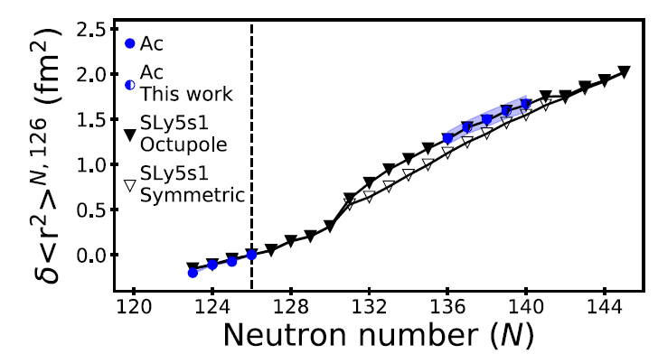
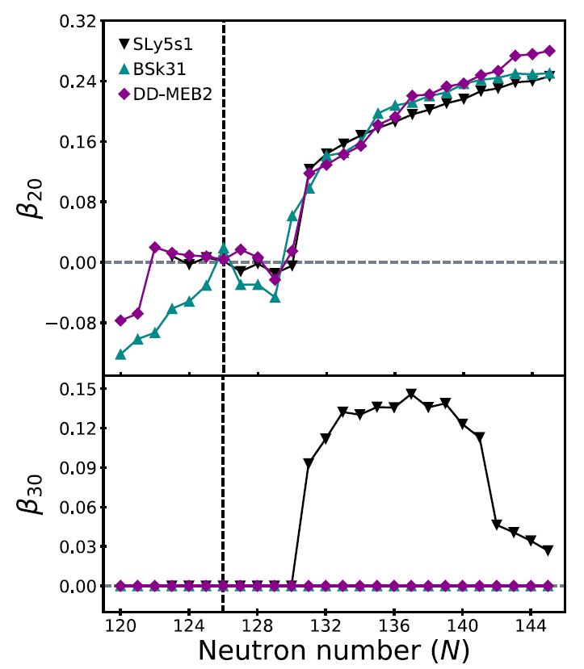
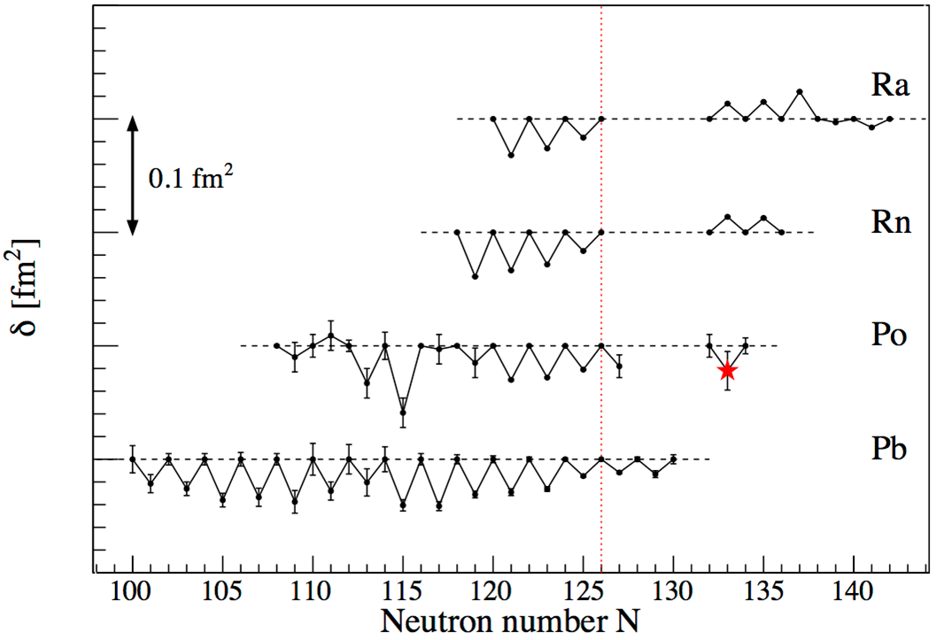
IS456: Beyond N=126
Recent Energy Density Functionals calculations for Ac have highlighted how the trend in the dr2 is not a linear extrapolation from N=126, but rather undergoes a step in the vicinity of N=130.
This behavior coincides with where the calculations suggest an onset of octupole deformation.
Measurements of dr2 between N=126 and 132 are necessary to benchmark this with experimental observation.
Odd-even staggering investigation in the region N=132-140 in polonium would also shed light on the possible correlations between the dr2 behavior and the shapes in this region.
E. Verstraelen et al, Physical Review C 100 (2019) 044321.
D. Fink et al, Physical Review X 5 (2015) 011018.

Slide 9
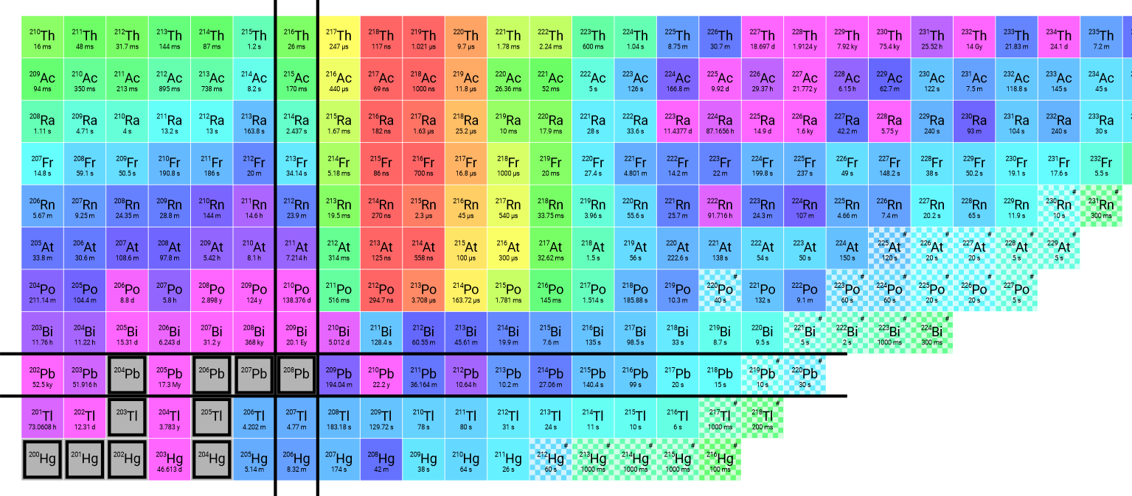
IS456: challenges
Isobaric contamination!
* Yields estimated based on ABRABLA calculations
** Constant in-target feeding by ²²³Ac with T_{1/2} = 2 min
A | Polonium |  | Francium
 | T_{1/2} | Yield* [ions/μC] | T_{1/2} | Yield [ions/μC]
211 | 25.2 s | 2 x 10⁴ | 3 min | 10⁸
212 | 45.1 s | 2 x 10⁴ | 20 min | 10⁸
219 | 10.3 min | 3 x 10¹ | 20 ms** | 10³
220 | - | 1 x 10¹ | 27.4 s | 10⁷

Slide 10
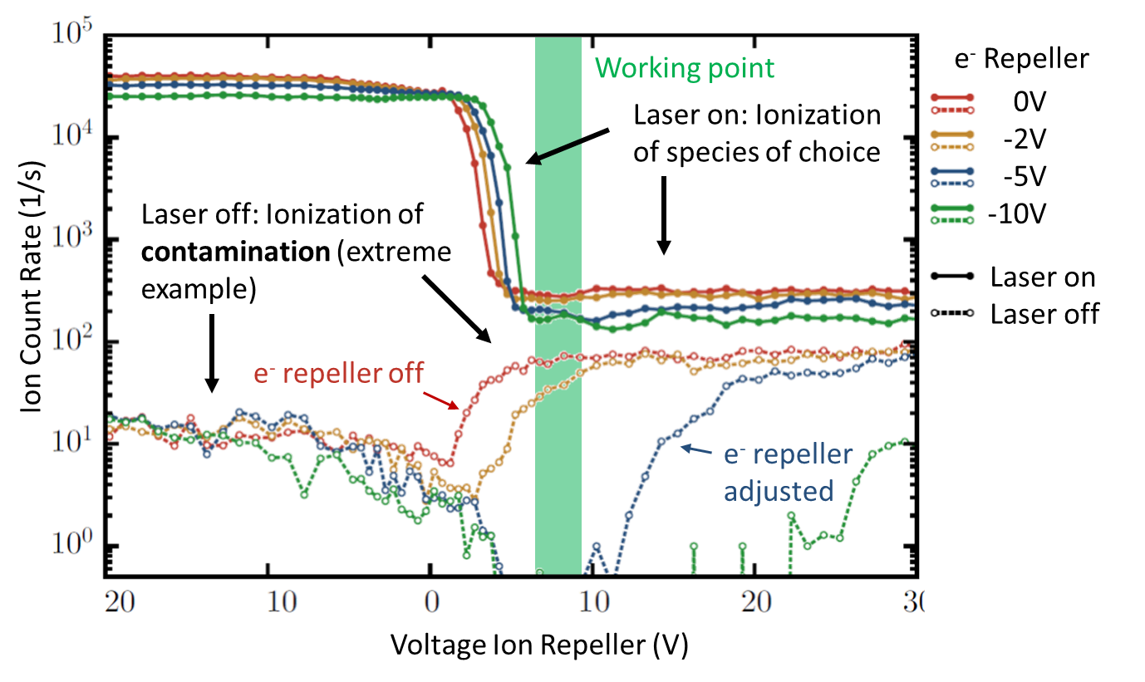
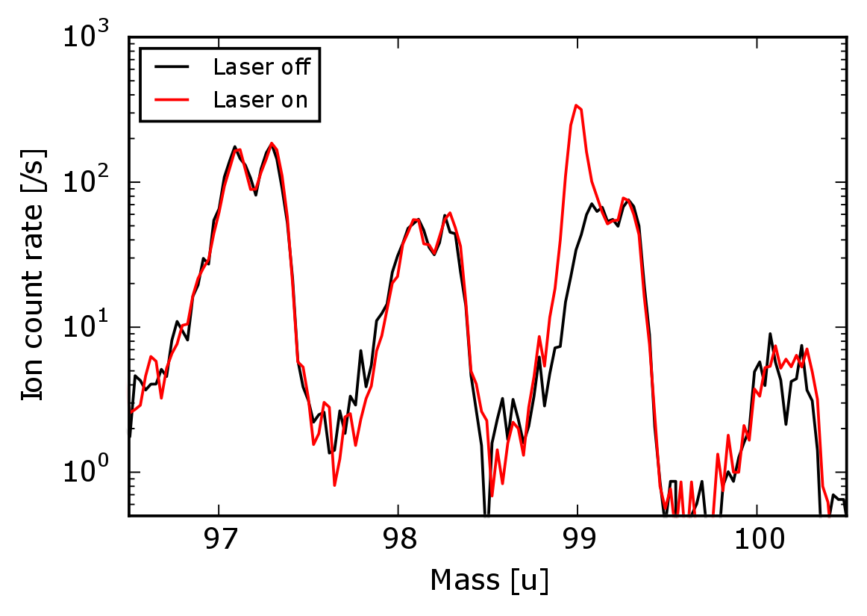
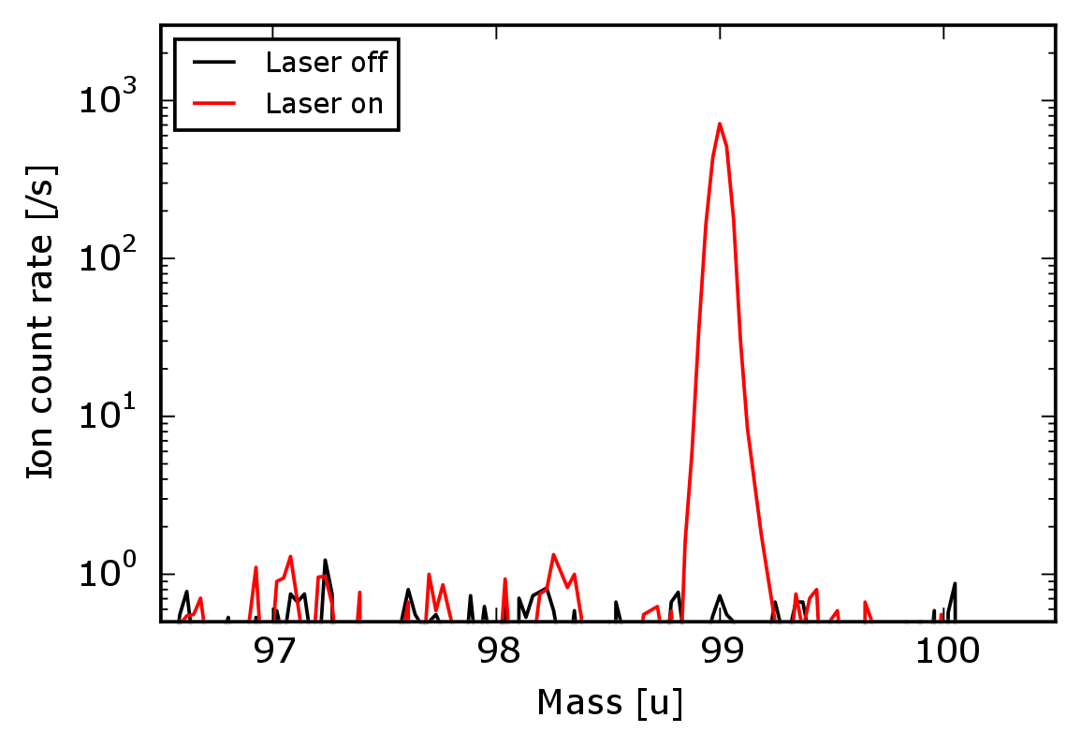
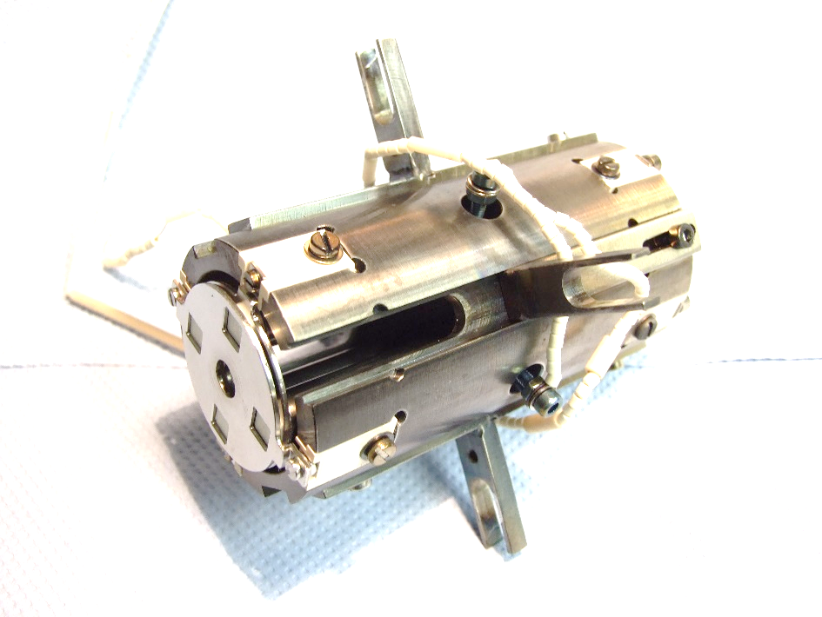
IS456: Solutions
LIST 2.0!
2012 attempt showed promise (e.g. hfs of ²¹⁷Po, first α decay spectroscopy of ²¹⁹Po) but suppression of ²¹²Fr was far inferior to that of ²⁰⁵Fr.
Electron impact ionization of decay products of radioactive material deposited on the LIST surfaces (namely from deposited isobaric Ra) is the reason.
A new LIST has been designed in Mainz with a double repeller system to prevent surface ions AND electrons from entering the RFQ.
The LIST 2.0 will be implemented as an ISOLDE standard ion source in the course of 2020 ready for the facility restart in 2021.
Ion Count Rate (1/s)
Mainz test with ⁹⁹Tc
Reinhard Heinke starting at ISOLDE on 2 Dec 2019
Ion Count Rate (1/s)
M. Truemper, BSc Thesis (2015), Mainz.
R. Heinke, PhD Thesis (2019), Mainz.
Mass (amu)

Slide 11
IS456: challenges
Detection
X
X
A | Polonium |  | Francium
 | T_{1/2} | Decay mode | T_{1/2} | Decay mode
211m | 25.2 s | >99.9% α | 3 min | 87% α / 13% β
212m | 45.1 s | >99.9% α | 20 min | 43% α / 57% β
219 | 10.3 min | 28% α / 72% β | 20 ms | α
220 | - | - | 27.4 s | >99.6% α
The Windmill is dead and buried and never to be seen again…
FC is not an option for those beams
T_{1/2} in ²¹⁹⁻²²⁰Po is not favorable for decay counting

Slide 12
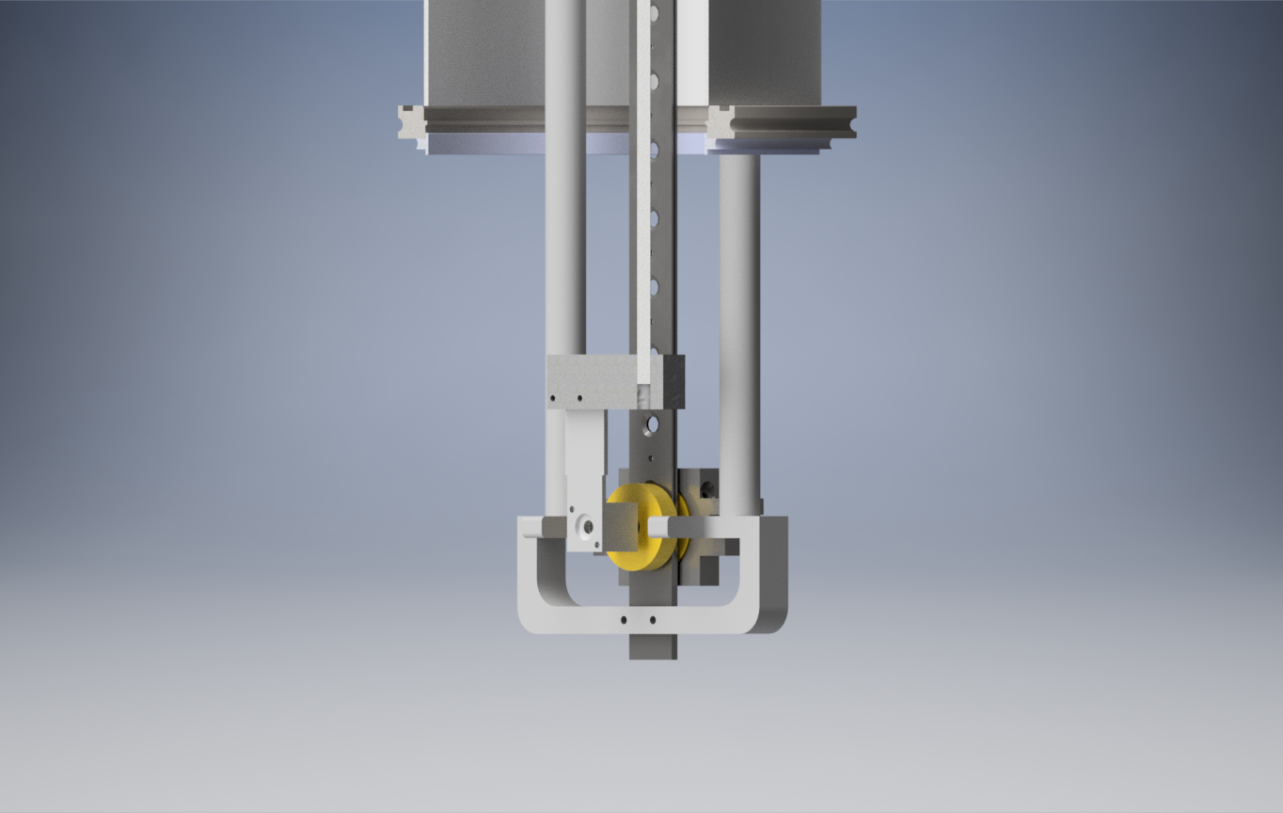
IS456: Solutions
IDS is equipped with a moving tape to remove the long-lived activity, perfect for ^{219,220}Po.
The implantation point is surrounded by charged particle detectors and γ-ray detectors for a comprehensive measurement of the decay of the implanted activity.
Full synchronization with RILIS is established for scanning.
New α chamber & IDS
A replacement for the Windmill has been developed and tested for IS637.
It consists of a similar Si sandwich around a ladder with 10 C foils.
An integrated FC is available for beam transport / tuning.
Ladder with C-foils
Faraday Cup
Full Si-detector
IS637
Ion beam
Free decay spectroscopy data acquired in the process
Annular Si-detector

Slide 13
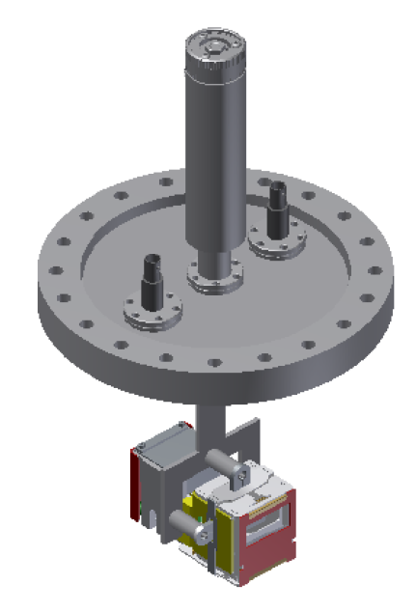
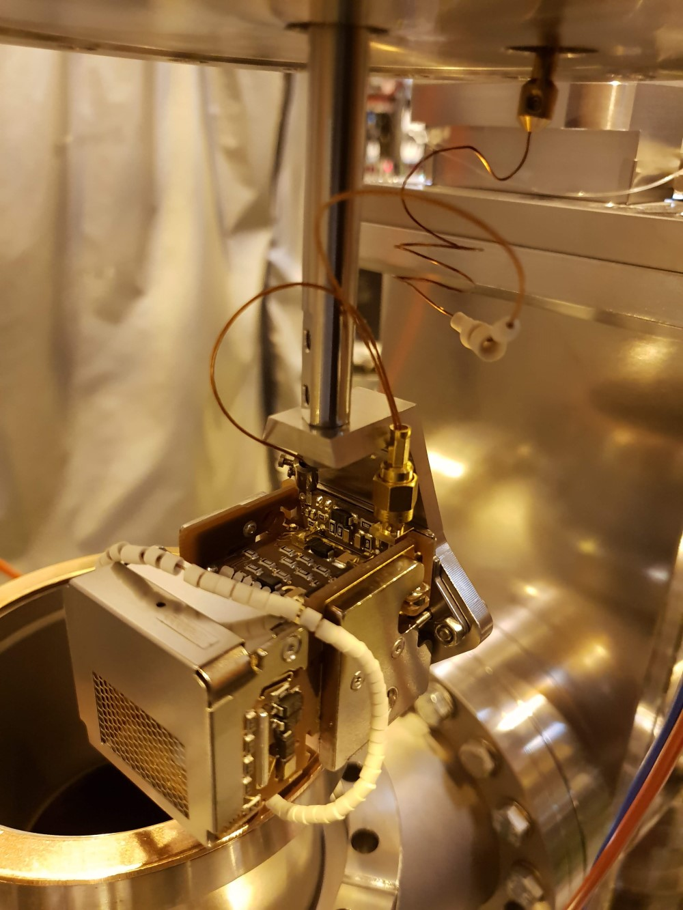
IS456: Solutions
Single-ion counting
Single-ion counting capability is currently available in the ISOLDE Central Beam Line.
This would allow to measure long-lived isotopes like ²¹⁹⁻²²⁰Po quickly and efficiently.
NOT for ²⁰⁸⁻²¹⁰Po

Slide 14
IS456: Shifts breakdown
The IS456 scientific case remains current and unchallenged
  No dr2 data on N=128, Z>83
  No new information on the configuration of the high-spin isomers
  New insight into the dr2 for N=130-140 requires new experimental data
  No new decay data on ^{219,220}Po
Main challenges have been addressed
  New LIST with double repeller to be fully integrated at ISOLDE
  New detection systems: α chamber, IDS, single-ion counting
 | Isotope | Number of shifts
LIST test |  | 2
Reference measurements | ^{196,208-210}Po | 2.5
HFS & IS | ^{211m}Po | 2
HFS & IS | ^{212m}Po | 2
HFS, IS & decay | ²¹⁹Po | 7
HFS, IS & decay | ²²⁰Po | 7
 | TOTAL | 22.5

Slide 15
Extra slides

Slide 16



IS456: Collaboration
E. Ahmed, A. Algora, B. Andel, A.N. Andreyev, S. Antalic, A.E. Barzakh, B. Bastin, M. Bissell, M. Borge, K. Chrysalidis, T.E. Cocolios, B. Cooper, J. Cubiss, H. De Witte, K. Dockx, D.V. Fedorov, V.N. Fedosseev, R. Ferrer, K.T. Flanagan, S. Franchoo, L. Fraile, H. Fynbo, L. Ghys, L.J. Harkness-Brennan, R. Heinke, D.S. Judson, J. Konki, U. Koster, I. Lazarus, N. Lecesne, R. Lica, N. Marginean, B.A. Marsh, C. Mihai, P.L. Molkanov, E. Nacher, A. Negret, J. Ojala, R.D. Page, J. Pakarinen, A. Perea, H. Perrett, L. Popescu, V. Pucknell, C. Ricketts, S.R. Rothe, H. Savajols, M.D. Seliverstov, S. Sels, C. Sotty, M. Stryjczyk, O. Tengblad, J. Van de Walle, P. Van den Bergh, P. Van Duppen, M. Vandebrouck, V. Vedia, M. Venhart, S. Vinals, R. Wadsworth, N. Warr, K.D.A. Wendt, S.G. Zemlyanoy

Slide 17
IS456: scientific output
6 papers & 5 conference proceedings with >250 citations
  2 technical conference proceedings (EMIS NIMB) + 3 conference proceedings with results
  1x EPJA, JPG, PLB, PRA, PRL, PRX
3 theses
  1 MSc
    Wim Dexters, KU Leuven 2010
  2 PhD
    Thomas Cocolios, KU Leuven 2010
    Daniel Fink, Heidelberg 2015

Slide 18
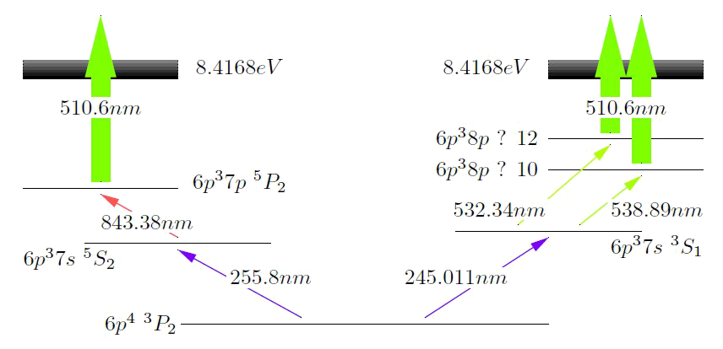
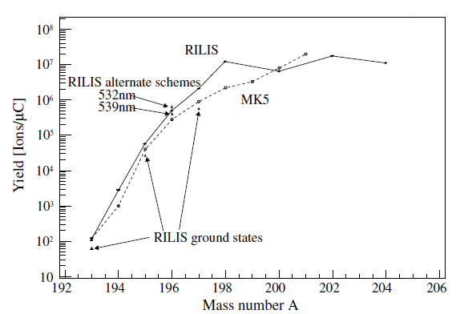
IS456: Timeline
Phase 0: 2006
First laser ionization tests
Saturation of the optical transitions
Yields of ¹⁹³⁻²⁰⁴Po
T.E. Cocolios et al, NIMB 266 (2008) 4403-4406.

Slide 19
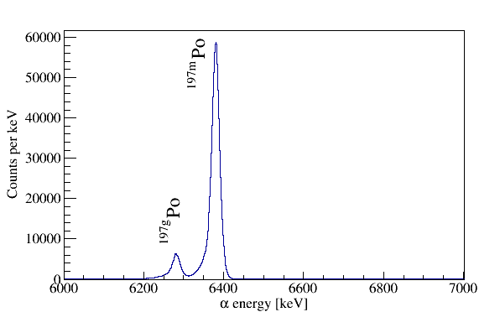
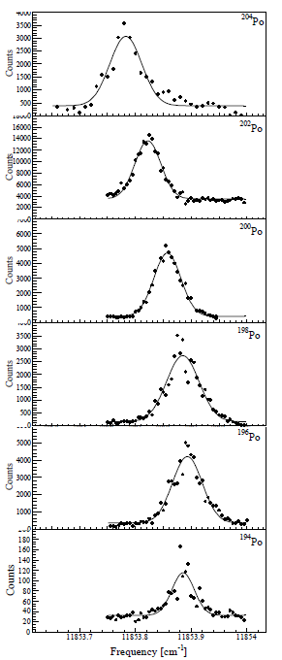
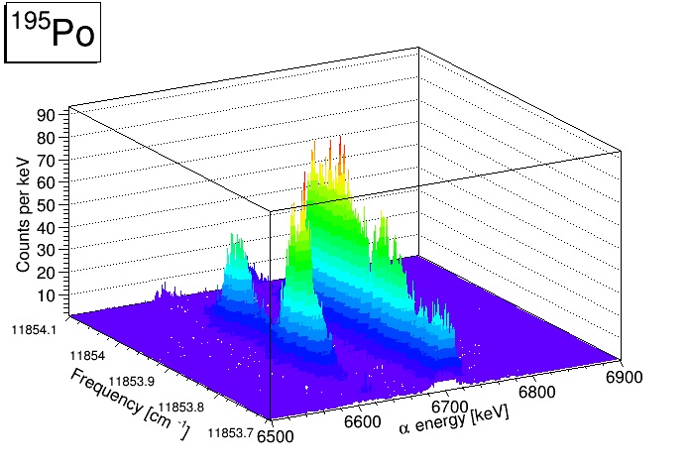
IS456: Timeline
Phase 0: 2006
First laser ionization tests
Saturation of the optical transitions
Yields of ¹⁹³⁻²⁰⁴Po
Phase 1: 2007
Simultaneous GLM / CA0 beams
Windmill: ¹⁹³⁻¹⁹⁹Po
Tape station: ^{199-200,202,204}Po
Too little overlap with literature data to extract the observables of interest!

Slide 20
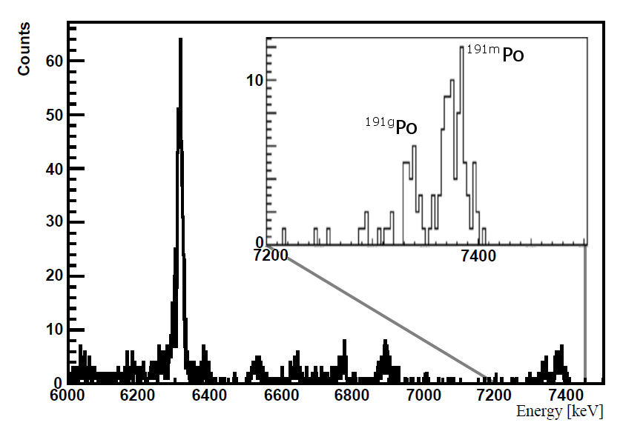
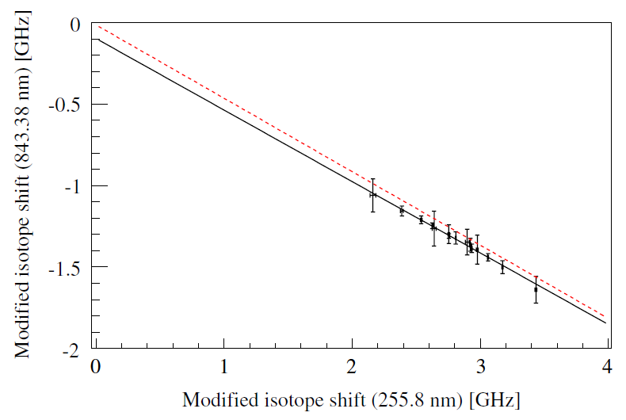
IS456: Timeline
Phase 0: 2006
First laser ionization tests
Saturation of the optical transitions
Yields of ¹⁹³⁻²⁰⁴Po
Phase 2: 2009
Repeat of key measurements
Faraday cup: ^{206,208-210}Po
Pseudo offline: ^{211g}Po
Not using GLM to reach ^{216,218}Po
Extra tape station: ²⁰¹⁻²⁰³Po
Extreme sensitivity: ¹⁹¹Po
Phase 1: 2007
Simultaneous GLM / CA0 beams
Windmill: ¹⁹³⁻¹⁹⁹Po
Tape station: ^{199-200,202,204}Po
Isobaric Fr/Ra was the limiting factor in the neutron-rich isotopes
T.E. Cocolios et al, Physical Review Letters 106 (2011) 052503.
B. Cheal, T.E. Cocolios, S. Fritzsche, Physical Review A 86 (2012) 042501.

Slide 21
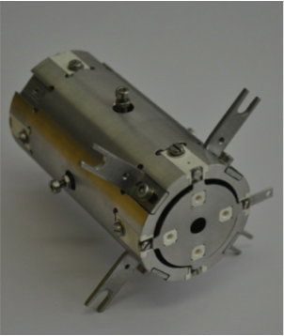
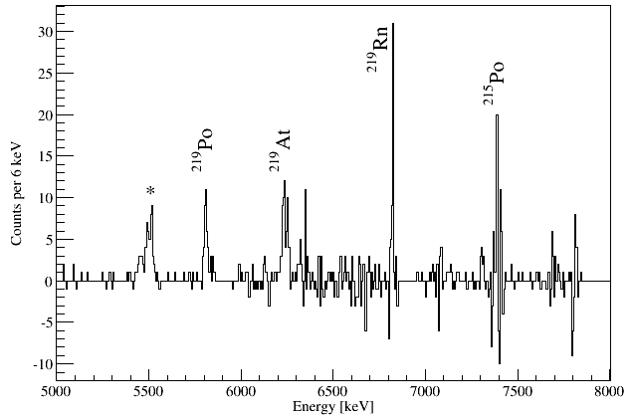
IS456: Timeline
Phase 0: 2006
First laser ionization tests
Saturation of the optical transitions
Yields of ¹⁹³⁻²⁰⁴Po
Phase 3: 2012
LIST test
Proof-of-principle measurements
HFS: ²¹⁷Po
Alpha decay: ²¹⁹Po
Phase 1: 2007
Simultaneous GLM / CA0 beams
Windmill: ¹⁹³⁻¹⁹⁹Po
Tape station: ^{199-200,202,204}Po
Phase 2: 2009
Repeat of key measurements
Faraday cup: ^{206,208-210}Po
Pseudo offline: ^{211g}Po
Not using GLM to reach ^{216,218}Po
Extra tape station: ²⁰¹⁻²⁰³Po
Extreme sensitivity: ¹⁹¹Po
D. Fink et al, NIMB 317 (2013) 417-421.
D. Fink et al, Physical Review X 5 (2015) 011018.

Slide 22
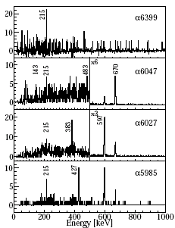
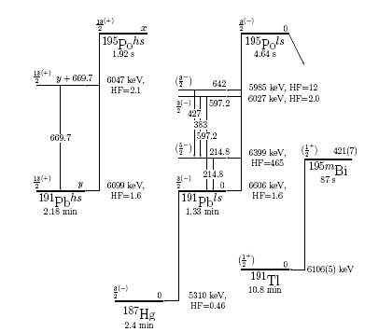
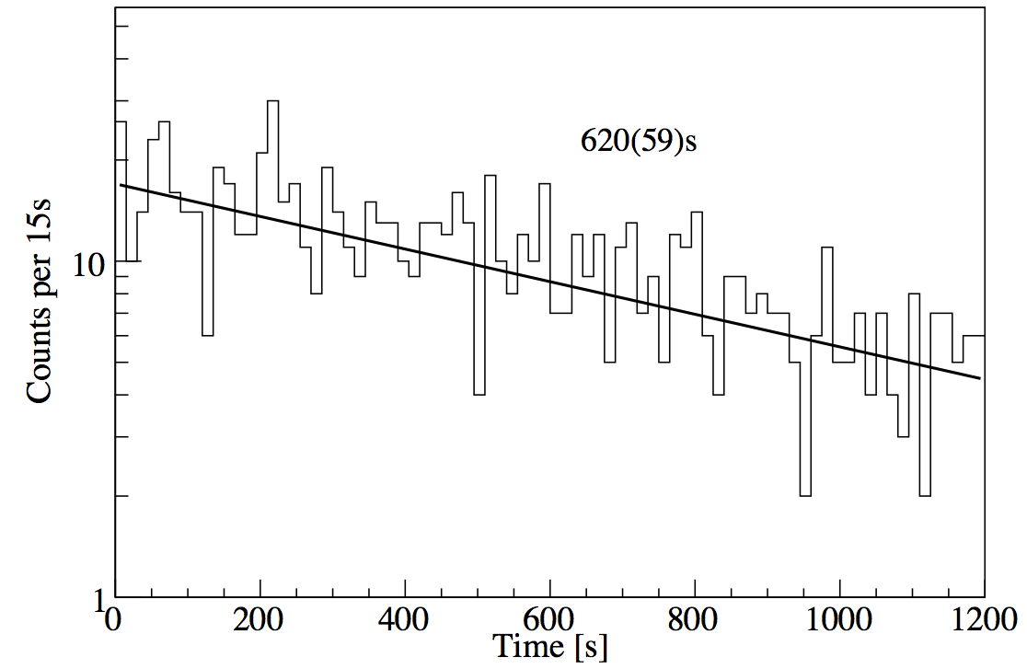
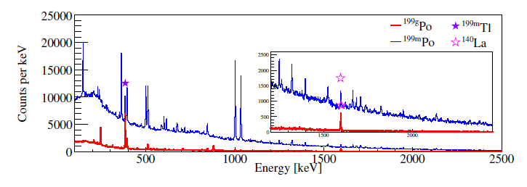
IS456: decay spectroscopy results
¹⁹⁵Po
²¹⁹Po
¹⁹⁹Po
ISOLDE Tape Station
T.E. Cocolios et al, JPG 37 (2010) 125103.
T.E. Cocolios et al, JPCS 381 (2012) 012072.
D. Fink et al, Physical Review X 5 (2015) 011018.

Slide 23
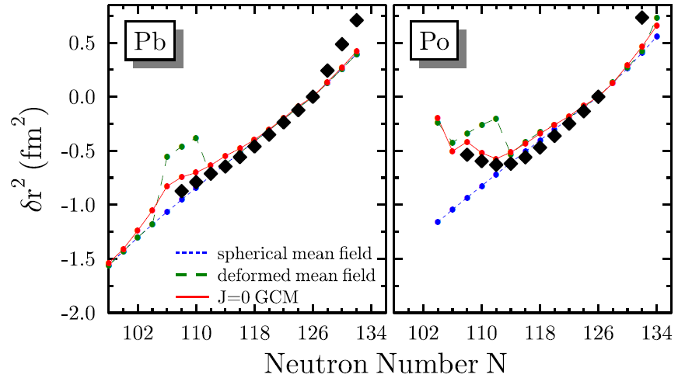
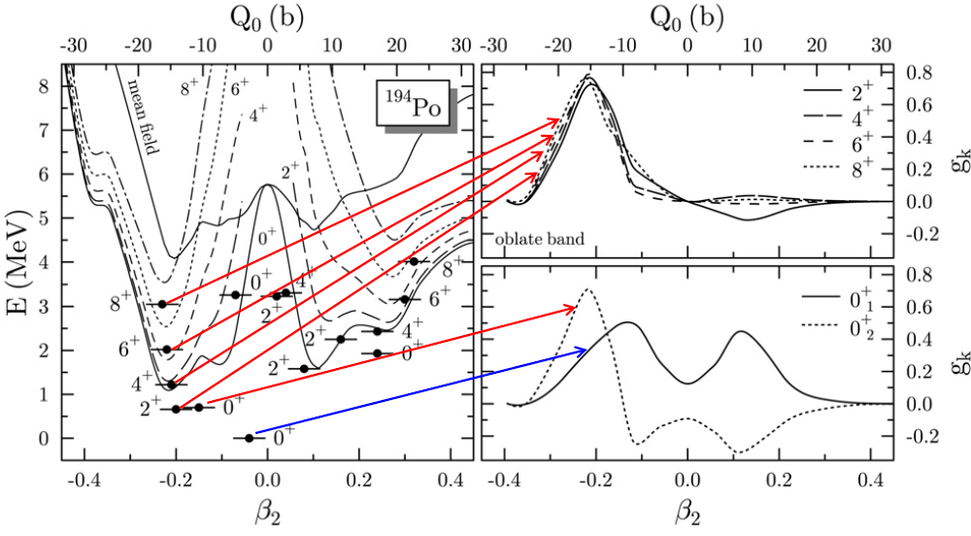
IS456: Shape coexistence near ¹⁸⁶Pb
M. Bender, private communication, adapted from M. Bender et al, PRC 73 (2006) 034322.
T. Grahn et al, Nuclear Physics A 801 (2008) 83-100.
T.E. Cocolios, Hyperfine Interactions 238 (2017) 16.

Slide 24
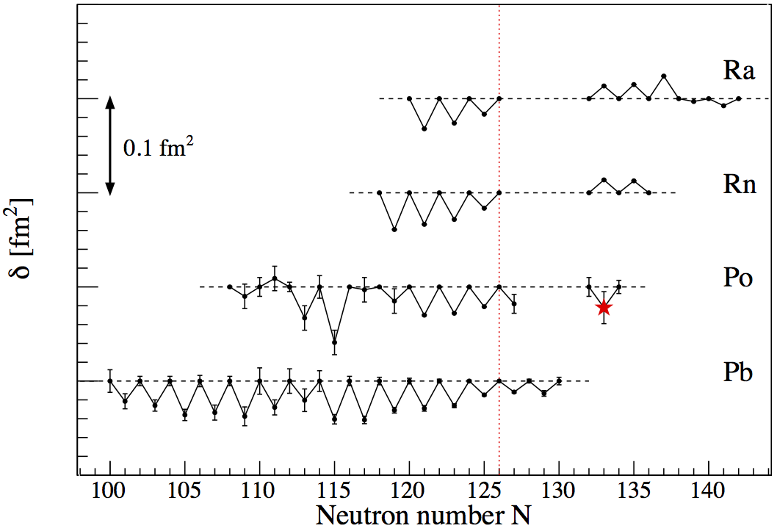
IS456: odd-even staggering
The reversal of the odd-even staggering in dr2 has been observed in the region also known for its reflection asymmetry. As polonium is located at the low-Z edge of this region, investigating its charge distribution is crucial to further understand the link between these two properties.
D. Fink et al, Physical Review X 5 (2015) 011018.

Slide 25
IS456: Publications
Main scientific publications
  T.E. Cocolios et al, Structure of 191Pb from α- and β-decay spectroscopy, Journal of Physics G 37 (2010) 125103.
  B. Cheal, T.E. Cocolios, T.E. Cocolios, W. Dexters, M.D. Seliverstov et al, Early onset of ground state deformation in neutron deficient polonium isotopes, Physical Review Letters 106 (2011) 052503.
  S. Fritzsche, Laser spectroscopy of radioactive isotopes: Role and limitations of accurate isotope-shift calculations, Physical Review A 86 (2012) 042501.
  M.D. Seliverstov, T.E. Cocolios, W. Dexters et al, Charge radii of odd-A ¹⁹¹⁻²¹¹Po isotopes, Physics Letters B 719 (2013) 362-366.
  M.D. Seliverstov, T.E. Cocolios, W. Dexters et al, Electromagnetic moments of odd-A ^{191-203,211}Po isotopes, Physical Review C 89 (2014) 034323.
  D.A. Fink, T.E. Cocolios et al, In-source laser spectroscopy with the Laser Ion Source and Trap: first direct study of the ground-state properties of ^{217,219}Po, Physical Review X 5 (2015) 011018.
Conference proceedings
  T.E. Cocolios, B.A. Marsh et al, Resonant laser ionization of polonium at RILIS-ISOLDE for the study of ground- and isomer-state properties, NIMB 266 (2008) 4403-4406, Proceedings to the EMIS Conference 2007 in Deauville, France.
  T.E. Cocolios et al, Early onset of deformation in the neutron-deficient polonium isotopes (decay spectroscopy of ¹⁹⁹Po), Journal of Physics: Conference Series 381 (2012) 012072.
  D.A. Fink, S.D. Richter et al, First application of the Laser Ion Source and Trap (LIST) for on-line experiments at ISOLDE, NIMB 317 (2013) 417-421, Proceedings to the EMIS Conference 2012 in Matsue, Japan.
  T.E. Cocolios, Shape coexistence in the lead region from a ground-state perspective, xxx, (2015) page 43-49, Proceedings to the ISTROS Conference 2013 in Častá-Papiernička, Slovakia.
  T.E. Cocolios, A new perspective on charge radii around Z=82, Hyperfine Interactions 238 (2017) 16, Proceedings of the 10th International Workshop on Application of Lasers and Storage Devices in Atomic Nuclei Research: “Recent Achievements and Future Prospects” (LASER 2016), Poznan, Poland

