Slide 1
SURFACE TREATMENT

Slide 2
HOW?
Open this link:
https://espace.cern.ch/TE-VSC-job-requests/Lists/Surface%20Treatment%202019/AllItems.aspx

Slide 3
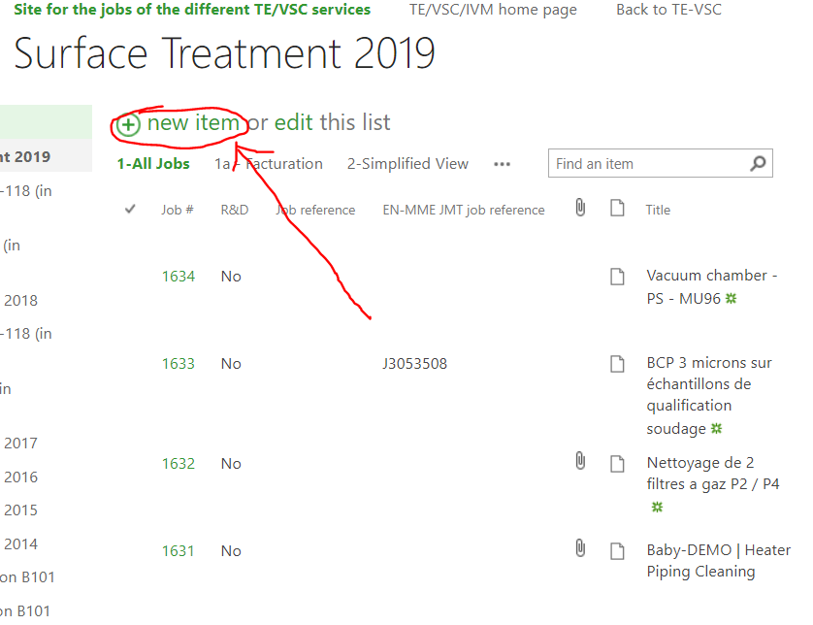
Click on “new item” to open a new surface treatment request

Slide 4
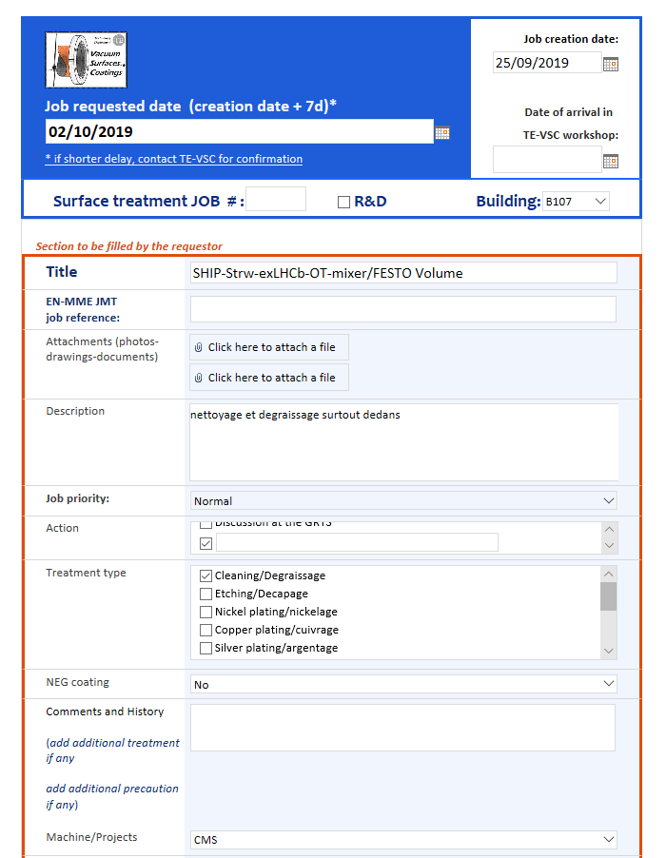
Complete the new page.
Please insert the name of the experiment in the title.

Slide 5
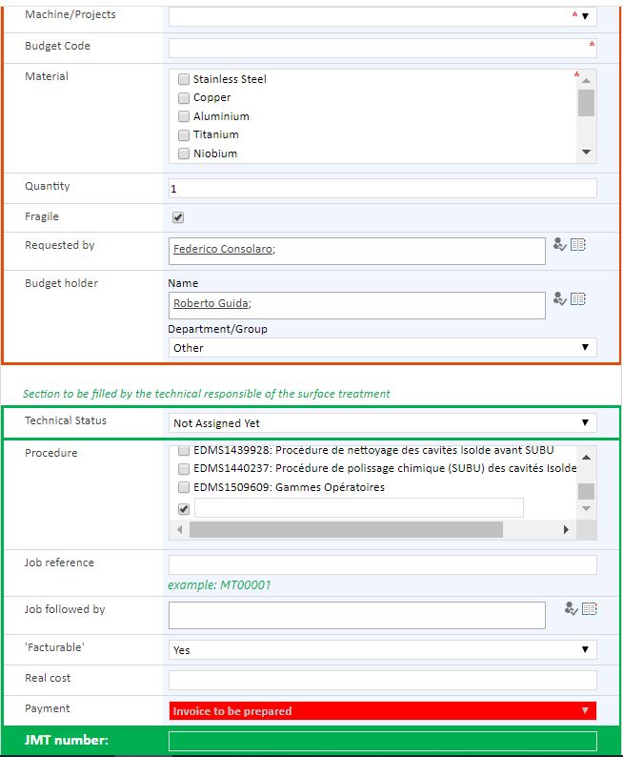

Slide 6
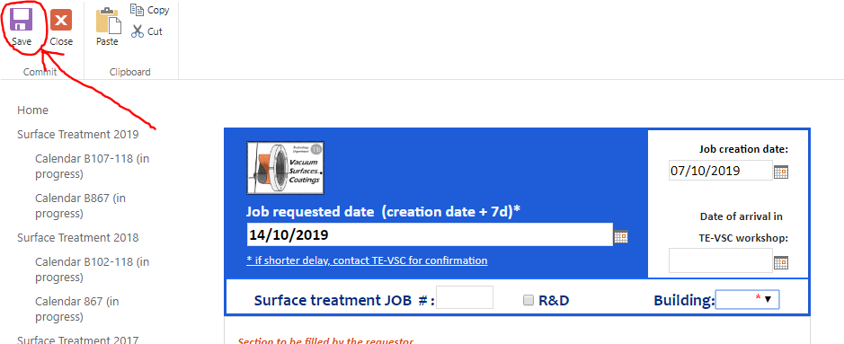
Save the page.

Slide 7
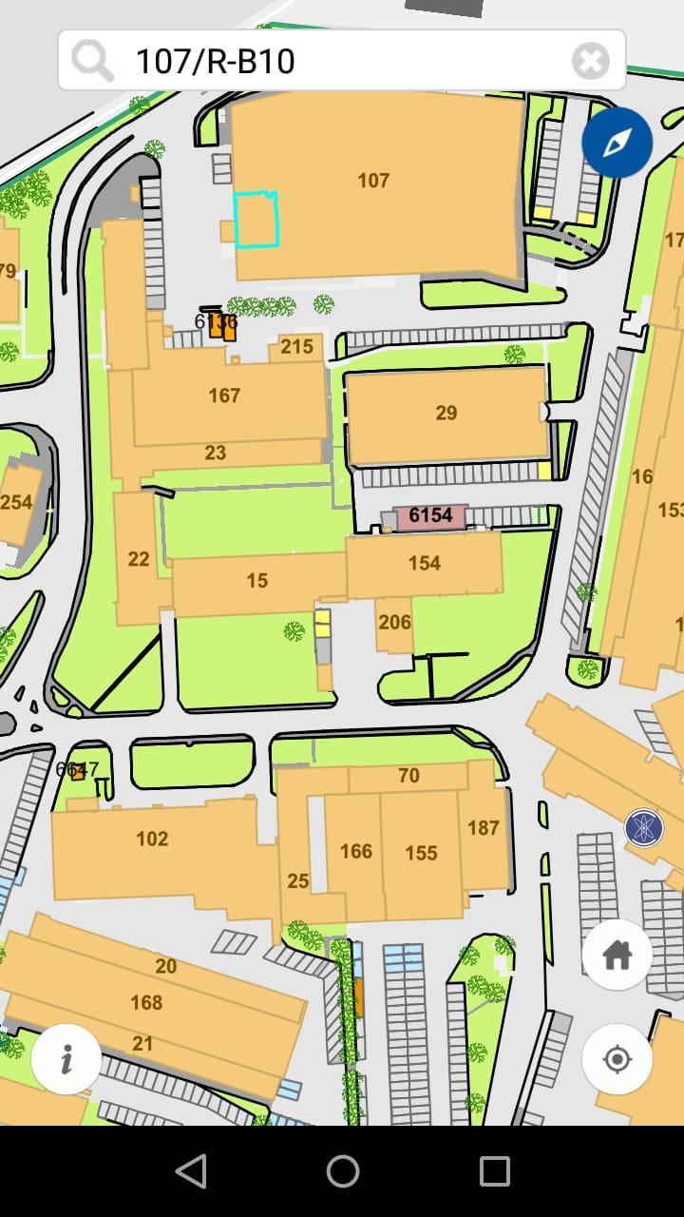
WHERE?
107-R-B10 MAGASIN MEYRIN

Slide 8
GENERAL INFORMATION
You can bring the piece there to yourself or with an internal transport request (if it is too big).
If the piece is big send an email to Marc Thieber (Marc.Thiebert@cern.ch) and ask if there is enough space for your material in the building.
For urgent job put the piece on higher shelf.
When the job is finished, you will receive an email and you could pick up the piece and sign the paper sheet.

