Slide 1
Cosmic Rays Activities @ Centro Fermi
Marina Trimarchi
Museo Storico della Fisica e Centro studi e Ricerche “E.Fermi” – Roma
Dipartimento MIFT – Università degli Studi di Messina
INFN – Sez. Catania

Slide 2
Outline
The Cosmic Box Contest
The PolarquEEEst project of Centro Fermi
Opening of the Museo Fermi in Rome
EEE@International Cosmic Day 2019

Slide 3
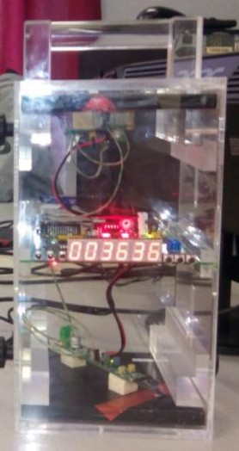
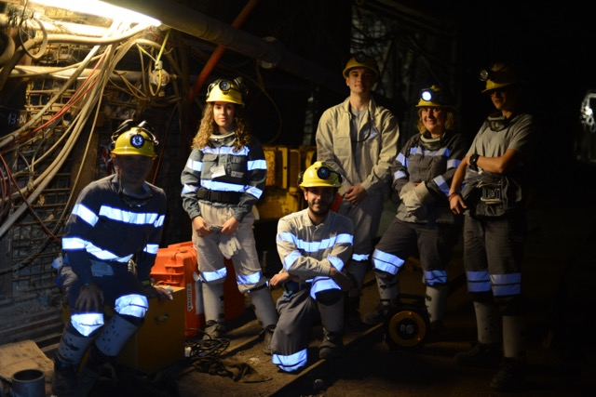
The Cosmic Box
Portable detector based on scintillation technique
Built from students of “ITI Avogadro”, Turin
1 kindly settled from INFN - Genova
Developed to measure the MRPC Efficiency
Used to measure cosmic ray flux

Slide 4
The Cosmic Box Contest
The school presenting the best research project win a Cosmic Box
3 Winners:
Liceo Galilei (Lanciano); IIS Beretta (Gardone VT); Liceo Fermi (Paternò)
Example → Liceo Galilei (Lanciano)
  Measurement of Cosmic Ray absorption in bituminous limestone
    8-levels Mine “Foce Valle Romana” of Majella
Results of the measurements will be presented
by the students during one of our usual monthly
Coordination Meetings open to Schools

Slide 5
Outline
The Cosmic Box Contest
The PolarquEEEst project of Centro Fermi
Opening of the Museo Fermi in Rome
EEE@International Cosmic Day 2019

Slide 6
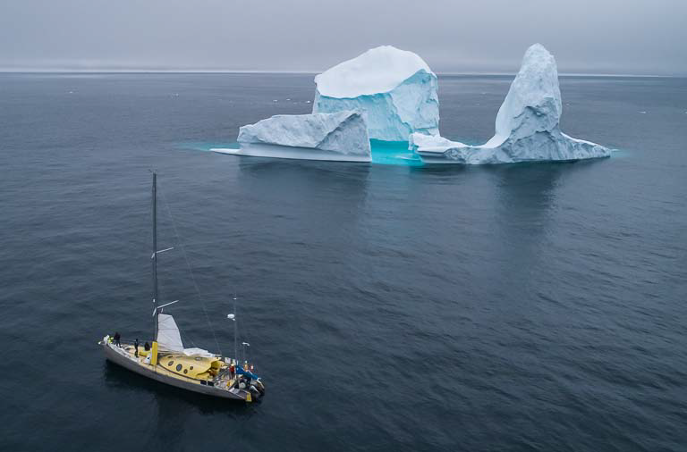
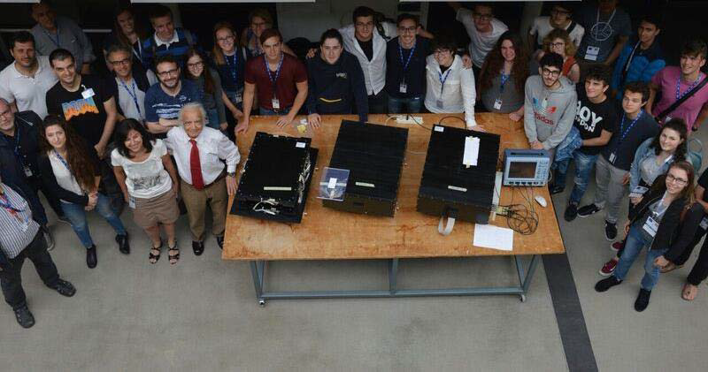
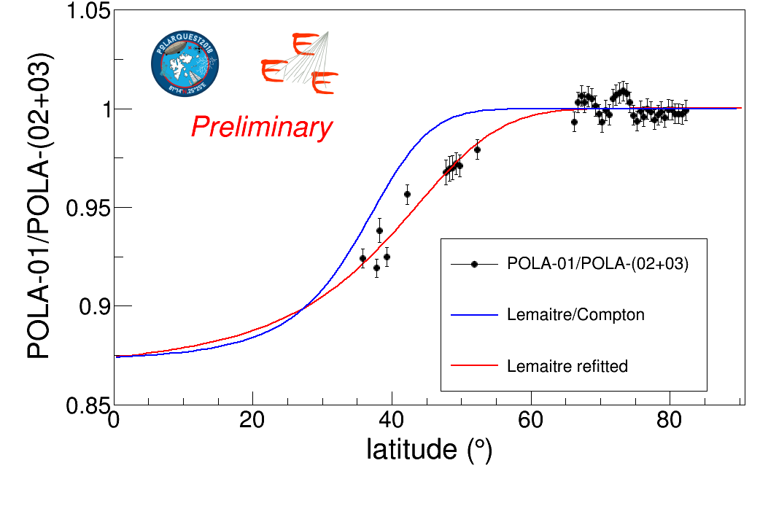
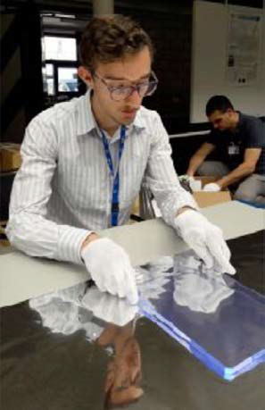
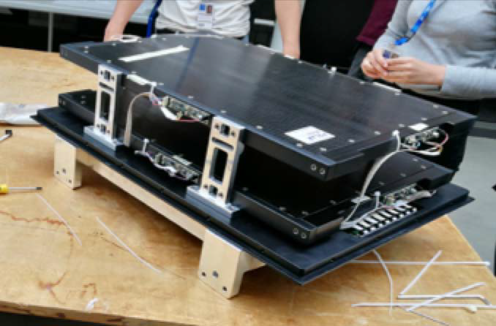
The PolarquEEEst project
PolarquEEEst mission 2018
Assembly of the POLA detectors@CERN
  High school students from Italy, Norway and Switzerland
Preliminary results

Slide 7
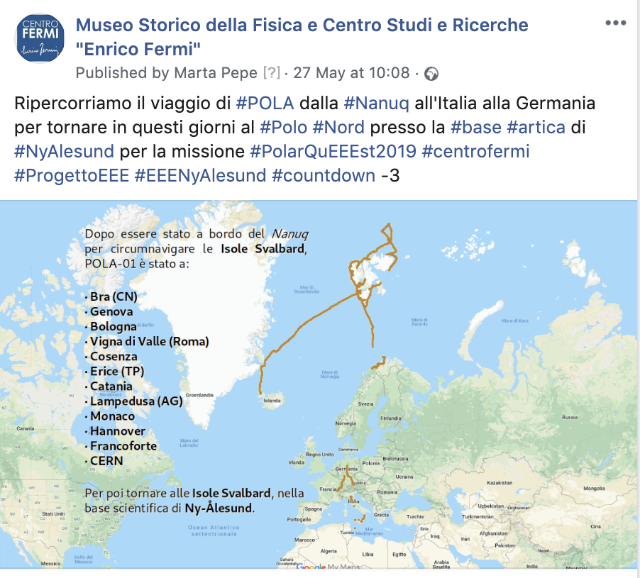
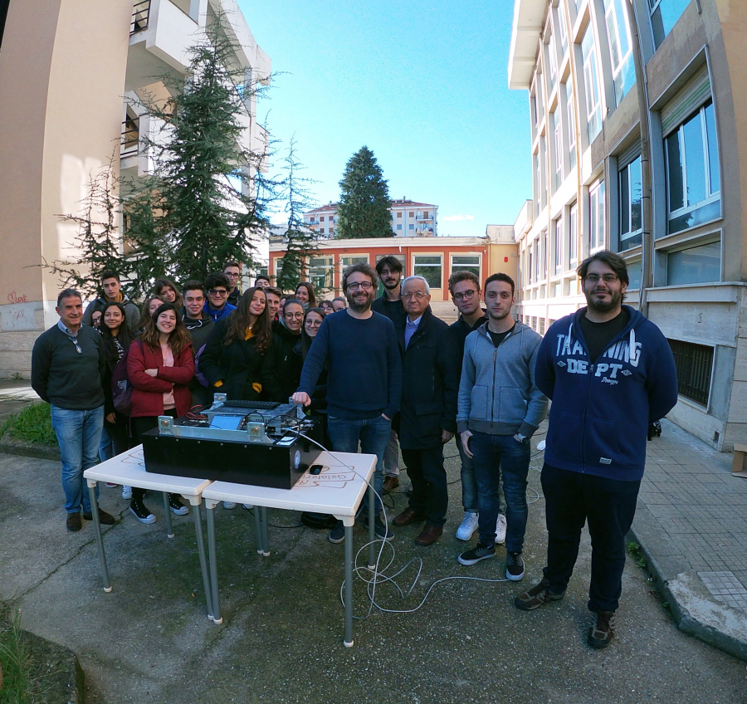
The POLA journey
POLA01 started its adventure on July 2018 on Nanuq
Then it reached as far as Lampedusa, and traveled across Italy and Europe, getting back to North Pole on May 2019
For each step of the journey, events have been organized in the EEE schools

Slide 8


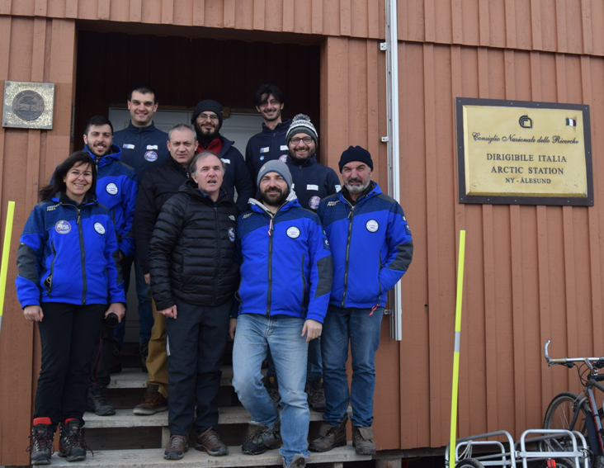
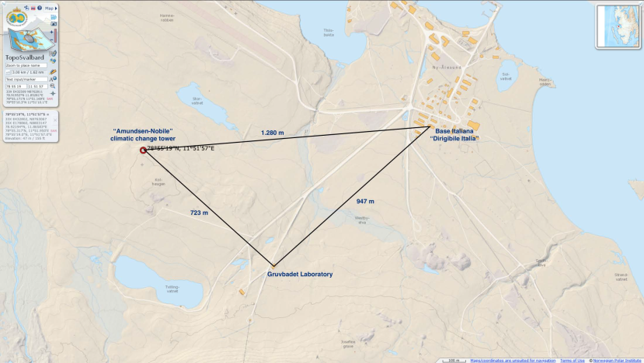
PolarquEEEst 2019
PolarquEEEst2019 LOGO
3 POLA detectors installed in Ny.Alesund, Svalbard, Norway

Slide 9
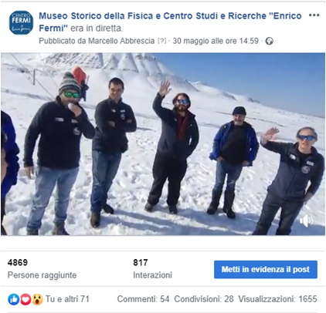
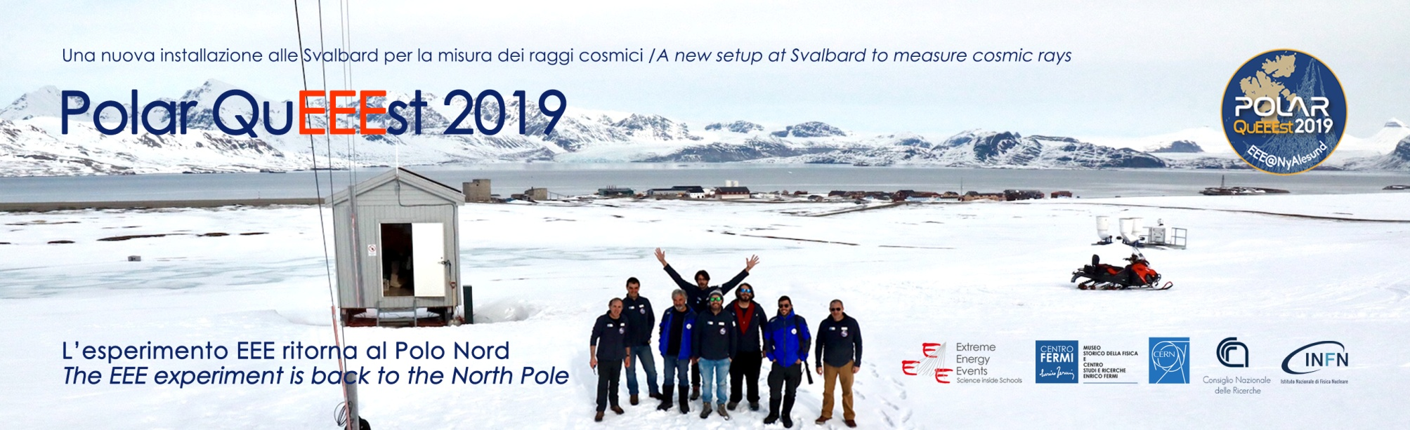
The Live Event
<<EEE@NyAlesund>>
Broadcasted on Centro Fermi FB Page on May 30th, at 15:00
To date, ∼5000 contacts visualized the recorded broadcast, and 800 interacted with it (likes, sharing, etc)
Active participation by the EEE schools, that posted interesting and funny questions
INFN, CNR, PolarquEEEst2018 and <<La Scienza Coatta>> shared the news in their networks

Slide 10
Outline
The Cosmic Box Contest
The PolarquEEEst project of Centro Fermi
Opening of the Museo Fermi in Rome
EEE@International Cosmic Day 2019

Slide 11
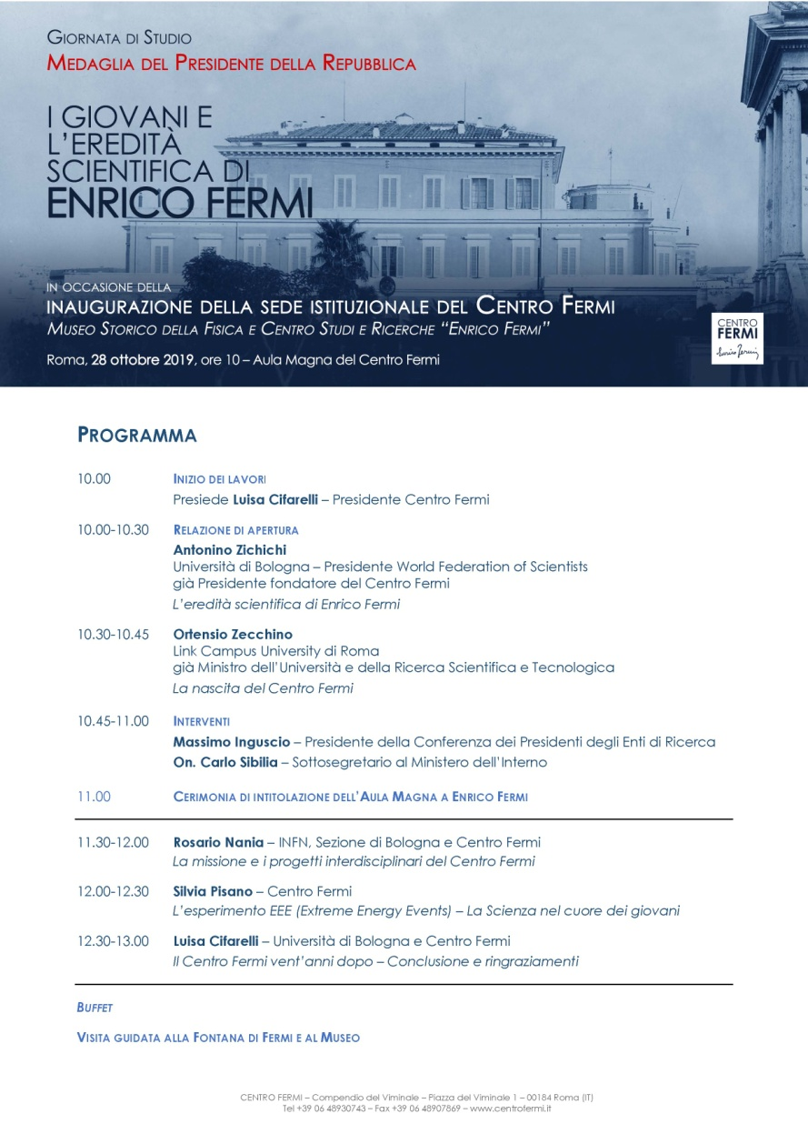
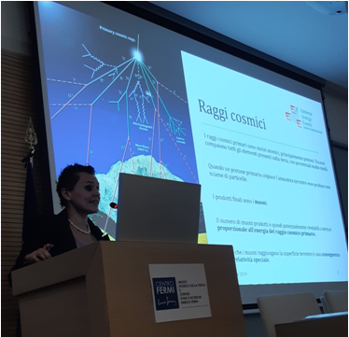
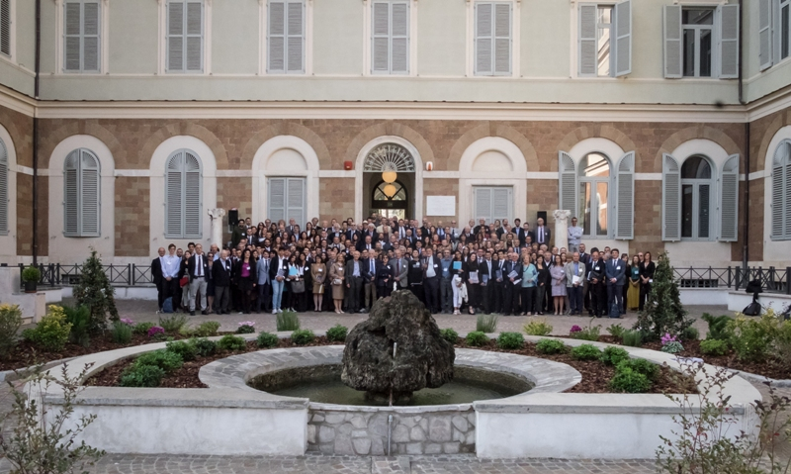
Opening of the
Museo Fermi in Rome
Historical building of Via Panisperna, the “Royal Physics Institute of the Rome University” from 1881 to 1936.

Slide 12
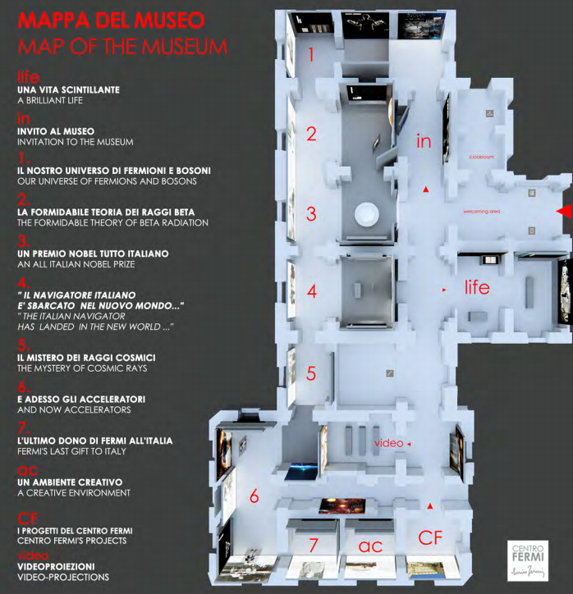
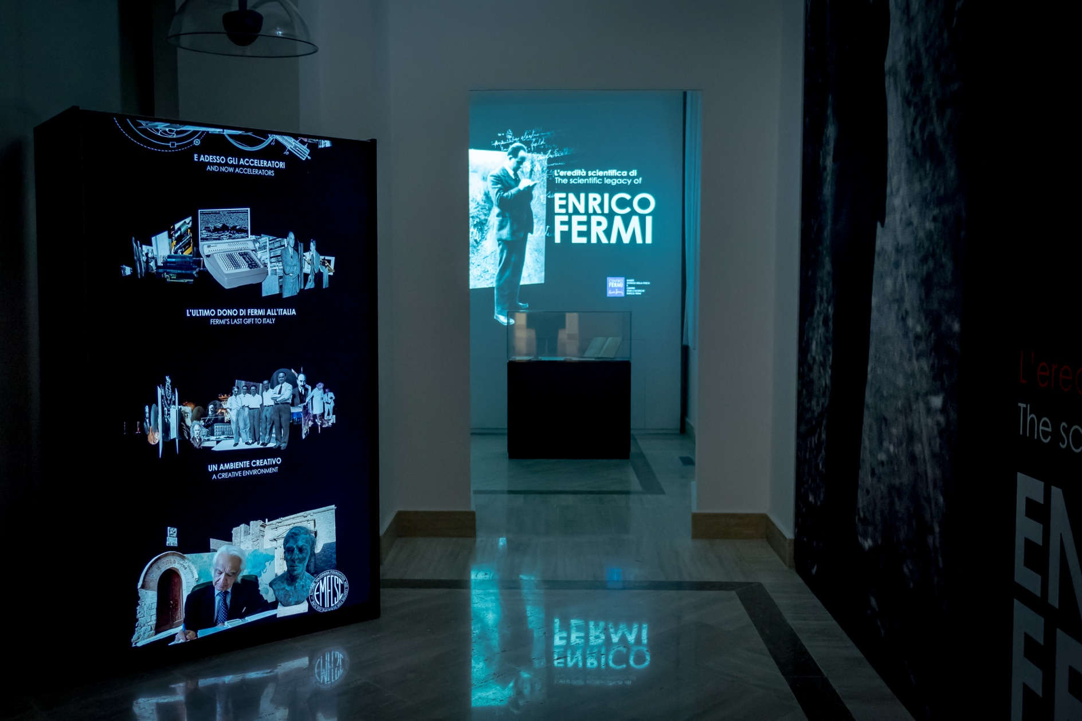
Opening of the
Museo Fermi in Rome
One of the next IPPOG Meetings in Rome?

Slide 13
Outline
The Cosmic Box Contest
The Social Adventure: <<EEE@NyAlesund>>
Opening of the Museo Fermi in Rome
EEE@International Cosmic Day 2019

Slide 14
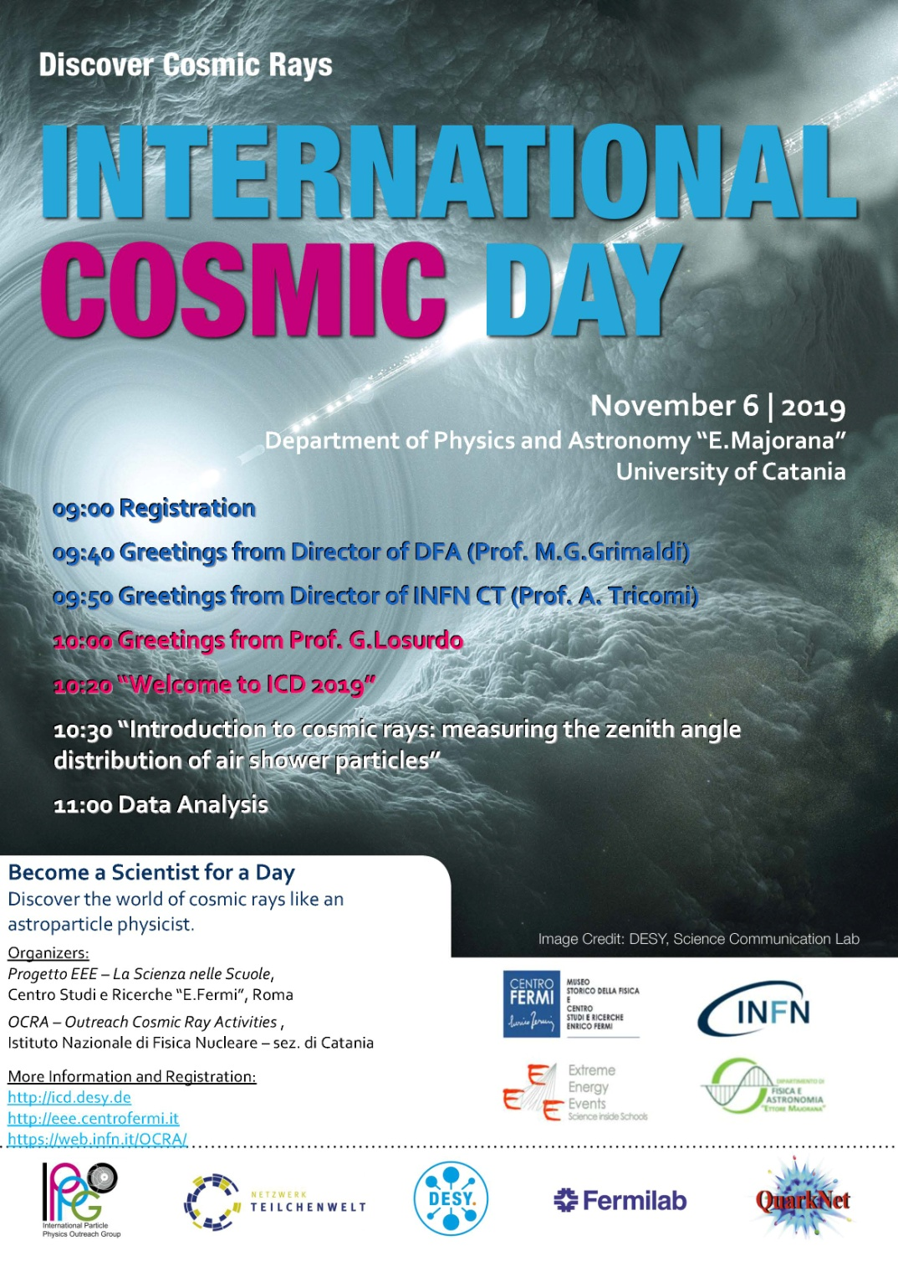
Agenda of the event
Similar for all EEE schools
With a central common part
Opportunity for Collaboration between EEE and INFN - Ocra experiment

Slide 15
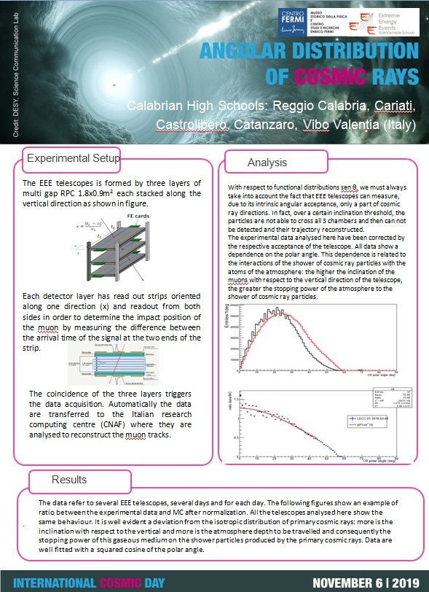
EEE@ICD 2019
39 Italian High School, 14 Local Researchers, 46 teachers and 430 students, distributed in 9 local sites:
  Dipartimento di Fisica di Torino
  Dipartimento di Fisica di Bari
  Dipartimento di Fisica di Catania
  Liceo Volta, Lodi
  Liceo Chiabrera Martini, Savona
  Liceo Banzi Bazoli, Lecce
  Liceo Pacinotti, Cagliari
  Liceo Duca degli Abruzzi, Treviso
  Liceo Patrizi, Cariati
  Data from EEE telescopes
    Analyzed with ROOT

Slide 16
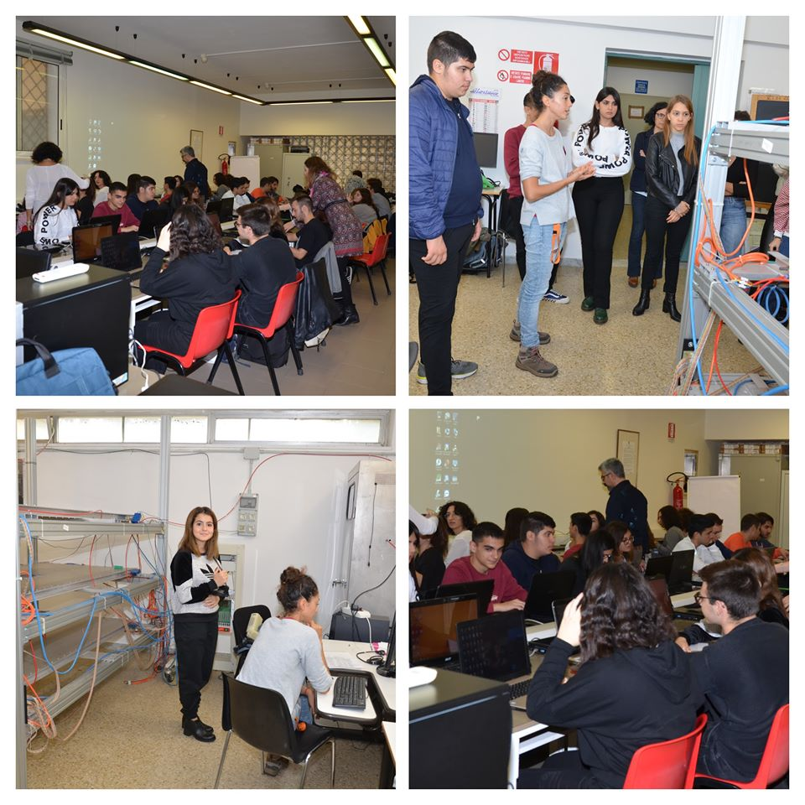
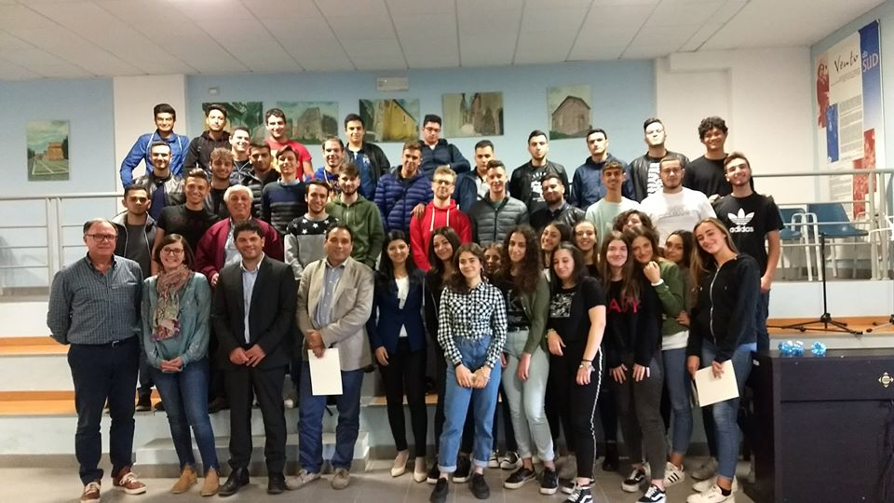
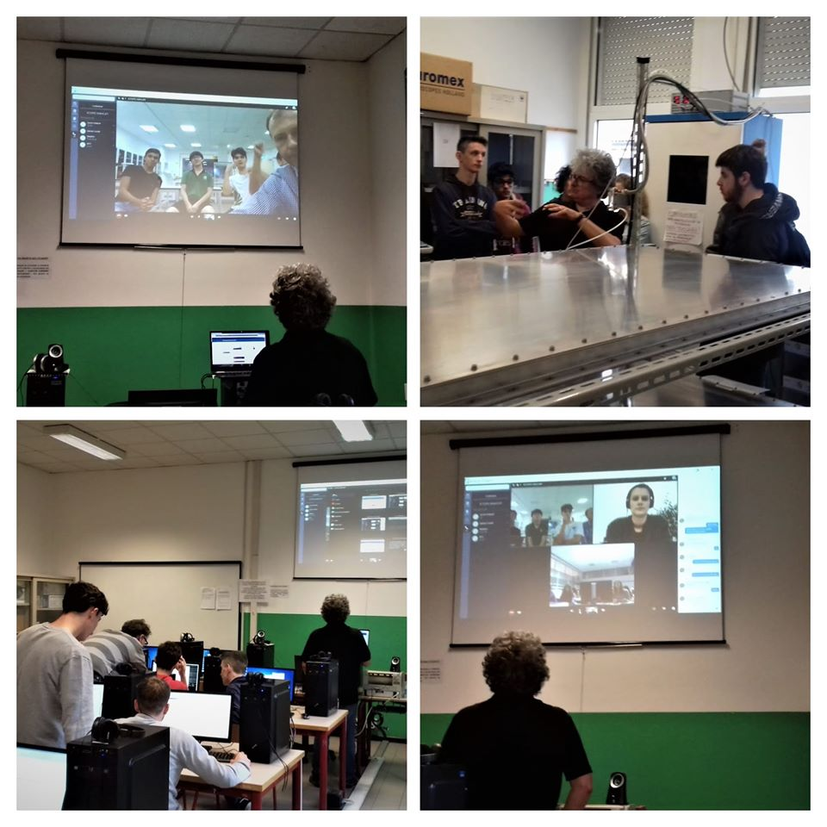
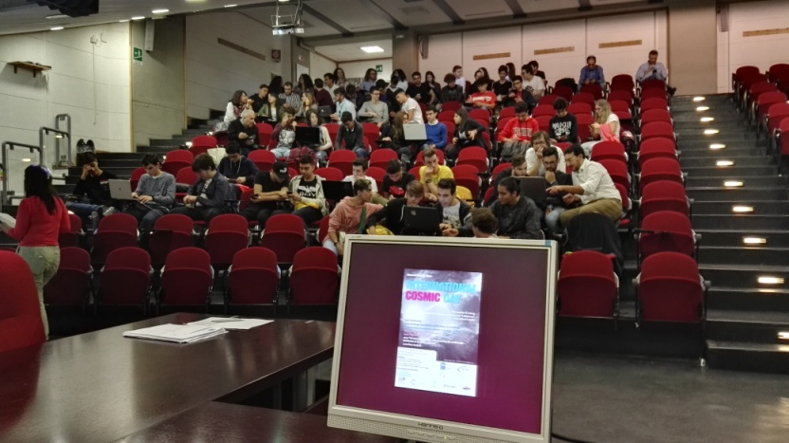
EEE@ ICD 2019

Slide 17
Conclusions
The Cosmic Box Contest
  The school presenting the best research project wins a cosmic box
    3 Winners →very interesting research projects, actually taking data
      Students will report to the collaboration during monthly Coordination Meetings
The PolarquEEEst project of Centro Fermi
  3 permanent detectors installed at Dirigibile Italia CNR Arctic Station
    Good engagement of students and public in the promotion of the related events
Opening of the Museo Fermi in Rome
  Historical building of Via Panisperna, having hosted the “Royal Physics Institute of the Rome University ” until 1936
    One of the next IPPOG Meetings in Rome?
EEE@International Cosmic Day 2019
  As for past 2 editions, huge participation of EEE project
    39 High Schools, 14 researchers, 46 Teachers, 430 Students
  Innovations of 2019 edition:
    Opportunity of Collaboration with INFN OCRA Experiment
    EEE data analyzed with Root

