Slide 1




Speakers and Publications
Committee
Status as of November 2019
Pedro Abreu for the IPPOG-SPC, IPPOG Autumn Meeting, CERN, 29th November/2019

Slide 2

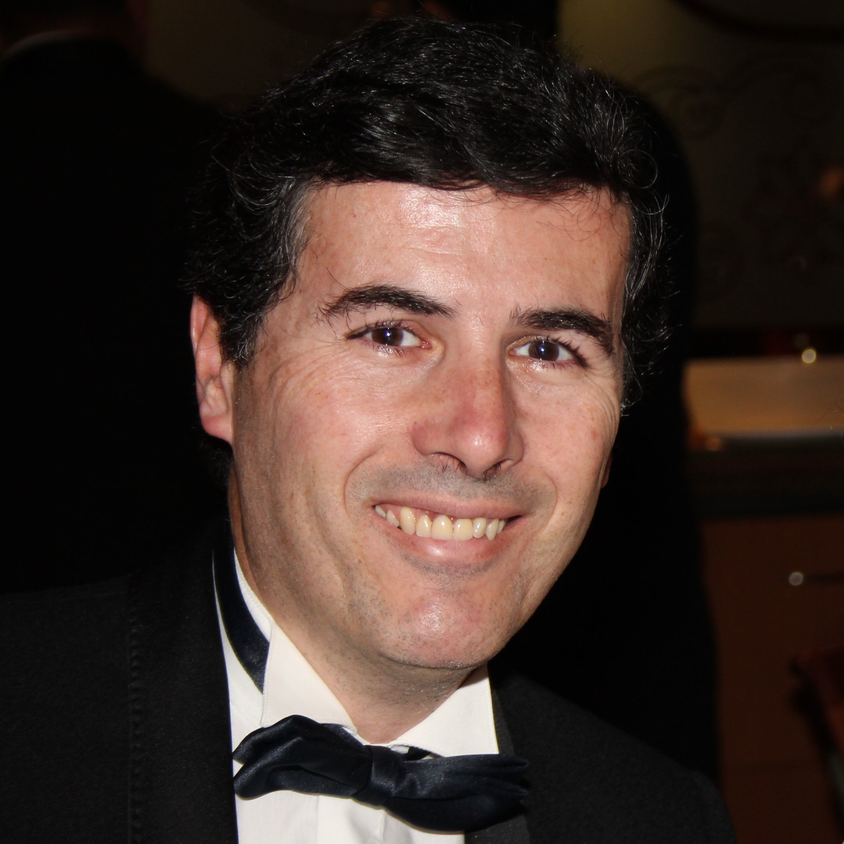

Hello!
I am Pedro
Today I am here to speak about Conferences!
You can find me at abreu@lip.pt
(.abreu, pedro abreu)

Slide 3
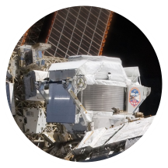
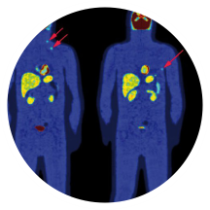
1.
IPPOG-SPC
The mandate
Overview on and collection of relevant events and collection of relevant material:
(Google docs file, not disclosed here and available upon request)
Follow-up of the whole process and quality assurance
Assignment of speakers and circulation of material
Follow the publication process

Slide 4
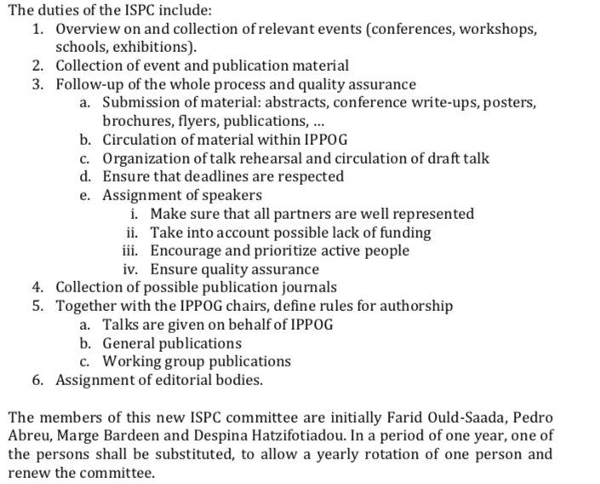
1a.
The document
(for your reference)

Slide 5
2.
IPPOG-SPC
Membership
The members of this “new” ISPC committee are initially Farid Ould-Saada, Pedro Abreu, Marge Bardeen and Despina Hatzifotiadou. In a period of one year, one of the persons shall be substituted, to allow a yearly rotation of one person and renew the committee ☺☺☺.
Not happened. Reported in May 2019. Not happened yet.

Slide 6
3.
The list of conferences
(my choice, next page)

Slide 7
2019
Nickname | Event | Place | Dates | Deadline | #Sent | #Talks | Speaker(s)
APS April Meeting | APS April Meeting | Denver, Co, USA | 13-16 April | Over | 1 | 1 | Ken Cecire
LHCP2019 | LHC Physics Conference | Puebla, Mexico | 20-25 May | Over | 1 | 1 | Sascha Melhase
EPSHEP2019 | EPS High Energy Physics Conf. | Ghent, Belgium | 10-17 July | 29/04/19 | 2+1 |  | Hans Peter B, Ivan Melo, Uta Bilow,
ICFNP2019 | Int’l Conf. on New Frontiers in Physics | Kolympari, Crete, Gr. | 21-29 August | 30/05/19 | 1 |  | Despina Hatzifotiadou
DPF2019 | Meeting Division of Particles and Fields | Boston, Ma, USA | 29 July - 2 August | 31/05/19 | 1 | 1 | Rick Dowdr (on behalf of Ken Cecire)
CHEP2019 | Computing in High Energy Physics | Adelaide, Australia | 4-8 November | 31/05/19 | 3+1 |  | Steve Goldfarb, Farid Ould-Saada, Marzena Lapka, Lukas Graczykowski
Quark Matter | Quark Matter 2019 | Wuhan, Cn | 4-9 Nov. | 1/7/2019 | 0
today
7/8

Slide 8
2020
Nickname | Event | Place | Dates | Deadline | #Sent | #Talks | Speaker(s)
ESOF2020 | EuroScience Open F. | Trieste, Italy | 5-9 July | 15/06/19 | ?
ICHEP2020 | Int’l Conference on High Energy Physics | Prague, Czech Rep. | 30 July - 5 August | February 2020? | ?
QCHS 2020 | Quark Confinement and Hadron Spectrum | Stavanger, Norway | 27 July – 1 August | ? | 1? | 1 | Yiota Foka (?)
PANIC 2020 | Particles and Nuclei IC | Lisboa, Pt | 31/8-4/9 | ?
8/8

Slide 9
3.
Take-home messages
Good representation at conferences so far!
DESPERATELY NEED PEOPLE WILLING TO GO TO A CONFERENCE ON BEHALF OF IPPOG!
Do not kill the messenger…but CHANGE IT! (the IPPOG-SPC Members, that is)

Slide 10



Thanks!
to all the people contributing to conferences!
...and for your attention!
Planting
a future
Any questions?
You can find me at abreu@lip.pt
10/8

