Slide 1
A GNSS measurement for High School Students of EEE Project
Marina Trimarchi
Museo Storico della Fisica e Centro Studi e Ricerche “Enrico Fermi”, Roma
Dipartimento MIFT, Università degli Studi di Messina
INFN – Sezione di Catania

Slide 2
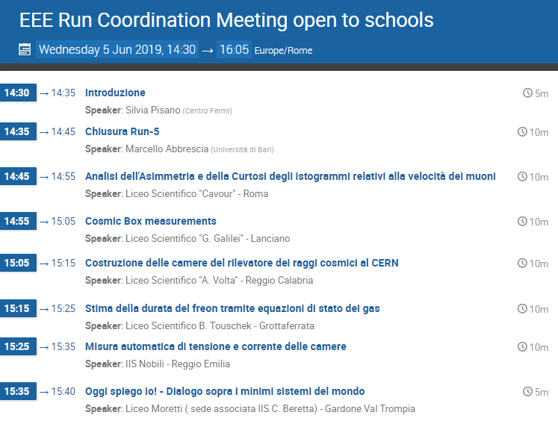
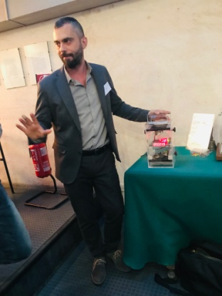
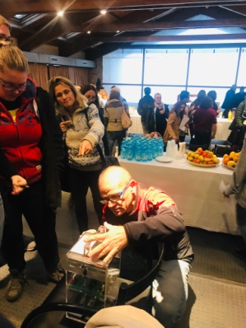
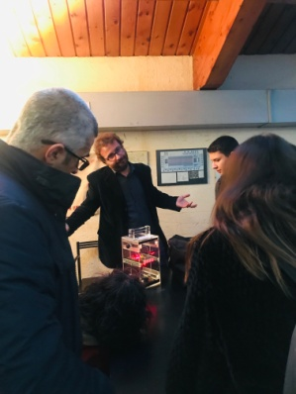
EEE Meetings for Students
Coordination Meetings
Students report about their activity on EEE
Status and Maintenance of the Telescopes, Data Analysis, Questions and Discussions
General Lessons from EEE researchers
Hardware, Software, Organization of events
Conferences of EEE project
Students describe their activities
General Lessons and Masterclasses
Students in groups perform measurements and data analysis and report about their work
Prizegiving for best contributions and analysis

Slide 3
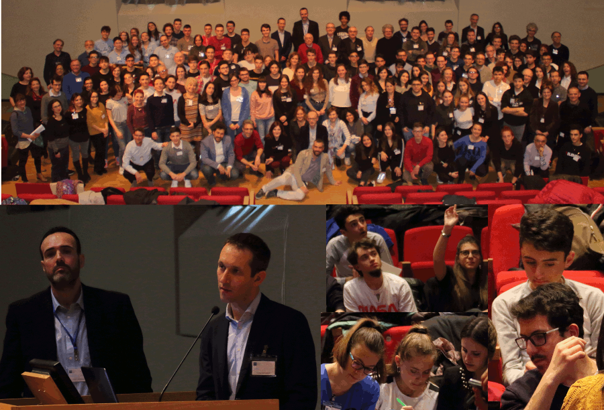
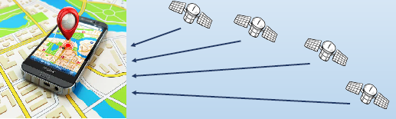
10° Conference of CF Projects
Turin, March 6-8, 2019
In collaboration with Dr. M. Sellone and Dr. G.Cerretto
Istituto Nazionale di Ricerca Metrologica
How a GNSS works
4 satellites in view
Solve 4 non linear equations to get position and time
Distance measurements
  through the time of flight of a signal sent by a transmitter on the satellite
    Δt between clock on satellite and on receiver
Global Navigation Satellite System
Simulation of GNSS functioning by measuring the range between local representative receiver and satellites

Slide 4
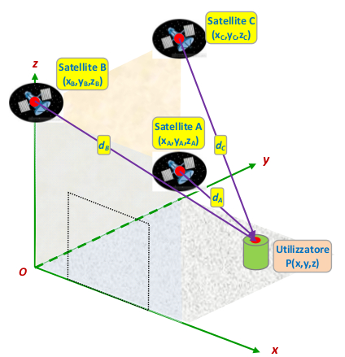
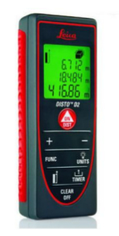
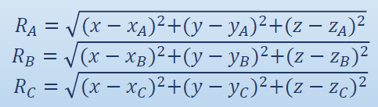
10° Conference of CF Projects
Turin, March 6-8, 2019
Exercise for students:
Put 3 simulated satellites on a cartesian reference
    Simple positions: on the intersections between walls
Use a laser distance meter to measure their positions
  (x_{A}, y_{A}, z_{A}),(x_{B}, y_{B},z_{B}),(x_{C}, y_{C}, z_{C})
Measure your distances from the 3 satellites
    d_{A}, d_{B}, d_{C}
The laser distance meter uses the time of flight of a laser to compute distances
    →Then the signal is transmitted and received by the same instrument
        →As the receiver and the satellite clocks are sinchronized → Only 3 range measurements required
Compute your position by inverting the equations of distances
Check the results with an “actual measurement” → rule, laser meter, etc.
4

Slide 5
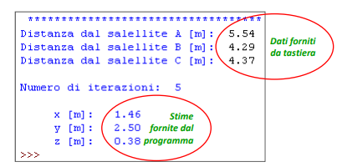
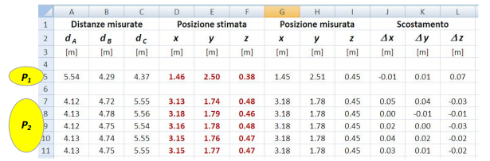
10° Conference of CF Projects
Turin, March 6-8, 2019
Example of Results
Python Code developed by Dr. V.Pettiti (INRIM)
    2 points → P1 and P2
Compare
  Estimated Coordinates (given by the code)
  Measured Coordinates (obtained by an instrument)
Max observed deviation → 5 cm
    Uncertainties of the same order of magnitude in satellite positions
    Not complete orthogonality of the walls
A good method for didactic experiment!

Slide 6
Useful links
General lessons:
  https://agenda.centrofermi.it/event/120/contributions/1041/
  https://agenda.centrofermi.it/event/120/contributions/1042/
Python code:
***If you plan to use code, please cite author: “Valerio Pettiti (INRIM)””****
  https://indico.cern.ch/event/855335/contributions/3627925/attachments/1953452/3244196/Simula_GPS_Pettiti_EEE.py

