Slide 1
18th IPPOG Meeting – CERN– 29 Nov 2019
Exhibits & Exhibitions WG Report
H.P. Beck, Universität Bern, Chair
S. Goldfarb, University of Melbourne, Chair

Slide 2
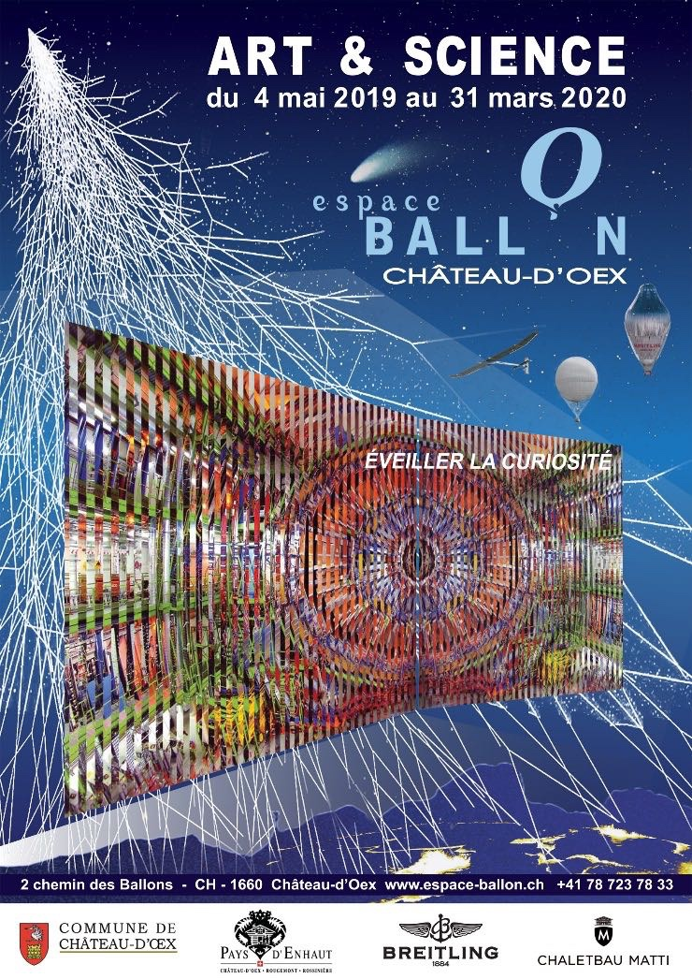
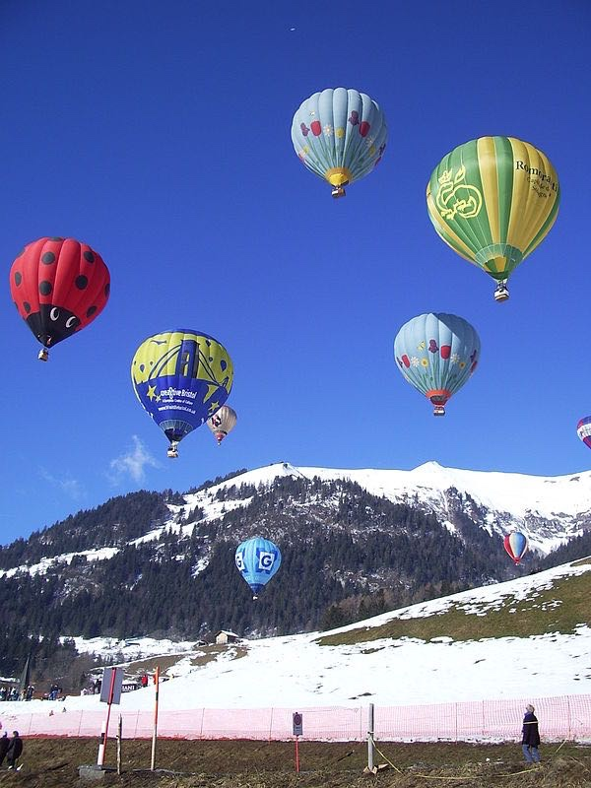

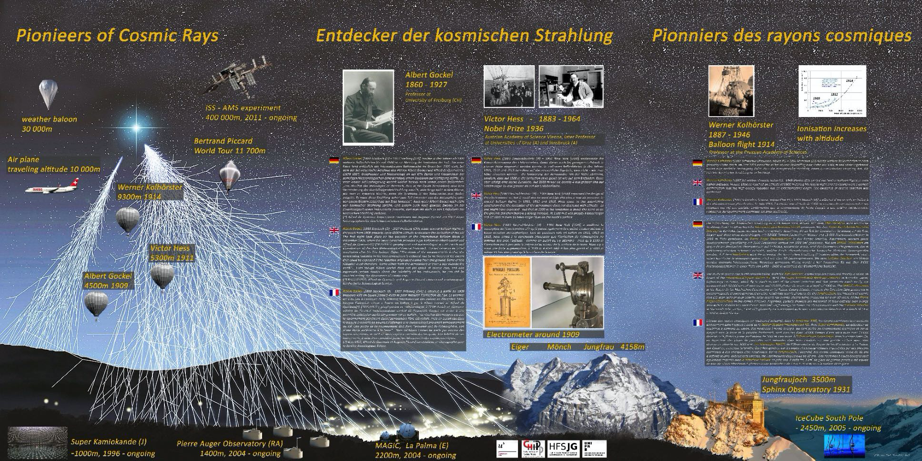
Hot Air Balloons Exhibition at Château-d'Oex
Summary
  A museum that initially had nothing to do with science, particle physics, accelerators, CERN, the Universe, etc. was thinking about its next temporary exhibition - initially only Michael’s art was an attractor.
  A narrative with local relevance allowed to bring the visitor, who expected balloons, to get driven into particle physics and the modern understanding of the Universe in an easy to follow story starting with balloon flights in 1909.
  Adding works of art related to the science shown adds another level of how to emotionally involve visitors in the subject.
  Visitors were taken in unexpectedly and were immediately fascinated.
  The museum attracted many more visitors than in other years.
  The museum is planning to prolong this temporary exhibition by one more year till March 2021!
  Even in a geographically detached and rural location, particle physics enacts fascination !

Slide 3
Art & Science Exhibition in Zagreb
Museum of Contemporary Art - 2022
Art and Science Exhibition
  Art connected with fundamental science
  Science from ORIGIN network
    CERN, Gravitation waves, Muongraphy, ICECUBE, DUNE, astro-particle et al
  Workshops for students
    From kindergarten to universities
    Cultural Collisions format (see Michael’s talk)
Bulding on the experience from ORIGIN and Art@CMS
  Exhibitions already organised in the region Contacts with musem already established
  They are very enthusiastic
  Starting the project very soon (for 2022)

Slide 4
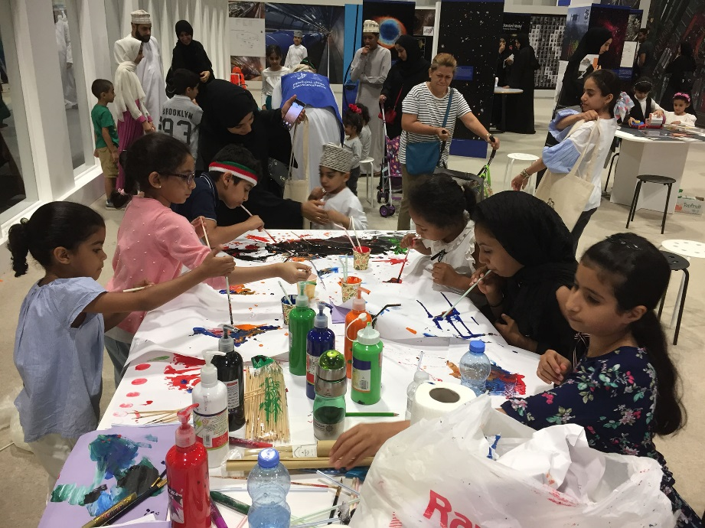
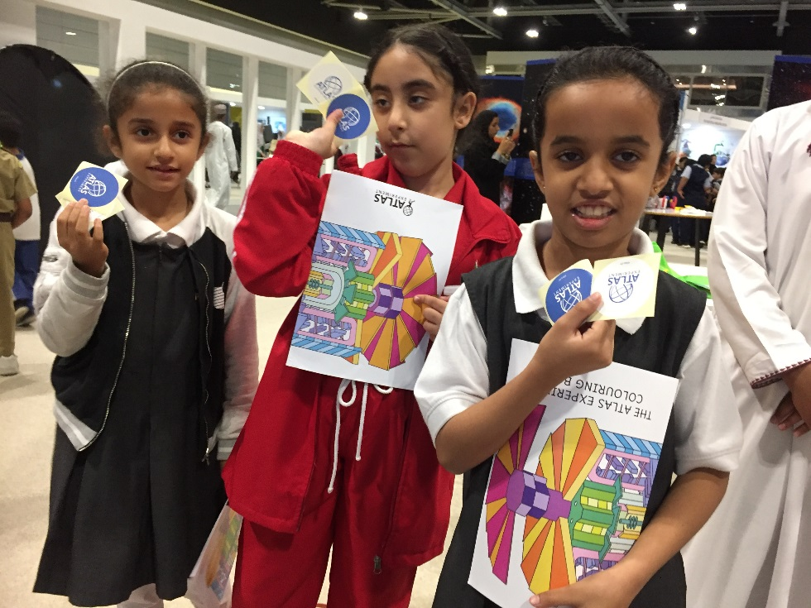
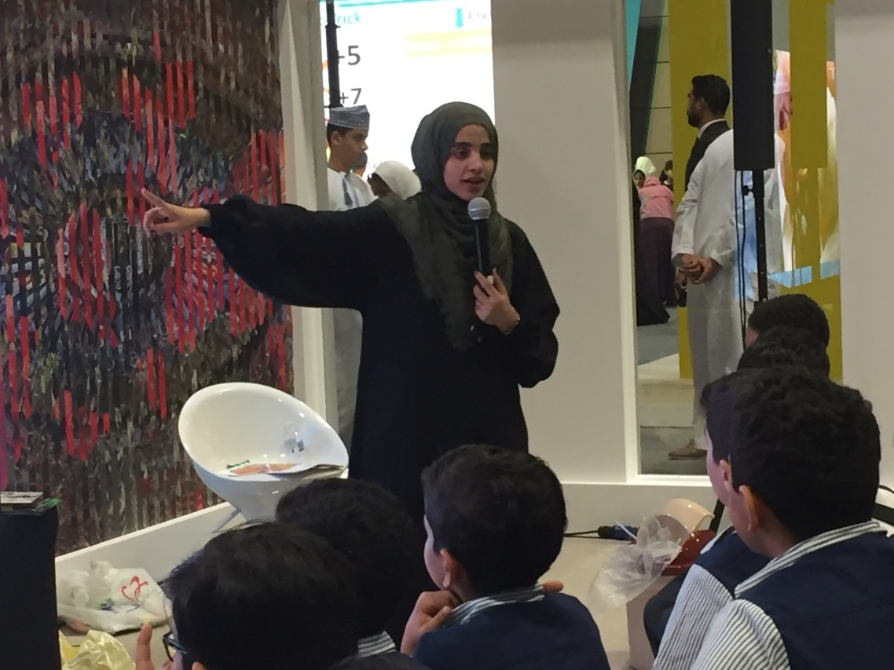
ORIGIN cross-disciplinary science education, engagement & networking
Supported by
  ATLAS, ALICE, CMS, LHCb, LIGO, VIRGI, ICEcube, DUNE, Muography, Perimeter Institute, Canadian Light Source, and other international partners
Objectives:
  cross-disciplinary science engagement & networking with special emphasis on education
THINK globally ACT locally –
  support our science community where they need support -> at their HOME country
  “Arts as a tool to engage actively - empower them to own the topic and allow them to contribute”
Scientific Methodology triggers Critical Thinking
Art fosters Creative Thinking
Oman

Slide 5
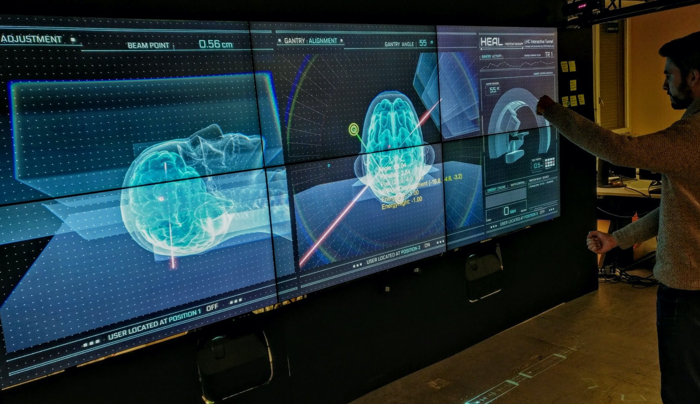
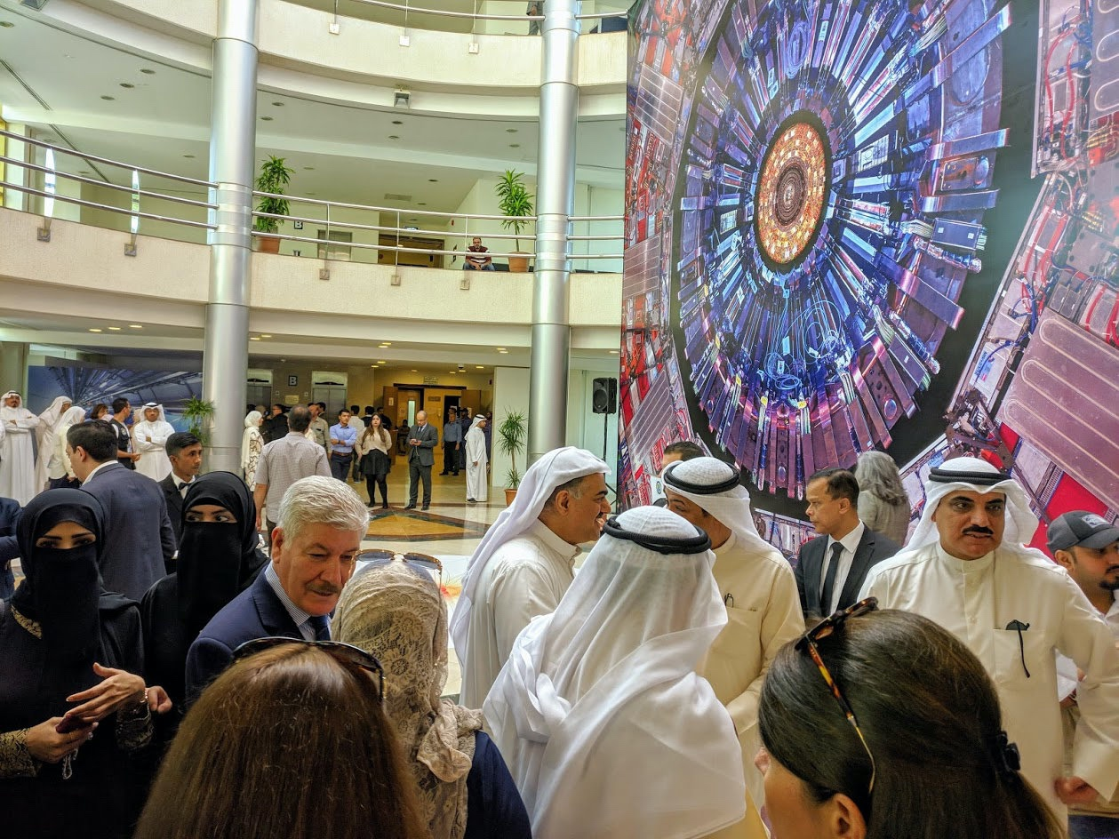
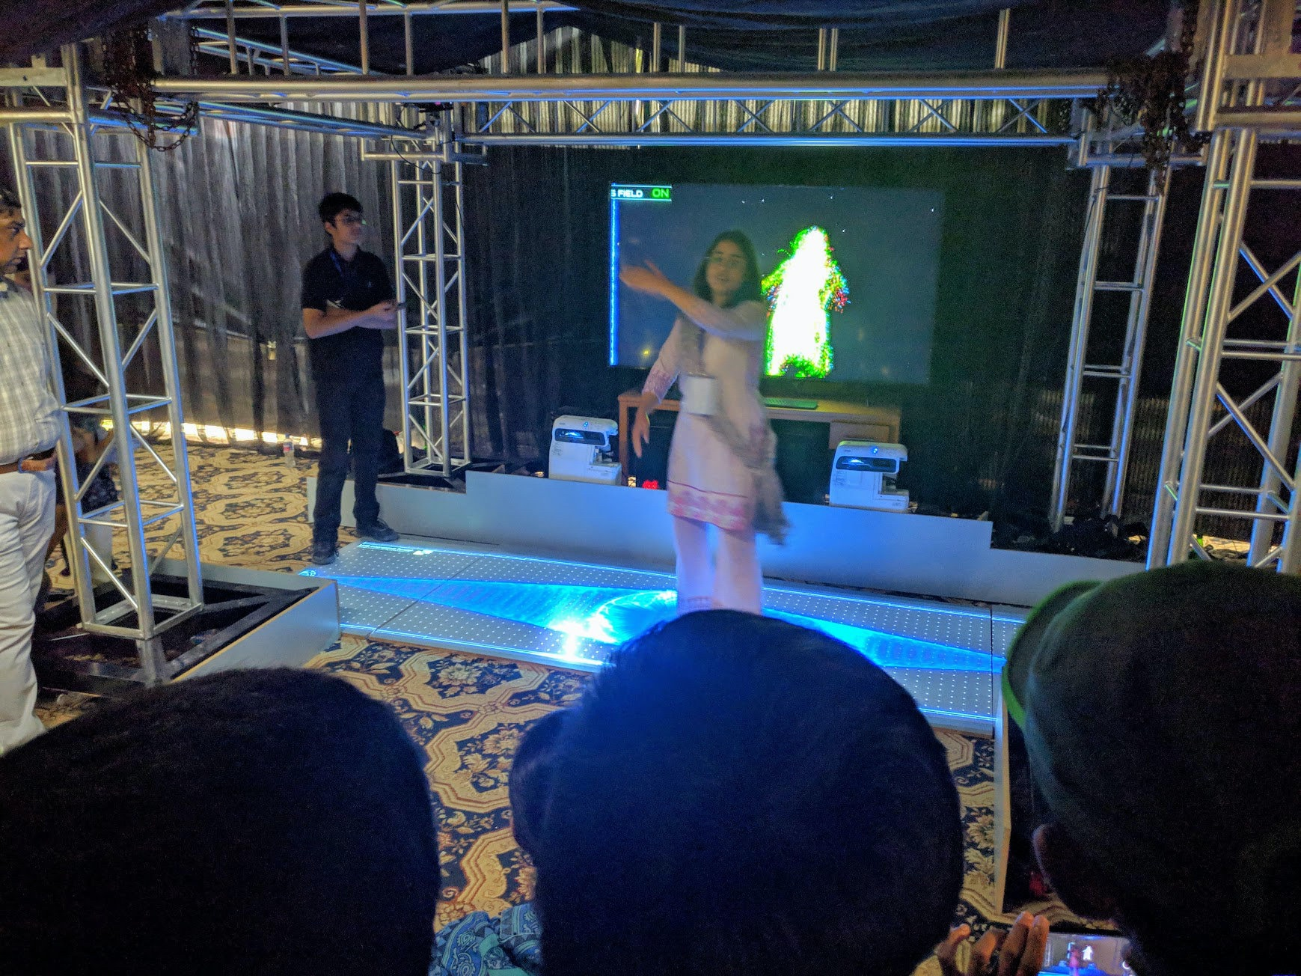
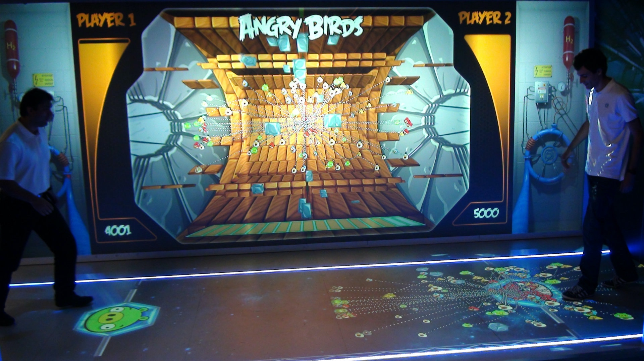
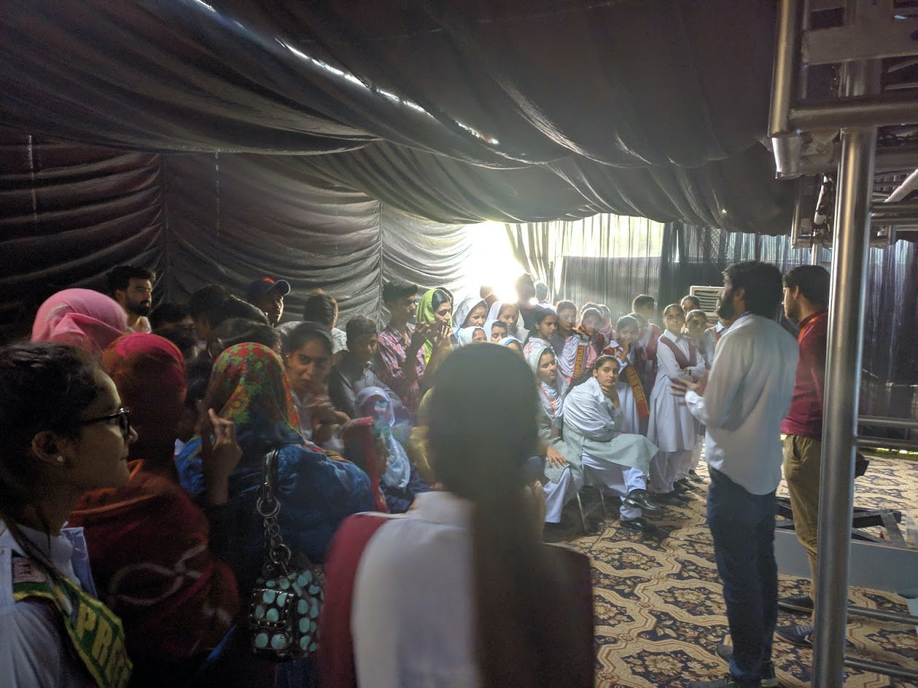
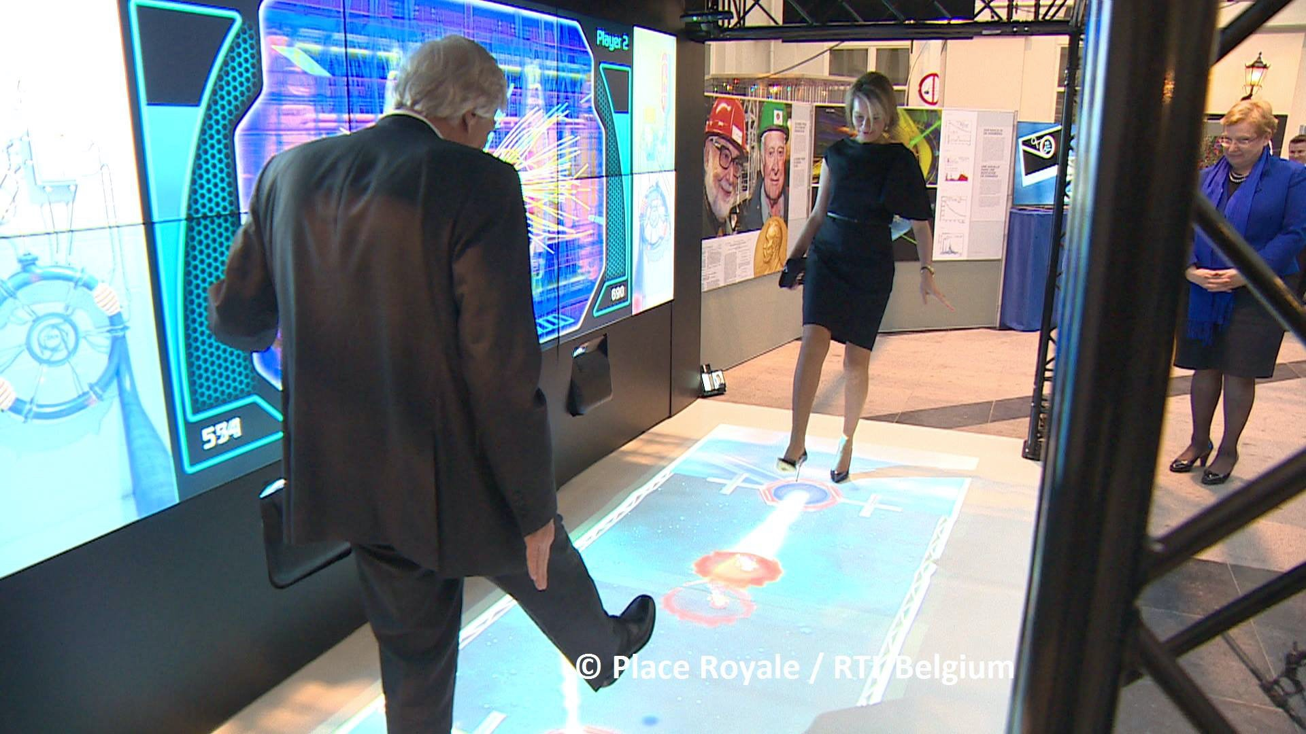
Recent Lessons in Engagement Abroad at the CERN Media Lab
Bahrain

Slide 6
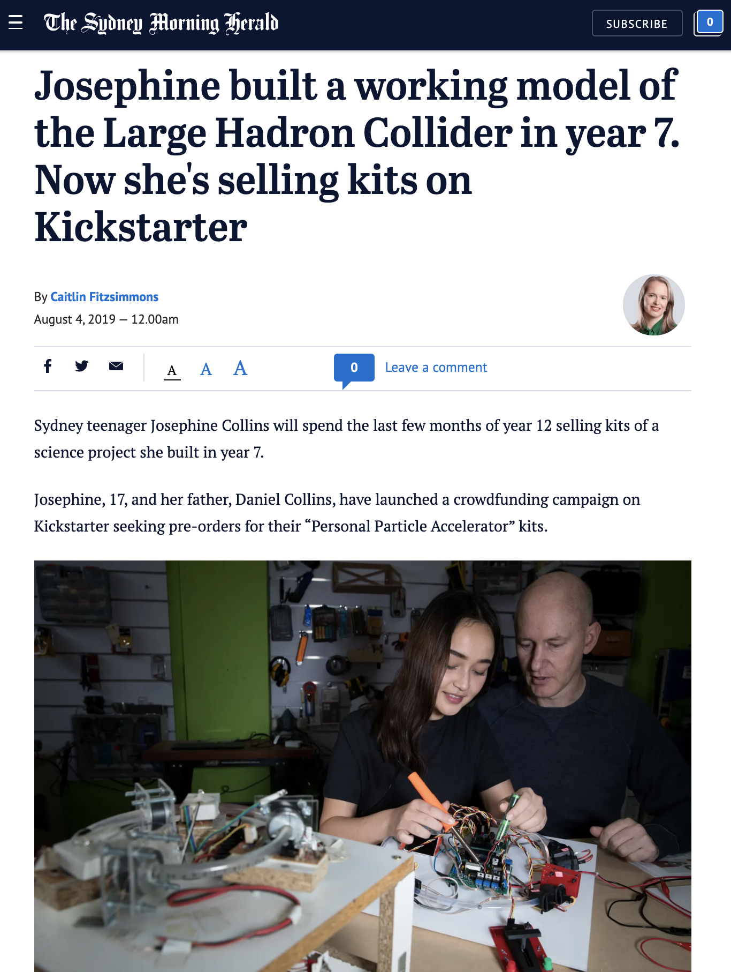
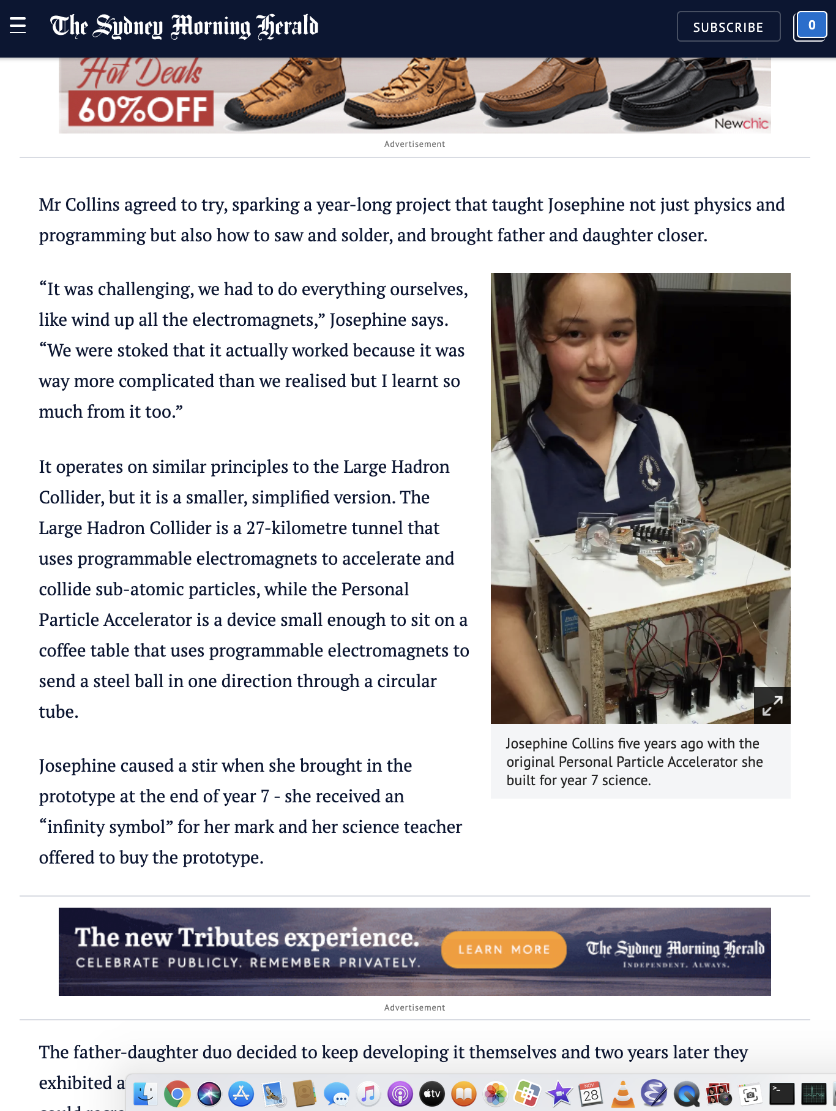
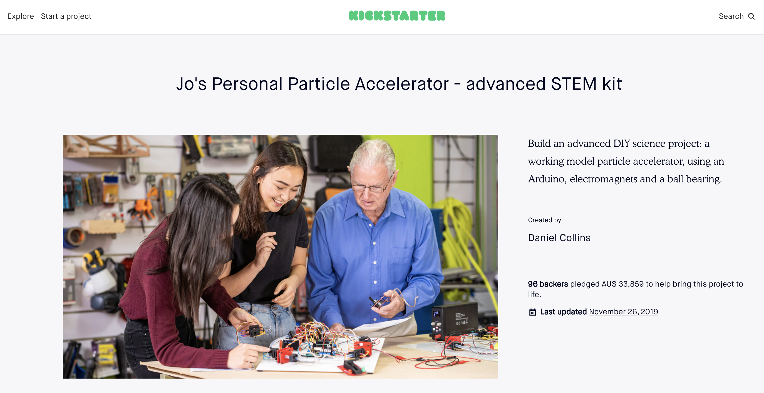
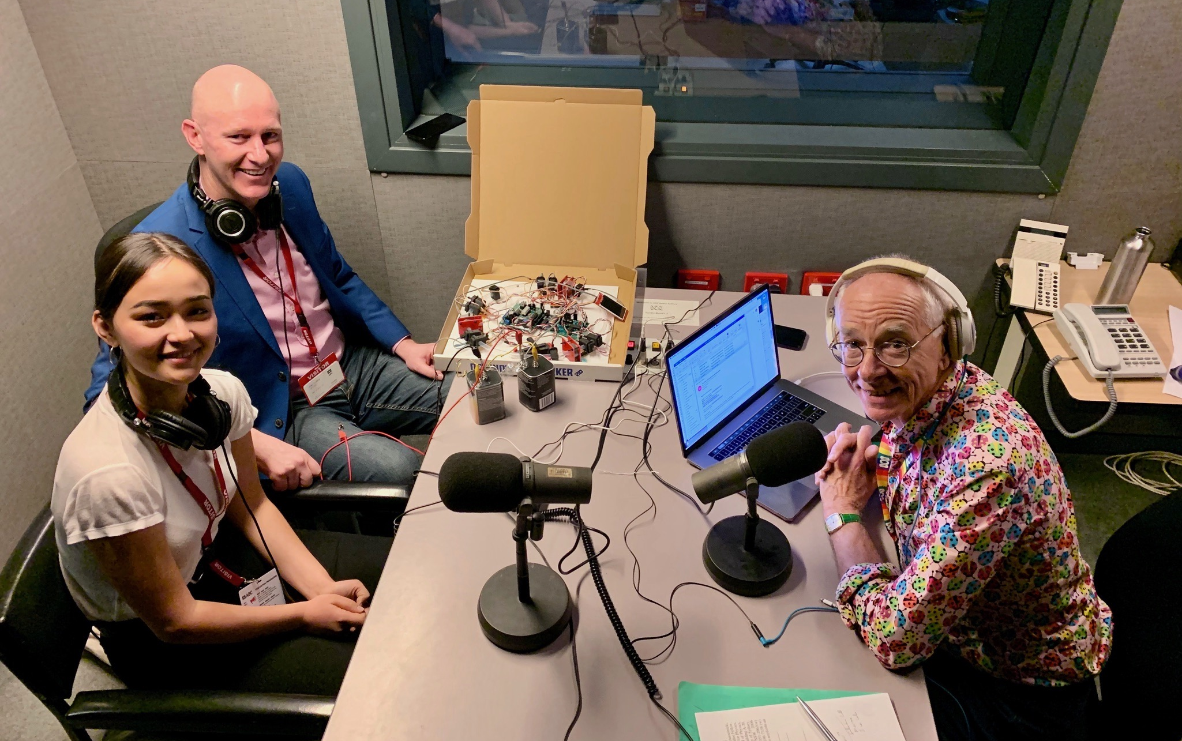
Josephine’s Personal Particle Detector

Slide 7
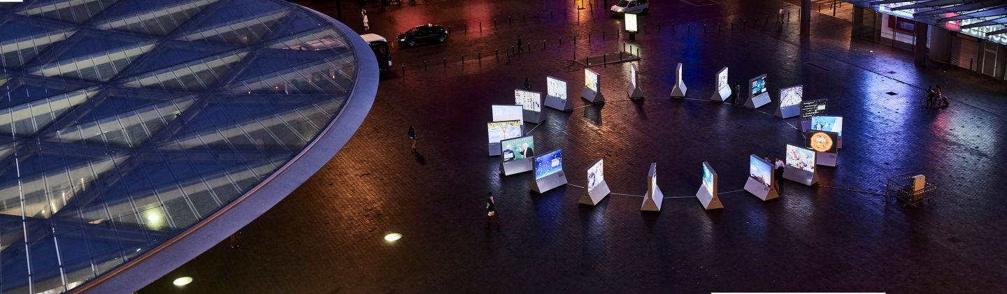
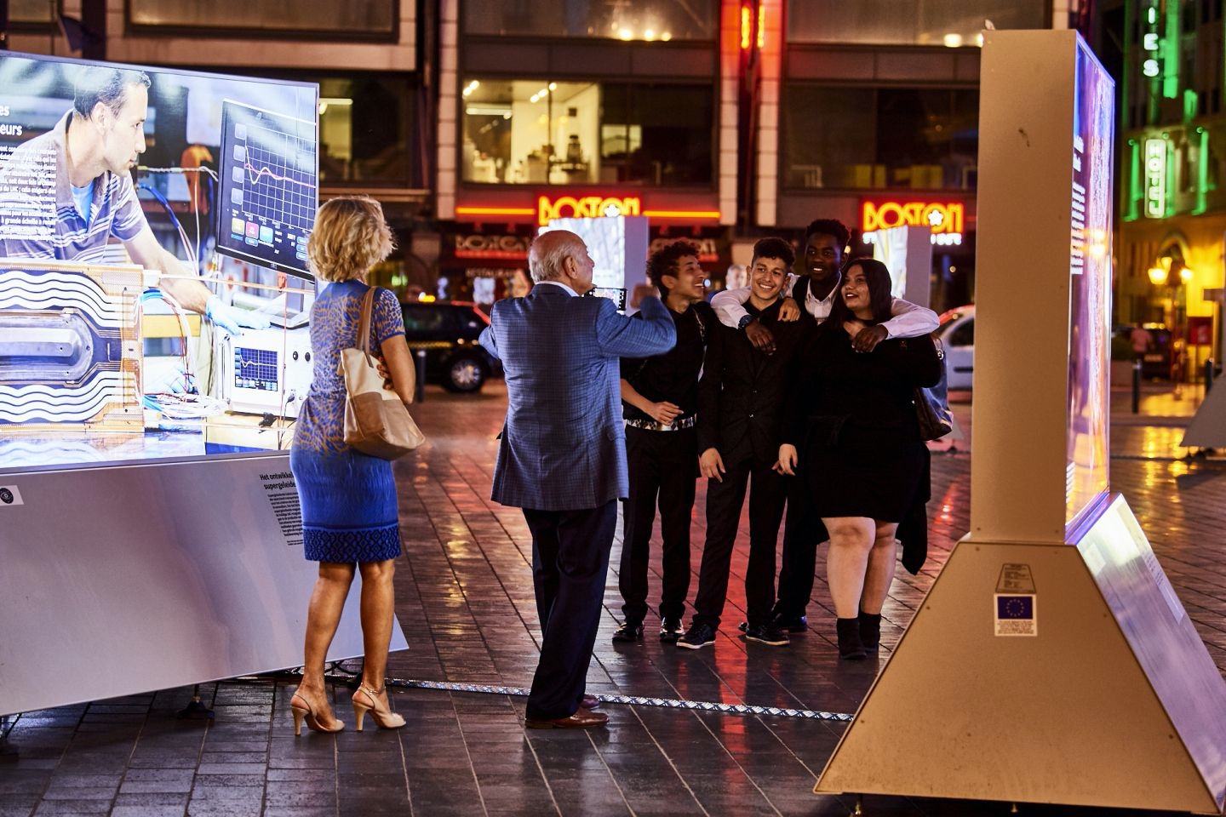
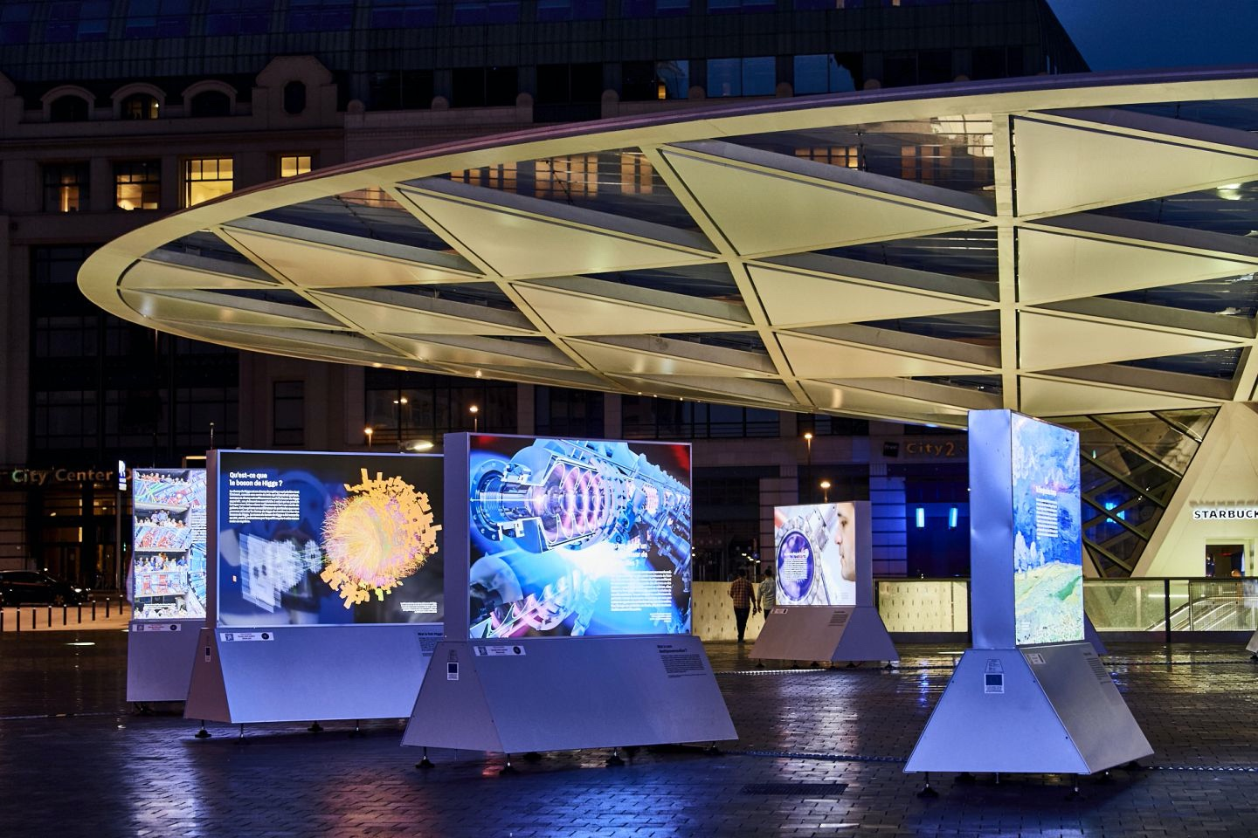
Exhibits for Post-LHC Machines
The Code of. The Universe
  A photographic travelling exhibition
  Pilot project following recommendation by CERN’s Host States
  Highlight the main physics questions, the key technologies to explore them and the societal impact (with a focus on areas covered by the FCC study)
  Co-developed with Lammerhuber editions
  Multilingual content & online website
  Cities opened so far: Vienna, Wiener Neustadt, Graz, Brussels, Grenoble coupled to conferences & public events
Questions - Future Steps
  How can we communicate about future RIs to the general public?
  Which are the topics we need to include as part of an exhibition (physics, technology, applications, socio-economic impacts)?
  How can we make exhibitions more interactive?

Slide 8
Common Themes and Thoughts
Common Themes of ORIGIN / CERN Traveling Exhibitions
  Exhibitions support local engagement, local champions
  Create points of contact to local networks
  Local organisation is essential and desired
Take Aways
  Key points IPPOG made to EPPSU 2020 (published note, discussion with WG5)
    Global support for science needs to be fostered and supported
    Post-LHC projects will require major public support
    IPPOG serves as a means to foster and optimise local involvement with global strategies
  Efforts like ORIGIN and CERN Traveling Exhibit are directly in line with these points
    Both create and support local networks of artists, scientists, educators, stakeholders
    Both promote science through excitement of current research, while embracing local culture
  There is much room for IPPOG to become involved
    We need to be involved in strategic planning
    This does not mean taking ownership, but it means securing support

