Slide 1
High Power Targets
Challenges for next-generation high-intensity neutrino beams
Kavin Ammigan
The 22nd International Workshop on Neutrinos from Accelerators (NuFact 2021)
10 September 2021

Slide 2
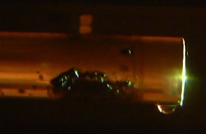
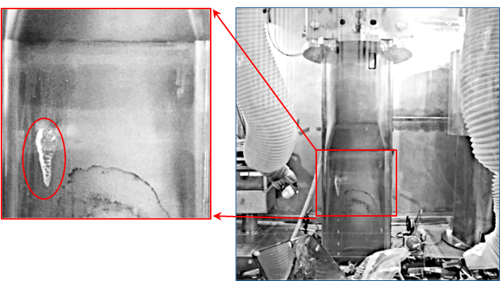
Robust High-Power Targets Critical in Maximizing the Efficiency of Neutrino Production
Recently, major accelerator facilities have been limited in beam power not by their accelerators, but by target survivability concerns
NuMI-MINOS, FNAL (2010-11)
  Reduced beam power (-10% to -40%)
  Target failures attributed to faulty welds
MLF, J-PARC (2015-16)
  Early replacement of target
  Limited to 200 kW when resuming ops
SNS, ORNL
  Reduced beam power (-15%) frequently in 2013-14
  Target vessel failures attributed to faulty welds and dynamic stresses
MINOS NT-01 target (FNAL)
SNS target vessel (ORNL)
Next-generation multi-MW accelerator target facilities present even greater challenges
LBNF DUNE 1.2-2.4 MW, Hyper-K 1.3 MW, Future neutrino facilities 4 MW+
Target R&D essential to:
Avoid compromising particle production efficiency by limiting beam parameters
Maintain reliable operation and accurately predict component lifetime

Slide 3
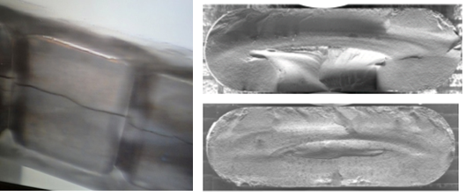
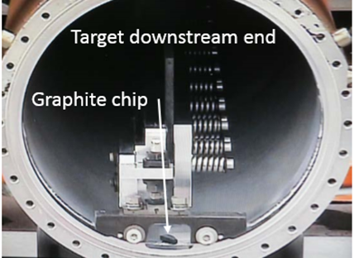
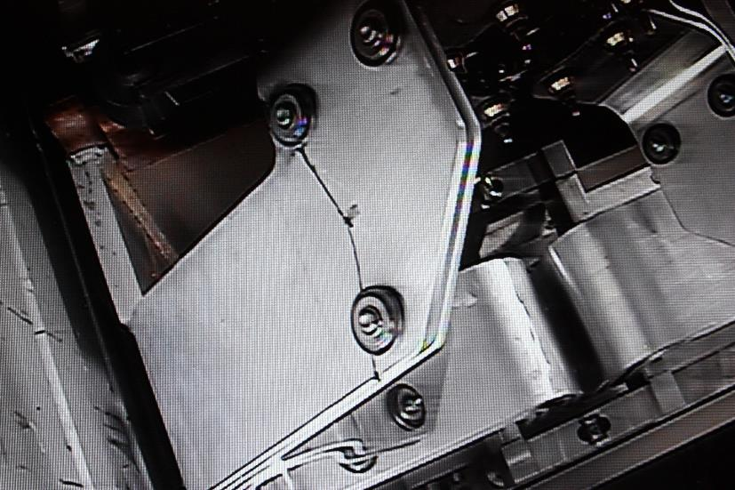
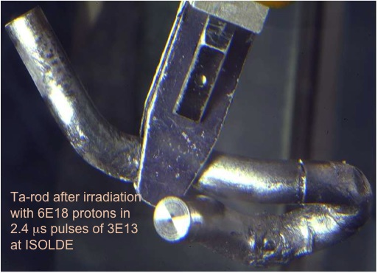
What we want to avoid…
MINOS NT-02 target failure: radiation-induced swelling (FNAL)
Be window embrittlement (FNAL)
NOvA MET-01 target fin fracture (FNAL)
MINOS NT-01 target containment water leak (FNAL)
Horn stripline fatigue failure (FNAL)
ISOLDE target (CERN)
Target containment vessel cavitation (ORNL - SNS)

Slide 4
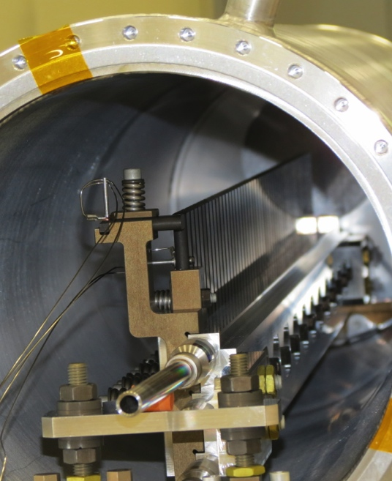
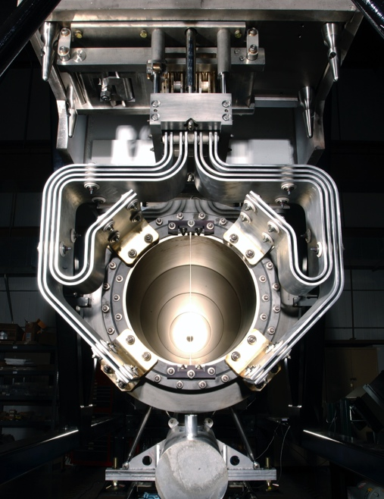
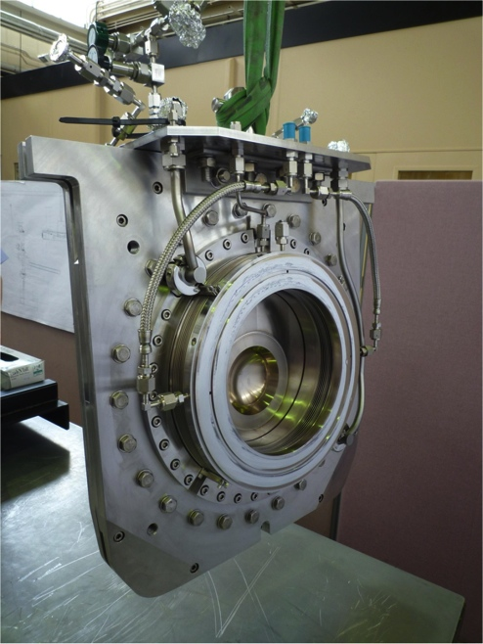
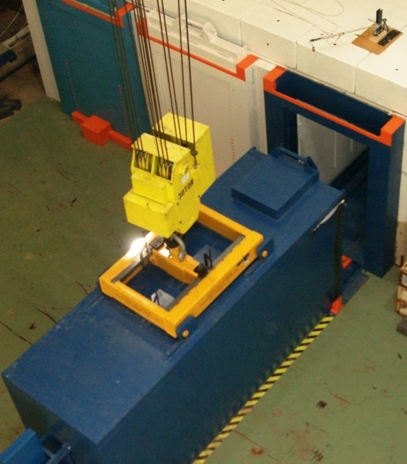
High Power Targetry Scope
Target
  Solid, Liquid, Fixed, Rotating
Facility Requirements
  Remote Handling
  Shielding & Radiation Transport
  Air Handling
  Cooling System
Other beam-intercepting devices
  Collimators
  Collection optics (horns, solenoids)
  Monitors & Instrumentation
  Beam windows
  Absorbers

Slide 5
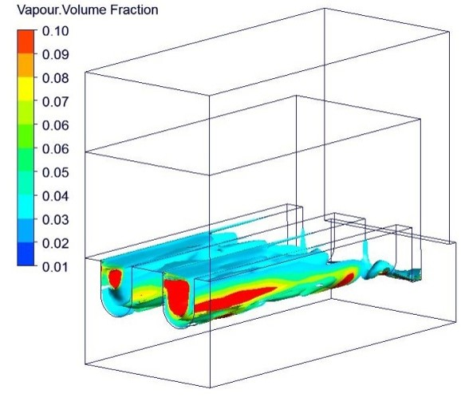
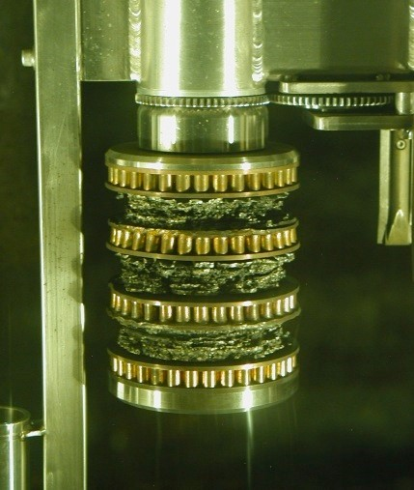
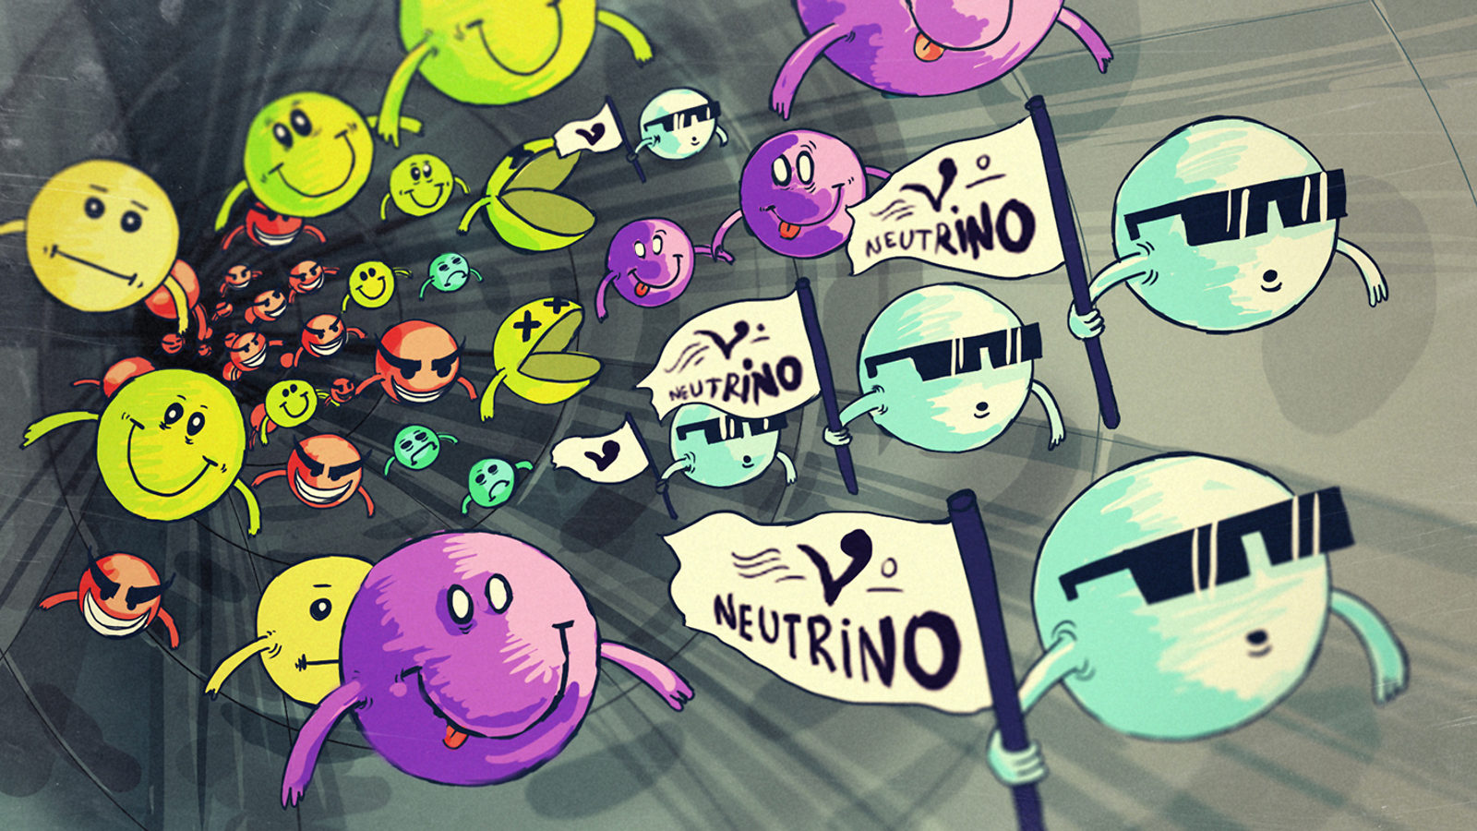
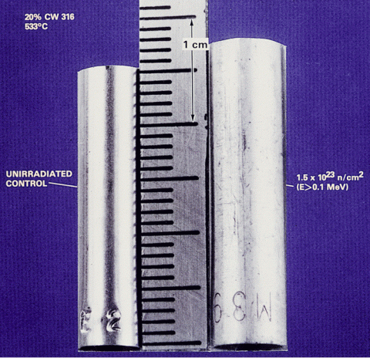
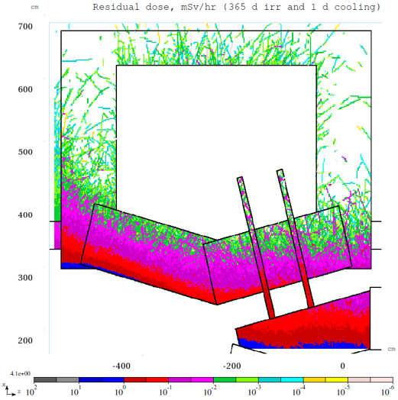
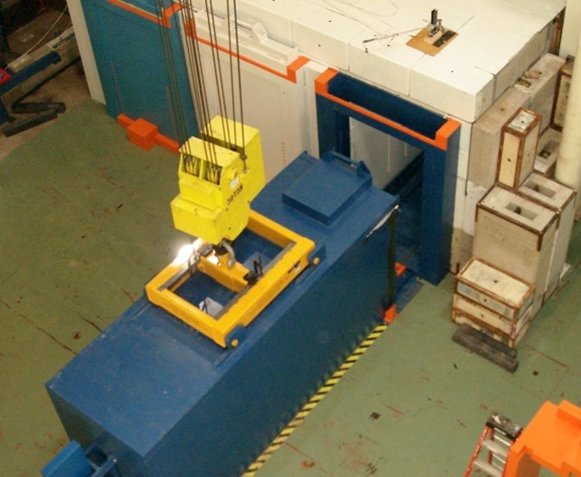
High Power/Intensity Targetry Challenges
Heat removal
Thermal shock
Thermal Shock and Radiation Damage identified as most cross-cutting challenges of high-power target facilities
Physics performance
Radiation damage
Additional neutrino beams challenges
Primary beam handling and instrumentation
Accuracy and consistency of beam inputs
Focusing elements
Beam-based alignment
Secondary beam instrumentation
Hadron production
Operational safety
Storage and disposal

Slide 6
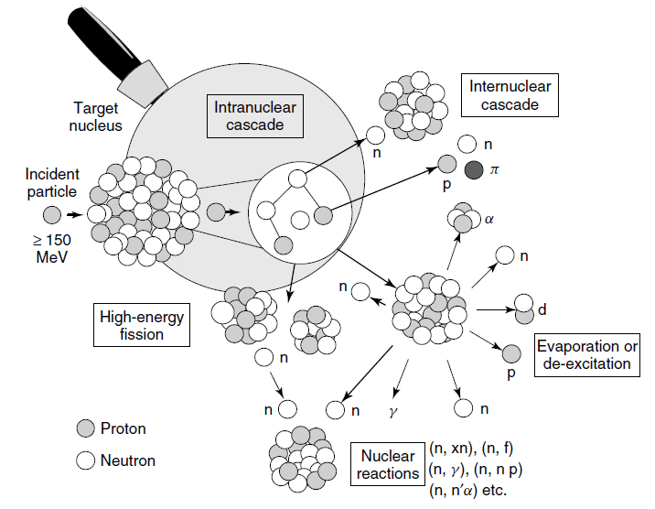
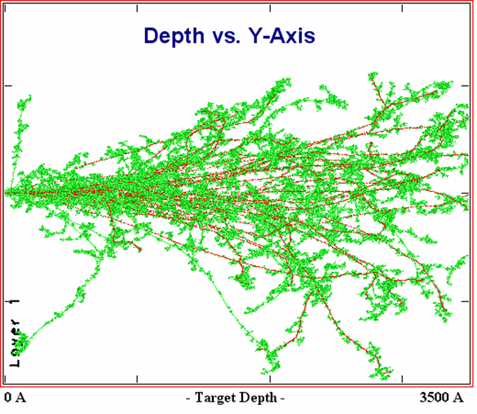
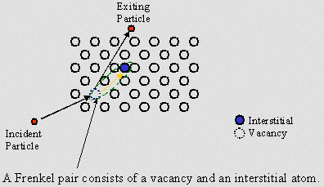
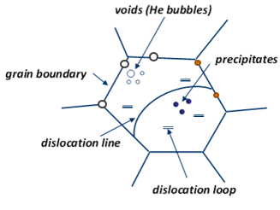
Radiation Damage in Materials
Beam-induced damage to the microstructure
Atomic displacements (cascades)
  Displacement Per Atom (DPA) = Average number of stable interstitial/vacancy pairs created
Creation and agglomeration of point defects
Segregation (precipitation) or depletion of point defect sinks
Creation of transmutation products (H and He production)
From D. Filges, F. Goldenbaum, in:, Handb. Spallation Res., Wiley-VCH Verlag GmbH & Co. KGaA, 2010, pp. 1–61.

Slide 7
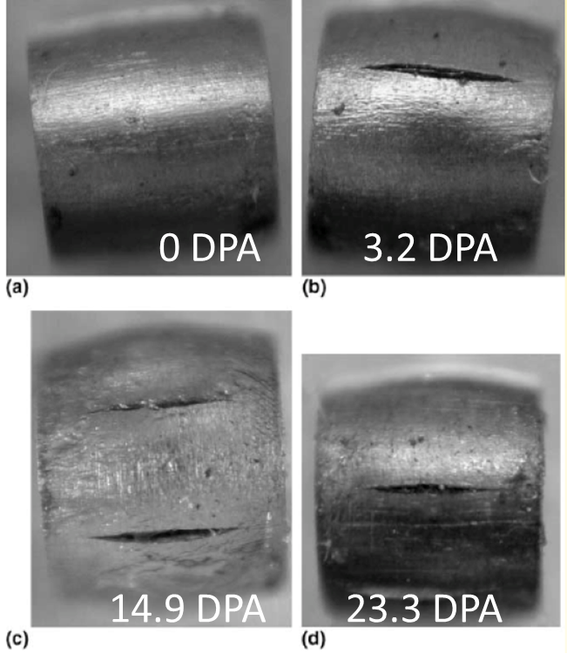
Radiation Damage Effects
Atomic displacements in crystal lattice (DPA) cause bulk property changes
  Embrittlement
  Creep
  Swelling
  Fracture toughness reduction
  Thermal/electrical conductivity reduction
  Coefficient of thermal expansion
  Modulus of Elasticity
  Accelerated corrosion
Transmutation products
  H, He gas production causes void formation and embrittlement
Radiation damage effects very dependent upon material and irradiation conditions
  Temperature, dose rate, particle energy/type
S.A. Maloy et al., J. Nuclear Materials, 343, pp. 219-226, 2005

Slide 8
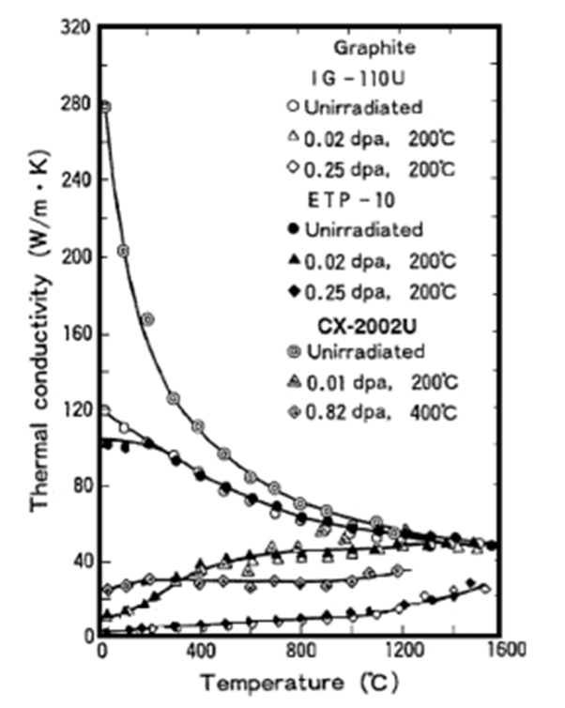

Radiation Damage Effects
Complex lattice swelling in graphite
D.L. Porter and F. A. Garner, J. Nuclear Materials, 159, p. 114 (1988)
Void swelling in 316 Stainless Steel tube exposed to reactor dose of 1.5 x 10²³ n/cm²
N. Maruyama and M. Harayama, Journal of Nuclear Materials, 195, 44-50 (1992)
Factor of 10 reduction in thermal conductivity of graphite after 0.02 DPA

Slide 9
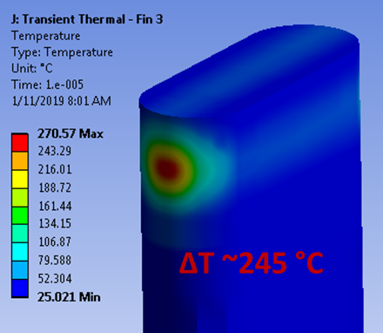
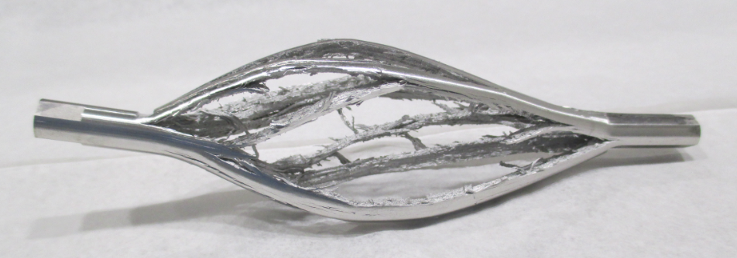
Thermal Shock Effects (stress waves)
High-intensity pulsed beam creates localized area of compressive stress, generated due to fast expansion of material surrounded by cooler material
  NuMI 1-MW graphite target: ΔT~250 K in 10 µs (2.5 x 10⁷ K/s)
Dynamic stress waves travel through the target at sonic velocities
Thermal shock can induce plastic deformation, cracking and fatigue failure
beam
Iridium target tested at CERN’s HiRadMat facility
Temperature rise during 10 µs pulse in NuMI 1-MW graphite target (FNAL)
Ta-rod after irradiation with 6 x 10¹⁸ protons in 2.4 μs pulses of 3 x 10¹³ at ISOLDE (photo: J. Lettry)

Slide 10
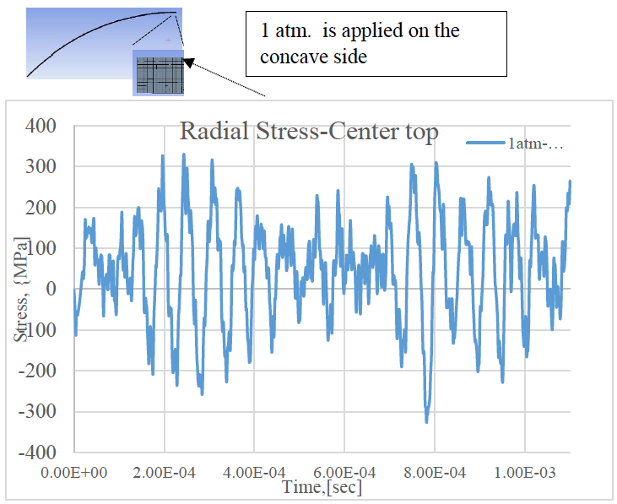
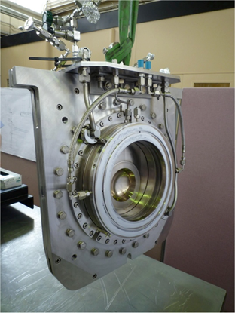
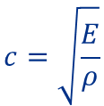

Stress Wave Example: T2K Window
T2K Titanium beam window
Material response depends on:
Specific heat (temperature jump)
Coefficient of thermal expansion (strain)
Modulus of elasticity (stress)
Flow stress behavior (plastic deformation)
Strength limits (yield, fatigue, fracture toughness)
$$σ=\sqrt{ρE}∙α∙L∙\frac{∆T}{∆t}$$
Initial stress wave amplitude
Cyclic stress loading environment can lead to fatigue failure
Heavy dependence on material properties
  But material properties dependent upon radiation damage
$$c=\sqrt{\frac{E}{ρ}}$$
Elastic wave speed

Slide 11
Radiation Damage Data
Use of data from nuclear materials research is limited and cannot be directly utilized
Effects from low-energy neutron irradiations do not equal effects from high-energy proton irradiations
n
1-14 MeV
p
100+ MeV
Irradiation Source | DPA rate (DPA/s) | He gas production (appm/DPA) | Irradiation Temp (˚C)
Mixed spectrum fission reactor | 3 x 10⁻⁷ | 1 x 10⁻¹ | 200-600
Fusion reactor | 1 x 10⁻⁶ | 1 x 10¹ | 400-1000
High energy proton beam | 6 x 10⁻³ | 1 x 10³ | 100-800

Slide 12
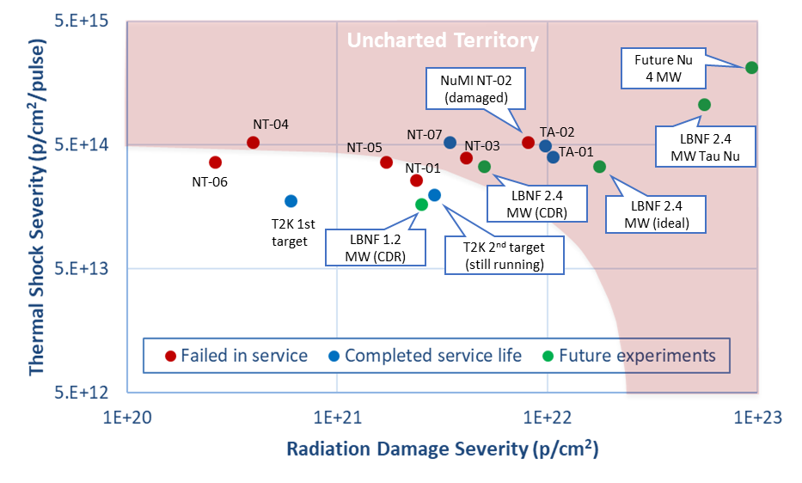
Neutrino HPT R&D Materials Exploratory Map
~10x increase in accumulated proton fluence expected in future multi-MW facilities

Slide 13

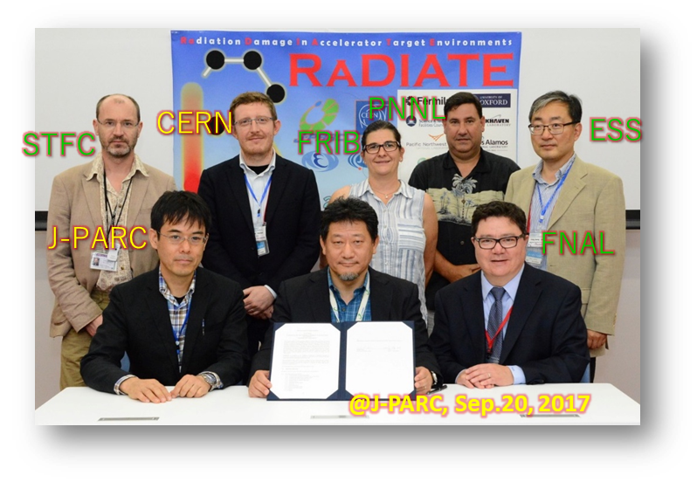











R a D I A T E Collaboration
Radiation Damage In Accelerator Target Environments
Objective:
Harness existing expertise in nuclear materials and accelerator targets
Generate new and useful materials data for application within the accelerator and fission/fusion communities
Activities include:
Analysis of materials taken from existing beamline as well as new irradiations of candidate target materials at low and high energy beam facilities
In-beam thermal shock experiments
radiate.fnal.gov
Program manager: Dr. Frederique Pellemoine (FNAL)

Slide 14
High Power Target Materials R&D
Examine targets and beam window materials behavior under prototypic multi-MW proton beam conditions
Benefits to multi-MW targets
Alloy/grade and heat treatment choice
Identify novel candidate materials
Cooling system design and operating temperature
Tolerable beam intensities
Expected lifetimes
Graphite (target core) studies:
  Beam-induced swelling and fracture studies
  High-dose ion irradiation of graphite
Beryllium (beam window) studies:
  NuMI beam window analysis & Helium ion implantation
  Post-irradiation examination of BLIP-irradiated specimens
  In-beam thermal shock testing at CERN’s HiRadMat facility
Titanium (beam window) studies:
  Tensile testing of BLIP-irradiated specimens
  Low-energy ion irradiation and nano-indentation
  World first high-cycle fatigue testing of irradiated titanium at FNAL
Novel materials studies:
  Electro-spun nanofibers, high-entropy alloys, metal foams, MoGr, highly-ductile TFGR tungsten

Slide 15
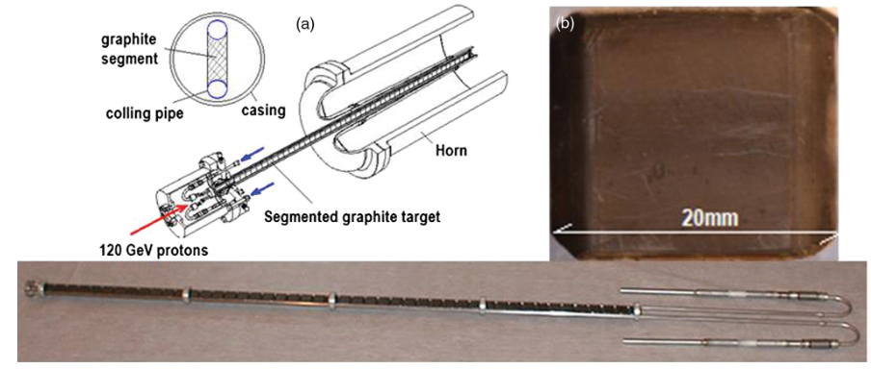
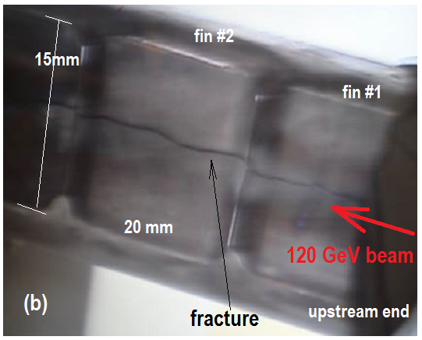
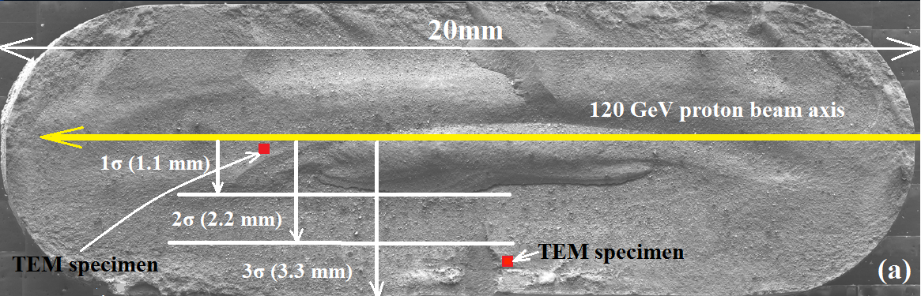
Analysis of Fractured NuMI Target Fin
NuMI target (NT-02) autopsy and examination
Peak fluence: 8 x 10²¹ p/cm²
Beam energy: 120 GeV
Spill duration: 10 µs, 4 x 10¹³ protons/pulse
Duty cycle: 1.87 s
Estimated peak DPA: 0.63
y
Detailed PIE at PNNL
z
Bulk swelling of ~4%

Slide 16
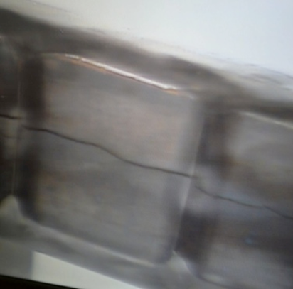
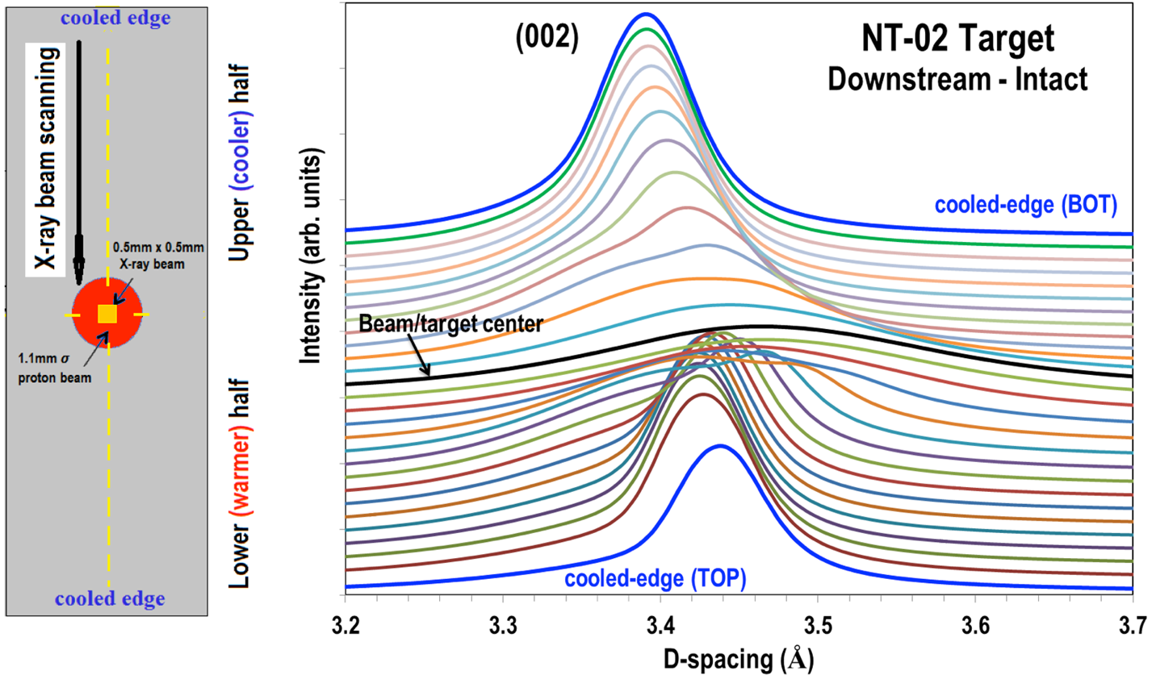
X-Ray Diffraction of NuMI Graphite Fin at NSLS-II
XRD shows lattice growth and amorphization at the beam center
Irradiation temperature ~60 °C (330 °C during pulse)
N. Simos et al., PRAB, 22 (2019)

Slide 17
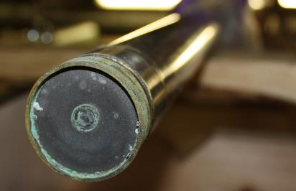
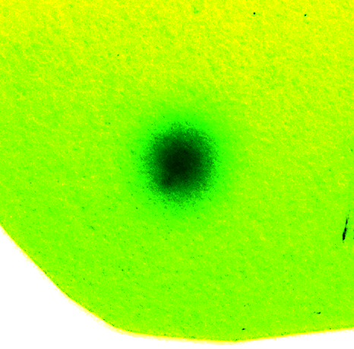
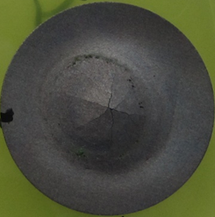
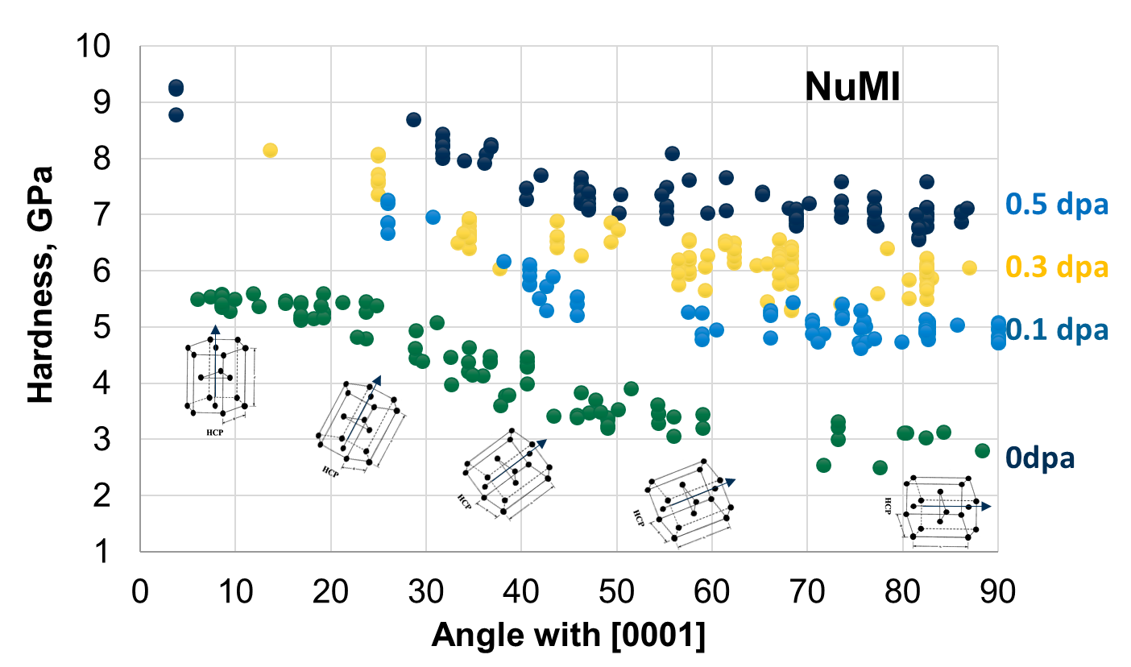
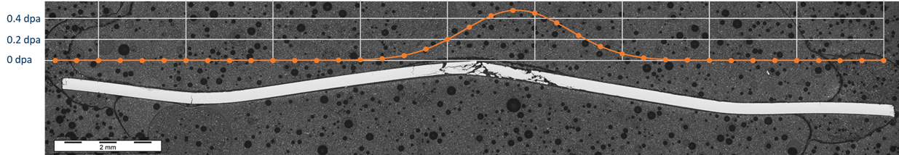
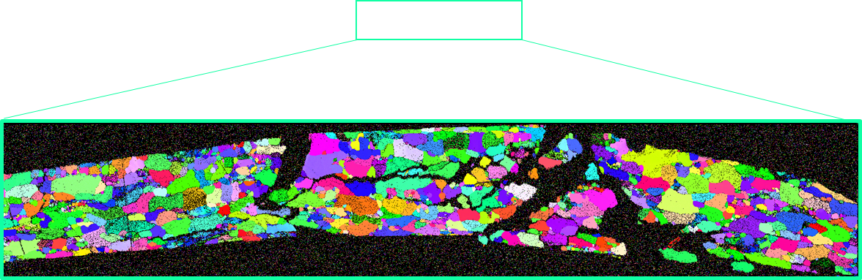
NuMI Beryllium Window Analysis
120 GeV proton beam
1.54 x 10²¹ POT (0.5 peak DPA)
T ~ 50 ⸰C
19 mm
Observed transition from transgranular fracture to grain boundary/mixed mode fracture in irradiated Be
Significant hardening even at 0.1 DPA
Hardness of irradiated Be less anisotropic
Increased hardness means less ductility (more brittle)
V.Kuksenko et al. J. Nuclear Materials, 490, pp.260-271 (2017)

Slide 18

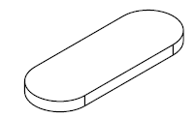
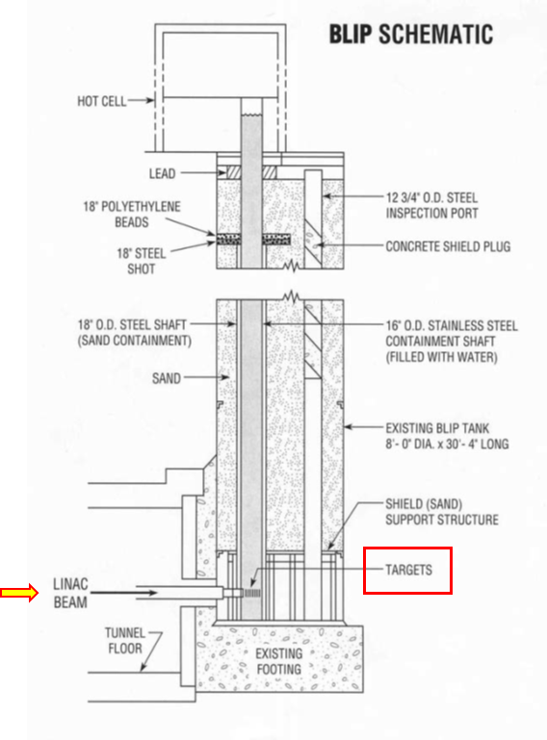
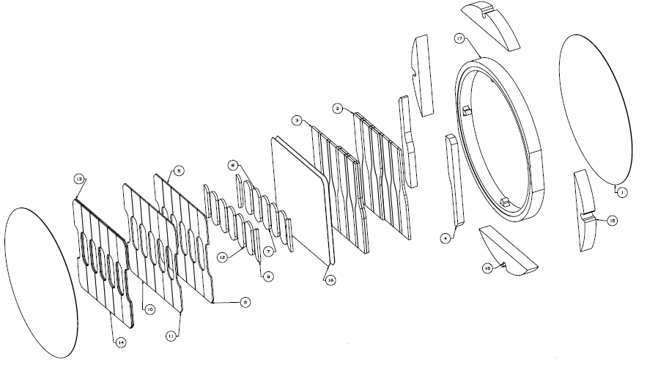
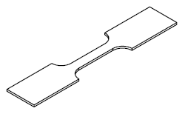
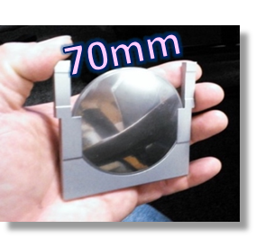
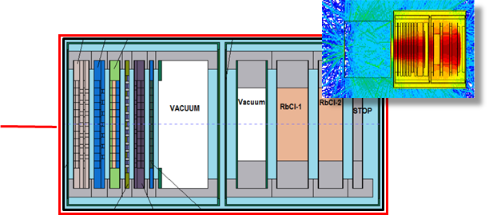
High Energy Proton Irradiation at BNL’s BLIP Facility
Unique facility for material irradiation in tandem with medical isotope production
High energy protons: 66 – 200 MeV with 165 µA peak current
Microstructural analysis specimens
Fatigue specimens
    RaDIATE multi-material irradiation campaign
    181 MeV p irradiation for 8 weeks
      Over 200 specimens from 6 RaDIATE collaborators
    Participants: BNL, PNNL, FRIB, ESS, CERN, J-PARC, STFC, Oxford, FNAL
    Completed irradiation in 2018
      4.5 x 10²¹ accumulated protons on target
      Peak DPA: 0.95 (Ti alloy)
    Post-Irradiation Examination ongoing
      Mechanical/Thermal testing
      Microstructural analysis
Tensile specimens
Will benefit many facilities including LBNF, T2K, BDF at CERN, FRIB, and HL-LHC collimators
Material targets
Isotope targets

Slide 19
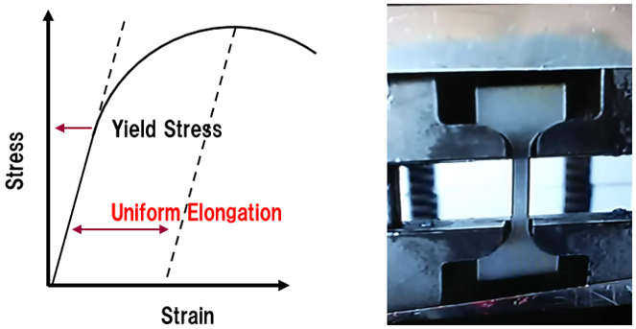
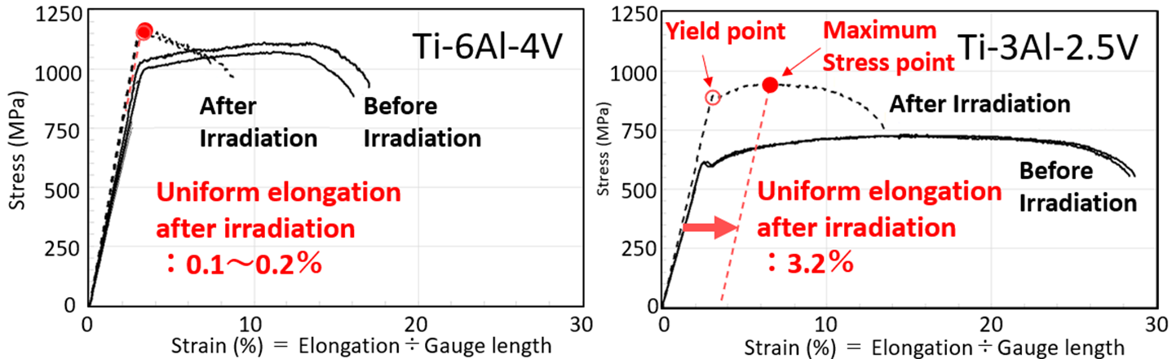
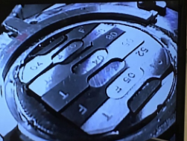
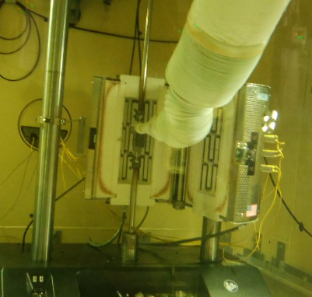
BLIP Ti Alloy Tensile Testing
Stress-strain curves for Ti-6Al-4V (left) and Ti-3Al-2.5V (right)
Ti-6Al-4V loses almost all of its uniform elongation (UE) after irradiation
  Important to retain UE in a target material as it allows for plastic deformation without rapid growth of cracks and sudden failure
Evidence that Ti-3Al-2.5V alloy is more radiation-tolerant
Testing done in hot cell

Slide 20






High-Cycle Fatigue Testing of Irradiated Ti Alloys
Ultrasonic mesoscale Fatigue Rig (UFR) at the UKAEA-MRF
Extraction of meso-fatigue foil from BLIP capsule in PNNL hot cell
Reduced fatigue strength
20 kHz = 10⁸ cycles in 1.5 h
3rd Generation Fatigue Testing Machine (FTM) under development
BLIP 2017-2018 Ti foils have been shipped from PNNL to MRF for testing over the coming months

Slide 21





Low-Energy Ion Irradiation
Alternative method to mimic high-energy proton-induced radiation damage
High damage (DPA) accumulation in short time (without activation)
Shallow damage depth (use of micro-mechanics and meso-scale testing)
Dual/Triple beams irradiation needed to reproduce transmutation gas production
Michigan Ion Beam Laboratory
Graphite irradiation with 4.5 MeV He⁺⁺ ions
A. Burleigh and Prof. J. Terry (IIT)
TEM: e- diffraction shows increase in d-spacing and decrease in a-spacing, similar to failed NT-02 target
AFM measurements show bulk swelling of ~3.8 µm in the irradiated region

Slide 22



Helium Implantation in Beryllium
Hardness of He-ion irradiated vs. non-irradiated Be samples
3 µm damage layer
T_{irrad}: 50 and 200 ⸰C
0.1 DPA, 2000 appm He
Irradiated
He implantation peaks
Helium produced at high rates in Be with high energy proton beams (~3000 appm/DPA)
At low temperatures, He atoms do not diffuse while at high temperatures, He atoms become mobile and can fill vacancy clusters to form damaging He bubbles
He bubbles observed in NuMI Be window after annealing at 360 °C
However, higher temperatures are generally desired to anneal displacement damage (see hardness plot above)
S. Kuksenko, RaDIATE Collaboration Meeting, 2019

Slide 23









Thermal Shock Experiments at CERN’s HiRadMat Facility
HRMT24 – BeGrid (2015)
HRMT43 - BeGrid2 (2018)
Observed distinctive thermal shock response for various beryllium grades
  2.8E13 ppp, σ: 0.3 x 0.28 mm
Detected plastic strain ratcheting from multiple beam pulses
Successful validation of Be S200FH Johnson-Cook strength model
First and unique test with pre-irradiated material specimens (Be, C, Ti, Si)
  3.5E13 ppp, σ: 0.27 x 0.22 mm
First test on nanofiber electro-spun fiber mats and metal foam (SiC, ZrO, Al₂O₃)
Dynamic online measurements of graphite cylinders
Profilometry to measure plastic out-of-plane deformations
Online measurements and benchmarking of graphite cylinders
Confidence in modeling beam-induced thermomechanical response
LDV radial displacement
Johnson-Cook model validation
$$σ_{Y}=\left[A+B(ε_{eff}^{p})^{n}\right]\left[1+Cln{\dot{ε}}^{∗}\right]\left[1−T_{H}^{m}\right]$$
Sigraflex specimens
Numerical simulation benchmarking in progress
Profilometry and PIE work ongoing at UKAEA MRF, UK
Damage observed in Sigraflex (LHC dump material) prompted further investigation
F. Nuiry, CERN
K. Ammigan et al., Phys. Rev. Accel. Beams 22, 044501.

Slide 24






Novel Targetry Materials: Electrospun Nanofibers and HEAs
    Nanofiber electro-spinning at Fermilab
    Nanofiber continuum is discretized at the microscale to allow fibers to absorb and dampen thermal shock, and discontinuity prevents stress wave propagation
    Evidence of radiation damage resistance due to nanopolycrystalline structure of the material
    High-Entropy Alloy (HEA) development at UW-M
    Alloys consisting of 3 or more principal elements
    Excellent inherent properties including enhanced radiation damage resistance
Electrostatically driven electrospinning process
(a)
(b)
(a) Conventional alloy, (b) High-entropy alloy (Miracle & Senkov, 2016)
Electro-spinning set-up at Fermilab
SEM image of Zirconia nanofibers
Reduction in irradiation-induced void distribution in nickel and multi-component HEAs after 3-MeV Ni+ ion irradiation at 773 K
Lu, 2016

Slide 25
Ongoing and Future Target R&D Activities
Complete PIE of BLIP irradiated materials and HiRadMat specimens
Execute the next HiRadMat experiment in 2022 and ensuing PIE and data analysis
Ion irradiation studies to correlate with HE-proton (at higher doses and elevated temperatures at MIBL and IRRSUD facility)
Plan next multi-material HE-proton irradiation within the RaDIATE collaboration framework
Develop more effective and alternative testing methods to reduce cost and duration of R&D cycles
  Low-energy ion and electron beam for irradiations, pulsed electron beam for fatigue and thermal shock studies)
Radiation damage modeling: Ab initio and molecular dynamics material modeling (UW-M, PNNL)
Develop and qualify novel materials for next-generation target facilities (HEAs, nanofibers, etc.)
Explore novel targetry concepts: flowing powder, pebble bed, He-cooled spherical array targets

Slide 26
Summary
Future neutrino beams present critical target facility challenges
  Understanding material behavior under intense multi-MW beams is high priority
  Radiation damage effects from lattice disruptions and gas transmutations
  Beam-induced thermal shock limit of materials
Materials R&D essential to help design robust targetry components and maximize primary beam power on target and secondary particle production
  Globally coordinated R&D activities are producing useful results
  Alternative testing methods essential to support R&D program
  Several novel target concepts and materials are being explored and developed

Slide 27

Thank you

Slide 28
Supplemental Slides

Slide 29

Neutrinos at the Main Injector (NuMI beam)
Target station able to operate with 1-MW proton beam since FY21
Main injector proton beam (120 GeV/c) smashes into a 1.2 m long graphite target to create charged pions and kaon.
The pions are focused by magnetic horns and decay into muons and muon neutrinos in a 700-m long decay pipe, allowing time for pions of various momenta to decay and produce the desired neutrinos.
Beam detectors downstream of the decay pipe monitor the neutrinos produced and residual charged particles for the experiments.

Slide 30




Neutrino target – MINOS (400 kW)
Helium atmosphere
Beryllium windows
Water cooled graphite core

Slide 31



Neutrino target – NOvA AIP (0.7 – 1 MW)
Helium atmosphere
Beryllium windows
Water cooled aluminum pressing plates
Graphite core

Slide 32



Future Neutrino Target – LBNF-DUNE (1.2 – 2.4 MW)
Conceptual 1.2 MW target design
Helium atmosphere
Titanium target containment windows
Helium gas cooled graphite core

