Slide 2
ESS Accelerator Status and Commissioning Plans
PRESENTED BY Natalia Milas

Slide 3
Agenda
1 The ESS project
2 Current Schedule
3 Current Status of the ESS Accelerator
4 Commissioning plans for the NCL
5 SCL installation and plans
6 Beyond the Accelerator Commissioning

Slide 4
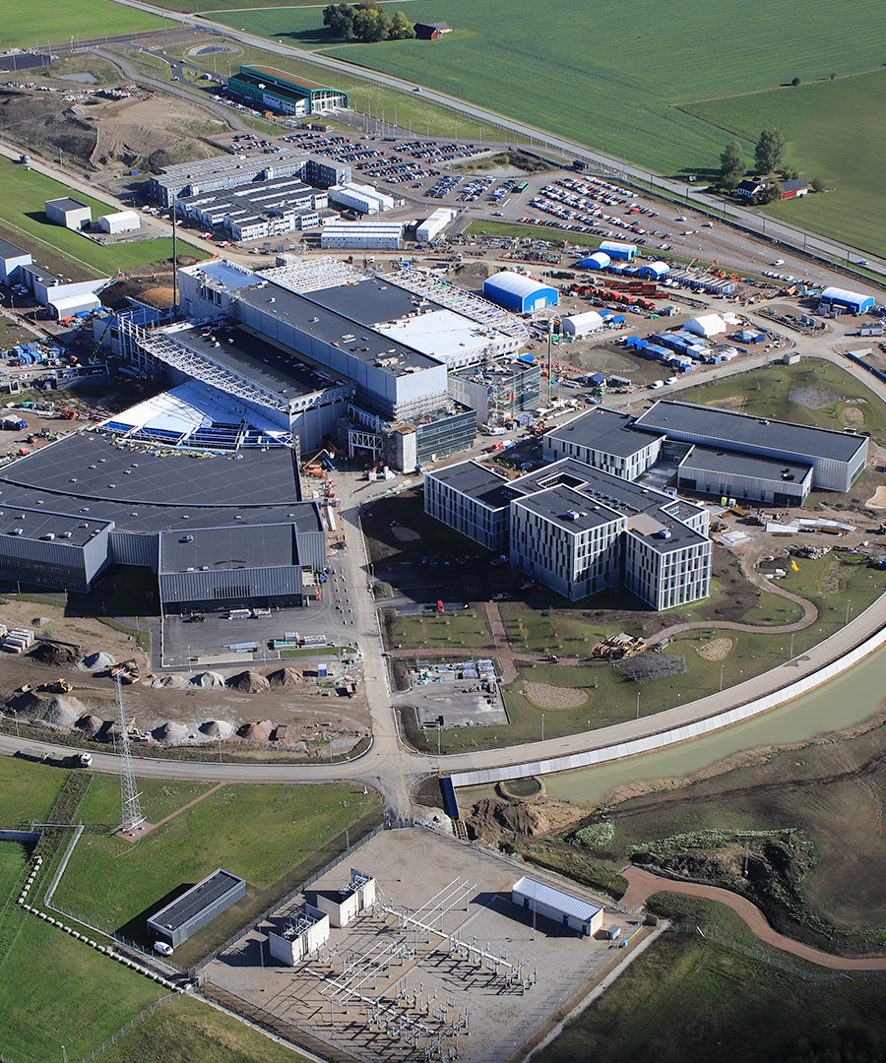
1
The ESS Project

Slide 5
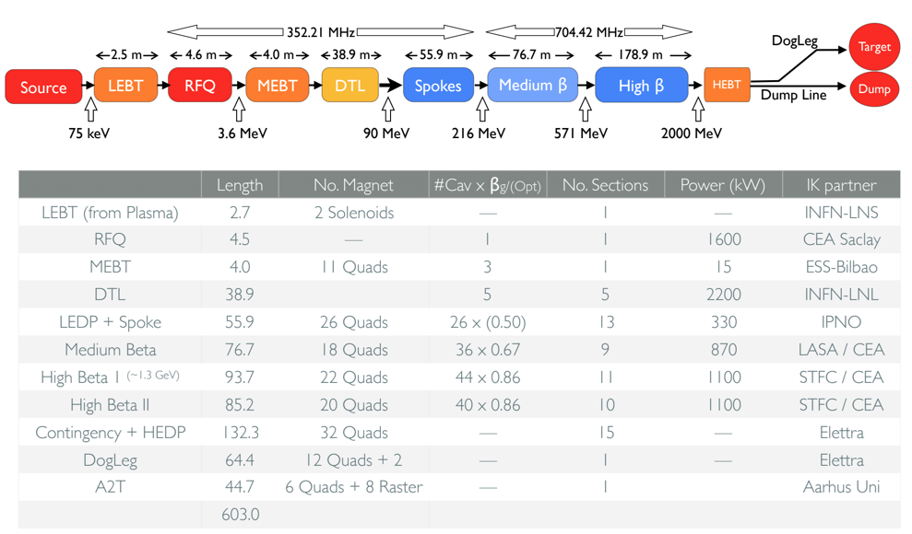
The ESS Project
Courtesy: M. Eshraqi

Slide 6
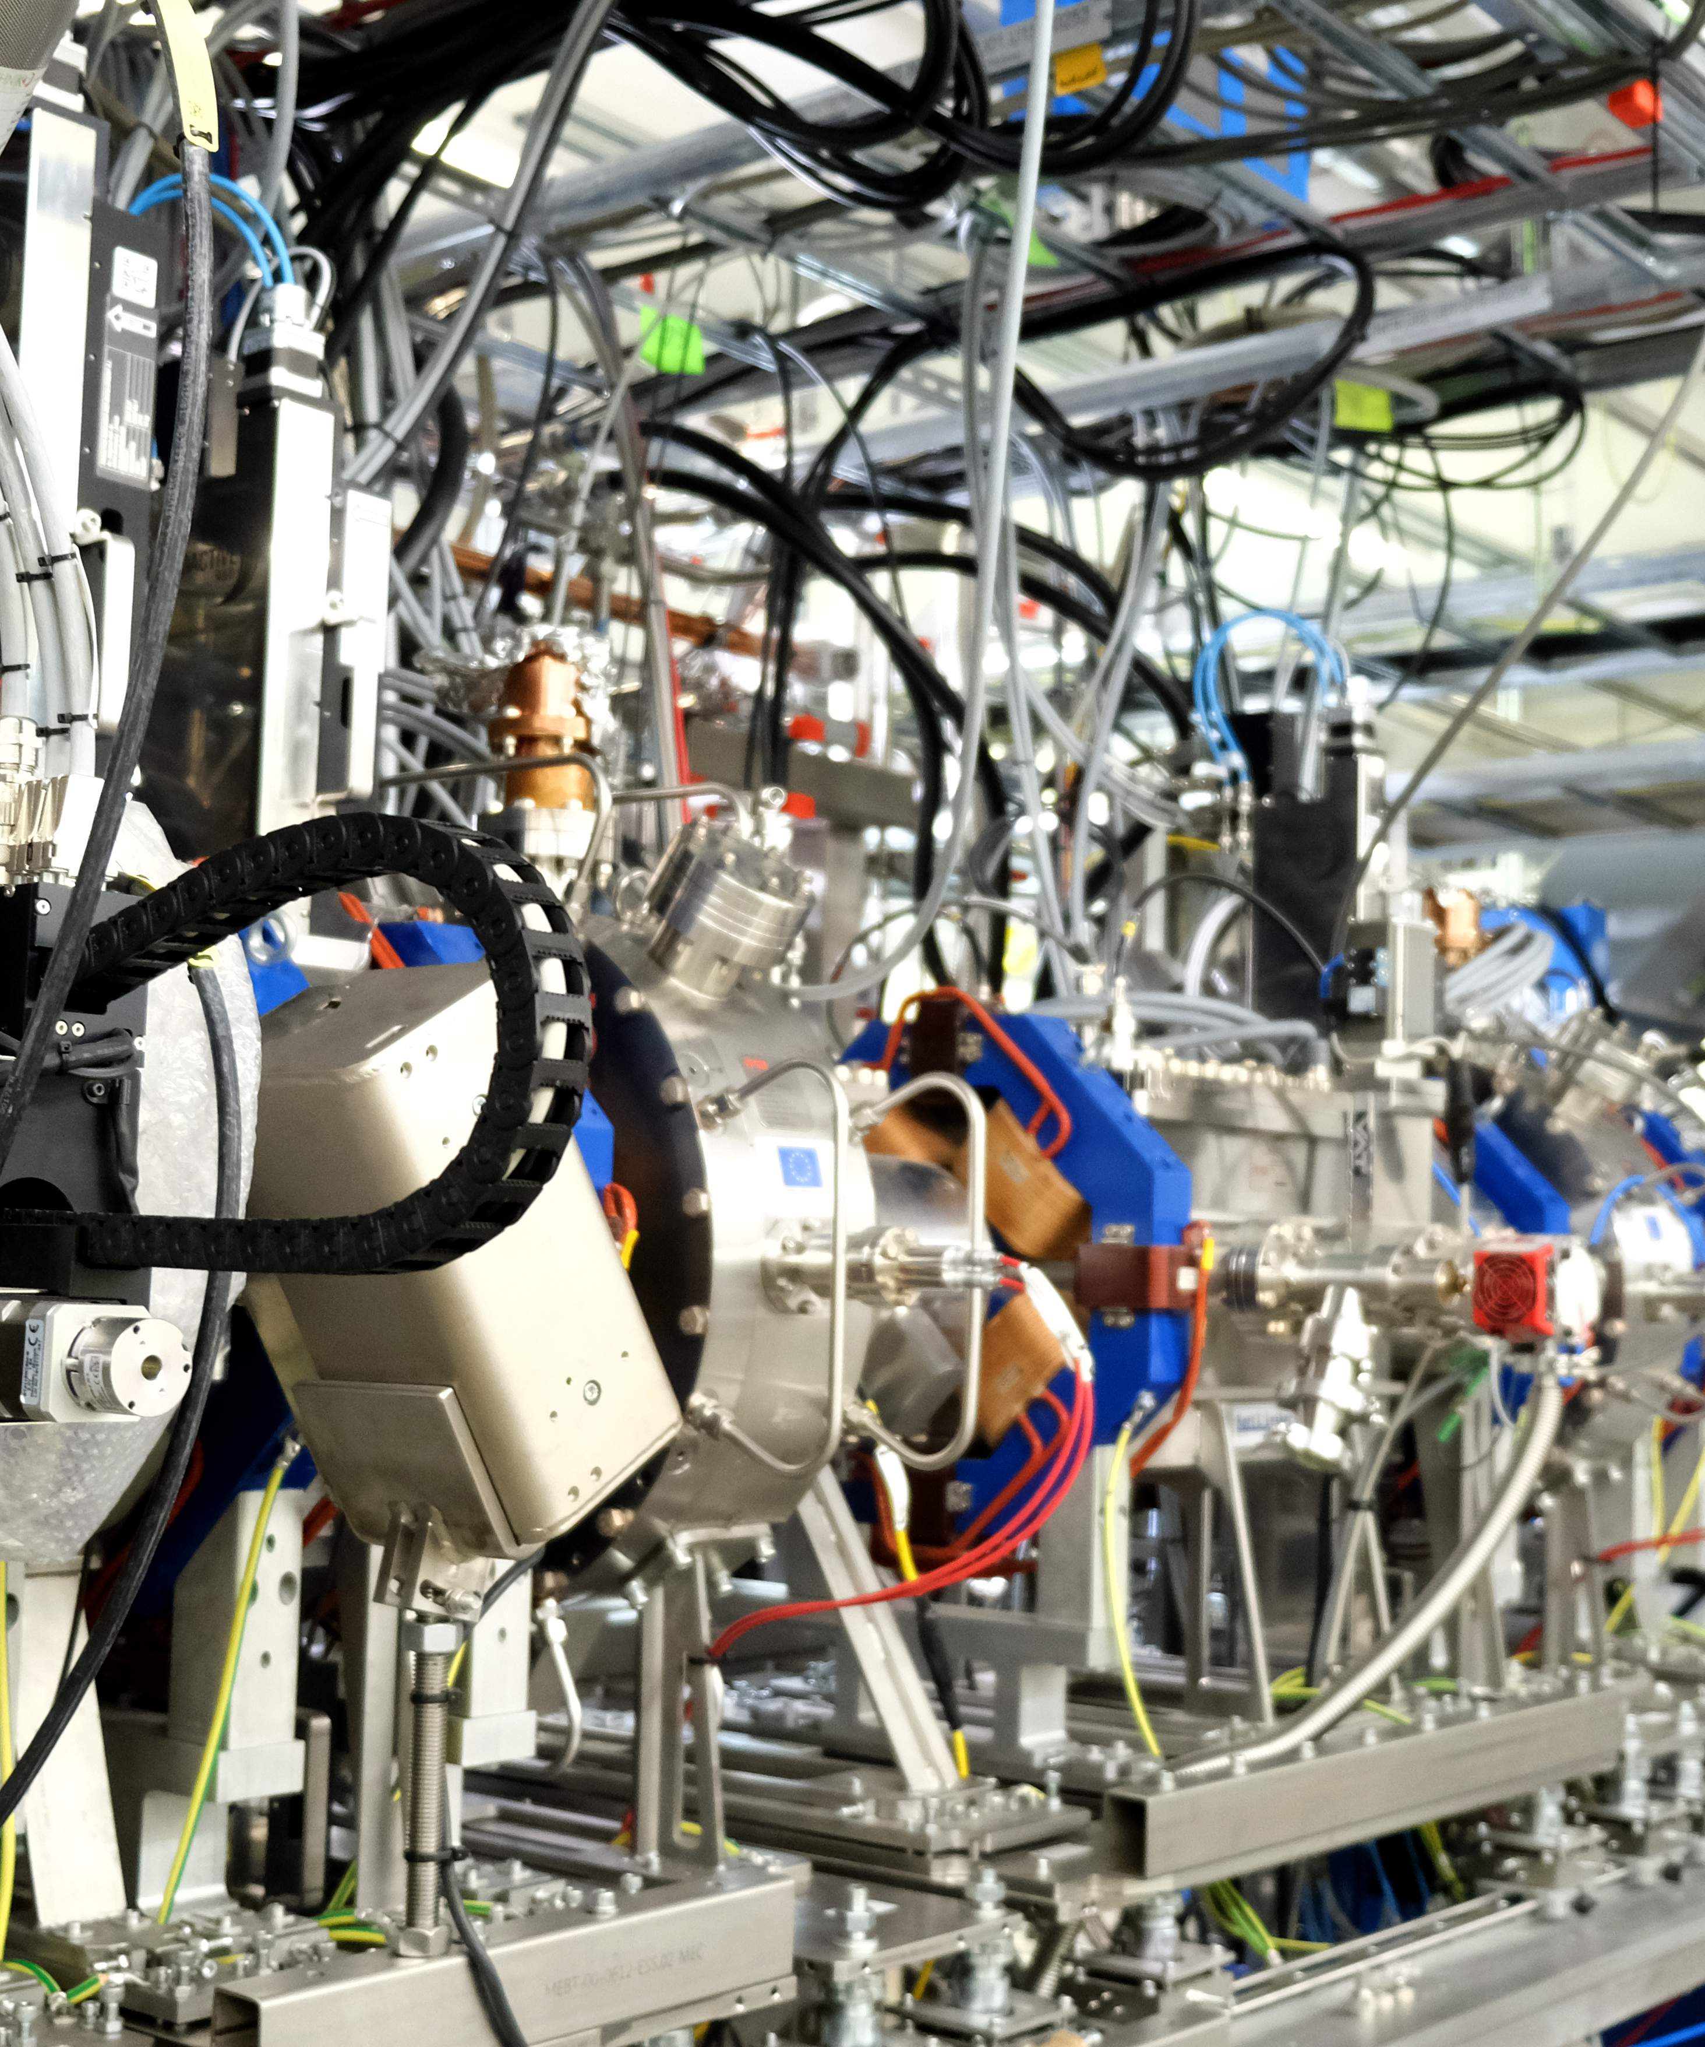
2
Current Schedule

Slide 7
Schedule
NCL and beyond
  NCL installation in ongoing at the moment. Next step is the DTLs installations.
  Cryo distribution line for MB and HB is done. Spokes underway.
  TS2 and Freya are measuring the Elliptical and Spokes cavities.
  Cryo plant, LWU and PRL all installed and tested. RF distribution line is also completed.
SRR2A
SRR2B
SRR3
2021
Today
Sep 7 '21
Feb 16 '22
Oct 14 '22
2022
2023
2021
Apr
Jun
Aug
Oct
Dec
Feb
Apr
Jun
Aug
Oct
Dec
Feb
2023
RFQ Conditioning
Jun 9 '21 - Jul 30 '21
Beam Commissioning (ISrc to MEBT FC)
Sep 20 '21 - Nov 19 '21
MEBT Bunchers Conditioning
Feb 2 '22 - Mar 1 '22
DTL1 Conditioning
Feb 2 '22 - Mar 1 '22
Beam Commissioning (ISrc to DTL1 FC)
Mar 2 '22 - Apr 12 '22
DTL2 Conditioning
Aug 19 '22 - Oct 6 '22
DTL3 Conditioning
Aug 26 '22 - Oct 13 '22
DTL4 Conditioning
Aug 22 '22 - Oct 7 '22
Beam Commissioning (ISrc to DTL4)
Oct 28 '22 - Feb 6 '23
Courtesy: C. Plostinar

Slide 8
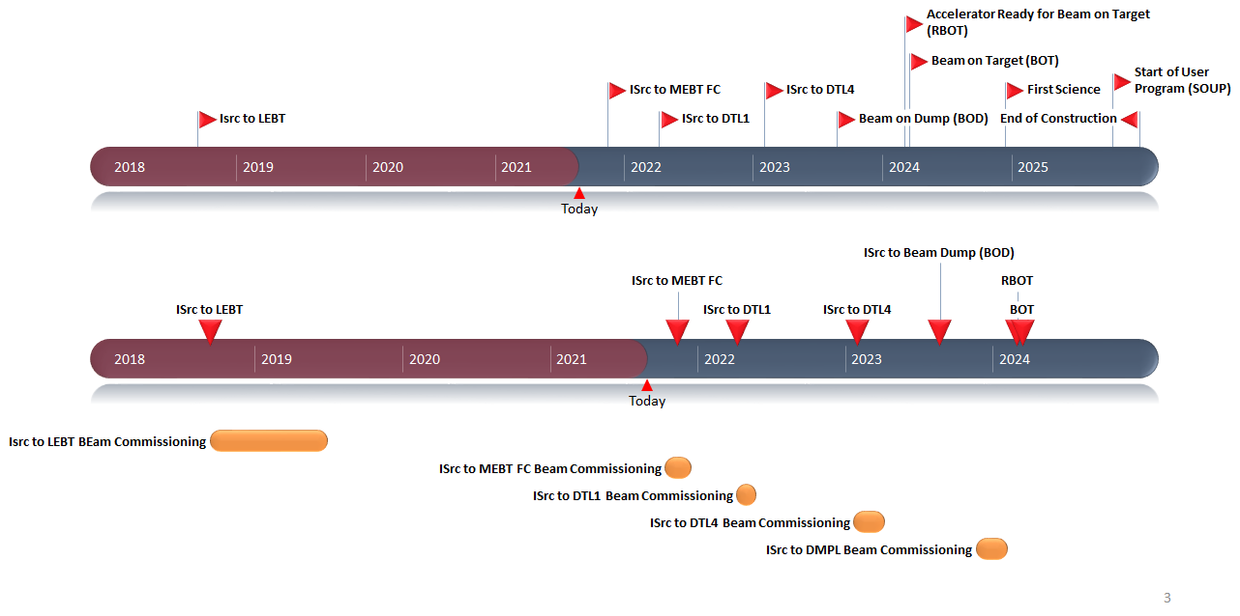
Overall Schedule
Latest Schedule

Slide 9
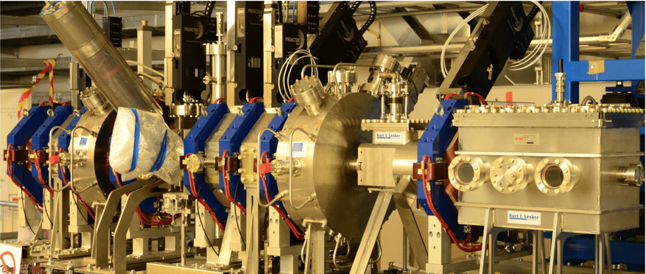
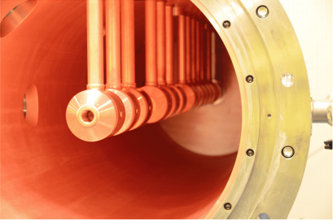
3
Current Status of the ESS Accelerator

Slide 10
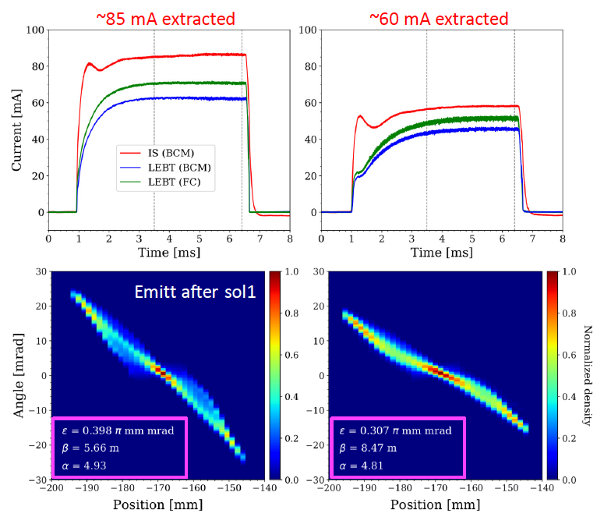
Normal Conducting Linac
Ion Source and LEBT Commissioning (2018-2019)
  Source and LEBT were commissioning between 2018 and 2019
  Source proved to be very flexible.
  We suspect the beam is coming out with a larger divergence than expected from simulations (still to be verified)
  Emittance is a bit higher than the design as well.
  Still some equipment left to be tested a commissioning at this next round (2021): iris and new chopper.

Slide 11
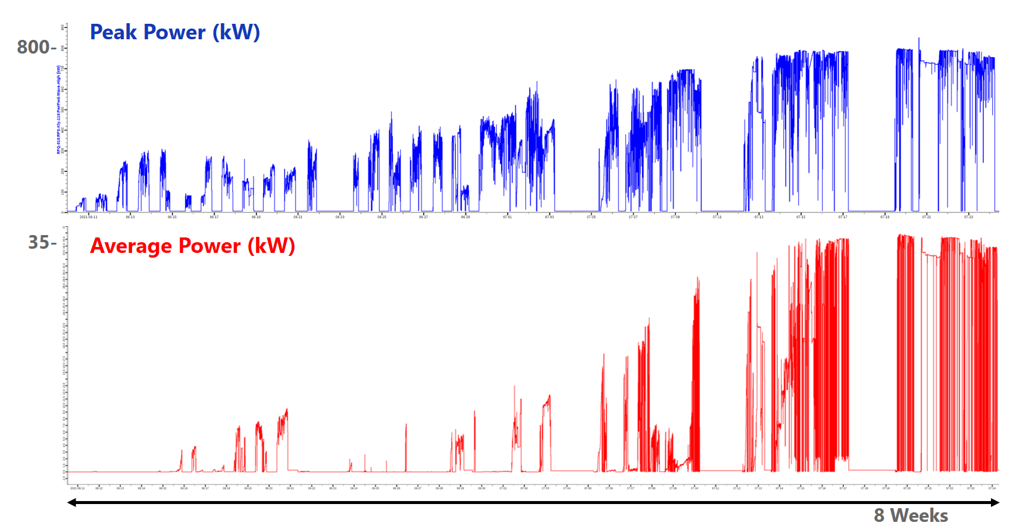
Normal Conducting Linac
RFQ conditioning was completed in July 2021

Slide 12
Normal Conducting Linac
MEBT and DTL
  DTL1 tank is installed (August 2021) and the next tanks installations will follow in 2022.
  MEBT is fully installed. RF power for the buncher cavities is the one piece still missing.
  We have only the critical diagnostics installed and integrated (with controls)

Slide 13

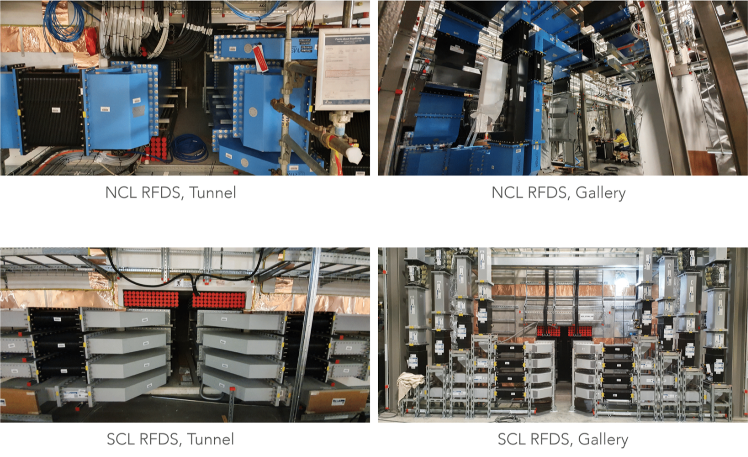
Infra and Support
RF Distribution Line

Slide 14
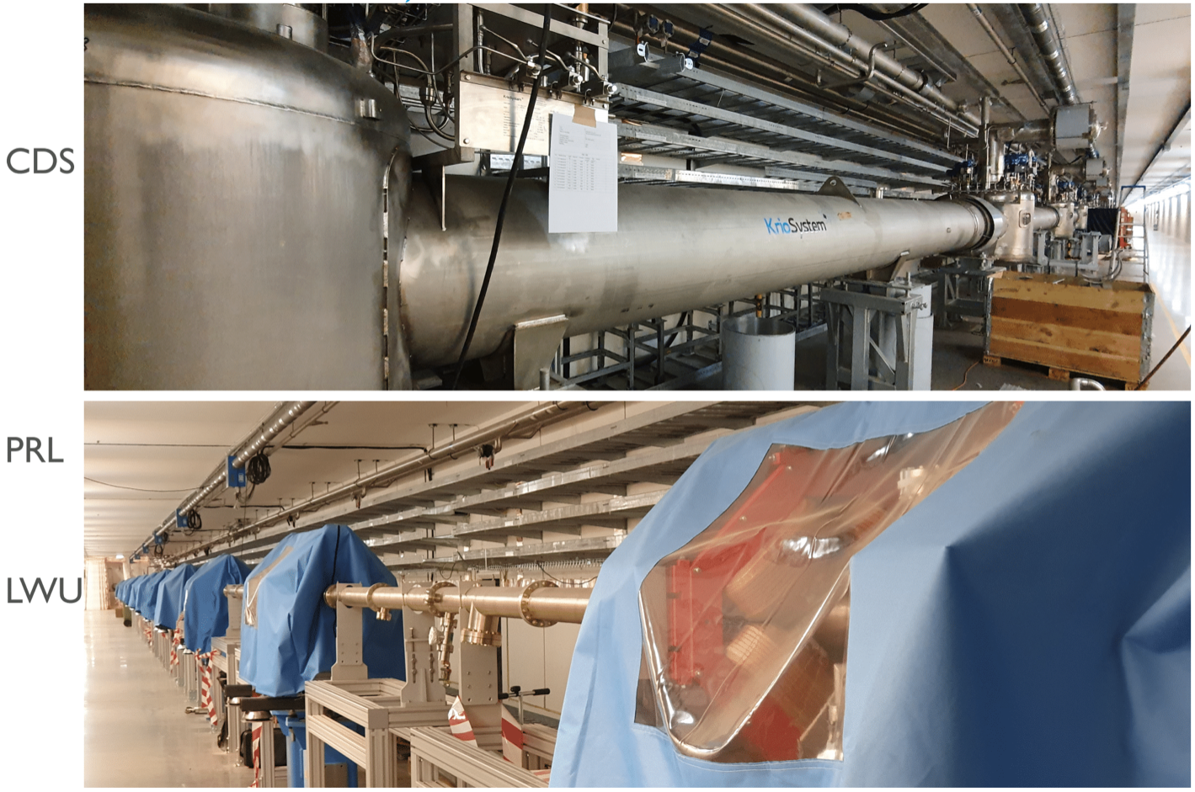
Infra and Support
Cryo Distribution System, Phase Reference Lina and Linac Warm Units

Slide 15
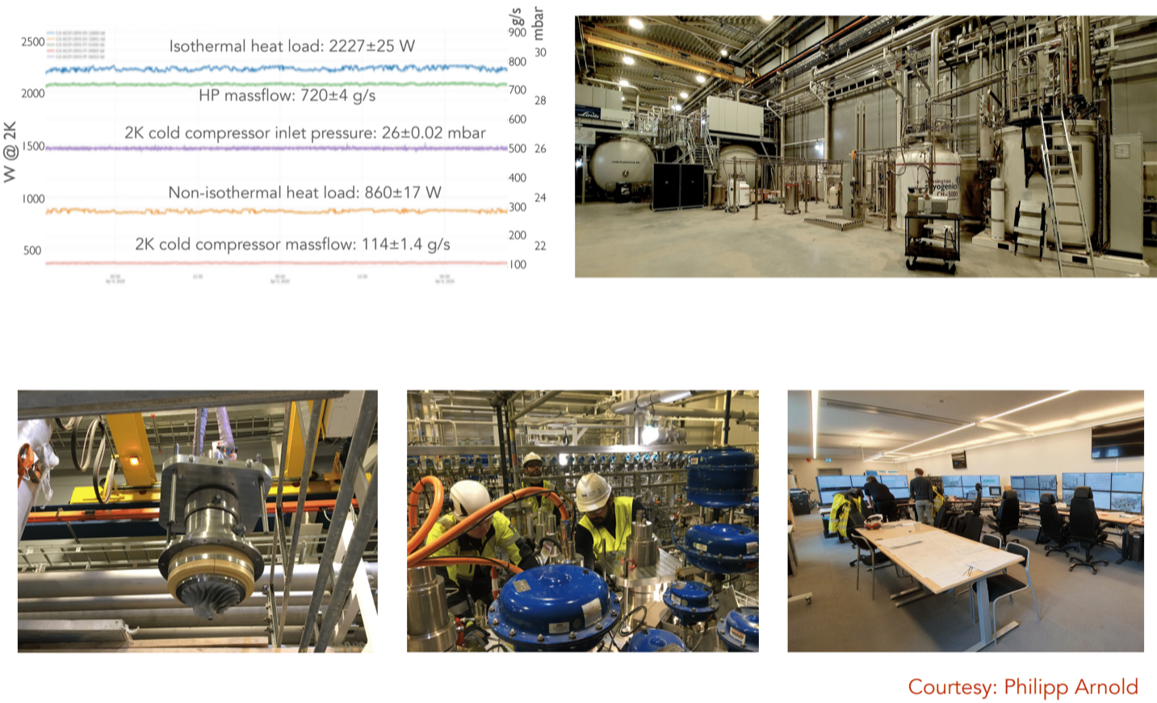
Infra and Support
Cryo Plant

Slide 16
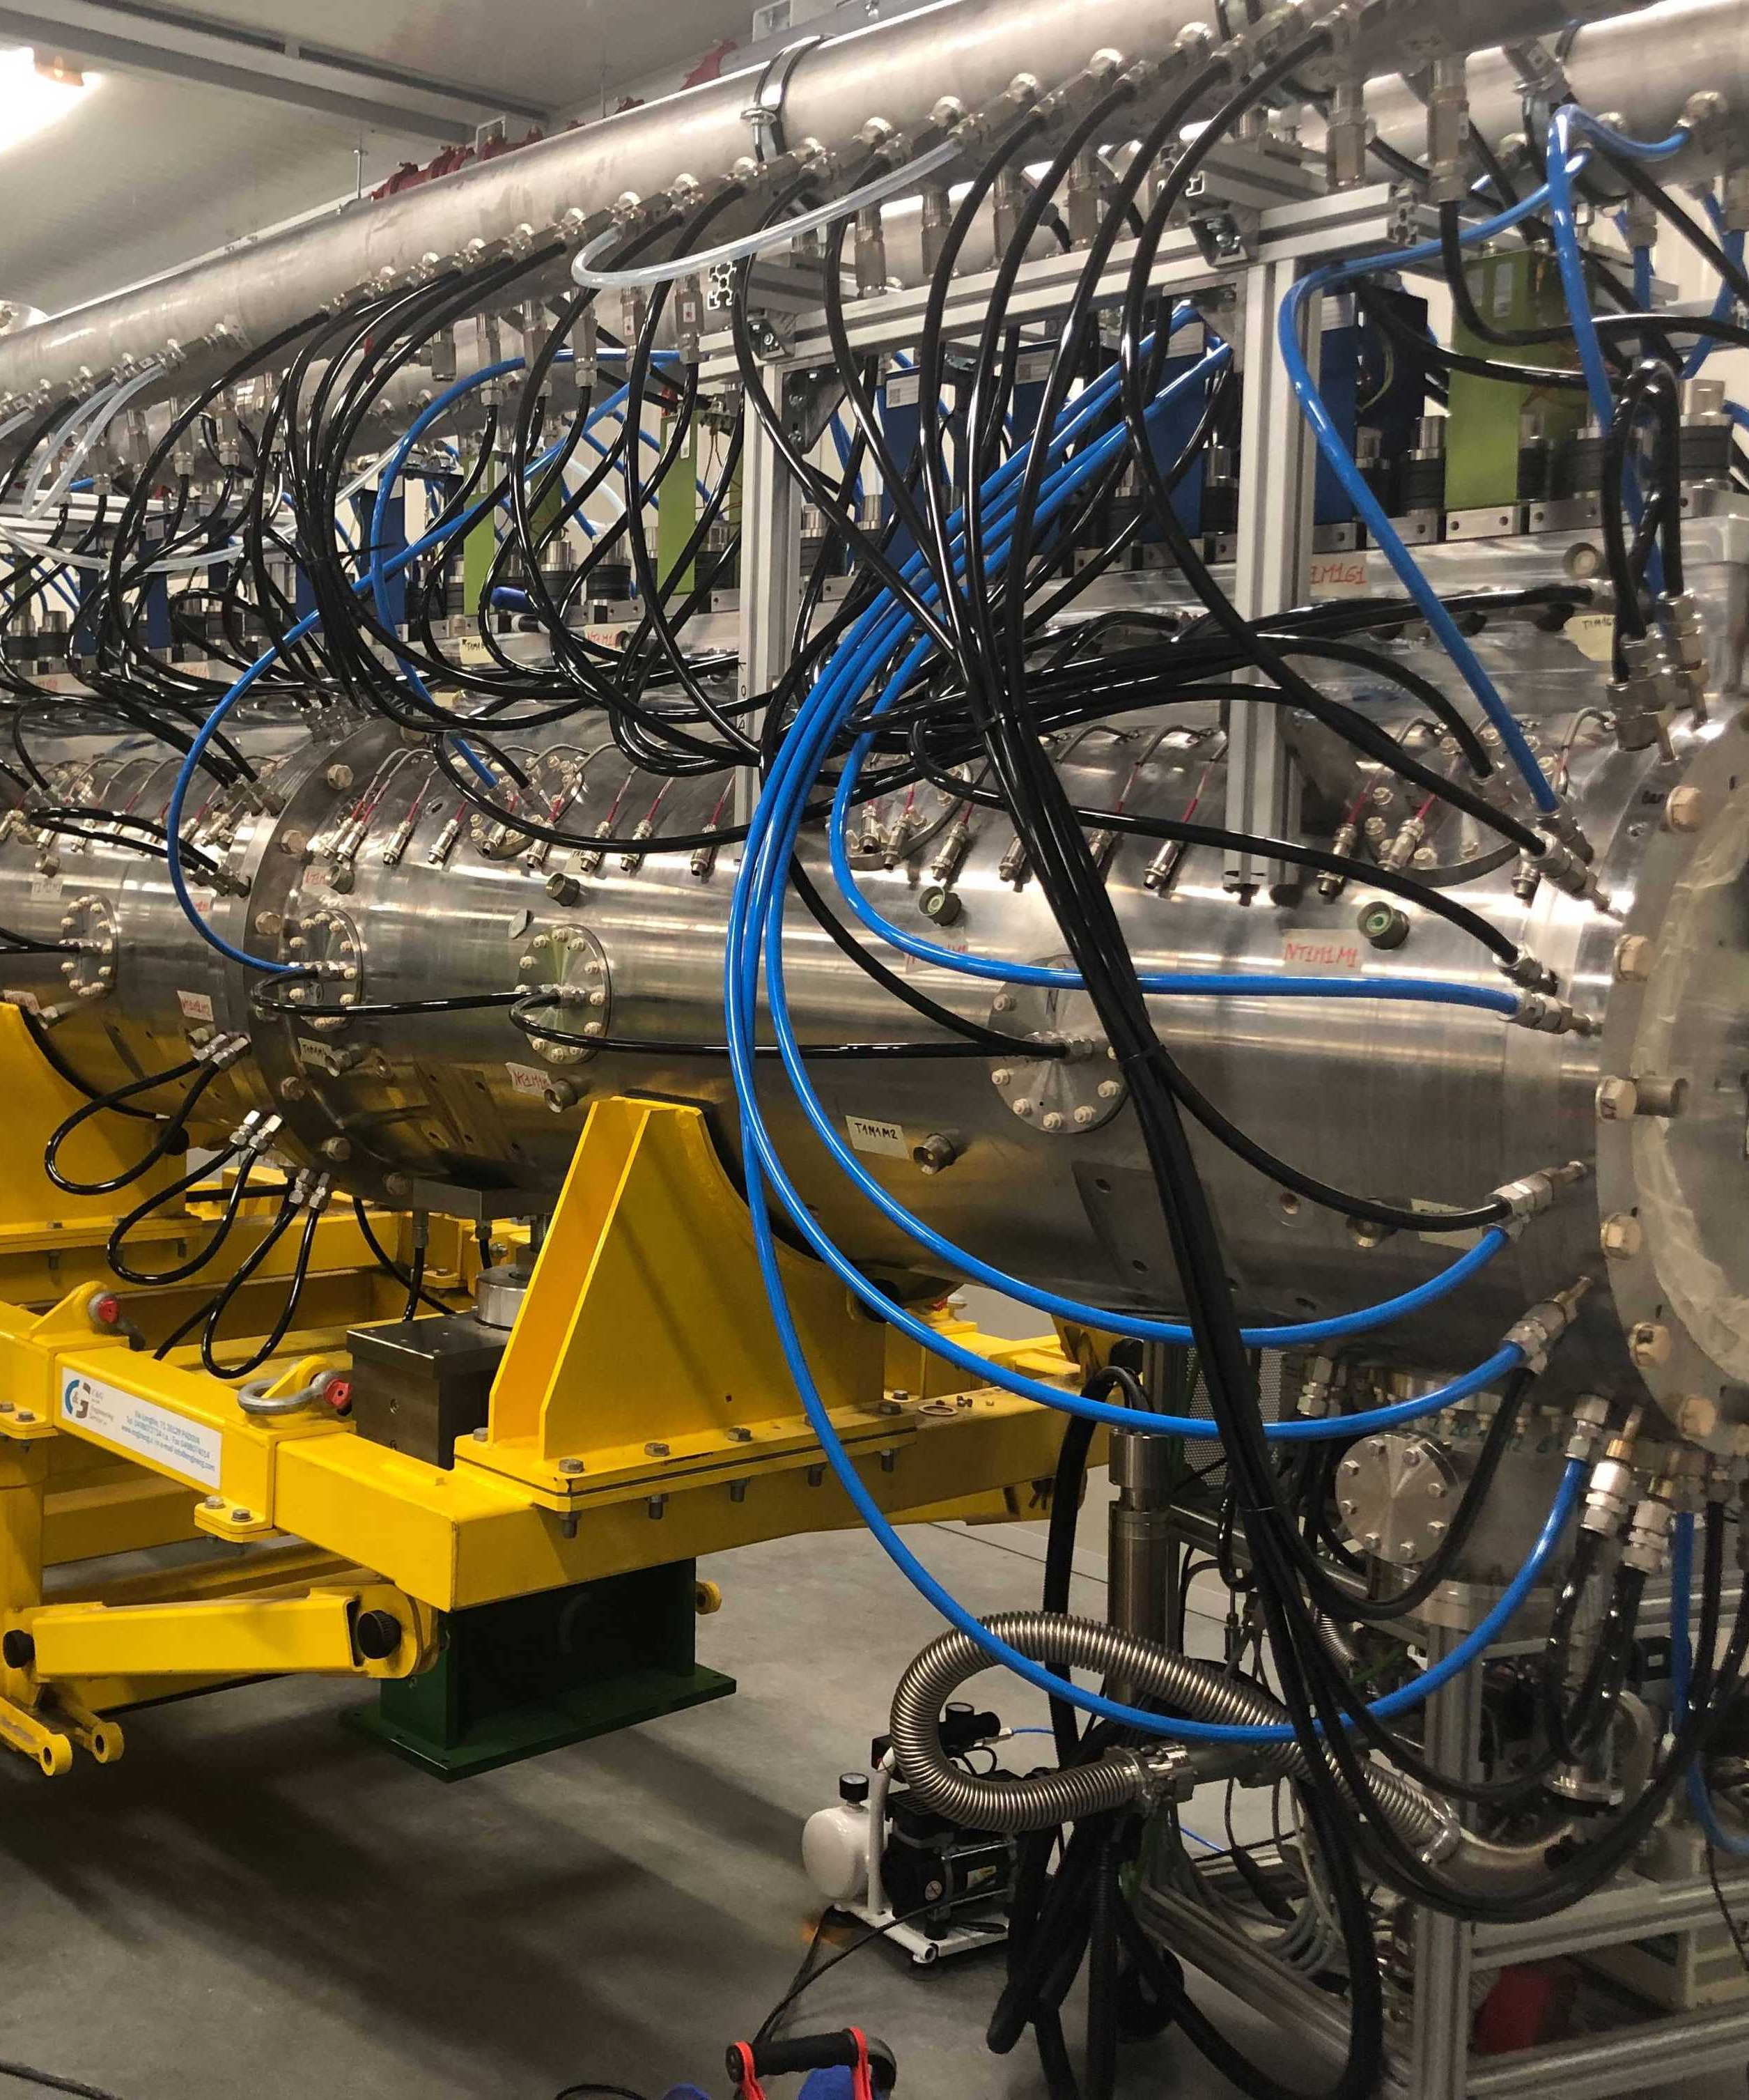
4
Commissioning plans for the Normal Conducting Linac

Slide 17
NCL Conditioning and Commissioning Phases
NCL Licence to Operate these phases received from SSM
Conditioning
Beam to MEBT FC (SRR2A)
Ion Source
LEBT
Beam to DTL1 FC (SRR2B)
Ion Source
LEBT
RFQ
MEBT up to the FC
Bunchers not powered
RFQ
MEBT
DTL1
Bunchers powered
Powered
Beam to DTL4 FC (SRR3)
Ion Source
LEBT
RFQ
MEBT
DTL1-4
Conditioning
Conditioning
RFQ
MEBT Bunchers
DTL1
DTL2
DTL3
DTL4
Critical Diagnostics
Courtesy: C. Plostinar

Slide 18
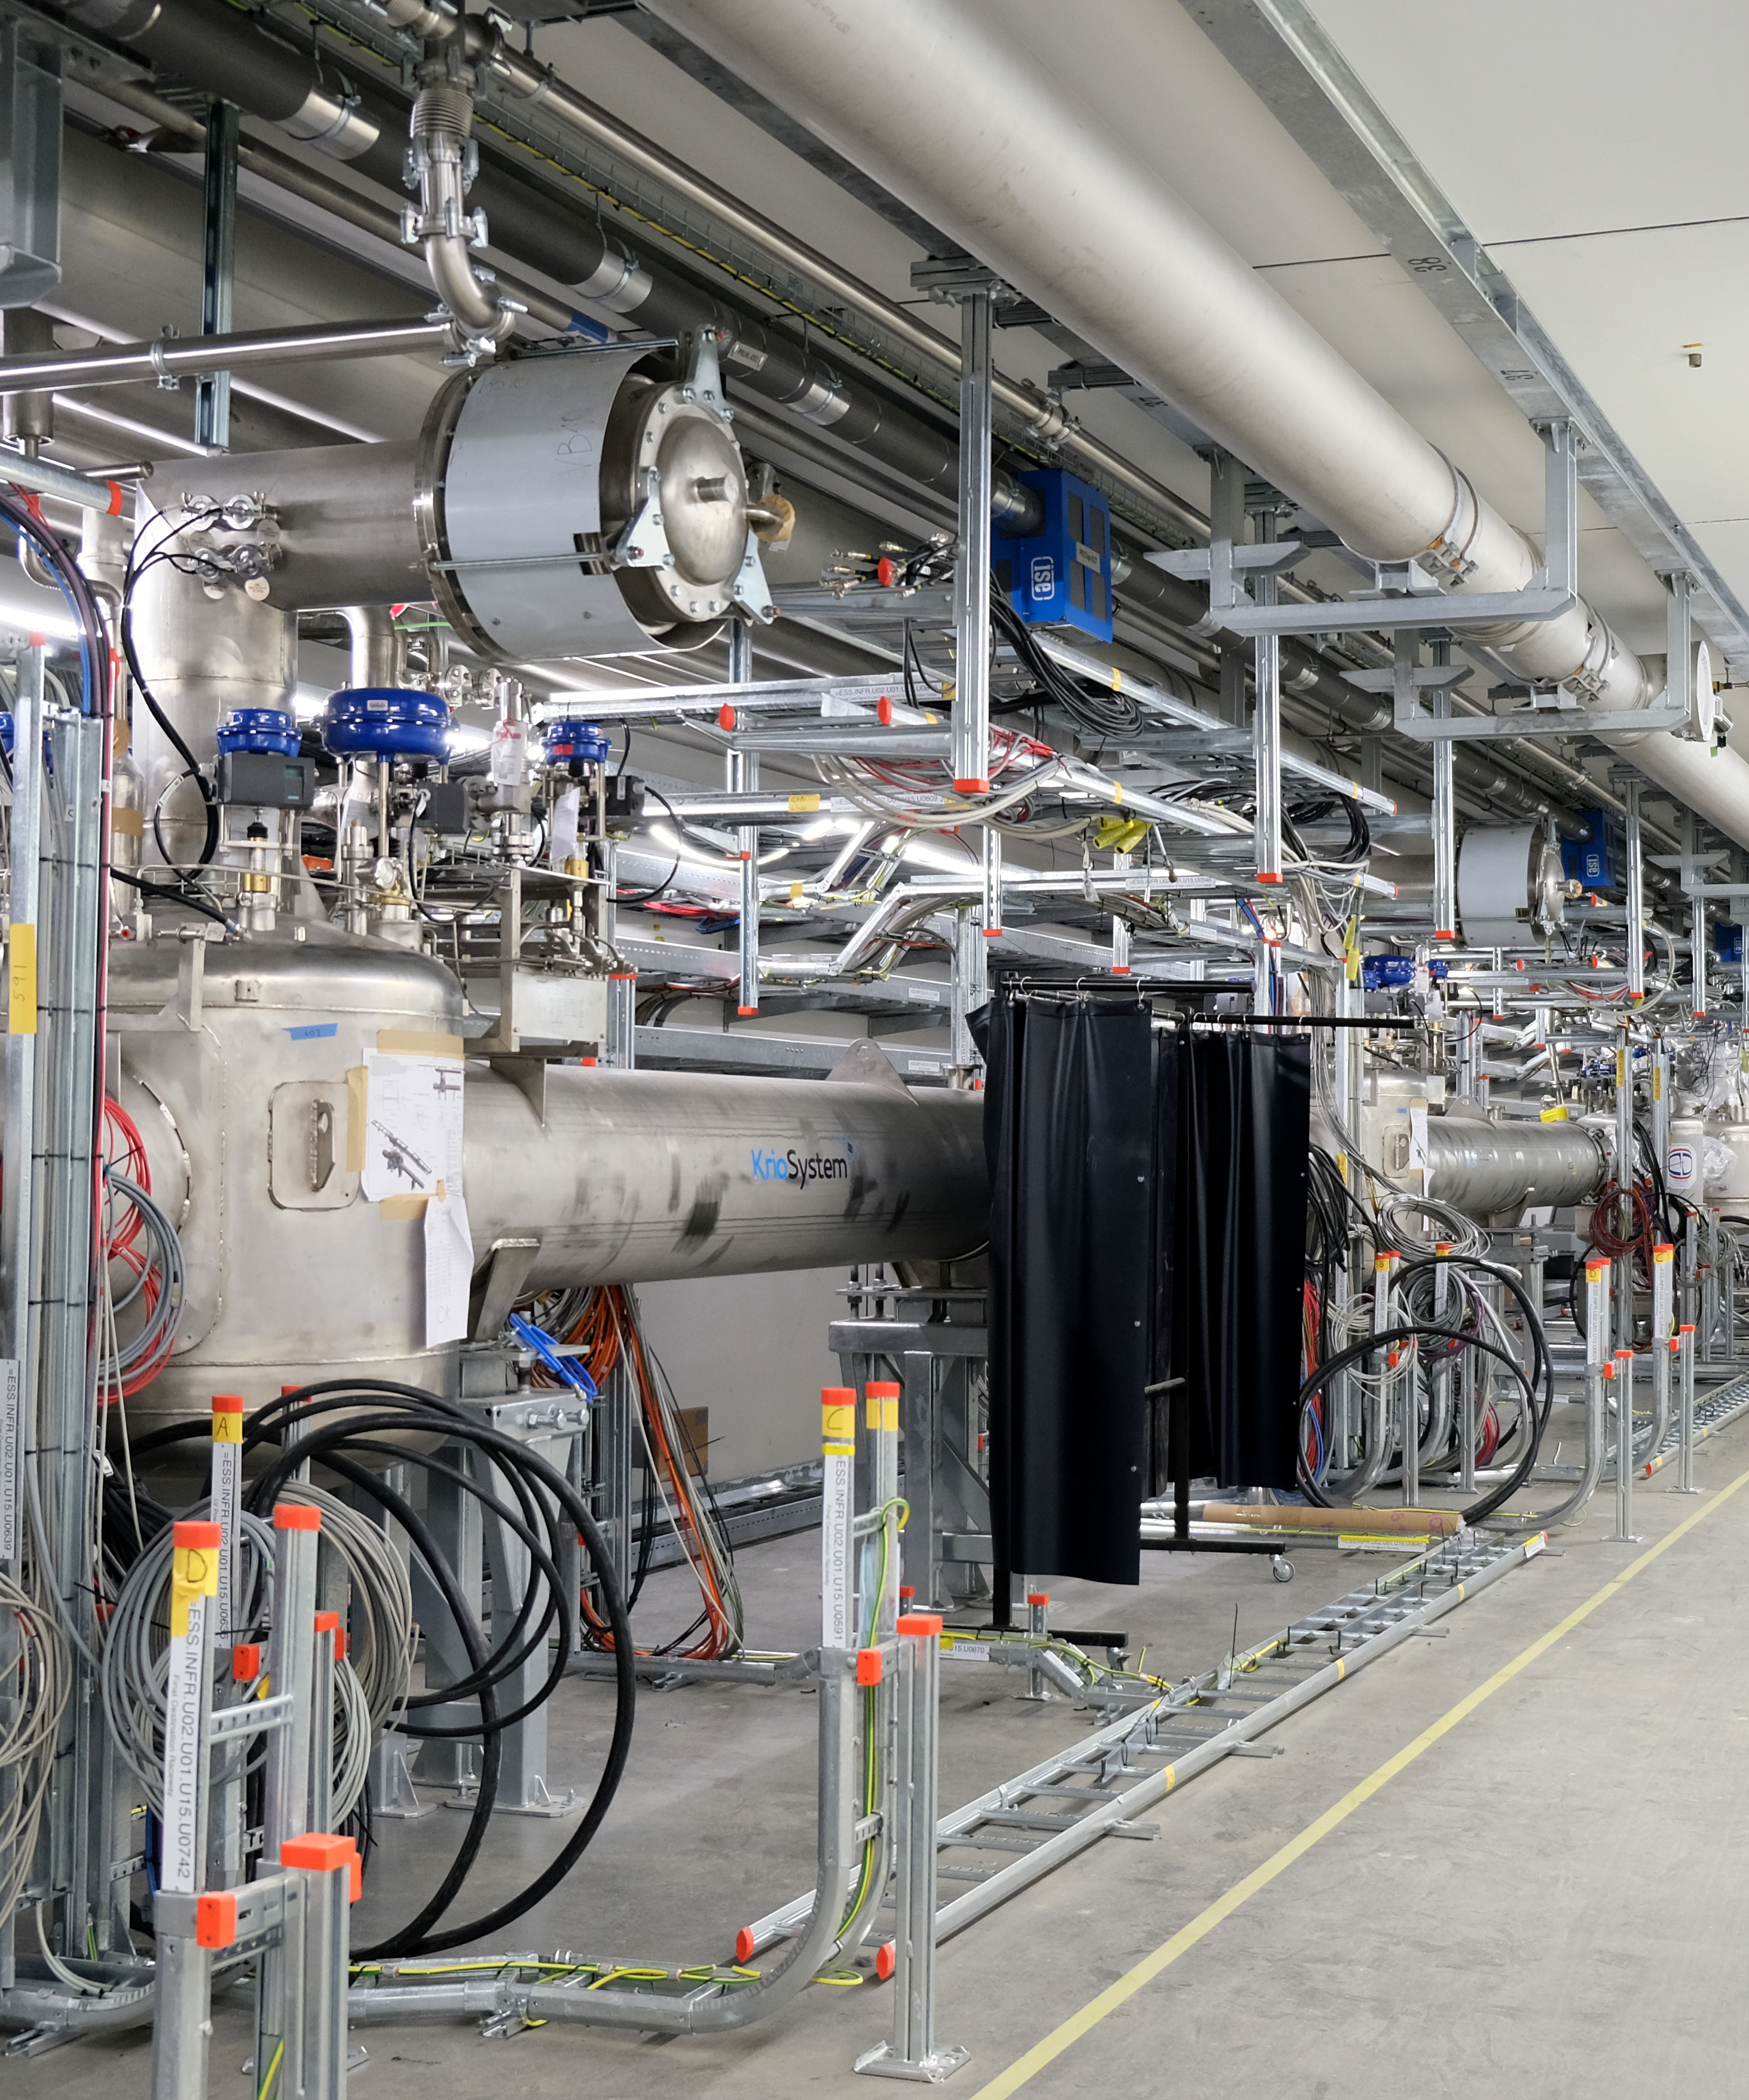
5
SuperConducting Linac installation and plans

Slide 19
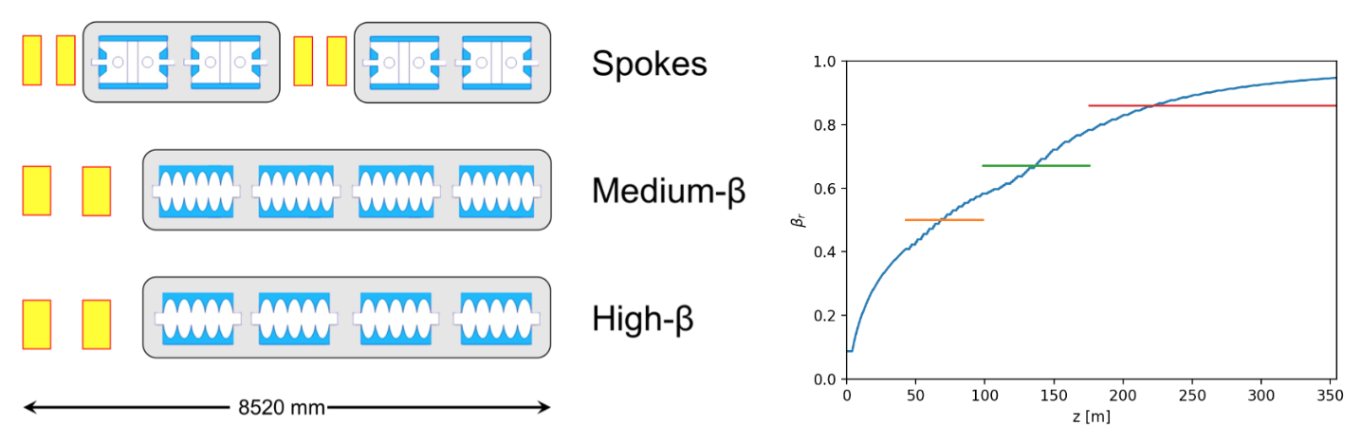
Superconducting Linac
Spokes, Medium and High Beta Cavities
  Cavity parameters:
    Spokes: 2 cavities per cryostat, 13 cryostats in total, max. gradient 9MV/m. Built by IPNO Orsay
    Medium Beta Ellipticals: 6-cells cavities, 4 per cryostat and 9 cryostats in total. Max gradient is 16 MV/m. Built by CEA.
    High Beta Ellipticals: 5-cells cavities, 4 per cryostat and 21 cryostats in total. Max gradient is 20 MV/m. Built by CEA.

Slide 20
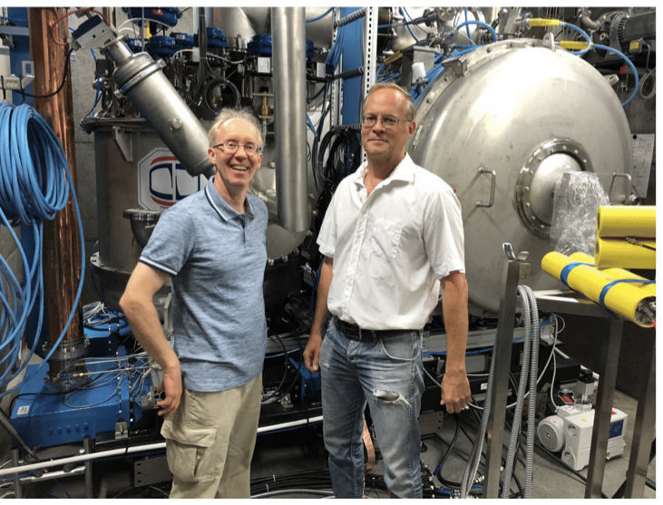

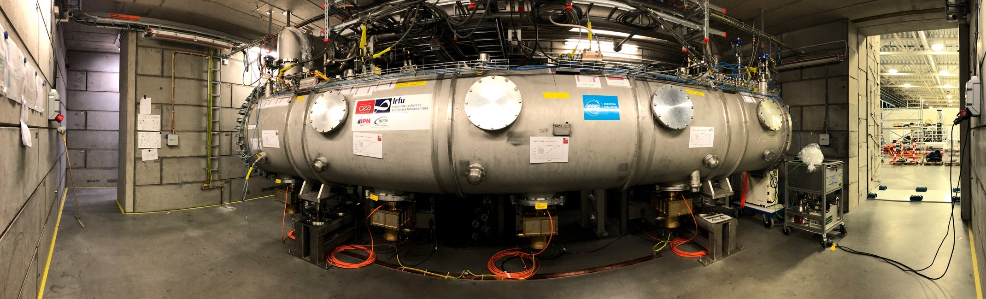
Superconducting Linac
Test Stands
  Spokes cryomodules are to be tested in Uppsala at Freia Lab (right)
  Elliptical (medium and high beta) cryomodules are being tested at ESS (below)

Slide 21
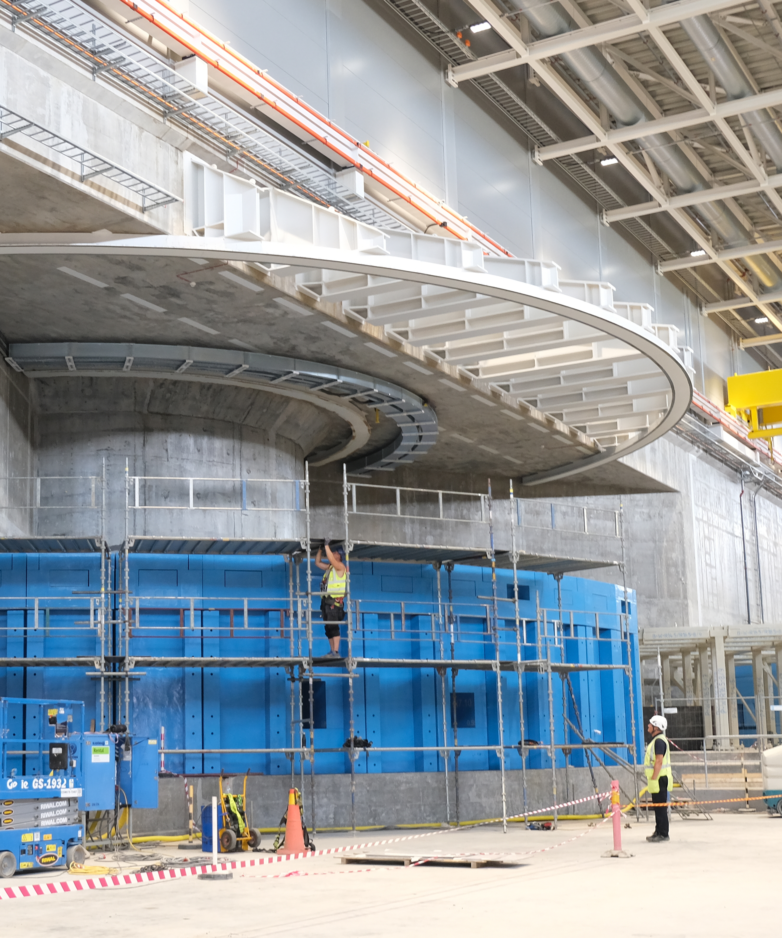
6
Beyond the Accelerator Commissioning

Slide 22
Construction Schedule and Power Ramp-up
Schedule and latest news
Construction of the ESS complex will be finished by the end of 2021 and the whole site will be handed over from Skanska to us in 2022.
User Program Schedule
  Beam on Target is scheduled for 2025, First Science (friendly Users) for March 2026 and Start of User Program for September 2026.
  We will start with 4 of the 15 scheduled instruments.
Machine power ramp-up:
  Start with 571 MeV proton beam (1.3 MW)
  Increase to 800 MeV (2 MW) (5 cryostats in HB)
  We will have all cryo and cavities but no RF power for the remaning cavities in the HB. Increase step by step (additional 40 M€)

Slide 23
ESSnuSB and Muon Collider Collaboration
Projects ESS Beam Physics group is involved
Talk on ESS contribution to ESSnuSB by Ben Folsom (ESSνSB Linac and Transfer Line: Lattice Design and Error Studies)
We are also involved in the discussion about the Muon Collider with CERN
  Proton Complex Working group.
  We have a final meeting now in October to define the next steps.
  There are some synergies with EEnuSB and some interesting points to study (source development, linac studies, accumulator and buncher rings etc)

Slide 24
Thank you!

