Slide 1
How High School Teachers can help narrow the gender gap in STEM Education
22nd International Workshop on Neutrinos from Accelerators
10 September 2021
Niharika Kulshreshtha
The Scindia School
Fulbright Scholar 2011-’12

Slide 2
Present Scenario- India
In a survey of girl students aged 12 to 14 in India, 93 percent said they considered STEM as a career choice
According to All India Survey on Higher Education (AISHE) 2018-19 by Ministry of Education, women constitute nearly 43 percent of the total STEM enrolments in the country.

Slide 3
Present Scenario- India
Only three percent of women enroll in PhD in Science and six percent opt for a PhD in Engineering and Technology.
They account for only 14 percent of the total scientists, engineers, technologists in research development institutions.

Slide 4
Present Scenario- India
The AISHE report reflects an increase in women enrollment, particularly in medicine-related courses.
During the same period, enrolment in Bachelors in Technology course went up from 39 in 2016-17 to 42 in 2019-20.

Slide 5
Globally
According to the UNESCO groundbreaking report Cracking the code: Girls’ and women’s education in STEM, only 35% of STEM students in higher education globally are women, and differences are observed within STEM disciplines.
For example, only 3% of female students in higher education choose information and communication technologies (ICT) studies.
Notes:
https://en.unesco.org/stemed)

Slide 6
Globally
The gender gaps are particularly high in some of the fastest-growing and highest-paid jobs like AI, computer science and engineering.

Slide 7
Recognition
Till 2020 seven women have won the Nobel Prize in Chemistry (3.8% of 186 laureates in total), four have won the Nobel Prize in Physics (1.9% of 216 laureates in total).

Slide 8
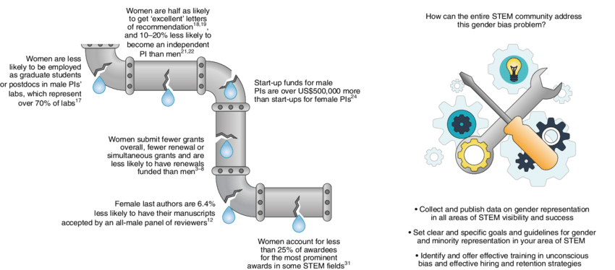
Leaky Pipeline in STEM
Source: Grogan, Kathleen. (2018). How the entire scientific community can confront gender bias in the workplace. Nature Ecology & Evolution. 3. 10.1038/s41559-018-0747-4.

Slide 9
Why it Matters
STEM careers are the jobs of the future
These will be the driving force for innovation, social wellbeing, inclusive growth and sustainable development.

Slide 10
Why it Matters
The under-representation of women in STEM puts them at a high risk of being displaced by technology.
49.6% of the world population is female.

Slide 11
Why it Matters
Results in unequal opportunities
Opportunity Cost: Lost potential

Slide 12
Role of Teachers
Teachers can play a significant role in dissipating stereotypes in STEM education. The most effective way to narrow the gender gap in STEM is to prevent it in the first place. By taking an early-age approach, I believe that the pipeline can be plugged before it begins to leak.

Slide 13
Strategies
Catch them Young
Female Role Models
STEM Organisations exclusively for Girls
Career Paths in STEM
Notes:
Cracking the code: Girls’ and women’s education in science, technology, engineering and mathematics (STEM)

Slide 14
Strategies
Training teachers for gender – sensitive classrooms
Working on developing Spatial Skills
Providing positive feedback
Create a classroom environment that sparks curiosity and fosters long-term interest through project-based learning, innovative tasks and technology.

Slide 15
Strategies
Beware of stereotypes
Stereotyping of Academic subjects
Textbooks
Language of the Textbooks and illustrations
Unconscious bias

